Slide 1
Sify AWS Offerings

Slide 2
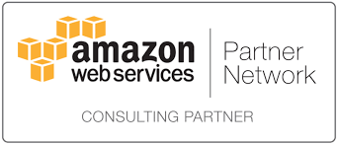
Sify AWS Services - Introduction
Sify offerings on AWS is roofed under GoInfinit AWS+ and AWS Digital Services. GoInfinit AWS⁺ offers unique advantage of Single Window Solution for all your AWS IaaS needs, right from Connectivity (DirectConnect) to setting up IT on AWS, securing your AWS setup as well as 24x7 monitoring and management with an aim to provide you seamless access, easy migration, impregnable security and optimized operations. Sify Digital Services will help Customers Cloud Transformation providing Application Modernization , DevOps, Data Management & Analytics and Bots adoption and transformation Services.
Sify is AWS Advanced tier Consulting partner, bringing together the strength of Cloud Ready Operations, Automation and deep expertise across Discovery, Assessment, Architecture, Migration as well as Management along side with Security and Governance for AWS environment with industry leading SLA
We also bring capabilities to provide you unified, integrated, single pane of glass of management across your private IT and AWS IT, thus enabling you enterprise control, security and governance on an Internet scale and agile AWS cloud.
Advanced Tier
2

Slide 3
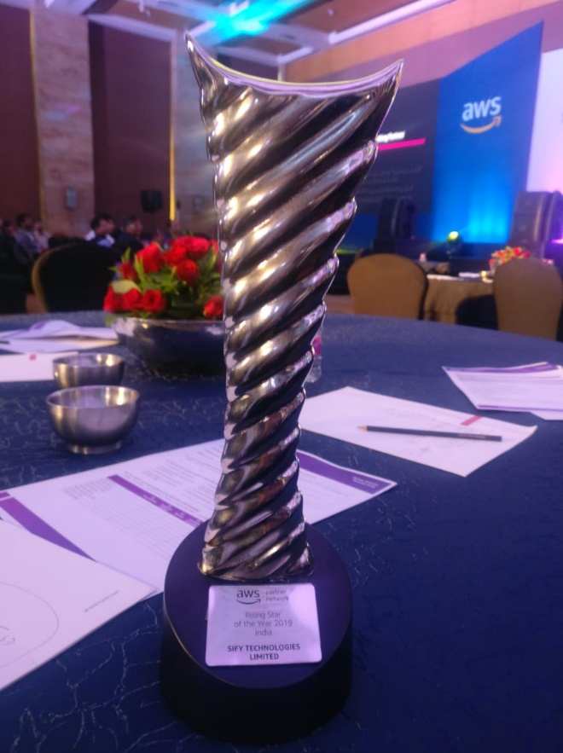
SIFY AWS Practice
Team is skilled comprising of AWS Certified Engineers, achieving the following Certifications
Solution Architect Professional
Developer – Associate
Solution Architect – Associate
DevOps Professional
AWS awarded SIFY “Rising Star of the Year 2019”
Rapidly Growing number of customers
Customer Managed Currently
Livewire-AWS | Talisman-Prod
Maxbupa-Prod | Cholamandalam-Finance
Primarc | Nexval
Pinnacle | DHFL Pramerica
Saija Finance | MacAppStudio
UGRO Capital | Sify_VFS Global
Cavin Care Primary | Sify-VFS-VDP-Project
ExcelCare Hospital | Untag Fashion Pvt. Ltd
Greenply | Shyam Metallics
QualityCare-Prod | Sastasundar.com
BSEB | BMWIL
Aparna Constructions-Prod | OdishaTV
USHA-Prod | Fibre2fashion
Edcon-Exports-Prod | MlIC
Under Implementation
AGGREGATE INTELLIGENCE INC
HOWRAH MUNICIPAL CORPORATION
C TEL INFOSYSTEMS PVT LTD
QUALITY CARE INDIA LTD
DESAI JEWELLERS PVT LTD
TATA SPONGE IRON LTD
LUX INDUSTRIES LTD - CONNECTIVITY
CANCER TREATMENT SERVICES HYDERABAD
RUBAN PATLIPUTRA HOSPITAL PVT LTD
Finolex Plasson Industries Pvt Ltd
ROBO SILICON PVT LTD-CONNECTIVITY

Slide 4








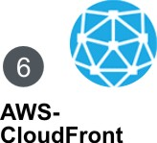


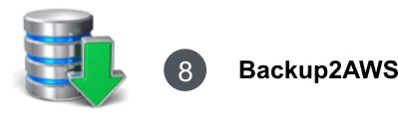

Sify GI AWS+ – Service Catalog
Notes:
Our GoInfinit AWS+ service portfolio caters to the requirement if you are already using AWS and also if you are new to AWS.
Consider a scenario if you are new to AWS and have a setup in a captive DC or in other colo providers DC or on other public / private cloud setup. We will help you in discovering and analysing the existing infra and design a solution on AWS. Offering is named as AWS-READY.
Now based on solution we designed, if customer is willing to move his workload to AWS then he can do so by subscribing for AWS-MIGRATE service.
Before migrating workload to AWS or to start new setup on AWS, you have to subscribe for infrastructure and services on AWS, for e.g. EC2, EBS, RDS, S3, etc. If you already have an AWS account for single billing we can consolidate your AWS account under Sify and on month end we will charge you along with other professional services. If you do not have then we will create new account for you and will subscribe AWS services for you. Services on AWS is covered under AWS-IT offering.
Comparing to traditional IT when you have your infrastructure ready, you outsource to managed service provider to manage and ensure uptime. Here as a part of 4th offering i.e. AWS-MANAGE we will manage and monitor your IT setup on AWS on 24 X 7 basis. As a part of MANAGE service looking at your utilisation trends we will help you optimise your infra spend on AWS.
When you decide to host on public cloud, security is a key concern. Roofed under AWS-SECURE we offer security services from 24 X 7 world class Security Operation Centre.
CloudFront is our sixth offering under GoInfinit AWS+ that offers acceleration and better user experience. We are also a partner of Akamai but CloudFront is an obvious choice for content serving if infrastructure is hosted on AWS.
We are also a Direct Connect partner of AWS, that helps us in offering and unique proposition of Integrated AWS and Private Cloud. On demand and pay as per usage option of AWS has allowed customers to store their Backup and setup their DR site on AWS. But what if primary site is of AWS?
We have solutions, our Backup2AWS offering helps you in backing up your AWS site data either in Sify IDC or your own DC. Similarly our Recover2AWS offering helps you in setting up your DR site either in Sify IDC or in your own DC.

Slide 5
Sify GI AWS+ – Service Catalog continue…….
GoInfinit AWS⁺
1
AWS-READY
Workload assessment and AWS fitment analysis as per ‘Well Architecture Framework’
2
AWS-MIGRATE
Migration services to AWS IT with minimal or zero disruption
3
AWS-IT
IT resources on AWS
4
AWS-MANAGE
Managing AWS IT including OS / DB / Application & Web servers
5
AWS-SECURE
Right fit security for AWS IT, driven by business and compliance needs
6
AWS-CloudFront
Acceleration and better user experience for serving content.
7
AWS-DirectConnect
End to end network connectivity to setup private network connectivity to AWS
8
Backup2AWS
Data backup for existing IT setup on AWS
9
Recover2AWS
Disaster recovery site of existing IT setup on AWS
5
Notes:
Here is our AWS portfolio in a gist. We have a wide options available to address the needs of Enterprises today. AWS-READY, AWS-MIGRATE, AWS-IT, AWS-MANAGE, AWS-SECURE, AWS-CloudFront, AWS-DirectConnect, Backup2AWS and Recover2AWS are the 9 key elements of GoInfinit AWS+ product portfolio that complete the entire IT Infrastructure requirements of customers today.

Slide 6
Sify GI AWS+ – aws digital innovation Catalog continue…….
Digtial Services on AWS
INITIATIVE
PRODUCT OFFERING
Enterprise Applications on Cloud(AWS)
Application Modernization
Cloud native applications, mobile applications, Tech Stack upgrade - ECS,EKS, Fargate, API Gateway, Mircoservices, Lambda, SWS, SNS, SQS, ElasticCache , RDS
Chatbot and NLP capabilities
Bots – LEX AI, Rekognition, Polly,TensorFlow
Containerization and DevOps Capabilities
ECS, EKS, Fargate,CodeDeploy, CodeCommit, CodeBuild, Elastic Beanstalk, OpsWork, Gitlab, Ansible, SVN, JIRA, Jenkins, Sonarcube, Jmeter, Selinium
Enterprise Data on Cloud(AWS)
Analytics
S3, Data Pipeline, Kenisis, Athena, Redshift, EMR, Dynamo DB, Document DB, Elastic search, Quicksight
Data Lakes
Dashboard and Visualization
Notes:
Here is our AWS portfolio in a gist. We have a wide options available to address the needs of Enterprises today. AWS-READY, AWS-MIGRATE, AWS-IT, AWS-MANAGE, AWS-SECURE, AWS-CloudFront, AWS-DirectConnect, Backup2AWS and Recover2AWS are the 9 key elements of GoInfinit AWS+ product portfolio that complete the entire IT Infrastructure requirements of customers today.

Slide 7
GI AWS+ – AWS-READY
Sify IT Discovery and Analytics Service aims at providing a comprehensive review of IT, business and financial implications of moving to the cloud. Designed for organizations that are advancing toward a cloud model — whether it is a private, public or a hybrid solution and helps in designing as per AWS “Well Architecture Framework
Stages | Initial Assessment | Design and Plan
Activities | Requirement gathering Understand use cases Understand applications non-functional requirements Identify scalability metrics and infrastructure sizing Identify single point of failure at web / app / DB layer | Create architecture diagram using AWS best practices Create network diagram Define backup and retention policy Define migration approach Sign-off for design phase
7
Notes:
READY is one of an offering under GoInfinit AWS+ for customers who do not have their existing IT in AWS and wanted to start with AWS. Discovering the existing infrastructure in terms of sizing, capabilities, model and warranty; requirement gathering considering future road map, analysing cloud ready work loads, implication listing after work load movement to cloud, required architecture design on AWS and finally defining project plan for shift are covered as deliverables under READY.

Slide 8

GI AWS+ | AWS-READY Enables…..
Organisations achieve a Cloud state of mind which will help them achieve their goals for business growth, greater resilience and faster innovation.
IT
Efficiency, Cost, Continuity
Consult: Assessment
Business
Agility, Speed
Design & Plan :
Well-Architected Frame work
Developers
Productivity, Access
Roadmap development
End users
Experience, Ease of use
Notes:
We have a team of certified AWS resources with on an average 10+ years of working experience in IT industry. Good understanding on industry best practices and knowledge on AWS infra services enables us in offering consulting service. We do assessment of existing infra and design infra on AWS cloud as per AWS defined “Well Architected Framework”. Given that we have more than 15 years of experience as a service provider, we can help customer in defining their road map and future IT requirement based on their business goals.
Consulting and design as per AWS’s reference guideline helps IT in achieving operational efficiency, cost optimisation and business continuity. Because of this customer’s business gets the required scalability, flexibility and agility. Developers will achieve better productivity and easy of access to required IT. This in turn will help customer is getting better experience for their end users.

Slide 9
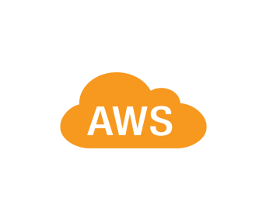


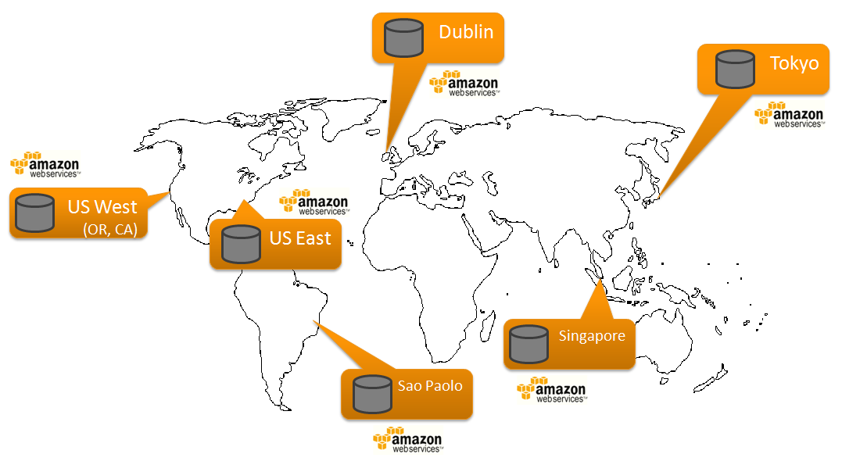
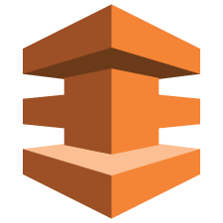


GI AWS+ | AWS-MIGRATE
AWS Migration practices offers a smooth transition of Infrastructure / applications from current state (Physical or Virtual) to AWS platform with minimal or zero disruption. Sify leverages industry leading tools and migration experts to delivery smooth / flawless transformation
Infrastructure
Migration
Platform
Migration
Customer branch
Migration Factory
Sify MPLS VPN
3
Process
Migration
Application
Migration
1
AWS DX
Sify DC
Customer data in AWS global region
2
Customer DC
Zero-defect Migration to AWS India, leveraging:
GlobalCloud Connect and / AWS-DirectConnect
MPLS VPN network and / AWS-DirectConnect
AWS-DirectConnect
Migration Factory – Facilitate As-Is transition
1
2
3
9
Notes:
MIGRATE is one of an offering under GoInfinit AWS+. Organisations need to migrate to current technologies but they lack the skills, resources or time to migrate. We offer MIGRATE service from Sify’s Cloud Migration Factory (CMF) which is a managed suit of services utilizing a standard set of tools, processes, and procedures that delivers migration of workloads from specific source (x86 based physical, virtual, HP UX, AIX, etc.) to specified Target platform.
Infrastructure, Platform, Process or Application, we have defined procedures and methodologies for migration from current state (physical or virtual) to AWS. With industry leading tools, skilled resources and end to end control over network eliminates outages and maintain business continuity during migration. GlobalCloud connect, AWS-DirectConnect and India wide MPLS VPN network helps us in achieving control over network.

Slide 10
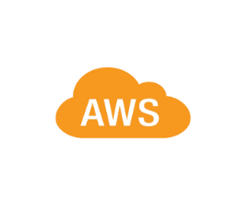

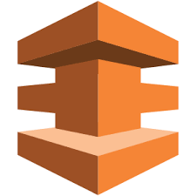




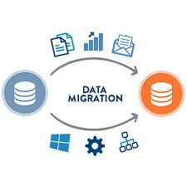
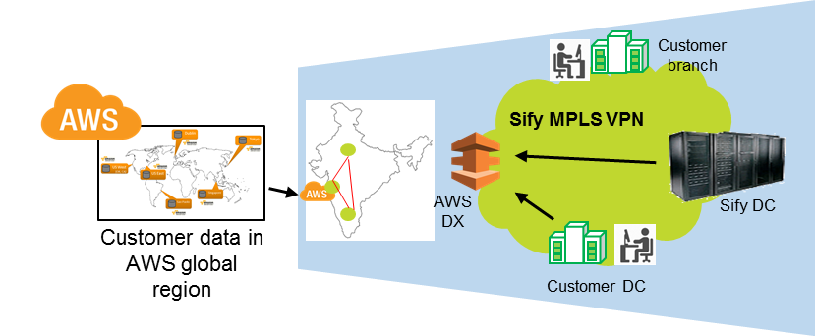

GI AWS+ | AWS-MIGRATE Enables…..
Network connectivity
Zero defect migration
Sify Rabale DC – AWS DX2 of India region
With right approach, right tool sets, right processes & practices
Seamless & non disruptive migration with committed latency
Checklist driven and defined time bound phased approach for migration
Existing migration capabilities
Single window partner
V 2 V | P 2 V | Platform | Database | Version
For assessment, network and migration
Expertise across infrastructure and platform migration
Assessment
Complemented by AWS assessment practices
10
Notes:
AWS DirectConnect switch is at Rabale data centre, this enables us isn achieving seamless and non disruptive migration with committed latency. We have been doing this migration from last 15 years under Sify’s Cloud Migration Factory (CMF). Factory model ensures that migration follows best practices, protects your data during movement and validate accuracy after migration.
Service is complemented with “AWS-READY” service and will follow the migration approach provided as a deliverable in AWS-READY. While customer has choice to take both offerings independently, but if delivered as single window solution, offers complete peace of mind to customer with single ownership on the outcomes expected.

Slide 11
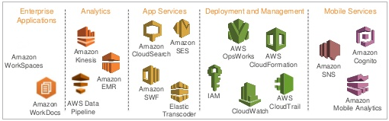
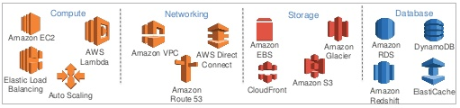
GI AWS+ | AWS-IT
Sify offers complete IT stack on AWS Platform to customer as single window solution, whereby customer gets IT resources on AWS along with management, security, connectivity and optimization under single construct and SLA.
Platform services
Core / Foundation services
11
Notes:
Sity provides end to end coverage of AWS IT portfolio giving choice to customers to have single window partner for not just management and support of AWS IT, but also providing the AWS IT components as part of integrated solution.
The offering is completely transparent whereby customer gets visibility of what is subscribed with AWS and various usage reports.
We are authorized channel reseller as well as Public Sector partner for AWS. As part of its AWS-IT portfolio, Sify brings together the design of right fit architecture leveraging AWS IaaS components as well as suggesting right commercial model to leverage basis customer business and usage patterns. This provides effecting, cost optimized solution approach on AWS Cloud.

Slide 12
GI AWS+ | AWS-IT Enables…..
Technology stack wise on premise solutions mapped to AWS
Technology stack | On premise solution | AWS
Network | VPN, MPLS | Amazon VPC, VPN, Amazon Direct Connect
Security | Firewalls, NACLs, routing tables, disk encryption, SSL, IDS, IPS | Amazon Security Groups, Amazon CloudHSM,
 |  | NACLs, routing tables, disk encryption, SSL, IDS, IPS
Storage | NAS, SAN, SSD | Amazon EBS, Amazon S3, Amazon EC2 Instance storage (SSD), Amazon EFS
Computer | Hardware, Virtualization | Amazon EC2
Content Delivery | CDN Solutions | Amazon CloudFront
Databases | DB2, MS SQL Server, MySQL, Oracle, PostgresSQL, MongoDB, Couchbase | Amazon RDS, Amazon DynamoDB, DB2, MS SQL Server, MySQL,PostgesSQL, Oracle, MongoDB, Arora
Load Balancing | Hardware and software load balancers, HA Proxy | Amazon Elastic Load Balancer, software load balancers, HA Proxy
Scaling | Hardware and software clustering, Apache ZooKeeper | Amazon Auto Scaling, software clustering, Apache ZooKeeper
Domain Name Services | DNS providers | Amazon Route 53
Analytics | Hadoop, Cassandra | Amazon Elastic MapReduce, Hadoop, Cassandra
Data Warehousing | Specialized hardware and software solutions | Amazon RedShift
Messaging and workflow | Messaging and workflow software | Amazon Simple Queuing Service, Amazon Simple Notification Server, Amazon Simple Workflow Service
Caching | Memcached, SAP Hana | Amazon ElastiCache, Memcached, SAP Hana
Archiving | Tape library, off site tape storage | Amazon Glacier
Email | Email software | Amazon Simple Email Service
Identity Management | LDAP | Amazon IAM, LDAP
Deployment | Chef, Puppet | Amazon AMIs, Amazon CloudFormation, Amazon OpsWorks, Chef, Puppet
Management and Monitoring | CA, BMC, Rightscale | Amazon CloudWatch, CA, BMC, Rightscale
12
Notes:
Network – Security – Storage – Compute – CDN and Database technology stack, available on-premise solution and solution available on AWS which Sify can offer as a part of integrated solution.

Slide 13
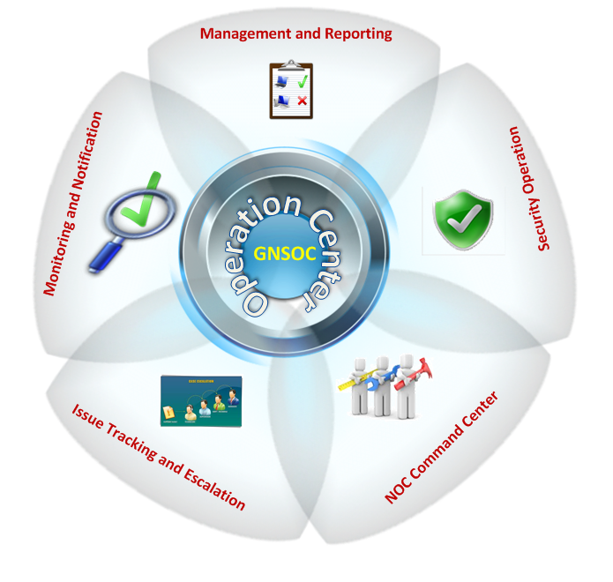
GI AWS+ | AWS-MANAGE
AWS-MANAGE Stack offers extensive suit of monitoring and management services for AWS IT covering OS, DB, Applications and other in-scope elements. Sify’s offers its management stack from industry leading Cloud Nerve Center – CNC, which is purpose built to drive hyper automation and lean operations for Cloud IT
Cloud Operations
24x7 Service Desk
Monitoring and Incident Resolution
Service Requests such as User Management, AWS resource provisioning
Change Management
Patch Management
Periodic Log Archival
Database Operations
Database User Management
Database Backup & Restore
Database Health Checks and predefined admin tasks
High availability & Business continuity
Continuously review AWS Infrastructure setup to ensure High Availability as per business goals.
Define and Execute Backup & Retention policy as per RPO/RTO goals
HA/DR drills
Cloud Nerve Centre
13
Notes:
We understands that to make customer’s Cloud journey a success, it is important to understand and address critical cloud related aspects like Security, Service Management, Governance, Risk and Compliance, Monitoring, Automation and Cloud Lifecycle Management.
AWS-MANAGE Stack offers extensive suit of monitoring and management services for AWS IT covering OS, DB, Applications and other in-scope elements. Sify’s offers its management stack from industry leading “Cloud Nerve Center” – CNC, which is purpose built to drive hyper automation and lean operations for Cloud IT.

Slide 14

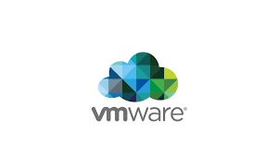


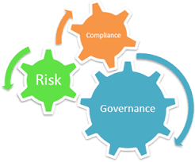







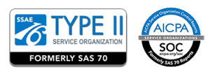
GI AWS+ | AWS-MANAGE Enables…..
End to end Managed service partner
Unified dashboard
Network, AWS IT, Security, Backup, DR & private IT
Single dashboard spanning across AWS & private setup.
Cloud Management dashboard
Governance, Risk & Compliance
Innovative engagement models
Schedule, run control tests | Conduct audits | Identify failures
Gain – Share
AWS Spend based
Shared / Dedicated resource pool
Identify and remediate failure
50 Customers
of
5 Customer
Single system of record for IT
Process & tool maturity
Asset, Inventory & Service mapping
Advance application support
Platform support, operation, network & user
Certification
SAP basis and functional support
14
Notes:
While customer has choice to opt for Sify’s MANAGE offering or to mange setup on its own, but if delivered as single window solution, offers complete peace of mind to customer with single ownership on the outcomes expected.
Network – IT – Security – Backup – DR and Private IT, Sify provides end to end manage service with an unified dashboard across AWS and private setup. We schedule and conduct regular audits as a part of governance and compliance. Unlike traditional manage services our charging for managed services is outcome based.
Sify’s manage service practices and procedures follows ITIL standards, integrated monitoring and IT Service Management platform with AWS offers benefit of unified view to IT setup across public and private setup.

Slide 15
GI AWS+ | AWS-SECURE
Sify with its state of art SOC facility and Security Framework, offers right fit security for all your AWS IT setup, driven by your business and compliance needs. Sify has built deep expertise, tools and security architecture to ensure you compliance and control over AWS IT.
AWS Account
`Security services
Network access control
Audit logging
Guest OS patching / security
Anti-malware
IDS / IPS
Vulnerability assessment
Penetration testing
IAM User
IAM User
Customer
Configurable
AWS Services used by Customers
Amazon
Provided
AWS Global Infrastructure
Hardware
Software
Network
AWS Data Centres
15
Notes:
Sify with its state of art SOC facility and Security Framework, offers right fit security for all AWS IT setup, driven by customer’s business and compliance needs. Sify has built deep expertise, tools and security architecture to ensure compliance and control over AWS IT.
As a part of split responsibility matrix for security, cloud service provider (AWS) is responsible for security in data centres and global infrastructure. Whereas security of configurable services like account, VMs, users, platform services, etc. is customers responsibility.

Slide 16
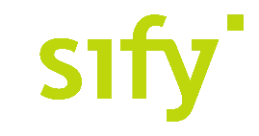
GI AWS+ | AWS-SECURE Enables…..
Assess
Design
Deploy
Manage
Improve
Network Security
Perimeter Security Solutions – Firewalls, NIPS, Malware Protection, DDoS Defense
Host Security
HIPS, FIM, Virtual Patching, Anti-Ransomware, Log analytics
Identity & Access Management
Privileged Access Management, MFA, SSO
Security Management, Governance & Compliance
Application Security
Web Application Firewalls, Malware Scanning, Web App testing, Code Review, Penetration Testing
Data Security
Data Encryption, Key management, Database Activity Monitoring
SIEM, Log Management, VMS, Compliance auditing
Sify an IT Service Management & Information
Security Management partner for cloud
services
16
Notes:
AWS-SECURE offering covers security services those are part of customers responsibility and enables us to became an Information security partner for customer.
Our portfolio of security services broadly touches up on
Network security,
Host security,
Data security,
Application security,
Identity management,
SIEM and log management.
Like IT services, security is also a continuous evolving cycle. Assessment -> Design -> Deployment -> Management -> Improvement -> And cycle continues.

Slide 17
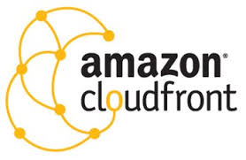
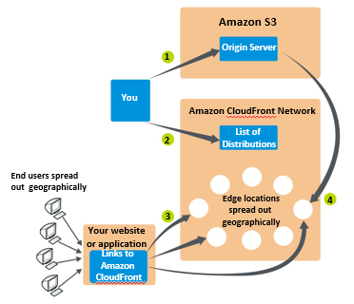
GI AWS+ | AWS-CloudFront
AWS-CloudFront offers acceleration and better user experience for serving the content. This ensures that IT is not just agile and scalable, but also fast, seamlessly accessible across all devices.
17
Notes:
Sify offers a choice of AWS CloudFront service as a part of integrated solution. Offering is completely transparent and customer will get full visibility of used storage and data transfer in consolidated usage report from AWS.
CloudFront offers acceleration and better user experience for serving content. This ensures that IT is not just agile and scalable but also fast, seamlessly accessible across all devices. It is recommended to use acceleration service from AWS when application setup and content is hosted on AWS and hence CloudFront is the default choice to get better result.

Slide 18
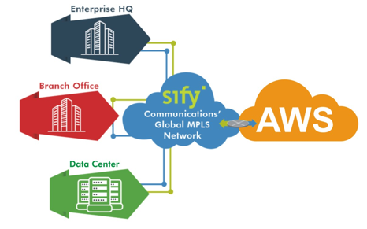
GI AWS+ | AWS-Direct Connect
Sify as Direct Connect partner of AWS, as well as MPLS network service provider offers end to end network connectivity services to setup up private network connectivity to AWS on pay per use as well as commit bandwidth
Key value propositions
End to end coverage
Access
WAN
DX2
Committed latency
Guaranteed availability
GlobalcloudConnect
Flexible pricing
18
Notes:
Sify as Direct Connect partner of AWS, as well as MPLS network service provider offers end to end network connectivity services to setup up private network connectivity to AWS on pay per use as well as commit bandwidth.
Control over Access, WAN and DX2, 2nd DirectConnect switch in India region, enables Sify to offer committed latency and guaranteed availability.

Slide 19








GI AWS+ | AWS-Direct Connect Enables…..
1
Integrated private + AWS cloud
2
Migration
Sify’s DC Container proposition. Hybrid cloud platform
Customer DC
Global region to India region | Current IT setup to AWS setup
SIFY DC
Global region
India region
INTEGRATION
Sify DC
3
Site Recovery
4
Data Seeding
Leveraging direct connect for backup, DR and archival
To AWS Cloud from 15 local Sify hubs in India
5
Zero latency cloud connect
6
Private Network
Extending zero latency connect to AWS at Sify’s Rabale DC
Extend IT to AWS as similar network zones
Amazon certified colocation
SIFY DC
Notes:
AWS Direct Connect makes it easy to establish a dedicated network connection from a customer’s premises to AWS. Using AWS Direct Connect, a customer can establish private connectivity between AWS and their datacentre, office, or colocation environment, which in many cases can reduce network costs, increase bandwidth throughput, and provide a more consistent network experience than Internet-based connections.
Leveraging DirectConnect if hosted private setup in Rabale data centre, Sify can extend connection to AWS with zero latency. DirectConnect can also be leveraged for Backup, DR solutions and migration to AWS with committed latency.

Slide 20











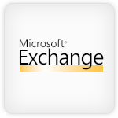


GI AWS+ | Backup2AWS
GoInfinit Backup2AWS is an Integrated Data Protection solution to enables organisations to protect your data across your IT, Private Cloud or Public Cloud (AWS / Azure / Sify Cloud) giving customer complete control over protection and recovery policies through single unified portal. Platform provides Real Time Analytics into RPO / RTO, Backup policies, Compliance, Backup Criteria’s, Recovery and Data Access Frequencies.
DirectConnect
Data in AWS
Sify / Customer DC
Sify DC 2 / Customer location – OPTIONAL
MGMT SERVER
MEDIA SERVER
SIFY BACKUP GRID
Frequency: 24 Hrs | RI: 8 Hrs
S3
Over the Internet
1G/10G LINK
Glacier
Connectivity from Backup Grid - FC FABRIC / IP FABRIC to retrive
CloudStor
BackupStor
Production Data
2ndCopyStor
TapeOut
Import / Export
Optional
Optional
Data Protection solution FOR AWS
Notes:
Backup2AWS is an Integrated Data Protection solution to enables organisations to protect your data across your IT, Private Cloud or Public Cloud (AWS / Azure / Sify Cloud) giving customer complete control over protection and recovery policies.
For cost optimisation most of organisations are considering data protection solution using cloud. There are two possible scenarios for solution using cloud 1) Backup of data ON cloud and 2) Backup of data FOR cloud.
For purpose of this session let’s focus on data protection solution FOR cloud and to be specific Backup FOR AWS. Application environment setup in AWS region replicating data to required Sify Data centre or customer data centre. The connectivity can be with VPN over Internet or DirectConnect. Data will be replicated from AWS on continuous basis with compression and deduplication at source site to optimise bandwidth. Only incremental changes will be replicated. Data can be backed up and stored either in third party storage device or Linux servers as per customer requirement, set have to be created at the time of disaster for recovery.
Data backed up can be used for file / folder level recovery or full server recovery. Secondary backup solution like Tape Out / 2nd copy store can also be achieved from Backupstore.

Slide 21





GI AWS+ | AWS-Recover2AWS
GoInfinit Recover2AWS is an Unified Data Protection Solution with Cloud enabled DR. It enables faster recovery with complete protection for organizations critical IT system on AWS Cloud, with no change to the source IT set up.
Standby phase –
On premise & AWS solution run side by side.
Inactive for production
Elastic
Load Balancer
Route 53
Application is active in on-premise environment with a warm standby in AWS environment.
In a disaster, all traffic is routed to AWS environment.
Database replication is setup for failover to a database server in AWS.
Reverse Proxy / Cashing server
Reverse Proxy / Cashing server
EC2
Recovery phase –
In case of disaster of production system.
Application Server
Application Server
EC2
Standby environment in AWS will be scaled up for production load.
DNS records are changed to route all traffic to AWS.
Database Server
Master
Mirroring / Replication
Slave DB Server
Data Volume
Scale up for production use
Sify / Customer DC
Scaled down stand by
AWS Availability Zone
21
Notes:
Recover2AWS is an unified data protection solution with cloud enabled DR. Organisations are considering Disaster Recovery (DR) solution using cloud. There are two possible scenarios for solution using cloud 1) DR ON cloud and 2) DR FOR cloud.
For purpose of this session let’s focus on DR solution FOR cloud and to be specific DR FOR AWS. For Disaster Recovery solution Sify will setup a standby environment in either Sify DC or customer DC. Host based replication will enable data replication between AWS site and DR site. The connectivity can be with VPN over Internet or DirectConnect.
In case of Disaster standby environment will be scaled up for production load. The possible scenarios for workload replications are 1) File and Folder protection with both DC and DR in active state. 2) Full server protection with both DC and DR in active state & 3) Full server protection with active DC and passive DR, target VMs will be in off state and will be booted only in case of disaster.
Host based DR tool for management and replication is must to achieve this solution. As per customer requirement sify will size connectivity bandwidth and will help customer is achieving required RTO / RPO.

Slide 22



GI AWS+ | AWS digital innovation
DevSecOps
App
Modernization
AI/ML
Analytics
Sales Bot
Service Bot
Informational Bot
Application Bot
Productivity Bot
IOT Bot
Big Data
Data Visualization
Data Lake
Consulting
Infrastructure Management
Configuration Management
Deployment Automation
Cloud Infrastructure Ready
Cloud Optimize
Cloud Native

Slide 23




GI AWS+ | AWS digital innovation: AI/ML
Contact Center Bots
Chatbots for customer service
Account inquiries
Bill payment
Service update ….
Informational Bots
Chatbots for everyday consumer requests
News updates
Weather information
Game scores ….
Application Bots
Build powerful interfaces to mobile applications
Book tickets
Order food
Manage bank accounts ….
Enterprise Productivity Bots
Streamline enterprise work activities and improve efficiencies
Check sales numbers
Marketing performance
Inventory status ….
Internet of Things (IoT) Bots
Enable conversational interfaces for device interactions
Wearables
Appliances
Auto ….

Slide 24
GI AWS+ | chatbot Enables…..
Improving Customer Experience & Reducing costs
Deflecting live chats, email, and phone support through self-service automation reduces operational costs for contact center and reduced response time to customers
Supporting growth without increasing costs
By handling more customer interactions with a chatbot and deflecting the number of interactions that require a live agent, you can grow your customer base, expand your geographic footprint, and introduce new products and services without increasing your human capital costs.
Monetizing self-service
A chatbot gives you the opportunity to build and grow new revenue streams through proactive offer management and reduced shopping cart abandonment.
Improving customer loyalty
Reducing customer effort keeps customers coming back, which in turn, keeps your profitability higher as your customer lifetime value increases.

Slide 25















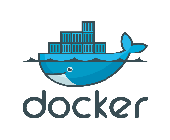
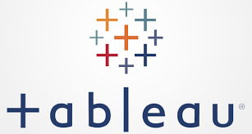


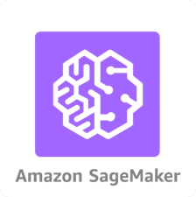
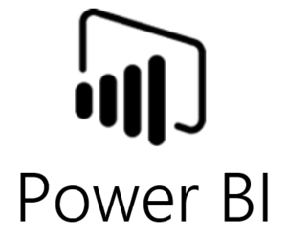





GI AWS+ | AWS digital innovation: data lake
Amazon IoT
Security Groups/ NACLs
Directory
Service
Route53
AWS KMS
AWS IAM
CloudWatch
CloudTrail
On-premise connectivity
Batch
Object Storage / Unstructured Data
Amazon S3
EC2 or ECS
AWS RDS
AWS Glue
BYOL
Time Series Data
Direct
Connect
DynamoDB
Real-time
BYOL
AWS Kinesis Firehose
Structured Data
Amazon Redshift
ec2
DMS
AWS EMR
AWS Glue
Ingestion
Storage
Analytics
Visualization

Slide 26
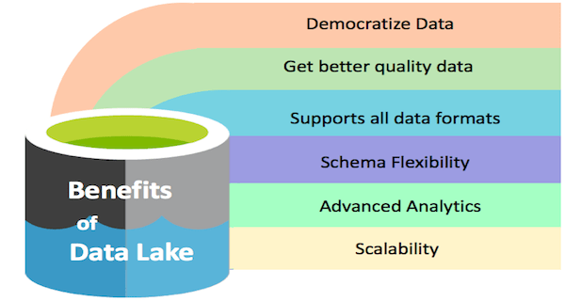
GI AWS+ | data lake Enables…..
A data lake is a centralized repository that allows to store all your structured and unstructured data at any scale. It can store the data as-is, without having to first structure the data, and run different types of analytics—from dashboards and visualizations to big data processing, real-time analytics, and machine learning to guide better decisions.
There is more data than people think
Data
Data platforms need to
grows
>10X
Every 5 years
live for
15
years
scale
1000X

Slide 27



GI AWS+ | AWS digital innovation: devops
AWS CodeStar
Source
Build
Test
Production
AWS CodeCommit
AWS CodeBuild
Third Party Tooling
AWS CodeDeploy
AWS CodePipeline

Slide 28
GI AWS+ | devops Enables…..
TECHNICAL BENEFITS
CULTURAL BENEFITS
BUSINESS BENEFITS
Continuous software delivery
Less complexity to manage
Faster resolution of problems
Happier, more productive teams
Higher employee engagement
Greater professional development opportunities
Faster delivery of features
More stable operating environments
Improved communication and collaboration
More time to innovate (rather than fix/maintain)

Slide 29
GI AWS+ | AWS digital innovation: app modernization
Cloud Infrastructure ready Apps | Cloud Optimized Apps | Cloud Native Apps
Migrate/Lift and Shift | Modernize
Application’s Compute Target
Applications deployed to IAAS cloud environments | Monolithic or N-Tier apps deployed to PAAS app services like AWS Elastic Beanstalk or Azure App Service or container services | Containerized microservices, API gateways, serverless functions
Data target
SQL or any relational database on a VM | Managed databases on the cloud like AWS RDS/Aurora or Azure SQL databases | Fined-grain databases per microservice, based on managed cloud Databases or NoSQL databases
Advantages
No re-architecting, no new code Least effort for quick migration After moving to the cloud, it’s easier to modernize even more | No re-architecting Minimal code/config changes Improved deployment and DevOps agility lower costs for hosting and management Automation of some of the routine operation tasks taken care by the cloud platforms | Architect for the cloud, you get the best benefits from the cloud but new code is needed Microservices cloud-native approaches Modern mission-critical applications, cloud-resilient hyper-scalable Fully managed services, Optimized for scale and agility Built on deployment and DevOps

Slide 30




GI AWS+ | Unique Selling Propositions (USP)
Single Window Solution partner
End to end AWS service coverage
Network, AWS IT, Security, Backup, DR & private IT
Assess, Architect, Migrate, Manage, Secure & Innovate
# | Features | Advantages | Benefits
1 | Single Window Solution Provider (Network, Security, AWS IT and Management) | Single Window Solution for all your AWS IaaS needs, right from Connectivity (DirectConnect) to setting up IT on AWS, securing your AWS setup as well as 24x7 monitoring and management | Easy adoption of AWS Cloud and cost savings
2 | End to end AWS service coverage - Access-Architect-Migrate-Manage, Secure & Innovate | Single point ownership to cover all aspects of AWS enablement with defined outcome | Simplified Execution and single point of ownership
3 | Integrated AWS network and security proposition | Sify with its DX Connect and Network, SOC capabilities, offers unique advantage of end to end service coverage | One Partner, Single engagement for all AWS needs
4 | Unified Dashboard across AWS IT and Private IT | Single dashboard for AWS IT as well as Private IT to give you unified view across your IT state | On-Tap visibility and Control for your complete IT
5 | AWS enabled digital transformation | Infrastructure aligned to your business needs | New business models, faster time to market
Notes:
Single Window Solution provider for Network, Security, AWS IT and Management is Sify’s USP against competitors. For customer Sify is a single point of contact for AWS service coverage – Access – Architect – Migrate – Manage and Secure.
Sify has DirectConnect, Network and 24 X 7 SOC capabilities with this we are offering single engagement for integrated network, IT management and security to customer. So at any point of time sify is the single neck to catch hold of for Sify. We have industry leading service management platform and monitoring tools that offer single view to customer’s entire lasd scape Private or Public.

