Slide 1
Future Proof CX:
Omnichannel Communication as a Service Platform

Slide 2

CONTEXT TODAY
Customer
Generation ‘Next’
Knowledge Explosion
Do it Yourself
Be Different, Do Different
Value Driven
Experience driven
Enterprise
Digital transformation
Move to Cloud
Customer is God
Survival of the fittest
Response to Business
Geography & Reach

Slide 3


ENTERPRISE COMMUNICATION – DIGITAL JOURNEY
TODAYS ENTERPRISE
DIGITAL ENTERPRISE
Silo Communication Channels
NLP/AI Capabilities
Legacy Infrastructure
Capital intensive, People Centric
Non-Collaborative Approach
Distributed Data spread
Integration Complex
Operational Efficiency & Productivity
Scale, Speed & Agility
CX Value Chain Driven
Single Communication Interface
Orchestrate & Automate Interactions
Data Access across touchpoints
Opex-based, Customer-Centric
Minimal On-Premise Infrastructure
Collaborative Approach
Easy Integration with Apps
Ease of Scale, Speed & Agility
Paradigm Shift
Need for a Frictionless Customer Communication Experience through the channels of their choice

Slide 4
MARKET OUTLOOK & GROWTH
FRICTIONLESS
EXPERIENCES FOR 2022 AND BEYOND
CAAS
Orchestration layer with Omni-Channel Communication Engagement Experience Journey

Slide 5
MARKET OUTLOOK & GROWTH
80%
of customers point to speed, convenience,
and knowledgeable help as the most important
elements of a positive customer experience
70%
of customers say connected processes, such as
contextualized engagement, are very important
to winning their business
73%
of customers point to customer experience as an
important factor in their decision making
$17.7
$17.9
billion world-wide market by 2024.
billion world-wide market by 2024.
55%
55%
YoY Growth rate, ~33% in 2020
Sources: IDC,Gartner PWC

Slide 6
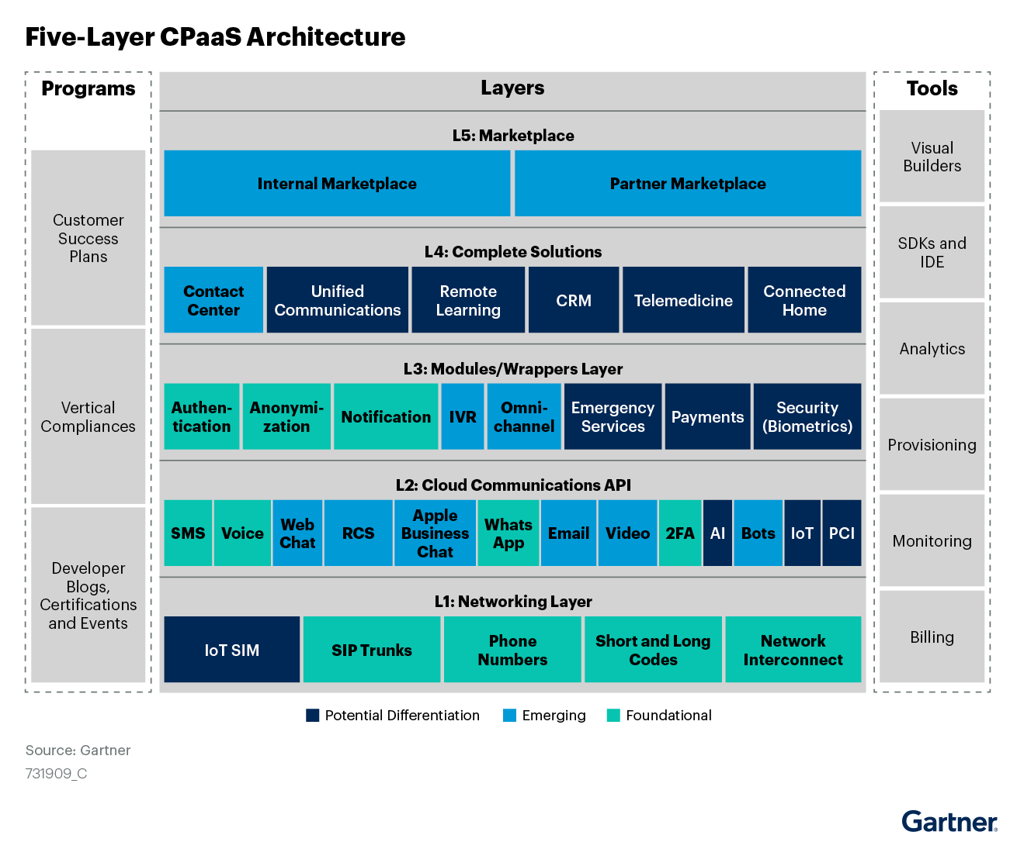
WHY CAAS
CAAS
Orchestration layer with Omnichannel Communication Engagement Experience Journey

Slide 7













ENTERPRISE COMMUNICATION ORCHESTRATION
Awareness & Research
Purchasing & Billing
Customer Service
Logistics
Fraud
Marketing & CRM
Customer Service
Logistics
Billing
Fraud
Inbound & Outbound Business Interactions
Customer Communication Channels
Enterprise
Communication Suite

Slide 8
ENTERPRISE SUCCESS BUILDING BLOCKS
Embedded communication capabilities requires:
Omni-channel
Infra Ready
Integration Ease
Orchestrated
Future-proof
Secure
Redundant
Compliant
Scalable
Customizable
Reach
Assurance
Opex Based
Flexible
ROI Driven
Cost-efficient

Slide 9
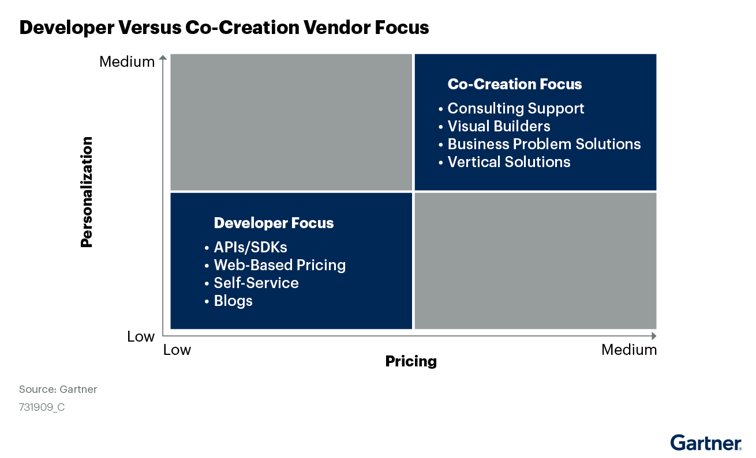
CAAS MODELS : DEVELOPER VS ENTERPRISE
Developer CAAS
Enterprise CAAS
Do it yourself Approach
Single purpose-based APIs, SDKs, IDEs
Build stage application lifecycle
Enterprise Developer Capability
Co-creator Approach
Plug & Play Interface
End to End Application Life-cycle
Support beyond Interface

Slide 10



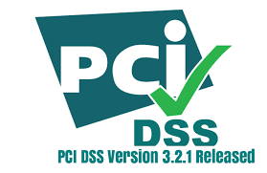
CHOOSE THE RIGHT PARTNER
Selection should be based on a combination of:
Geographical coverage — city, state, region, country
SI and consulting partnerships
Product roadmap
Omnichannel capability
Flexibility & Scalability
Depth of developer ecosystem
Onboarding Guides & Training programs
24 x7 Service support Team
Full SaaS solutions
Reliability & Security
Compliance – PCI DSS, HIPAA
Analytics/advanced analytics AI, ML, NLP and bots
SIFY + OZONETEL + FRESHWORKS
Visionary Quadrant

Slide 11
What makes your communications platform truly omnichannel?
Even though these two terms are used interchangeably, there is one thing that sets the two support systems apart. That is seamlessness.
Omnichannel | Multichannel
One across all channels & devices | Across several different channels
Seamless Experience | Intermittent Experience
Avoids miscommunication across channels | May cause miscommunication across channels
Enables Integrations | Disables Integrations
Better Response Time | Slow Response Time due to unoptimized channels

Slide 12



Building Better Brand Interactions in Remote Locations
CHALLENGE
As per 2022 data, 64.1% of the Indian population lives in rural areas.
In terms of penetration of active internet users, rural India lags with a 41% share compared to 59% for urban India.
But an increased mobile phone penetration has offered a great opportunity to connect with this demographic.
How can you build a strong brand presence in media-dark regions?
Are you leveraging communication channels effectively to drive brand recall & customer engagement?
How do you “talk to your customers” when they are unreachable via traditional media outlets?
Missed Call
Bots and IVR
Voice/SMS broadcasts

Slide 13
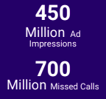
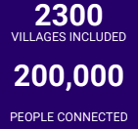
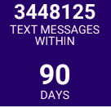
Impact in Numbers

Slide 14
Improving Productivity & Ensuring Effortless CX
Challenge:
Deriving high business value from Conversations & Understanding the Customers Better
Understand your audience better by:
Building a Scorecard/Dashboard
Identifying the pitch, speaking rate, sentiment, and interruptions
Keyword Analysis
Accessing Analytics recognize areas of improvement
Analyze 100% of your calls
Solution:
Speech Analytics can open possibilities for improving productivity and ensure the delivery of improved CX. It offers an innovative way to monitor interactions for quality and continuous improvement, analyzing data for quick decision making

Slide 15
Connect faster & directly improve wallet share
Challenge:
70% of the customer’s journey is based on how their experience with the enterprise. Quick responsiveness is the expectation to deliver an expected experience and delay in responses trigger the customer to drift away
Invest more time towards improved CX through effective use of contextual communication
Solution:
Reduce the first touch-point time frame
Ensure 3X more effective engagements & interactions
Improve productivity & ROI

Slide 16
Stay Connected Anywhere, Anytime
Challenge:
Allow customers/employees/offices in India to connect across the globe
Businesses often struggle to gain easy access with effective monitoring
Conversations lead to business. Stay connected with your customers 24 x7 to deliver higher CX
Solution:
Easy business rule-driven calling access to cost-effectively connect across the globe with centralized monitoring system and redundant infrastructure

Slide 17
A quick glance into the post - pandemic scenario
The pandemic has dramatically changed the way businesses are carried on.
With the key enabler being technology, there is more emphasis on personalization, customization, and delivering a better CX, meeting the customers exactly where they are in their journey.
Key Observations:
The need to eliminate physical infrastructure
Greater emphasis on Cloud
Enabling an Omnichannel Environment Automating touch points, simplifying operations at the backend, ensuring effortless CX for both - companies and customers
Cost-viability of CX while ensuring Convenience, Safety, Security, and Scalability

Slide 18







WHY US?
Low code Open API integrations offering high level customization
Error Free Cloud Deployment at Scale with no third-party dependencies
Cutting-edge Conversation AI
Strong Local & Global Presence with local numbers, Toll Free numbers, and over 100+ Hybrid deployments
Collaboration with almost all service providers
Custom solutions, cutting across all verticals including Manufacturing,Retail, Distrbution, IT/ITes, BFSI, Media,EdTech, Real Estate
HIPAA, PCI DSS Compliant ensuring high level of security

Slide 19












Delight Customers with Effortless Omnichannel Experiences
Delight Customers Everywhere
Service Automation
Have more meaningful conversations across the entire customer journey.
Omnichannel
A/I
Message & Bots
Master Service Excellence
Solve inquiries faster and provide highly personalized service.
Customer delight
Collaboration
Co-Browsing
Accelerate Time to Value
Unified Customer Profile
Simplified Ticketing
Our customers deploy new solutions in under 3 months

Slide 20
Delight Customers Anywhere
Potential Use Cases
Value Drivers
Business Benefits
Powerful & Intuitive Self-Service portal
Guided support & Auto-Suggested Solutions for Customers
A/I backed Service Bots
Optimize channel mix to reduce cost per inbound interaction
Improve call avoidance with self-service
Reduce Total Costs to Serve
Serve customers in channel of choice across modern messaging and digital channels
Unified & consistent omnichannel experiences
Conversations made easy with built-in telephony
Provide support in a customer’s channel of choice
Increase Customer Delight (CSAT)
Offer a seamless customer journey across channels and devices
Ensure agents have the right insights and knowledge across every channel
Powerful customer conext across every interaction
Conversational inbox
Reduce Customer Effort
(CES)
Simplify and unify how agents respond to inquiries across all channels

Slide 21
Master Service Excellence
Potential Use Cases
Value Drivers
Business Benefits
Centralized knowledge base available in digital and assisted channels
Real-time team collaboration with customer-context
Powerful service automation & workflows
Rapidly solve inquiries with greater automation, insights & knowledge.
Improve collaboration to greatly reduce handling times
Speed Up Resolution Times &
↓ Costs Per Inquiry
A unified desktop for all communication channels
Guided resolution with service workflows and A/I resolution paths
Proactive notification and ticketing automations
Reduce swivel chair with a unified desktop
Guide to solve complex problems
Reduce Attrition
Simplify onboarding with productivity tools on a single platform
Productivity tools such as canned responses, templates, scenario automations, suggestions, watcher, and more!
Robust routing and escalation rules
Streamline workflows with automation, routing and escalation rules.
Accelerate
Time-to-Productivity

Slide 22
Master Service Excellence
Potential Use Cases
Value Drivers
Business Benefits
Analyze incoming customer requests, prioritize cases for field service as necessary
Get live status updates remotely and close the loop with the customer on problem resolution
Get more field visibility
Boost collaboration of your support and field teams
Enhance profitability
Allow field technicians to access information from the field and resolve issues quickly
Assign field technicians to cases based on skill, location or priority
Empower your field teams to improve response time
Reduce number of visits
Get more jobs done efficiently
Accelerate Responses

Slide 23
Effortlessly Grow Customer Value
Potential Use Cases
Value Drivers
Business Benefits
Real-time alerts and workflows to quickly diagnose customer challenges
Data-driven insights that monitor customer health
Proactively understand customer challenges and anticipate their needs
Improve Life cycle Management
Effortlessly monitor customer health
Seamless transition from service resolution to next-best-offer
Unified Profiles to provide a single view into service and selling activities.
Transform service calls into sales opportunities w/ next-best-offers
Improve Walet Share
Enable sellers with customer insights to close deals faster
Innovate faster with greater business agility
Rapidly develop new apps that enable teams across the business to gain customer insights
Integrate flexibly with over 1,000+ marketplace apps.
Create an ecosystem of customer delight with greater interoperability
Accelerate Time to Value

Slide 24
GETTING STARTED
Look for broken journeys and moments that cause frustration, curiosity, and happiness.
The customer is looking to engage with a business or wants to be engaged with
Adopt a use case approach, deploy and then scale customer journeys that address specific customer needs and deliver specific KPIs.
For example, IVR calls deflection to Bot, contextual interactions, shift to digital channels for interactive experiences.
Identify the moments that matter

