Slide 1
SIFY MANAGED CISCO SD-WAN

Slide 2
SD-WAN FRAMEWORK
Deliver Customer Value, Not Just Cost Efficiency
Unify Managed services
Key enabler for Digital transformation
AGILE & FLEXIBLE
APPLICATION CENTRIC
PERFORMANCE AWARE
SOFTWARE BASED
Carrier agnostic Overlay architecture.
Multi-transport support.
Centralized control & Monitoring.
Unique topologies per segment.
Encryption, segmentation and service chains
Cloud off-ramping
Application aware routing.
Application based policies.
Application visibility & recognition.
Real-time enforcement of App SLA.
Centralized policy control.
Continuous quality assessment.& path liveliness
Consolidates multi provider WAN as a single fabric.
Faster convergence of application traffic.
Bandwidth augmentation with Active/Active utilization.
TCP optimization
Software platforms enabling physical or virtual CPE.
Zero touch provisioning.
Centralized configuration.
Agility for operations with analytics.
Interoperable with legacy.
Notes:
The WAN needs of a customer is treated with utmost priority at Sify.
The aim is not just to save costs but provide end to end value to the customer. This is done by leveraging applications, active performance monitoring and quick agile fixes.

Slide 3

SD-WAN – Network Transformation Enabler
In the cloud era, when we are witnessing a huge migration of workloads to the cloud, SDN is a big network transformation enabler, which intelligently and centrally controls the network architecture using software applications.
Customers can now utilize any Service provider, any transport type (MPLS/ILL/BB/4G-LTE) suiting Applications in their network
Allowing Application Prioritisation against only QoS
SD-WAN overcomes the shortcomings of legacy WAN architectures
Rapid and scalable deployment of network services with Zero Touch Provisioning, hence providing Agility
Cloud based Centralized Management platform provides real time visibility and unified management
All WAN links can be aggregated to give unified WAN pipe and links can be used in active-active
SD-WAN supports integration with legacy network architectures
Notes:
SDWAN transforms the way networks were being used.
Customers can now utilize any Service provider, any transport type (MPLS/ILL/BB/4G-LTE) suiting Applications in their network.
Cloud based Centralized Monitoring and Management platform provides real time visibility and unified management, device by device management is no more required.
SDWAN supports integration with legacy network architectures, so customers can do phase wise migration of sites.
All WAN links can be aggregated to give unified WAN pipe and links can be used in active-active. Real time quality assessment can be done to ensure dynamic traffic steering can be done basis link performance
End to End Managed services to drive efficiencies in the customer deployments to lead engagements through insights and value beyond cost economics. Platform is hosted in Sify Secure Cloud and all monitoring & management is done by technical experts from the NOC. No configuration interventions are required at branch sites.
Application based QoS : Platform gives complete Application awareness and policies to suit performance. Customers get clear visibility of site wise utilization of various Apps. App based SLA can be implemented.

Slide 4






Benefits of Cisco SD-WAN
Predictable app experience
Right security, right place
Enterprise grade, simplified
Support for evolving business application strategy
Cloud OnRamp for IaaS, SaaS and Colocation
Secure segmentation across entire network stack
Full edge security stack from branch to cloud and colocations
Intent-based networking with multi-domain policy
Proven deployments to over 10,000+ sites
One user interface for security and SD-WAN across branch, cloud, and colocation

Slide 5
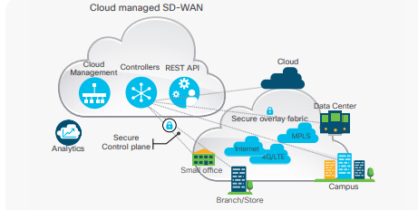
Why CHOOSE CISCO SD-WAN SOLUTION?
Existing Cisco Infrastructure, i.e., Cisco Hardware ISR series, only need to purchase DNA SD-WAN Licenses.
Global customer locations are already on Cisco platform and the network needs to be integrated.
Two phased approach for customers who want to invest on the hardware refresh immediately and have the network SD-WAN Ready for migration later.
Maintain flexibility with a cloud-first architecture to connect any user, to any application, across any cloud.
Increase user productivity by optimizing cloud and on-premises application performance with real-time analytics, visibility, and control.
Customers looking for operational simplification with single management dashboard for management of WAN, Cloud and Security •
Customers looking for full automation with RESTful integration into existing tools Rich Analytics.

Slide 6





Cisco SD-WAN Solution elements
Orchestration Plane
Management Plane
First point of authentication
Distributes list of vSmarts/ vManage to all Edge routers
Facilitates NAT traversal
vManage
Single pane of glass
Centralized provisioning, troubleshooting and monitoring
RBAC
vBond
Data Plane
vAnalytics
Control Plane
Physical or virtual transports
Zero Touch Provisioning
Establishes secure fabric
Implements data plane policies
Exports performance & other statistics
vSmart Controllers
Propagates control plane information between edge routers
Distributes data plane policies
Implements control plane policies
MPLS
4G
INET
Cloud
Data Center
Campus
Branch
Co-Lo
SD-WAN Edge Routers

Slide 7
Sify’s MANAGED SD-WAN FEATURE tiers
GOLD
DIAMOND (Gold +)
Gold +
PLATINUM (Diamond +)
Basic Path optimization with FEC and Packet Duplication
Diamond+
TCP Optimization
App and SLA based policy
Dynamic Routing (BGP, OSPF)
VNF Lifecycle Management
VPN Overlay,
Topology: Hub-n-spoke, NAT, Split tunnel,
2 VPNs: 1 transport, 1 service side
VPN with L2 or L3
Encryption: AES-256,
Policy support: Local ACL only, Data policy
QoS (classification, policing, remarking, scheduling),
App-aware routing (5 tuple only),
DPI for visibility, App visibility (name, throughput)
Viptela vManage platform,
Zero Touch Provisioning, Day 0 , day 1, day N Changes
Cloud OnRamp for IaaS and SaaS
Automated Service Stitching
Encrypted Traffic Analytics
Segmentation (Unlimited VPNs)
Cisco AMP and SSL proxy
URL filtering
Cisco Umbrella app discovery
Integrated Border for Campus (SD-Access)
Integration with ACI for Application SLA
Web Caching, DRE (incl. SSL proxy)
Voice Module and SRST Integration
Service-side routing
Mesh topology,
Multicast VPNs: 5 (1 transport, 4 service side)
Advanced policies: Service chaining, extranet
DPI for app-aware routing and policies
SaaS on-ramp (was CloudExpress)
VPNs: Up to system scale
WAN Full stack WAAS
TCP Optimization
Cisco Umbrella SIG Essentials
Web Content Filtering
Cloud App discovery and granular app control
Advanced Malware Protection (AMP) for web security
Additional Cisco Umbrella SIG Essentials
Licenses can be purchased separately.
Cisco Threat Grid
Platforms Supported: vEdge, ISR1K, ISR 4K, ASR
Subscription Model: Per Site Annual Recurring Charges
Includes- Edge CPEs, Platform Feature Subscription, Control Components and Managed Services

Slide 8
Security Feature's
Manage in Cloud or On-Prem
Full Edge
Security
Edge Router Flexibility
Single Pane of Glass
Provision
Manage
Monitor
Report
Troubleshoot
Embedded
Ent. Firewall App Aware
IPS
URL-Filtering
AMP and Threat Grid
Cloud
DNS/web-layer Security
Platforms
ISR 1K
ISR 4K
ENCS (ISRv)
CSR
ASR 1K (Ent FW App Aware and DNS/web-layer security)
vEdges (FW and DNS/web-layer security)

Slide 9



Multicloud Partners: SD-WAN Beyond the Branch
Microsoft
Amazon
Equinix
Google
Office 365 path selection and optimization improves the end user experience
Centralized management, automated configuration and policy changes with Azure
Easy network extension to Amazon AWS using virtual instances of on-prem devices
Native integration of SD-WAN end points into AWS Transit Gateway (TGW) Network
Ease of management with the ability to extend Cisco SD-WAN fabric into colocation
Establish direct and secure, private interconnection between branch and public clouds
Industry’s first application-centric multicloud networking fabric
Exchange service-level agreement settings, security policy, and compliance data, between SD-WAN and GCP
These Partnerships Will Help Accelerate Enterprise Cloud Strategy

Slide 10

Sd-wan security Driving towards SASE model
SaaS/IaaS
Application
SaaS/IaaS
Application
SaaS/IaaS
Application
Cloud Security
Colocation
Branch Security
On-Prem Security
Cloud Security & SASE
@Regional Hub
Thick branch with Routing and Security (SD-Branch model)
Thin branch with security in the cloud
Security Services as VNF at Regional Colocation Hub

Slide 11

Cisco SD-WAN Security & SASE Solution
Enterprise Firewall
Layer 3 to 7 apps classified
Intrusion Protection System
Most widely deployed IPS engine in the world
URL-Filtering
Web reputation score using 82+ web categories
Cisco
SD-WAN
Cisco Security
Adv. Malware Protection
With File Reputation and Sandboxing (TG)
SSL Proxy
Detect Threats in Encrypted Traffic
Umbrella Cloud Security
DNS Security/Cloud FW with Cisco Umbrella

Slide 12



Cisco SD-WAN Fully integrated with Umbrella
Easy to Consume
Fast to Deploy
Simple to Manage
Consistent packaging and entitlement reporting
Simplified billing with Enterprise Agreements
Flexible pre and post-paid payment terms for MSPs
Auto-registration of SD-WAN to Umbrella
Single touch auto-provisioning from Branch
Discovery and granular control of SaaS applications
Integrated troubleshooting and service assurance
Unified security policy and threat insights*
Identity aware based SD-WAN for better path selection*
A SASE architecture secured by leading real-time threat intelligence
*Roadmap – CY21

Slide 13
STRATEGY & OFFERS OF CISCO SD-WAN

Slide 14



Introducing 100 on 100 Offer
Tailored SD-WAN licensing structure built for smaller networks
Simplified orderability of hardware and software through a single DNA-EPLUS SKU
Optimized price/performance for smaller networks*

Slide 15
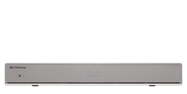
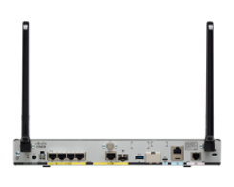
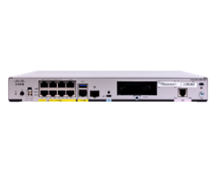






100 on 100 Offer Components
ISR1K Platform configurations
Cisco DNA-EPLUS
Branch
(up to 250MB)
ISR111X-8P
ISR111x-
4P or 8P
All the features of DNA Essentials plus premium cloud, analytics and security capabilities
ISR1100-4G
ISR112x-8P
Premium Cloud/Analytics
Cloud OnRamp for SaaS: M365
vAnalytics
Head-End
(up to 500MB)
ISR1100-6G**
Enhanced Security/ Compliance
Segmentation (3+1)
Cisco AMP*
URL filtering/SSL Proxy* Support
Management
No Bandwidth Tiering!**
vBOND
vManage
vSmart
vAnalytics
**ISR1100-6G is for both the Branch and the Head-End
**BW limited by router max
*8Gb DRAM & Boot Flash needed for advanced security
**SSL/TLS Proxy not supported on ISR1K platform

Slide 16
Cisco SD-WAN DNA EPLUS Details
Cisco DNA Advantage
Cisco DNA EPLUS
Cisco DNA Essentials
Cloud/Analytics
Bandwidth Flexibility
Cloud OnRamp for IaaS and SaaS
Automated Service Stitching
Encrypted Traffic Analytics
vAnalytics
Connectivity/Mgmt
Cloud or On-Prem Management
Flexible Topology
Hub and Spoke
Full Mesh/Partial Mesh
App and SLA based policy
Dynamic Routing (BGP, OSPF)
VNF Lifecycle Management
No Bandwidth Tiering (up to platform max)
Cloud
Security
Cloud OnRamp SaaS: M365*
Segmentation (Unlimited VPNs)
Cisco AMP and SSL proxy
URL filtering
Cisco Umbrella app discovery
Analytics
Security
vAnalytics
X-domain Innovations
Enterprise Firewall with Talos-powered IPS and application controls
Cisco Umbrella DNS Monitoring (visibility only)
Integrated Border for Campus (SD-Access), Integration with ACI for Application SLA
Security
SD-WAN Services
Segmentation (3+1 VPNs)
Cisco AMP*
URL filtering/ SSL Proxy Support*
Services
Basic Path optimization with FEC and Packet Duplication
TCP Optimization
Web Caching, DRE (incl. SSL proxy)
Voice Module and SRST Integration
Multicast
Cisco DNA Essentials
Cisco DNA Essentials
*8Gb DRAM & Boot Flash needed for advanced security
**SSL/TLS Proxy not supported on ISR1K platform

Slide 17
Cisco 1000 Series Integrated Services Routers (isr) - Value and Benefits
High Performance
Multi-core hardware architecture
Open and programmable operating system IOS® XE
Connectivity & Advanced Mobility
Gigabit Ethernet WAN, DSL (G. fast), LTE Advanced Pro
Gigabit Ethernet LAN , 802.11ac wave2 with Mobility Express
WAN & Application Assurance
Centralized management and orchestration with Cisco DNA Center and vManage
Zero touch deployment and provisioning
Comprehensive Security*
Ent. FW App aware, IPS, URL-F, AMP & TG, DNS/web- layer security on SD-WAN
Advanced threat defense with encryption at high-performance
*8GB DRAM & Flash required for UTD security features(IPS/IDS, URL-F, AMP/TG, DNS Security)

Slide 18
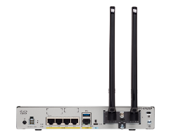
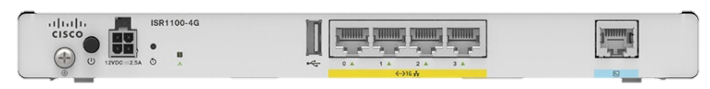
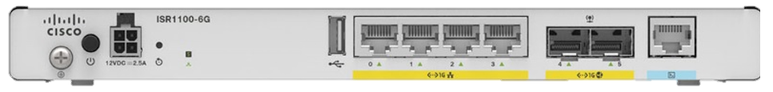
Cisco ISR 1000 Platform Family - Overview
C1101 Platform Series
C111X Platform Series
C112X Platform Series
ISR1100(X)-4G
ISR1100(X)-6G
LTE, W-Fi, PoE, DSL
LTE, Wi-Fi, PoE, DSL
LTE, Wi-Fi, PoE, DSL
SD-WAN Security
Can be upgraded from Viptela OS to
XE-SDWAN
Supports XE-SDWAN Software only
M2M (ATM/KIOSK/POS) Extended temperature & Dual Modem
Remote Workers
MSP CPE
Branch in a Box

Slide 19
SIFY MANAGED SD-WAN VALUE PROPOSITION

Slide 20
Sify Managed SD-WAN Service Lifecycle
A/c & BD Team
Project Manager
Engagement Manager
Solution architects
Activation & Delivery teams
NOC + Field Ops
Consult
Design
Implement
Migrate
Operate
Transition
Develop a right WAN strategy
Assess current network and propose an SDWAN design.
Align network design with transformation objectives.
Proof of concept against key objectives.
Network High level and low -level design.
Identify the right network partners
Cloud connect design.
Configuration templates.
Documentation
AT plan.
Project Management
Site RFE
Links RFU
Hardware supply, I&C.
Branch onboarding and provisioning.
AT & Ops handoff
Migration plan.
Migration calendar.
Sites RFM assessment.
Migration execution.
Roll back
Failure assessment
Documentation handover
Systems visibility
Design vs as-built
Customer contacts
Escalation matrix and review mechanisms
Custom KPIs.& SLA review
Spares transfer.
Reporting custom build up
Project signoff.
Network monitoring
Fault and Incident management.
Telco management.
Change, Assets Problem, config and SW management.
Security policy management
Solution sustenance & continuity.
Network MACDs

Slide 21

Sify as a SD-WAN partner
Network & Service Provider Agnostic Solution
Supports multiple transport types – MPLS/ Internet/ LTE/ DSL
Support for 3rd party ISP links
End-to-End Managed Services Model- Edge CPEs, Subscription, Installation & Support
Sify Owned Sify Managed Highly redundant SD-WAN Platform
Cloud based, Multi tenant platform hosted within Sify Core Net work infrastructure
Geo-redundant core for business continuity (Mumbai and Chennai)
High level of redundancy for Connectivity links for the platform
Managed 24x7 by skilled resources.
End to End Managed services to drive efficiencies, lead engagements through insights and value beyond cost economics.
Notes:
Why Sify is an ideal partner for SDWAN deployments:
Sify can provide SDWAN solution irrespective of Service providers and media types and provide End-to-End Managed Services Model- Edge CPEs, Subscription, Installation & Support.
Sify has created Geo redundant headend infra for SDWAN Control components in Sify’s own core network. This infra is managed 24x7 by skilled resources ensuring high availability. This high capacity infra can support multiple tenants and is highly scalable.

Slide 22

Sify as a SD-WAN partner
NOC, SOC and systems experience
Managing multi-vendor environments, single ownership, SLA driven
Integrated NOC & SOC, 24x7x365 monitoring and management
Visibility Tools -1200+ Man Years in Tools & Process
1800+ Network services strength
Inhouse cloud and application delivery
Capability and experience in all aspects of building cloud infrastructure
Managing public and hybrid cloud services
CloudInfinit CMP to provide multi cloud operational best practices
AWS/Azure/Oracle/Google cloud implementation
Delivering SaaS - ForumNXT, I-test, Safescrypt and E-learning
Pan India Regional Field team Structure
Sify presence in 1500+ cities in India
1300 + trained engineers on field covering 400+ locations
Project teams that deliver customer centric projects
Notes:
3. Sify has got unique experience in managing multiple Telecom Service providers and OEMs across the industry and can offer single ownership & unified SLA.
Sify has inhouse integrated NOC & SOC operational 24x7 which is manned by highly skilled resources. The Tools & ITIL framework ensures seamless services for customers.
4. Sify has Inhouse cloud and application delivery capabilities and experience in all aspects of building cloud infrastructure. We are managing public and hybrid cloud services. Its own CloudInfinit portal to provide multi cloud operational best practices. There is high level synergy with AWS/Azure/Oracle/Google cloud implementations. The team has proven skills in delivering SaaS - ForumNXT, I-test, Safescrypt and E-learning solutions for customers.
5. Sify has Pan India Regional Field team Structure with presence in 1500+ cities in India. There are 1300 + trained engineers on field covering 400+ locations. Dedicated Project teams that can deliver customer centric projects.

Slide 23
SD-WAN MANAGED SERVICES VS DIY

Slide 24
Managed SD-WAN opportunity is Big !
Global SD-WAN Managed Services
to grow at 76% CAGR to $5.7B
by 2023
Gartner report, “Forecast: Enterprise Networking Connectivity Growth Trends, Worldwide, 2018-2023, 2019 Update,” published on October 4, 2019

Slide 25
Different approaches adopted by enterprises
DIY SD-WAN
Shared-Responsibility Model
Service Provider Managed
SP manage and support Network services platform
Enterprise maintains service policies and configurations via portal
Enterprise owns and manages the end-to-end network and service platform
Service Provider manages the end-to-end network and service platform
Increased responsibility by the Service Provider equates to less risk for the Enterprise

Slide 26


Managed SDWaN Vs diy
DIY | SIFY’S SD-WAN AS A SERVICE
Usually built “on-premise”, increasing risk of maintenance and dependency on organization’s it team for maintenance | Usually built on “cloud” model, reducing risk of maintenance by availing MSPs offered “managed services” with end to end process being owned by the MSP
Requires capital expenditure (cap-ex) on procurement of the required hardware / software | Option of an op-ex based flat monthly rate service offering, freeing up the cash flow
Enterprise has to decide the platform, model numbers, capacity, features etc from A wide market | MSP designs the best-fit solution based on the enterprise’s current architecture and future needs
Notes:
Key Advantages of having “Managed SD-WAN” services are:
Streamlined Efficiency and Enhanced User Experience
Expertise, at a Lower Cost
Hosting it in the cloud
Performance
Time to value

Slide 27
Managed SDWaN Vs diy
DIY | SIFY’S SD-WAN AS a SERVICE
Platform/models will come to EOL/EOS, forcing the enterprise to a technology refresh | Technology refresh is the responsibility of the MSP
Dependency on organization’s it team for build, deploy, BAU (Business As Usual) operations and maintenance – increased expenditure | Access to MSPs domain-specific expertise for consulting along with access to dedicated helpdesk support for BAU operations and maintenance – frees up it team to focus on other critical market-facing processes and business innovations
Platform requires to be hosted locally, redundancy to be planned, high availability to be ensured, no SLAs in place | Platform is available in geo-redundant mode. Connectivity, power, hosting ensures ~100% availability, service offerings are backed with enterprise grade SLAs
Optimum utilisation of feature set depends on internal skillsets available | MSP teams are well-trained and up to date with the technology
RMA (Returns Material Authorization) and spares planning are a tedious process and involves additional cost | Spare's supply and replacement is a planned activity with standardised process of RMA followed

Slide 28
MANAGED SD-WAN SERVICES BENEFITS AND USE-CASES
Features | Benefits/Use-cases
Multiple access circuit types | Customer can use any of the transport network and transport types and the Managed Service Provider will manage the multiple access circuit types.
Expertise, at a Lower Cost | Managed services offerings provide organizations with the expertise required, without having to hire specialists, which again is a significant cost-avoidance. With organizations becoming increasingly multi-functional, the need for domain-specific expertise, both in terms of workforce and tools utilized, has increased manifold.
Streamlined Efficiency and Enhanced User Experience | MSP’s augment the operational efficiency of an organization by allowing its IT staff to focus on strategic initiatives and technological planning, while offloading the operational aspects of such initiatives to MSP’s MSPs provide services as per agreed Service Level Agreements (SLAs) that define the level of service offered over the contracted period of time. Proactive monitoring offered as part of the managed services offering ensures fast/efficient troubleshooting.
Visibility | Managed Service Provider configures to provide organizations with; Granular visibility into the Applications, SLA Path Metrics, Quality of Service Detailed end to end path performance reporting Site and link availability reporting Reporting is configured and enabled as required by the organizations
Subscription tier pricing | Based on throughput and features required Pay as you grow model
Scalability | Beneficial for large site deployments – typically in 100s and the site turn ups are huge. MSP ensures all the infrastructure is available to support the required scale.
Head End Infrastructure – Controller | Managed Service Provider builds the Head end infrastructure on a High-Availability robust architecture. Proactively monitored and Managed 24x7x365

Slide 29
SIFY MANAGED SD-WAN DELIVERABLES (1/2)
Deliverable | Description
Service portal | Portal to customer, able to view, configure, monitor WAN network performance of Sify and other providers
Capacity management | Measure WAN link utilization trends, create baselines and recommend customer on the actions taken – upgrade, downgrade
Transition and implementation services | Site survey, CRD, HLD and LLD. Deploy initial CPE devices across all sites. Perform MACD as and when changes required [bandwidth upgrade/downgrade, new features]
Proactive network monitoring | 24x7 Monitoring of network related faults and performance management. Able to view this alerts on self-service portal
Application visibility | Identify applications and sub-applications, report the performance of applications
Incident reporting and management | Trouble ticketing for all network related issues including other SP links. Detection of alerts from fault and performance management systems
Problem management | Diagnose, identify and isolate issues. Work on fix and workarounds with providers and SD-WAN vendors
Configuration management | Configuration of managed CPE devices, auditing, backup of configuration, template based config
Inventory management | Manages inventory of CPE devices, resources – IP address, VLAN etc

Slide 30
SIFY MANAGED SD-WAN DELIVERABLES (2/2)
Deliverable parameter | Description
Vendor management | Co-ordinate with vendors for issue reporting and resolution, faulty hardware management, recommended best practices
Change management | Scheduled network changes – changing software based on EOL, proactive identification of network issues and resolution, MACD of WAN links and bandwidth
Service desk | 24x7 technical support team to co-ordinate with customer for issue reporting and resolution
Hardware replacement time | Replacement of faulty hardware and components
Support systems | IAM, NTP, OOB management systems
Root cause analysis | Analysis of issues and identify root causes – including CPE and provider links

Slide 31
SIFY TOOLS, DASHBOARDS & ANALYTICS

Slide 32
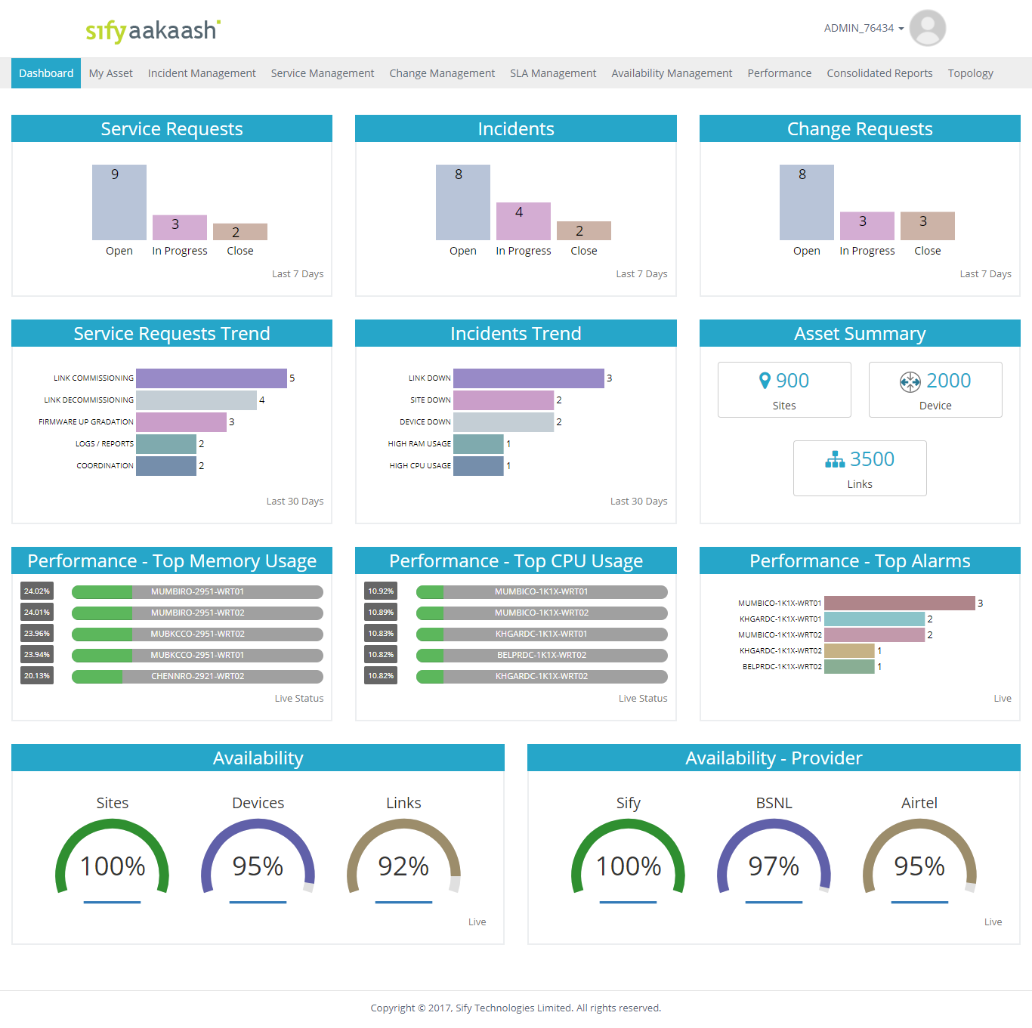
Sify NMS Tool
Customer Service Portal Highlights:
Sify Aakaash Portal is customer facing portal that offers integrated view of the Service requests, Network performance Reports, Inventory and trouble tickets that have been registered for the issues reported and identified pro-actively.
All the incidents and changes are recorded through the system for customer visibility as well as for analysis
Enhanced real-time and scheduled reporting based on defined configuration

Slide 33
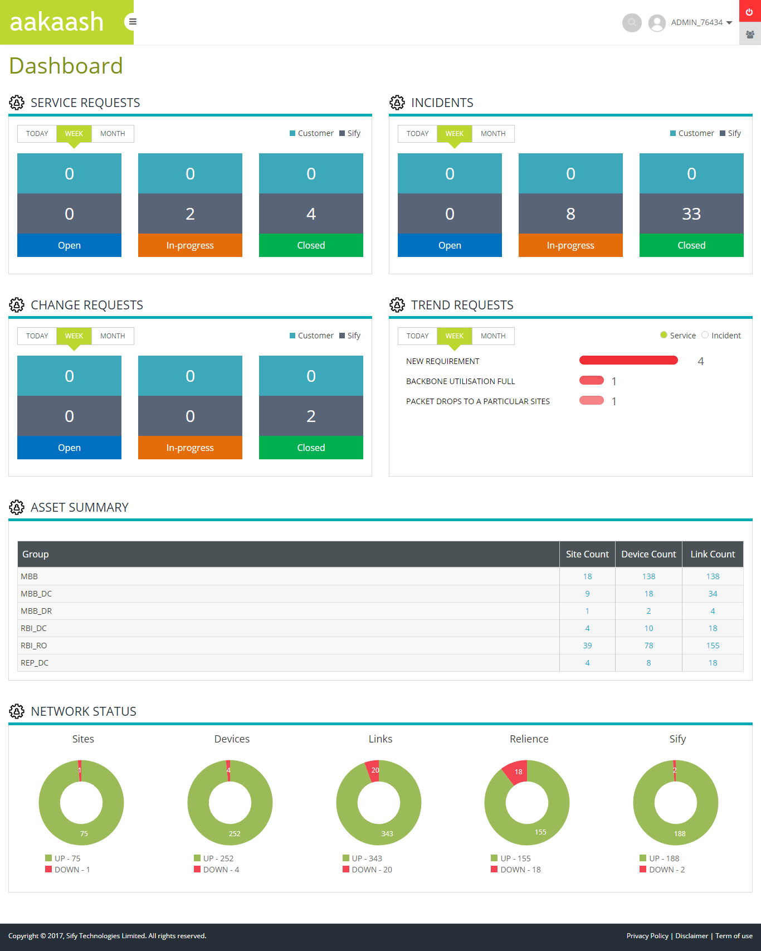
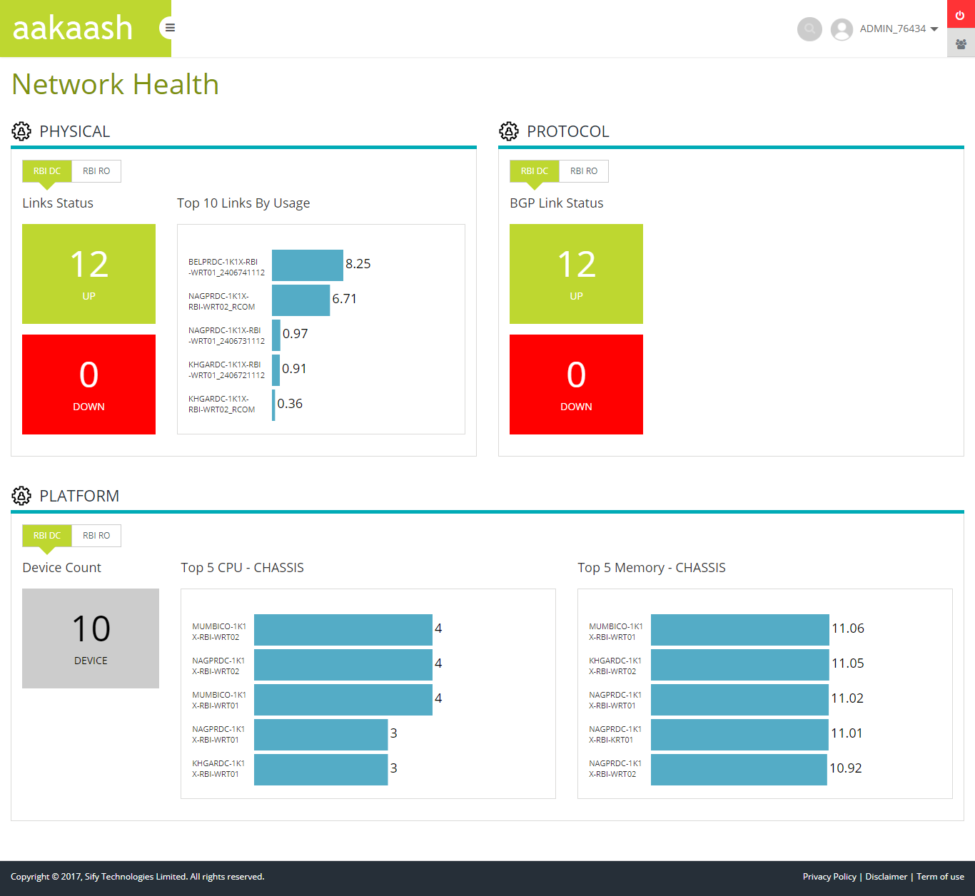
Sify NMS tool DASHBOARD

Slide 34
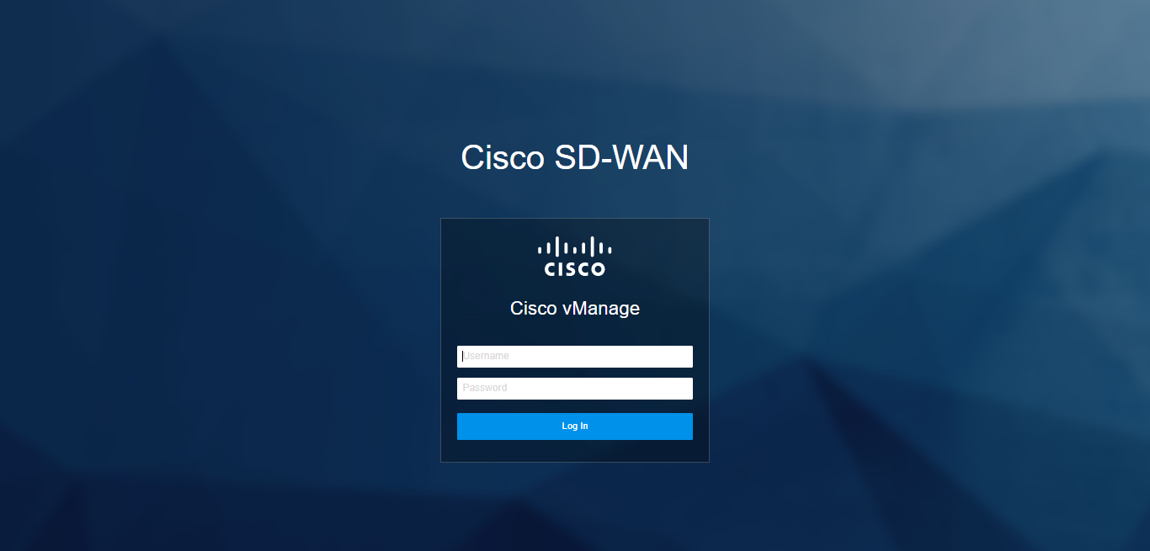
LOGIN PAGE

Slide 35
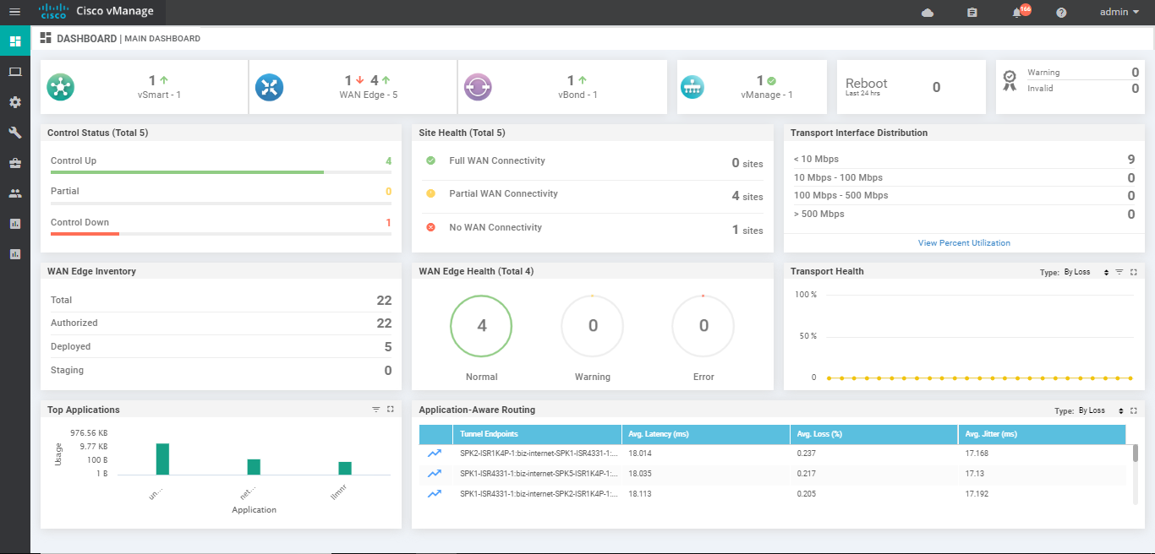
MAIN DASHBOARD

Slide 36
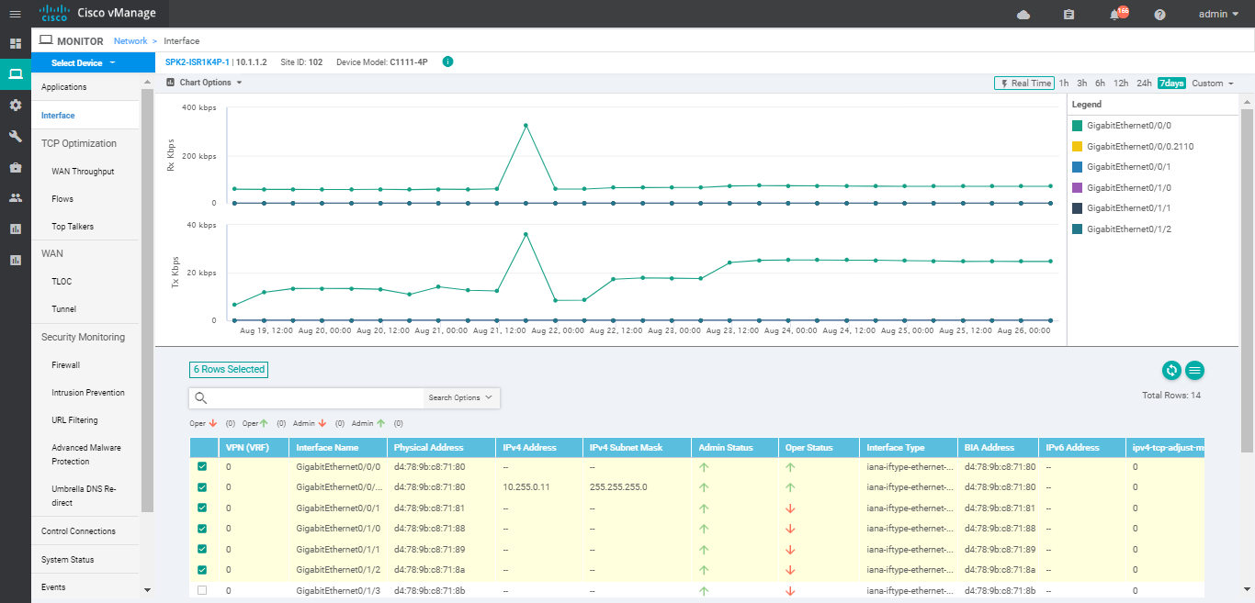
INTERFACE UTILIZATION REPORTS

Slide 37
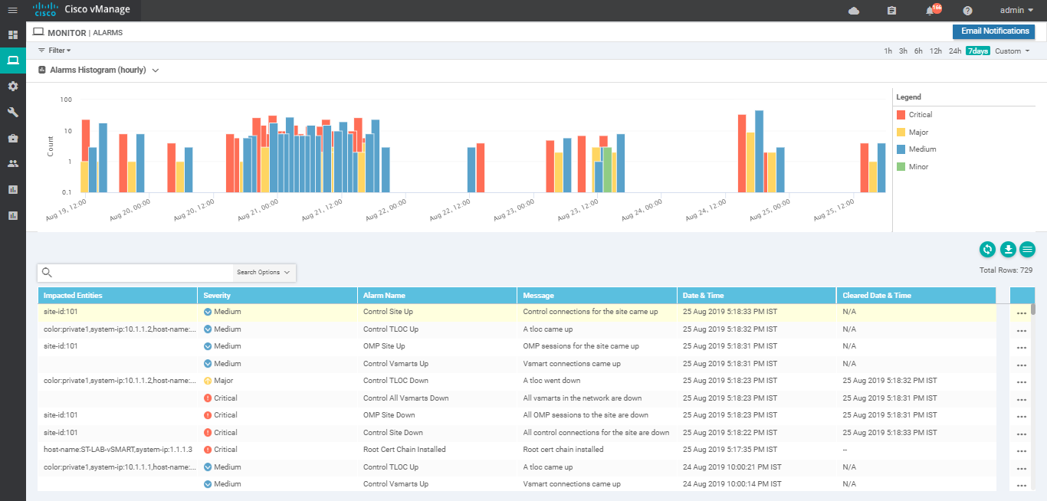
ALARMS CONSOLE

Slide 38
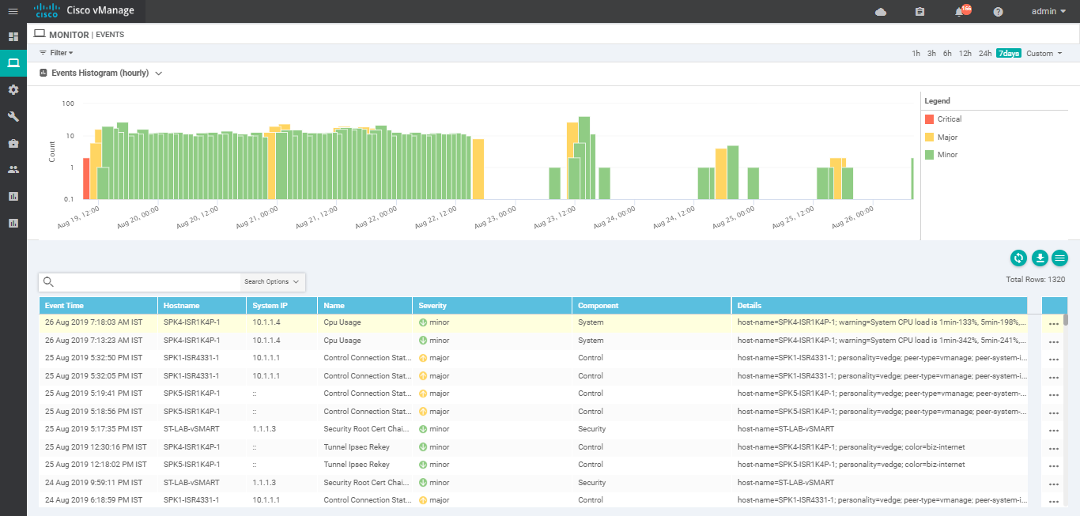
EVENTS CONSOLE

Slide 39
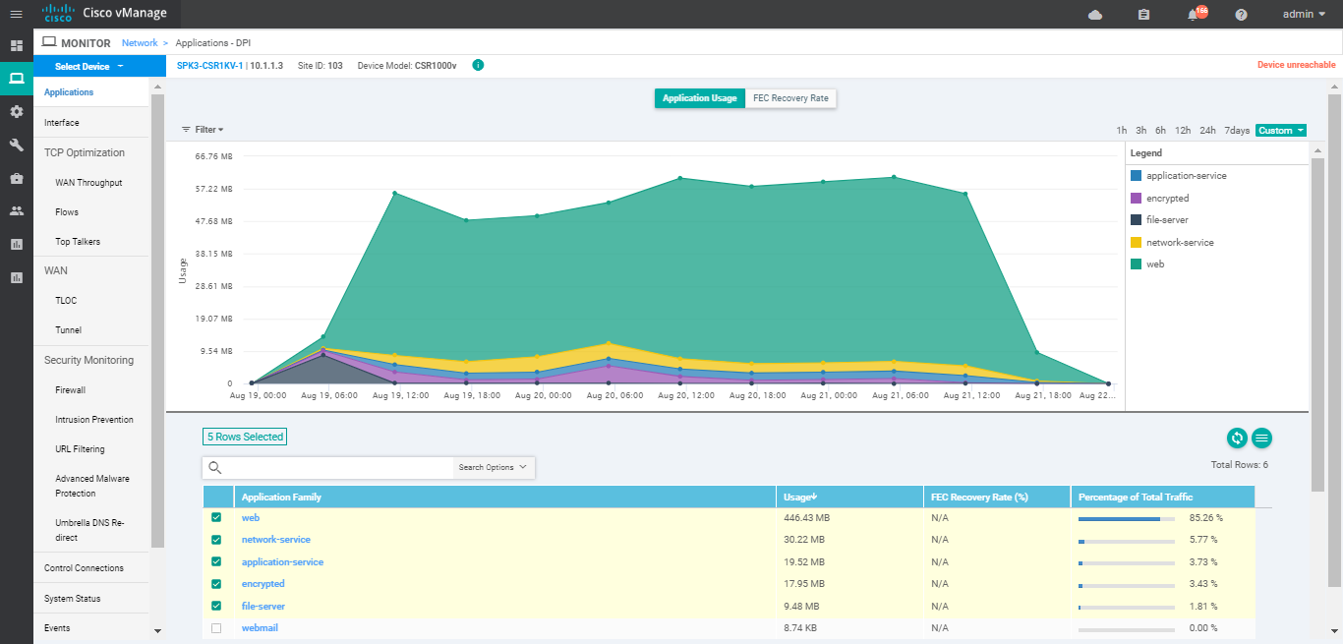
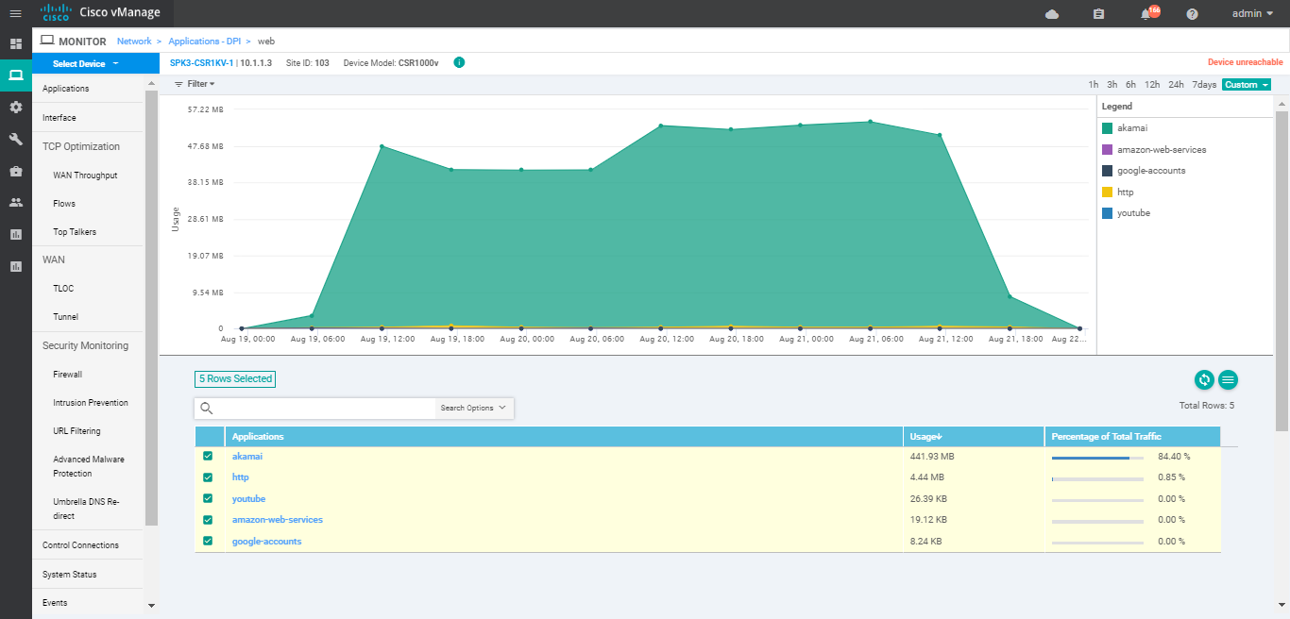
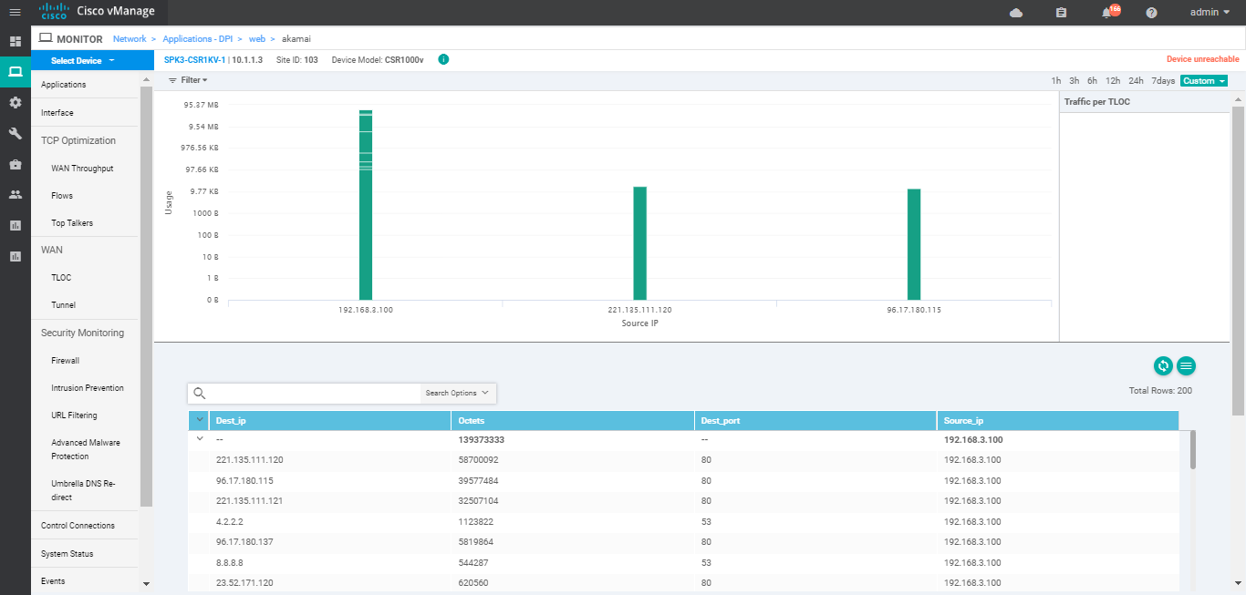
APPLICATION STATISTICS

Slide 40
SIFY MANAGED SD-WAN SUCCESS STORIES

Slide 41




CASE STUDY: One of the National Co-operative Banks - 55 Locations
CHALLENGES
SOLUTION
BENEFITS
Customer was looking for renewal of contract for primary connectivity and adding secondary connectivity
Routers had reached end of life
There was no visibility & managed services for the network
Tech refresh with SDWAN
Secondary connectivity on third party provider.
Complete managed services for both links & SDWAN solution.
Single ownership with Sify for management of all links and SDWAN infra
No capex & risk with new technology implementation
Application based routing & QoS with rate limiting for selected applications
CO-OPERATIVE BANKS
One of the National Co-operative Banks- 55 Locations

Slide 42
CASE STUDY: One of India’s leading Infrastructure Security companies- 250+ sites pan India
CHALLENGES
SOLUTION
BENEFITS
Heavy outflow with multiple MPLS & internet links for branch uptime
There was no visibility & control on the branch locations
Non standard and EOL CPEs in various branch locations
No fallback option in several locations
Tech refresh with SDWAN at all locations with in built LTE connectivity option
WAN Link consolidation with active-active architecture
Edge security with next gen firewall & UTM features
Complete managed services for both links & SDWAN solution
Single ownership with Sify for installation and 24x7 monitoring & management
Significant cost reduction with LTE/broadband as fallback for non critical traffic/locations
Zero touch unified security policies across pan India 250+ locations
SECURITY COMPANIES
One of India’s leading Infrastructure Security companies- 250+ sites pan India

Slide 43
CASE STUDY: One of India’s leading Healthcare companies- Phase 1: 12 Locations
CHALLENGES
SOLUTION
BENEFITS
Large pan India presence of core and satellite offices
Complex architecture, EOL routers with multiple P2P & MPLS links
Most applications need to move to the cloud and performance on MPLS network is slow
SD-WAN based simplified architecture with public cloud based DC as hub site with secure access from branches through internet
Edge security with next gen firewall & UTM features
Complete managed services for both links & SDWAN solution
Significant improvement in application performance with internet based access
Zero touch unified security policies across pan India locations
Single ownership with Sify for installation and 24x7 monitoring & management
Faster go to Market for phase 2 onwards sites
HEALTHCARE
One of India’s leading Healthcare companies –
Phase 1: 14 Locations

Slide 44

CASE STUDY: One of India’s largest PSU in Electricity Sector: 750 locations
CHALLENGES
SOLUTION
BENEFITS
Implemented many online systems to facilitate consumers. Required continuous efforts to make online systems more robust and efficient.
Most applications needed to be moved to the cloud , performance on MPLS network was slow
System not able to support deployment of any kind of topologies, such as any-to-any, Hub-spoke and Partial mesh.
Provision, install, configure & complete management of SD-WAN devices at all locations
Centralized authentication system to authenticate network elements of control plane, data plane and NMS management tool.
Traffic dynamically routed, based on application,
endpoint, and network conditions to deliver the best-quality experience.
Scalable solution to meet future requirements of the customer, as and when required and other features pertinent to minimizing overall system obsolescence during contract period.
Achieved centralized policy enforcement across all locations, dashboard-based monitoring and control of the entire WAN.
Solution provided application-level monitoring and traffic control to improve business-critical application performance, facilitated capacity management and planning, resulting in reduced network operating costs.
Single ownership with Sify for installation and 24x7 monitoring & management
PSU
One of India’s largest PSU in Electricity Sector:
750 Locations

