Slide 1

Sify Solution Presentation to BOI for Blade Server, Rack Servers, virtualization, Cloud Software and Storage
31st OCT 2018

Slide 2
AGENDA
SIFY CAPABILITIES
SCOPE UNDERSTANDING
CURRENT LANDSCAPE
PROPOSED SOLUTION
IMPLEMENTATION APPROACH
OPERATION & MANAGEMENT
PREREQUISITES, ASSUMPTIONS & OUT OF SCOPE
CASE STUDIES

Slide 3
DC & Cloud Services -- Infrastructure Transformation Partner
Data center experience
Cloud experience
Over 250 man-years of experience in Data Centre build & operations
Own Cloud Orchestration & Management IP which is hosting 300+ customers
Designed and built 12 Tier III DC’s in India with 2 lakhs + sq. ft.
Implemented Hybrid Managed Cloud for 100+ organizations
Hosting major Enterprises, Govt, PSU, Global Cloud and Content Providers
MeitY certified CSP, STQC audit completed
Extensive experience in delivering end-to-end Data Centre services from design, implementation, operations
DC IT and technology integration experience
Service provider experience
Experience of providing IAAS/PAAS/DRAAS (300+ customers) on our Sify Cloudinfinit platform
In house team of 400+ skilled and certified resources to deliver projects
Our Cloud services offer industry-leading SLAs with guaranteed 99.95% uptime

Slide 4







BFSI Credentials
Data center Services
Network Services
15+
network & transformation project executed
35%+
Revenue from BFSI
300+ data center services projects executed in BFSI
50+ & counting
Marquee logos in BFSI
Network Services
Data center migration & transition projects executed
Security services projects executed
10000+
Public sector
Bank offices
5000+
Co-operative
bank offices
100+ BFSI Private
35+ SOC Services
4500+
Private bank
offices
3000+
Public sector
Insurance co.
offices
80+ BFSI PSU
25+ Security Engagements
20+ Security Projects

Slide 5




















EXECUTION CAPABILITIES
LARGE DATA CENTER TRANSFORMATION PROJECTS
Preferred over players like IBM, Wipro, HCL & TCS
LARGE NETWORK TRANSFORMATION PROJECTS
Preferred over players like IBM, Wipro, Dimension Data, Tata Communications & Airtel
LARGE SECUIRITY SOLUTIONS PROJECTS
Preferred over players like Wipro, IBM, Dimension Data and Tata Communications
BUSINESS OUTCOME BASED MODELS
Preferrred over players like TCS, Wipro, Netmagic

Slide 6
People Capabilities and Strengths
550+
DATA CENTER AND MANAGED SERVICES
1800+
NETWORK SERVICES
70+
SECURITY SERVICES
225+
APPLICATION SERVICES

Slide 7
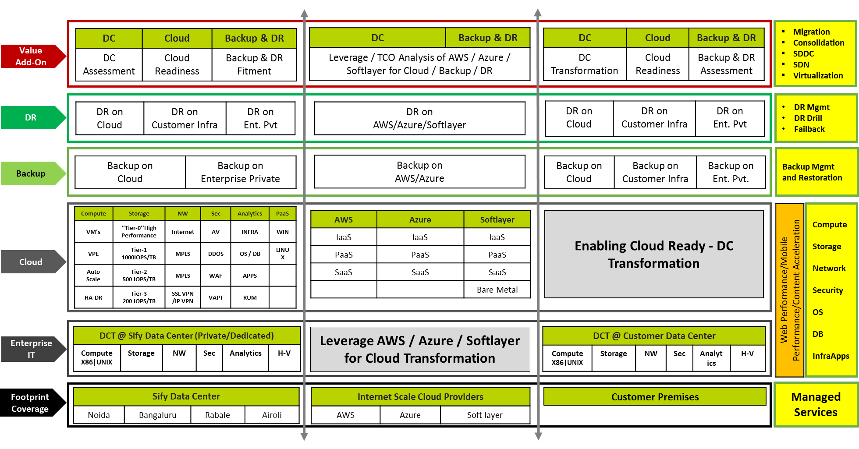
DC Transformation Aligned Services

Slide 8
Scope Understanding
INFRASTRUCTURE SCOPE
IMPLEMENTATION AND INTEGRATION
MIGRATION
Supply, Installation, Integration and facility management of Server Virtualization and facility management for existing infrastructure which includes:
Servers, Storage, SAN Switch, Virtualization Software, Cloud Software, Backup Software
32 cores of dark fiber cable for Chassis to switch connectivity
LC-LC Cable for Server to Switch
Cable for SAN Connectivity
Implementation & configuration of hardware, software components
Virtualization and cloud Set-up
Configure virtual machines (VMs)
Implementation of Cloud solution
Migrate existing application from Physical to Virtual (P2V), Virtual to Virtual(V2V) as per the requirement of the bank
Migration of Data from existing storage to new storage
Migration will happen in Phased manner as & when Existing Hardware is due for tech refresh.

Slide 9
Scope Understanding
Documentation
Project Management Documents
Project Charter, Project Schedule / Plan, Project Stakeholders
Standard Operating Procedures
Contact details and procedures for obtaining service from OEMs, OEM product and User manuals
detailed instruction for operation and
maintenance of the hardware (if any) and software is
to be delivered
Training
Provide training covering the following:
Overview of the components Installed
Technical Architecture
Server Virtualization
System Administration
Reresource management of hardware and software, storage allocation, backup management
Provide training documents for the proposed solution.
Warranty/ AMC
Warranty for 3 followed by 4th and 5th years AMC for all supplied H / W & S / W Components
FMS
Provide Operations & Management Services to operate and maintain the proposed solution for 5 Years.
Proposed Three L2 Engineers per shift (total 3 shifts) at DC for providing facilities management services round the clock.
One L3 Engineer per General Shift

Slide 10
Current BOI Landscape
Current BOI setup contain below mentioned Hardware & Software
48 Cisco Blade servers in DC & DR
Storage – Hitachi & Netapp
Cisco SAN & FC switches
Tape Library – Quantum
Backup Software – Commvault
Current Hypervisor - VMware

Slide 11
PROPOSED SOLUTION

Slide 12
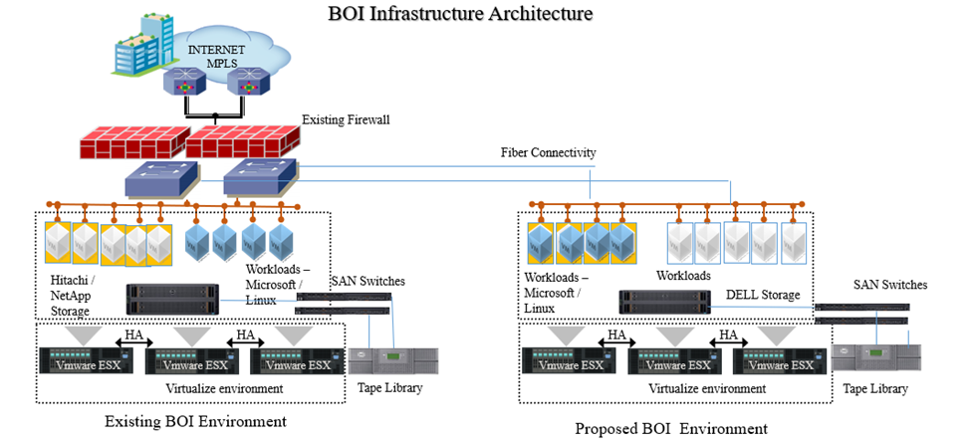
Sify Proposed – High level Architecture

Slide 13
Solution Stack and OEM Product Positioning
Sr No | Module | Make & Model
1 | Blade Server for DC & DR | Dell PowerEdge MX840C Server
2 | Blade Chassis for DC & DR | Dell PowerEdge MX7000 Blade Enclosure
3 | vCenter License for DC & DR | VMware vCenter
4 | Hypervisor Licenses for DC | VMware vSphere
5 | Cloud Licenses | VMware vRealize Suite 2017 Advance
6 | Connectrix 6610 SAN Switch, 48 Port | Dell EMC Connectrix - 6610 SAN Switch
7 | Connectrix 6510 SAN Switch, 8 Port | Dell EMC Connectrix - 6510 SAN Switch
8 | Tape Library | Dell ML3
9 | Rack Servers | Dell PowerEdge R740xd
10 | Primary Storage- DC & DR | Dell EMC SC7020
11 | Storage Type 1 & 2 | Dell EMC SC5020
12 | Back Up Software - DC & DR | Quest NetVault
13 | Luna PCI 7000 v5 7000 TPS HSM | gemalto
14 | Luna Backup Remote HSM | gemalto

Slide 14
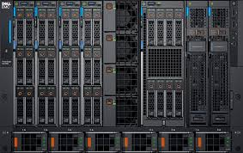
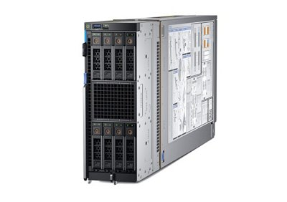
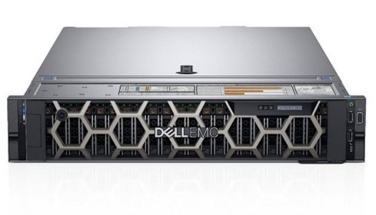
Compute Solution
Redundant Management Module for PowerEdge MX7000 Chassis
PowerEdge MX7000 Redundant Power
Supply, 3000W, (n+n)
ReadyRail II for MX7000
PowerEdge MX7000 Blade Enclosure
4x Intel Xeon Gold 6130 2.1G, 16C/32T, 10.4GT/s , 22M Cache, Turbo, HT (125W)
DDR4-2666 64GB LRDIMM
300GB 10K RPM SAS Hot-plug Hard Drive
Hardware RAID Card (RAID 1)
PowerEdge MX840C Server
Intel Xeon Silver 4112 2.6G, 4C/8T, 9.6GT/s, 8.25M Cache, Turbo, HT (85W) DDR4-2400
Chassis with Up to 24 x 2.5" Hard Drives for 2cpu
600GB 10K RPM SAS 12Gbps 512n 2.5in Hot-plug Hard Drive
Dual Port 16Gb Fibre Channel HBA
Dual Port 10Gb Direct Attach,
PowerEdge R740XD Server

Slide 15
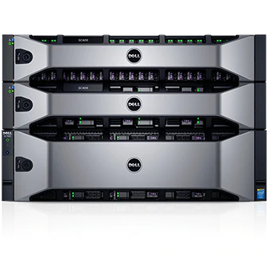
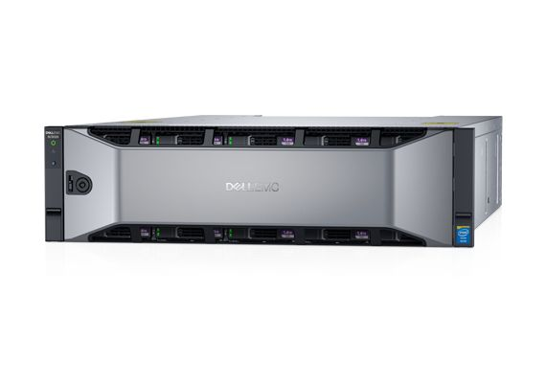
Storage Solution
Storage 1 SC7000 with 80 x 3.84 TB SED SSD (200 TBu) + 336 x 1.8 TB 10k SED SAS (300TBu) + 28 x 6 TB NL-SAS SED (100 TBu)
4 x 16 Gb FC , 4 x 10 Gbps IP ports, 8 x 12 Gbps SAS backend ports per controller Pair.
All Software bundled
Dell EMC Storage SC7020
SC5020 Storage Quote with following drives - 6 x 960 GB SSD, 4 x 16 Gb FC
4 x 10 Gbps IP ports, 8 x 12 Gbps SAS backend ports per controller Pair.
All Software bundled
Dell EMC SC5020 Storage Array

Slide 16
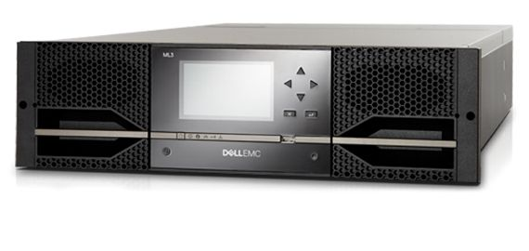
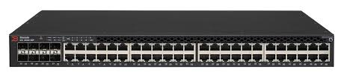
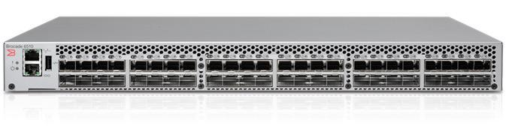
Tape Library & SAN Switch Solution
ML3 TL with 4 x LTO 7 FC Drives, (Total 72 slots ,correct?)
Encryption software & kit bundle
All software included.
Dell EMC ML3 Tape Library
SAN Switch 48 ports of 16 Gbps FC as per RFP ( In Pairs)
Brocade Switch 6610
SAN Switch 8 ports as per requirement for storage cluster ( In Pairs)
Brocade Switch 6510

Slide 17
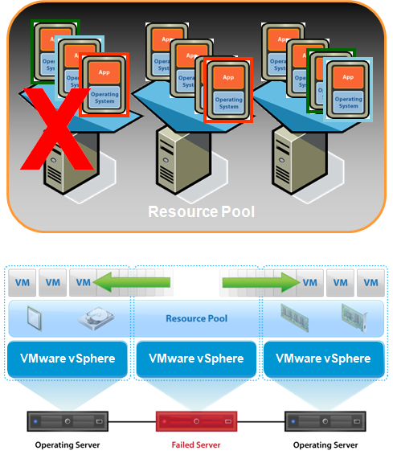
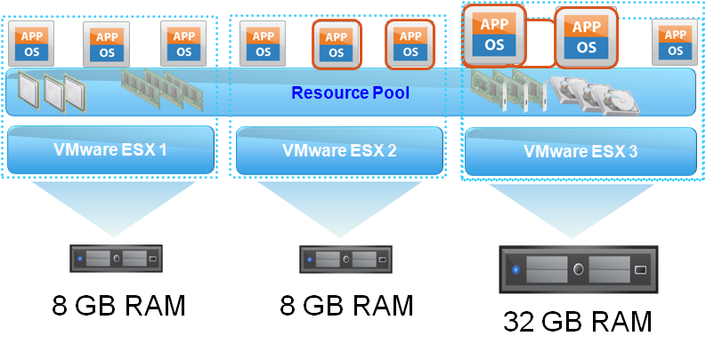
Virtualization-VMware vSphere
Benefits
Consolidation - One-time event that moves existing applications onto a fewer number of servers
Containment - An ongoing effort to virtualize new applications and manage growth of existing ones
Availability – Introducing virtualization to increase application availability and data recoverability
High Availability
Automated Workload Balancing
Enables the high availability of virtual machines by making it available on a different vSphere host in the event of a failure
Minimizes downtime and IT service disruption
Reduce cost and complexity compared to traditional clustering
Dynamic balancing of computing resources across resource pools
Intelligent resource allocation based on pre-defined rules

Slide 18
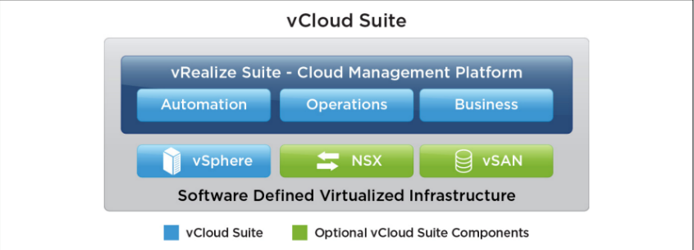
VMware Cloud Management Platform(CMP)
VMware's Cloud Management Platform (CMP) is a package that includes VMware’s market-leading vSphere® Enterprise Plus hypervisor with VMware’s hybrid cloud management platform.
VMware vSphere: Industry leading server virtualization platform.
VMware vRealize Suite Cloud Management Platform
VMware vRealize Automation™: Self-service, policy-based infrastructure and application provisioning and lifecycle management for virtual, physical, and public cloud environments.
VMware vRealize Operations™: Intelligent performance, capacity, and configuration management for multi-vendor environments.
Mware vRealize Log Insight™: Enables real time log management and log analysis.
VMware vRealize Business™ for Cloud: Automated costing, usage metering, and service pricing of multi-vendor virtualized environments

Slide 19
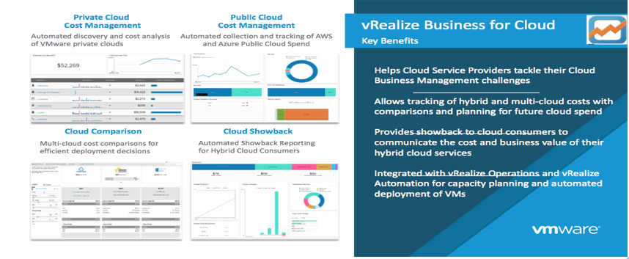
VRealize Business

Slide 20
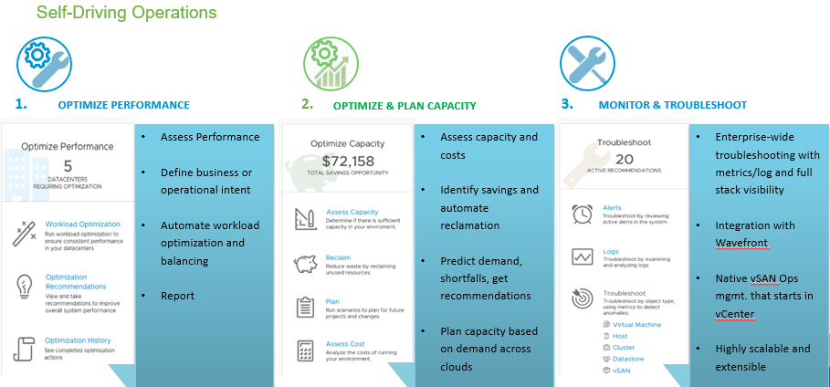
vRealize Operations

Slide 21
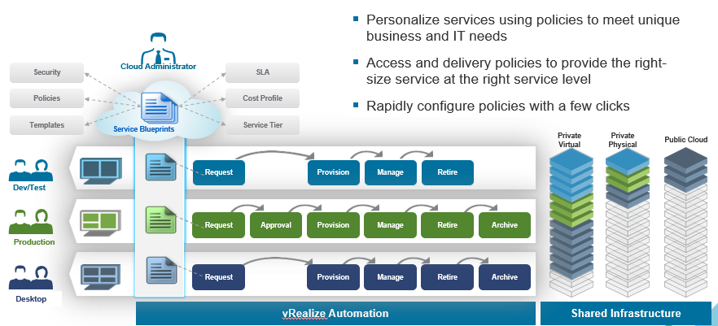
Policy based governance: Personalize the Cloud

Slide 22
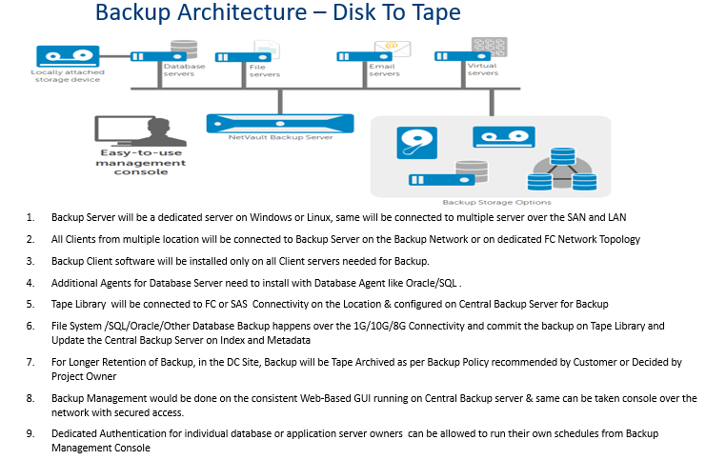
Backup Architecture – Disk To Tape

Slide 23
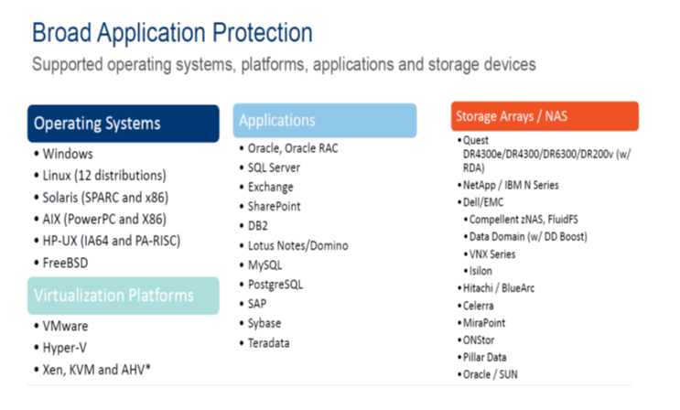
Backup Application Proposition

Slide 24
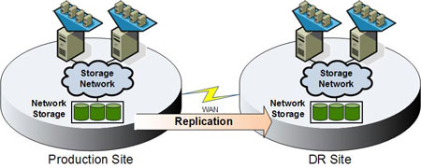
BCP & DR Architecture
Storage-Based Replication

Slide 25
IMPLEMENTATION APPROACH

Slide 26
Implementation Plan

Slide 27
Implementation Project Organisation
Customer Project Steering Committee
Sify PMO
Customer Project Manager
Sify Project Manager
Technical Lead -Compute
Technical Lead- Compute
Technical Lead - Storage
Technical Lead - Virtualization
Solution Architect
Customer Contacts
Implementation
Team
Implementation
Team
Implementation
Team
Implementation
Team
Procurement, Logistics
Enterprise Architect
Quality Assurance

Slide 28
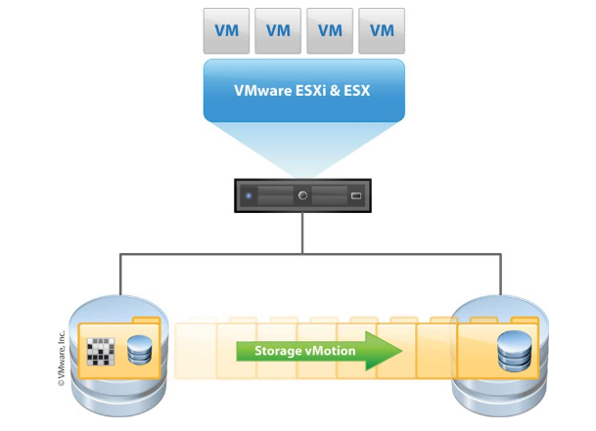
Migration plan - Storage VMotion
Storage vMotion is a component of VMware vSphere that allows the live migration of a running virtual machine's (VM) file system from one storage system to another, with no downtime for the VM or service disruption for end users. This migration occurs while maintaining data integrity.
You can move VM’s from one physical host to another, which is done rapidly over a high speed network connection, the original host and destination host stay in sync until the transfer it complete leaving the user unaware of the move.
Having all the servers as virtual machines, you only have to move the VM to another physical host, creating zero downtime for the users and allowing administrators to perform maintenance at any time

Slide 29
OPERATION & MANAGEMENT

Slide 30
Post Implementation Support and Facility Management
Sify will provide Operations & Management Services to operate and maintain the proposed solution for 5 Years.
Three L2 Engineer per shift (total 3 shifts) at for providing facilities management services round the clock in DC Location
One L3 Engineer will be available during general shift in the DC Location

Slide 31
PREREQUISITES AND ASSUMPTIONS

Slide 32
Prerequisites
Power provisioning for proposed infra
Rack provisioning for new hardware
Seating space for FMS engineers
Workstations for engineers
Access of existing infra during the migration process
Port availability on active components

Slide 33
ASSUMPTIONS
All required Software Licenses like Microsoft Windows, Microsoft SQL, Oracle database, RDS CAL will be provided by bank
Existing Active Directory, DNS and DHCP services are expected to be made available for this project
Relevant firewall ports required for the products to function need to be opened
Adequate Replication bandwidth to be provided for Replication based on RPO
Any new changes during the migration will be considered as Change Request.
Third Party integration Responsibility will be taken care from customer end.

Slide 34
OUT OF SCOPE
Security components
OS & DB licenses
Application management & maintenance

Slide 35
CASE STUDIES

Slide 36

Allahabad Bank : Virtualization Project
Infrastructure Scope
Supply, Installation, Commissioning and support of IT Infrastructure at Allahabad Bank Primary DC Site (Mumbai), DR Site (Lucknow) which includes:
Servers,
Storage,
Tape Drives,
SAN Switch,
Virtualization Software,
Cloud Software from 2nd year onwards,
Backup Software,
EMS,
10G ports for existing core switch
Passive cabling for connecting supplied servers with SAN switches and connecting other supplied devices / interconnectivity
Buyback of existing Infra
Implementation and Integration
Implementation & configuration of hardware, software components
Virtualization and cloud Set-up
Installation & configuration of the Virtualization software proposed
Configure virtual machines (VMs)
Create separate groups for Application Server set cluster, and Database Server set cluster, etc. as per application landscape
Implementation of Cloud solution 2nd year onward
Network
Installation of 10G ports in existing core switch and connect the proposed servers for network connectivity.
Migration
Migrate existing application (inventory list provided in the RFP) from Physical to Virtual (P2V) as per the requirement of the bank
Migration of Data from existing storage to new storage
Facility Management Services
Provide Operations & Management Services to operate and maintain the proposed solution for 5 Years.
One person per shift (total 3 shifts) at DC is required for providing facilities management services round the clock.
During quarterly DR Drills when Bank’s DR site at Lucknow acts as Primary Site, bidder will have to provide round the clock onsite support at DRS, Lucknow.
155 Servers in DC & 85 Servers in DR consolidated to 10 servers each in DC & DR

Slide 37
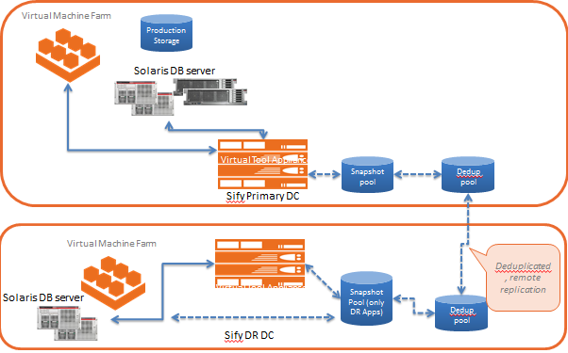
CASE STUDY–DC MS & TRANSFORMATION FOR MAX BUPA HEALTH INSURANCE
Max Bupa a leading heath insurance company, growing at a 30 % YOY rate. With a client base of 2 million. To be able to support the expected growth required to have an IT set up which is reliable, Scalable, Optimised, Secure, and always available. This initiative needs to cover the technology upgrade & transformation of the IT infrastructure and also the consolidation of the IT infrastructure and the Datacentre.
Drivers for the Opportunity
Transform the current Infrastructure to have the latest in technology, efficient and ready to scale.
Consolidate the applications infra in different data centre.
Provide high availability for the application with improved security.
Provide a round the clock monitoring and support
Solution
Built a Private Cloud for DC & DR
Migrate 100+ servers and 60 TB data migration
VMware, OVM based Hypervisors
Enabled DRaaS tool based replication and recovery at DC and DR with RTO/RPO SLA’s
Improved Security Significantly
Project Management for Implementation
Managed Services for 5 years
IT Landscape
Data Centre - 2 at Delhi, 1 at Mumbai
DR @ Bangalore
Key benefits
Business Services are continuously available
Improved Performance & Operational Efficiency
New Age DC + DR set-up
Zero Downtime Migration
Quick set up reducing planning and deployment time
Granular recovery intervals and data protection
Large Bandwidth to replicate DC data
Seamless transition to Managed Services
State of art tools, process and procedures

Slide 38
Data Center Transformation & Managed Services FOR GIC Re
GIC of India (GIC Re) was the sole reinsurance company in the Indian insurance market with over four decades of experience until the insurance market was open to foreign reinsurance players by late 2016 including companies from Germany, Switzerland and France. To be able to support the expected growth required to have an IT set up which is reliable, Scalable, Optimised, Secure, and always available. This initiative covers the technology upgrade & transformation of the IT infrastructure and Managed Services.
Drivers for the Opportunity
Transform the current Infrastructure to have the latest in technology, efficient and ready to scale.
Consolidate SAP and other critical applications infra in different data centre.
Provide high availability for the Business application with improved security.
Provide a round the clock monitoring and support
Solution
Build Hyper Converged Infrastructure for DC & DR
Migrate Infra to Private Cloud for DC & DR
Migrate Physical workload to Virtual with improved IOPS for SAP and related workloads
Migrate 50+ servers and 40 TB data migration
Vmware Suite, NSX, Orchestration Automation
Enabled DRaaS tool based replication and recovery at DC and DR with RTO/RPO SLA’s
Improved Security Significantly (SOC, SIEM etc.)
Managed Services for 5 years
IT Landscape
Data Centre - 1 at Mumbai
DR @ Bangalore
Managed Services
Incident Management
Change Management
Problem Management
IT Security Support
Call Centre, VC and Telecom Support
Network Support
Datacentre, Server, Storage, Back-up and disaster recovery Mgmt services
Database Support
Hardware Warranty/ AMC
Strategic Planning
Solution Benefits
Scalable & Elastic environment to react business needs
Security, Reliability, Availability & Serviceability
Best in Class Technology
Operations Best Practices & Tools
Management, Governance & Control

Slide 39
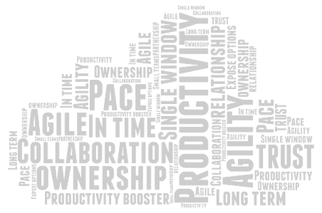

Thank You
Keeping you ahead

Slide 40
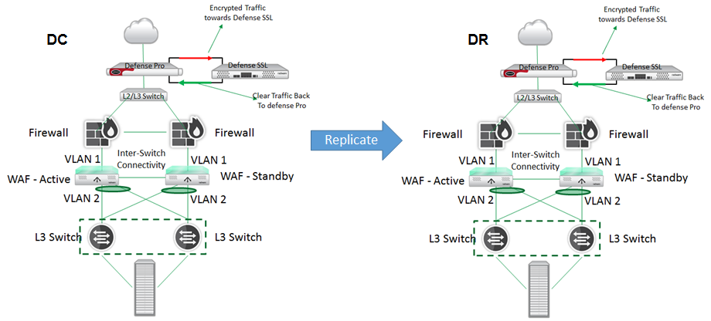
CASE STUDY – DHFL GI
DHFL One of India’s leading housing finance company. DHFL has an existing joint venture agreement with Prudential Financial, Inc. and holds 50% equity stake in DHFL Pramerica Life Insurance Company Private Limited (DPLI), a registered life insurance company in India regulated by the IRDAI.
Drivers for the Opportunity
New Venture role out
Insurance application role out
IRDA Compliance
Business continuity
SAP Landscape
Solution
Latest Infrastructure with Dell Blades servers & Storage at DC Airoli & DR Bengaluru on Virtualized Environment
SAP Application Infra Components
Cisco APIC Network
IRDA Compliant Security Network
Clusters for high availability
DRM tool for Application Continuity
Managed Services
IT Landscape - Data Center (1), DR(1)
Dell Chassis, Blades servers & Storage in HA at DC and single node configuration at DR
CISCO APIC enabled network
EMC De-Duplication Data Backup Solution at DC-DR
DDOS,PIM,DAM,SIEM,HSM & Security related components required for IRDA compliance implemented
Automated DR using DRM tool
Managed Services
24X7 proactive remote monitoring services (L3 Level Support)
Server, O/S, D/B Support
Secure online portal and tool set
Continuous monitoring of events , performance reporting, incident tracking and remediation, change management, inventory management, configuration management
Network Support
Security Support Services
Onsite team for Infrastructure Administration, stable, reliable and efficient operations.
ITIL based processes
Continual optimization of environment
Prompt issue identification and resolution
Help in change management, incident management and process management
Key benefits
99.95% Service Availability
Higher performance
Reduced footprint
Increased customer delight
Dashboard, State of the art tools, process and procedures

Slide 41

DHFL GI : Data Center Build
OBJECTIVES
R sites.
To roll out IT Application services for the new venture. Integration with existing infrastructure, DHFL required to expand it’s IT footprint and thus envisaged to setup new datacentre and DR sites
The new DD/ DR need to be built around security, management and compliance requirements governed by IRDAI compliance policies.
Design & Implementation Professional Services
Migrate existing / port new application to this new Private cloud setup
Managed services for the new DC-DR for the next 5 years, including NOC, SOC, WAN mgmt. and O&M services, DC-DR drills, documentation
Sr. No. | Solution Component | Technology Stack
1 | Core Switch - Leaf | Cisco
2 | Access Switch - Spine | Cisco
3 | Internet and Replication Router | Cisco
4 | Server | DELL EMC
5 | Storage | DELL EMC
6 | Firewall (Core) | Fortinet
7 | Perimeter Firewall with Anti-APT | Checkpoint
8 | URL filtering | Forcepoint
9 | DLP | Forcepoint
10 | Anti-Virus | TrendMicro
11 | Patch Management | Radia
12 | Privilege Identity Management | Arcos
13 | Raplication Tool | Perprtuuiti
14 | Vulnerability Management | Qradar
Total ACV 24.5CR & TCV 34CE

Slide 42
Our Scope Understanding
Supply, Installation, Integration, Implementation and facility management of Server Virtualization and facility management for existing infrastructure mentioned in the RFP for a period of 5 years
To submit a detailed plan for migration and implementation of Server Virtualization and cloud software.
To handle all matters relating to the configuration and operation of the system including but not limited to application, system interfaces, documentation, user manual documentation and training for the successful implementation of the system
To provide a comprehensive training plan and materials to carry out the training for the bank officials who will handle the project during implementation and after implementation
Solution should support all the existing application of Bank and also any other application which bank may implement in future
To ensure the support from respective OEM’s for infrastructure provided to carry out the activity for expansion, up gradation and configuration of Bank Virtualized environment during the period of contract

Slide 43
Sify Scope of Engagement
Study & Analysis of current landscape
DC & DR Cloud workload sizing
Provisioning of Private Cloud Infrastructure DC & DR
Migration of existing workload in to new setup
Backup solution –DC & DR
FMS & AMC – DC & DR
Pro-active monitoring and Management
Service reporting
Governance and Audit support
Continuous Improvement

Slide 44
Migration Phases
Planning
Manage
Requirement Gathering
Assessment of Existing infrastructure
Road map definition
High Level design
Approach for Design and Analysis
Application-Servers Dependency
Partition of servers for P2P | P2V | V2V
Ranking of Servers
Customer verification
Steady state
Service Catalog
Service Levels
Escalation Matrix
Maintenance
Governance
Complete design
Testing
Migration
Integration
Implementation
Documentation
Assessment
Implementation

Slide 45
MIGRATION METHODOLOGY

Slide 46
Migration flow
HLD/LLD
Of Transformed DC
New / Swing HW/SW Procurement
Build the Target DC with New and Swing Hardware
Establish Network to the Source DC & DR
Target DC Ready for Wire Migration
Phase 1a
Application Grouping
Target DC Ready for Wire Migration
P2V
V2V
Intel Platform Ready
P2V+V2V
MLIC
Migration
MLIC
Transformed DC in Production
Swing Hardware Ready
Data
Restore
Platform Ready
Semi Transformed DC
CUT OVER
Phased Over a Time Period
Releasing Swing Hardware
Delta Data Sync
HLD/LLD
For DR
Transformation DR with 100% Capacity
Phase 2

Slide 47
FMS – INFRA OF DC & DR

Slide 48
Process Flow
End user – Raise ticket
Notification to Sify
Agree on Priority
No
Yes
Client Ramification
Technical Assistance
Request Released
No
Yes
Change Request
Solution
User Acceptance Test

Slide 49
P2V Migration Approach
Program Management
Discovery
Optimize
& Design
Planning
Build &
Implement
Closure
Business
Compliance & Licensing
Migration Risks
Business Case Approval
Data Center Locations
Business Continuity Plans
Test Strategy & Plan
Project Management
Procurement
Handover Plan
IT Application
Inventory Baseline
Infra Applications
Business Applications
Dependency Tree & Map
Application Resizing
Application Consolidation
App Installation
App Reconfigure
Wire Migration
Testing & Validation
Sign Off
Decommission
Decide Move Bundle
IT Technology
Inventory Baseline
Network/Security
Compute
Storage
Bench Marking
Reference Architecture
Refresh Strategy
OEM finalization
Refresh Plan
Migration Plan
Migration Rehearsals
New Architecture
Migration Events
Lift & Shift
Wire Migrate
Testing & Validation
Sign Off
Decommission
Process
Process Maturity
Process Workflow
Service Reports
Service Catalogue
Process Re-engineering
Process Documentation
Awareness Planning
Tool Configuration
Catalogue Implementation
Process Acceptance
Criteria & Validation
Process Rollout Plan
Tools
Tool Assessment
Infra
Apps
Tool Selection
Tool Design
Mock -Ups
Tool Infrastructure
Tool Rollout Plan
Thresholds
Installation
Configuration
Testing
Data Porting
Go-Live
Documentation
Services
In-House Resource
Partner Resource
SOP / Run Book Review
Gap Analysis
Design New Operating
Model
Training
Knowledge Transfer
Steady State
Target Operating Model
Transfer Plan

Slide 50
VMware Cloud Management Platform(CMP)
VMware's Cloud Management Platform (CMP) is a package that includes VMware’s market-leading vSphere® Enterprise Plus hypervisor with VMware’s hybrid cloud management platform.
VMware vSphere: Industry leading server virtualization platform.
VMware vRealize Suite Cloud Management Platform
VMware vRealize Automation™: Self-service, policy-based infrastructure and application provisioning and lifecycle management for virtual, physical, and public cloud environments.
VMware vRealize Operations™: Intelligent performance, capacity, and configuration management for multi-vendor environments.
VMware vRealize Log Insight™: Enables real time log management and log analysis.
VMware vRealize Business™ for Cloud: Automated costing, usage metering, and service pricing of multi-vendor virtualized environments

Slide 51
Project Execution Methodology
P.O/LOI From Customer
Project Plan to customer.
Project Scope statement/ Joint Scope.
Solution revalidation with customer
Order Entry in System
Project evaluation/ Site survey
SOW/ final BOM Approval.
Kick off meeting with customer.
Initiation
Planning
Welcome Mail to customer
Site Readiness for installation.
P.O Request to procurement Team
P.O to Vendors.
Request to internal/ Partner Teams for items delivery
Coordination with customer for product delivery & receipt
Project review meetings with customer & internal Teams
Device configurations & integration as per scope with OEM.
Performance test of deployed hardware/software
UAT/Closure
Execution
Turn up request to customer.
UAT document and testing
I&C Sign off
Documentation
Service Handover to support team

Slide 52
Migration Plan
Conduct an AS-IS Infrastructure assessment
Estate Review (Server Hardware, Storage, Network, Backup & DR Infrastructure), Business requirements, Process Requirements, etc.
Conduct a thorough workload (IT Infrastructure, Applications, Databases) portfolio analysis
Compute, Network, Storage resource utilization, criticality, clustering solutions, platform dependency, backup strategy, Test / Dev / prod environment, etc.
Check for the dependencies on existing Infrastructure, Applications & Databases
Example: VLAN dependency, Other application services dependency, etc.
Sequencing the migration, data migration, re-sync of data before cut-over, testing and hand-over to managed services team

Slide 53
ASSUMPTIONS
Current on-going projects / changes in the development system will be approved and moved to Production during the migration phase.
Downtime window confirmation should be provided by BOI during Production cutover.
BOI will coordinate with third party for creating additional RFC Connectivity source systems (if any)
System Backup will be scheduled only after migration of current Landscape.
Any new changes during the migration will be considered as Change Request.
Third Party integration Responsibility will be taken care from customer end.
All required Licenses are in place

Slide 54
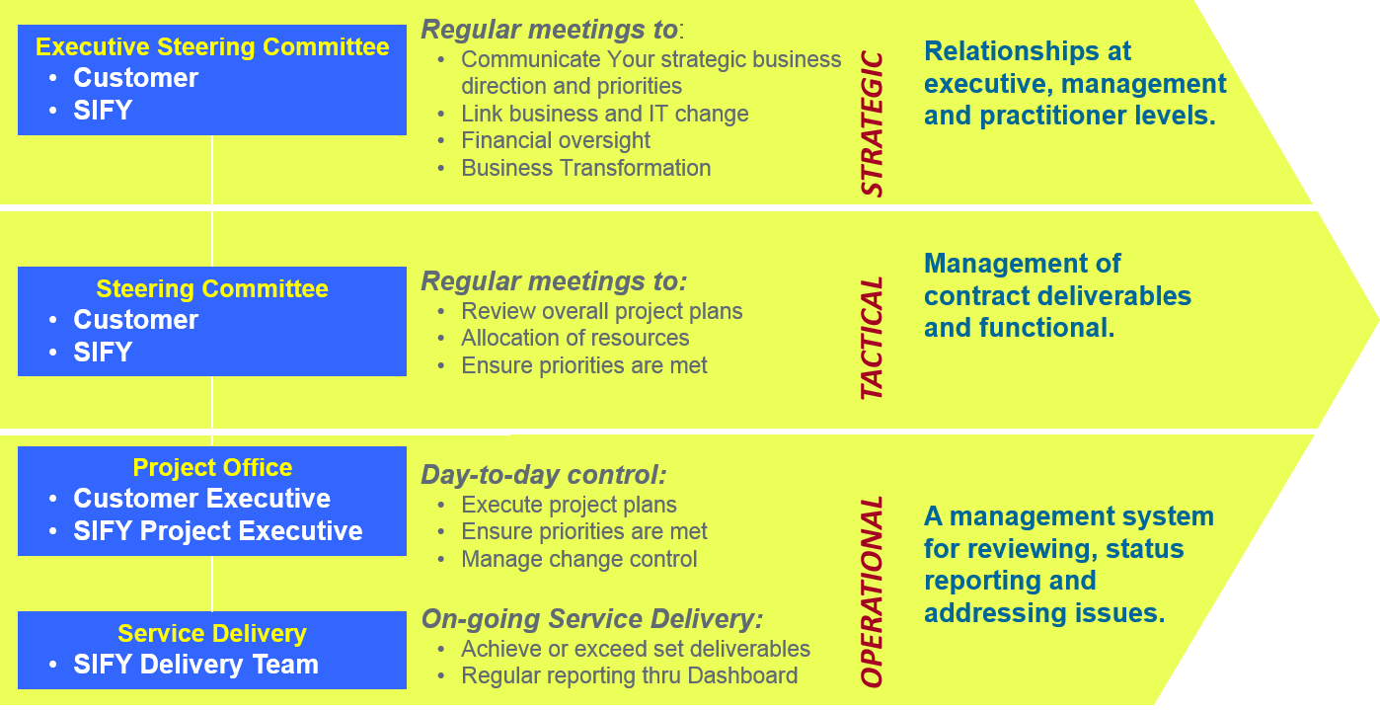
Governance Organization

Slide 55
Implementation Plan

