Slide 1

SIFY CAPABILITY PRESENTATION

Slide 2

AGENDA
SIFY TECHNOLOGY OVERVIEW
TRANSFORMING NSE
SIFY AS A STRATEGIC PARTNER
NETWORK MANAGED SERVICE SCALE CAPABILITIES
SIFY TECHNOLOGIES

Slide 3
SIFY TECHNOLOGY OVERVIEW
SIFY TECHNOLOGIES

Slide 4
SIFY’S JOURNEY SO FAR…
Established HQ in Chennai
Listed on NASDAQ
Launch of MPLS service in India
Raju Vegesna takes over as Sify’s Chairman
Launch of SAP Private Cloud services and practice
Launch of business outcome based models
1995
1999
2001
2006
2013
2017
1998
2000
2004
2012
2016
First private ISP in India
First Tier3 Datacenter in India
Launch of RIM services, NOC, SOC services
Launch of Cloudinfinit services
VPEC hybrid cloud and CI containers offerings launched
Sify has surfed the wave of technology disruption from its inception

Slide 5
TRANSFORMATION LED JOURNEY
Sify 1.0
Sify 2.0
Sify 3.0
Telecom Service Provider
Managed Network Services Integrator
Consumer Broadband
DC Hosting Provider
DC Transformation Partner
Portal Business
Cloud Infrastructure Provider
Managed Cloud Partner
On Premise Application Provider
Managed Hosted Apps/SaaS Provider
1999 - 2006
2006 - 2012
2012 Onwards

Slide 6
SIFY FINANCIALS
SIFY’S EVOLUTION
REVENUE & GROWTH
Cloud Transformation
Partner
CAGR 19%
Managed DC and N/W Services Provider
Converged ICT Services
Provider
Network/ Data Center
Service Provider
INR Crores
TELECOM SERVICES : IT SERVICES WALLET SHARE
PRODUCT REVENUE VS SERVICE REVENUE
In %
INR Crores

Slide 7
SIFY TODAY
TECHNOLOGY INTEGRATION SERVICES
Data Center IT
Network Integration
Information Security Services
Collaboration Services
End User Computing Services
TELECOM SERVICES
India Data Business
Global Data Business
Cloud Connect & Managed DWDM
Enterprise VoIP
Managed Network Services
APPLICATIONS SERVICES
iTest – Online Testing Platform
eLearning
Forum – Distribution Management System
Portal Solutions
DC, CLOUD & MANAGED SERVICES
Colocation/White labelling
Data center Transformation
Public Cloud (LaaS/PaaS)
Enterprise private and hybrid cloud
Cloud based DR
DC Managed Services
Managed Security Services
PLATFORM SERVICES
SAP / S4 Hana, Success Factors and hosted cloud infrastructure
Microsoft – Azure, Office & Productivity, Dynamics CRM
Oracle – SaaS, PaaS (HR, Database, Middleware, Cloud Machine)

Slide 8
SIFY – SERVICE PROVIDER WITH SI & APPLICATION EXPERIENCE
Infrastructure Service Provider
Application Services
Service Provider Partners
Data Network Services
No of nodes - 2510
No of POPs - 628
No. of cities we cover - 1035
Data Center Hosting Services
6 Tier III DCs at Mumbai, Bangalore, Chennai, Noida
2 Tier III upcoming DCs at Chennai, Hyderabad
Public Cloud Services
Cloud Infinit Center at Mumbai & Bangalore
Private/Hybrid Cloud Services
Hybrid Cloud Centers at Mumbai, Bangalore, Noida
Industry Standard Applications:
SAP
Microsoft
Oracle
Sify In-house:
I – Test
E – Learning
Forum
Portal
Data Network Services
Verizon (Global)
All leading SPs in India
Public Cloud Services
AWS
Azure
Content Service Provider
Akamai
Data Center Management (RIM + Onsite)
Managed Network Services (RIM + Onsite)
Managed Security Services (SOC + Onsite)
Cloud Infrastructure Management (RIM)
Cloud Migration Services
Network Integration
Data Center IT Infrastructure Integration
Network Integration
Collaboration Services Setup
Security Infrastructure Setup
Integration Skills
Managed Services Provider

Slide 9
SIFY’S INVESTMENT IN DIGITAL AGE TECHNOLOGY
TREND
INVESTMENT
Increase in number of cloud DCs from 4 to 6
Two new cloud DCs are under implementation; 100% growth in capacity by 2020
Cloud and Software Defined Network Orchestration IP developed by Sify
Increased adoption of cloud services
Outcome focussed managed services
Service catalogue based Managed Services
Outcome focussed KPI driven SLA
All services delivered as pay-per-use in the following models
Component Aligned
Usage Aligned
Business Outcome Aligned
Increasing demand for Utility models
Increasing play for service providers
Competence built up of Service Provider-led transformation in areas such as Network Integration, Hybrid Cloud & DC outsourcing
Converged services for IT & Telecom
Investment in all areas of ICT: Datacentre/Cloud, Network, IoT, Applications in service provider model built around productized services and delivered on utility models

Slide 10
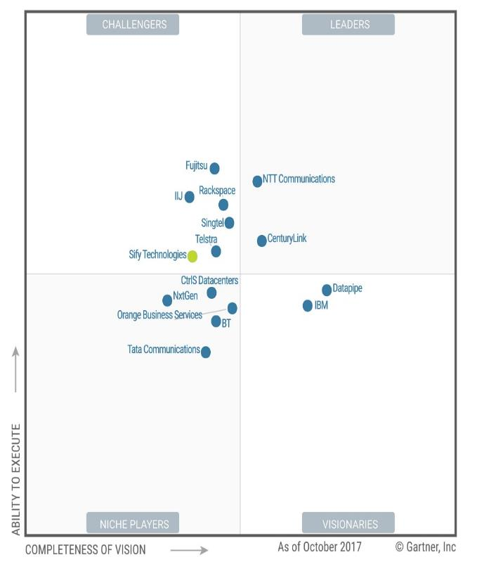




RECOGNITION
Sify moves up to the challenger position in the Gartner MQ for Managed Hybrid Cloud Hosting – Asia Pacific (2017)
Network Transformation Services 2018
Data Center Transformation Services 2018

Slide 11
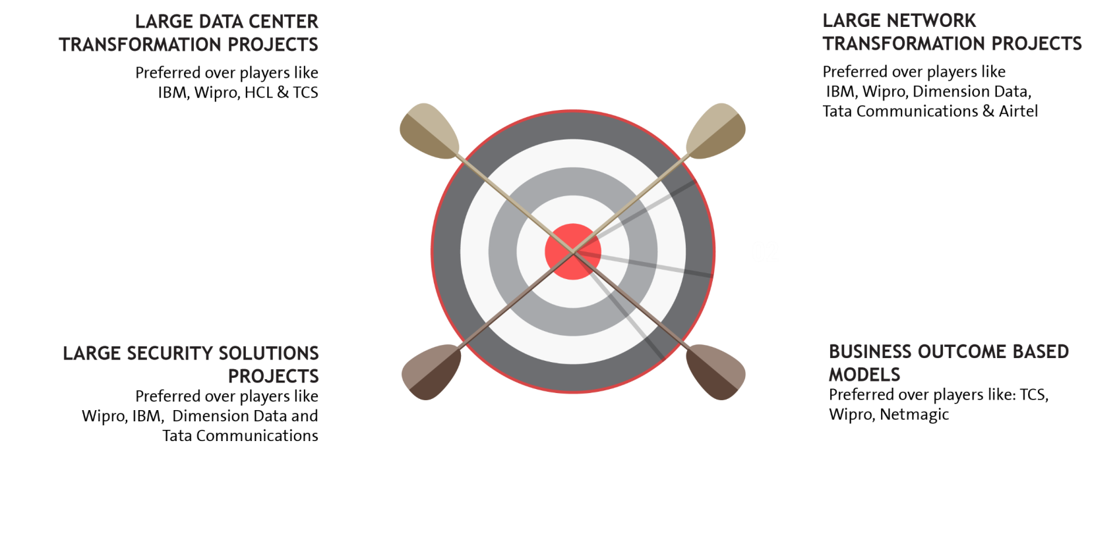


















EXECUTION CAPABILITIES

Slide 12




cloud@core
TM
ALIGNED TO OUR CUSTOMERS’ CLOUD TRANSFORMATION PURSUIT
CLOUD ENABLING
CLOUD INSPIRED
CLOUD PURE
CLOUD ENHANCED
Cloud DC
Hyper reach/Hyper scale transport Oracle FastConnect | ExpressRoute | DirectConnect | Partner Interconnect
Software Defined Network services
Cloud build Private | Hyperconverged | Enterprise
Security services for cloud
Migration and Implementation services
Sify CloudInfinit
Enterprise Multi-Tenant
Dedicated
Hosted SAP/S4 HANA
Azure Stack as a Service
Edge Connect Services
SD-WAN
Collaboration services on Cloud
AWS
Azure
OCI
GCP
Multi Cloud Management platform & services
Modern Applications
Kubernetes-as-a-Service
AI/ML
Forum DIGITAL
HCM Digital (iTest)
Learning Management
Internet-of-Things (IOT)
Industry Solution-as-a-Service

Slide 13
TRANSFORMING NSE
SIFY TECHNOLOGIES

Slide 14
NSE DIGITAL NETWORK
Digital Distribution Architecture
OBJECTIVES
Reliability and speed.
Highly resilient to failure
Uniform customer experience
members participation in an easy and equitable manner
flexible to evolving to support future digital distribution options
scaling with demand.
ARCHITECTURE CHANGES
Ethernet from Serial
Managed & Unmanaged CPE options for Members
Ability to provide last mile links on wireless interface
Network extension to reach pan India members.
Guarantee Higher uptime for POPs
Next Generation NSE network
PLAN
Network & POP design.
Implementation Plan
Migration Plan
BUILD
POP readiness.
Network readiness
NOC & Operations readiness.
MIGRATE
Ready for Migration
Core network migration.
Members migration
OPERATE
POP & Network Lifecycle
Members life cycle
NOC & SOC.

Slide 15
SIFY AS STRATEGIC PARTNER TO NSE
Sify as Master Network Services Integrator
Services partner
Infrastructure partner
Transformation partner
Our experience in rolling out large network integration projects like Department of Post (the single largest Enterprise network in the world).
Design, Build, Migrate and Operate services
NOC + SOC services
700+ POPs across the country enabling NSE to rapidly expand and deliver reliable services to Members.
Ready colocation facilities and Infrastructure.
Our experience, and collaborative relationships with other leading Telecom Service Providers
Enablement of “One India One rate” for the Members.
Sify wireless as an access to Members.
Sify aakaash as a digital platform for Member services.
NG Technology partner

Slide 16
NSE DIGITAL NETWORK - EXPANSION STRATEGIES SUMMARY
Current
Establish service POPs across locations with Maximum Member presence.
Nailed down lines for the Members to connect to the nearest POPs.
Diversity in Telecom a choice for the Members.
NSE moving from a Feed provider/ASP to a NSP.
Equitability of Members participation is divergent.
Infrastructure Build and operate economics doesn’t achieve scale and shifts focus from the core business.
Infrastructure led
Technology driven
Proposed
Create VPOPs leveraging Sify Infrastructure.
Dedicated or shared Infrastructure in the VPOPs.
Leverage Wireless access beyond current wireline modes for Members to connect.
Managed services model for consistent and SLA backed services to Members.
One India – One Rate for Members equality in pricing
Future
Leverage SDN and NFV technologies enabling NSE to be a true exchange service provider than a Network service provider.
NFV based Infrastructure for dedicated hardware strategy.
Managed SDWAN for Members to
Leverage BYOA
Leverage Internet to maximise reach.
Alternative in replacing all legacy and a good backup strategy.

Slide 17
PROPOSED STRATEGIES
Shared Infra Model
Dedicated Infra Model
Future Digital Distribution Model
Managed Sify POP
NSE DC/DR
NOC & SOC
Managed Sify POP
NSE DC/DR
NOC & SOC
NSE DC/DR
Sify Cloud
NOC & SOC
NSE DDN
NSE DDN
NSE Digital Distribution Network
Time based bandwidth on shared backbone
Logical separation for NSE Members
Dedicated Links for NSE network
Sify POP Router
NSE Router
vRouter
vSecurity
vSDWAN
VRF
NFV Infrastructure
SDWAN Gateway Node
Wireless access
Wireline access
Wireless access
Wireline access
Wireless access
Wireline
access
SDWAN/Internet
access
Member connectivity
Member connectivity
Member connectivity
Minimise cost and Maximise POP presence riding over Sify’s Multi service POPs.
Provide multi-access means to Members.
Bandwidth Optimisation with Time based leases.
Members critical Mass or VPOP service Maturity driven model
Economics of dedicated Infra justify the costs.
Independent refresh and risks from Sify Network Infrastructure
VPOPs with Next generation NFV based infrastructure.
Could be a common strategy across all physical and Virtual POPs.
Enables Members to leverage SDWAN to connect to the NSE Digital distribution network.

Slide 18
ONE INDIA – ONE RATE
NSE Today in 9 POP’s – Fixed Cost Model
Fixed Costs at the POP
POP Routers
Dedicated backbone costs
POP build out
Dedicated resources
Per Broker last mile cost
Beyond 8 cities/9 POP’s – One India One Rate
Usage Based Model – per member/per bandwidth port price
Price for:
Shared POP routers
Dedicated backbone costs per member
Shared POP
Shared resources
Example – Per broker/per 2 mbps price for network extension from Sify’s Chandigarh POP to the nearest NSE POP
Per Broker last mile cost
Lower the entry cost of starting services for NSE in a new city, may help quick scale of the member community
NSE can transition to a dedicated POP model after achieving the required scale seamlessly in the future

Slide 19
NG TECHNOLOGY : TRANSFORMATION PARTNER
SDN/NFV partner
Lower cost of POPs through NFVI
Software based highly reliable & resilient networks
Zero risk transition of NSE to the future
Internet based Multicast to maximize Members reach
Network for
the Cloud
Managed SDWAN for maximizing presence and decreasing cost for Members
SLA backed secure wireless offering cost effective rapid turn-up solutions

Slide 20
NSE POP OF THE FUTURE.
Open and Software defined Infrastructure.
Software defined enables the true characteristics of Digital networks – Self service, Agile and rapid.
Extends life of the network as infra moves from proprietary NPUs to general purpose hardware.
Improves economics in new POP roll out and in achieving scale.
Consolidates POP facility requirements. A minimum footprint could be as low as 3 RU.
Based on ETSI and Cisco SDN NFV open architecture.
Prime functions to start with could be routing, info-sec and SDWAN. Capability to deliver more services to the Member leveraging service chaining.
Member Self-service and service desk portal
Sify Network Operations center
End to End Assurance
Monitoring & Assurance
Lifecycle Management
Sify Cloud
POP Infrastructure
Network & Resource orchestration
Virtual Network Functions
E2E service orchestrator
Virtual router
Virtual Firewall
Virtual SDWAN
Virtual Network Function Manager
Virtual Infrastructure
Router Manager
Firewall Manager
SDWAN Manager
Virtual compute
Virtual network
Virtual storage
Infrastructure abstraction
Virtual Infrastructure Manager
POP Physical Infrastructure
Compute
Network
Storage
Openstack
Compute VIM
Network VIM

Slide 21

NSE DIGITAL DISTRIBUTION NETWORK: TRANSFORMATION WITH SIFY MANAGED SDWAN
For equitable service to all members, POP Expansion cannot be a winning strategy in the long run.
NSE needs to take an outside to inside view and see the members outlook of this transformation.
Members outlook from the Digital transformation could be
Low cost transport Independence from nailed down lines.
Faster turn up of services.
High availability at cheaper cost.
Inline with their IT and network evolution.
Self management capability.
More services per unit price.
Better visibility and security in subscribing to the mission critical service of NSE feeds.
Improved application performance
Sify’s Managed SDWAN with Viptella[Cisco] provides the right fit.
Sify Enterprise
service Management
Sify Network
Ops Centre

Slide 22



MEMBERS USECASES WITH SDWAN
Transport Independence
NSE Datacenters
Faster turn up of service
NSE Datacenters
4G/LTE
Internet
MPLS
4G/LTE
Internet
P2P Network
Member location
NSE POPs
Member location
NSE POPs
SDWAN provides transport independence with Multicast support. Members can have Internet based WAN and connect to DC or any of the POPs with SDWAN gateway to receive NSE feeds
P2P links have a high lead time compared to Internet links.
Members can connect with an Internet link and start working before the leased line delivery happens.
High Availability
NSE Datacenters
App aware routing
NSE Datacenters
4G/LTE
Internet
Internet
MPLS
P2P Network
P2P Network
Member location
NSE POPs
Member location
NSE POPs
SDWAN being software based and supporting Internet can enable a branch to be rerouted to any of the surviving SDWAN gateway thereby providing resiliency at low cost.
SDWAN brings in Application visibility thereby enabling routing to be application based. High cost links could be used for real-time apps and the rest could be routed on Internet

Slide 23
OUR WIRELESS ACCESS AS A LAST MILE FOR MEMBERS CONNECTIVITY
3015+ Base stations with 90000 Plus wireless customer links
FCC certified SMAC, High throughput, low latency, Near LOS, Licensed band
IEEE 802.1D, 802.1Q, Eth OAM, Routing, QoS, Encryption and Firewall.
Engineered in house as a complete product.
Flexible topologies – Point to point or Point to Multipoint.
Largest Point-to-point and Point-to-Multipoint fixed wireless deployments in the country
Operates in the licensed 5.725-5.825 GHz band
BSE can leverage the wireless infrastructure through:
Members can leverage Sify wireless link as a cost-effective way to connect their offices to the BSE network either as primary or as a backup solution to their existing wired media.
Invest and setup new Base stations to enable connectivity
AES 256-bit encryption
Upto 20Mbps/sector
Multicast support
Notes:
Base stations to cover wireless links
Engineered and developed products for wireless coverage.
Supports all Enterprise technologies

Slide 24
AAKAASH: A DIGITAL PLATFORM FOR MEMBERS
Project View
Member life cycle management
Service management
NSE branded
Digital Platform
Operations View
SLA Reporting
Billing & Invoicing
Service catalogue porting
Self-care digital platform
Possibility to integrate payments
Sales service portal
Promotions and
campaign

Slide 25
SIFY AS STRATEGIC PARTNER
SIFY TECHNOLOGIES

Slide 26
NETWORK SERVICES TRANSFORMATION PARTNER
Integrated NOC & SOC, 24x7x365 Operations
Managed Network and Security Service
Network Integrator
Network design, platform selection, solution interoperability, seamless migration
Visibility Tools -1200+ Man Years in Tools & Process
Outcome based services which are technology centric and OEM agnostic
Supported by Advance Toolsets - CA Spectrum, Service Now, CA e-Health
Managing multi-vendor environments, single ownership, SLA driven
Design, Analysis, Planning, Deployment, Integration & Transitioning
DoP, IDRBT, NSE, Muthoot, Sanmar, DHFL General Insurance, Max Bupa
Large Project Design and Rollout Experience
Investments in Digital and Cloud Network (SMAC)
Zero Latency connectivity into Cloud Service Providers Like AWS & Microsoft Azure
Capabilities of Delivering Managed Wifi & SD WAN from Sify Cloud
Cloud and Software Defined Network Orchestration IP developed by Sify

Slide 27
NETWORK SERVICES – KEY STRENGTH
Design Experience
Inhouse engineering design team of Service Provider class network (Sify + Customer Networks)
Experience of high availability and scale centric network design
Deployment integration and transition
Over 2 decades of Large Network Deployment, Integration and Transitioning experience
Some marquee Large projects like DoP, IDRBT, Muthoot, New India Assurance
Operation and maintenance
Project Management, Operations with a Field Team of 1300+ Trained Engineers on the field manning 400 POP Location
Deploy Personnel for Field & NOC Operations, Fault, Change & Vendor Management
Service provider management
360 degree engagement with all carriers (buy, deploy, manage and sell)
99.9995% uptime on backbone achieved on the network
NOC, SOC and Systems experience
Integrated NoC and SOC operations for the last 12+ years
Over 600 customers in dedicated/shared or hybrid mode of management
Visibility tools - 1200+ Man Years Experience in Tools & Process
Mature alliance and relationship with global leaders
Sify Service Provider IP Network is built on Cisco Technologies (For last 2 decades)
Many firsts Cisco technology implementation – CSR/WAAS/GETVPN/Optical 100G
Over 200+ POP routers of the same family inhouse managed by Sify
Sify Public & Private Cloud Setup on HP, Sify Storage on IBM Flash , Sify SAP ECC/HANA Platform on Cisco

Slide 28
SIFY: DIGITAL NETWORK VISION & ROAD MAP
Digital roadmap across all lines of business, support customers through their digital transformation journey
Our vision for Sify network in the digital age is based on the following principles:
Cloud like networks – Self-serviced, on-demand, agile and elastic, ubiquitous, measured to deliver a pay-per use model.
Every service as a managed, secured service.
Self-healing networks with co-related intelligence and feedbacks loops.
Leverage synergies between DC/Cloud/Applications and networks
Our Roadmap
Cloud services management
Automation, virtualised and open
Analytics
Common ops
Services
SDWAN as a Service
Security as a Service
WiFi as a Service
Cloud VPNs
NAAS
NOC
SOC
Central Orchestrator
Tenant Portal
Operator Portal
API
Relationship based assurance
Platforms
Network Services Orchestrator
End to End Assurance System
NED/API
WAE
Service Models
UIM
IAM
Policy DB
KPI Engine
Feedback Loops
Domain Controllers
Wi-Fi Controller
SDWAN Controller
NFV Orchestrator
Wi-Fi Management
Wi-Fi Analysis
NFV Manager
Policy Manager
VIM
License Manager
SD WAN Analytics
Flow Collectors
Security Analytics
Enterprise
Element/Network Managers
SDWAN
UCPE
Sify Network
Wireless Access
CORE
Partner Networks
Cloud Providers
Other Providers
Networks
Wi-Fi AP
Router /UTM
Metro Access
Security
Sify Cloud
IX
RAPIDS framework
Real-time and on-demand delivery | Agile automated and elastic | Policy and analytics driven |
Integrated fulfilment Processes and systems | Dynamic turn up of newer services and Secure networks

Slide 29
NETWORK MANAGED SERVICE SCALE CAPABILITY
SIFY TECHNOLOGIES

Slide 30
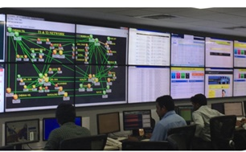
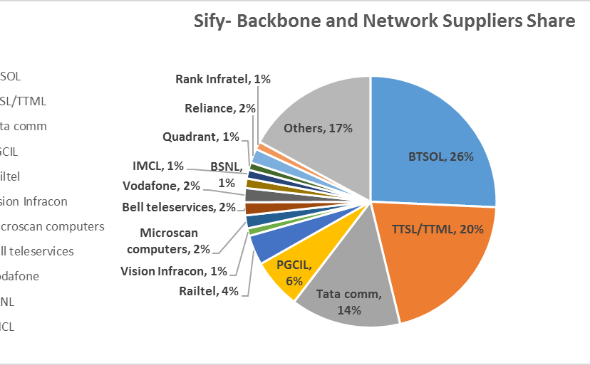
OUR NETWORK MANAGED SERVICES & OPERATIONS CAPABILITIES
Integrated NoC and SoC
24x7x365 Operations
Adherence to ITIL Framework supported by advanced toolsets
Deployment of industry standard tools
CA Spectrum, CA eHealth, ServiceNow
Detailed CRM Workflows in Oracle
Customer Portal for near-real time view and reporting dashboards
Expertise in aligning to customer-owned monitoring & ticketing tools
Expertise in API integration for infra-tools
Scale of Operations
Over 600 managed Enterprise customers
1.35 Lacs+ Enterprise connections implemented
76,000+ managed customer links
44,650+ managed CPE
Experience of managing Carrier Network Infrastructure
Service Provider Management
Engagement with over 10 NLD providers for backbone communication
Collaboration with BSNL/MTNL, Bharti, Tata Communications, Vodafone, Reliance, PowerGrid, RailTel
360 degree carrier engagement
Experience of managing multiple physical access media

Slide 31
OUR NETWORK EXPERTISE & SKILL SET
 | Total Resources | Technical skill sets | Other Training
Network engineering and solution | 47 | CCNA + CCNP + CCIE
SDN CoE | 32 | Dec Ops, Scripting, Tools, Network Management, ITIL
Central NoC | 150 | CCNA + CCNP
Service operations | 40 | CCNA + ITIL
Service operations – Field PMO and project managers | 1317 32 | PMP Prince and CCNA | Internal Training
SDM Service desk Infrastructure operations | 177 115 80 | ITIL CCNA | Internal Training Internal Training Internal Training
Deep Engineering Expertise
Deep Cisco expertise-CCNA, CCIE
Integrated SDN CoE
Advanced L2/L3 Engg
L1 teams trained in FLT on diverse media
Experience in deployment of Hybrid Management models
Project Management
PMI framework-based Project governance
Dedicated Project team for planning & Control
Integrated tools to track, monitor and report on the project
Dedicated Project Execution team and logistic teams
Extensive Field Teams
1300+ trained engineers on field, covering over 400 manned locations
Project teams that deliver customer centric projects
Business Relationship Management
Extensive Quarterly Business & Service Reviews
Proactive solution & service enhancement recommendations
Proactive Network cost optimization

Slide 32
SIFY’S MANAGED SERVICES - DDA
NETWORK MANAGEMENT
SERVICE MANAGEMENT
MEMBERS MANAGEMENT
Network Uptime
Link Uptime
End-to-End Latency
Response & Resolution Times
Change Management
Capacity & Utilization
Call Attendance Rate
Filed Support
Service Request Completion
SLAs
24*7*365 monitoring of Network Infrastructure.
Incident, Problem and Change Management.
Software version and updates
Spares and service support
Inventory management
Network configuration and change.
Capacity and Availability management
Tools for Network monitoring and performance management.
Tools for tickets, support and reports
Change, Incident and Problem records.
Uptime/SLA and capacity reports.
Provide monitoring feeds and reports to exchange.
Periodic and on-demand reports on network health and ticket resolutions.
Setup a round the clock helpdesk
Commissioning/Migration/Decommissioning
Configuration guidelines for Members
Field management for hands and feet support
Liaison with service providers
Service provider Governance.
SCOPE

Slide 33
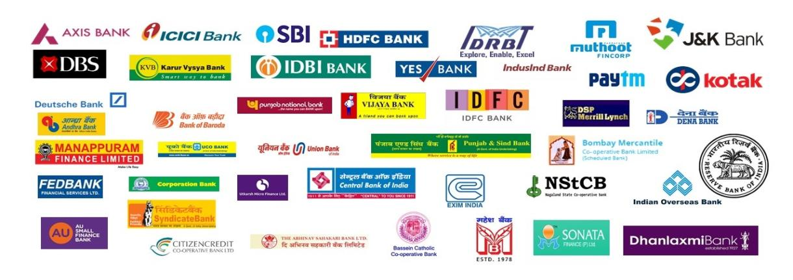

SIFY – FSI CUSTOMERS

Slide 34

Thank you
SIFY TECHNOLOGIES

