Slide 1


CAPABILITY PRESENTATION TO RBI

Slide 2
Evolution and Growth : Services Led
Sify Evolution
Revenue & Growth
CAGR 18.5%
INR Crore
Telecom: IT services wallet share
Product Revenue vs Service Revenue
In %
INR Crore

Slide 3







BFSI Credentials
Data center Services
Network Services
15+
network & transformation project executed
35%+
Revenue from BFSI
300+ data center services projects executed in BFSI
50+ & counting
Marquee logos in BFSI
Network Services
Data center migration & transition projects executed
Security services projects executed
10000+
Public sector
Bank offices
5000+
Co-operative
bank offices
100+ BFSI Private
35+ SOC Services
4500+
Private bank
offices
3000+
Public sector
Insurance co.
offices
80+ BFSI PSU
25+ Security Engagements
20+ Security Projects

Slide 4
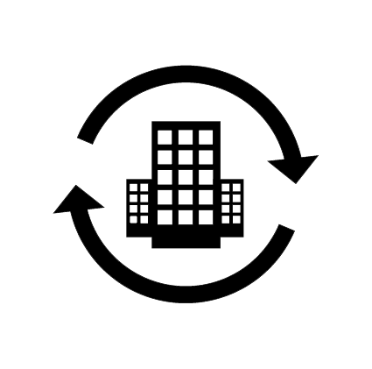
ICT Services Led Transformation Leadership in BFSI (1/2)
Transformation of DC & DR along with Infrastructure refresh
Migration to Sify Data Center and Managed Services.
Max Bupa Health Insurance
General Insurance Corp.
Transform and private build cloud – Hyper converged infra for DC & DR. Migrate workloads to Private Cloud & Managed Services.
Insurance Information Bureau
Transform and build private cloud & Managed Services.
Transformation of DC & DR along with Infrastructure refresh, virtualization & cloud set-up. Migration of applications from existing physical to virtualized environment and Managed Services.
Allahabad Bank
DC & Cloud
Transformation
Oriental Insurance Corp.
Consolidation and Refresh of infra for hosting the core insurance application & Managed Services.
Strategic Green Field Data Centre / Disaster Recovery Site Build + Migration + Managed Services for 5 years.
DHFL General Insurance
Max Life Insurance
Hybrid Infrastructure – Private Cloud and Public Cloud – Sify CloudInfinit and AWS

Slide 5


ICT Services Led Transformation Leadership in BFSI (2/2)
Design, supply, integration, operations and management of 44 RBI locations,10 datacentres and 300+ Member banks secured network infrastructure in an outsourced model.
INFINET
Design, implementation, integration, migration, operations and management of private network providing connectivity to members across the nation.
NSE
Network
Transformation
Design, integration, operations and management of 3,500 locations secured multi tower IT infrastructure in a managed services model.
Muthoot Fincorp
Design, implementation, integration, operations and optimization of Security Operations Center solutions incl. SIEM, PIM, DLP, VAPT across DC & DR
Syndicate Bank
Design, implementation, integration, operations and optimization of Security Operations Center supporting 30000 EPS & 1000 devices
Central Bank of India
Security
Transformation
Design, implementation, integration, operations and optimization of Security Operations Center solutions incl. PIM, DLP, VAPT, AV, MDM, AD, APT etc. across DC & DR
United Bank of India

Slide 6
Key References – Private (BFSI) (1/2)
Vertical | Reference Customers | Transition | DC/DR Hosting | DC IT Infra/ Private Cloud | DR IT Infra/DRaaS | Cloud | Managed Services
Insurance | Max Bupa | ü | ü | ü | ü | ü | ü
Financial Ins. | LIC housing finance corporation | ü | ü | ü | ü | ü | ü
Insurance | Avantha Ergo Life Insurance | ü | ü | ü | ü | ü | ü
 | Max Life | ü | ü | û | û | ü | ü
 | Tata AIG Life Insurance Company Ltd | ü | û | û | û | û | ü
 | HDFC Life | û | ü | û | û | û | ü
 | Apollo DKV Insurance | û | û | û | ü | ü | û
 | Aviva Life Insurance | û | û | û | ü | ü | û
 | Star Union Daichi Life Insurance | ü | û | û | û | û | ü
 | Health Insurance TPA | û | ü | û | û | û | û
Payment Gateway | Billdesk | û | ü | ü | ü | û | ü
 | Paytm | û | ü | û | û | û | û
 | YouFirst Money Express | û | ü | û | û | û | ü

Slide 7
Key References – Private (BFSI) (2/2)
Vertical | Reference Customers | Transition | DC/DR Hosting | DC IT Infra/ Private Cloud | DR IT Infra/DRaaS | Cloud | Managed Services
Banking | IndiaIdeas.com Ltd (BillDesk Payment Gateway) | ü | ü | û | ü | ü | û
 | The Thane District Central Co-op Bank Ltd. | ü | û | ü | ü | û | ü
 | Fedbank Financial Services Ltd. | ü | ü | û | û | ü | ü
 | Bombay Mercantile Bank | ü | ü | ü | ü | ü | ü
 | Axis Bank | ü | ü | û | ü | û | û
 | J&K Bank | ü | ü | û | û | û | û
 | Yes Bank | û | û | û | ü | û | û
 | The Hindustan Co-op Bank Ltd. | ü | ü | ü | ü | û | ü
 | Corporation Bank | û | ü | û | û | û | û
 | The Nagaland State Co-operative Bank Ltd. | û | û | ü | ü | û | ü
 | Bassein Catholic Co-operative Bank | ü | ü | ü | ü | ü | ü
 | Citizen Co-operative Bank | ü | ü | û | ü | ü | ü

Slide 8
Key References – PSU (BFSI)
Vertical | Reference Customers | Transition | DC/DR Hosting | DC IT Infra/ Private Cloud | DR IT Infra/DRaaS | Cloud | Managed Services
Insurance | Oriental Insurance Company Limited | ü | ü | ü | ü | ü | ü
 | General Insurance Corporation | ü | ü | ü | ü | û | ü
 | NIA | û | ü | ü | ü | ü | û
 | National Insurance Corporation | ü | û | ü | û | û | ü
Banking | Allahabad Bank | ü | û | ü | ü | û | ü
 | OBC | û | û | ü | ü | û | ü
 | State Bank of India | ü | û | û | ü | û | ü
 | UCO Bank | û | û | ü | ü | û | ü
 | Bank Of Baroda | û | û | ü | ü | û | ü
 | Andhra Bank | û | û | û | û | û | ü
 | Dena Bank | û | û | û | û | û | ü
 | Vijaya Bank | û | û | û | û | û | ü

Slide 9
Key References – PSU/Government
Reference Customers | Transition | DC/DR Hosting | DC IT Infra/ Private Cloud | DR IT Infra/DRaaS | Cloud | Managed Services
IOCL | û | û | ü | ü | û | ü
ONGC Tripura power corporation | û | û | ü | ü | û | ü
West Bengal state electricity development corporation | ü | û | ü | ü | û | ü
State DC (Kerala, Chhattisgarh, Tripura, Meghalaya, Sikkim, Punjab, Tamilnadu DR) | û | ü | ü | ü | ü | ü
NIC | û | ü | ü | ü | û | ü
Kanpur electricity supply company | û | û | ü | ü | û | ü
UPPCL | ü | û | û | û | ü | ü
NISCAIR | û | û | û | û | û | ü
TNDRC | û | û | ü | ü | û | ü
PSPCL | ü | û | ü | ü | ü | ü
UP High Court | ü | ü | ü | ü | ü | ü
Power grid corporation | û | ü | ü | ü | ü | ü

Slide 10
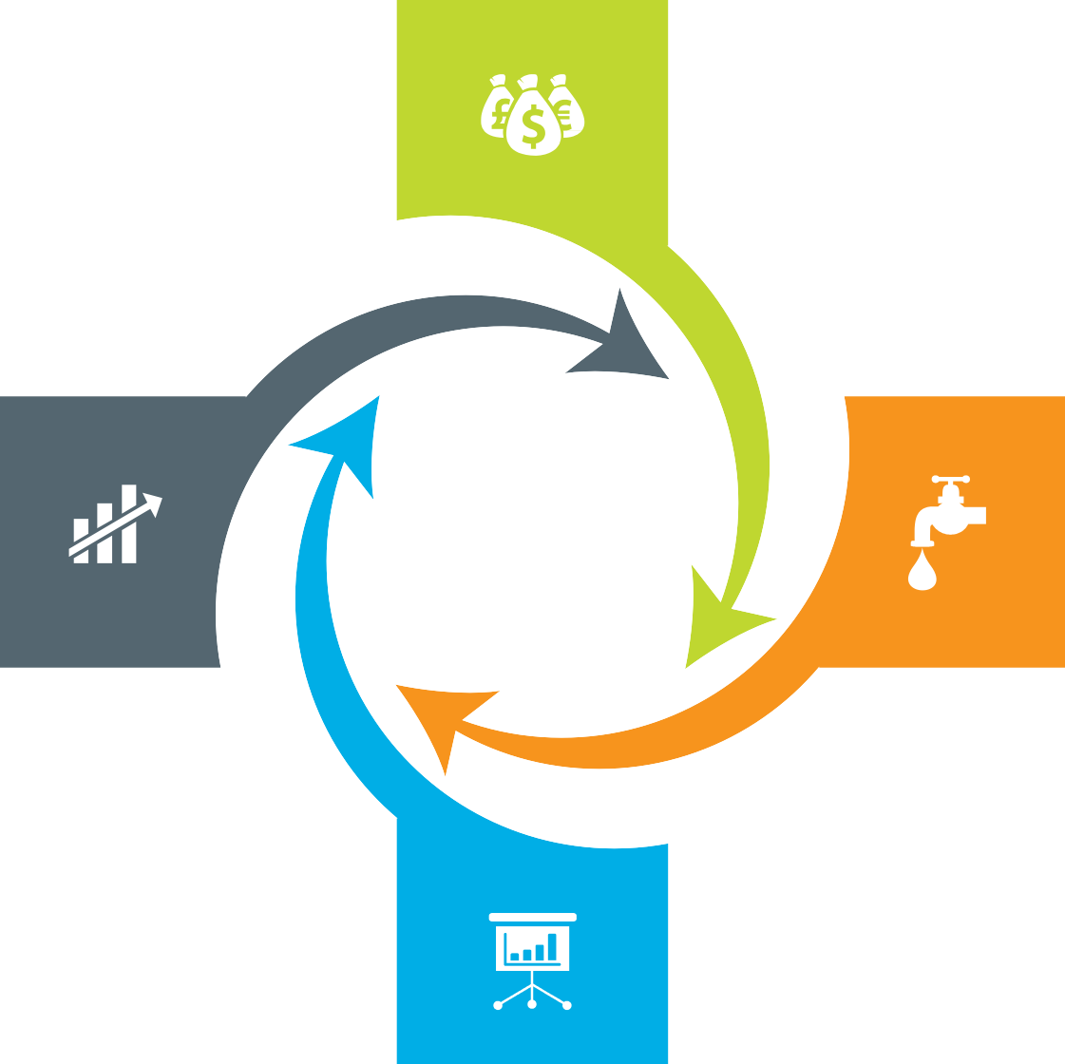
Our Engagement Models
Assets + Services Systems are owned by the client and annuity based payout for services
Outcome based Client engagement is based on defined business outcome generated by IT solutions and services
ENGAGEMENT MODELS
Usage based No upfront investment by client and payout is based on consumption
Component based Reduced upfront investment as client
subscribes to infrastructure owned by Sify as a part of their overall infrastructure
requirement

Slide 11














Execution Capabilities: Strategic/ Transformation Projects
Preferred over players like: IBM, Wipro, HCL & TCS
Preferred over players like: IBM, Wipro, Dimension Data, Tata Comm. & Airtel
Large Data Center Transformation Projects
Large Network Transformation Projects
Transformation across Vectors
Preferred over players like: Wipro, IBM, Dimension Data & Tata Comm.
Large Security Solutions Projects
Business outcome based models
Preferred over players like: TCS, Wipro. Netmagic
11

Slide 12


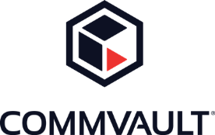








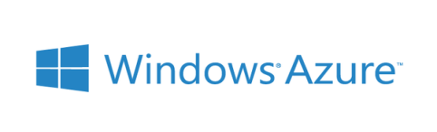
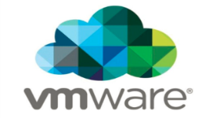














Strategic Partnerships
Technology Partners
Cloud and Acceleration Partners
Application Partners
Security Partners

Slide 13
Our People Capabilities and Strengths
550+
Data center and Managed services
1800+
Network services
70+
Security services
225+
Application services

Slide 14
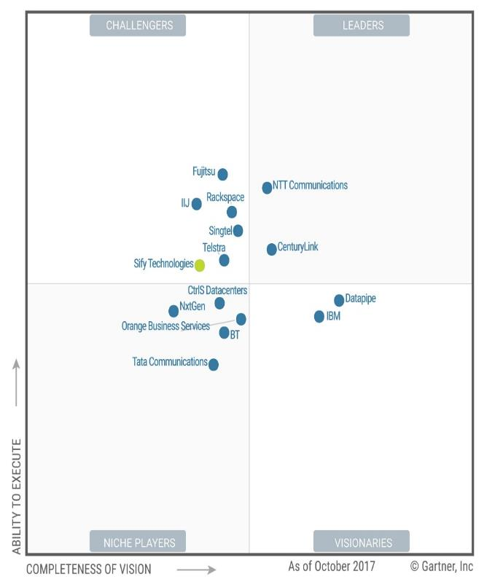

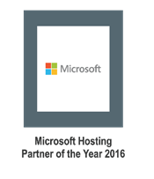
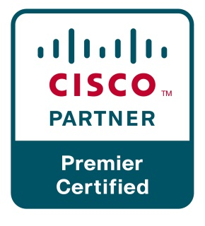
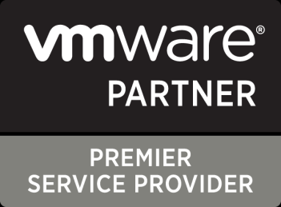

Recognitions
Partner of the year 2017
Network Transformation Services
2018
Data Center Transformation Services
2018
Sify moves up to the challenger position on the Gartner MQ

Slide 15




cloud@core
TM
ALIGNED TO OUR CUSTOMERS’ CLOUD TRANSFORMATION PURSUIT
CLOUD ENABLING
CLOUD INSPIRED
CLOUD PURE
CLOUD ENHANCED
Cloud DC
Hyper reach/Hyper scale transport Oracle FastConnect | ExpressRoute | DirectConnect | Partner Interconnect
Software Defined Network services
Cloud build Private | Hyperconverged | Enterprise
Security services for cloud
Migration and Implementation services
Sify CloudInfinit
Enterprise Multi-Tenant
Dedicated
Hosted SAP/S4 HANA
Azure Stack as a Service
Edge Connect Services
SD-WAN
Collaboration services on Cloud
AWS
Azure
OCI
GCP
Multi Cloud Management platform & services
Modern Applications
Kubernetes-as-a-Service
AI/ML
Forum DIGITAL
HCM Digital (iTest)
Learning Management
Internet-of-Things (IOT)
Industry Solution-as-a-Service

Slide 16
Data Center and Cloud Services Driven Infrastructure Transformation Partner
Data center experience
Cloud experience
Over 250 man-years of experience in Data Centre build & operations
Own Cloud Orchestration & Management IP which is hosting 300+ customers
Designed and built 12 Tier III DC’s in India with 2 lakhs + sq. ft.
Implemented Hybrid Managed Cloud for 100+ organizations
Hosting major Enterprises, Govt, PSU, Global Cloud and Content Providers
MeitY certified CSP, STQC audit completed
Extensive experience in delivering end-to-end Data Centre services from design, implementation, operations
DC IT and technology integration experience
Service provider experience
Experience of providing IAAS/PAAS/DRAAS (300+ customers) on our Sify Cloudinfinit platform
In house team of 400+ skilled and certified resources to deliver projects
Our Cloud services offer industry-leading SLAs with guaranteed 99.95% uptime

Slide 17
Our Data Center Transformation Framework
TENETS
OFFERING
TENETS
OFFERING
Right Fit IT Strategy
Optimized IT and OPS
Future Ready
Discovery
& Assessment
ROI Analysis
Transformation Roadmap
Application as Service
Business Aligned
Pay per use model
SAP
Microsoft
Oracle
Sify Apps
Apps
Transformation
IT
Modernization
Assessment
OFFERING
TENETS
OFFERING
Infra
P – V
V – V
Platform
Win8 – Win10
Apps
Lotus - Exchange
Agility
Autonomous
Predictive Analytics
Change the Business
Digital IT
IOT
TENETS
}
‘’0’’ Defect Migration
Seamless
End to end ownership
Cloud
Innovation
Sify’s
DCT Framework
Migration
Security
Transformation
Infrastructure
as a Service
TENETS
OFFERING
TENETS
OFFERING
Seamless
Impregnable
Audit & Compliance driven
Network
End Point
IT
Agility
Future Ready
Consumption
Private Cloud
Enterprise Cloud
AWS/Azure/ CI
Hybrid IT
Backup
DR
Acceleration
DC Security
OPS
Transformation
TENETS
OFFERING
Cloud Nerve Center
Shade and Dedicated Pool
End to end Management
Automation
Lean Operations
Cloud Ready

Slide 18
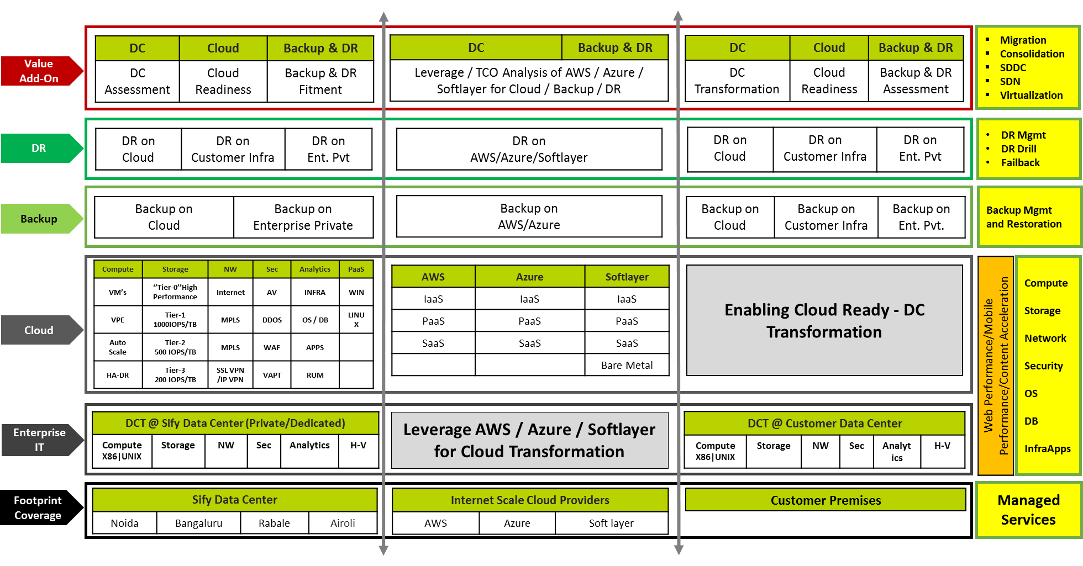
Data Center Transformation Aligned Services

Slide 19
Network Services Transformation Partner
Integrated NOC & SOC, 24x7x365 Operations
Managed Network and Security Service
Network Integrator
Network design, platform selection, solution interoperability, seamless migration
Visibility Tools -1200+ Man Years in Tools & Process
Outcome based services which are technology centric and OEM agnostic
Supported by Advance Toolsets - CA Spectrum, Service Now, CA e-Health
Managing multi-vendor environments, single ownership, SLA driven
Design, Analysis, Planning, Deployment, Integration & Transitioning
DoP, IDRBT, NSE, Muthoot, Sanmar, DHFL General Insurance, Max Bupa
Large Project Design and Rollout Experience
Investments in Digital and Cloud Network (SMAC)
Zero Latency connectivity into Cloud Service Providers Like AWS & Microsoft Azure
Capabilities of Delivering Managed Wifi & SD WAN from Sify Cloud
Cloud and Software Defined Network Orchestration IP developed by Sify

Slide 20
Network Services – Key Strengths
Design Experience
Inhouse engineering design team of Service Provider class network (Sify + Customer Networks)
Experience of high availability and scale centric network design
Deployment integration and transition
Over 2 decades of Large Network Deployment, Integration and Transitioning experience
Some marquee Large projects like DoP, IDRBT, Muthoot, New India Assurance
Operation and maintenance
Project Management, Operations with a Field Team of 1300+ Trained Engineers on the field manning 400 POP Location
Deploy Personnel for Field & NOC Operations, Fault, Change & Vendor Management
Service provider management
360 degree engagement with all carriers (buy, deploy, manage and sell)
99.9995% uptime on backbone achieved on the network
NOC, SOC and Systems experience
Integrated NoC and SOC operations for the last 12+ years
Over 600 customers in dedicated/shared or hybrid mode of management
Visibility tools - 1200+ Man Years Experience in Tools & Process
Mature alliance and relationship with global leaders
Sify Service Provider IP Network is built on Cisco Technologies (For last 2 decades)
Many firsts Cisco technology implementation – CSR/WAAS/GETVPN/Optical 100G
Over 200+ POP routers of the same family inhouse managed by Sify
Sify Public & Private Cloud Setup on HP, Sify Storage on IBM Flash , Sify SAP ECC/HANA Platform on Cisco

Slide 21
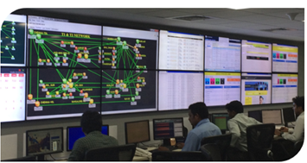
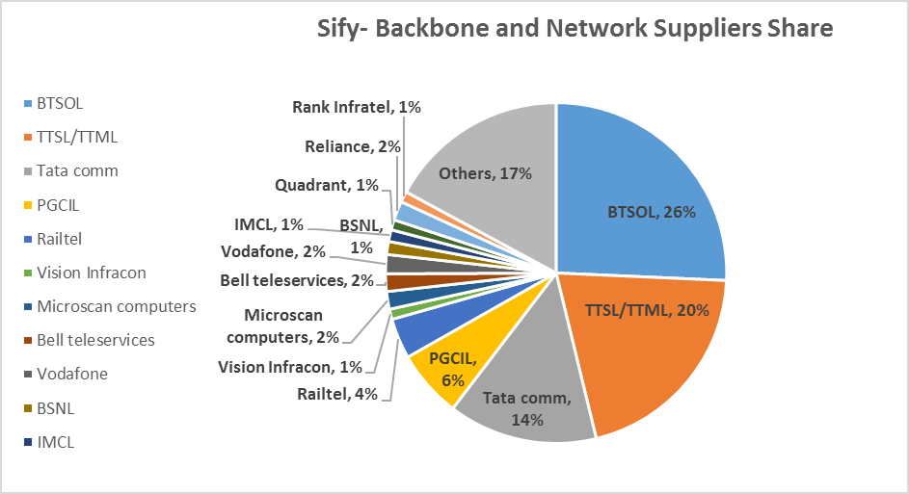
Our Network Managed Services & Operations Capabilities
Integrated NoC and SoC
24x7x365 Operations
Adherence to ITIL Framework supported by advanced toolsets
Deployment of industry standard tools
CA Spectrum, CA eHealth, ServiceNow
Detailed CRM Workflows in Oracle
Customer Portal for near-real time view and reporting dashboards
Expertise in aligning to customer-owned monitoring & ticketing tools
Expertise in API integration for infra-tools
Scale of Operations
Over 600 managed Enterprise customers
1.35 Lacs+ Enterprise connections implemented
76,000+ managed customer links
44,650+ managed CPE
Experience of managing Carrier Network Infrastructure
Service Provider Management
Engagement with over 10 NLD providers for backbone communication
Collaboration with BSNL/MTNL, Bharti, Tata Communications, Vodafone, Reliance, PowerGrid, RailTel
360 degree carrier engagement
Experience of managing multiple physical access media

Slide 22
Our Network Expertise & Skill Set
Deep Engineering Expertise
Deep Cisco expertise-CCNA, CCIE
Integrated SDN CoE
Advanced L2/L3 Engg
L1 teams trained in FLT on diverse media
Experience in deployment of Hybrid Management models
Business Relationship Management
Extensive Quarterly Business & Service Reviews
Proactive solution & service enhancement recommendations
Proactive Network cost optimization
Project Management
PMI framework-based Project governance
Dedicated Project team for planning & Control
Integrated tools to track, monitor and report on the project
Dedicated Project Execution team and logistic teams
Extensive Field Teams
1300+ trained engineers on field, covering over 400 manned locations
Project teams that deliver customer centric projects

Slide 23
Network References & Transformation Capabilities
Customer | Network Design | Network Build/Integration | Network Managed Services | Bandwidth Service Provider | Network Security | Network consolidation transformation | SDN | Managed Wifi
Department of Post | ü | ü | ü | ü | û | ü | û | û
IDRBT | ü | ü | ü | ü | ü | ü | û | û
National Stock Exchange | ü | ü | ü | ü | û | ü | ü | û
New India Assurance | ü | ü | ü | ü | û | ü | û | û
Oriental Insurance Company | û | û | ü | ü | û | û | û | û
Syndicate Bank | û | û | ü | ü | û | û | û | û
United Commercial Bank | û | û | ü | ü | û | û | û | û
United Bank of India | û | û | ü | ü | û | ü | û | ü
Oriental Bank of Commerce | û | û | ü | ü | û | û | û | ü
Muthoot Fincorp | ü | ü | ü | ü | û | ü | û | û
City Union Bank | û | û | û | ü | û | û | û | û
Indian Overseas Bank | û | û | ü | ü | û | û | û | û

Slide 24
Sify DDoS Capabilities

Slide 25
WAN Transformation with Sify Managed SDWAN
Deliver Customer Value, Not Just Cost Efficiency
Unify Managed services
Key enabler for Digital transformation
Agile & Flexible
Application centric
Performance aware
Software based
Carrier agnostic Overlay architecture.
Multi-transport support.
Centralized control & Monitoring.
Unique topologies per segment.
Encryption, segmentation and service chains
Cloud off-ramping
Application aware routing.
Application based policies.
Application visibility & recognition.
Real-time enforcement of App SLA.
Centralized policy control.
Continuous quality assessment.& path liveliness
Consolidates multi provider WAN as a single fabric.
Faster convergence of application traffic.
Bandwidth augmentation with Active/Active utilization.
TCP optimization
Software platforms enabling physical or virtual CPE.
Zero touch provisioning.
Centralized configuration.
Agility for operations with analytics.
Interoperable with legacy.

Slide 26
Sify Managed SDWAN: Value Propositions
1
2
3
Difficult to simplified operations
Connectivity-centric to App centric
Cloud Enablement
Discover , understand needs and manage performance
Facilitate & manage performance
Automation, programmability, consolidation and agility
4
5
6
Inflexible to Flexible
Visibility & Analytics
Security
Hybrid WAN, Topologies, Physical/Virtual, convergence
Behaviours, Trends and feedback loops
Cloud perimeter branch and user security.
Managed services to drive efficiencies, lead engagements through insights and
value beyond cost economics.

Slide 27
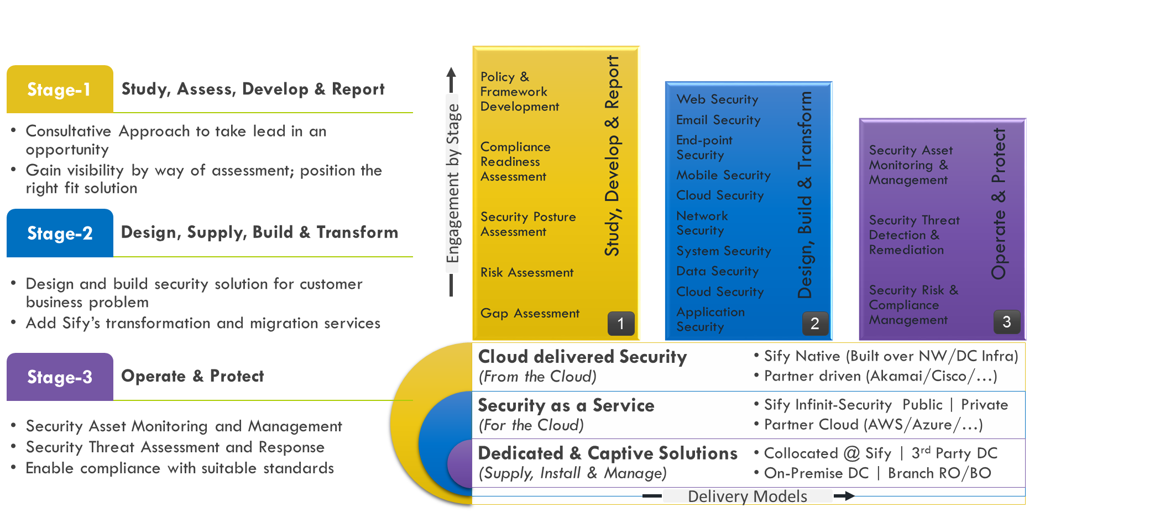
Our Security Services Engagement Models

Slide 28
Security Services Execution Proof Points
Reference Customers | Information Security Consulting | Security Transformation | Professional Services | Security Operations | Incident Response | Solution Landscape
Syndicate Bank | ✓ | ✓ | ✓ | ✓ | ✓ | SIEM, PIM, DLP,VA PT, Network Forensics,
UBI | ✓ | ✓ | ✓ | ✓ | ✓ | AV, DLP,Web Security, PIM, MDM, AD, APT, DDOS, WAF
DHFL | ✓ | ✓ | ✓ | ✗ | ✗ | SIEM,WAF,DAM,PIM,DLP
CBI | ✓ | ✓ | ✓ | ✓ | ✓ | SIEM
PSB | ✓ | ✓ | ✓ | ✓ | ✓ | SIEM, PIM, WAF, APT
PNB | ✓ | ✓ | ✓ | ✓ | ✗ | DLP, PIM, Config Management
BOI | ✓ | ✓ | ✓ | ✗ | ✗ | Threat Protection
Max Bupa | ✓ | ✓ | ✓ | ✓ | ✓ | SOC, APT, Firewall, DRM
ONGC | ✓ | ✓ | ✓ | ✗ | ✗ | Web Security, Firewalls
IOCL | ✓ | ✓ | ✓ | ✗ | ✗ | Firewall, Web Security, SLB
NTPC | ✓ | ✓ | ✓ | ✗ | ✗ | SIEM, NIPS, PIM,

Slide 29
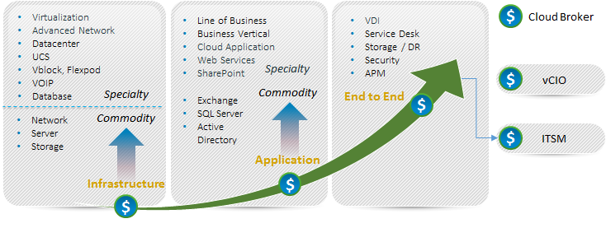
Our Tools and Automation Capabilities
Application Monitoring
SERVER MONITORING
CLOUD MONITORING
SAP
Microsoft Exchange
IBM WebSphere
Apache Tomcat
Microsoft IIS
JBoss
SharePoint
Sybase EAServer
Lotus Notes
MS Lync
MS Active Directory
Oracle WebLogic
Microsoft Windows Server
Linux/Unix
Solaris, AIX, HP-UX, Linux, Sinix, Tru64 UNIX, Red Hat
Cisco Unified Computing System (UCS)
IBM Power Systems
Novell Open Enterprise Server
Private
Flexpod, Vblock
Public
Amazon, Rackspace, MS Azure, Google App Engine, Google Apps, SFDC CRM
Citrix CloudPlatform
vCloud
Cloud Monitor (Websites)
Virtualization Monitoring
NETWORK MONITORING
Database Monitoring
VMware
Citrix XenServer
Microsoft Hyper-V
Oracle Solaris Zones
IBM PowerVM
Red Hat Enterprise Virtualization
Router and Switch
Network Response Time
Cisco Qo5
Cisco IP SLA
Flow Analysis
Oracle DB
Microsoft SQL Server
Informix
IBM DB2
MySQL
Sybase
Service desk as service
Big Data & CUSTOM APPS
Storage Monitoring
VoIP / VDI monitoring
Provide Service Desk in Multitenant Model
Hadoop, Cassandra, Mongo DB
Customizable packages for open source applications or in house applications
EMC
IBM System Storage
NetApp
Cisco VoIP
Citrix XenDesktop / XenApp
Hitachi
29

Slide 30




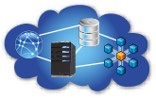

Our Tools and Automation Capabilities
UNIFIED MONITORING OF PUBLIC AND PRIVATE IT ENVIRONMENTS
Application Monitoring
Server Monitoring
Cloud Monitoring
Virtualization Monitoring
Database Monitoring
Storage Monitoring.
Data Center Monitoring
Main Frame Monitoring
Response Time Monitoring
Big Data Monitoring
Basic Network Monitoring
Features
What can we monitor
Multitenancy
Dashboard & Reports
Distributed Architecture
Unified Trending
Visual Alarms & Reporting
Email Alerting
3rd Party Integration (Service Now for ITSM )
Agent and Agent less Monitoring
UMP (Portal ) available via Mobile
Dashboards and Reporting
Service Levels
End User Response Time
Performance and Availability
Events and Faults
Power
Efficiency
Network
LAN & WAN
Server
Physical & Virtual
Database
IT & Business
Application
Commercial & Custom
Cloud
Public & Private
30

Slide 31
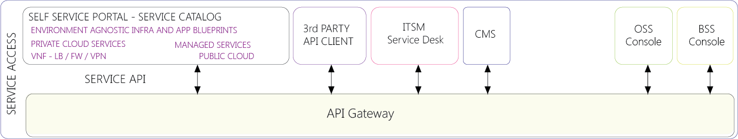
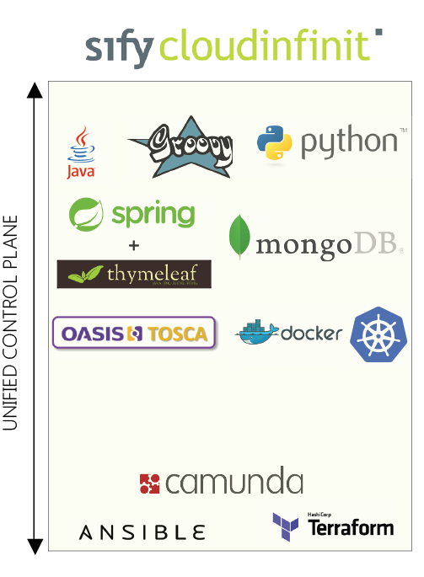

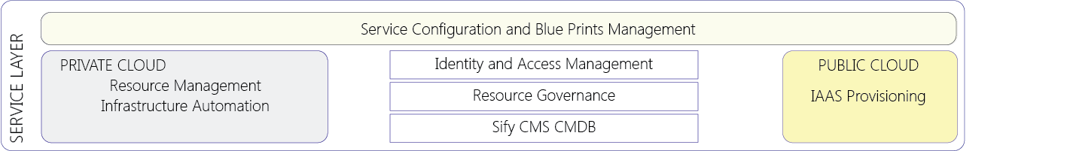
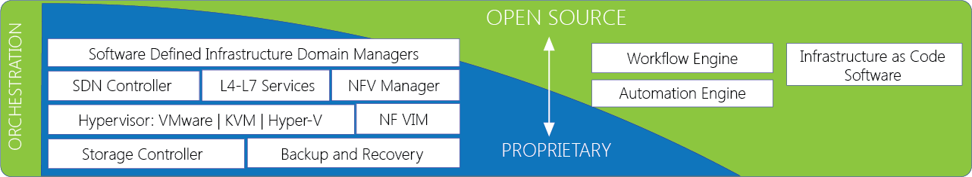
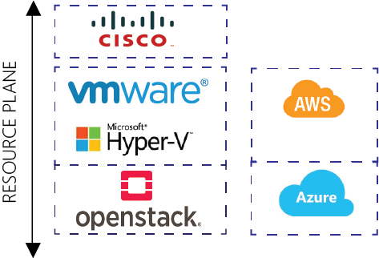
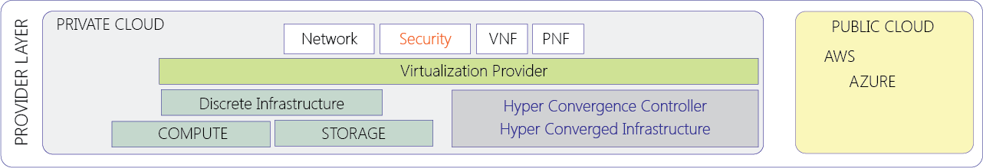
Our Tools and Automation Capabilities
31

Slide 32
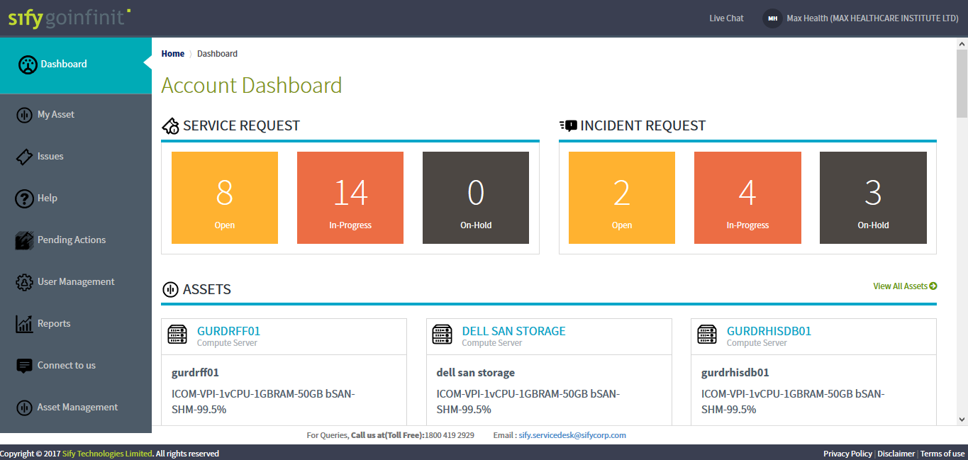
Our Tools and Automation Capabilities

Slide 33
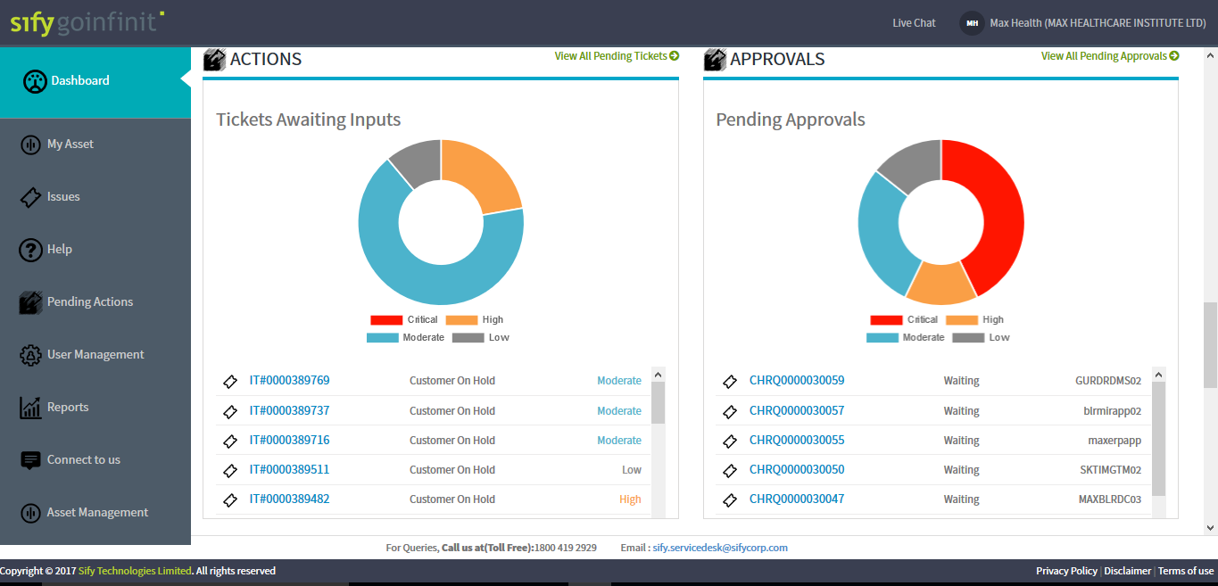
Our Tools and Automation Capabilities

Slide 34




Why Sify for RBI? (Gaurav and Arindam to add information)
Sify customer in BFSI
Data to be added
DC partner for 5-10 years
Data to be added
Network partner
Data to be added
Security partner
Data to be added

