Slide 1
Axis Bank – NDR Requirement
AT SIFY Bangalore DATA CENTER Facility
26 MAY 2021

Slide 2
AGENDA
SESSION OBJECTIVE
SIFY DC AND INFRASTRUCTURE ADVANTAGE
Metro Connectivity
Bangalore DC facility
CUSTOMERS IN SIFY DC
CERTIFICATIONS & RECOGNITION

Slide 3


SESSION OBJECTIVES
To visit and understand the infrastructure and technical details of Sify DC facility in Bangalore
Introduction and company overview
To share Infrastructure and Technical details of the Bangalore DC facility

Slide 4






Infrastructure designed and built for hybrid cloud
CLOUD DATA CENTERS
VIRTUAL PRIVATE
CLOUD
CLOUDCONNECT
Enterprise Cloud grid available with data centers
Hyperscale Connectivity to AWS, Azure, GCP, Oracle
“DC inter-connect”
data superhighway to
48 on-net data centers
10 Pan-India DCs with 71 MW capacity.
Adjacent Hyperscale CSPs
Hyperscale Connectivity to AWS, Azure, GCP, Oracle “DC inter-connect” data superhighway to
48 on-net data centers
APPLICATIONS
MULTICLOUD OPERATIONS CENTRE
NETWORK
App Modernization,
Kubernetes,
Industry Solutions as Services
Cloud, DC, Security, Network, Applications
Largest MPLS network
(by connections)
3100+ PoPs across 1600 towns in India

Slide 5




cloud@core
TM
ALIGNED TO OUR CUSTOMERS’ CLOUD TRANSFORMATION PURSUIT
CLOUD ENABLING
CLOUD INSPIRED
CLOUD PURE
CLOUD ENHANCED
Cloud Data Centres
For Enterprises and Hyperscale CSPs
Private Cloud at DC
Hyperconverged | Enterprise
Hyper reach/Hyperscale NW
Hyper Reach/Hyperscale transport
Data Center Interconnect
SD-WAN
Migration Services
Migration and Implementation services
IaaS at Cloud DCs
CloudInfinit
  Enterprise Multi-Tenant
  Dedicated
  Hosted SAP/S4 HANA
  Azure Stack as a Service
Edge infra aligned to Cloud
Edge Connect Services
Hyperscale Platforms adjacent to Cloud DCs
AWS
Azure
OCI
GCP
Multi-cloud Management platform & services
Digital Services
App Modernization
Kubernetes-as-a-Service
Digital Apps (SaaS)
Forum DIGITAL
HCM Digital (iTest)
Learning Management
Internet-of-Things (IOT)
Industry Solution-as-a-Service

Slide 6
Hybrid IT - “cloud@core”
Service Management
Self-Service Catalog Portal
SERVICE DESK
MONITORING
MANAGEMENT
METERING
HYBRID IT MANAGEMNT
SIFY MULTICLOUD PLATFORM
Public Cloud / Private Cloud | Software Defined Infrastructure | Integrated Approach
Security and Compliance
HYBRID IT SERVICE
HYBRID IT COMPONENTS
Private Cloud / Sify CI
AWS
SAP HANA
AZURE
NW & Security
Platform
Automation
Colo
OCI
Subscription Model
GOOGLE
Build Model
SIFY PREMISE
IaaS, PaaS, SaaS
SIFY PREMISE / ON PREMISE
Architect-> TRANSFORM -> OPERATE

Slide 7
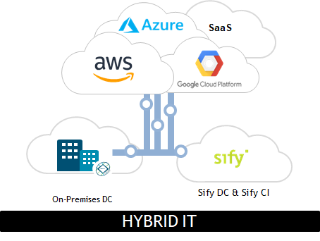

Your partner of choice
BUILD + SERVICE MODEL
Sify has the desired Skills, Experience and Solutions required to meet our customers key digital priorities.
We have been successfully managing more than 900 customers across our DCs, Sify CloudInfinit, AWS, Azure, OCI to ensure continuous consumption, increase efficiency, lower operating costs and achieve infrastructure independence at scale

Slide 8








SIFY’s DATA CENTRE experience SNAPSHOT
20 years of experience
in Build, Own, Operate
Carrier-Neutral Data Centers
10 Data Centers
with 71 MW IT Power in key cities
Truly
carrier-neutral
More than 90% of fiber links are from non-Sify Telecom Providers
Multiple Internet Exchange
ecosystem facilitating OTTs and ISPs interconnect via portal
Multi year experience
of managing Hyper-scale, Internet Exchange customers
Roadmap
to add
200 MW in next 4 years
Rich Interconnect Ecosystem
Hyperscale Cloud, Multiple Internet Exchanges, Content IP peering nodes & ISP Interconnect
Self-service Portal
for Cross Connects and rack space: deployment in 2-5 business days
Sify confidential – To be strictly followed by NDA

Slide 9

SIFY’S DATA CENTER FOOTPRINT
NOIDA
Tower 1
9.6MW
NOIDA - Tower 2
16.0 MW
Oct 2022
NOIDA - Tower 3
16.0 MW
Oct 2023
Mumbai 1
Vashi
0.9 MW
Mumbai 2
Airoli
5.4 MW
Mumbai 3
Rabale - Tower 1
11.5 MW
Kolkata 1
1.6 MW
MUMBAI
Hyderabad 1
8.0 MW
Mumbai 3
Rabale - Tower 2
9.6 MW
Mumbai 3
Rabale - Tower 3
Mumbai 4
Rabale – Tower 1
6.0 MW
Dec 2021
Mumbai 4
Rabale - Tower 2
26 MW
Oct 2022
BENGALURU
Bangalore 1
Electronic City
4 MW
CHENNAI
Existing
* incl. planned expansion
Upcoming
Planning
Chennai 1 Tidel Park
1.1 MW
Chennai 2
Siruseri – Tower 1
16.0 MW
Jun 2022
Chennai 2
Siruseri – Tower 2
16.0 MW
Dec 2022
Chennai 2
Siruseri – Tower 3
16.0 MW
Jun 2024
All Power references are Design IT Power at Full Capacity

Slide 10

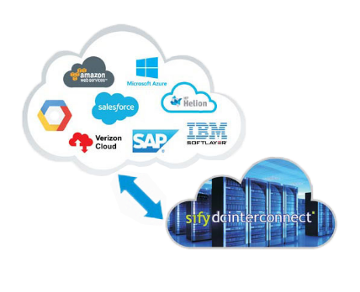
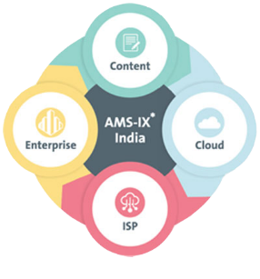
GLOBALCLOUDCONNECT- bringing cloud to you
GlobalCloudConnect equips an enterprise to connect its on – prem DCs with Cloud Workloads over a secure and deterministic network.
AMS- IX, carrier neutral Internet Exchange offering high quality IP Peering and interconnectivity services.
48 Interconnected DCs with 1600+ POPS
End to End Availability: 99.5% and above
100Mbps (Fast Ethernet) to 10 Gbps (10 Gigabit Ethernet) and 1G
High Availability with Hybrid Setup
Secure & Reliable Connections
Traffic Engineering & Cost Efficient

Slide 11



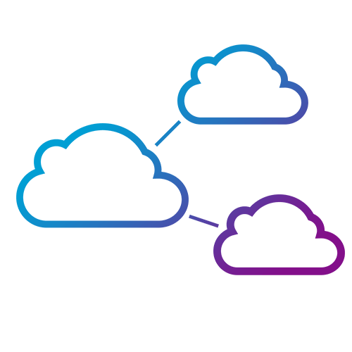


Infrastructure ADVANTAGE
SIFY ASSETS
RELEVANCE TO DIGITAL ENTERPRISE
  10 Pan-India DCs with 71 W capacity
  To add 200 MW in next 4 years, doubling capacity
Hosting for hyperscale operators
Centerpiece of the hybrid cloud
Cloud Adjacency
  Largest MPLS network (by connections)
  3100+ PoPs across 1600 towns in India
Internet growth from non-metros
Platform to move content to “edge”
  “Cloud Connect” data superhighway
  48 on-net data centers
Cost-effective terabit network scale
Interconnect Public and Private clouds
  Enterprise and Hybrid Multi Cloud
  Enterprise Cloud grid fabric
Public / Private / Hybrid Clouds
Cost effective and pay-as-you-go model
  Remote Operations Centers
  NOC, SOC, managed services
Global and domestic IT outsourcing
Supports outcome-based services model
  Applications and solutions
  iTest, ForumNXT, eLearning, SAP, Oracle, App Modernization
IT-enablement for distributed businesses
Supports Digital Transformation initiatives

Slide 12
SIFY ICT services KEY FACTS points
PEOPLE
700+
100+
DC, Cloud & Managed Service Team
Certified Security Experts
CUSTOMERS
+400
70+
30+
Enterprise Cloud clients
Private cloud & DR clients
CDN & Cloud Security clients
PROJECTS
10+
500+
300+
80+
IT Ops Transformation projects
Datacenter services projects executed
Datacenter Migration projects
Platform Migration Projects
VOLUME
22K+
100K+
91k+
5000+
7 Petabyte
Managed Tickets per Month
Network Devices
Managed Mailbox
Security Devices
  Managed Storage and Back-up

Slide 13
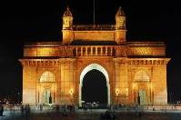

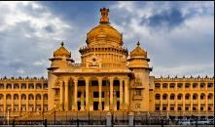
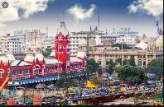



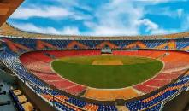
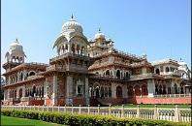

Phase -1 Metro – 10 Cities
Mumbai
Delhi
Bangalore
Chennai
Hyderabad
  16 DCs/CLS sites.
  1200+ Kms of fiber.
  500+ buildings connected.
  7.6 Tbps lit capacity
  7 Datacenters
  1300Kms of fiber.
  200+ buildings connected.
  6.6 Tbps lit capacity
  8 DCs
  1400+ Kms of Fiber.
  600+ buildings connected.
  1.8 Tbps of lit capacity
  9 DC/CLS
  530 Kms of Fiber
  200+ buildings connected.
  12.6 Tbps of lit capacity.
  3 DCs
  1100 + Kms of Fiber
  450 + Buildings Wired
  1TB of lit capacity
Kolkata
Pune
AHMEDABAD
JAIPUR
COCHIN
  3 DCs
  950 + Kms of Fiber
  350 + Buildings Wired
  700GB of lit capacity
  2 DCs
  550 + Kms of Fiber
  150 + Buildings Wired
  400GB of lit capacity
  Planned Q1 2021-22
  Planned Q1 2021-22
  Planned Q1 2021-22
Notes:
Self Explanatory

Slide 14
Bangalore dc key highlights

Slide 15
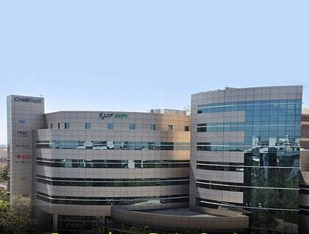
SIFY BANGALORE AS DISASTER RECOVERY CENTER
Addressing biggest market segments like BFSI, E-Commerce & Retail, Media & Entertainment
Managed Services 24x7 Regular Backup & DR Support
Major portion of the DC will be a Colo and Private Cloud deployment
DR Services through Sify’s Pre-validated architecture and tools to fulfil required SLAs
Site Address:
Sify Technologies Limited
Unit No A/303, 3rd Floor, Cyber Park,
Plot no 76, 77. Electronic City Phase 1,
Bangalore 560 100
GPS Map:
https://goo.gl/maps/SbeNWoPFnYeC3sVL9

Slide 16
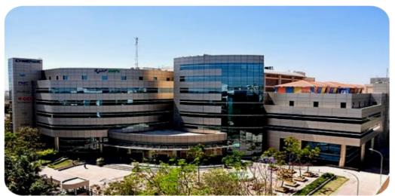
SIFY Bangalore DC - key Facts
Architectural & Building Structure
Seismic Zone: Zone II
Seismic Protection: Building strengthened as per IS 1893: 2002 criteria for earthquake resistant design of structure
Structural Floor Loading : 1200 Kg/Sq. mt for Proposed Datacenter Floor
Freight Elevators: 2 Ton
Passenger Lifts : 4 numbers
Perimeter Wall & Doors : 2 Hours Fire rated
Integrated Building Management System
Access Control : Multi layer access control system
Video Surveillance : 24*7 for all critical areas with retention for 90 days
Fire Detection : Addressable smoke detectors
VESDA: Aspirating Smoke Detectors
Fire Suppression : NOVEC 1230 and FM200
Addressable Water leakage Detection
Ultra sonic Rodent repellent system
Building Features
Floors in building: 7Floors (B+G+5), Reinforced concrete structure building
Total Area : 54,359 Sq ft
Raised Floor area : 20,000 Sq ft (15000 Sq. ft. for proposed 1st floor server hall and 5000 sq ft for 3rd floor server hall)
Server Hall Location: 1st and 3rd floor
Slab to Slab height: 3658mm
Raised Floor Height: 600mm
Power System
Incoming supply: 11KV dedicate feeder
Total Designed Power Capacity: 4MW
Service Provider: BESCOM
UPS Configuration: N + N
Battery Backup : 10 mins on full load
Distribution: Dual Feed up to Racks
Generator Configuration: N + 1
Fuel Storage : 48 hours / 25000 liters on full load
Cooling System
Cooling System : DX type PAC machines
CRAC Redundancy : N+1
Temperature : 22 +/- 2 deg C
Humidity : 55 +/- 5 % RH
Dust Control : Less than 5 Micron

Slide 17




BENEFITS OF BEING HOSTED AT Bangalore DC
Native availability of:
CloudInfinit - Public Private/ Virtual Private
SAP Grid
Seismic Zone stability
Preferred choice for DC-DR
Built for high density racks
Minimal latency with Axis Bank current DR site
Interconnected with 48 DCs across India
Presence of Sify Network POP
Multiple fiber entry paths
10+ BFSI customers hosted in the same site
100% uptime since 2008
Multi layer stringent security
24 x 7 operational support

Slide 18
Network Resources – Sify Bangalore DC
Carrier Availability
Sify
Airtel
Tata Communications
Reliance Jio
Vodafone
PGCIL
BSNL
Tata Teleservices Ltd
Railtel

Slide 19
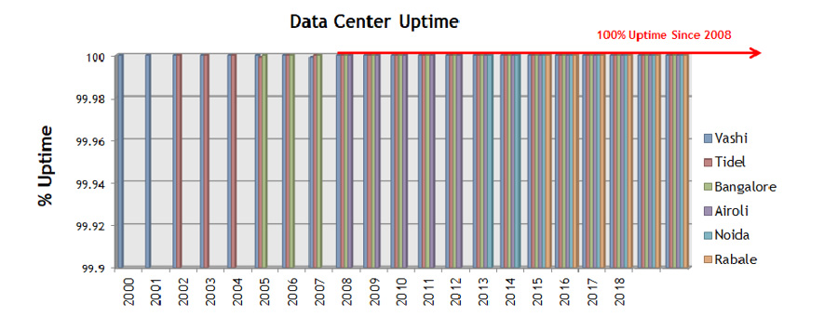
IMPECCABLE UPTIME PERFORMANCE
Uptime Commitment 99.982%
2019
2020

Slide 20
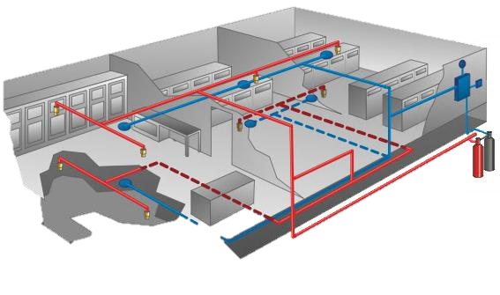
Operational Security at the DC Facility
Fire detection and suppression
  Multi-sensor fire detection and alarm
  Fire suppression with NOVEC 1230 for Server Halls, UPS Rooms, Battery Rooms
  Common areas with sprinkler
  Fire hydrants and manual portable fire extinguishers
  High sensitivity smoke detection with aspirating smoke detection systems
Water Leak Detection Systems
Ultrasonic Rodent Repellent Systems
Public Address Systems
Onsite fire marshals and regular fire drills
Compliance to local fire codes

Slide 21






























INDIA’S BFSI INDUSTRY LEADERS ARE IN SIFY DATA CENTERS
Largest
bank in India
Largest
Pvt Bank in India
Largest
e-wallet company in India
Industry leading BFSI company’s Data Center runs on Sify

Slide 22













Bfsi customers hosted at SIFY Bangalore dc

Slide 23












Other key customers hosted at SIFY Bangalore dc

Slide 24
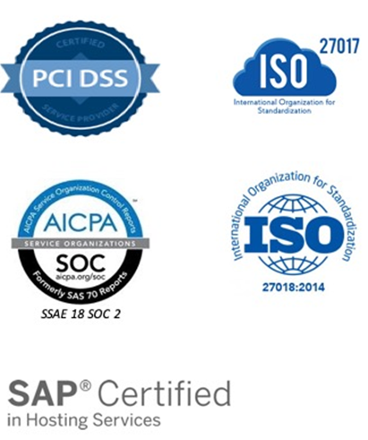
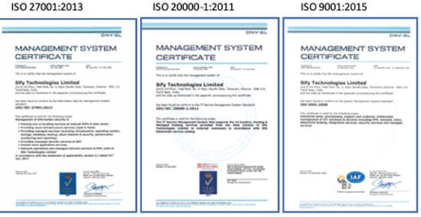
Compliance and CERTIFICATIONS

Slide 25
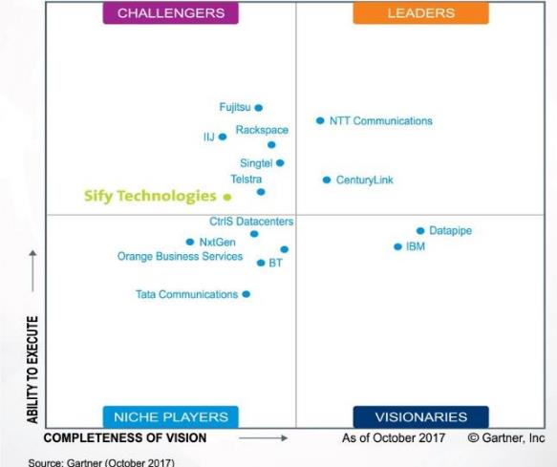










INDUSTRY RECOGNITIONS
Recognition in Market Guide for Public Cloud Managed and Professional Services Providers APAC 2020
Recognition in Critical Capabilities for Managed Hybrid Cloud Hosting APAC 2018
Recognition in Market Guide for Top Data Center Service Providers 2018
Recognition in Market Guide for Vulnerability Assessment
and Penetration Testing Consulting Services in India 2019
Recognition as a notable vendor in MQ for Data Center Outsourcing and Hybrid Infrastructure Managed Services, Asia/Pacific 2019
Major Player in
MarketScape for Cloud
Managed Services APeJ 2019
The Economic Times Iconic Brands 2020
Hybrid Multi Cloud
Data Center Transformation Services
2018
Network Transformation Services
2018
Leadership Recognition
Cloud Transformation (2018)
Network Transformation (2019)
Sify in Challenger Quadrant in Gartner MQ for
Managed Hybrid Cloud Hosting APAC 2017
Hosting Partner

