Slide 1
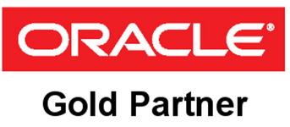
Oracle EBS R12 Technical Upgradation
Jan 2019

Slide 2
AGENDA
AGILE BUSINESS UNITS
ORACLE Services – Portfolio of Offerings
Services Value Proposition
Select list of Customers
Case Study – KEIIP
Case Study – Sify

Slide 3
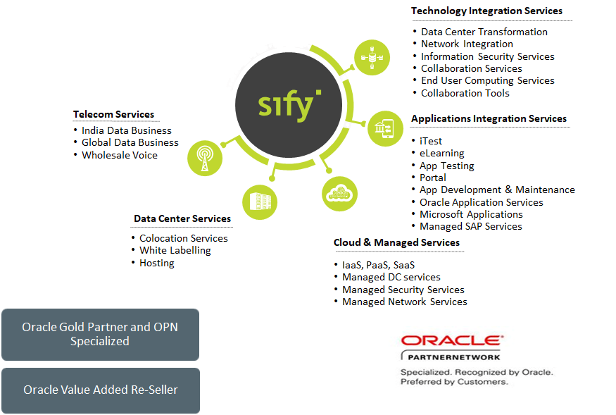
AGILE BUSINESS UNITS
Technology Integration Services
Data Center Transformation
Network Integration
Information Security Services
Collaboration Services
End User Computing Services
Telecom
Data Center Services
India Data Business
Global Data Business
Wholesale Voice
Collaboration Tools
Colocation Services
White Labelling
Hosting
Application & Platform Services
Oracle – SaaS, PaaS (HR, Database, Middleware, Cloud Machine) e- Business Suite (ERP), Technology Platforms
SAP S/4 Hana, SuccessFactors, CEC & Cloud Infrastructure Services
Microsoft – Azure, Office & Productivity, AX Retail, Dynamics CRM
iTest – Online Testing Platform
eLearning
Forum – Distribution Management System
Portal Solutions
Cloud & Managed Services
Public Cloud (IaaS, PaaS, SaaS)
Enterprise Private / Hybrid Cloud
Cloud based DR
Managed DC services
Managed Security Services
Managed Network Services

Slide 4
ORACLE Services – Portfolio of Offerings
ExadataCloud@Sify: Exadata-As-A-Service
Engineered system / Cloud Machine - At Customer Premises
Engineered system / Cloud Machine - At Sify
1
Upgrade/Migration: Oracle Applications (EBS) Upgrade
Upgrade/Migration: Technology Platform Upgrade (Database/SOA) - From earlier version to Latest Version
Upgrade/Migration: Infrastructure Upgrade - From On-Premise to Sify Cloud
Implementation Services: SaaS Implementation with Cloud Platform
Implementation Services: On-Premise Implementation - Implementing Oracle Applications with Technology Extensions
Implementation Services: Platform implementation with Cloud Platform
Infrastructure-As-A-Service
Implementation Services: SaaS Implementation with Cloud Platform
Implementation Services: Platform implementation with Cloud Platform
ORACLE
5
Migration & Implementation(M&I) Services
2
Incubation Services
Licenses
Managed Services
4
3
Oracle Applications - On Premise
Oracle Applications - Cloud Subscription
Oracle Technology - On Premise
Oracle Technology - Cloud Subscription
Oracle Application (EBS) Managed Services - On-Prem/Cloud
Oracle Platform Managed Services
Oracle Infrastructure Managed Service

Slide 5
Services Value Proposition
Only Oracle partner in the region to offer Exadata-as-a-Service
Smaller configurations (lower than Oracle’s offering)
Expertise of managing Oracle Cloud Machine Infrastructure in Sify DC
CP WholeSale
Cloud Infrastructure at Sify
Oracle SaaS
Offering &
Value
Differentiations
Cloud Infra-structure at Customer
Expertise in:
Large scale On Premise deployment of Oracle Applications – KEIIP: an ADB project
Implemented Oracle SaaS like CPQ, Sourcing, Sales Cloud internally
Oracle PaaS
Oracle’s partner-of-choice for PaaS.
Expertise in:
Upgrade/Migration Services in Database & Middleware
Development & Testing Services

Slide 6






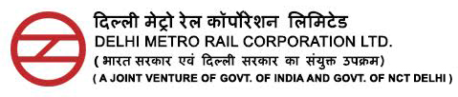





Select list of Customers

Slide 7
Case Study – KEIIP
Client
Overview
KEIIP (Kolkata Environmental Improvement Investment Program) is an entity formed by Government of Kolkata to meet the growing needs of basic amenities of people located outskirts of Kolkata like water distribution and sewage processing thru Sewage Treatment Plants. Funded by ADB, KEIIP identifies work packages (Projects) under different tranches based on ADB Loan Number.
Scope of work
Solution highlights
Upgradation of Applications from 11.5.9 to R12.2.6 (Dev/Test) and DB from 9.2.0.3 to 12c
Modules include Financials, Purchasing & Projects
About 50 CEMLI Components to be migrated and around 40 new components developed
Documenting business process
Cash management module newly implemented
Upgraded of DB 9i to 12c & Application from 11.5.9 to R12.2.6 in DEV/TEST server
Documented AS IS - TO BE process for business
Installation of GST patches
Go Live planned within 6 months
Developed custom modules Work Estimation, Insurance & Custom components
Benefits
Project Challenges Addressed
Enhanced user experience
Improvement in Project Accounting and Application performance
Improvement in Performance of Measurement books (Custom Module)
Unsupported versions of DB & Applications.
Complex business process mapping
Multilevel Approval process for PO & Invoice.
User training

Slide 8

Case Study – Sify
Client
Overview
Sify Technologies Limited is an Indian information and communication technology company providing end to end ICT solutions including telecom services, data center services, cloud & managed services, transformation integration services and application integration services. Sify Technologies Limited played an important role during the early spread of Internet and e-commerce in India.
Scope of work
Solution highlights
R12 Reimplementation of R12.2.5 from 11.5.10.2
Re-Implementation of SCM, Financials, CRM, Install base in (DEV/TEST/PRD) and GST
Modules include Financials, SCM, Projects, CRM, Quoting & Install Base, Sales Cloud
Documenting business process
Mapping business requirements in Oracle EBS additional process
Restructuring COA & High level organization restructure
Replacing third party tool with Oracle for CAPEX material movement & revamping Band width procurement with Bolton solution in oracle
GL Consolidation across geography locations.
Training materials for all streams are compiled in UPK
Complete Master data (Incl. Item, Supplier & Customer) restructured.
Benefits
Project Challenges Addressed
Enhanced user experience
Improvement in SCM, Finance & CRM performance/additional features & Custom solutions
Improvement in business process through implementing additional modules
Large no of customizations and custom solutions (15).
Large volume of Data migration
Complex business process mapping
Multilevel Approval process each business functions.
User training

Slide 9


Sify as a transformation partner
Workload migration service
Move from on-prem to Public and/or Private cloud
/ or
On–premise DCs to Sify’s world class Datacenters
Cloud assessment service
Recommend the to-be architecture and approach for a least disruptive and reliable migration
Multi cloud managed service
Multi-cloud infrastructure and applications
Managed security services
Implement consistent set of controls to prevent security threats
Continuously monitor to detect security breaches
Tactical threat containment and automated response

Slide 10

Sify’s cloud expertise extends over
All aspects of building cloud infrastructure
Managing public and hybrid cloud services
CloudInfinit CMP to provide multi cloud operational best practices
AWS/Azure/Oracle/Google cloud implementation
Delivering SaaS - ForumNXT, I-test, Safescrypt and E-learning
Investments in cloud infrastructure helping customers embrace multi-cloud platform
CloudInfinit (Enterprise multi tenant and private)
Disaster recovery on cloud model
Disaster recovery for public cloud workloads
SAP Grid
Hosted Azurestack
Exadata as a service
CloudInfint CMP
Orchestration platform
Service Now
CA UIM

Slide 11
Data Center Transformation Framework
Sify Value Proposition – Continual Service Lifecycle Improvement
Future Ready Right Fit IT Strategy
End to End Ownership for ‘0’ Defect Migration
Agile, Pay per Use Business Aligned
Zero downtime Lean Operations
Ready for Multi Cloud and Cloud Native
IT Modernization
Assessment
Workload Migration
Infrastructure
as a Service
OPS
Transformation
Security
Transformation
Discovery and Assessment
ROI Analysis
Transformation Roadmap
P2V / V2V
Migration and implementation of SAP / Oracle / Microsoft
Multi Tenant and Hosted Private with CloudInfinit / Exadata / Azure Stack / SAP Grid
AWS / Azure
Hybrid / Multi Cloud
Self Service
Managed Services Advanced Profile (Sys Admin)
Application Performance Mgmt
Security from the Cloud for workloads
Security of the Cloud for Infra
Compliance Solutions

Slide 12







Cloud Migration Services
Multi Cloud
Optimize apps
Optimize capacity, performance and configurations across multi-cloud environments
Secure apps
Identify & implement consistent security policies and micro-segmentation between VM/apps enabling a “zero trust” security posture
Migrate apps
Move workloads at scale using cold, warm or live migration across a WAN optimized layer 2 network stretch
Analyze apps
Understand the complexity of moving each app and the dependencies between tiers of the app as well as external entities
Discover apps
Identify network flow between apps, discover services, app tiers and, VMs/servers that comprise the apps
Customer Datacenter

Slide 13










EXECUTION CAPABILITIES and credentials
500+
300+
80+
Datacenter services projects executed
Datacenter Migration projects
Platform Migration Projects
Datacenter Transformation Projects
Datacenter migration Projects

