Slide 1



CAPABILITY PRESENTATION TO ITC INFOTECH
June ‘18

Slide 2

AGENDA
01
INTRODUCING SIFY
02
DATA CENTER AND CLOUD TRANSFORMATION CAPABILITIES
03
NETWORK SERVICES TRANSFORMATION CAPABILITIES
04
SECURITY SERVICE ENGAGEMENT MODELS
05
TOOLS & AUTOMATION CAPABILITIES
06
CASE STUDIES

Slide 3

Introducing sify

Slide 4
SIFY’S JOURNEY SO FAR…
Established HQ in Chennai
Listed on NASDAQ
Launch of MPLS service in India
Raju Vegesna takes over as Sify’s Chairman
Launch of SAP Private Cloud services and practice
Launch of business outcome based models
1995
1999
2001
2006
2013
2017
1998
2000
2004
2012
2016
First private ISP in India
First Tier3 Datacenter in India
Launch of RIM services, NOC, SOC services
Launch of Cloudinfinit services
VPEC hybrid cloud and CI containers offerings launched
Sify has surfed the wave of technology disruption from its inception

Slide 5
SIFY FINANCIALS
SIFY’S EVOLUTION
REVENUE & GROWTH
Cloud Transformation
Partner
Converged ICT Services
Provider
CAGR 19%
Managed DC and N/W Services Provider
Network/ Data Center
Service Provider
INR Crores
TELECOM SERVICES : IT SERVICES WALLET SHARE
PRODUCT REVENUE VS SERVICE REVENUE
In %
INR Crores
Notes:
Our financial journey in the past 5 years has been a true reflection of our stellar capabilities
We have transformed ourselves from a ‘Network/Data center provider’ to a ‘cloud transformation partner’
We have grown by 19% over the past 5 years with a Y-O-Y growth of almost 20%
The share of revenue from our DC centric IT services has grown over the years with the contribution rising from 34.3% in FY 2013-14 to almost 52% in FY 2017-18
The bulk of our revenue comes from services with the services revenue being 12-20 times of our revenue from products

Slide 6
SIFY’S INVESTMENT IN DIGITAL AGE TECHNOLOGY
TREND
INVESTMENT
Increased adoption of cloud services
Increase in number of cloud DCs from 4 to 6
Two new cloud DCs are under implementation; 100% growth in capacity by 2020
Cloud and Software Defined Network Orchestration IP developed by Sify
Outcome focussed managed services
Service catalogue based Managed Services
Outcome focussed KPI driven SLA
Increasing demand for Utility models
All services delivered as pay-per-use in the following models
Component Aligned
Usage Aligned
Business Outcome Aligned
Increasing play for service providers
Competence built up of Service Provider-led transformation in areas such as Network Integration, Hybrid Cloud & DC outsourcing
Converged services for IT & Telecom
Investment in all areas of ICT: Datacentre/Cloud, Network, IoT, Applications in service provider model built around productized services and delivered on utility models

Slide 7
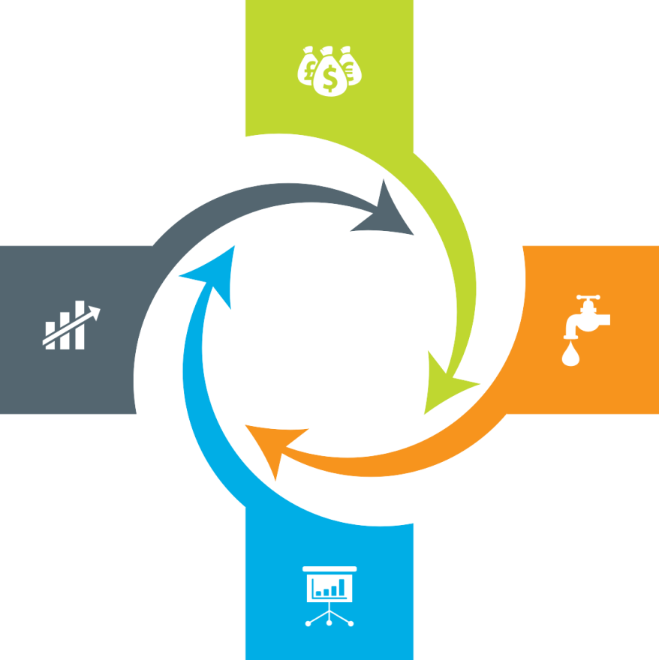
Our Engagement Models
Assets + Services Systems are owned by the client and annuity based payout for services
Outcome based Client engagement is based on defined business outcome generated by IT solutions and services
Usage based No upfront investment by client and payout is based on consumption
Component based Reduced upfront investment as client subscribes to infrastructure owned by Sify as a part of their overall infrastructure requirement

Slide 8
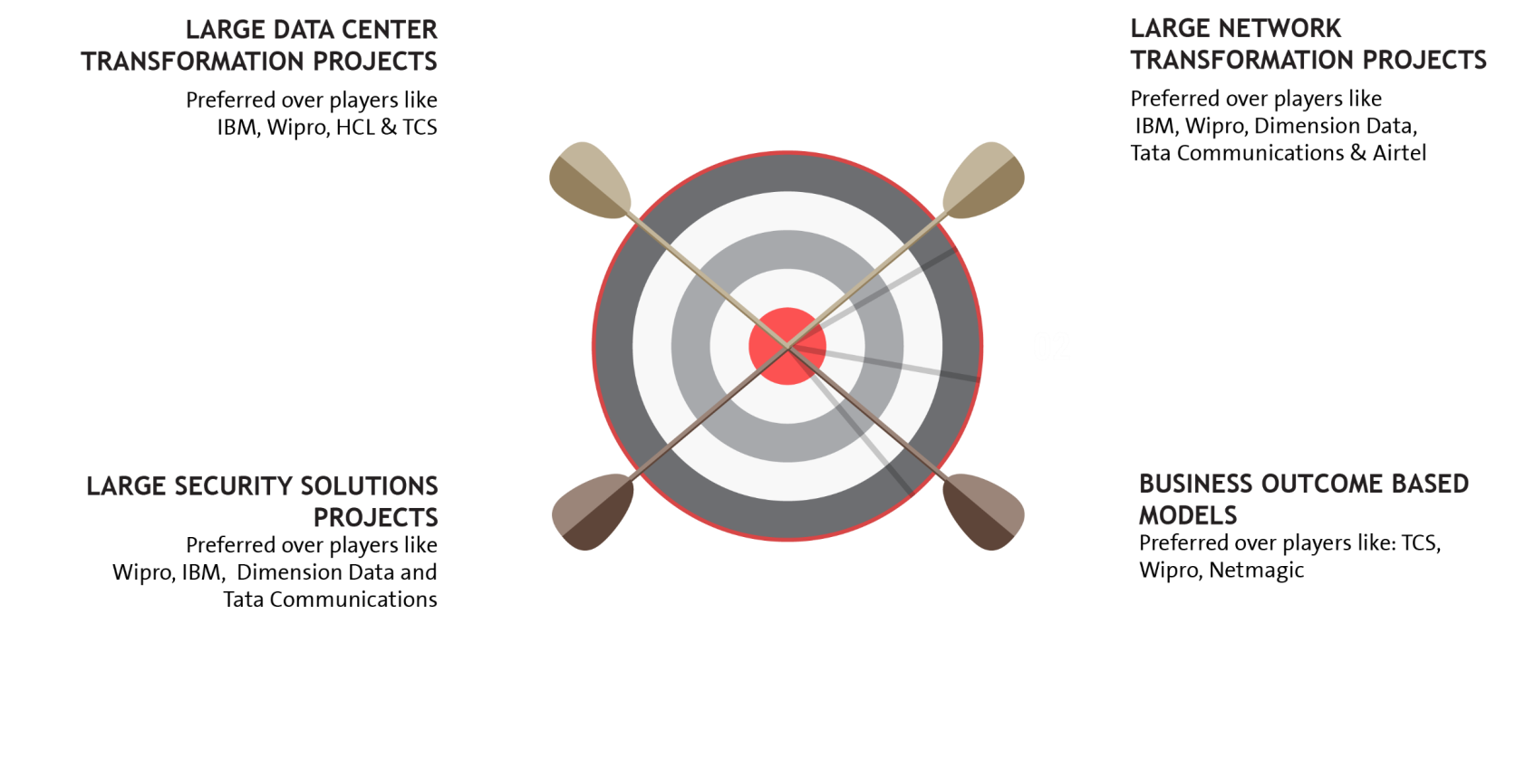

















EXECUTION CAPABILITIES

Slide 9


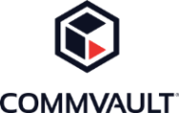









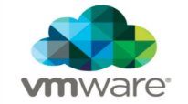














Strategic Partnerships
Technology Partners
Cloud and Acceleration Partners
Application Partners
Security Partners

Slide 10
Our People Capabilities and Strengths
550+
DATA CENTER AND MANAGED SERVICES
1800+
NETWORK SERVICES
70+
SECURITY SERVICES
225+
APPLICATION SERVICES

Slide 11
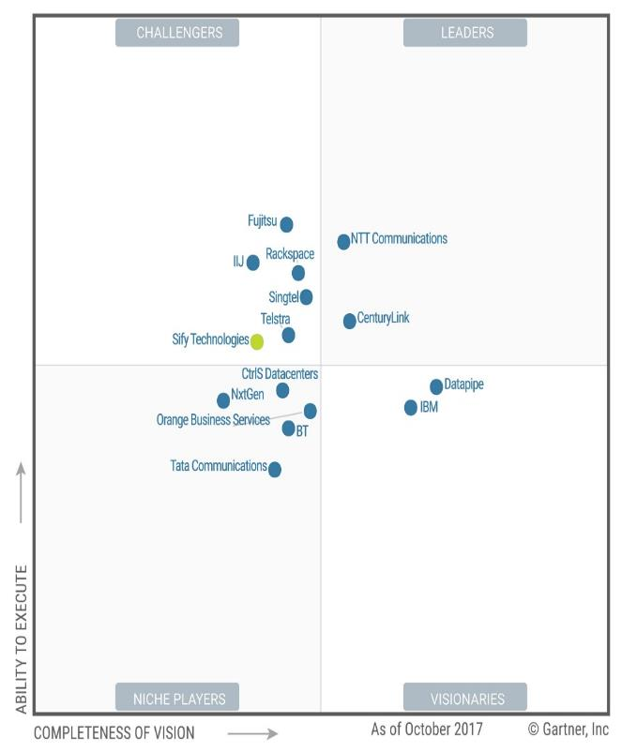
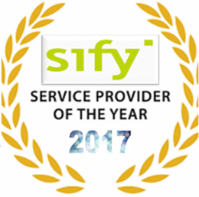
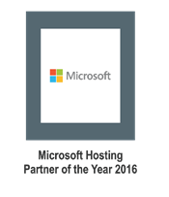
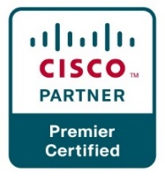
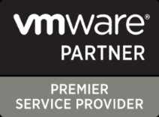

Recognitions
Partner of the year 2017
Network Transformation Services
2018
Data Center Transformation Services
2018
Sify moves up to the challenger position in the Gartner MQ for Managed Hybrid Cloud Hosting – Asia Pacific (2017)

Slide 12




cloud@core
TM
ALIGNED TO OUR CUSTOMERS’ CLOUD TRANSFORMATION PURSUIT
CLOUD ENABLING
CLOUD INSPIRED
CLOUD PURE
CLOUD ENHANCED
Cloud DC
Hyper reach/Hyper scale transport Oracle FastConnect | ExpressRoute | DirectConnect | Partner Interconnect
Software Defined Network services
Cloud build Private | Hyperconverged | Enterprise
Security services for cloud
Migration and Implementation services
Sify CloudInfinit
Enterprise Multi-Tenant
Dedicated
Hosted SAP/S4 HANA
Azure Stack as a Service
Edge Connect Services
SD-WAN
Collaboration services on Cloud
AWS
Azure
OCI
GCP
Multi Cloud Management platform & services
Modern Applications
Kubernetes-as-a-Service
AI/ML
Forum DIGITAL
HCM Digital (iTest)
Learning Management
Internet-of-Things (IOT)
Industry Solution-as-a-Service

Slide 13
DATA CENTER AND CLOUD TRANSFORMATION CAPABILITIES

Slide 14
Data Center and Cloud Services Driven Infrastructure Transformation Partner
Data center experience
Cloud experience
Over 250 man-years of experience in Data Centre build & operations
Own Cloud Orchestration & Management IP which is hosting 300+ customers
Designed and built 12 Tier III DC’s in India with 2 lakhs + sq. ft.
Implemented Hybrid Managed Cloud for 100+ organizations
Hosting major Enterprises, Govt, PSU, Global Cloud and Content Providers
MeitY certified CSP, STQC audit completed
Extensive experience in delivering end-to-end Data Centre services from design, implementation, operations
DC IT and technology integration experience
Service provider experience
Experience of providing IAAS/PAAS/DRAAS (300+ customers) on our Sify Cloudinfinit platform
In house team of 400+ skilled and certified resources to deliver projects
Our Cloud services offer industry-leading SLAs with guaranteed 99.95% uptime

Slide 15
Our Data Center Transformation Framework
TENETS
OFFERING
TENETS
OFFERING
Application as Service
Business Aligned
Pay per use model
SAP
Microsoft
Oracle
Sify Apps
Right Fit IT Strategy
Optimized IT and OPS
Future Ready
Discovery & Assessment
ROI Analysis
Transformation Roadmap
Apps
Transformation
IT
Modernization
Assessment
OFFERING
TENETS
OFFERING
Infra
P – V
V – V
Platform
Win8 – Win10
Apps
Lotus - Exchange
Agility
Autonomous
Predictive Analytics
Change the Business
Digital IT
IOT
TENETS
}
‘’0’’ Defect Migration
Seamless
End to end ownership
Cloud
Innovation
Sify’s
DCT Framework
Migration
Security
Transformation
Infrastructure
as a Service
TENETS
OFFERING
TENETS
OFFERING
Seamless
Impregnable
Audit & Compliance driven
Network
End Point
IT
Agility
Future Ready
Consumption
Private Cloud
Enterprise Cloud
AWS/Azure/ CI
Hybrid IT
Backup
DR
Acceleration
DC Security
OPS
Transformation
TENETS
OFFERING
Cloud Nerve Center
Shade and Dedicated Pool
End to end Management
Automation
Lean Operations
Cloud Ready

Slide 16
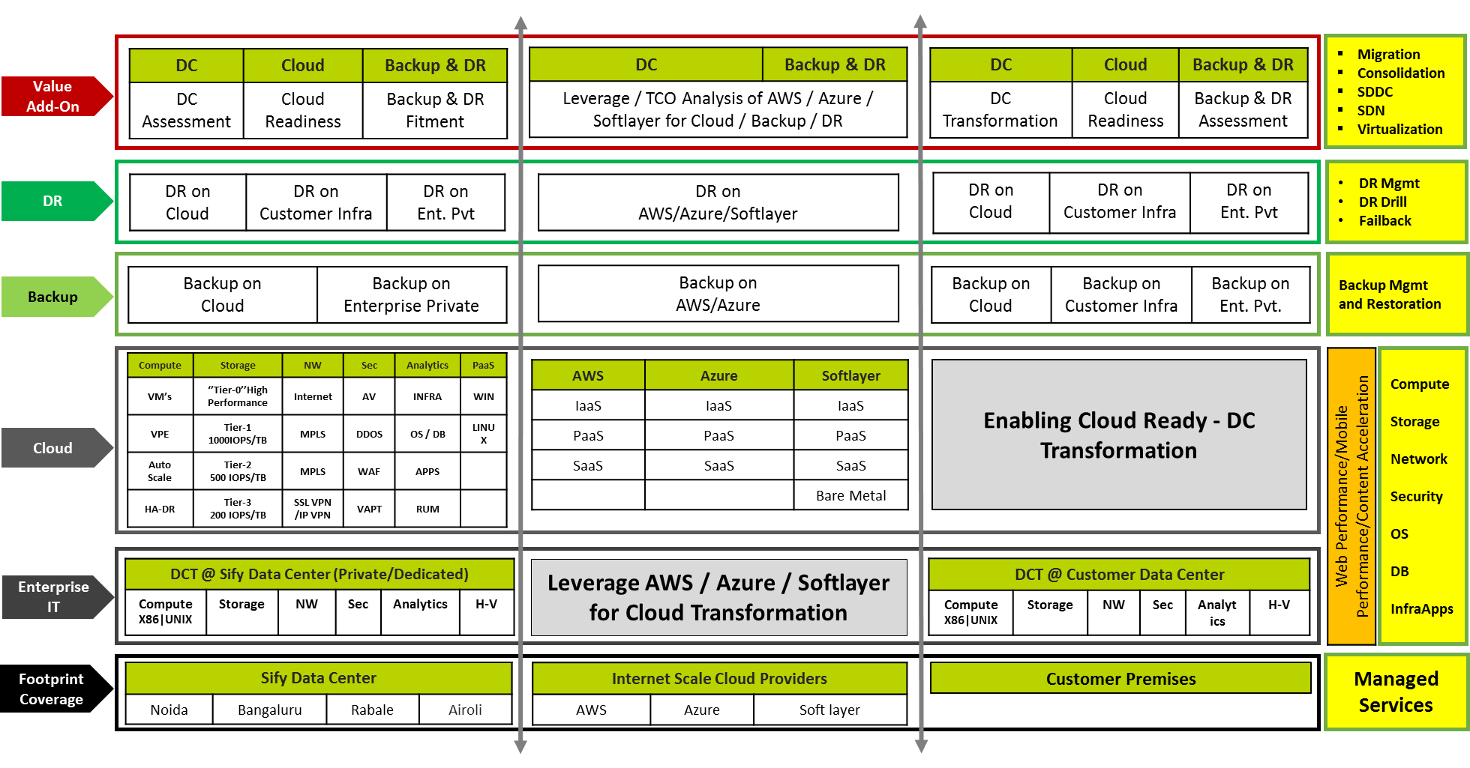
Data Center Transformation Aligned Services

Slide 17




DR SERVICES: MODELS
ON-PREMISE
SIFY CLOUD
SIFY COLOCATION
PUBLIC CLOUD (AWS/ AZURE)
DRaaS
DR Services through Sify’s Pre-validated architecture and tools to fulfil required SLAs
DR Build
DR delivery model build as per Customer environment and Business Demand
DR Consultation
Complete Assessment of environment to decide backup / DR Strategy
Managed Services
DR Support Services for Customer’s Existing/new Setup
DRaaS
Pay-As-You-Go Disaster Recovery as a Service
Protect the security and continuity of critical IT service delivery
DRaaS
Pay-As-You-Go Disaster Recovery as a Service
Protect the security and continuity of critical IT service delivery.
DR Build
DR delivery model build as per Customer environment and Business Demand
Managed Services
Regular Backup & DR Support services | Profile/policy administration
DRaaS
Pay-As-You-Go Disaster Recovery as a Service
Protect the security and continuity of critical IT service delivery.
Protect, replicate, recover & convert seamlessly
DR Build
DR delivery model build as per Customer environment and Business Demand

Slide 18
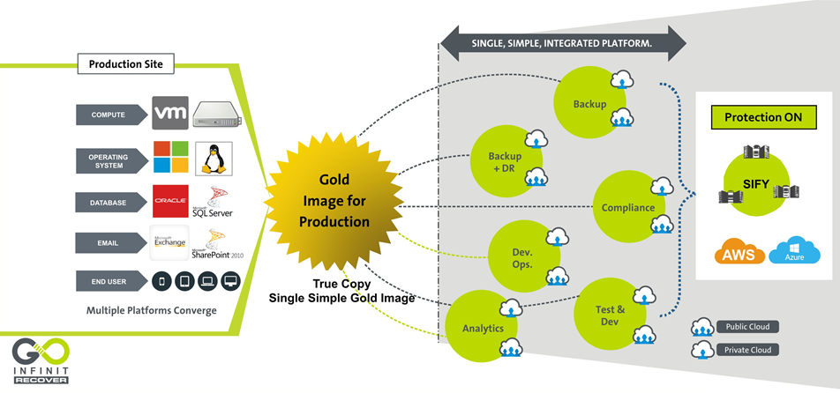
DR Services – Goinfinit Recover

Slide 19














Key customer References (DC, Telecom, Cloud, dr & managed services)

Slide 20
















Key customer References (DC, Cloud, dr & managed services)

Slide 21
Key References – Private (BFSI) (1/2)
Vertical | Reference Customers | Transition | DC/DR Hosting | DC IT Infra/ Private Cloud | DR IT Infra/DRaaS | Cloud | Managed Services
Insurance | Max Bupa | ü | ü | ü | ü | ü | ü
Financial Ins. | LIC housing finance corporation | ü | ü | ü | ü | ü | ü
Insurance | Avantha Ergo Life Insurance | ü | ü | ü | ü | ü | ü
 | Max Life | ü | ü | û | û | ü | ü
 | Tata AIG Life Insurance Company Ltd | ü | û | û | û | û | ü
 | HDFC Life | û | ü | û | û | û | ü
 | Apollo DKV Insurance | û | û | û | ü | ü | û
 | Aviva Life Insurance | û | û | û | ü | ü | û
 | Star Union Daichi Life Insurance | ü | û | û | û | û | ü
 | Health Insurance TPA | û | ü | û | û | û | û
Payment Gateway | Billdesk | û | ü | ü | ü | û | ü
 | Paytm | û | ü | û | û | û | û
 | YouFirst Money Express | û | ü | û | û | û | ü

Slide 22
Key References – Private (BFSI) (2/2)
Vertical | Reference Customers | Transition | DC/DR Hosting | DC IT Infra/ Private Cloud | DR IT Infra/DRaaS | Cloud | Managed Services
Banking | IndiaIdeas.com Ltd (BillDesk Payment Gateway) | ü | ü | û | ü | ü | û
 | The Thane District Central Co-op Bank Ltd. | ü | û | ü | ü | û | ü
 | Fedbank Financial Services Ltd. | ü | ü | û | û | ü | ü
 | Bombay Mercantile Bank | ü | ü | ü | ü | ü | ü
 | Axis Bank | ü | ü | û | ü | û | û
 | J&K Bank | ü | ü | û | û | û | û
 | Yes Bank | û | û | û | ü | û | û
 | The Hindustan Co-op Bank Ltd. | ü | ü | ü | ü | û | ü
 | Corporation Bank | û | ü | û | û | û | û
 | The Nagaland State Co-operative Bank Ltd. | û | û | ü | ü | û | ü
 | Bassein Catholic Co-operative Bank | ü | ü | ü | ü | ü | ü
 | Citizen Co-operative Bank | ü | ü | û | ü | ü | ü

Slide 23
Key References – PSU (BFSI)
Vertical | Reference Customers | Transition | DC/DR Hosting | DC IT Infra/ Private Cloud | DR IT Infra/DRaaS | Cloud | Managed Services
Insurance | Oriental Insurance Company Limited | ü | ü | ü | ü | ü | ü
 | General Insurance Corporation | ü | ü | ü | ü | û | ü
 | NIA | û | ü | ü | ü | ü | û
 | National Insurance Corporation | ü | û | ü | û | û | ü
Banking | Allahabad Bank | ü | û | ü | ü | û | ü
 | OBC | û | û | ü | ü | û | ü
 | State Bank of India | ü | û | û | ü | û | ü
 | UCO Bank | û | û | ü | ü | û | ü
 | Bank Of Baroda | û | û | ü | ü | û | ü
 | Andhra Bank | û | û | û | û | û | ü
 | Dena Bank | û | û | û | û | û | ü
 | Vijaya Bank | û | û | û | û | û | ü

Slide 24
Key References – PSU/Government
Reference Customers | Transition | DC/DR Hosting | DC IT Infra/ Private Cloud | DR IT Infra/DRaaS | Cloud | Managed Services
IOCL | û | û | ü | ü | û | ü
ONGC Tripura power corporation | û | û | ü | ü | û | ü
West Bengal state electricity development corporation | ü | û | ü | ü | û | ü
State DC (Kerala, Chhattisgarh, Tripura, Meghalaya, Sikkim, Punjab, Tamilnadu DR) | û | ü | ü | ü | ü | ü
NIC | û | ü | ü | ü | û | ü
Kanpur electricity supply company | û | û | ü | ü | û | ü
UPPCL | ü | û | û | û | ü | ü
NISCAIR | û | û | û | û | û | ü
TNDRC | û | û | ü | ü | û | ü
PSPCL | ü | û | ü | ü | ü | ü
UP High Court | ü | ü | ü | ü | ü | ü
Power grid corporation | û | ü | ü | ü | ü | ü

Slide 25
NETWORK SERVICES TRANSFORMATION CAPABILITIES

Slide 26
NETWORK SERVICES TRANSFORMATION PARTNER
Integrated NOC & SOC, 24x7x365 Operations
Managed Network and Security Service
Network Integrator
Network design, platform selection, solution interoperability, seamless migration
Visibility Tools -1200+ Man Years in Tools & Process
Outcome based services which are technology centric and OEM agnostic
Supported by Advance Toolsets - CA Spectrum, Service Now, CA e-Health
Managing multi-vendor environments, single ownership, SLA driven
Design, Analysis, Planning, Deployment, Integration & Transitioning
DoP, IDRBT, NSE, Sanmar,
Large Project Design and Rollout Experience
Investments in Digital and Cloud Network (SMAC)
Zero Latency connectivity into Cloud Service Providers Like AWS & Microsoft Azure
Capabilities of Delivering Managed Wifi & SD WAN from Sify Cloud
Cloud and Software Defined Network Orchestration IP developed by Sify

Slide 27
NETWORK SERVICES – KEY STRENGTH
Design Experience
Inhouse engineering design team of Service Provider class network (Sify + Customer Networks)
Experience of high availability and scale centric network design
Deployment integration and transition
Over 2 decades of Large Network Deployment, Integration and Transitioning experience
Some marquee Large projects like DoP, IDRBT, Muthoot, New India Assurance
Operation and maintenance
Project Management, Operations with a Field Team of 1300+ Trained Engineers on the field manning 400 POP Location
Deploy Personnel for Field & NOC Operations, Fault, Change & Vendor Management
Service provider management
360 degree engagement with all carriers (buy, deploy, manage and sell)
99.9995% uptime on backbone achieved on the network
NOC, SOC and Systems experience
Integrated NoC and SOC operations for the last 12+ years
Over 600 customers in dedicated/shared or hybrid mode of management
Visibility tools - 1200+ Man Years Experience in Tools & Process
Mature alliance and relationship with global leaders
Sify Service Provider IP Network is built on Cisco Technologies (For last 2 decades)
Many firsts Cisco technology implementation – CSR/WAAS/GETVPN/Optical 100G
Over 200+ POP routers of the same family inhouse managed by Sify
Sify Public & Private Cloud Setup on HP, Sify Storage on IBM Flash , Sify SAP ECC/HANA Platform on Cisco

Slide 28
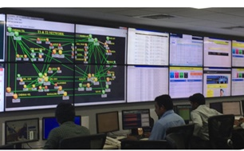
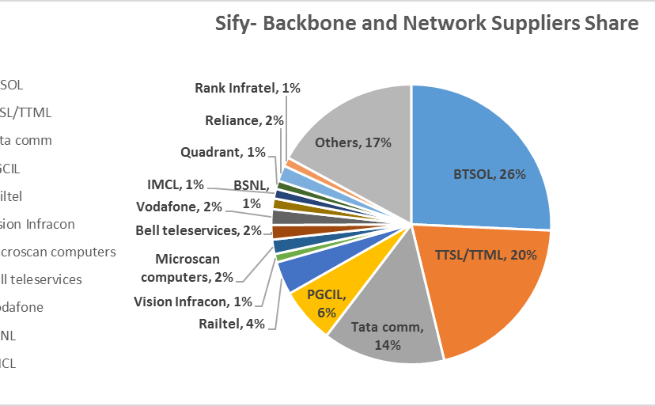
OUR NETWORK MANAGED SERVICES & OPERATIONS CAPABILITIES
Integrated NoC and SoC
24x7x365 Operations
Adherence to ITIL Framework supported by advanced toolsets
Deployment of industry standard tools
CA Spectrum, CA eHealth, ServiceNow
Detailed CRM Workflows in Oracle
Customer Portal for near-real time view and reporting dashboards
Expertise in aligning to customer-owned monitoring & ticketing tools
Expertise in API integration for infra-tools
Scale of Operations
Over 600 managed Enterprise customers
1.35 Lacs+ Enterprise connections implemented
76,000+ managed customer links
44,650+ managed CPE
Experience of managing Carrier Network Infrastructure
Service Provider Management
Engagement with over 10 NLD providers for backbone communication
Collaboration with BSNL/MTNL, Bharti, Tata Communications, Vodafone, Reliance, PowerGrid, RailTel
360 degree carrier engagement
Experience of managing multiple physical access media

Slide 29
OUR NETWORK EXPERTISE & SKILL SET
 | Total Resources | Technical skill sets | Other Training
Network engineering and solution | 47 | CCNA + CCNP + CCIE
SDN CoE | 32 | Dec Ops, Scripting, Tools, Network Management, ITIL
Central NoC | 150 | CCNA + CCNP
Service operations | 40 | CCNA + ITIL
Service operations – Field PMO and project managers | 1317 32 | PMP Prince and CCNA | Internal Training
SDM Service desk Infrastructure operations | 177 115 80 | ITIL CCNA | Internal Training Internal Training Internal Training
Deep Engineering Expertise
Deep Cisco expertise-CCNA, CCIE
Integrated SDN CoE
Advanced L2/L3 Engg
L1 teams trained in FLT on diverse media
Experience in deployment of Hybrid Management models
Project Management
PMI framework-based Project governance
Dedicated Project team for planning & Control
Integrated tools to track, monitor and report on the project
Dedicated Project Execution team and logistic teams
Extensive Field Teams
1300+ trained engineers on field, covering over 400 manned locations
Project teams that deliver customer centric projects
Business Relationship Management
Extensive Quarterly Business & Service Reviews
Proactive solution & service enhancement recommendations
Proactive Network cost optimization

Slide 30
SIFY’S MANAGED SERVICES – DIGITAL DISTRIBUTION ARCHITECTURE
NETWORK MANAGEMENT
SERVICE MANAGEMENT
MEMBERS MANAGEMENT
Network Uptime
Link Uptime
End-to-End Latency
Response & Resolution Times
Change Management
Capacity & Utilization
Call Attendance Rate
Filed Support
Service Request Completion
SLAs
24*7*365 monitoring of Network Infrastructure.
Incident, Problem and Change Management.
Software version and updates
Spares and service support
Inventory management
Network configuration and change.
Capacity and Availability management
Tools for Network monitoring and performance management.
Tools for tickets, support and reports
Change, Incident and Problem records.
Uptime/SLA and capacity reports.
Provide monitoring feeds and reports to exchange.
Periodic and on-demand reports on network health and ticket resolutions.
Setup a round the clock helpdesk
Commissioning/Migration/Decommissioning
Configuration guidelines for Members
Field management for hands and feet support
Liaison with service providers
Service provider Governance.
SCOPE

Slide 31
WAN Transformation with Sify Managed SDWAN
Deliver Customer Value, Not Just Cost Efficiency
Unify Managed services
Key enabler for Digital transformation
AGILE & FLEXIBLE
APPLICATION CENTRIC
PERFORMANCE AWARE
SOFTWARE BASED
Carrier agnostic Overlay architecture.
Multi-transport support.
Centralized control & Monitoring.
Unique topologies per segment.
Encryption, segmentation and service chains
Cloud off-ramping
Application aware routing.
Application based policies.
Application visibility & recognition.
Real-time enforcement of App SLA.
Centralized policy control.
Continuous quality assessment.& path liveliness
Consolidates multi provider WAN as a single fabric.
Faster convergence of application traffic.
Bandwidth augmentation with Active/Active utilization.
TCP optimization
Software platforms enabling physical or virtual CPE.
Zero touch provisioning.
Centralized configuration.
Agility for operations with analytics.
Interoperable with legacy.

Slide 32
Sify Managed SDWAN: Value Propositions
1
Connectivity-centric to App centric
2
Cloud Enablement
3
Difficult to simplified operations
Discover, understand needs and manage performance
Facilitate & manage performance
Automation, programmability, consolidation and agility
4
Inflexible to Flexible
5
Visibility & Analytics
6
Security
Hybrid WAN, Topologies, Physical/Virtual, convergence
Behaviours, Trends and feedback loops
Cloud perimeter branch and user security.
Managed services to drive efficiencies, lead engagements through insights and
value beyond cost economics.

Slide 33
Sify Managed SD WAN Components
BRANCH INFRA
CENTRALIZED CLOUD INFRA
SD-WAN CPE
Data plane component
Deployed in each site to terminate WAN links – internet and MPLS
Available as hardware appliance model or in VM form factor
Standalone or HA deployment (Active-Standby)
Various bandwidth subscription models
CONTROLLER
Control plane component
Deployed in DC/DR
High availability mode
Complete discovery of WAN
CPE devices
WAN links
Enables discovery of other spoke sites and prefix exchange
Facilitates in IPSEC key exchange and establishment
DIRECTOR
Management plane component
Deployed in DC/DR
High availability mode
Initial on-boarding of CPE
Configuration of WAN
Link configuration
IPSEC configuration
Dynamic and performance routing
App aware routing
Northbound API
ANALYTICS
Management plane component
Deployed in DC/DR
High availability mode
Gathers visibility and reporting data of WAN
CPE health and link monitoring
Application fingerprinting
Granular reporting – per site, per app, per user, user to app to WAN mapping
NOC SERVICES

Slide 34

Typical Enterprise SD-WAN TopologY
Geo-redundant Control components in HA
Director
Analytics
Director
Analytics
Controller
Controller
Cloud hosted – AWS, Azure, GCP
Google
Youtube
SD-WAN CPE
Social media
File sharing
SD-WAN CPE
Internet apps
Internet
SD-WAN CPE
SD-WAN CPE
O365
Skype for
business
DC
SD-WAN CPE
Salesforce
Oracle
SD-WAN CPE
3rd party
MPLS
Webex
SD-WAN CPE
SD-WAN CPE
Cloud based business apps
DR
SAP
CRM
SD-WAN CPE
Sify MPLS
SD-WAN CPE
ERP
SD-WAN CPE
SD-WAN CPE
On-premise Business apps
Regional offices/Branches
Multi-provider transport network
HO/DC/DR/Cloud
Application eco-system

Slide 35
Sify Managed SD-WAN FeatureS
Transport independence
MPLS
Internet
3G/LTE
DSL
Any to any IPSEC VPN
Native IPSEC VPN support
Any to any IPSEC VPN between sites
Automatic rekeying
PSK and PKI support
Real time performance monitoring
Synthetic and inline measurement
Uni-directional and bi-directional
Latency, loss, jitter and MOS
Identify performance issues on end to end WAN paths
App visibility & app aware routing
App and sub-app discovery
Custom app fingerprinting
Application performance based path selection
Effective WAN load balancing
Across multiple WAN types
Active-Active
Active-Standby
Per flow and per packet
WAN optimization
FEC
Packet striping
Packet replication
TCP optimization
App optimization – in roadmaps
Management
Zero touch provisioning
2FA
Template based configuration – similar sites, feature wise
Visibility
CPE health – CPU, RAM, IO
Availability report – Site and link
Link statistics
End to end path performance
App and sub-app performance
Per link, per site, per app analysis
Security
Stateful firewall
Web filtering
IPS/IDS
Anti-virus
Segmentation and multi-VRF
Subscription tier licensing and Cloud support
Bandwidth and Feature based
Pay as you grow model
Public cloud presence – Azure, AWS
Centralized controller
Cloud based
Geo-redundant HA mode
IPSEC and Routing control plane
Configuration, monitoring and analytics
Multi-tenancy
CPE
White labelled device
x86 based appliance
Virtual appliance – ESXi and KVM
Universal CPE

Slide 36
Sify Managed SD-WAN Security Features
URL
SSL
Stateful firewall
URL filtering
SSL inspection
Anti-virus
IDS/IPS
L3 and L4 based stateful firewall
Zone based firewall
Application level gateway
Local lookup – faster processing
Master central repository lookup
Category, reputation, whitelist/blacklist, User-ID based integration
Actions – deny, allow, inspect, bandwidth control, time of day, HTTP redirect to captive portal
Security package updates – refresh local URL DB
Inspect various attributes of SSL certificates and enforces security policy
SSL inspection policy
Expired SSL certificates
Untrusted issuers
Restrict cert extensions
Unsupported ciphers/key lengths/versions
Action
Drop, allow, reject client, reject server
Blocks unwanted apps
Prevent malware and exploits into the network
Signature, heuristics
Signature based file type – FTP, HTTP, SMTP, POP3, IMAP
Blocks known and unknown network and application vulnerability
Protocol anomaly, protocol decoder, heuristics based, malformed packets, Fragmentation attacks, signature based, custom vulnerability signatures
Integrated DoS mitigation
DoS profiles – Syn, ICMP and UDP floo

Slide 37
Sify Managed SD-WAN: Subscription TierS
P
Bronze
Silver
Gold
Diamond
Platinum
ZTP
VRRP
OSPF – LAN
MP-BGP – Controller
Routing policies
VRF
QoS/HQoS
Bronze+
IPSEC transport
Any to any IPSEC
Stateful firewall
Silver+
Performance measurement – synthetic and inline
App visibility
App aware routing
FEC, Packet striping & cloning
Gold+
CGNAT DoS protection
URL filtering
SSL inspection
Diamond+
IDS/IPS
Anti-virus
SSL decryption

Slide 38
Network References & Transformation Capabilities
Customer | Network Design | Network Build/Integration | Network Managed Services | Bandwidth Service Provider | Network Security | Network consolidation transformation | SDN | Managed Wifi
Department of Post | ü | ü | ü | ü | û | ü | û | û
IDRBT | ü | ü | ü | ü | ü | ü | û | û
National Stock Exchange | ü | ü | ü | ü | û | ü | ü | û
New India Assurance | ü | ü | ü | ü | û | ü | û | û
Oriental Insurance Company | û | û | ü | ü | û | û | û | û
Syndicate Bank | û | û | ü | ü | û | û | û | û
United Commercial Bank | û | û | ü | ü | û | û | û | û
United Bank of India | û | û | ü | ü | û | ü | û | ü
Oriental Bank of Commerce | û | û | ü | ü | û | û | û | ü
Muthoot Fincorp | ü | ü | ü | ü | û | ü | û | û
City Union Bank | û | û | û | ü | û | û | û | û
Indian Overseas Bank | û | û | ü | ü | û | û | û | û

Slide 39
SECURITY SERVICE ENGAGEMENT MODELS

Slide 40
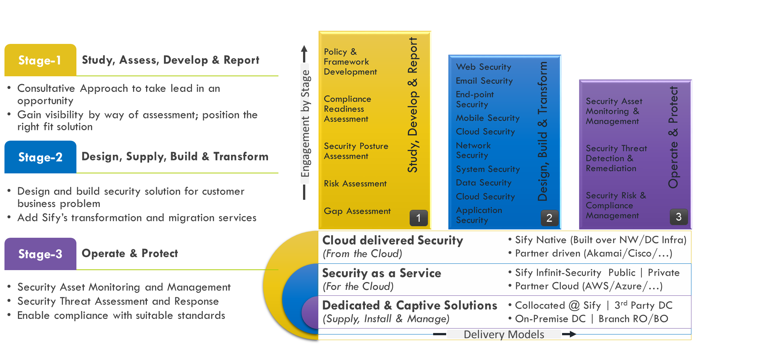
Our Security Services Engagement Models

Slide 41
Sify DDoS Capabilities

Slide 42
Security Services Execution Proof Points
Reference Customers | Information Security Consulting | Security Transformation | Professional Services | Security Operations | Incident Response | Solution Landscape
Syndicate Bank | ✓ | ✓ | ✓ | ✓ | ✓ | SIEM, PIM, DLP,VA PT, Network Forensics,
UBI | ✓ | ✓ | ✓ | ✓ | ✓ | AV, DLP,Web Security, PIM, MDM, AD, APT, DDOS, WAF
DHFL | ✓ | ✓ | ✓ | ✗ | ✗ | SIEM,WAF,DAM,PIM,DLP
CBI | ✓ | ✓ | ✓ | ✓ | ✓ | SIEM
PSB | ✓ | ✓ | ✓ | ✓ | ✓ | SIEM, PIM, WAF, APT
PNB | ✓ | ✓ | ✓ | ✓ | ✗ | DLP, PIM, Config Management
BOI | ✓ | ✓ | ✓ | ✗ | ✗ | Threat Protection
Max Bupa | ✓ | ✓ | ✓ | ✓ | ✓ | SOC, APT, Firewall, DRM
ONGC | ✓ | ✓ | ✓ | ✗ | ✗ | Web Security, Firewalls
IOCL | ✓ | ✓ | ✓ | ✗ | ✗ | Firewall, Web Security, SLB
NTPC | ✓ | ✓ | ✓ | ✗ | ✗ | SIEM, NIPS, PIM,

Slide 43
TOOLS & AUTOMATION CAPABILITIES

Slide 44
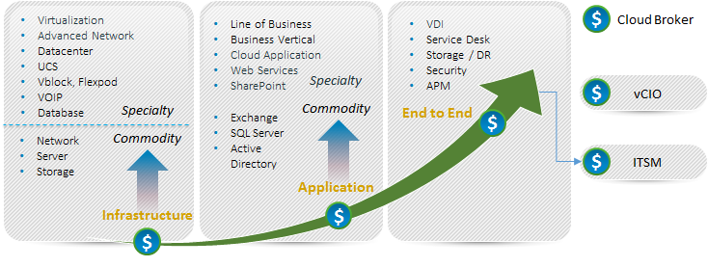
Our Tools and Automation Capabilities
Application Monitoring
SERVER MONITORING
CLOUD MONITORING
SAP
Microsoft Exchange
IBM WebSphere
Apache Tomcat
Microsoft IIS
JBoss
SharePoint
Sybase EAServer
Lotus Notes
MS Lync
MS Active Directory
Oracle WebLogic
Microsoft Windows Server
Linux/Unix
Solaris, AIX, HP-UX, Linux, Sinix, Tru64 UNIX, Red Hat
Cisco Unified Computing System (UCS)
IBM Power Systems
Novell Open Enterprise Server
Private
Flexpod, Vblock
Public
Amazon, Rackspace, MS Azure, Google App Engine, Google Apps, SFDC CRM
Citrix CloudPlatform
vCloud
Cloud Monitor (Websites)
Virtualization Monitoring
NETWORK MONITORING
Database Monitoring
VMware
Citrix XenServer
Microsoft Hyper-V
Oracle Solaris Zones
IBM PowerVM
Red Hat Enterprise Virtualization
Router and Switch
Network Response Time
Cisco Qo5
Cisco IP SLA
Flow Analysis
Oracle DB
Microsoft SQL Server
Informix
IBM DB2
MySQL
Sybase
Service desk as service
Big Data & CUSTOM APPS
Storage Monitoring
VoIP / VDI monitoring
Provide Service Desk in Multitenant Model
Hadoop, Cassandra, Mongo DB
Customizable packages for open source applications or in house applications
EMC
IBM System Storage
NetApp
Cisco VoIP
Citrix XenDesktop / XenApp
Hitachi
44

Slide 45





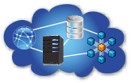
Our Tools and Automation Capabilities
UNIFIED MONITORING OF PUBLIC AND PRIVATE IT ENVIRONMENTS
FEATURES
Dashboards and Reporting
WHAT CAN WE MONITOR
Multitenancy
Dashboard & Reports
Distributed Architecture
Unified Trending
Visual Alarms & Reporting
Email Alerting
3rd Party Integration (Service Now for ITSM )
Agent and Agent less Monitoring
UMP (Portal ) available via Mobile
Application Monitoring
Server Monitoring
Cloud Monitoring
Virtualization Monitoring
Database Monitoring
Storage Monitoring.
Data Center Monitoring
Main Frame Monitoring
Response Time Monitoring
Big Data Monitoring
Basic Network Monitoring
Service Levels
End User Response Time
Performance and Availability
Events and Faults
Power
Efficiency
Network
LAN & WAN
Server
Physical & Virtual
Database
IT & Business
Application
Commercial & Custom
Cloud
Public & Private
45

Slide 46
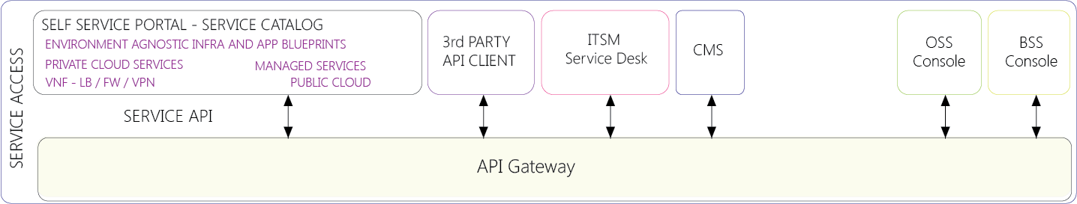
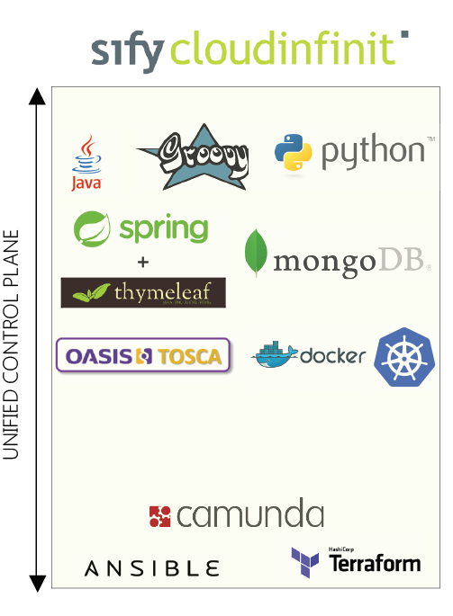

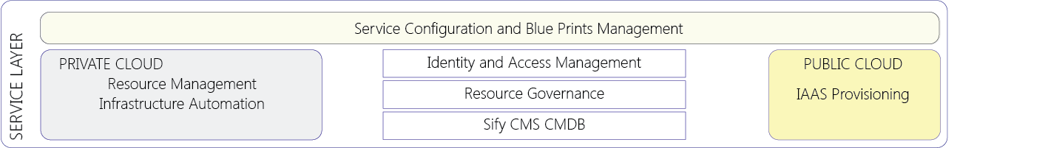
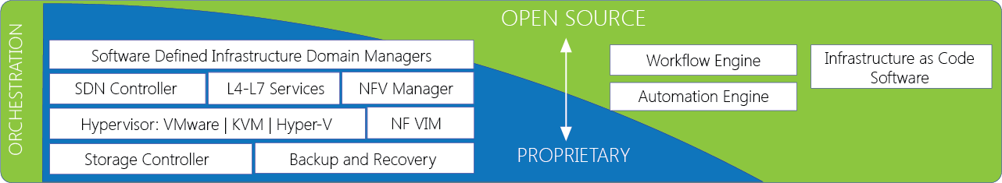
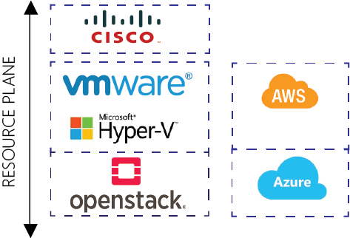
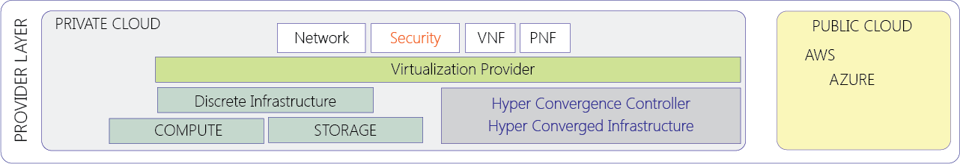
Our Tools and Automation Capabilities
46

Slide 47

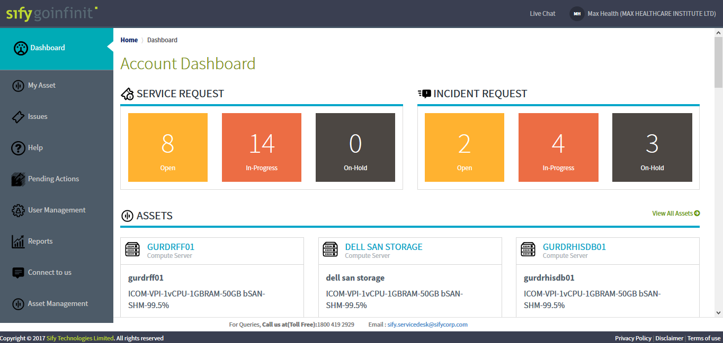
Our Tools and Automation Capabilities

Slide 48
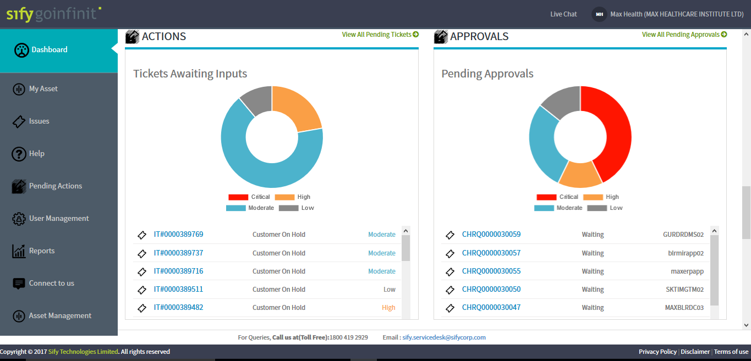
Our Tools and Automation Capabilities

Slide 49
CASE STUDIES

Slide 50
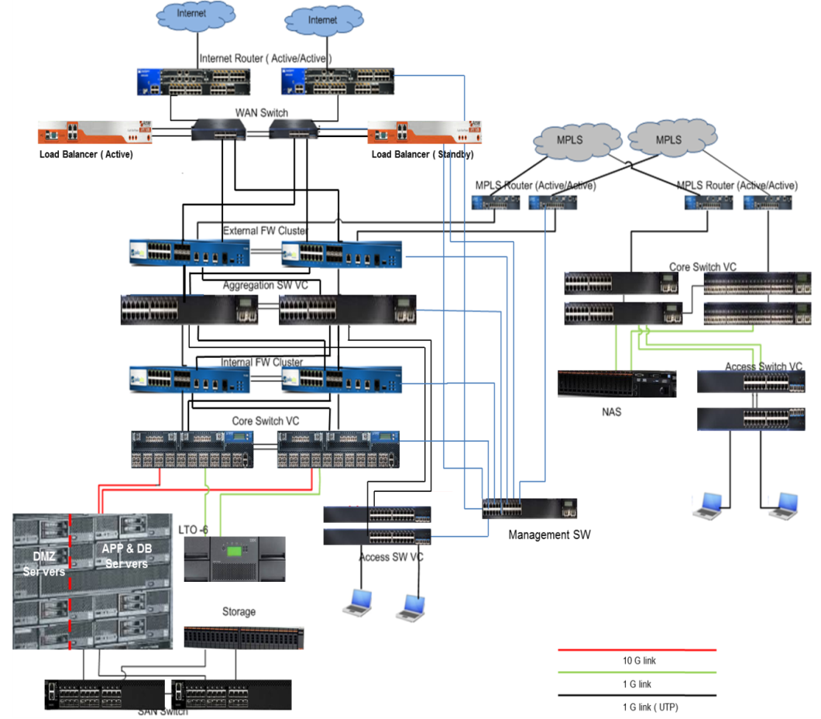
Case Study: ONGC Tripura power company ltd.
Requirement: Data Center and IT Infrastructure at Delhi and Palatana Plant for ERP implementation and other IT infrastructure requirements, monitoring & management, support for 5 years
Solution
Smart Rack Solution with integrated power, cooling and BMS, Safety and Security system
IT infrastructure for SAP ERP implementation, and other supporting applications, Highly scalable blade servers virtualized with KVM hypervisor
Centralized storage and Backup solution
Network and security infrastructure routers, switches, perimeter and internal firewalls, Load Balancers, DLP, reverse proxy and mail gateway solution
MPLS and Internet connectivity
CA EMS suite including, APM, UIM Server & Network, SDM, Spectrum, Client Automation

Slide 51
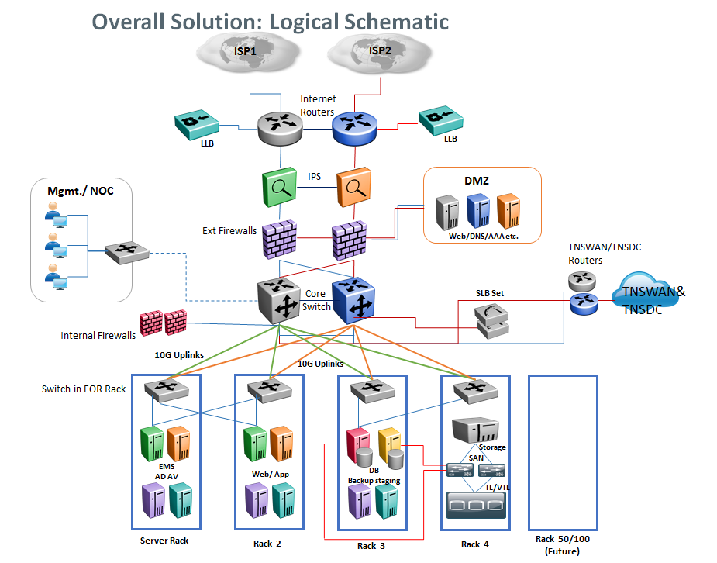
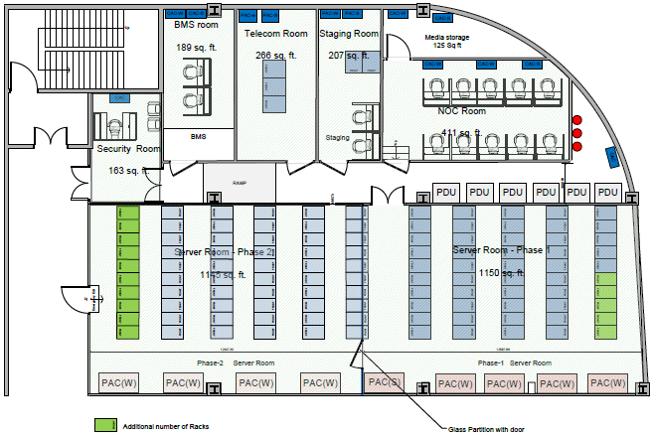
Case Study: tamilnadu state disaster recovery center
Requirement: Disaster Recovery Center to offer DR as a Service for the applications deployed in State Data Centre. Scope includes site preparation, complete IT and NON IT infra. Solution for 50 racks scalable to 100 racks and FMS, Monitoring & management for 5 years
Solution
Data Center as per Tier III guidelines , SFA Phase I- 1150 Sq.Ft, Phase II-1145 Sq.Ft.
Highly available and scalable IT infrastructure
3 way storage replication-DR, existing DC and NDR sites
External virtualization for existing storage
DRM tool sets and GSLB for automated DR and drills
CA EMS suite for monitoring, performance and fault management, SLA and helpdesk management
Internet and MPLS connectivity
WAN optimization solution
Data center Security with perimeter & internal firewalls, NIPS, SIEM and access management tools

Slide 52
CASE STUDY – State Data Centers
State Data Center is envisioned as the ‘Shared, reliable and secure infrastructure services center for hosting and managing the e-Governance Applications of State and its constituent departments’. SDC is envisaged to establish a robust infrastructure to enable the Government to deliver the services quickly and effectively to its stakeholders
Drivers for the Opportunity
Consolidation of services, applications and infrastructure
Online Delivery of Services, Citizen Information/ Services Portal
Central data repository
Secure Data Storage
Solution
Reliable and Secure New generation latest hardware
Scalable & Highly available design
Centralized Management tools
Data Center as per TIA 942 guidelines
N+N level redundancy for power distribution
Operation & Management for 5 Years
Technology stack implemented for SDCs
Components | Kerala State SDC | Sikkim State SDC | Tripura State SDC | Meghalaya State SDC | Chhattisgarh State SDC | Punjab State Data Center
FMS Team Size | 34 | 21 | 21 | 21 | 33 | 20
Server HW | IBM | IBM | HP | IBM | IBM | HP
Storage | IBM | IBM | HP | IBM | NetApp | HP
Tape Lib | NetVault | IBM | HP | IBM | IBM | HP
Router | 3Com | HP | Cisco | Cisco | HP | HP
Switches | 3Com | 3Com | Cisco | Cisco | HP | HP
Firewall | Fortigate | Fortigate | Fortigate | Cisco | Fortigate | Checkpoint
Load Balancer | Radware | Radware | Cisco | Cisco | Cisco | Array
EMS | CA | CA | CA | Tivoli | Tivoli | CA
BMS | Honeywell | Honeywell | Honeywell | Honeywell | Honeywell | Honeywell
Helpdesk | CA | CA | CA | IBM-TSR | IBM-TSR | CA

