Slide 1

SIFY’S DIGITAL TRANSFORMATION CAPABILITIES
MAY 2021

Slide 2
Understanding of Business and Digital transformation journey
1400
Employees
10800 Cr.
Revenue
Respiratory Dermatology Oncology
17 Manufacturing Unit Globally
Digital Transformation
Data Driven Organization
SAP, Supply Chain, Big Data
Centralized Data Lake – For Advance Analytics
AI Solution– Improve Pro-Active Incidents & Analysis
Blockchain – For Authenticity & Quality of Drugs
TECHNOLOGY VISION
Cloud
Moving Apps to Cloud
Security - Scale with Business growth
Compliance - to operate & manage
Regulatory Requirement
Pharma Covigilance, Track and trace, Product Serialisation
Business Vision
R&D to Innovate and develop new medical needs, affordable medication across and
compliance to stringent audits of regulatory bodies

Slide 3
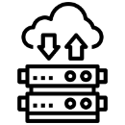


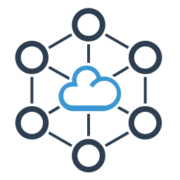
Sify engagement
SAP, Exchange, Covigilance, Track & Trace, Product Serialisation, clinical development apps & other pharma apps
Web based Apps, Open Text documentation, sales & distribution, mobility, procurement, etc.
DC hosted On Premise
& Partial DR at TCL
Using TCL Links & Citrix SDWAN to connect with multiple locations

Slide 4






We believe everything that can be migrated to cloud must be migrated
For the rest, we have cloud adjacent datacenters to configure the most efficient hybrid multi cloud
Enabling your hosted applications work seamlessly with cloud applications as if they are in the same datacenter
With a 10G+ speed connection to the hyperscale cloud at less than 100 microseconds latency
Sify owns the entire assessment, migration, security and managed services from any current state to any desired cloud configuration

Slide 5




cloud@core
TM
ALIGNED TO OUR CUSTOMERS’ CLOUD TRANSFORMATION PURSUIT
CLOUD ENABLING
CLOUD INSPIRED
CLOUD PURE
CLOUD ENHANCED
Cloud Data Centres
For Enterprises and Hyperscale CSPs
Private Cloud at DC
Hyperconverged | Enterprise
Hyper reach/Hyperscale NW
Hyper Reach/Hyperscale transport
Data Center Interconnect
SD-WAN
Migration Services
Migration and Implementation services
IaaS at Cloud DCs
CloudInfinit
Enterprise Multi-Tenant
Dedicated
Hosted SAP/S4 HANA
Azure Stack as a Service
Edge infra aligned to Cloud
Edge Connect Services
Hyperscale Platforms adjacent to Cloud DCs
AWS
Azure
OCI
GCP
Multi-cloud Management platform & services
Digital Services
App Modernization
Kubernetes-as-a-Service
Digital Apps (SaaS)
Forum DIGITAL
HCM Digital (iTest)
Learning Management
Internet-of-Things (IOT)
Industry Solution-as-a-Service

Slide 6


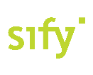



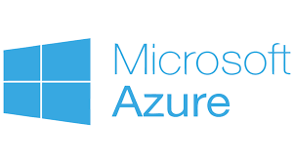
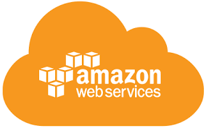
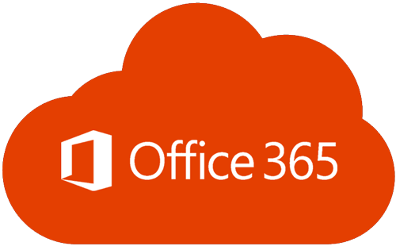
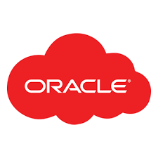


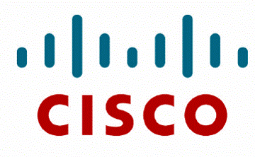

Enabling Hybrid Cloud solution
Integrating Solutions to Deliver Best Outcome
On-Premises environment
Public Clouds and SaaS
Multi-cloud Orchestration, Management, Metering and Service Desk
Application Performance, Monitoring and
Hybrid DR Automation
Campus
Branch
Security Controls, Governance Risk & Compliance
SDI, Hyper Converged Infrastructure,
Storage & Data Protection
Managed
Private Cloud
(Colo/Customer)
Edge
Software Defined Network
HYBRID CLOUD

Slide 7



















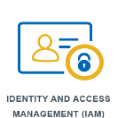








Sify engineered security services (Cloud/DC)
Security Services Stack
for Sify DC & Cloud
Security Services Stack
for any cloud
Sify GoInfinit
Cloud
VPI | VPE | Private
Public &
On-premise Cloud
AWS | Azure | VMware
Cloud native
Security services
VPDC FW
Services
Web App
Firewall
Network
IPS
VPN GW
Cloud DDOS
Protection
PIM
Log Mgmt.
SIEM
Cloud CDN
WAF
Micro-segmentation
NBA
Security Asset
Management
Key Mgmt
Services
Deception
MFA
CASB

Slide 8














Technology Integration Services
SOC Services and Managed Detection & Response
Network Security
Enterprise Apps & Data Security
Identity and access management
Cloud Security & Compliance
DC Build IT/ NON-IT
Managed Wireless
Hyperconverged Solution
Security
Software Defined Access
Application Data Management
Build, deploy and operate client IT infrastructure, Bundle with
Sify’s Telecom and Datacenter offerings
SD-WAN &
NAC Solution
Application Centric / SDN Datacenter
Data Centre
Smart Edge & WAN
TECHNOLOGY INTEGERATION SERVICES
Private, Hybrid Cloud Solutions
Collaboration
Solution

Slide 9









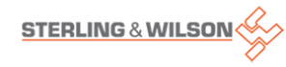







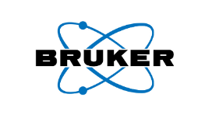
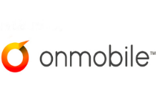
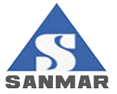

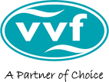




Snapshot of sify’s sap offerings
Cloud Migrations & Carve Outs
SAP Application Management
Upgrades & Conversions to HANA
Implementation & Roll-out Services
and many more …

Slide 10

MANAGED Services PORTFOLIO
Data Center-Centric Services
End User centric services
20 years of experience in DC and Cloud management
15 years of experience in securing enterprise IT
Experience in running enterprise Apps and SaaS
Digital Experience Management using Global Platforms
CLOUD & DATACENTER CENTRIC SERVICES
Cloud assessment & migration
DC (Colocation / White Labelling)
CloudInfinit multicloud CMP
CloudInfinit enterprise Cloud
Hosted SAP Cloud/ Azure Stack/ Oracle Exadata as a service
Multicloud managed services
Oracle, AWS, Azure Cloud services
MANAGED SECURITY SERVICES
Implement consistent set of controls to prevent security threats
Continuously monitor to detect security breaches
Tactical threat containment and automated response
APPLICATION & PLATFORM SERVICES
Design and implementation of SaaS (ForumNXT, SFFNxt, iTest, LMS)
Implementation of enterprise apps (S4HANA, O365, Dynamics CRM)
Application migration: on-prem to Cloud
App modernisation
Big data and Analytics
END USER SERVICES
Digital Experience Management Platform
Operational Data Analysis & Insights
AIOps enabled Service Desk (including application L0 support)
Desktop as a Service
Workplace as a Service
DC ASSESSMENT, SERVER FARM OPTIMISATION, CLOUD STRATEGY,LICENSE OPTIMISATION (HARDWARE & SOFTWARE), APPLICATION AUDIT
Notes:
Sify offers a plethora of managed services around infrastructure management, spread across Data Center centric services and end user centric services. Intrinsically, the former involves managed services around cloud and DC centric services, security services and application & platform services.
In terms of Cloud and DC centric services, these involve DC and Cloud assessment and migration services, colocation services, multi cloud managed services around Sify’s enterprise cloud and partner public clouds.
In terms of managed security services, it involves proactive threat management and detecting security breaches.
In terms of managed application and platform services, it involves SaaS/enterprise apps implementation and cloud migration, app modernization and data analytics.
In terms of end user services, it involves Digital Experience Management, deriving data intelligence and delivering desktop and workplace as a service.
Other services include comprehensive DC assessment, Server Farm optimization , Enterprise cloud strategy management, hardware and software license optimization and application audit services.

Slide 11
Sify Cloud enhanced services
Value-Chain Transformation
Intelligent Applications
DevOps
Conversational AI
DIGITAL SERVICES
RPA & Cognitive Automation
AI (Facial Recognition /
Text Extraction)
Analytics
Machine Learning

Slide 12
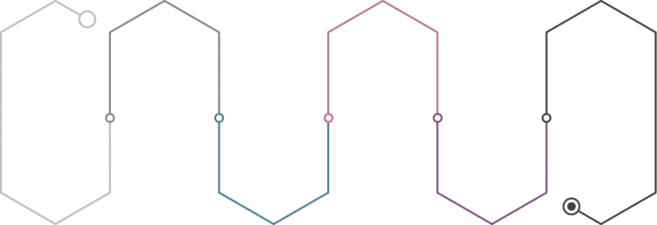
Sify Value Chain Platform - A truly All Ops Coverage
DevOps
ComplianceOps
AIOps
Tool Chain Setup
Continuous Integration
Continuous Deployment
Compliance Automation
Cost/Workload Optimization
Incident Prediction / Remediation
DevOps Prediction
Environment Provisioning
Application Provisioning
Security Assessment
Security Testing
Track Atomic Progress
Measure KPIs
CloudOps
SecOps
GovernanceOps

Slide 13
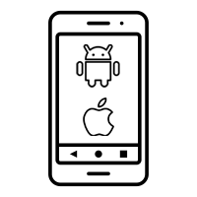



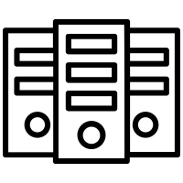

Modern Applications | Sify’s Center of Excellence
Hybrid Mobile Apps
Native iOS Mobile Apps
Native Android Mobile Apps
Interactive 3D, VR, AR & MR Apps
Server Side Applications
AI, ML & Deep Learning
Computer Vision Natural Language Processing & Chat Bots
Html5 | jQuery | Cordova | Onsen UI | AngularJS | Ionic | NativeScript | React Native
Objective-C | Swift
Java
Unity 3D | 3ds Max | Three.js
Node JS | PHP | Angular
TensorFlow | OpenCV | Tesseract | AWS Recognition | AWS Lex

Slide 14
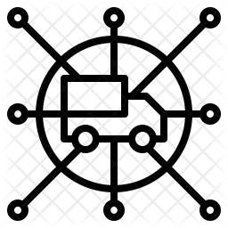


ForumNxt Portfolio
Distributor Konnect
Value Added Services
Mobility
Corporate Portal
Dealer Portal
Corporate Salesman
Dealer Salesman
Merchandising Application
Perfect Store-Image Recognition
AI/ML Chatbots
Gamification and Loyalty Programs
eRetail – Retailer Enablement Program
Intelligent Merchandising – Marketing Productivity
Notes:
(3 Minutes) - Features
This brings us to the offering's portfolio of ForumDIGITAL, which is categorized into 4 components.
The first bucket, Dealer Konnect, consists of the web portals, to be used by the corporate and the distributor users. Corporate users on their portal can perform various activities, around planning, execution, tracking, governance and control of the activities and tasks performed by the distributor portal.
Distributor portal on the other hand, is more about the transactions, where it can be used to create purchase orders, sales invoices, credit & debit notes etc. Distributor portal also gets to monitor and plan the movements of its salesman, which brings us to the next bucket, Mobility.
This bucket consists of 3 mobile application, aimed at corporate salesman, distributor salesman and merchandiser. With the reins controlled by the corporate and the distributor portal. Corporate salesman and merchandising application are tagged to the corporate portal, where a corporate salesman must perform various activities on behalf of the company, like collections from the distributors, creating purchase order for the distributor and so on. Where as, merchandising application helps the merchandiser to perform his tasks in the market, like ensuring planogram compliance, share of shelf, display equipment's condition check and so on.
Distributor salesman mobile application on the other hand is tagged to the distributor portal, which enables the salesman to service the market on behalf of the distributor. Collections, taking sales order from the retailers, stock entry are some of the tasks that this application helps him to do.
We then have Analytics, which consists of data visualization reports in form of interactive BI dashboards to provide a holistic view of the company’s performance.
And then the Value-added services, which speaks about the advanced digital offerings in the portfolio, that complements the core product and provide extra value in multitudes. We have Image recognition, to define a perfect store and process the defined metrics every time an image is clicked to have a standard measurement of various parameters required in a retail store to complement our merchandising application
AI/ML Chatbots: AI enabled chatbots, where a user can ask questions from the chatbot to get a data backed answer. These chatbots can help the salesman in the market, or the distributors in performing their tasks on the distributor portal. These chatbots can have several use cases and can be very versatile in helping the users.
Gamification and Loyalty Programs: Gamification brings the sales team on one platform and gamify their jobs, which leads to a more productive working environment, where the motivation of the field force is fueled by positive reinforcement. A company can employ various use cases in employing gamification for their field force; dashboards, challenges for the quarter or month, points earned etc. to name a few. Loyalty Programs, is a process designed for logical allocation and redemption of the loyalty points to various stakeholders in the supply chain. These programs have just one objective, that is to encourage the usage of this application, so that the corporate can have an accurate picture of the performance.
eRetail, is our retailer application to bring the retailer into the technology ecosystem, this application allows the retailer to place the orders directly to the distributors, which makes it easier for the companies to manage the remotely located retailers, whom the distributors are not able to service frequently. Apart from ordering, there are many other features in this application, like feedback, view of active schemes, notifications etc.
And, Intelligent Merchandising, is to to optimize the communication to the consumers by the brands, this offering covers Digital asset management and intelligent campaign management to efficiently manage the ad campaigns and the content thus ensuring marketing productivity.

Slide 15
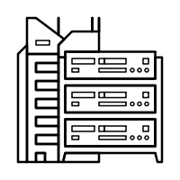



DR SERVICES: MODELS
ON-PREMISE
SIFY CLOUD
SIFY COLOCATION
PUBLIC CLOUD (AWS/ AZURE)
DRaaS
DR Services through Sify’s Pre- validated architecture and tools to fulfil required SLAs
DR Build
DR delivery model build as per Customer environment and Business Demand
DR Consultation
Complete Assessment of environment to decide backup / DR Strategy
Managed Services
DR Support Services for Customer’s Existing/new Setup
DRaaS
Pay-As-You-Go Disaster Recovery as a Service
Protect the security and continuity of critical IT service delivery
DRaaS
Pay-As-You-Go Disaster Recovery as a Service
Protect the security and continuity of critical IT service delivery.
DR Build
DR delivery model build as per Customer environment and Business Demand
Managed Services
Regular Backup & DR Support services | Profile/policy administration
DRaaS
Pay-As-You-Go Disaster Recovery as a Service
Protect the security and continuity of critical IT service delivery.
Protect, replicate, recover & convert seamlessly
DR Build
DR delivery model build as per Customer environment and Business Demand

Slide 16
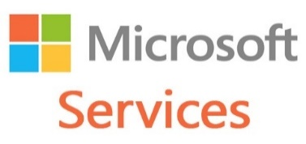
CLOUD Services PORTFOLIO for Microsoft services
Azure IaaS – Compute, Storage, ASR
Azure PaaS – SQL, Media, IoT Hub
Azure Dev Test
Networking
Workload Assessment
Migration/ App Upgradation
Azure Stack Marketplace
Azure Cloud Services
Azure Stack Private Cloud
Migration/ Deployment/ Administration/ Upgrade
Hybrid Exchange set & management
Integration with CRM, Power BI, Kaizala etc.
O 365 / D365
Express Route Integration
Hybrid Cloud Integration across on prem, Sify Cloud, Public Cloud
Journey to Cloud
Productivity Tools
Hybrid Cloud
Managed &
Administration
Services
DB Consolidation and Upgrade
BI Analytics/ AI/ ML platform integration with applications
IoT Hub integration with AI/ML and Managed Services
Data and AI
Azure Managed Services – Patch Management, Dev Op / Dev Test environment Creation and Management
Application Creation / SQL on Azure

Slide 17
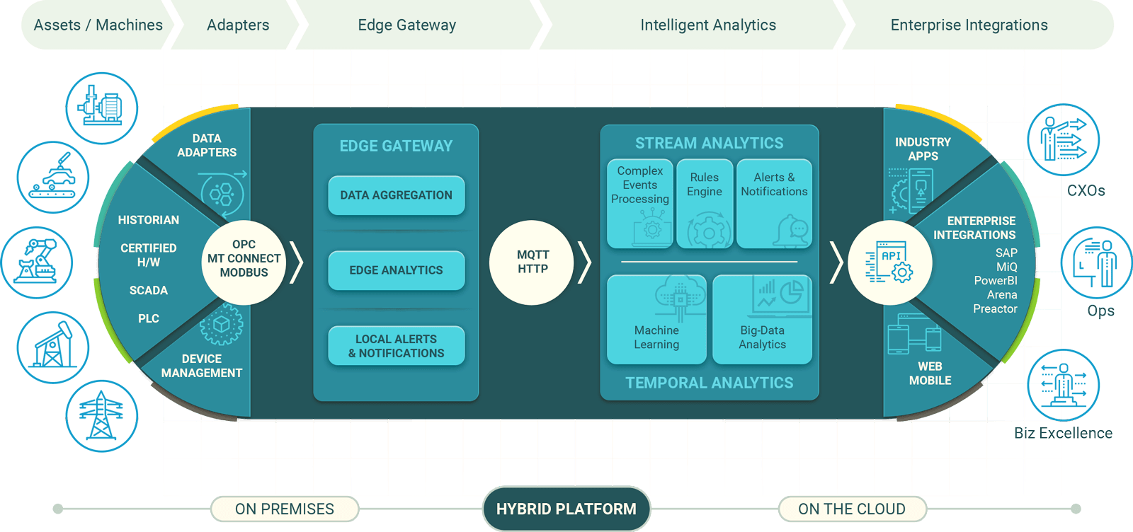
IOT communication architecture
Edge Infra
Cloud Infra

Slide 18







Sun Pharma: DIGITAL TRANSFORMATION FOR Pharmaceuticals
PHARMACEUTICALS
Project Objective
Implement a resilient, secure and future-ready infrastructure during uncertain times while ensuring minimal disruption
Integrated Value and Outcome
Completed UAT and Production Setup migration to Sify DCs with minimum disruption within 20 days only - one of the fastest complex workload migrations
Physical lift and shift + migration to 2 sites in a span of 3 days.
Provision for a “Parallel Setup” before migration to ensure near-zero downtime
Additionally, owned IT service assessment, management and governance
Significant improvement in infrastructure availability and application performance
Value for Client
The Cloud-ready IT Infrastructure ensured them business agility, resilience and security. The huge savings over next 5 years could now be used for strategic plans such as Pharma R&D etc.
Value for Sify
Penetration into Pharmaceutical vertical with new prospects. A great reference for DC co-location and door opener for hybrid cloud journey.
Project Model
Co-location Opex model
Competition
CtrlS, Nxtra (Airtel), NextGen
DC Migration Led
Sify’s Uniqueness Experience with similar IT setups, Cloud adjacent DC, Migration services
Contract Duration
5 years

Slide 19
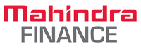

MAHINDRA FINANCE: DIGITAL TRANSFORMATION FOR NBFC
Nonbanking financial
Project Objective
Implement integrated future ready digital infrastructure on Hybrid cloud architecture for hosting core application and virtualizing landscape on a scalable Cloud Infrastructure with end-to-end Migration.
Integrated Value and Outcome cloud@core products and services:
All VMware applications to be migrated to sifycloudinfinit
All non-VMware apps to move to new Private Cloud (VMware).
Old Solaris Server in DC with interconnect to Private Cloud.
Google cloud connect at near 0 latency with cloud adjacency.
High BW hyperscale networks for data replications
Hybrid security framework for both hosted & cloud footprint.
Hybrid cloud management platform for management of the Hosted Private and AWS Cloud footprint.
Value for Client
Zero defect & minimum down time during migration, TCO optimization via billing based on pay as you go model, Single point of ownership for all infra consolidations, single SLA covering the infra and network. DR as a service. Oracle instance migration to OCI over Fast Connect.
Value for Sify
Complete ownership for Infra and Network which has given wide scope for offering managed services, DR-as a service on SIFY CI. Hyper connect to OCI can be leveraged for core ORACLE app.
Project Model
Private Cloud IT Build model along with Sify Enterprise Multi-Tenant Cloud for Cloud Bursting.
Competition
CtrlS, NexGen, Netmagic, Tech Mahindra, Wipro & TCS
HYBRID CLOUD LED
Sify’s Uniqueness The proposed Data Centre at Mumbai has a latency of less than 250 microseconds from AWS & Oracle Cloud; and less than 1 millisecond from TCS’s SaaS cloud located at CtrlS Navi Mumbai DC. Hybrid and Multi Cloud set up at the least latency, lowest connectivity cost and the best performance between the environments in multiple DC & Cloud. The same Data Centre hosts Sify’s multi-flavoured Cloud Infinit platforms ( Public, Private, Virtual Private) from where our customers can subscribe to IaaS/PaaS.
Contract Duration
5 years – large annuity revenue stream
Contract Value
US $3.6+ Million

Slide 20

MAX HEALTH: DIGITAL TRANSFORMATION OF HEALTHCARE
HEALTH CARE
Project Objective
Deployment of Max Healthcare application on Sify Cloud Platform to achieve digital initiative goals & increased revenue.
Integrated Value and Outcome
cloud@core products and services:
Started with hosted virtualization and managed services several years ago in first generation initiatives.
Migrated to sifycloudinfinit with cloud@core in second generation initiatives with minimal disruption
DRaaS from cloud@core is configured to mitigate the risk from unplanned disaster to prevent impacting the business
Hyper reach network connectivity for all hospitals with the enterprise cloud
Hybrid security and Managed Services for all applications
Value for Client
Max Health could provide better patient care and create new streams of revenue. As a one stop IT infrastructure partner Sify helped rationalize costs and release funds for modernization.
Value for Sify
Moving up the value chain from hosted virtualization to enterprise multi-tenant, this has reinforced our vision to significantly enhance the quality of revenue by upselling cloud and managed services to colocation and small footprint managed services customers.
Project Model
Fully services model(vis-à-vis existing capex + services model)
Competition
DELL, HP, IBM
HYBRID CLOUD LED
Sify’s Uniqueness Integrated value proposition built on: Private Cloud + Network Services + Disaster Recovery Services + Managed Services
Contract Duration
5 years – large annuity revenue stream
Contract Value
US $2.2+ Million

Slide 21



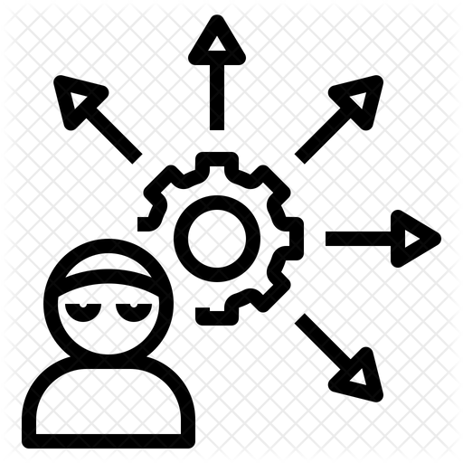
CASELETS: CLOUDINFINIT
“Infrastructure Modernization @ Leading FMCG ”
Requirement
Delivered
Outcome
Infrastructure requirement for running new & existing workloads
CIO’s take on environment,
Modern Infra required for running the current workloads to meet performance & availability needs
Infra setup required for launching new applications
High availability setup to ensure availability and protection against any interruptions
Infra Refresh – Technology Obscelence a challenge
Assess - Assess the environment & build the plan for running new & older workloads
Phase-I :
Assess and Advise to Modernize and Transform
IT infrastructure
Create a Plan to modernize the infra for running existing workloads
Create a Plan to deploy Infrastructure for new applications
Phase-II :
Migrate the applications to the new Modern infrastructure
Build a geographically redundant DR Site to ensure highest availability
Test the applications for performance &
availability
Build DC & DR for new applications
Modernize and transform the complete Infra / Network / Security
Ensure the performance, availability efficiency, and usability of existing applications & new applications are met
Ensure IT Continuity through a Geographically redundant DR Site
Enable IT to meet the SLA’s required by
Business
Achieve Technology Obscelence
Over USD 30K annual savings on DC+DR TCO
Notes:
(3 Minutes) - Features
This brings us to the offering's portfolio of ForumDIGITAL, which is categorized into 4 components.
The first bucket, Dealer Konnect, consists of the web portals, to be used by the corporate and the distributor users. Corporate users on their portal can perform various activities, around planning, execution, tracking, governance and control of the activities and tasks performed by the distributor portal.
Distributor portal on the other hand, is more about the transactions, where it can be used to create purchase orders, sales invoices, credit & debit notes etc. Distributor portal also gets to monitor and plan the movements of its salesman, which brings us to the next bucket, Mobility.
This bucket consists of 3 mobile application, aimed at corporate salesman, distributor salesman and merchandiser. With the reins controlled by the corporate and the distributor portal. Corporate salesman and merchandising application are tagged to the corporate portal, where a corporate salesman must perform various activities on behalf of the company, like collections from the distributors, creating purchase order for the distributor and so on. Where as, merchandising application helps the merchandiser to perform his tasks in the market, like ensuring planogram compliance, share of shelf, display equipment's condition check and so on.
Distributor salesman mobile application on the other hand is tagged to the distributor portal, which enables the salesman to service the market on behalf of the distributor. Collections, taking sales order from the retailers, stock entry are some of the tasks that this application helps him to do.
We then have Analytics, which consists of data visualization reports in form of interactive BI dashboards to provide a holistic view of the company’s performance.
And then the Value-added services, which speaks about the advanced digital offerings in the portfolio, that complements the core product and provide extra value in multitudes. We have Image recognition, to define a perfect store and process the defined metrics every time an image is clicked to have a standard measurement of various parameters required in a retail store to complement our merchandising application
AI/ML Chatbots: AI enabled chatbots, where a user can ask questions from the chatbot to get a data backed answer. These chatbots can help the salesman in the market, or the distributors in performing their tasks on the distributor portal. These chatbots can have several use cases and can be very versatile in helping the users.
Gamification and Loyalty Programs: Gamification brings the sales team on one platform and gamify their jobs, which leads to a more productive working environment, where the motivation of the field force is fueled by positive reinforcement. A company can employ various use cases in employing gamification for their field force; dashboards, challenges for the quarter or month, points earned etc. to name a few. Loyalty Programs, is a process designed for logical allocation and redemption of the loyalty points to various stakeholders in the supply chain. These programs have just one objective, that is to encourage the usage of this application, so that the corporate can have an accurate picture of the performance.
eRetail, is our retailer application to bring the retailer into the technology ecosystem, this application allows the retailer to place the orders directly to the distributors, which makes it easier for the companies to manage the remotely located retailers, whom the distributors are not able to service frequently. Apart from ordering, there are many other features in this application, like feedback, view of active schemes, notifications etc.
And, Intelligent Merchandising, is to to optimize the communication to the consumers by the brands, this offering covers Digital asset management and intelligent campaign management to efficiently manage the ad campaigns and the content thus ensuring marketing productivity.

