Slide 1


SIFY CAPABILITY PRESENTATION - HEALTHCARE

Slide 2

AGENDA
01
Key industry drivers in Healthcare
02
Cloud adoption and Sify relevance in Healthcare
03
Introducing Sify & Cloud @ Core
04
Sify engagement models/key strengths
05
Sify customer references

Slide 3

KEY INDUSTRY DRIVERS IN HEALTHCARE

Slide 4

HEALTHCARE OVERVIEW
The healthcare industry is expected to grow to Rs. 24 trillion by 2022.
5 sub verticals driven by 6 success factors
1
Hospitals
Better Customer Experience
Tele-medicine and home healthcare are the fastest growing segments in healthcare
2
Tele-medicine
Better Operational Efficiency
Regulatory
Compliance
Healthcare companies make money by collecting more in payments by patients and insurance companies than their operating costs.
3
Diagnostic
Success
Factors
Healthcare consists of hospitals, pharmaceutical companies, Diagnostics centers, Medical equipment/supplies manufacturers and tele-medicine providers.
Medical Equipment & Supplies
4
Better Data Management
Technological Development
Digital transformation is a priority in healthcare providers. Healthcare providers are subject to various technical and physical compliances
Pharmaceutical
5
CAPEX/OPEX Reduction

Slide 5
Future of healthcare
Trend | Present scenario | Emerging technology adoption leading to a changed scenario
Telemedicine Remote patient care and access | Expensive equipment connect single patients to a specialist Moderate growth and adoption | Integrated care networks connecting patients to a wide range of providers Reduced cost of VC expanding the scale, scope and reach Increased convenience
M-Health Healthcare on mobile devices | Delayed access to care providers Long waiting time for basic diagnosis | On the spot basic analytics improving quality Real time information availability to decision makers Personalized patient care & remote monitoring
Information systems | Delayed response to the customer Inaccurate / outdated data | Efficient processes/workflows Unique patient identification
Training & Development | Classroom training Limited reach, availability | e-learning, virtual classrooms improving accessibility to medical trainees Increased reach Hands on training through simulation

Slide 6
RELEVANCE OF ICT FOR YOUR DIGITAL JOURNEY
CLOUD
The foundation of your digital transformation journey
Emerging Tech
ICT Enabler
Trend
Connectivity, UCaaS, Collaboration
Connectivity, Cloud infra & Apps, UCaaS
E-learning, AR/VR, Video collaboration
AI, AR/VR, Mobile
Cloud infra & Apps, Security, SaaS Application
Connectivity, Cloud infra Apps
Cloud computing, Big Data/ Analytics
Training & Development
Telemedicine
Mobile Application, Analytics, AI/ML
Information systems
M-Health

Slide 7
Cloud adoption & sify relevance in healthcare

Slide 8
Cloud for HEALTHCARE industry
Challenges
Cloud Solution
Biggest Challenges in Healthcare Sector –
Quality patient care
Timely & accurate service delivery
Virtual Infra on Pay-per-use Model for Hospitals, Pharmaceutical companies, Diagnostics, Medical Equipment Companies
Leverage cloud ecosystem partner's platform to deliver integrated healthcare experience facilitating Faster time to innovate
Drive omni-channel touch-points and mobility to make healthcare information seamless and secure using hybrid clouds
Redirect investment for strategic initiatives instead of Infrastructure
Flexibility of cloud-based operating model lets hospitals experience shorter development cycles for new digital services like remote patient monitoring, diagnosis and care
Leverage productivity applications such, as email and CRM on cloud, for cost benefits
Ability to monitor and enforce compliance with Indian healthcare regulations for security, patient data confidentiality

Slide 9










USE CASE 1: data storage
Application Context
The electronic storage of medical records data in hospitals and clinics
Facilitate the use of analytics to understand trends (medical, economic, demographic, etc.) in healthcare
Remote patient monitoring, diagnosis and care
Benefits
Easy and fast retrieval of medical information by medical personnel and patients
Access to data for continuous monitoring of a patient’s history, diagnostic reports, and current health condition
Flexible Cloud based models lead to shorter development cycles
Success Factors
Better Customer Experience
Regulatory Compliance
Technological Development
Better Data Management
Better Operational Efficiency

Slide 10










USE CASE 2: connected ecosystem
Application Context
Mobile first experience for patient management, outcome based payment and point of care decision support
Connectivity of medical devices and personal devices on a network with role based policy and security architecture
Automatic update of vital parameters from patient to EHR
Benefits
Seamless customer experience and access to real-time data
Improved patient care by having access to information from all the clinicians involved in the patient’s care
Ensures that the right aid is available at the right time for the patient
Success Factors
Better Customer Experience
Technological Development
Better Data Management

Slide 11
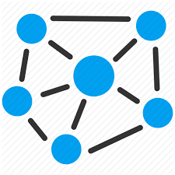





USE CASE 3: remote communication
Application Context
Establish effective face-to-face communications including data sharing between hospitals and remote Doctors/ Heath care Specialists
Remote training and tele-medicine
Benefits
Video Collaboration will change the overall Patient Care by having access to rich information anytime, anywhere across diverse geographies
Convenient and flexible option for dispersed groups to
connect and share rich information thereby improving
patient care
Success Factors
Regulatory Compliance
Technological Development
Better Data Management

Slide 12



USE CASE 4: Training
Application Context
Establish effective face-to-face communications including data sharing between hospitals and remote Doctors/ Heath care Specialists
Remote training and tele-medicine
Benefits
Video Collaboration will change the overall Patient Care by having access to rich information anytime, anywhere across diverse geographies
Convenient and flexible option for dispersed groups to
connect and share rich information thereby improving
patient care
Success Factors
Regulatory Compliance
Technological Development
Better Data Management

Slide 13
Sify overall relevance
Solution | Healthcare Functions | Sify Services
Cloud services | High performance driven diagnostics to provide quality patient care Compliance driven dedicated IT Platform Integrated Healthcare services | Sify GoInfinit Cloud+ AWS- GoInfinit AWS+ Azure – GoInfinit Azure+ CDN – GoInfinit Accelerate Security – GoInfinit Secure Sify Global Cloud Connect
Data Center Transformation: hybrid cloud, policy-based governance | Modernize healthcare infrastructure and applications to enable programmable infrastructure, omnichannel experience, self service, automation, security and compliance on the go | Sify Private Cloud – GoInfint Container GoInfinit Cloud AWS/Azure Sify Tier III Data Centers Sify Global Cloud Connect Sify Managed Services
Data Center Colocation | Reduce IT hosting costs and enable digital transformation | Colocation and colocation managed services
Data Protection | Compliance with IRDA guidelines on customer data, disaster recovery | Goinfinit Backup, Goinfinit Recover

Slide 14
Sify overall relevance Contd.
Solution | Healthcare Functions | Sify Services | Sify Customers as Reference
Application services(Industry Standard Applications) | CRM, analytics & Machine learning for better patient engagement Develop repository and offer secure access IT Infrastructure Management | Exadata-As-A-Service, Oracle I Iaas/Paas, Oracle advanced security, Oracle DB vault & firewall, Azure stack, Office 365 Suite & EMS, Azure AD, Power BI, IDaaS, DB Management System
Application services (Sify Applications) | Elearning (LMS), Medical training Aid in Supply Chain Management | ITest, ForumNxt, E-Learning, Talent Management, Portal & app development
Telecom & Data Networks | Enablement of virtual branches, Inter-Site Connectivity Information sharing Remote collaboration with doctors and specialists | Data Center Interconnect, Global Cloud Connect, Azure ExpressRoute, AWS Direct Connect, Managed WiFi, Internet of Things, Managed Network, Sify VC Services | Abbott Healthcare, Apollo Hospital, Max Healthcare, Basavatarakam Indo American Cancer Hosp
Security Consulting & Managed Services | Compliance with IRDA guidelines on IT security, Protection against data breaches, hacks and leakages | Security Consulting services, network security services, managed security services | Sri Krishna Pharmaceuticals, Abbott Healthcare, Max Healthcare

Slide 15
INTRODUCING SIFY & cloud@core

Slide 16
SIFY SOLUTION
TECHNOLOGY INTEGRATION SERVICES
Data Center IT
Network Integration
Information Security Services
Collaboration Services
End User Computing Services
TELECOM SERVICES
India Data Business
Global Data Business
Cloud Connect & Managed DWDM
Enterprise VoIP
Managed Network Services
APPLICATIONS SERVICES
iTest – Online Testing Platform
eLearning
Forum – Distribution Management System
Portal Solutions
DC, CLOUD & MANAGED SERVICES
Colocation/White labelling
Data center Transformation
Public Cloud (IaaS/PaaS)
Enterprise private and hybrid cloud
Cloud based DR
DC Managed Services
Managed Security Services
PLATFORM SERVICES
SAP / S4 Hana, Success Factors and hosted cloud infrastructure
Microsoft – Azure, Office & Productivity, Dynamics CRM
Oracle – SaaS, PaaS (HR, Database, Middleware, Cloud Machine)

Slide 17




cloud@core
TM
ALIGNED TO OUR CUSTOMERS’ CLOUD TRANSFORMATION PURSUIT
CLOUD ENABLING
CLOUD INSPIRED
CLOUD PURE
CLOUD ENHANCED
Cloud DC
Hyper reach/Hyper scale transport Oracle FastConnect | ExpressRoute | DirectConnect | Partner Interconnect
Software Defined Network services
Cloud build Private | Hyperconverged | Enterprise
Security services for cloud
Migration and Implementation services
Sify CloudInfinit
Enterprise Multi-Tenant
Dedicated
Hosted SAP/S4 HANA
Azure Stack as a Service
Edge Connect Services
SD-WAN
Collaboration services on Cloud
AWS
Azure
OCI
GCP
Multi Cloud Management platform & services
Modern Applications
Kubernetes-as-a-Service
AI/ML
Forum DIGITAL
HCM Digital (iTest)
Learning Management
Internet-of-Things (IOT)
Industry Solution-as-a-Service

Slide 18







CLOUD@CORE: AGILITY, FLEXIBILITY & CHOICES
Commitment beyond Infra: Platform & SaaS
Investment and IP Commitments
CLOUD@CORE
Commitment beyond Cloud: Network for Cloud
Commitment to make Cloud secure
Capability and Commitment to build Cloud
Commitment of providing choices

Slide 19
How cloud@core powers HEALTHCARE of future
cloud@core
TM
ALIGNED TO OUR CUSTOMERS’ CLOUD TRANSFORMATION PURSUIT
Secure storage of valuable patient data and protect against various attacks
Implement cloud based ERP’s and institutes’ communication services and enable collaborative solutions
CLOUD ENABLING
CLOUD INSPIRED
CLOUD PURE
CLOUD ENHANCED
Cloud DC
Hyper reach/Hyper scale transport Oracle FastConnect | ExpressRoute | DirectConnect | Partner Interconnect
Software Defined Network services
Cloud build Private | Hyperconverged | Enterprise
Security services for cloud
Migration and Implementation services
Sify CloudInfinit
Enterprise Multi-Tenant
Dedicated
Hosted SAP/S4 HANA
Azure Stack as a Service
Edge Connect Services
SD-WAN
Collaboration services on Cloud
AWS
Azure
OCI
GCP
Multi Cloud Management platform & services
Modern Applications
Kubernetes-as-a-Service
AI/ML
Forum DIGITAL
HCM Digital (iTest)
Learning Management
Internet-of-Things (IOT)
Industry Solution-as-a-Service
Provide online learning solutions, remote diagnosis and enable connected communication
Create cloud based IT infrastructure and IT Transformation

Slide 20
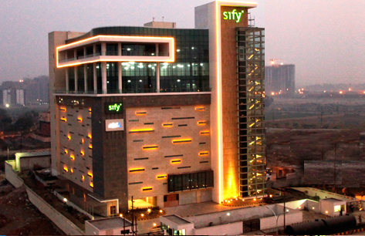
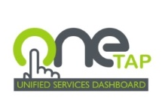
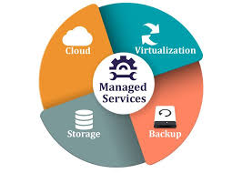
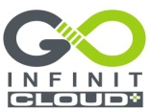
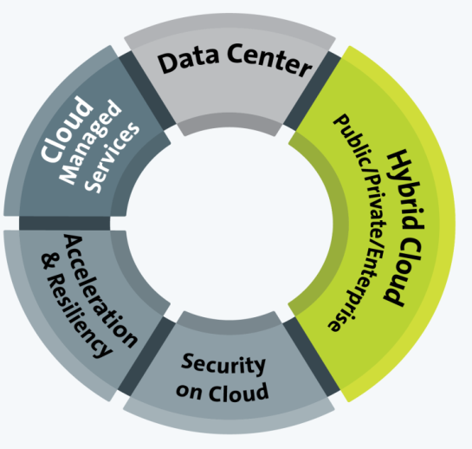


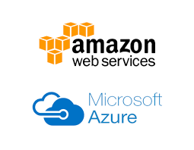
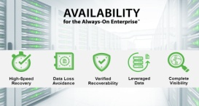
DATA CENTER SERVICES - CLOUD @ CORE
Rack | Space | Power
Managed Hosting Services
Cloud Ready
Managed Services
Enterprise Cloud
Cloud Nerve Center
OneTap | Dashboard
Security & Unified Reporting
Enterprise Grade
Secure & Custom Choices
Network Connected
Private Cloud
Converged | Hyper Converged
Fully Dedicated
Cloud in a BOX
Hybrid Ready
Application Acceleration & Security
Content | Media Delivery.
Cloud Security
Enterprise Application Access
CLOUD SERVICES
@ CORE
CLOUD SERVICES
@CORE
Public Cloud Services
Hyper Scale
Pay Per Use
Over 120+ Platforms
Resiliency Services
DR as a Service
Backup as a Service
Cyber Resiliency Service
Cloud Security Services
Zero Trust Security
SIEM Across Public, Private, Hybrid.
Cyber Resiliency

Slide 21
security transformation - Cloud @ core
Cloud delivered Security
From the Cloud
Security Services on utility model
Security for OT
Cloud Access Security
Securing Operations Technology
O365 | Salesforce | Google Apps
Data Security on Cloud
SDN & NFV based Services
Protecting Sensitive Data in the cloud
ADC | WAF | NGFW | NIPS
Vendor-agnostic approach
Cloud at Core
of Security
Transformation
Security Analytics
Security for Mobility
Enrich Intelligence with Visibility and Analytics
Anti-Phising | Anti-rogue
Securing the End Points
Security as a Service
User | Device | Thing
For the Cloud
Security Services build for Cloud IT

Slide 22
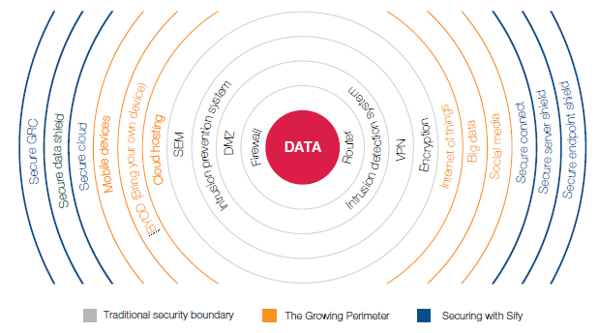
SECURITY SERVICES – CLOUD@CORE
Business drivers for securing IT environment
Advanced data breaches using sophisticated techniques
Increased exposure to hacktivism due to integration of new technologies
Increasing guidance and frameworks from industry organizations
Privacy and data protection regulations

Slide 23





Application services - cloud@core
Digital Platforms and Solutions on Cloud
Talent Management Service
Cloud driven Sify Mobile Application Solutions
Learning Analytics : Sify Learning Record Store for Learning Analytics solutions
ForumNxt and SffNxt
Sify LiveWire LMS : (3.0 and 4.0 under development. New UX and mobile app)
Business Process as a Service
Sify Customer Learning Portal Solutions
True SaaS Model
Partnerships :
Buzzyears Campus Management System
2. Sum Total Talent Management Suite
3. Partner HCM Integration on Cloud (Ramco)
Application & Registrations on Cloud
ForumNxt on Cloud
iTest on Cloud
AWS | Sify Cloud
Audit Apps on Cloud
SffNxt on Cloud
AWS | Sify Cloud
Exam day Support on Cloud
Support on Mobility and Cloud
CLOUD AT CORE
Results & Counselling on Cloud

Slide 24


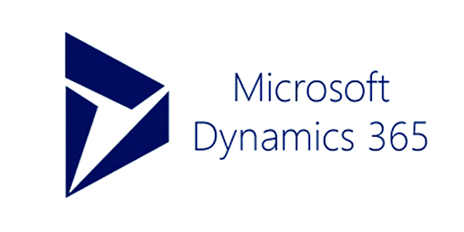
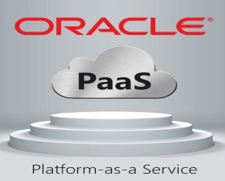
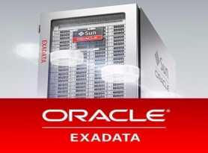









APPLICATION & PLATFORM SERVICES – Cloud@core
Sify Application and Platform Services
Applications
Big Data / Analytics
Platform
PaaS
IoT/ Blockchain
Network/Security
Storage/Compute
SAP Private and Public Cloud for S/4 HANA
Sify Application and Platform Services
SAP Cloud Platform
Automation / ML
PaaS
SAP Private and Public Cloud
SAP Cloud Platform
IaaS
SaaS
PaaS
PaaS
SaaS
IaaS
AIS-2 Cloud @ Core
AIS-2 Cloud @ Core

Slide 25



NETWORK SERVICES - CLOUD@CORE
Unified SLA
Integrated network and service management delivering high performance
Deliver transformational WANs to deliver transformational IT projects
Remote User
Branch Office
Internet
Integrated and scalable multi-service network
Enhanced business productivity
Sify WAN Transformation
Corporate Office
Mobility
MPLS
Public Cloud
Data Center
Optimal expense management
Integrated and uniform security management in the enterprise WAN
UC & C
Operational efficiency

Slide 26
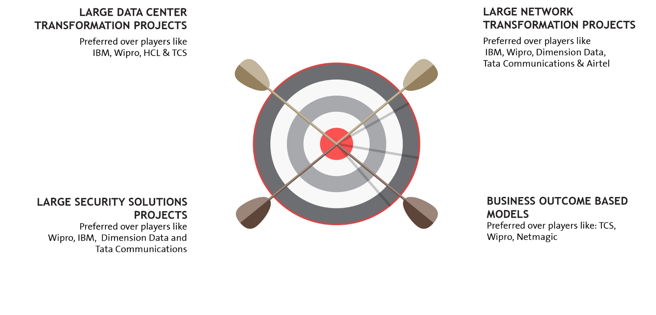


















EXECUTION CAPABILITIES

Slide 27










CLOUD@CORE: ALIGNING TO OUR VERTICAL STRATEGY

Slide 28
Sify engagement models and key strengths

Slide 29
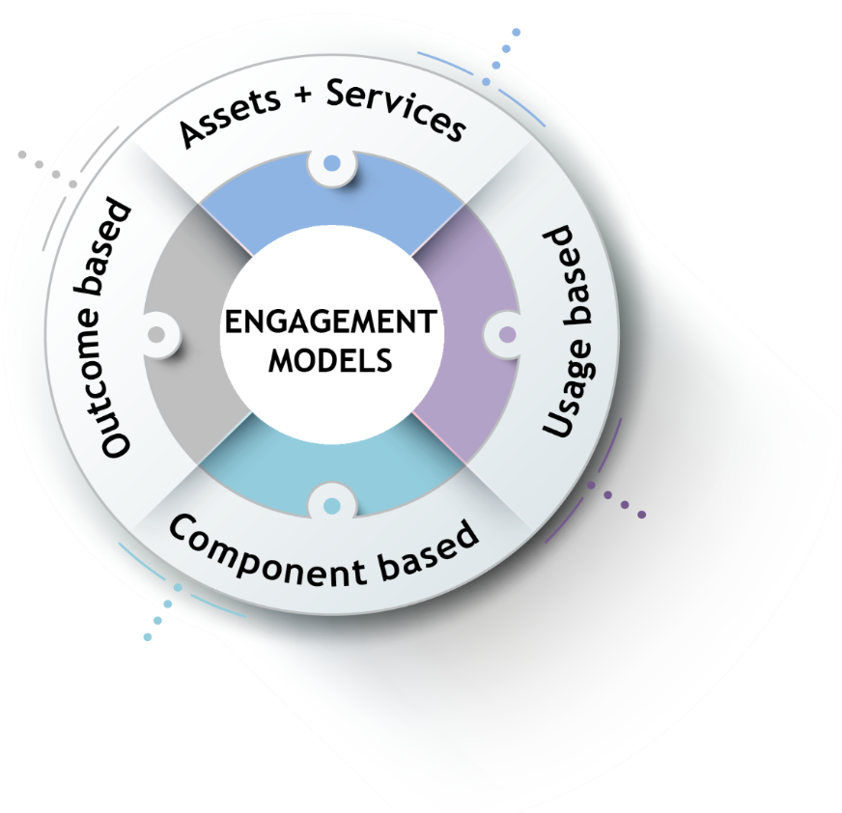
ENGAGEMENT MODELS
Systems are owned by the client and annuity based payout for services
Client engagement is based on defined business outcome generated by IT solutions and services
Less
Hardware
People
Licenses
No upfront investment by client and payout is based on consumption
Reduced upfront investment as client subscribes to infrastructure owned by Sify as a part of their overall infrastructure requirement

Slide 30
Our People Capabilities and Strengths
550+
DATA CENTER AND MANAGED SERVICES
1800+
NETWORK SERVICES
70+
SECURITY SERVICES
225+
APPLICATION SERVICES

Slide 31



























Strategic Partnerships
Technology Partners
Cloud and Acceleration Partners
Application Partners
Security Partners

Slide 32
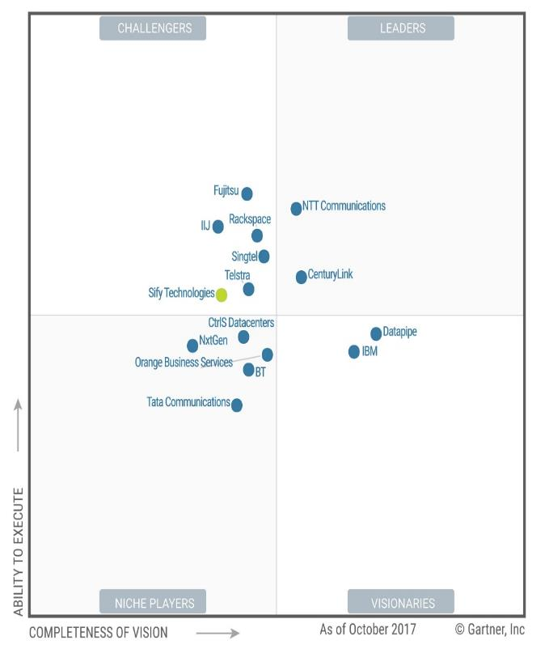


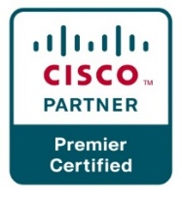


Recognitions
Partner of the year 2017
Network Transformation Services
2018
Data Center Transformation Services
2018
Sify moves up to the challenger position in the Gartner MQ for Managed Hybrid Cloud Hosting – Asia Pacific (2017)

Slide 33
SIFY CUSTOMER REFERENCES

Slide 34







CUSTOMER LOGOS (WIP)

