Slide 1


SIFY CAPABILITY PRESENTATION – E-COMMERCE

Slide 2

AGENDA
01
Key digital drivers in e-commerce
02
Cloud adoption and Sify relevance in e-commerce
03
Introducing Sify & Cloud @ Core
04
Sify engagement models/key strengths
05
Sify customer references

Slide 3

Key digital Drivers in e-commerce

Slide 4
Future of e-commerce
Trend | Current Scenario | Future Scenario and Benefits (Customer/ organization)
Data Storage | On-premise | IaaS & SaaS models provide flexibility in developing new sites with considerable reduction in time to go-live. Data security, easy backup and data recovery
Customer experience | Images of the product in different angles Dimensions of the products mentioned separately | Customers who typically shop online, with the help of augmented reality have the chance to view the product in form of a model they can interact with in the same manner they would if they were visiting a physical store Not only can the buyers interact with the product but also can they explore its functionalities
Customer Support | Outsourcing to BPOs or hiring resources | Customers: Chatbots provide prompt and accurate information and help resolve customers’ queries faster and better Recommendation Engines analyze customer buying behavior and recommend products to the customers Organization: Capex/opex reduction
Inventory/Supply chain Management | Manual methods to track inventory Real time tracking not possible or very difficult | IoT sensors and RFID tags make management of inventory in real-time possible, streamlining the entire flow Robotic process automation (RPA) allows supply chain leaders to cut costs, eliminate keying errors, speed up processes and link applications

Slide 5
Relevance of ict in the digital transformation journey
Trend | Future Technology | ICT Enablement
Data Storage | Cloud | Analytics, Cloud based applications & Cloud Infrastructure, Security
Customer experience | Augmented Reality | Connectivity, Applications
Customer Support | Artificial Intelligence | Cloud based Applications & Cloud Infrastructure, Network, Security
Inventory/Supply chain Management | IoT Blockchain | Network, Cloud based applications & cloud infrastructure, Security
Cloud is the foundation of all future technologies

Slide 6
Cloud adoption and sify relevance in e-commerce

Slide 7
Cloud for E-commerce
Solution
Cloud enabled infrastructure
Challenges
Virtual Infra on Pay-per-use Model
Biggest Challenges in e-commerce sector -
Changing demands and market scenarios
Customer loyalty
Capex/opex
The cloud architecture and memory utilization helps customers to handle increased workloads and meet the fluctuating demands in the peak season
While a sudden spike in traffic can slow down a website and make it unresponsive, cloud computing provides greater bandwidth, computational power, and storage
With cloud computing, the costs of developing and maintaining IT infrastructure cuts down since there is no need to invest in hardware or software infrastructure
Cloud-based architectures are disaster tolerant. A cloud-based platform with built-in redundancy can save the business from data loss. It keeps the data secure, backed-up and easily accessible

Slide 8
USE CASES-CLOUD SERVICES
Application Context
Cloud services for capturing real-time status of consignments, carriers etc.
IT infrastructure for all the administrative solutions( HR, Finance, etc)
Hosting Analytics & BI Engine
Benefits
Higher Supply Chain visibility
Customers will pay for only what they use thereby aligning to the Value based model
Creating personalized services for the Customer based on trend analysis
Enhanced user experience at low costs

Slide 9
USE CASES-CONTEXTUAL MESSAGING
Application Context
Enabling personalization by smooth recording of Customer data that is context driven (based on preferences and habits)
Benefits
Brand recall in the Customer through the personalized updates, thereby resulting in Brand Loyalty

Slide 10
USE CASES-SECURITY
Application Context
DDoS Services/ APT Protection Services for Cybersecurity against security breach of confidential customer information while payments
Benefits
Customer information will be secure and cannot be misused

Slide 11
sIFY relevance
Trend | Future Technology | ICT Enablement | Sify Relevance
Inventory/Supply chain Management | IoT Blockchain | Connectivity, Cloud based applications & cloud infrastructure, Security | Sify Network services, Application and platform services, DC transformation and cloud services, Sify security services
Customer experience | Augmented Reality | Connectivity, Cloud based applications & cloud infrastructure | Sify Network services, DC transformation and cloud services
Customer Support | Artificial Intelligence | Cloud based Applications & Cloud Infrastructure, Connectivity, Security | Sify Network services, Application and platform services, DC transformation and cloud services, Sify security services
Data Storage | Cloud Computing | Analytics, Cloud based applications & Cloud Infrastructure, Security | Application and platform services, DC transformation and cloud services, Sify security services

Slide 12
Sify overall relevance
Solution | E – commerce functions | Sify services
Cloud services | On demand infrastructure with pay-as-you-go model Fully managed enterprise grade, virtual infrastructure for enabling retail platforms Management of complete retail data Scalable test and development test environment Cloud-based SCM systems can seamlessly integrate with existing and interdependent systems on the back end, including inventory management, product information management, CRM, ERP and store fulfillment and returns management, to streamline the entire business process. Hosting Chat bots and intelligent assistants | Sify GoInfinit Cloud+ AWS- GoInfinit AWS+ Azure – GoInfinit Azure+ CDN – GoInfinit Accelerate Security – GoInfinit Secure Sify Global Cloud Connect Goinfinit Container, VPE Goinfinit Auxiliary Services
Data Center Transformation: hybrid cloud, policy-based governance | Speeds up ROI with investments in digital solutions with Cloud & Managed Infra with Opex model minimize Capex Consolidation, optimization, virtualization and workload migration for agile and scalable retail management systems | Sify Private Cloud – GoInfint Container GoInfinit Cloud AWS/Azure Sify Tier 3 Data Centers Sify Global Cloud Connect Sify Managed Services
New Age Digital Solutions | AR/VR product demos and walkthroughs AR/VR advertising and communication | Sify AR/VR development solutions Sify Application development Sify Cloud Storage

Slide 13
Sify overall relevance Contd.
Solution | E – commerce functions | Sify services
Application services(Industry Standard Applications) | CRM & Analytics for better customer engagement Analytics & Machine Learning for better merchandizing and supply chain management Cloud ERP solutions | Oracle advanced security, Oracle DB vault & firewall, Azure stack, Office 365 Suite & EMS, Azure Media Services, Power BI, DB Management System
Application services(Sify Applications) | Supply chain management & optimization Mobile App Development | ForumNxt
Connectivity | Predictive equipment maintenance is used for managing energy, predicting equipment failure or detecting other issues Smart Transportation - Maintenance of transport, tracking and route optimization Smart shelves can automatically monitor inventory in stores and notifies the manager when an SKU is about to go out of stock | Data Center Interconnect, Global Cloud Connect, Azure ExpressRoute, AWS Direct Connect, Managed WiFi, Managed Network Sify MPLS, Ethernet Sify IOT services, Analytics services
Security Consulting & Managed Services; Data Protection | Protection against data breaches, hacks and leakages, phishing Proactive incident management and response | Security Consulting services, managed security services Goinfinit Backup, Goinfinit Recover

Slide 14
Introducing sify and cloud@core

Slide 15
SIFY TODAY
TECHNOLOGY INTEGRATION SERVICES
Data Center IT
Network Integration
Information Security Services
Collaboration Services
End User Computing Services
TELECOM SERVICES
India Data Business
Global Data Business
Cloud Connect & Managed DWDM
Enterprise VoIP
Managed Network Services
APPLICATIONS SERVICES
iTest – Online Testing Platform
eLearning
Forum – Distribution Management System
Portal Solutions
DC, CLOUD & MANAGED SERVICES
Colocation/White labelling
Data center Transformation
Public Cloud (IaaS/PaaS)
Enterprise private and hybrid cloud
Cloud based DR
DC Managed Services
Managed Security Services
PLATFORM SERVICES
SAP / S4 Hana, Success Factors and hosted cloud infrastructure
Microsoft – Azure, Office & Productivity, Dynamics CRM
Oracle – SaaS, PaaS (HR, Database, Middleware, Cloud Machine)

Slide 16




cloud@core
TM
ALIGNED TO OUR CUSTOMERS’ CLOUD TRANSFORMATION PURSUIT
CLOUD ENABLING
CLOUD INSPIRED
CLOUD PURE
CLOUD ENHANCED
Cloud DC
Hyper reach/Hyper scale transport Oracle FastConnect | ExpressRoute | DirectConnect | Partner Interconnect
Software Defined Network services
Cloud build Private | Hyperconverged | Enterprise
Security services for cloud
Migration and Implementation services
Sify CloudInfinit
Enterprise Multi-Tenant
Dedicated
Hosted SAP/S4 HANA
Azure Stack as a Service
Edge Connect Services
SD-WAN
Collaboration services on Cloud
AWS
Azure
OCI
GCP
Multi Cloud Management platform & services
Modern Applications
Kubernetes-as-a-Service
AI/ML
Forum DIGITAL
HCM Digital (iTest)
Learning Management
Internet-of-Things (IOT)
Industry Solution-as-a-Service

Slide 17
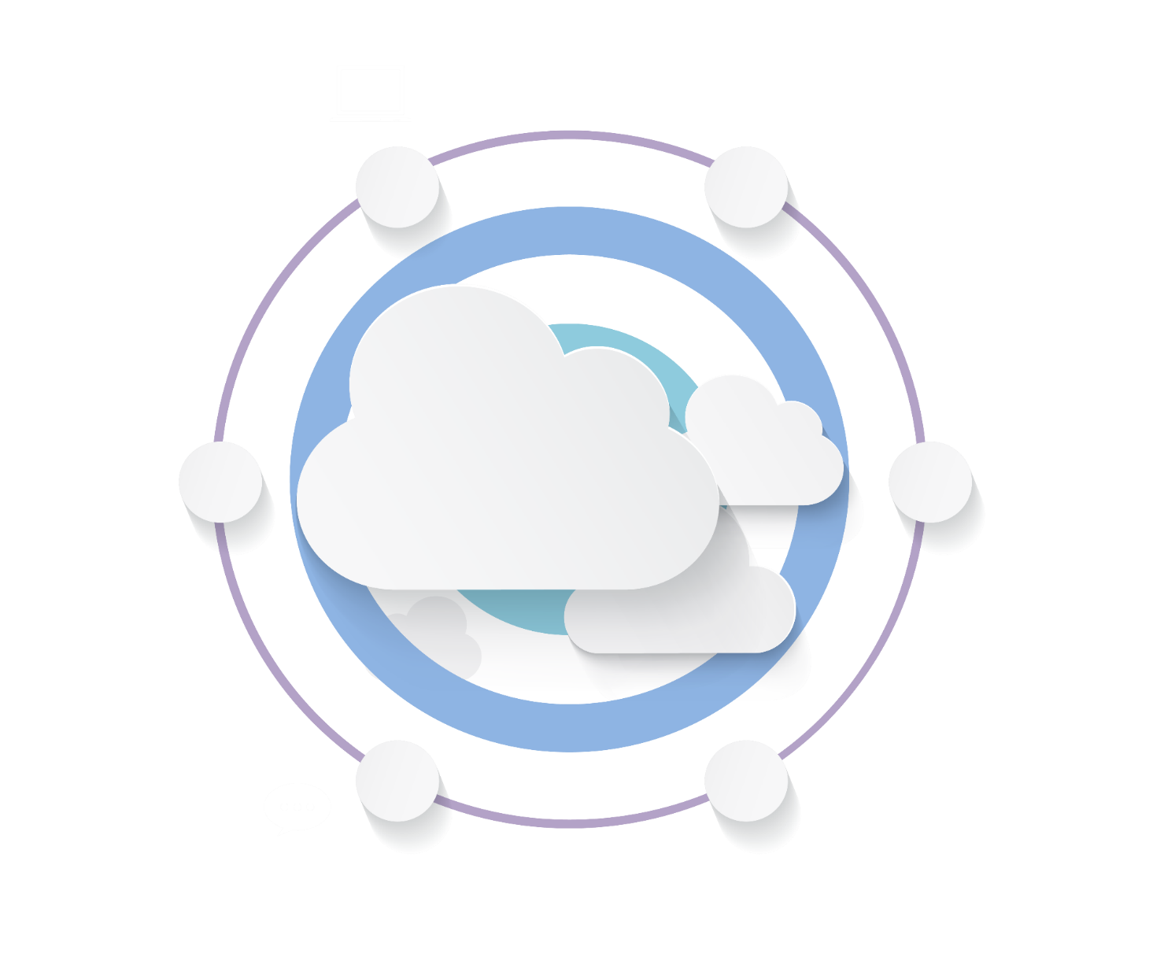






CLOUD@CORE: AGILITY, FLEXIBILITY & CHOICES
Investment and IP Commitments
Commitment beyond Infra: Platform & SaaS
CLOUD@CORE
Commitment beyond Cloud: Network for Cloud
Commitment to make Cloud secure
Capability and Commitment to build Cloud
Commitment of providing choices

Slide 18
How cloud@core powers e-commerce of future
cloud@core
TM
ALIGNED TO OUR CUSTOMERS’ CLOUD TRANSFORMATION PURSUIT
Valuable customer data is secure. There also no need to invest in on prem hardware
Implement cloud based ERP’s
CLOUD ENABLING
CLOUD INSPIRED
CLOUD PURE
CLOUD ENHANCED
Cloud DC
Hyper reach/Hyper scale transport Oracle FastConnect | ExpressRoute | DirectConnect | Partner Interconnect
Software Defined Network services
Cloud build Private | Hyperconverged | Enterprise
Security services for cloud
Migration and Implementation services
Sify CloudInfinit
Enterprise Multi-Tenant
Dedicated
Hosted SAP/S4 HANA
Azure Stack as a Service
Edge Connect Services
SD-WAN
Collaboration services on Cloud
AWS
Azure
OCI
GCP
Multi Cloud Management platform & services
Modern Applications
Kubernetes-as-a-Service
AI/ML
Forum DIGITAL
HCM Digital (iTest)
Learning Management
Internet-of-Things (IOT)
Industry Solution-as-a-Service
Better supply chain management and tracking
Create cloud based IT infrastructure and IT Transformation

Slide 19
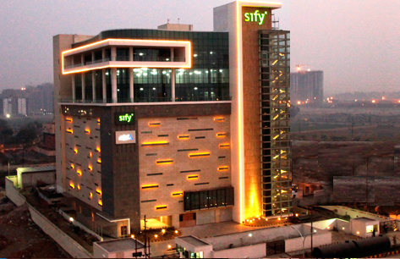
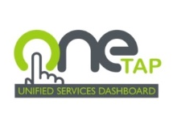
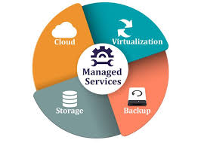
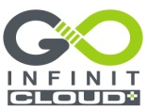
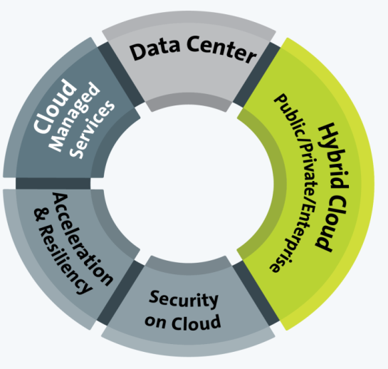


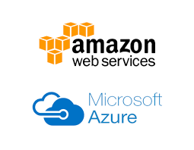
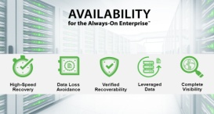
DATA CENTER SERVICES - CLOUD @ CORE
Rack | Space | Power
Managed Hosting Services
Cloud Ready
Managed Services
Enterprise Cloud
Cloud Nerve Center
OneTap | Dashboard
Security & Unified Reporting
Enterprise Grade
Secure & Custom Choices
Network Connected
Private Cloud
Converged | Hyper Converged
Fully Dedicated
Cloud in a BOX
Hybrid Ready
Application Acceleration & Security
Content | Media Delivery.
Cloud Security
Enterprise Application Access
CLOUD SERVICES
@ CORE
CLOUD SERVICES
@CORE
Public Cloud Services
Hyper Scale
Pay Per Use
Over 120+ Platforms
Resiliency Services
DR as a Service
Backup as a Service
Cyber Resiliency Service
Cloud Security Services
Zero Trust Security
SIEM Across Public, Private, Hybrid.
Cyber Resiliency

Slide 20
security transformation - Cloud @ core
Cloud delivered Security
From the Cloud
Security Services on utility model
Security for OT
Cloud Access Security
Securing Operations Technology
O365 | Salesforce | Google Apps
Data Security on Cloud
SDN & NFV based Services
Protecting Sensitive Data in the cloud
ADC | WAF | NGFW | NIPS
Vendor-agnostic approach
Cloud at Core
of Security
Transformation
Security Analytics
Security for Mobility
Enrich Intelligence with Visibility and Analytics
Anti-Phising | Anti-rogue
Securing the End Points
Security as a Service
User | Device | Thing
For the Cloud
Security Services build for Cloud IT

Slide 21
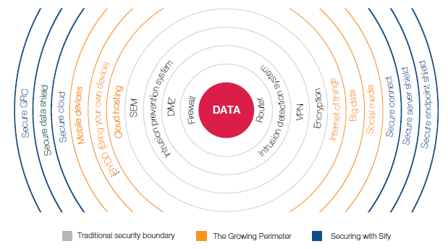
SECURITY SERVICES – CLOUD@CORE
Business drivers for securing IT environment
Advanced data breaches using sophisticated techniques
Increased exposure to hacktivism due to integration of new technologies
Increasing guidance and frameworks from industry organizations
Privacy and data protection regulations

Slide 22





Application services - cloud@core
Digital Platforms and Solutions on Cloud
Talent Management Service
Cloud driven Sify Mobile Application Solutions
Learning Analytics : Sify Learning Record Store for Learning Analytics solutions
ForumNxt and SffNxt
Sify LiveWire LMS : (3.0 and 4.0 under development. New UX and mobile app)
Business Process as a Service
Sify Customer Learning Portal Solutions
True SaaS Model
Partnerships :
Buzzyears Campus Management System
2. Sum Total Talent Management Suite
3. Partner HCM Integration on Cloud (Ramco)
Application & Registrations on Cloud
ForumNxt on Cloud
iTest on Cloud
AWS | Sify Cloud
Audit Apps on Cloud
SffNxt on Cloud
AWS | Sify Cloud
Exam day Support on Cloud
Support on Mobility and Cloud
CLOUD AT CORE
Results & Counselling on Cloud

Slide 23
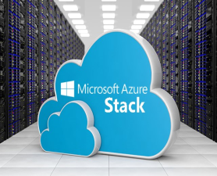
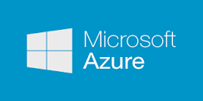
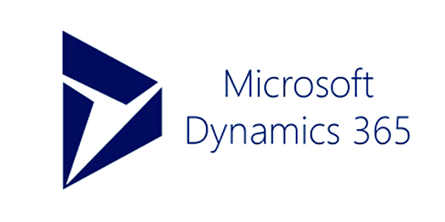
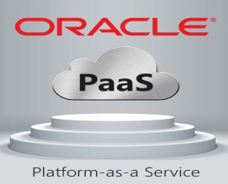
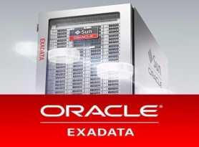
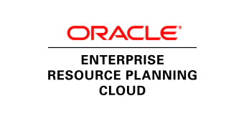








APPLICATION & PLATFORM SERVICES – Cloud@core
Sify Application and Platform Services
Applications
Big Data / Analytics
Platform
PaaS
IoT/ Blockchain
Network/Security
Storage/Compute
SAP Private and Public Cloud for S/4 HANA
Sify Application and Platform Services
SAP Cloud Platform
Automation / ML
PaaS
SAP Private and Public Cloud
SAP Cloud Platform
IaaS
SaaS
PaaS
PaaS
SaaS
IaaS
AIS-2 Cloud @ Core
AIS-2 Cloud @ Core

Slide 24



NETWORK SERVICES - CLOUD@CORE
Unified SLA
Integrated network and service management delivering high performance
Deliver transformational WANs to deliver transformational IT projects
Remote User
Branch Office
Internet
Integrated and scalable multi-service network
Enhanced business productivity
Sify WAN Transformation
Corporate Office
Mobility
MPLS
Public Cloud
Data Center
Optimal expense management
Integrated and uniform security management in the enterprise WAN
UC & C
Operational efficiency

Slide 25
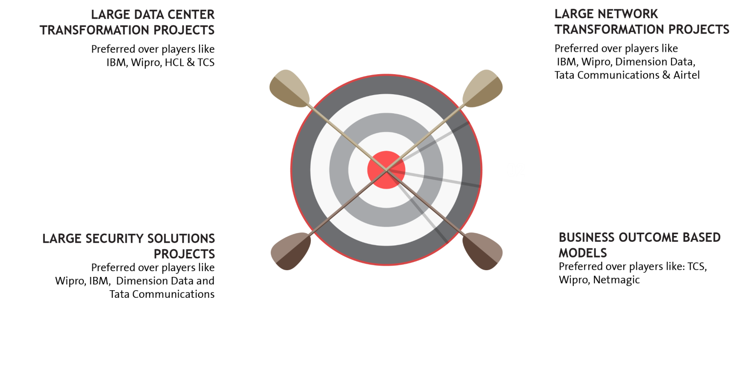

















EXECUTION CAPABILITIES

Slide 26
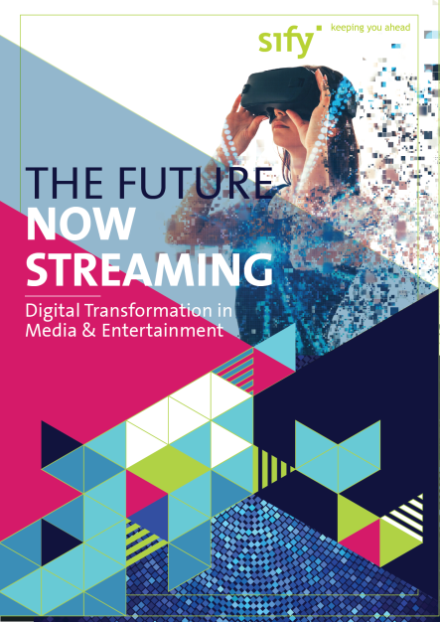
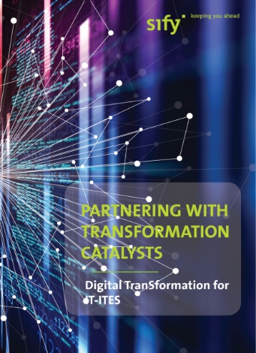

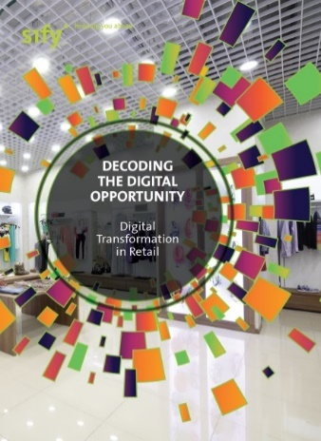
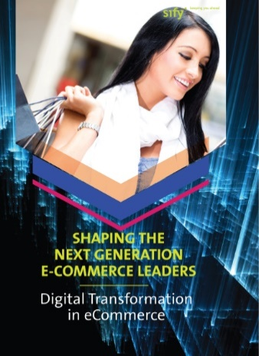

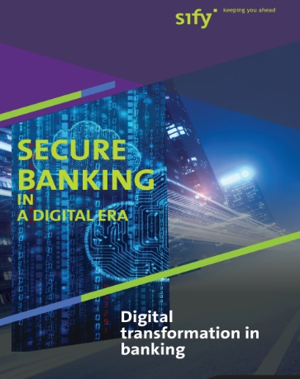

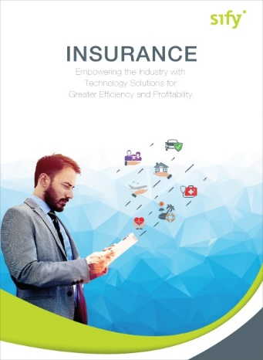

CLOUD@CORE: ALIGNING TO OUR VERTICAL STRATEGY

Slide 27
Sify engagement models/key strengths

Slide 28
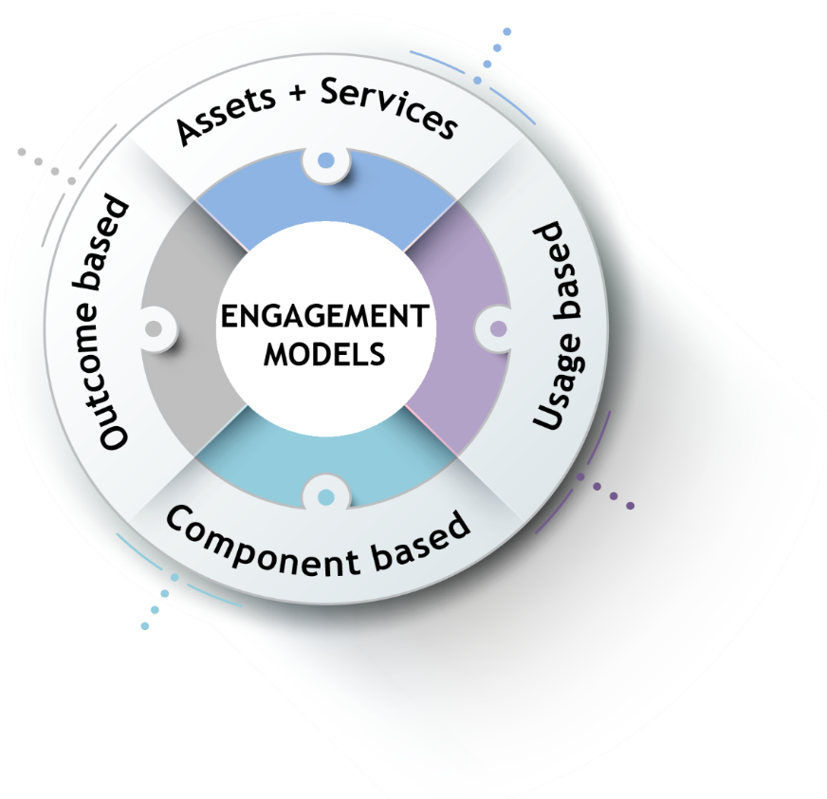
ENGAGEMENT MODELS
Systems are owned by the client and annuity based payout for services
Client engagement is based on defined business outcome generated by IT solutions and services
Less
Hardware
People
Licenses
No upfront investment by client and payout is based on consumption
Reduced upfront investment as client subscribes to infrastructure owned by Sify as a part of their overall infrastructure requirement

Slide 29
Our People Capabilities and Strengths
550+
DATA CENTER AND MANAGED SERVICES
1800+
NETWORK SERVICES
70+
SECURITY SERVICES
225+
APPLICATION SERVICES

Slide 30











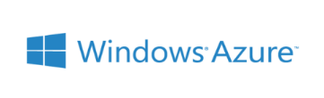
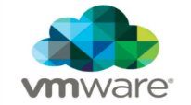














Strategic Partnerships
Technology Partners
Cloud and Acceleration Partners
Application Partners
Security Partners

Slide 31
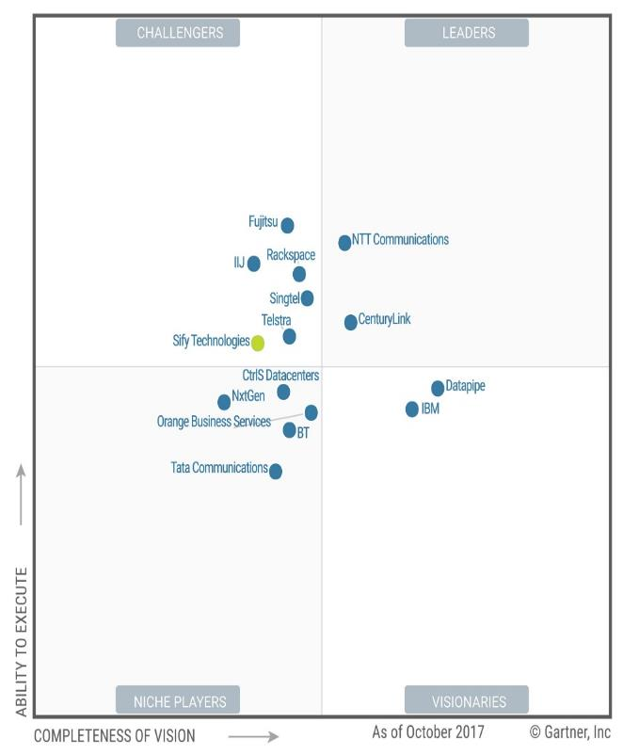

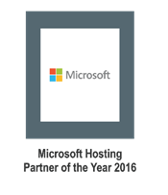
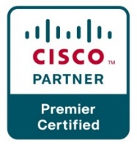
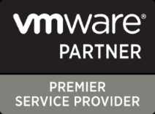

Recognitions
Partner of the year 2017
Network Transformation Services
2018
Data Center Transformation Services
2018
Sify moves up to the challenger position in the Gartner MQ for Managed Hybrid Cloud Hosting – Asia Pacific (2017)

Slide 32
Sify customer references

Slide 33



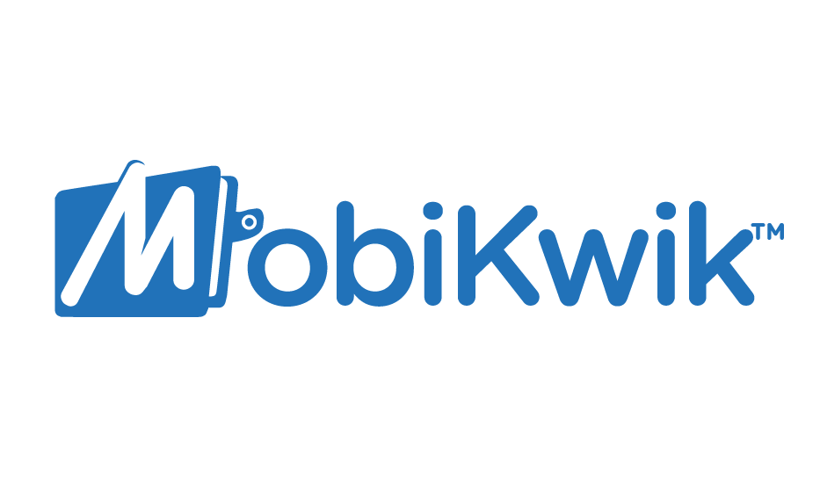







Key customers

