Slide 1
SIFY DATA CENTER Infrastructure
PRESENTATION TO KANSAI NEROLAC PAINTS LIMITED
MAY 2021

Slide 2
AGENDA
KNPL’s present Infrastructure Setup and Requirement Understanding
Sify Solution and Migration Approach
Business Benefits and Details of Data Center
Next Steps
2

Slide 3
AGENDA
Sify’s Proposed solution
Data Center Details
Next STEPS
Why Sify
3

Slide 4
Insight on KNPL Current Data center setup
Primary Data Centre
On–Premise @ Nerolac House Mumbai managed by KPNL Team
NDR
Same Premises Separate Floor managed by KPNL Team
5 IT Load
30 KVA
4 UPS Capacity
80 KVA in HA
7 Telecom
SIFY, Airtel, TCL & BSNL Managed by Airtel
6 Power Source
DUAL – TATA and BEST
3 No. of Racks
14 – 15

Slide 5






Requirement Details
6 No. of Racks to be hosted in primary Location
Physical Migration / Lift & Shift
1 No. of rack to be hosted for NDR
Power Required 30 KVA Appx. consumed
IP Address to be Retained
RH&E Support
2 Seating Place
Dedicated Space
Offsite Tape Logistics
Managed and Monitored Cross Connect at DC and NDR: SIFY, Airtel, TCL, BSNL

Slide 6
Sify’s Proposed solution

Slide 7
Requirement Details
Capacity provisioning for 6 No. of Racks @ Tier III DC AIROLI NEW MUMBAI
Additional Consideration
Migration/Physical Lift Shift
Capacity provisioning for 1 Rack for NDR @ Same location different floor
Power @ Actuals
IP Address will
be retained
RH&E Support
Optional
2 Seating Place
Dedicated Cage for
Rack Space
Offsite Tape Logistics
Biometric Access
for Cage
Managed and Monitored Cross Connect at DC and NDR: SIFY, Airtel, TCL, BSNL

Slide 8
Solution Factors for BUSINESS High Availability
Solution Factors | Our Offering | Business Advantage KPNL
Data Centre Certification | Tier III | Concurrent Maintainable DC with high redundancy ensures availability and resiliency
Data Centre Seismic Location | Zone III | Moderate earthquake zone reduces risk due to natural calamity
Air Conditioning Availability | N+1 redundancy 22 +/- 2 deg. C 50 +/- 5 RH | Ensure Optimum cooling availability and DC operative conditions as per ASHAREA guidelines
Active Component Redundancy | UPS : N+ N ; Chiller : N + 1 | Fully redundant UPS path ensures business critical applications always run uninterrupted
Power Distribution Path | DUAL (Active : Active) | power redundancy through a combination of multiple power substation ensure 100% power availability
Site Availability | 99.982 % | Guaranteed uptime with SLA for business continuity
Network Connectivity | Redundant 3 high speed Fiber Connectivity entry path | Ensure High Availability of network connectivity for Business
Scalability Option | Availability of more than 400 Racks space | Business scalability in same facility for expansion

Slide 9



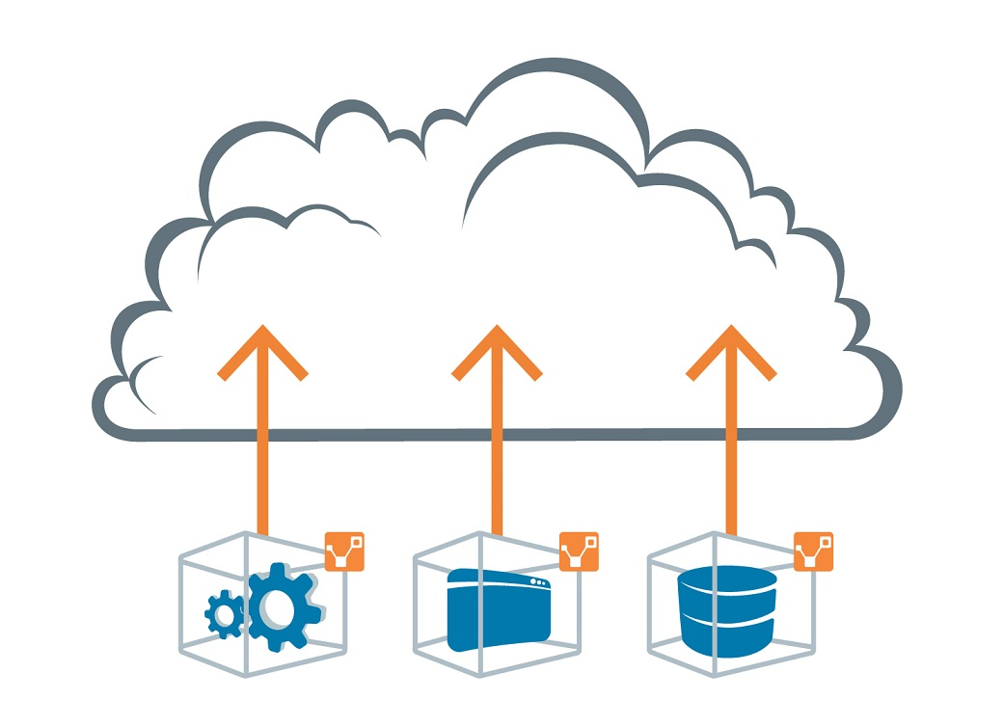

Project phases
1 Day
Post Migration Support
Technical support for one month
2-3 Days
2-3 Days
Acceptance and Sign off
Operations Handover
1 Weeks
Migration
Execution of the physical migration
Assessment and Planning
Assessment Migration strategies based on criticality, application groups and business approvals
Data Gathering
Understanding of the current landscape, Establishing Pre-requisites for migration

Slide 10
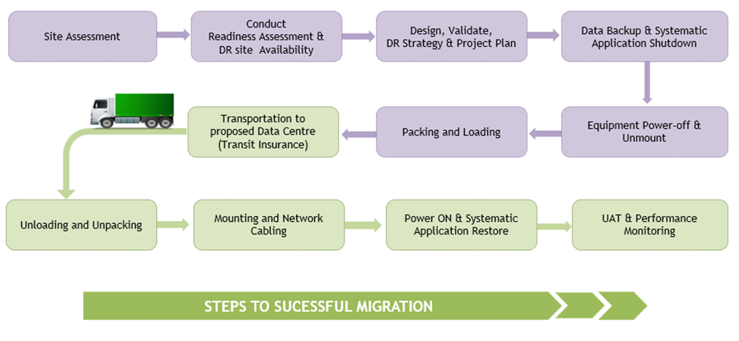
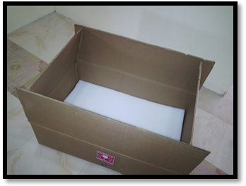
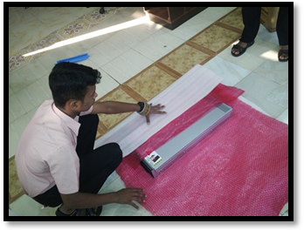
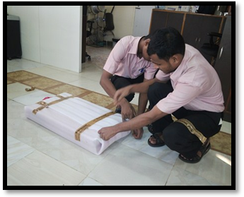
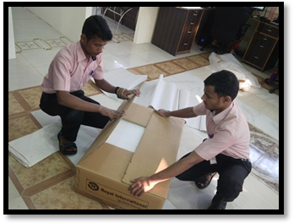
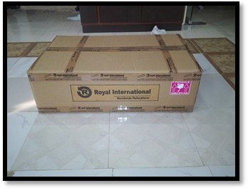
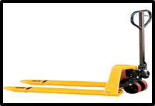
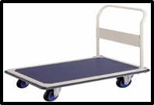
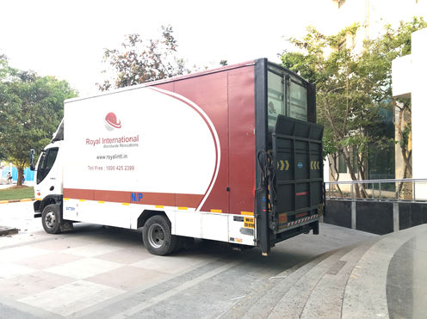
Lift and Shift PROCEDURE

Slide 11
Data Center Details

Slide 12
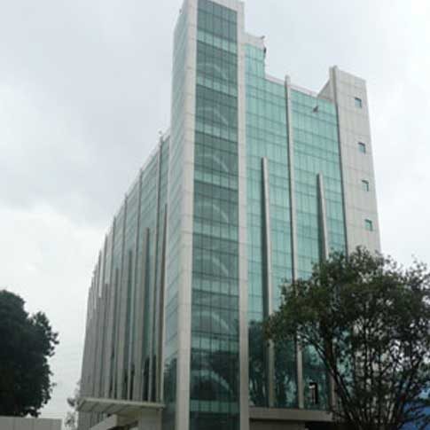
SIFY AIROLI DATA CENTER
Addressing biggest market segments like BFSI, E-Commerce & Retail, Media & Ent
Facilitates Private Cloud/Hybrid cloud Platform
Major portion of the Data Center will be a private cloud deployment
Near DR for Hyperscale Data Center projects
Failover to public cloud services (Airoli- Rabale as Data Center and near Data Center site) with <1ms latency
29 Years of Lease
Start Date – Jan ’08 End Date – Jan ’37
SITE ADDRESS
Sify Technologies Limited
Reliable Plaza, K10
Thane Belapur Road
Navi Mumbai -400710
GOOGLE MAPS LINK
https://goo.gl/maps/JbDrcTk9gKv

Slide 13



IMPECCABLE UPTIME PERFORMANCE - how we do it
Security:
Zero loss time incident,
Ensuring Security Standards
Zero Trust Architecture and Security Training
Colocation Guidelines
Physical and Digital Layer
Risk Assessment & Mitigation
Safety:
Zero loss time incident,
Ensuring Safety culture
Infra Operations:
Zero loss time incident,
Tracking of capacity & process management
Safety Lab and Safety Training
Safety Awareness Rounds
Safety Excellence Program
Risk Assessment & Mitigation
Subject Matter Expert &
Quality Assurance
Skillset Mapping, Training, Assessment
360o Audits to identify SPoF,
End Of Life, Bottlenecks
Computerized maintenance management system
100% Uptime Since 2008
Achieving 100% uptime for the Data Center is easy, but maintaining it continuously is only possible with a sustainable model that includes strong process management and automation-supporting process strengthening.

Slide 14
airoli DATA CENTER - Fact Sheet
Architectural & Building Structure
Seismic Zone: Zone III
Seismic Protection: Building strengthened as per IS 1893: 1984 criteria for earthquake resistant design of structure
Structural Floor Loading : 1500 Kg/Sq. mt for Proposed Datacenter Floor
Freight Elevators: 2.5 Ton
Passenger Lifts : 2 numbers
Perimeter Wall & Doors : 2 Hours Fire rated
Building Features
Floors in building: 7 Floors, Reinforced concrete structure building
Total Area : 1,20,000 Sq ft
Raised Floor area : 45,000 Sq ft
Server Hall Location: 4th to 6th Floors
Slab to Slab height: 3800mm
Raised Floor Height: 600mm
Integrated Building Management System
Access Control : Multi layer access control system
Video Surveillance : 24*7 for all critical areas with retention for 90 days
Fire Detection : Addressable smoke detectors
VESDA: Aspirating Smoke Detectors
Fire Suppression : FM 200 used for Server Halls and Battery Rooms.
Addressable Water leakage Detection
Ultra sonic Rodent repellent system
Power System
Incoming supply: 110KV dedicated substation
Total Designed Power Capacity: 10.5MVA
Service Provider: MSEB
UPS Configuration: N + N
Battery Backup : 10 mins on full load
Distribution: Dual Feed up to Racks
Generator Configuration: N + 1
Fuel Storage : 24 hours on full load
Cooling System
Cooling System : DX type PAC machines
CRAH Redundancy : N+1
Temperature : 22 +/- 2 deg C
Humidity : 50 +/- 10 % RH
Dust Control : Less than 5 Micron

Slide 15
SUBSTATION NETWORK
220KV Substation
Kalwa
220KV Substation
Vashi
Onsite Substation of 110 KVA
Connected to 220 KVA substation on both sides that are part of National Grid
LILO
LILO
LILO
110KV Substation
Mahape
110KV Substation
Sify, Airoli
110KV Substation
NOCIL
Airoli DC

Slide 16
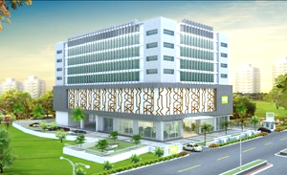
FACT SHEET of Hyderabad DATA CENTER – Future DR Roadmap
Click here for the .pdf version
SURVEY NO 145/1, Financial District, Nanakramguda, Gachibowli, Hyderabad | Building Features Floors in building: B+G+8 Floors Raised Floor area: Approx. 35,000 Sq. Ft. Structural Design: IS 456:2000, Importance Factor 1.5 Structural Floor Loading: 1500 Kg/sq.m. Freight Elevators: 1x2.5 Ton, 1x2 Ton Passenger Lifts: 3 Nos. + 1 No Fire rating of Walls & Doors: 2 Hours | Building Management Integrated Building Management System Physical Security: 7 levels Access Control: Smart Card and Biometric Video Surveillance: 24x7 for all critical areas Retention: 90 days
Electrical Power Feeder: 33KV dedicated feeders Design power capacity: 6400kW UPS Configuration: N+N Power density: 3kW to 15kW Battery Backup: 10 minutes on full load Distribution: Dual bus to racks with PDUs enabled with branch circuit monitoring Generator Configuration: Fully redundant, separate for IT & Non-IT Fuel Storage: 48 hours at full load capacity | Cooling Chillers Type: Air cooled chillers CRAC Redundancy: N+2 Temperature Control: As per ASHRAE guidelines Humidity Control: 50+/-10% RH | Network Dedicated MMR (2 Nos.) at ground floor Four Fiber entrance to the building. Network room at each Data Center floor Presence of all telecom service providers
 | Amenities Work Kiosks Conference Room Parking Break-out Areas | Certifications (proposed) ISO 27001, Information Security Management ISO 9001, Quality processes ISO 20000, ITIL based Service Delivery SAP Certified SSAE 16 Certified PCI DSS
^ raised floor may vary with customized floor option
~ the power density can vary from 100w/sq ft to 300w/sq ft and customization possible for higher density racks

Slide 17
Next STEPS

Slide 18
Next Steps
Correction on information gaps
Additional Information
Details on labelling and cabling
Refined and detailed assessment
Data Center Visit

Slide 19
Why Sify

Slide 20



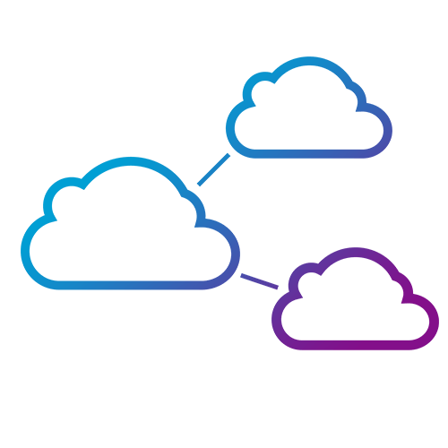


Infrastructure ADVANTAGE
SIFY ASSETS
RELEVANCE TO DIGITAL ENTERPRISE
  10 Pan-India DCs with 71 W capacity
  To add 200 MW in next 4 years, doubling capacity
Hosting for hyperscale operators
Centerpiece of the hybrid cloud
Cloud Adjacency
  Largest MPLS network (by connections)
  3100+ PoPs across 1600 towns in India
Internet growth from non-metros
Platform to move content to “edge”
  “Cloud Connect” data superhighway
  48 on-net data centers
Cost-effective terabit network scale
Interconnect Public and Private clouds
  Enterprise and Hybrid Multi Cloud
  Enterprise Cloud grid fabric
Public / Private / Hybrid Clouds
Cost effective and pay-as-you-go model
  Remote Operations Centers
  NOC, SOC, managed services
Global and domestic IT outsourcing
Supports outcome-based services model
  Applications and solutions
  iTest, ForumNXT, eLearning, SAP, Oracle, App Modernization
IT-enablement for distributed businesses
Supports Digital Transformation initiatives

Slide 21




Additional BENEFITS OF BEING HOSTED at Sify
Native availability of:
CloudInfinit - Public Private/ Virtual Private
SAP Grid
Azure Stack
Least latency from Hyperscale CSPs
Interconnected with 48 DCs across India
Western region Network hub
Navi Mumbai region has dense fiber connectivity with multi-TB network capacity.
Cloud Connect services to ensure workloads and data can move between Clouds quickly and effectively.
Direct Connect to AWS
Xpress Route to Azure
Fast Connect to Oracle Cloud
Cloud Connect to GCP

Slide 22













Customers in Sify Airoli DATA CENTER
Leading banks in Airoli DATA CENTER
Other BFSI Customers in Airoli DATA CENTER

Slide 23

















VERTICAL-WISE CUSTOMERS IN Airoli DATA CENTER (partial)
Automobiles
Manufacturing
Retail
IT/ITeS
Real Estate
Others

Slide 24









Customers who DECIDED for Airoli data center (<12 months)

Slide 25



























INDIA’S BFSI INDUSTRY LEADERS ARE IN SIFY DATA CENTERS
Largest
bank in India
Largest
Pvt Bank in India
Largest
e-wallet company in India
Industry leading BFSI company’s Data Center runs on Sify

Slide 26
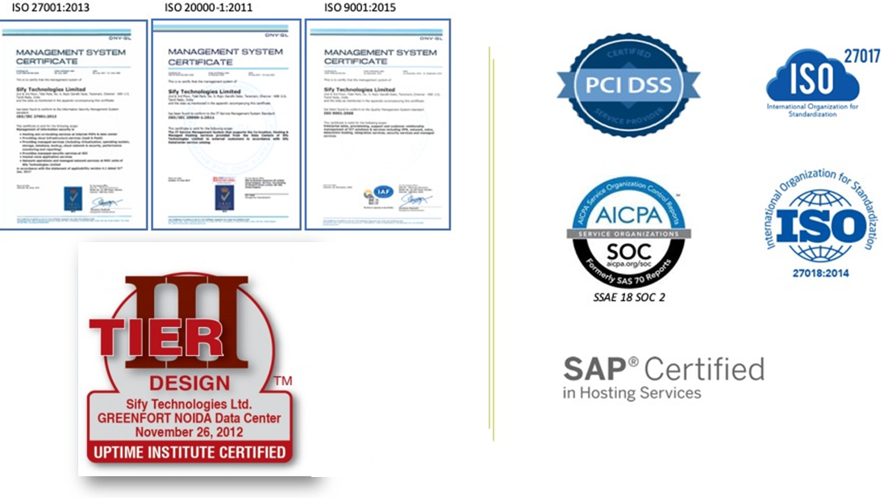
Compliance and CERTIFICATIONS

Slide 27
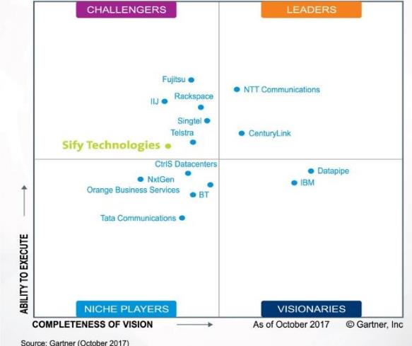






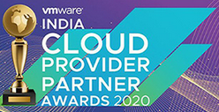



INDUSTRY RECOGNITIONS
Recognition in Market Guide for Public Cloud Managed and Professional Services Providers APAC 2020
Recognition in Critical Capabilities for Managed Hybrid Cloud Hosting APAC 2018
Recognition in Market Guide for Top Data Center Service Providers 2018
Recognition in Market Guide for Vulnerability Assessment
and Penetration Testing Consulting Services in India 2019
Recognition as a notable vendor in MQ for Data Center Outsourcing and Hybrid Infrastructure Managed Services, Asia/Pacific 2019
Major Player in
MarketScape for Cloud
Managed Services APeJ 2019
The Economic Times Iconic Brands 2020
Hybrid Multi Cloud
Data Center Transformation Services
2018
Network Transformation Services
2018
Leadership Recognition
Cloud Transformation (2018)
Network Transformation (2019)
Sify in Challenger Quadrant in Gartner MQ for Managed Hybrid Cloud Hosting APAC 2017
Hosting Partner

Slide 29
Insight on KNPL Current Data center setup
DC ON Prem in Nerolac House Mumbai
Current DC area:
SQ. FT.
Age of DC
UPS:
80KVA in HA
Air-condition:
20-22BTU
No of Racks
NDR same premises separate floor
Telcom connectivity from 4 service providers: SIFY, Airtel, TCL & BSNL
Dual Power service provider: BEST & Tata Power
Setup managed by KNPL team
Telecom link are currently monitored by Airtel
Network devices will be collocated

Slide 30
KNPL’s Requirement
6 Racks in DC and 1 rack in NDR in same premises separate floors with 30KVA power at actuals
RH&E support
2 seating place
Offsite tape movement service
STS as per revert from KNPL
Cross connect for service providers: SIFY, Airtel, TCL and BSNL for DC and NDR
Monitoring of links to be done
IP needs to be as it is
Dedicated cage for Rack space

Slide 31
Proposed solution
6 Racks in @ Tier 3 Airoli DC
Optional
1 rack in NDR in same premises on separate floor
Dedicated cage for Rack Space
Power at actuals
RH&E support
Biometric access for cage
2 seating place
Offsite tape movement service
STS as per revert from KNPL
Cross connect for service providers: SIFY, Airtel, TCL and BSNL. for DC and NDR
Monitoring of links to be done
IP needs to be as it is

