Slide 1




CAPABILITY PRESENTATION TO Mahindra & Mahindra
June ‘18

Slide 2
AGENDA
01
MANUFACTURING 4.0
02
INDIAN MANUFACTURING INDUSTRY
03
INDIAN AUTOMOTIVE INDUSTRY
04
SIFY CAPABILITY MAPPING

Slide 3

MANUFACTURING 4.0

Slide 4
INDUSTRY 4.0
Industry 4.0
Industry 3.0
Industry 2.0
Electronics, IT and industrial robotics for advanced automation of production processes
Electronics, IT and Internet constitute the beginning of information age
Digital Supply Chain
Smart Manufacturing
Digital products, services and business models
Data Analytics and action as a core competency
Industry 1.0
Mass production, with machines powered by electricity and combustion engines
Introduction of assembly lines
The invention of mechanical production powered by water and steam powered industrial revolution
1800
1900
1970
2015+
Industry 4.0 is the convergence of business IT and manufacturing IT systems.

Slide 5

INDUSTRY 4.0: MANUFACTURING FOR THE 21ST CENTURY
Cloud
INDUSTRY 4.0
AI & machine learning
IoT/M2M
END-TO-END DIGITIZATION OF ALL PHYSICAL ASSETS
Advanced Analytics
Big Data
AND
THEIR INTEGRATION INTO DIGITAL ECOSYSTEMS WITH VALUE CHAIN PARTNERS
3D Printing
AS WELL AS
CONTRIBUTING DIGITAL TECHNOLOGIES
Virtual & Augmented Reality
Advanced Robotics
Energy Storage & Harvesting
Touch Interfaces
WITH DATA & ANALYTICS AS A CORE CAPABILITY
Source: McKinsey
Notes:
Industry 4.0 disrupts the value chain and requires companies to rethink the way they do business. Enterprises need to drive the digital transformation of their business to succeed in this new environment.
A set of disruptive digital technologies will transform the manufacturing sector
Data, computational power, and connectivity. This cluster, which comprises big data, the Inter- net of Things (IoT), and cloud technology, is mainly driven by a significant reduction in costs that makes the ubiquitous use of sensors and actuators possible and allows for affordable yet powerful storage, transmission, and processing. For example, in the IoT, sensors and actuators embedded in physical objects are interconnected via wired and wireless networks. These networks churn out large volumes of data that flow to computers for analysis, while all physical objects are able to both sense their environment and communicate autonomously among each other.
Analytics and intelligence - While for a long period of time, only simple and repetitive tasks could be performed by robots, advances in artificial intelligence and machine learning as well as the exponential increase in available data and improved statistical techniques enable digitization and automation of knowledge work and advanced analytics . One prominent application of the AI software lies in cancer care. Several US hospitals use AI to identify treatment options for individual patients by analyzing their medical information against research literature, case histories, and established treatment guidelines, along with feedback from expert oncologist
Human-machine interaction. The driver of greater human-machine interaction is increased consumer familiarity with new ways of interacting with machines that come from the growing use of personal devices. Touch interfaces are already ubiquitous in the consumer world today and gesture recognition as well as virtual and augmented reality devices are increasingly in use
Digital-to-physical conversion is the fourth:Here, a combination of decreasing costs, expanding range of materials, and advances in precision and quality are the drivers of relevance. For example, 3D printing has moved from only being applicable to polymers and metals to a broad range of materials, including glass, biocells, sugar, and cement. It is not just additive manufacturing that is becoming more relevant, but also technologies like advanced robotics and increasingly cost-effective options for storing energy and innovative ways of harvesting energy.

Slide 6
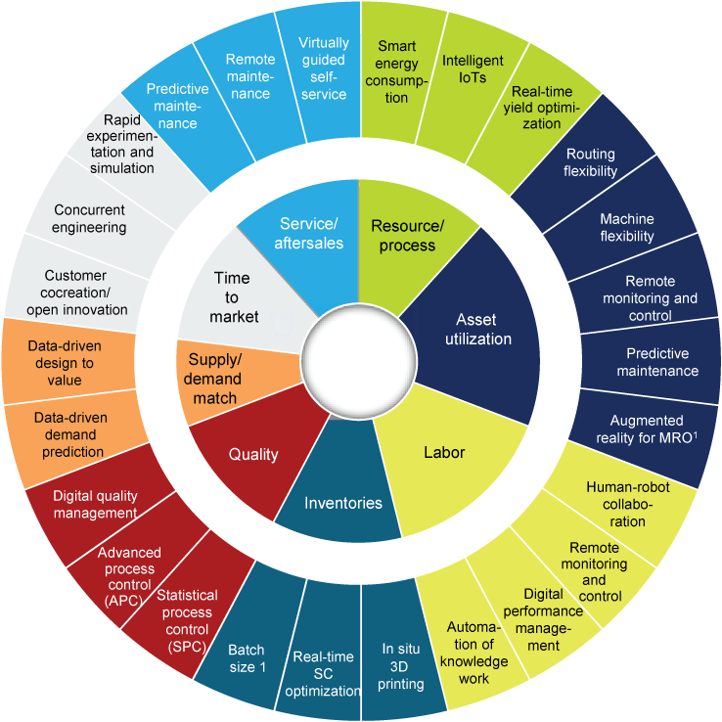

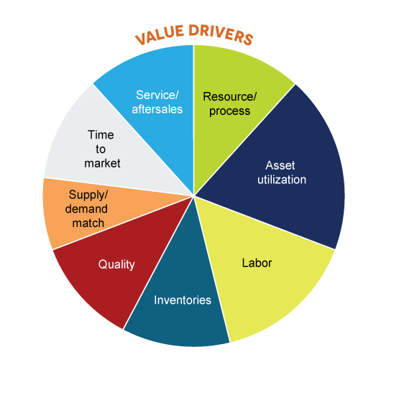







MULTIPLE LEVERS OF VALUE CREATION
8
Secomea's remote access technology facilitates service and predictive maintenance
1
ABB predicts various process variables in lime kiln plants to in-crease productivity
2
Condition-based maintenance at BMW and GE leads to fewer breakdowns
7
Local Motors leverages 3-D printing, crowd-sourcing, and micro-factories
3
Knapp uses augmented reality glasses to increase ware-house worker effectiveness
6
Automotive player uses big data analytics to adapt offerings to customer needs
Automotive player
4
Würth developed "intelligent" storage boxes to improve inventory management
5
Toyota uses advanced analytics to decrease quality issues in production
Source: McKinsey

Slide 7
Industry 4.0 value add
ADDITIONAL REVENUE FROM
2.9 %
Digitising products and services within the existing portfolio
New digital products, services and solutions
Personalised products and mass customisation
2.9 % increase expected in revenue from digital products until 2020
LOWER COST AND EFFICIENCY GAINS FROM
$28 Bn cost reduction for the automotive industry until 2020
Real time control & optimization
Predictive maintenance on key assets
Digitisation and automation of processes
3.9 %

Slide 8
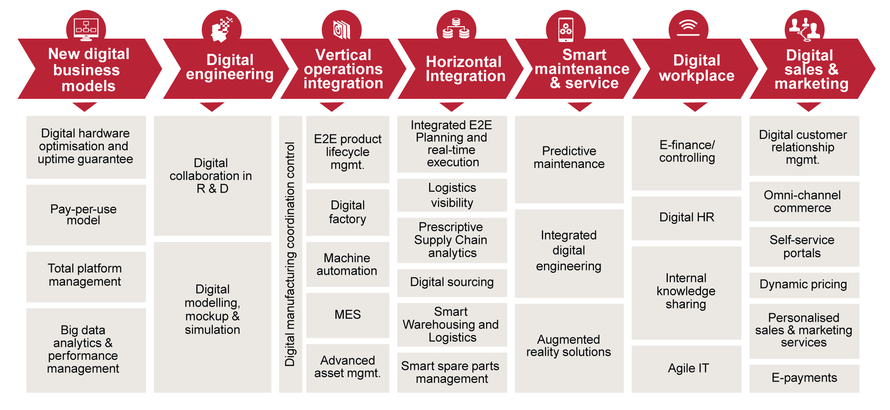
DIGITIZATION OF MANUFACTURING VALUE CHAIN
Source: PwC
Source: PwC

Slide 9
INDIAN MANUFACTURING INDUSTRY OVERVIEW

Slide 10

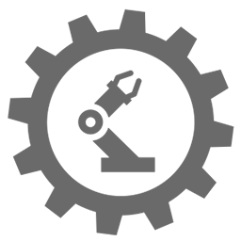



Indian Manufacturing Industry – Market size & growth
Manufacturing (Gross Value Added)
CAGR 4.5%
INR Crore
17% – Contribution of Manufacturing in Indian GDP
USD 1 Tn- Expected Indian Manufacturing Size by 2025
Manufacturing (Gross Capital Formation)
90 Mn– Jobs to be created in Manufacturing sector by 2025
CAGR 13.88%
INR Crore
6th – India’s Ranking in top Manufacturing Nations
181 Products – to be locally manufactured India currently imports

Slide 11




MANUFACTURING – key sub-verticals in indian market
AUTOMOBILE SECTOR
Accounts for 7.1% of the country's GDP
25.3Mn automobiles produced in FY17
Total production volume grew at a CAGR of 4.43% during FY12-17
Automobile exports from India increased 15.81% YoY in April-February 2017-18
IRON & STEEL SECTOR
Production forecast to double by 2031, with growth rate expected to go above 10% in FY18
As of 2018, India is the world’s 3rd largest producer of crude steel (up from 8th in 2003)
India’s steel production in 2017 stood at 101.4 MT
CEMENT SECTOR
India - world’s 2nd largest cement market, both in production and consumption
As of FY17, a total of 575 operational cement plants in the country
Cement industry has capacity of 460 MTPA as of December 2017
TEXTILE SECTOR
Contributes 14% to industrial production and 4 per cent to GDP
India’s textile market as of Feb 2018 was around US$ 150 Bn
Govt aims to achieve US$300 billion worth of textile exports by 2024-25 and create additional 35 million jobs

Slide 12

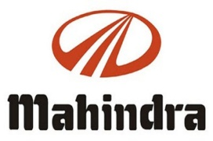




Major investments and developments in manufacturing sector
Announced plans to expand its manufacturing capacity to 60,000 units per annum within a span of 18 months
Planning to invest Rs 1072 Cr on its new engine plants and projects
Setting up an electric vehicle (EV) manufacturing unit in Gujarat at an estimated cost of Rs 4,000 crore
Entered into a JV with Tata to set up a new facility in Hyderabad to manufacture Boeing AH-64 Apache helicopter fuselages
Plans to invest Rs 500 crore to set up another unit in Maharashtra to make mango, pomegranate and orange-based citrus juices
Plans to set up a new manufacturing unit near Bengaluru by making an investment Rs 1,059 crore

Slide 13
INDIAN AUTOMOTIVE INDUSTRY

Slide 14
Indian automotive industry: Market size & growth
Govt. of India envisages 6M hybrid and electric vehicles by 2020
The Indian Automotive industry is on a steady rise
14.78%
2017-18
16.12%
2017-18
2016-17
2016-17
Growth in Production
Growth in Automobile exports
Notes:
Sources:
http://www.siamindia.com/statistics.aspx?mpgid=8&pgidtrail=9
https://www.ibef.org/industry/india-automobiles.aspx

Slide 15




Trends in automotive industry to improve customer experience
Automotive AR market is expected to grow at a CAGR of almost 18 % by 2020.
Mercedes-Benz offers a rescue assist app that informs drivers about vehicle and driving conditions
AUGMENTED REALITY
Showrooms are being transformed into omni channel market places where customers can experience real time driving experience through VR devices
Audi virtual showrooms in London, which is an example of VR enabled showroom gives customers a real time driving experience
VIRTUAL REALITY
Google and Tesla are both expending millions of dollars on autonomous cars and R&D teams.
In October 2016, Tesla announced that all new Tesla vehicles will come equipped with all the hardware needed for fully-automated driving
Volvo XC40 launching soon in India is expected to have semi autonomous capabilities
AUTONOMOUS VEHICLES
Using advanced self-diagnostic systems, drivers are instantly alerted of any problem, reducing mechanical failures and recalls
Michelin’s tyre monitoring program uses predictive analytics and telematics to monitor tyres’ health and can predict when it needs replacement
PREDICTIVE MAINTENANCE

Slide 16
Indian automotive industry: KEY HIGHLIGHTS
Accounts for 7.1% of the India’s GDP with Electric vehicle (EV) sales expected to witness a double-digit growth till 2020
Automobile players in the Indian market expected to be a world leader in the 2W and 4W market by 2020
Big investments and experimentation in Crossover vehicles will be seen, for its versatality and practicality
Due to the safety benefits and cost-effective nature of 3D printed cars, 2018 will witness larger investments from big-name manufacturers
M&M leading the electric fleet cars market
Partnership with Uber for deploying its electric sedans in New Delhi & Hyderabad
Additional INR 500 Cr of investment for enhancing the electric plant in Chakan
Driverless with autonomous vehicles - After Google and Uber, 2018 will witness a string of automotive giants launching their own variants of autonomous vehicles
2018 will witness a higher number of cars with interconnected features that will allow app developers to adapt their offerings to cross platform users on mobile, tablet etc.

Slide 17




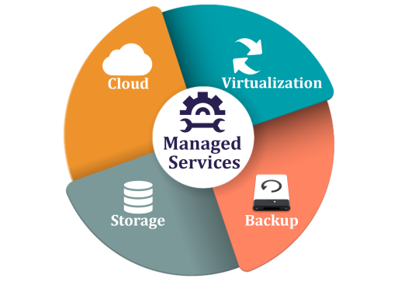
KEY ICT TRENDS
ICT trends that will redefine the Business Strategy of all the key players not wanting to become obsolete tomorrow!
CLOUD
SECURITY
IoT
MOBILE
REMOTE MANAGED SERVICES
PaaS, IaaS to aid Advanced Analytics, ML & Big Data
Enablement of ‘Voice of customer ‘ programs to collect customer feedback
Improved visibility, transparency & adaptability
Greater multichannel integration
protected APIs to permit integration among ecosystem partners
Security of data generated from sensors etc which are vulnerable to viruses and hackers
‘Internet of vehicles’ & connected cars have entered the foray
Connected vehicles (to the internet) to be the next big ‘thing’, with steady adoption in the next 4 years
Paperless monitoring at garages
Access to accelerometer information
Connecting wirelessly to any onboard devices, getting insight into the cars
Hassle-free, on-time fault rectification with zero downtime (complete management of ICT infrastructure)
Less pressure on internal IT staff
Ability to focus on core competencies

Slide 18


AUTOMOTIVE GIANTS ADOPTING ICT
Sify transformed one of the most complex WAN networks in the automotive industry, leading to seamless operation of the dealer network
CHALLENGE
With the company increasing its product portfolio, a more robust dealer management system was needed to digitize the supply chain system
The dealer outlets were geographically dispersed
Sales are highly dependent on applications and a high performance WAN
SIFY SOLUTION
Sify designed the WAN across media and technologies
WAN is monitored and managed by the Sify Network Operating Center (NOC)
WAN security and compliance are enforced through a remote Security Operations Center (SOC)
Sify provided the company with secure access to remote users
BENEFITS
Low operations overhead and lower TCO
Seamless operations of the dealer network, consistent performance of the dealer management system on-site
High uptime with service resiliency
Secure and compliant WAN network, on par with global standards

Slide 19




AUTOMOTIVE GIANTS ADOPTING ICT
Need: comprehensive network coverage for DDoS attacks, for ensuring that external threats do not bring down the infrastructure
Multiple bandwidth speeds and optimal bandwidth usage
Solution Offered: Managed DDoS solutions
Activity: By removing attack traffic within the Tata Communications’ IP backbone, this service rapidly clears threats in the cloud before they hit the customer network. Both bandwidth and security option was utilized ensuring problem escalation and resolution in taken care of at a single source.
Benefit:
Improved business continuity and availability of critical infrastructure
24x7x365 service mitigates DDoS attacks while legitimate network traffic passes through
Improved regulatory and information security compliance
Scalability per bandwidth requirements
High-speed, scalable, redundant backbone architecture
Need:- Hosted on an outdated infrastructure at the end of its lifecycle.
Bandwidth was not optimized and the company recognized that the maintenance costs were no longer sustainable.
Furthermore, the old website infrastructure was not scalable, preventing the company from supporting new online initiatives as well as the increasing number of visitors to the website.
Solution Offered: Cloud Computing (IaaS Model)
Activity:- The company decided it wanted the scalability, flexibility, and cost benefits of cloud computing, and chose AWS. Lamborghini was able to take advantage of the AWS self-service approach to quickly design and implement a new architecture that could scale up or down to meet workload demands.
Impact:- Reduced the cost of our infrastructure by 50%, while at the same time achieving better performance and scalability. Today, their time-to-market is close to zero

Slide 20
SIFY CAPABILITY MAPPING

Slide 21
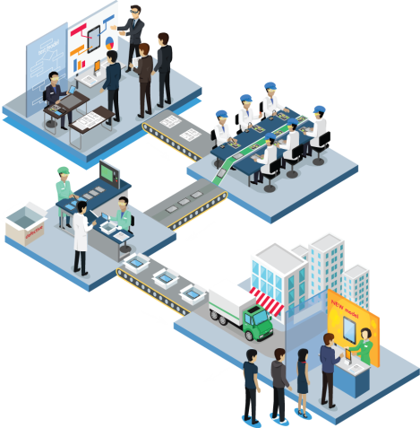
SIFY’s IOT PLAY
SHOP FLOOR
OUTSIDE SHOP FLOOR
Sify managed Wi-Fi converts factory floor into Connected factory
Sify Wi-Fi helps in IT & OT integration by connecting things, machine, database, business systems
Fleet management
Cold chain monitoring
With Sify managed Wi-Fi and IoT application, one can do asset tracking, TAT control, wireless tooling, cyber physical interfacing
Connected refrigerator
Predictive analysis, Operational intelligence through data in motion analysis at the edge and data at rest analysis in cloud
Heavy equipment tracking
Building energy management
Connected appliance
Air quality management
Waste management
Product as a service
Employee tracking and safety

Slide 22



















SIFY's APPLICATION PLAY
SAP S/4 HANA
SALES
PROCUREMENT
MANUFACTURING
MAINTENANCE
SIFY’S
PRIVATE CLOUD
ENGINEERING
SCM
QUALITY
PROJECTS
FINANCE
IT
SAP S/4 HANA
Sify Data Center
Advanced Availability to Promise
Accelerated
MRP
Integrated
Quality
Management
Efficient
Procurement
Distributor
Salesman
Retailer
Effective Order Management
Real time Inventory Management
Advanced Finance
Sify Forum (DMS + mobility)

Slide 23
We can elevate you!
With the new digital wave SIFY aims to elevate organisations and be their trusted partner for ICT needs
CLOUD
SECURITY
IoT
MOBILE
REMOTE MANAGED SERVICES
Simplified ERP solution with intuitive User Interface
On-premise or hosted private Cloud infrastructure
Sify cloudinfinit
Sify Global Cloud Connect
AWS, Azure Stack (Partnership with Akamai, SAP, Oracle & Microsoft)
Protection against data breaches, hacks and leakages, phishing
Proactive incident management and response through-
DDOS
SOC
Security Managed Services
APT
SIEM
Enable transformation to a connected workplace and connected devices
‘Sify Wifi Services
Sify IoT services with Aeries
Oracle MCS (Mobile Cloud Service)
Enable development of Mobile solutions through-
Managed WiFi
Managed Network
Sify MPLS
Ethernet
Sify Managed Services – reduce IT hosting costs
Migrating workloads to fully managed private and public cloud infrastructure
Sify Managed Services

Slide 24
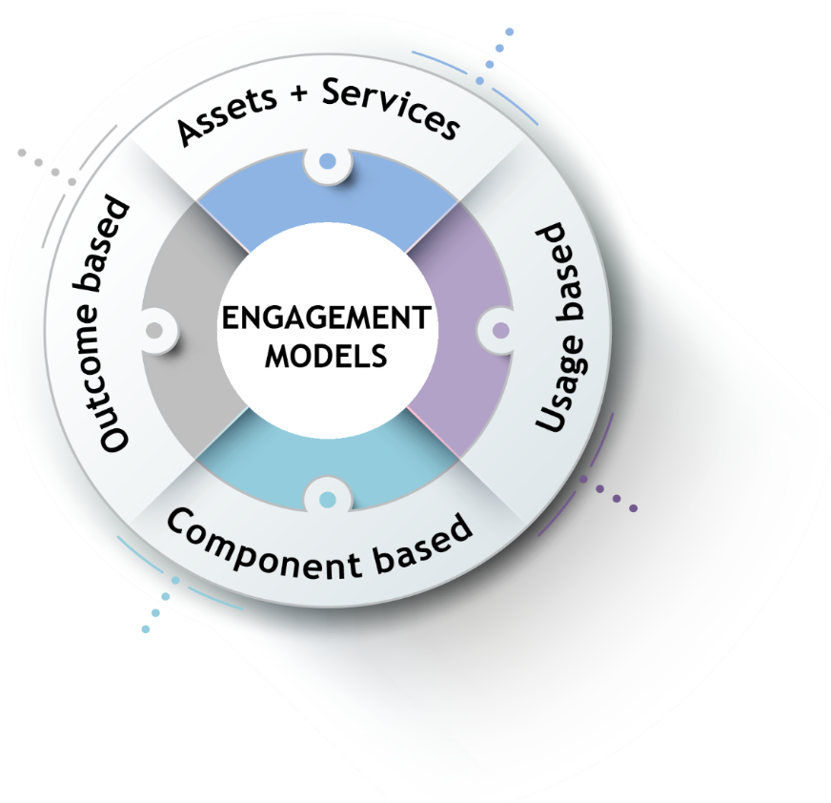
ENGAGEMENT MODELS
Less
Hardware
People
Licenses
Systems are owned by the client and annuity based payout for services
Client engagement is based on defined business outcome generated by IT solutions and services
No upfront investment by client and payout is based on consumption
Reduced upfront investment as client subscribes to infrastructure owned by Sify as a part of their overall infrastructure requirement

Slide 25
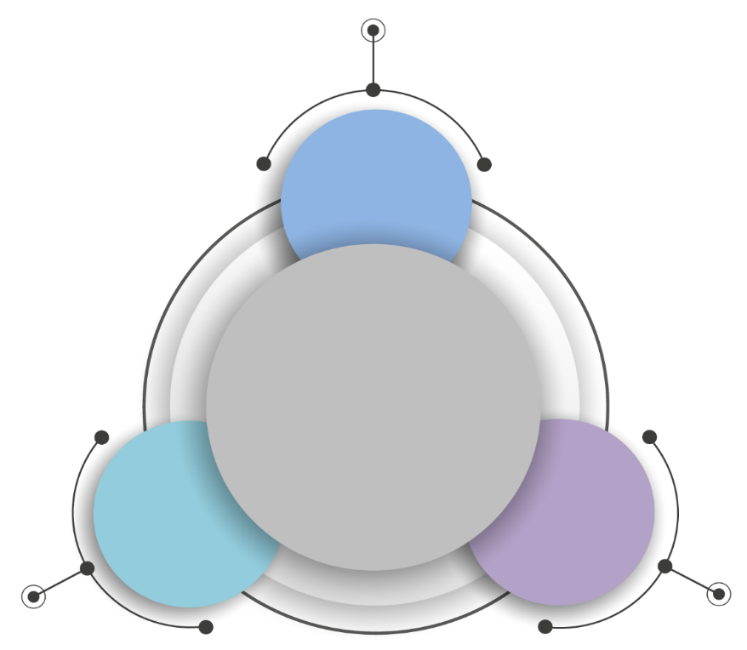



COMMERCIAL MODELS
Model 1
COMPONENT ALIGNED
Per Mbps
Per Rack
Aligning ICT
to chargeback to the unit of measurement defined
by business
Model 3
BUSINESS ALIGNED
Model 2
USAGE ALIGNED
Per Transaction
Per Outcome
Per vCPU
Per vRAM
Per ## SAPS

Slide 26








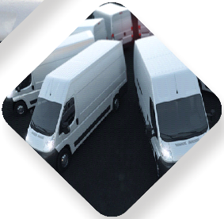

OUR SERVICES MODEL ALIGNED TO CUSTOMERS’ DIGITAL JOURNEY
UTILITIES
HEALTHCARE
INSURANCE
TRAVEL
Pay per bill
Pay per patient
Pay per policy
Pay per trip
EDUCATION
RETAIL
STOCKS
MANUFACTURING
Pay per
Pay per item
Pay per
Pay per tonne
student
transaction
Sify
Service
Transformation
Consumption
Model
Unit

Slide 27


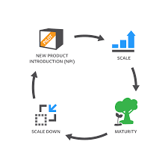

Organizational Shift and Sify Capabilities for Industry 4.0
MARKETING & SALES
CRM & Digital
Customer Analytics
Sales force Enablement
OPERATIONS
IIOT
Asset Management
SCM Digitization
PLM
Process Visualization
Digital Product Development
Digital Twin
HR & Security IOT Security
Workforce Management
IP Protection
Key activities shaping each function
Connect Devices
Sify IOT Platform & Network Services
Develop Applications
Sify application & managed services
Host on Cloud/DC
Sify Cloud & DC Hosting
Secure Infrastructure
Sify Security Services
The Sify Capability

Slide 28
Manufacturing trends vs Sify investments(WIP)
INDUSTRY 4.0 TREND | ICT IMPACT | SIFY INVESTMENTS/CAPABILITIES
Supply chain digitization, Analytics, AI & ML for predictive maintenance and asset management | Cloud | 6 PAN-India cloud enabled data centers with a total capacity of 47 MW Private and public cloud platforms with partnerships with leading cloud providers like AWS and Azure
Protection of sensor generated data and intellectual property | Security | 15+ years experience of Information Security Life Cycle Management. Experience covering 30+ OEM solutions & Platforms
Enable connected manufacturing and unlock deeper insights | Internet Of Things | Managed WiFi and IOT providing complete IT &OT integration End to End IOT integration connecting things, machines, database and business systems
Cross and inter-connectivity of devices and machines | Networks & Connectivity | Largest MPLS network (by connections) spanning 1400 cities and towns Managed SDWAN with built in security and performance management
Development of new digitally empowered apps and remote management of IT infra & services | Applications & RMS | Partnerships with application providers such as SAP, Oracle and Microsoft Expertise in developing applications with in house apps such as I-Test, Forum

