Slide 1

SAP S/4 HANA cloud solution for
Mahindra & Mahindra
January ‘21

Slide 2
Sap - EXPERIENCE ADVANTAGE
50+
50+
20+
No. of SAP cloud customers
No. of SAP systems migrated to cloud
No. of SAP DR
10,000+
25+
100+
Size of supported SAP User base
No. of customers on
Basis support & AMS
Years of Basis experience

Slide 3
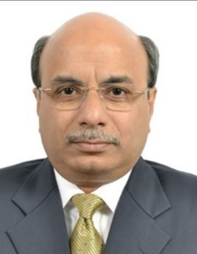

SIFY’s engagement TEAM
Subhasish Dhar
Head of Delivery – Application Services
Subhasish has 30 years of strong solution-focused consulting experience across multiple domains in Digital, IBM, SAP and Sify. Being with SAP India Consulting for more than 5 years followed by 13 years in SAP Global Delivery, Subhasish has delivered large and complex business solutions for customers across the globe in multiple industries.
Role in Project : Delivery Governance
Kunal Joshi
Lead Solution Architect SAP
Kunal has 20+ years of experience in SAP Solutioning with SAP Basis Background and Certifications on HANA, Oracle and SAP and has been with Sify for last 3+ years as the Lead of Sify’s SAP Solutioning team. He handles Solution Design, and Presales for All Major SAP opportunities pan India. In his earlier role in HP Kunal has delivered 100+ SAP migrations
Role in Project : Solution Design for SAP Infrastructure and Application Migration

Slide 4
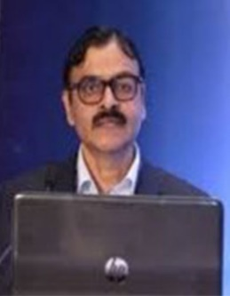
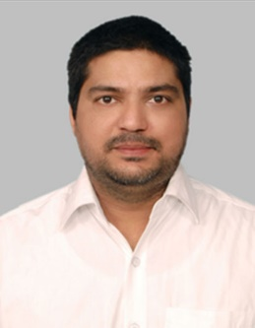
SIFY TEAM
Prashant Pimpalekar
Head – SAP Practice & Delivery
Prashant has total 30 years of experience and has been with Sify for last 6.5 years. As the Head SAP Practice & Delivery, he is responsible for seamless delivery of SAP projects, developing competencies & sales/presales enablement. His technical articles are published in Dataquest, Communications Today & ERPITWorld.com.
Role in Project : SAP Migration Head
Venkata Ramana R
Technical Lead of SAP BASIS/HANA
Venkata has total 15 years of experience in SAP BASIS with multiple SAP Certifications and has been with Sify for last 4+ years as the Lead of Sify’s SAP BASIS/HANA team, he handles the all SAP BASIS AMS accounts ,SAP Implementation , SAP workload migration and DR setup projects.
Role in Project : SAP Migration Practice

Slide 5


























Snapshot of sify’s sap offerings…
Cloud Migrations & Carve Outs
SAP Application Management
Upgrades & Conversions to HANA
Implementation & Roll-out Services
and many more …

Slide 6
SAP Practice
Competencies
Types of Projects Delivered
Accelerators / Automation enablers used
SAP Technical –
SAP HANA, Basis
SAP ABAP / Fiori / EP / PI-PO / BI
SAP Functional
FICO/MM/SD/PP/PM/QM/ HCM/PS/APO/WM
More than 60% of team is SAP S/4 HANA certified (Migration / Logistics / Financials)
SuccessFactors
Average SAP Experience – 6.5 yr.
Hosting on Sify CI / AWS / Azure
Migration / DR – Sify CI / AWS/Azure
OS/DB, HANA Migrations
SAP S/4 HANA greenfield implementation
Data archiving
SAP GST deployment
SAP DCS deployment
eSigning / integration of digital signatures
Power BI – SAP Integration
SAP Application Management Services
Avantra
Solution Manager
SAP SWPM
SAP SUM
eCATT
ASR (by Microsoft)
ServiceNow

Slide 7
MATURE SAP PRACTICE
More than 60% of consultants are SAP-certified:
SAP S/4 HANA conversion
SAP Cloud Platform Integration
SAP Extended Warehouse Management
S/4 HANA Financials
S/4 HANA Sales
S/4 HANA Sourcing & Procurement
S/4 HANA Asset Management
functional / migration related certifications)
ABAP for SAP HANA
SAP Fiori
SAP Process Orchestration
OS/DB Migration
HANA 2.0
Solution Manager
SAP System Administration (SAP HANA)
SAP Activate Project Manager
Average SAP work experience of our resources – 5+ years
Team trained on S/4 HANA conversion

Slide 8
SAP Certified GRID
Certified since 2013 in following operations
SAP Certified in
Hosting Operations
SAP Certified in
Cloud & Infrastructure Operations
SAP Certified in
SAP HANA Operations
SAP Certified
in
Application Operations for SAP S/4 HANA
SAP Certified
in
Application Operations for SAP Business Suite
Notes:
Sify undergoes a bi-annual audit conducted by SAP wherein the auditor (from SAP SE) visits Sify office / datacenter / team & conducts a thorough audit for 2 days. We got our services audited successfully in 2015, 2017 & recently in Nov. 2019. Certifications are valid for 2 years (from the date of audit) .

Slide 9
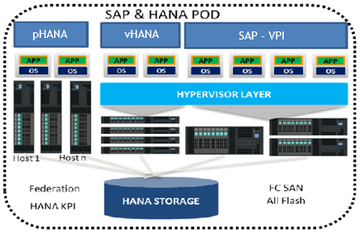
SIFY’s SAP HANA GRID
Enterprise Network Perimeter Security (FW/IPS).
Enterprise network grid with 10Gig reserve throughput for production traffic.
Enterprise Hypervisor VMware platform with reserved resource as per SAP guideline.
HANA certified all flash Storage SAN on 16 G FC protocol for high throughput, IOPS and low latency.
VMware - HANA best practice, anti-affinity rule strictly followed for high availability.
HANA KPI is maintained at all level to adhere to SAP guideline and certification.
Isolated network adapters for backup, management and monitoring traffic.
Enterprise disk-based Backup grid with Geo vaulting remote copy

Slide 10


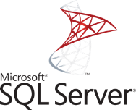


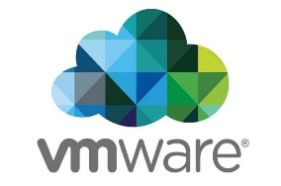
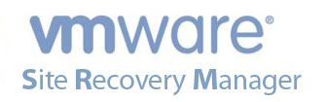


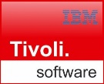


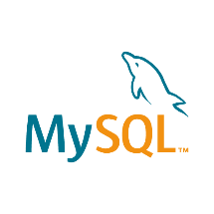

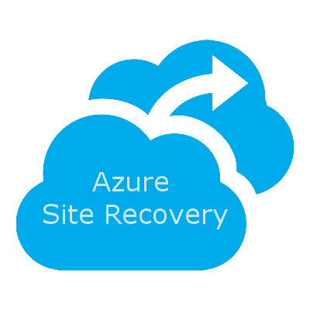





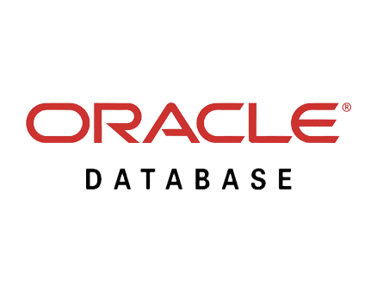





















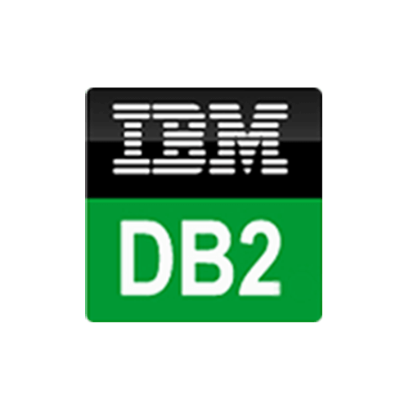



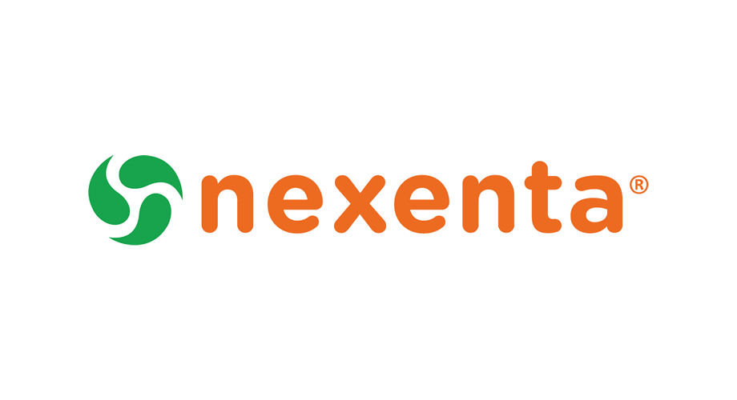
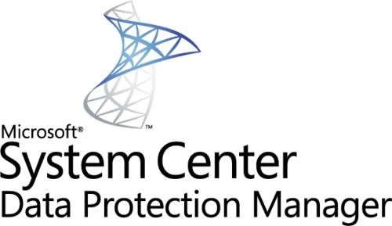














Technology Capabilities
OS & Applications
Backup
Database
Storage
Virtual Infra & Cloud
Network
DR Tools

Slide 11
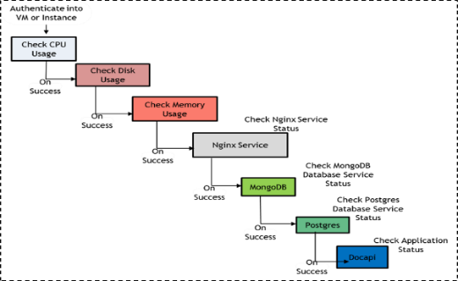
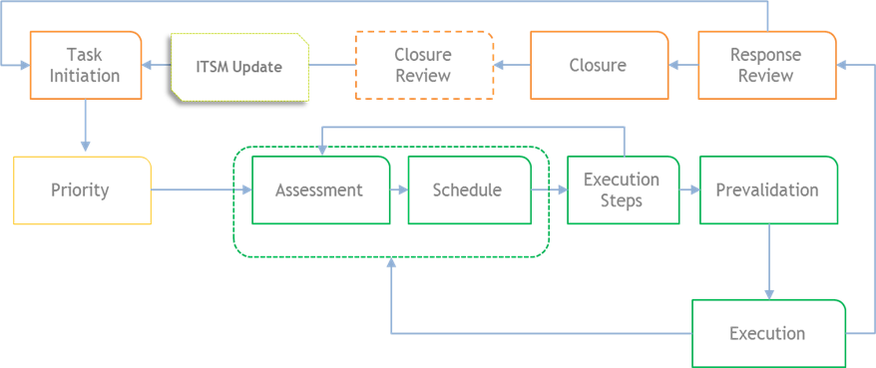
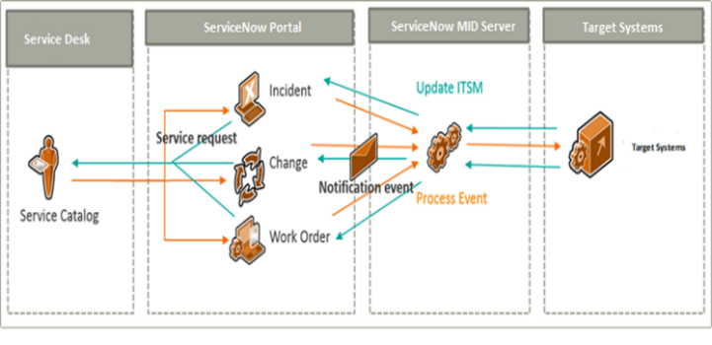
Automation
Workflow automation
Run Book automation
Service desk integration
Few reference for use case automated
Active Directory User Management
Exchange Mailbox Management
Linux File deployment from SVN
DNS Records
VMware ESX Hardening
Log rotation on systems and network devices
Message parsing on Active Directory & Microsoft Exchange Servers
Daily Health checks on Network devices, Storage Systems & Databases
Configuration backup of SAN / LAN Switches & Firewalls
Automated Ticket Routing
Workflow & Runbook based automation for predefined request categories
Pre-fetch & auto update tickets with high CPU/Memory consuming processes
CMDB Updates
Integrated OEM Ticketing & Escalation (Live for AWS)
Notes:
David

Slide 12
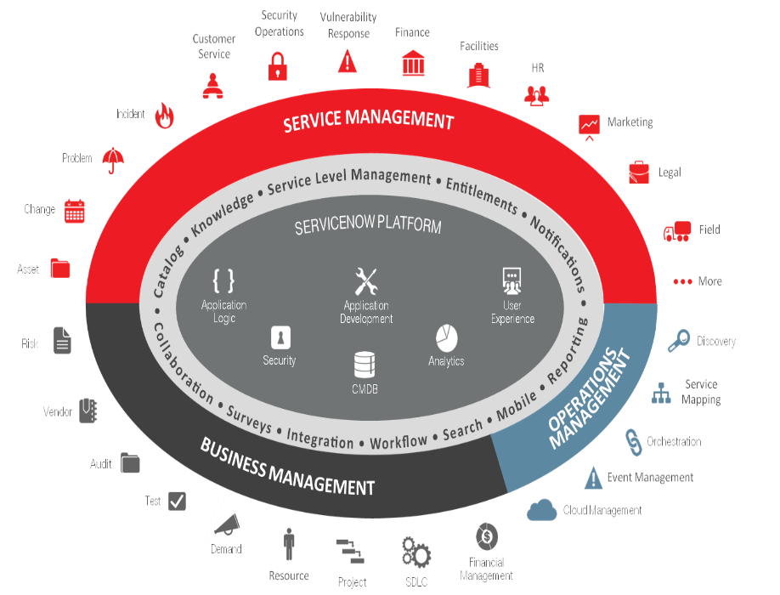
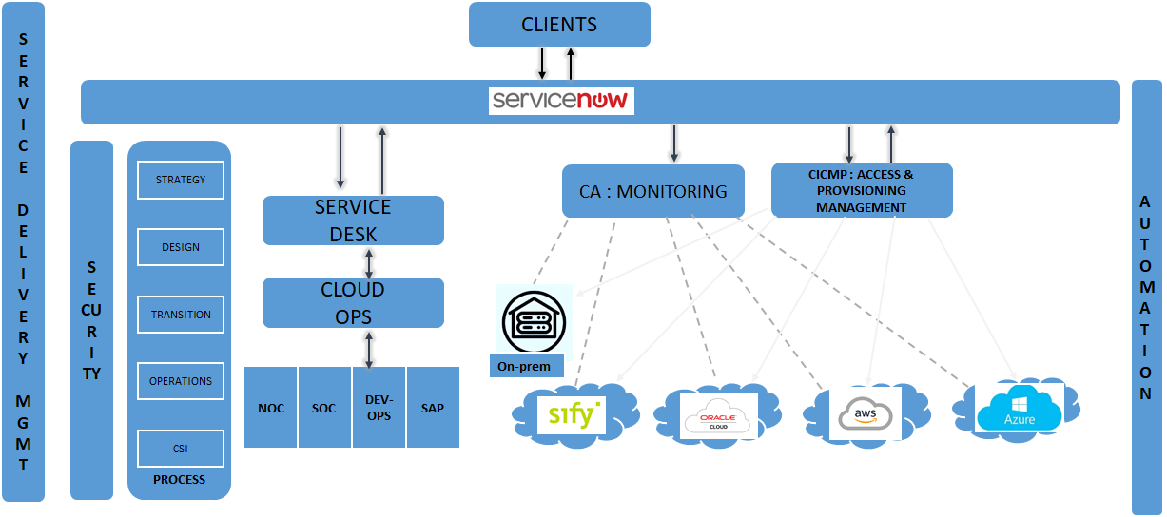

ITSM tool Capability
ServiceNow is the ITSM and dashboarding tool
All monitoring and management tools of network, security, data center and cloud services are integrated into ServiceNow.
Infrastructure Automation
Workflow Automation
IT Process Automation

Slide 13
Monitoring Landscape
APPLICATION MONITORING
SERVER MONITORING
CLOUD MONITORING
Microsoft Exchange
Apache Tomcat
Microsoft IIS
SharePoint
MS Active Directory
Microsoft Windows Server
Linux/Unix
Solaris, AIX, HP-UX, Linux, Sinix, Tru64 UNIX, Red Hat
Cisco Unified Computing System (UCS)
IBM Power Systems
Novell Open Enterprise Server
Private
Flexpod, Vblock
Public
AWS, Rackspace, MS Azure, Google App Engine, Google Apps, SFDC CRM
Citrix CloudPlatform
OpenStack
Apache CloudStack
vCloud, Pure Storage
Docker, Nutanix
VIRTUALIZATION MONITORING
NETWORK MONITORING
DATABASE MONITORING
VMware
Citrix XenServer
Microsoft Hyper-V
Router and Switch
Network Response Time
Cisco Qo5
Cisco IP SLA
Flow Analysis
Cisco NX/MDS
HANA
Oracle
Microsoft SQL Server
MySQL
DB2
Postgre
MongoDB
DATACENTER MONITORING
STORAGE MONITORING
VOIP / VDI MONITORING
Data Center Power, Cooling & Energy
EMC
Hitachi
Nimble
IBM System Storage
Dell
NetApp
HP
Cisco VoIP
Citrix XenDesktop / XenApp
RESPONSE TIME MONITORING
Website
Application
Email
DNS, DHCP
Database
Active Directory

Slide 14
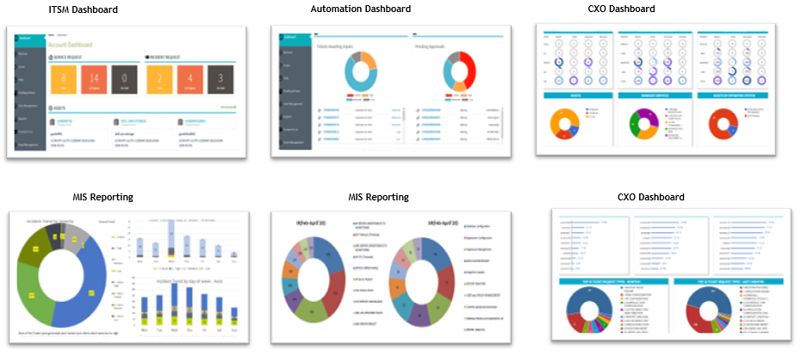
Dashboards & MIS Reporting

Slide 15



















PARTIAL LIST OF Sify’s SAP HANA Customers
Manufacturing
Healthcare & Pharma
Utilities
FMCG
Power

Slide 16















PARTIAL LIST OF Sify’s SAP DR Customers
Manufacturing
Construction & Real Estate
Logistics and Distribution
FMCG
PSU
Healthcare & Pharma
Power
Enterprise limited
(CCL & Solutions)

Slide 17
Sify’S SAP CLOUD
Set up in 2014 for hosting SAP HANA and non-HANA systems in TDI model.
HANA systems deployed in both dedicated and shared cloud model depending on the size and customer preferences.
Entire setup is certified by SAP SE Waldorf for Hosting Operations, HANA Operations, Cloud & Infrastructure Operations and Application Operations for S/4 HANA and Business Suite. Recertified every 2 years most recently in Oct 2019.
Sify provides and manages SAP HANA cloud infrastructure for 50+ customers with 20+ on HANA.
The consolidated size of shared cloud HANA systems currently managed by Sify is around 50 TB which is growing over time.
Sify manages multi-cloud and hybrid deployments of SAP landscape comprising of Sify’s own SAP grid, hyper scale cloud.
pHANA
vHANA
SAP - VPI

Slide 18
SIFY’s SAP HANA GRID
Enterprise Network Perimeter Security (FW/IPS).
Enterprise network grid with 10Gig reserve throughput for production traffic.
Enterprise Hypervisor VMware platform with reserved resource as per SAP guideline.
HANA certified all flash Storage SAN on 16 G FC protocol for high throughput, IOPS and low latency.
VMware - HANA best practice, anti-affinity rule strictly followed for high availability.
HANA KPI is maintained at all level to adhere to SAP guideline and certification.
Isolated network adapters for backup, management and monitoring traffic.
Enterprise disk-based Backup grid with Geo vaulting remote copy
Integrated Industry leading ITSM, monitoring and automation tools for managing entire landscape on a single pane of glass.

Slide 19


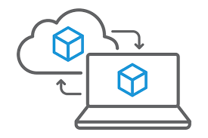


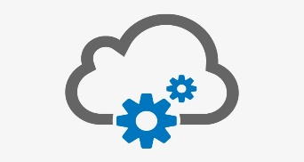

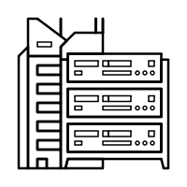




Rich experience of SAP migrations & DR
On Premise --> Sify InfinitSAP
Other Provider --> Sify InfinitSAP
Upgrades with Migrations
On Premise / Hosted --> AWS
On Premise --> On Premise
DR Setup on Cloud
Successfully migrated 50+ SAP systems
25+ migrations executed with re-platforming
20+ SAP DR on Cloud
10+ migrations with simultaneous technical upgrades or updates
Experienced in complex SAP Data Carve-out

Slide 20

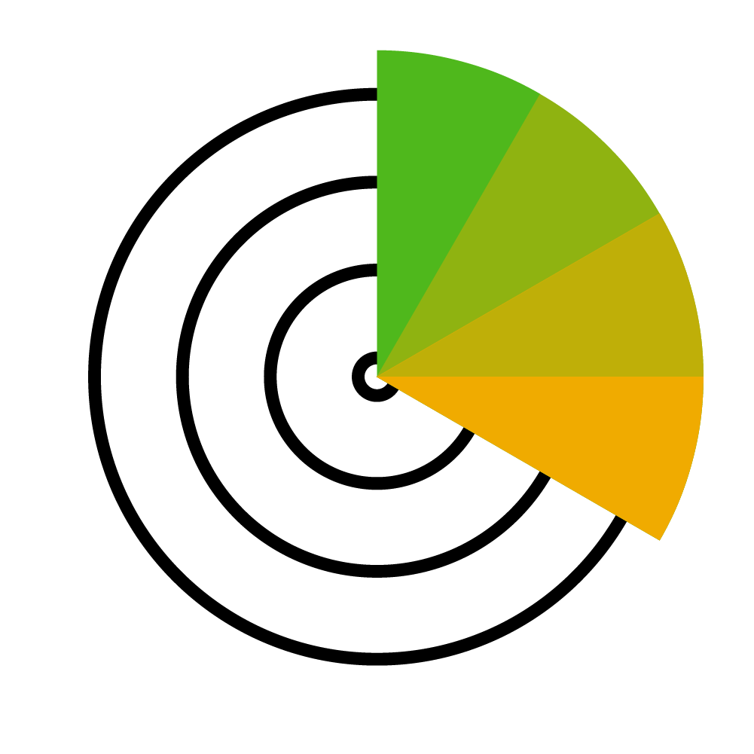


SAP APPLICATION MANAGED SERVICES
Business Improvement
Business Improvement
Support customer in validation and activation of new business processes (features)
Requirements finalization
Configuration and testing
Release new / changed business processes / functionalities
Application Functional Services
SAP S/4 HANA / ECC Functional Application Services
Application Management
Event Management
Change Management
Incident Mgmt & Request Fulfillment
Application Management
Application trouble shooting
Bug fixes in existing configuration
Bug fixes in enhancements
Basis Services
Basis Administration
Event Management
Recurring review of job and application logs
follow up of relevant error messages
Cloud integration (end-to-end monitoring)
Change Management
Technical change management
Integration management
Incident Mgmt (across systems) & request fulfillment
Follow-up of error messages
Cloud Technical Services
Infrastructure Managed Services
Cloud Infrastructure
S/4 HANA /ECC Cloud Infrastructure
Infrastructure Managed Services
Application Managed Services
Notes:
- Offer test management and execution. Cleaning up the current system.

Slide 21

Manage. Monitor. Automate
SAP BASIS Administration – Logical extension for SAP cloud
Many of our cloud customers selected Sify for Basis support
On premise / Sify SAP cloud / hyper scalers / hybrid
DC / DR / Priamary + Secondary
Flexible & scalable support models
24x7 coverage
Cost effective – benefits of tools and automation
Reduced person dependency, knowledge process framework
Not reliant on SAP tools only
Avantra
Technical Performance Monitoring
Cloud Automation
Reporting & Dashboards
Proactive Management
Full Landscape Visibility
Automation
Time savings
Improve quality & consistency
Business Process Monitoring
Audit, Security & Compliance
Predictive Resource Consumption

Slide 22
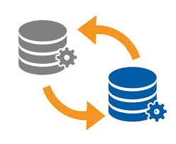

COMPLEX migrations - TATA sponge – SAP Carveout
TATA SPONGE has purchased Steel business unit from UML (Usha Martin Limited). As part of agreement and out of statuary requirement, business specific data pertaining to only the Steel Business needed to be carved out of Usha Martin’s system and moved to new SAP landscape set up in AWS.
Scope of Work
Solution Highlights
Perform Selective carve-out of SAP data based on specific Profit Centers, Cost Centers, Plants from source SoH system`
Set up a new SoH landscape on AWS with the Carve-out data
Migrate APO, DMS, Portals from on Premise to AWS
Integration of SAP systems between SoH, APO, EP, DMS
Built the SAP Sandbox server from PRD server and Data Carve out has been carried successfully.
The End User connectivity for the New Cloud Servers
Site to site VPN connectivity
SAP integration & landscape were maintained
Challenges
Benefits
Maintaining SAP system Connectivity with APO, EP during & after carveout
Clear separation between data that may be transferred and data that cannot leave the selling company under any circumstances for compliance reasons
Risks for the continuation
Avoidance of impairments of the SAP systems during the carve-out
Identification of the data to be transferred to the buyer’s systems
Data protection during carve-out
Improvement in SAP system performance
Carving out only specific data based on profit center
Minimal business impact
Harmonization of data
Reduction of time due to the optimization framework

Slide 23

SEForge- S/4 HANA migration to sify cloud
Client
Overview
SEForge is an engineering components manufacturing company in India supplying fully-finished castings and forgings
Scope of Work
Solution Highlights
Landscape design SAP S/4 HANA (DEV/QA/PRD)
SAP S4 HANA (DEV/QAS/PRD)
SAP Fiori GW (DEV / PRD)
DMS (DEV/ PRD)
SAP Solman & Router Installation & Configuration
Migrate SAP landscape from Cntrl-S DC to Sify DC.
Providing AMS SAP BASIS support
Daily morning shares the monitoring sheet to customer reference.
Monthly share the TR import History details.
Quarterly share the SAP Audit Log Report
Benefits
Challenges
Improvement in SAP system and DB performance
Daily perfect monitoring and maintain reports
Less MPLS Bandwidth Link Between source and target
Data Copy from Cntrl-S DC to Sify DC
Minimum downtime for Migration

Slide 24

Tata STEEL MINING - S/4 HANA Deployment on hybrid cloud
Client
Overview
T S Alloys Limited manufactures metal products. The Company offers ferrochrome products. T S Alloys serves customers globally.
Scope of Work
Solution Highlights
Landscape design SAP S/4 HANA 1610 (DEV/QA/PRD) roll-out
S/4 HANA DC on AWS
S/4 HANA DR on Sify’s SAP Grid
Basis Administration and support in project phase and Post Go_live
Implementing the SAP DEV,QAS and PRD server on Sify Cloud
Documented AS IS - TO BE process for business
Configuration of SAP S/4 BASIS and Security design
Benefits
Challenges
DC and DR in 2 different seismic zones on hybrid cloud
Improvement in SAP system and DB performance
Scalablity (being on Cloud)
Stringent Timelines
User training

Slide 25

RCI Industries – S/4 HANA Implementation & AMS
Client
Overview
RCI Industries and Technologies Limited is a private company which offers Indian handicrafts, specially made by Copper & Brass metals. It also has copper strips and copper wire as its product. Sify is implementing the ERP software, SAP S/4 HANA 1610 FSP2 at RCI Industries and technologies limited.
Scope of Work
Solution Highlights
Implementation of SAP S/4 HANA 1610 FSP2 on cloud solution
Landscape design SAP S/4 HANA 1610 (DEV/QA/PRD)
Documenting business process
Mapping business requirements in SAP
Fiori apps, output and reports
S4HANA – AMS & books closure for 4 Quarters
Implementing the SAP DEV,QAS and PRD server on Sify Cloud
Documented AS IS - TO BE process for business
Configuration of SAP S/4 HANA FI,CO, MM, SD, PP, PM, PS, HR, Basis, ABAP modules
Developing custom programs for process enhancements
Developing Fiori application for analytical and transactional requirements
100 No of Users
200 Man-days AMS support
20 No of CR’s completed in AMS period
Benefits
Challenges
Enhanced user experience
Improvement in SAP system and DB performance
Scalablity (being on Cloud)
Content copy and Best practice activation
Complex business process mapping
Master data and transaction data upload for open items
User training

Slide 26

Emami Cement – SAP S/4 HANA DR
Client
Overview
A well-know diversified group with strong manufacturing operations. It has chosen SAP S/4 HANA as ERP for the backend operations.
Scope of Work
Solution Highlights
This is a greenfield SAP S/4 HANA implementation.
Infrastructure provisioning for SAP
Managed Services(OS, Virtualization)
Managed Backup Services.
Network &Security Services.
Disaster Recovery setup for SAP HANA Production System.
Phase 1: One SAP HANA SP10 physical box for QAS and DEV,with 7 VMs, another SAP HANA SP10 Production Physical box with 3 VMs & Phase 2 - BI/BW 7.4 provisioning completed
Phase 3: DR needed after 18 months
Implementation DC location – Navi Mumbai (Rabale).
Implementation DR location – Bangalore.
HANA DB size 350 GB
RTO: <=4 hours and RPO: <=30minutes
Benefits
Challenges
This solution is aligned to client’s business objectives. They wanted to leverage S/4 HANA’s Simple Finance offering, besides the usual SAP ECC core modules
Single window governance of Infra.
Minor issues in Data Centre Readiness
There were some issues in ‘last mile’ connectivity (client office in Chhattisgarh)

Slide 27
Highlights of proposed solution for M&M
HANA and non-HANA server platform configured on current generation processors of Cascade Lake platinum and gold
All HANA production systems are sized based on DDR memory (no persistent memory used)
Storage is on all Flash platform
HANA platforms set up as dedicated physical systems
Enterprise hypervisor virtual private cloud for other application and non-HANA databases
DC and NDR : TIER-III/TIA942 Certified Facilities
High-Availability, Scalability, Interoperability, Security, Managed Network
Integrated industry leading ITSM, monitoring and automation tools for managing entire landscape on a single pane of glass
Synchronised replication to meet RTO and RPO
DC and NDR connected through Sify’s MetroX Connect on high throughput and < 1 ms latency
RPO and RTO for NDR
Zero RPO from DC to NDR using synchronous replication
With third party clustering tool like Servicegaurd for SAP near zero RTO can be achieved for the HANA systems

Slide 28










Proposed architecture
SIFY
INTERNET
M&M Existing
DC
M&M Existing
NDR
250 Mbps
Sify DC (Mumbai)
500 Mbps
PRIVATE CLOUD
SIFY
P2P
500 Mbps
SIFY
P2P
WAN ROUTERS
SIFY
P2P
PERIMETER
FIREWALL
WAN SWITCH
SIFY
INTERNET
500 Mbps
SIFY Proposed NDR
NDR
M&M Existing FAR DR
NDR
PIM
1 Gbps LAN Extension
250 Mbps
CORE SWITCH
500 Mbps
Management
Switch
SAP HANA SERVERS

Slide 29

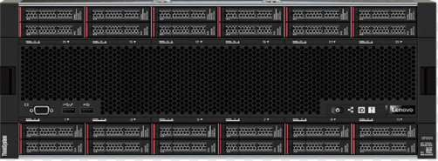
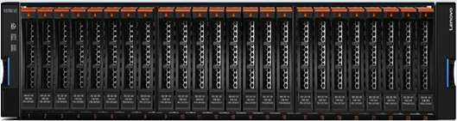
Infra configurations in DC : HANA and non-hana
32C (5218) / 128GB / 2 * 300GB HDD / 4 * 10G / 92560 SAPS (Production)
32C (5218) / 384GB / 2 * 300GB HDD / 4 * 10G / 92560 SAPS
2P / 40C (6248) / 384GB / 2 * 300GB / 4 * 10G / NO OS / 122410 SAPS
NON HAHA DB
Virtualized Application servers
NON HANA application Server
Physical (5 nodes)
VM VM VM VM
VM
(18 nodes)
. . . . . . . .
16G FC Fabric in HA
10G Ethernet Fabric in HA
(8276L - 28 Core) / 224 Core / 12TB HANA TDi Server with OS (1 no.)
HAHA Production 01 Upgradable up to 24 TB
8260L - 24 Core) / 192 Core / 12TB HANA TDi Server with OS (1 no.)
HAHA Non-Production Upgradable up to 24 TB
8260L / 96 Core / 4.6TB HANA TDi Server (3 no.)
HANA systems Upgradable up to 6 TB
Storage 01
120 SSD for HANA Nodes
140 TB SAS (Effective) for Appls

Slide 30
Infra configurations in NDR : HANA and non-hana
32C (5218) / 128GB / 2 * 300GB HDD / 4 * 10G / 92560 SAPS (Production)
32C (5218) / 384GB / 2 * 300GB HDD / 4 * 10G / 92560 SAPS
2P / 40C (6248) / 384GB / 2 * 300GB / 4 * 10G / NO OS / 122410 SAPS
NON HAHA DB
Virtualized Application servers
NON HANA application Server
Physical (3 nodes)
VM VM VM VM
VM
(14 nodes)
. . . . . . . .
16G FC Fabric in HA
10G Ethernet Fabric in HA
(8276L - 28 Core) / 224 Core / 12TB HANA TDi Server with OS (1 no.)
HANA Production 01 Upgradable up to 24 TB
8260L / 96 Core / 4.6TB HANA TDi Server (2 no.)
HANA Systems Upgradable up to 6 TB
Storage 01
75 SSD for HANA Nodes
120 TB SAS (Effective) for Appls

Slide 31


MIGRATION APPROACH
Key Considerations
Smooth transition to Cloud landscape
Minimum Business disruption
Approach
Sify will Migrate Current systems to Cloud using Replication Method.
Systems will be migrated landscape wise (e.g. All development in one phase, followed by Quality and then Production).
During the Migration Sify will require 1 Downtime in each Phase which will be switchover period of around 4 hours.
Before any Switchover UT, SIT and UAT will be performed jointly by Sify & M&M teams.
NDR will be built within 72 hours once Production environments will be moved to Sify Cloud.
FAR DR will be configured at Bangalore location post DC and NDR is operational from Mumbai.

Slide 32
MIGRATION APPROACH
Setup Development/Test/Production Application architecture in Sify DC Cloud (same DB as Current DB)
DC Switchover to Sify’s DC and Change access of Test users to Sify cloud for 1st level testing
System wise cutover to New DC with logical grouping
Installation of Application at NDR and Start Replication from Sify DC Cloud to Sify NDR Cloud
Start Replication of landscape from Current DC to Sify Cloud
Testing of New Environment with Test Users and Note down the changes required during cutover
DC Switchover to Sify Cloud with Change of User Access

Slide 33
High level Activities
M&M
SIFY
M&M
Backup of Current System before starting Replication
Changes in Current Production system for Replication
Provide Backup Plan to M&M to initiate Backups
Provide Parameters for Replications to M&M team
Installation of SAP systems at Sify DC
Enable Replication parameters at DR(Sify) site
Switchover from current DC to Sify DC
Installation of SAP in NDR location (SifyDC)
Enabling Replication between Sify DC and DR
User Acceptance Testing will be performed by M&M Business Users.

Slide 34
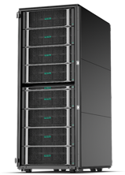
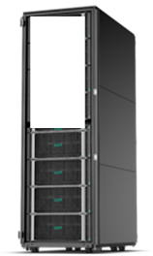

DC – NDR replication for clustered environment
SD Flex 8P / 12TB compute block (Production)
SD Flex 8P/12TB compute block (Near DR)
HPE Serviceguard Extension for SAP HANA System Replication
Smart Quorum for Full-proof Failure Fencing mechanism
Safesync System Replication to protect data integrity
Self-tuning HANA operation timeout monitoring
Decision logic for instance restarts vs takeover
Automation of failure detections, secondary takeovers and role reversals
HANA-aware easy deployment and administration
HPE Serviceguard
For SAP HANA
Sync Replication
HPE Serviceguard
Cluster
For ECC CI
Server 01
Server 02
Storage 01
Sify DC#1 & Sify NDR#1
Storage 02

Slide 35
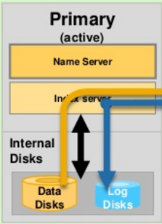
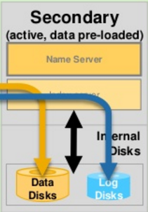
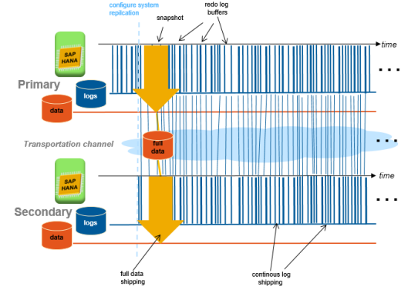
Sify’s disaster recovery APPROACH for Non Clustered Systems
DC
synchronous Replication with Log Replay
DR
Initial Full Data Shipping
Operation mode log replay: Initial full data and redo log shipped to secondary

Slide 36

WHY SIFY FOR SAP MIGRATION, INFRASTRUCTURE AND MANAGEMENT?
Matured Delivery for Cloud Migrations
Invested in State of art Tools and Automation
Single Vendor for end-to-end Application Uptime SLA
One stop shop for taking SAP to Cloud
Trusted Cloud Advisor-choice of Cloud Infrastructure
Expertise in S/4 HANA Implementation and Conversion
Integrated play across Telecom, Cloud and SAP Services
Experienced in specialized Migrations like carve-out
Notes:
And how we offer everything under one roof?
Because we have the tools and automation, we have the people skilled and certified, we have the processes qualified in various audits.
To summarise: huge installed base across all sizes and verticals
Our key Sales motions in 2020
Migration of SAP DC / DR to Sify CI
Conversion of ECC to S/4 HANA and upgrades
SAP Basis and Application Managed Services
S/4 HANA implementation
End to end delivery capability
Example of single point of ownership example Fieldfresh, Tata Sponge

Slide 37
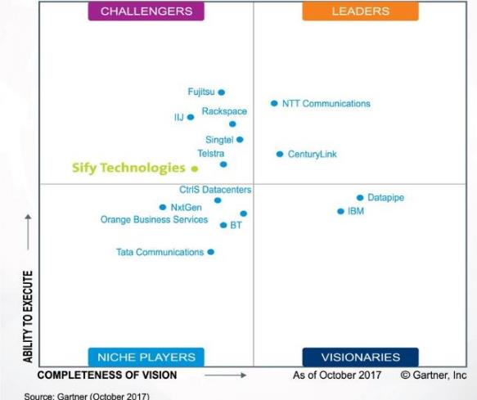





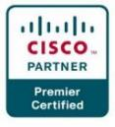


INDUSTRY RECOGNITIONS
Recognition in Market Guide for Public Cloud Managed and Professional Services Providers APAC 2020
Recognition in Critical Capabilities for Managed Hybrid Cloud Hosting APAC 2018
Recognition in Market Guide for Top Data Center Service Providers 2018
Recognition in Market Guide for Vulnerability Assessment and Penetration Testing Consulting Services in India 2019
Recognition as a notable vendor in MQ for Data Center Outsourcing and Hybrid Infrastructure Managed Services, Asia/Pacific 2019
Major Player in
MarketScape for Cloud
Managed Services APeJ 2019
The Economic Times
Iconic Brands 2020
Hybrid Multi Cloud
Data Center Transformation Services
2018
Network Transformation Services
2018
Sify in Challenger Quadrant in Gartner MQ for Managed Hybrid Cloud Hosting APAC
Hosting Partner
Leadership Recognition Cloud Transformation (2018)
Network Transformation (2019)

