Slide 1

Sify – SOC Presentation
Navin Fluorine International Limited
November 2021

Slide 2
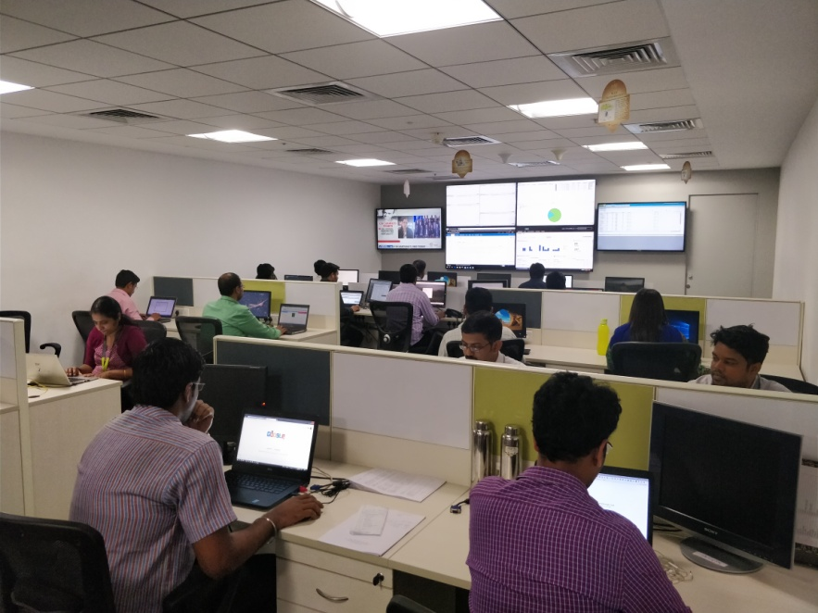
Security Delivery Credentials
15+
50K/Y
1 Million
30+
Security Operations Experience
Security Incidents
Alerts
OEM Solutions & Platforms Integration
250+
5000+
90+
10+
MSS ( 250+)
MDR Captive (10)
MDR Shared / Hybrid (15)
GRC(25)
Customers
IT Assets
Skilled Associates
Compliances
ISO 27001, 17,18, ISO 9000, TL 9000, ISO 20000, MEITY, MHCE, CERT –IV-D, SSAE, PCI-DSS-C,D, CERT-IN, SOX

Slide 3
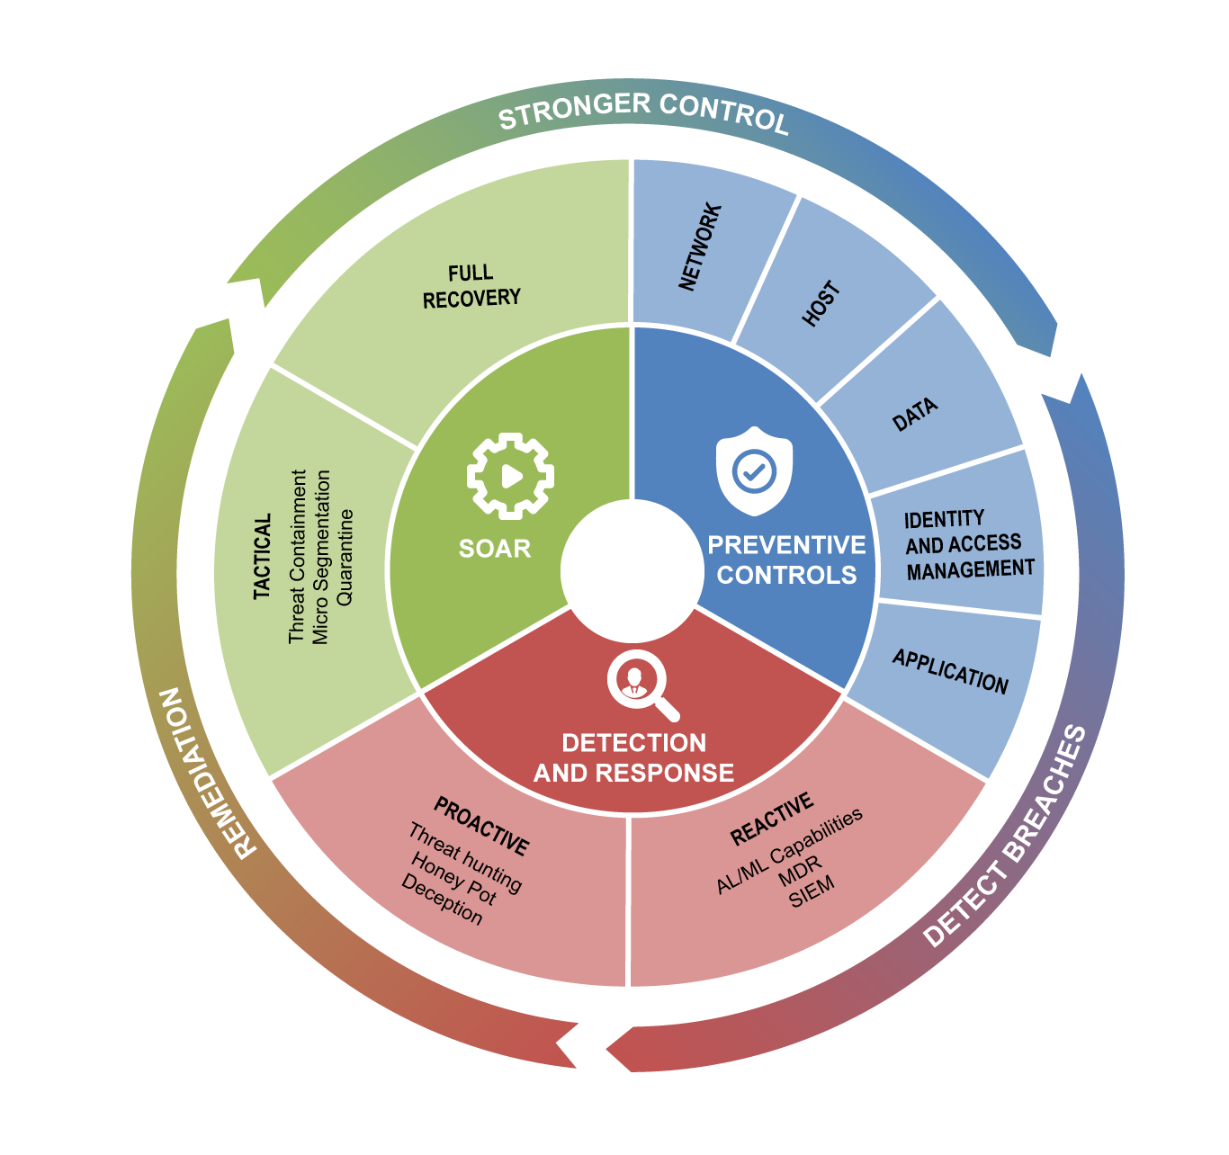
What does Sify Do?
Sify Takes over customer responsibility
Engagement by Stage
STUDY, ASSESS and REPORT
Policy framework development
Compliance readiness assessment
Security posture assessment
Gap and Risk Assessment
DESIGN, BUILD and TRANSFORM
cloud and Network security
End point and mobile security
Identity and Access Management Security
System and Data security
Cloud and Application security
OPERATE and PROTECT
Security asset monitoring and management
Security threat detection and remediation
Security risk and compliance management
User Behavior Analytics
Security as a service for implementation and management of preventive controls (asset management) - MSSP
Managed Detection and Response for monitoring and management of security breaches and vulnerabilities - MDR
Notes:
Sify helps their customers with both build and operate model as well as with the services model
With the Build and Operate model, we understand the customer requirements and then build the solution to meet the customer requirements and also help them by running the SOC operations with captive resources.
With the Services Model, we provide the remote managed services support for the customers security landscape with the help of our MSS team and also extend the Security Monitoring Services with the help of our MDR Team

Slide 4





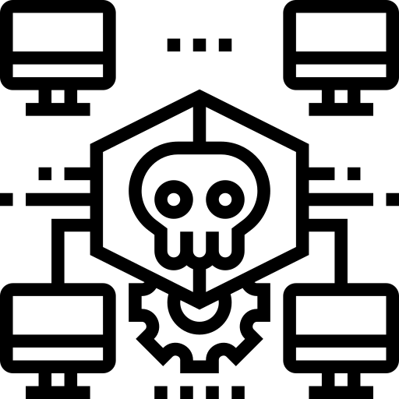
Advantage Sify
More than 2 decades of experience in managing cybersecurity for large and medium enterprises
Integrated platform with automated threat life cycle management
Delivering state of the art SOC services with industry leading tools for more than a decade
Managing multiple security technologies for large enterprises
Securing hybrid IT infrastructure with a single platform
Experience of managing critical security infra of manufacturing and health care clients (like NFIL)

Slide 5
Security Services Execution Proof Points
Reference Customers | Information Security Consulting | Security Transformation | Professional Services | Security Operations | Incident Response | Solution Landscape
Syndicate Bank | ✓ | ✓ | ✓ | ✓ | ✓ | SIEM, PIM, DLP,VA PT, Network Forensics,
UBI | ✓ | ✓ | ✓ | ✓ | ✓ | AV, DLP,Web Security, PIM, MDM, AD, APT, DDOS, WAF
DHFL | ✓ | ✓ | ✓ | ✗ | ✗ | SIEM,WAF,DAM,PIM,DLP
CBI | ✓ | ✓ | ✓ | ✓ | ✓ | SIEM
PSB | ✓ | ✓ | ✓ | ✓ | ✓ | SIEM, PIM, WAF, APT
PNB | ✓ | ✓ | ✓ | ✓ | ✗ | DLP, PIM, Config Management
BOI | ✓ | ✓ | ✓ | ✗ | ✗ | Threat Protection
Max Bupa | ✓ | ✓ | ✓ | ✓ | ✓ | SOC, APT, Firewall, DRM
ONGC | ✓ | ✓ | ✓ | ✗ | ✗ | Web Security, Firewalls
IOCL | ✓ | ✓ | ✓ | ✗ | ✗ | Firewall, Web Security, SLB
NTPC | ✓ | ✓ | ✓ | ✗ | ✗ | SIEM, NIPS, PIM,

Slide 6
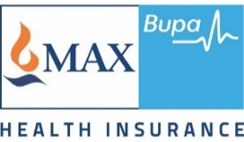



SIFY Clients Profile
One among the world largest automobile manufacturing company
A security infrastructure management contract for managing 450+ UTM firewall across India along with day-to-day security operations support with effective Incident and Change management process.
One among top 5 Oil marketing company
An Information security outsourced pact which includes 24X7 security Threat Monitoring , Anti-phishing and Anti-Rogue services, Security operations, security posture assessment, advisories and reporting on a shared security services model.
One among the world largest automobile manufacturing company
A security infrastructure management contract for managing 450+ UTM firewall across India along with day-to-day security operations support with effective Incident and Change management process.
One of the largest manufacturing and chemical exporting company
A datacenter migration and security management deal providing security operations and Information security services along with 24x7 proactive event monitoring, audit and assessment, advisories and reporting on a shared security services model.
No of Managed CI’s: 3000+
No of Managed CI’s: 3000+
No of Managed CI’s: 50+
No of Managed CI’s: 1750+

Slide 7



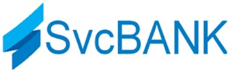
SIFY Clients Profile
Worlds largest construction and heavy equipment manufacturing company
A complete security infrastructure management contract along with 24X7 security Threat Monitoring, consulting services, audit and assessment, best practices, advisories and reporting on a shared services support model.
One among the largest private BFSI client
An outsourced deal for complete managed security services for providing security operations along with 24x7 proactive near real time security Threat Monitoring, alerting and reporting on a shared service model.
One of the best Tabaco manufacturing and distributing company
A total infrastructure outsourcing deal which includes security operations and 24x7 proactive security Threat Monitoring, alerting and reporting on a shared service model.
Worlds leading food processing and distributing company
A complete outsourcing deal for field fresh foods with comprehensive SOC management and 24x7 proactive security Threat Monitoring, alerting and reporting on a shared service model.
No of Managed CI’s: 30+
No of Managed CI’s: 3000+
No of Managed CI’s: 3000+
No of Managed CI’s: 30+

Slide 8




Leading Bank – Union Bank
Bank’s goal: To create a reliable system that could synthesize and aggregate massive amounts of security log data from thousands of devices, to help respond quickly to threats.
Objective
Why Sify was chosen?
Sify’s value additions
To address changing threat landscape
To strengthen over all security posture
Hardware refresh
To meet regulatory compliance requirements
Large footprint in providing BFSI security solutions
Experience in executing large & complex security transformation projects
Address End – End Information Security Life-cycle need for enterprises from any industry vertical
Experience covering 30+ OEM solutions & Platforms
24x 7 operations, covering 100+ cities
15+ Security controls refreshed/ deployed and integrated with existing infrastructure
22+ devices configured including 4 NGFW, 2 WAF, 2 PIM and 2 VM
54+ Switches and Routers configured
4+ SOC analyst and 4+ Infra security analyst deployed
Combination of MSSP and MDR services
8

Slide 9

Leading Bank – The New India Assurance
Bank’s goal: To create a highly scalable system that could grow with their customer base and secure themselves against cyber-threats.
Objective
Why Sify was chosen?
Sify’s value additions
Higher Scalability
Assess security risks and provide a comprehensive analysis
To meet regulatory compliance requirements
Hardware refresh
Provide a unified near real-time view of security posture
24x 7 operations, covering 100+ cities
Experience covering 30+ OEM solutions & Platforms
Address End – End Information Security Life-cycle need for enterprises from any industry
Large footprint in BFSI security solutions
Experience in executing large & complex security transformation projects
Devices configured including 4 NGFW, 2 IPS 2 WAF/LB, 2 ANTI APT, 2 RSA and 2 PIM
57+ cyber alerts configured and managed
8+ SOC analyst deployed
Combination of MSSP and MDR services
9

Slide 10
A LEADING heath insurance company CHOSE SIFY TO DESIGN HOLISTIC soc SOLUTION
MAX BUPA HEALTH INSURANCE’s Goal: To create a reliable system that could synthesize and aggregate massive amounts of security log data from thousands of devices, to help respond quickly to threats
Objective
Why Sify was chosen?
Sify’s value additions
Security control refresh and additional controls to address changing threat landscape
Deploying additional complementary security controls to strengthen over all security posture
Provide effective infrastructure management capabilities
To meet regulatory compliance requirements
Provide a unified near real-time view of security posture
Large footprint in providing security solutions
Experience in executing large & complex security transformation projects
Address End – End Information Security Life-cycle need for enterprises from any industry vertical
Experience covering 30+ OEM solutions & Platforms
24x 7 operations, covering 100+ cities
15+ Security controls refreshed / Deployed and integrated with existing infrastructure
Integration with SIEM for providing improved visibility of security events
Configuration fine tuning for security / performance optimization
10

