Slide 1
Presentation to TATA STEEL
Managed Network proposal
October’18

Slide 2
Tata Steel current network concerns
Inconsistent End-user experience
Consistent network performance
Proactive monitoring of the network
Configuration management
Lack of Network Visibility
Inefficient systems and Fragmentation

Slide 3
Key Expectations of TSL
Deep Insights into the network for building application contexts
Event Correlation across the network for faster resolution.
Contextual dashboards for easy snapshots across the network
Asset Management to understand service chain, impact relationships
Outcome based Managed services partner.
Improve End user experience through improved network reliability.
Capable, mature and experienced partner
Cost optimization through effective utilization of network assets

Slide 4
Enterprise networks at the crossroads
Network architecture
Operations Efficiency
Cloud chaos
App-focused view of the world, from development to deployment to data path.
Own platform dependencies and pipeline and can deploy at will.
Per APP architectures in the cloud from a shared network.
SDN based fabrics.
SDWAN in the WAN and Cloud
Network Virtual functions.
Platforms that can manage latest technologies.
Application visibility into the network
Device sprawl and IOT
Users expect the same experience across devices.
Compatibility of multi user multi device to the organisation.
More applications on the network and hence more users [OT]
Wi-Fi everywhere
Converged networks
User based policy
Converged network management.
Users to applications context and policy
IT
Transformation
Skipping Security
Security stands in the way for Business agility and is the first causality.
Increased attack surface
Security standardization platforms.
Common policy
SIEM operations with threat intelligence.
SOC to augment security controls
Dis-economy of scale
As APPS scale, OPS scale cannot be a vertical scale.
Trade offs of scale over stability and speed over security
Automation
Devops
Infrastructure as code.
Orchestration.
Config Templates
Open platforms

Slide 5
Operational efficiency through network management
1
Plug n play based Automation.
Service Orchestration beyond scripting.
Multi Vendor capability
Technology capability – SDN/NFV/SDWAN
Data driven design through COE.
POC and Pilot.
Network continuity– EOL & EOC.
Harvest Knowledge to rules.
Rules to policy automation.
Deploy
Discover
Monitor
Manage
Troubleshoot
Remediate
Comply
Upgrade
8
2
Reconciliation & data integrity
Inventory management.
Service Relationships
Varied Telemetry – SNMP/Log/Flow/NETCONF/REST
Policy based management.
Auto discovery of compliance
Audit and correction.
The Eight facets of Reliable Operations
Alarm & Event correlation
Contextual relationships – App, Infra & User.
Real time views.
7
3
Data unification
Run book automation.
Metrics – MTTI,MTTK,MTTF, MTTV
Skilled people & KB.
Auto-remediation
6
Proactive & Predictive Ops.
Baseline processes.
Continual improvement processes – improve MTBF metrics.
Analytics for automation and planning.
4
Deep visibility.
Root cause analysis
Skilled people & KB.
Documentation
Standardization
5

Slide 6
Managed Service scope
NETWORK
SERVICES
SLA
Type | Count
MPLS Links | 207
Internet Links | 4
Cloud Links | 1
Core Switch | 18
Firewall | 5
Router | 64
Switch | 4181
Identity Service Engine | 1
KVM Switch | 162
Collaboration Devices | 190
Wireless Access Point | 1964
Wireless LAN Controller | 6
Outdoor Wireless Active Unit | 102
Proactive Monitoring of WAN,LAN & WLAN
Monitor Performance & Resolve network problems.
Real time alerting
Triage & Trouble shooting
Correlation of network event
Inventory management
Network configuration and change Management
Capacity and Availability management
Change, Incident and Problem records.
Chronic alarms
Application based monitoring (Performance)
Management reporting dashboard
Provide monitoring feeds and reports to TSL
NOC Uptime | 99.99%
NOC Availability | 24*7*365
Response Time for any request | Immediate
MTTR for any request | 15 mins to 2 Hrs
MTTR for any Incident | 15 mins to 8 Hrs
Telephonic/Email support availability | 24*7*365

Slide 7
Managed Service scope & Exclusions
WAN Scope
Type | Count | Remarks
MPLS Links | 207 | MPLS TCL MPLS, Sify MPLS & GMPLS links. One Router per link to be considered.
Internet Links | 4 | One device per link
Cloud Links | 1 | One device per link
Total | 212
Assumption: 200 Nos. P2P links are not considered in WAN scope. These links are terminating on the devices which is already part of the LAN scope
LAN Scope
Type | Count | Remarks
Core Switch | 18
Firewall | 5
Router | 64 | Rotuer which are part of the LAN
Switch | 4181 | Includes distribution & access swtiches in LAN
Identity Service Engine | 1
KVM Switch | 162
Collaboration Devices | 190 | Includes TP & other VC end points
Total | 4621
WLAN Scope
Type | Count | Remarks
Wireless Access Point | 1964
Wireless LAN Controller | 6
Outdoor Wireless Active Unit | 102 | There is a discrepancy in the nos. As per Location asset details it is 102. But as per asset sheet of Out door Radio links it is 217. The count taken here is as per the location asset list.
Total | 2072
SL # | SCOPE EXCLUSIONS:
1 | Any SOC services involving SIEM are excluded for the service.
2 | Telephony and contact centre for Service desk are not included.
3 | End device (Laptop /Desktop) monitoring & management.
4 | Firewall, Server & Storage device management
5 | Network topology discovery for end user assets.
6 | Application performance monitoring.
7 | Providing Servicedesk tool.
8 | Helpdesk infra like laptop/desktop/land line phones for Sify engineers at TSL -ITS site
9 | Monitors / video wall for dashboard view.
10 | Field visits for any issues that could arise during troubleshooting.
11 | AMC of existing Network equipment / devices.
12 | End-of support devices that do not have a valid contract with the OEM.
13 | Device which do not have telemetry capability.
14 | Maintaining a cache of critical spares at TSL locations.
15 | SLA contract that involves external stakeholders such as Service providers & AMC vendors.

Slide 8
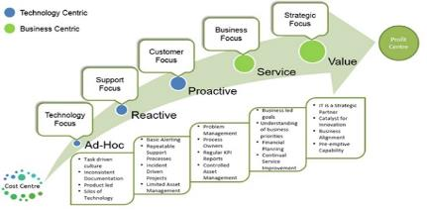
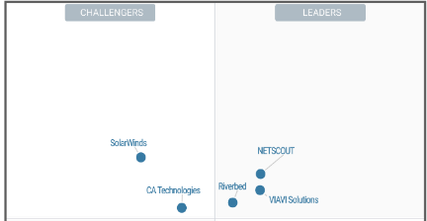
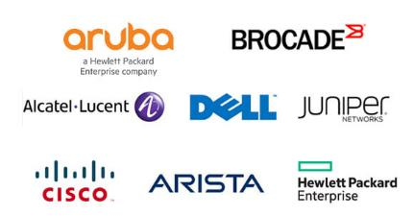
CRITICAL SUCCESS FACTORS in the project
Partner with demonstrated capability of Managed services
Network Management Systems maturity & capability
Skills and expertise in Operating multi-vendor networks.
Experienced ICT player with MSP offerings for last 15 years.
Manages networks of Critical Infrastructure of India
  National Stock Exchange
  Indian Financial Network.
  India POST
Flexible delivery and Outcome aligned models
Sify leverages CA NMS and Aruba Airwave for the Managed services.
Present in Gartner's quadrant capable to manage Multi vendor networks.
Sify managed services are built on the same platforms. Expertise in deployment and gaining maximum mileage.
As a network service provider and MSP, Sify has built certified skills in Multi technology and vendor platforms.
Our skills enable customer to continue with Cost effective Engineering.
Continuous improvement and enabler for technology transitions.

Slide 9
SIFY SOLUTION APPROACH

Slide 10
Our Network Managed services transition approach
PROJECT MANAGEMENT
Project Tracking
TRANSITION MANAGEMENT
ENGAGEMENT MANAGEMENT
INITIATION
PLANNING
INTEGRATION
TRANSITION
STEADY STATE
Project Comms
Establish Project Organization
Validation of assumptions and solution
Finalize network connectivity.
SOW closing.
Identification of key risks and
Resource mobilization mitigations.
Ordering.
Kickoff Meeting
Reviewing Asset Inventory details
Review stakeholders Management scope for TSL
Review & understand network in scope
ServiceNow Integration plan and readiness.
Field visits to validate.
OOB network readiness
Cloud readiness.
Management systems readiness.
Testing.
ServiceNow integration
CMDB Setup
Network discovery.
Dashboards and reports readiness.
Shadow Support
Understand current network support processes.
Incidents process flows
Technical knowledge and process transition from TSL
Governance mechanism.
NOC handover and service onboarding plan
Service desk readiness.
NOC readiness.
Pilot calls and workflow testing.
Commencement the operations.
Governance process initiated.
Engagement management process initiated.
Escalation process initiated
Project governance
Service governance

Slide 11

Our Network Management Framework
PROCESS
Executive
Service support
Service delivery
Contract
Configuration Management
Release Management
Policy
Change Management
Governance
Compliance
BRM
Change Management
Configuration Management
Release Management
Escalation
Contract
Service delivery
Incident Management
Problem Management
Incident Management
Problem Management
Architects
Service
management
Reports
Policy
Request
Service Desk
Reports
Optimise
Knowledge
PEOPLE ROLES & RESPONSIBILITIES
Incident
Change
CMDB
Config item
SME
Problem
Change
Event Managers
Access Management
Reports
Config
Policy
Reports
TECHNOLOGY
Event filtering, forwarding and aggregation
Network management
Network/Security Ops
Incident
Fault Management
Configuration Management
Performance Management
Security
Management
Domain Managers
Problem
Incident
Change
Incident
Incident
Change
Service/Help Desk
Problem
Problem
Problem
Problem
Mediation with Embedded Instrumentation
Incident
SNMP
Logs
Config
XML
Telnet
SSH
Radius
REST
TL1

Slide 12



Systems architecture
Service management
ITIL Support & CSP
Service portal
Service desk.
Tickets & service requests.
Incident & Problem management.
SLA management
Asset management
Change Management
CMDB
Organization wide SOR
Intelligent event correlation.
Faster root cause analysis.
Change management
Network modelling & Monitoring.
Network Topology
Inventory.
Network Config.
Operation analytics.
Contextual diagnostics.
Event Management
Service context
Wi-Fi coverage.
Mobile device performance
Visual analytics.
Wireless network health
Traffic analysis
Configuration management.
WLC management.
Spectrum
Network Fault and Event management
Performance manager
Network health monitoring system
Airwave
Wireless management
RF health
User and device.
Wireless controller management.
Wireless topology
AP health and performance.
Analytics.
SNMP
CLI
Log
Flow
API
SNMP
WAN
LAN
Wi-Fi

Slide 13
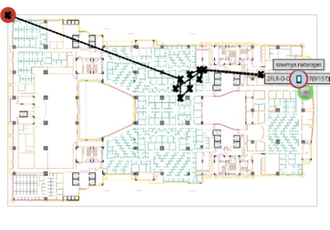
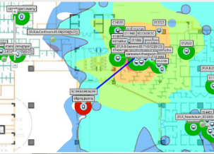
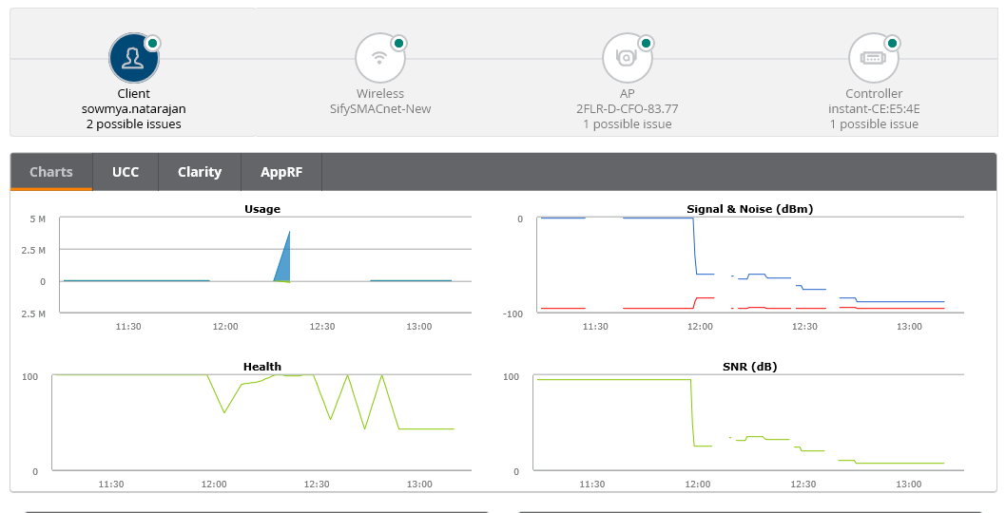
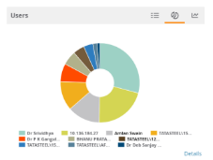
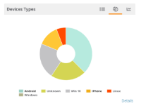
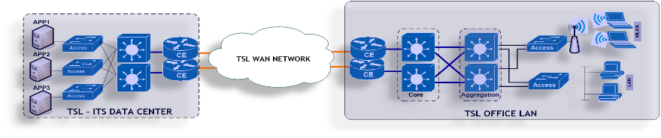
Wireless Management
Mean time to Repair
User context to network
Playback to understand problems
Identify
Know
Fix
Verify
Building context to correlate a problem
Analytics to plan and operate networks

Slide 14
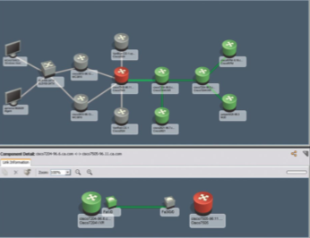
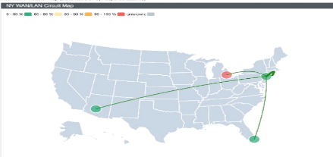
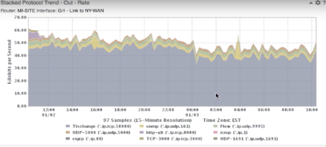
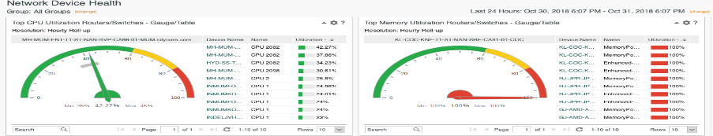

Network Management
Visual root cause analysis
WAN overview
Link contexts with application traffic & device health

Slide 15
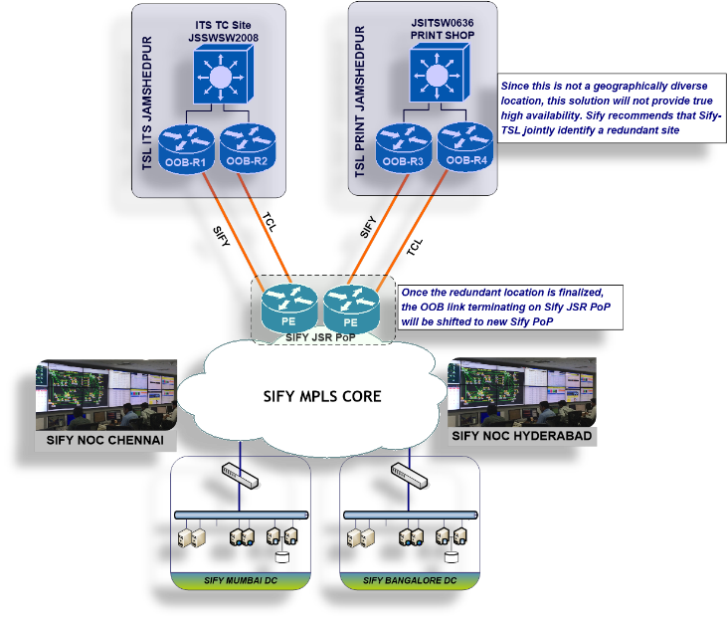
Management Network – Reliable monitoring
OOB Management network is designed to be separate & secure with monitoring capabilities from TSL ITS premise to Sify DC & DR ends.
Traffic separation on Sify MPLS is done by dedicated VRF connecting TSL infrastructure to Sify MS-NOC.
Two OOB Links terminating on dual routers to connect TSL ITS & Print locations to Sify JSR PoP

Slide 16
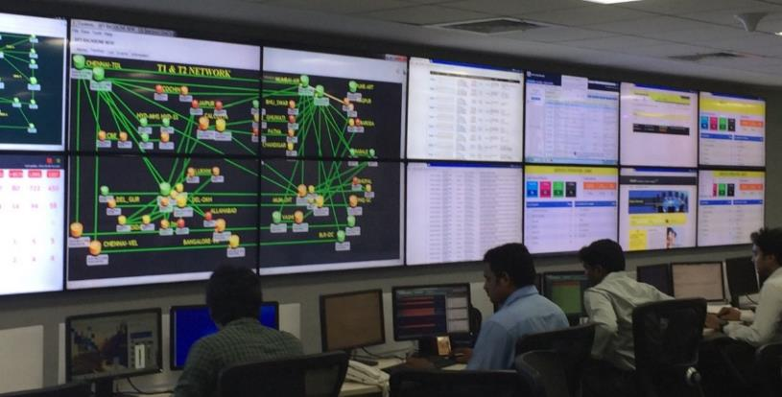
Sify Global Network Operations Centre
2333 POPs
Infra LINKS 4000
9000 IP/MPLS Nodes
120022 Wireless AP
600+ Managed Network customers
76000+ Managed WAN links
47000+ Managed CE
4000+ Tickets/day
100+ circuits /day
400+ Skilled people
Service desk
Managed LAN
Fault Management
Managed WAN
Perf Mgmt.
Shared NOC
SLA Management
Captive NOC
Capacity Mgmt.
Managed Infra.
Network Security
Managed Security
Regulatory Mgmt.
NW INTEGRATION
Change Mgmt.
PROJECT DELIVERY
VOICE
TELECOM
ENTERPRISE
SECURITY
FACILITY
POPs

Slide 17
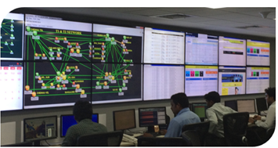
Sify’s Network Managed Services scale
Integrated NoC and SoC
24x7x365 Operations
Adherence to ITIL Framework supported by advanced toolsets
Deployment of industry standard tools
CA Spectrum, CA eHealth, ServiceNow
Detailed CRM Workflows in Oracle
Customer Portal for near-real time view and reporting dashboards
Expertise in aligning to customer-owned monitoring & ticketing tools
Expertise in API integration for infra-tools
Scale of Operations
Over 600 managed Enterprise customers
1.35 Lacs+ Enterprise connections implemented
76,000+ managed customer links
44,650+ managed CPE
Experience of managing Carrier Network Infrastructure
Service Provider Management
Engagement with over 10 NLD providers for backbone communication
Collaboration with BSNL/MTNL, Bharti, Tata Communications, Vodafone, Reliance, PowerGrid, RailTel
360 degree carrier engagement
Experience of managing multiple physical access media

Slide 18




Our Managed service delivery models
Sify
Management systems
Managed Network Services
Managed Security services
Lifecycle management services
Helpdesk & L1
Sify Central NOC & SOC
Customer Owned NOC
Managed Network Services
Managed Security services
Lifecycle management services
Helpdesk & L1
Fault, performance, Change and Vendor Management
Incident alerting, analysis and support.
State data centers
Customer Owned
Management systems

Slide 19








NOC Infrastructure
Network Management systems
Ubiquitous access on the Sify Network
Highly reliable and resilient infrastructure
Flexible to scale
SIFY MPLS BACKBONE
Sify BANGALORE
Sify MUMBAI
NOC/SOC Facilities
Tier 3 Datacenters
Backbone on-net sites with multiple provider presence.
Seamless access to the managed assets
Sify Chennai
Sify Hyderabad

Slide 20
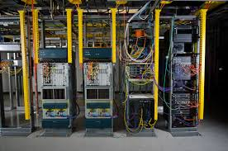
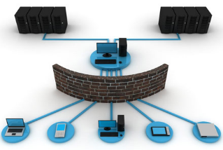

Our people competency
SP Networking
Technologies
Enterprise Network
Technologies
DC Network
Technologies
SP IP/MPLS Technologies – MPLS, MPLS-TE, Multicast, MPLS-TP, VPLS, IPv6 VPNS, CG-NAT
SDN/ACI
ISP Network Technologies – DDoS, IP Analytics, Internet routing policies, IPv6 Internet
Optical Networking (DWDM/OTN/SDH/MEN/CEN)
Enterprise WAN – Private, SP VPN, IPSec, SSL, Multicast, NAT
SDWAN
Wi-Fi
Enterprise LAN – Branch, Central office, Campus Networks
Enterprise – Voice & Video conferencing
Enterprise DCN – SAN, DCE LAN, Cloud Networking, Network Security – Firewall, IPS, Web filtering, UTM, AAA
Enterprise WAN – Private, SP VPN, IPSec, SSL, Multicast, NAT
Enterprise LAN – Branch, Central office, Campus Networks
Enterprise – Voice & Video conferencing
Enterprise DCN – SAN, DCE LAN, Cloud Networking, Network Security – Firewall, IPS, Web filtering, UTM, AAA

Slide 21
Transition & Project Management
PROJECT IMPLEMENTATION PLAN
Go Live /
Service Commencement Date
Pre Transition
Transition
Planning
Transition
W0
W1
W2
W3
W4
W6
W7
W8
Project Organization Chart
Resource mobilization
Review Asset Inventory
OOB Link commissioning
Project Manager
DC /DR hardware setup
Project & Governance owner
Tools Installation
Transition Manager
Technical Transition owner
NMS Integration with ServiceNow
Integration Team (on-site)
Integration Team (Off-site)
Understand and review the existing network support process
Review the Existing monitoring, ticketing tools and escalation matrix of TSL.
Technical knowledge and process transition from TSL
ServiceNow Integration
NDR teams
Systems team
NOC onboarding teams
NOC handover
Project Initiation
Network & Systems Integration
Planning
Transition

Slide 22
Steady state organisation
Engagement Manager
Operations governance
SLA Management
Contract Management & Billing.
New scope management
Change Management.
L1 support
Configuration management
Change Management
Problem Management
N/W Commissioning and Upgradation
Service Desk
NOC
L3 (1)
Technical Manager
TL (2)
L2 support
Application Support
Incident Management
Service Request handling
Telephonic Support
Email Support
Notification and Updates
BSO management
Field Force Dispatch
L1 (9)
L2 (7)
TSL ITS Premise
ServiceNow Support
L1(9)
Service Desk
Sify Premise
TSL IT teams interface
Proactive Monitoring
Alert Validation
Ticket Assignment
Infrastructure Health Check
Email and SMS Alert notification
L3 support
Advanced N/W troubleshooting
Root cause analysis
OEM Coordination for support and maintenance
Problem Management
Firmware/Patch Update

Slide 23
Project Risks
TSL Scope
Sify Scope
Very Likely |  |  | Lack of complete Network Inventory information Adequate permissions from IT to complete the discovery process ServiceNow Integration
Likely | Access to TSL facility | IT Infrastructure setup for tool installation Timely release of PO to meet project deadlines | Hiring of resources to be stationed in ITS Jamshedpur Scope changes – new additions to scope defined
Unlikely |  | Project communication & governance
Occurrence/ /Impact | Low | Moderate | High

Slide 24
Risk Mitigation
# | Risk Statement | Risk Category | Scope | Impact | Mitigation Plan
1 | Lack of complete network inventory information | High | TSL | Impacts project planning Will extend timelines to complete | TSL to share complete inventory. In the absence of such information from TSL, Sify shall deploy tools to undertake such discovery, with a timeline of 2-3 weeks to complete the activity.
2 | Hiring of resources to be stationed at Jamshedpur | High | Sify | Onsite work delays | Sify will initiate hiring of resources upon receiving a confirmation of award of the project
3 | ServiceNOW integration - permissions | High | TSL | Delays in overall project timelines | TSL must enable internal permissions access to network, devices etc from the start of the project.
4 | IT Infrastructure setup for tool installation | Medium | Sify | Steady state operations will be delayed | Sify will initiate procurement of hardware/ licenses upon receiving confirmation of award of the project
5 | Timely release of the purchase order to meet project deadlines | Medium | Sify | Project commencement delays | TSL to arrange for a formal communication in case the PO process is likely to get delayed
6 | Access to Sify teams to work onsite at ITS J’pur | Low | TSL | Hampered access to sections of campus | This is work in progress. Will be completed mid-Nov.
7 | Scope changes | High | TSL | Impacts project planning & will extend timelines to complete Escalation in project cost | Early discussion with TSL IT team to review scope and eliminate any ambiguity. Any escalation in project cost will be communicated to TSL.
8 | Project communication & governance | Moderate | Sify | Delays in decision making | Sify and TSL will define a communication and governance structure during the project phase, at project kick-off

Slide 25
Our Experience
NSE
INFINET
DOP

Slide 26
NATIONAL STOCK EXCHANGE

Slide 27
NSE Requirements
Digital Distribution Architecture
OBJECTIVES
Reliability and speed.
Highly resilient to failure
Uniform customer experience
members participation in an easy and equitable manner
flexible to evolving to support future digital distribution options
scaling with demand.
ARCHITECTURE CHANGES
Ethernet from Serial
Managed & Unmanaged CPE options for Members
Ability to provide last mile links on wireless interface
Network extension to reach pan India members.
Guarantee Higher uptime for POPs
Next Generation NSE network
PLAN
Network & POP design.
Implementation Plan
Migration Plan
BUILD
POP readiness.
Network readiness
NOC & Operations readiness.
MIGRATE
Ready for Migration
Core network migration.
Members migration
OPERATE
POP & Network Lifecycle
Members life cycle
NOC & SOC.

Slide 28
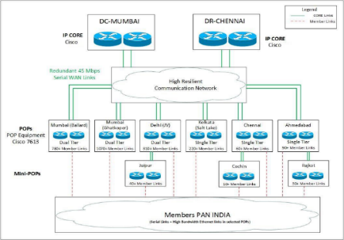
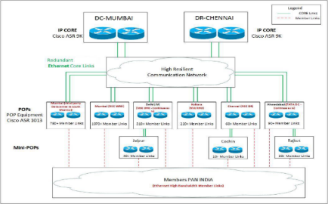
PLANNING & DESIGN APPROACH
Key components to planning a successful transition to the digital distribution architecture
AS-IS
Network Design
Backbone Network design
Platforms design.
POP design
Telecom Plan
Routing & Resiliency
Security design
Network Management
NMS systems
NOC design
Helpdesk Plan
Staffing Plan
OOB Network.
Migration Plan
Discovery
Migration strategy
Order of Migration
Members grouping.
TO-BE
Sify Project Management
Design Team
Delivery Teams
Field Teams
Alerts

Slide 29
KEY OUTCOMES & VALUE OF THE PROJECT
Member Management
Network & Security Operations
Security Operations
Virtual PoPs
Live Migration
  24 x 7 Helpdesk
  Migration, Commissioning, Decommissioning
  Service provider management & governance
  Hands & feet support on field
  Setup a NOC for 24x7x365 monitoring
  Inventory management
  Spares & Support
  Capacity & availability management
  Infrastructure protection
  DC Security
  Workstation Security
  Management Security
  Physical Security
  Leverage Sify’s network to redefine NSE’s operations
  Flexibility, innovation, agility of operations
  Complex transitioning
  Complete the project while the NSE network is live and conducting business
Redefine the business operations of NSE through technology innovation

Slide 30
INFINET - IDRBT

Slide 31
INFINET Network Evolution
Y1999-Y2006
Y2006-Y2008
Y2008-Y2017
Y2016
1.0
2.0
3.0
4.0
  VSAT and Leased line based network
  2000 VSATs spread over 300 cities.
  Predominantly 3 DCs
  Managed by IDRBT
  Migrate to an MPLS network.
  Redundant providers
  10 Datacenters.
  Unclear designs, ambitious expectations and please all RFP.
  Successful design and Migration.
  Efficient design, implementation, operations and scale.
  99.99% uptimes across all Datacentres.
  Multi provider Network
  Target uptime of 99.9975%.
  Multicasting & BCP.
  Dedicated Replication networks.
  Member banks reliability.
Design | IDRBT
Network Integration | Hughes
Managed services | IDRBT
Design | IDRBT
Network Integration | Sify + RCom
Managed services | Sify + Rcom
Design | Sify
Network Integration | Sify + RCOM
Managed services | Sify +RCOM
Design | Sify
Network Integration | Sify
Managed services | Sify

Slide 32






INFINET – Future IP Network
Sify Enterprise
service Management
SIFY
Beacon
E2E Network
Management
Sify Network
Ops Centre
MB GROUP
Hub & Spoke MPLS VPN
IPSec VPN
BSNL
Any to Any MPLS VPN
GET VPN
CCIL
IFTAS
Sify
MEMBER BANKS
INTEGRATION
RCom
RBI REGIONAL
OFFICES
BSNL
IDRBT HYD
IDRBT - BELAPUR
MEMBER BANKS
TCL
Sify
RBI GROUP
Tikona
RCom
Railtel
Kharghar
Belapur
Nagpur

Slide 33
Sify Value proposition
Design
Partnerships
Network Integration
Managed services
Understanding INFINET network, customers and applications.
Mitigate current paint points.
Scale, Performance and reliability needs
Carrier relationships by being a customer and a Provider.
Major partner of Cisco and a customer of Cisco.
Skills and Project expertise.
Integrated NSP and NI delivery processes.
Deliver the incumbent advantage.
Centralized NOC with integrated systems for core and Edge.
ITIL compliant processes and systems.
In-house developed systems
End to End Solution
Tunnelless VPN for scale, performance and multicast.
Performance & Event based Resiliency
Segregation of networks for security & performance
6 providers for Availability with redundant & divergent links.
Cisco Routers and GET VPN technology.
Zero downtime migration.
Enable facility readiness, offload major customer processes.
One representative for INFINET customers.
New KPIs integration to understand network better.
Application performance visibility.
Software reliability, compliance audits

Slide 34
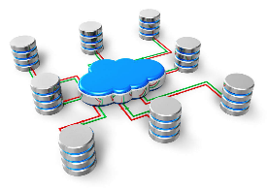



Process additions to Managed services
Configuration Assessment
  Create Standards in line with BCPs
  Implement Standards
  Maintain Documentation
  Periodic audit
  Periodic Review of standards
Software Management
  Determine Software needs.
  Test, validate, and pilot chosen software versions.
  Cisco SNTC +Bug scrub +Cisco PSIRT
  Document successful versions
  Consistently deploy or upgrade to standard software version.
Network Automation
  Automate Configuration Checks
  Automate performance checks
  Automate EEM validity checks.
  Automate Performance checks
Spares Management
  Distributed spares for DC locations – 10% of installed base
  RBI RO – 7% of installed base
  Dedicated spares stock for INFINET.
  NBD replacement from OEM.
  Spare locations within reach of RBI facilities

Slide 35
DIGITISATION OF INDIA POST

Slide 36
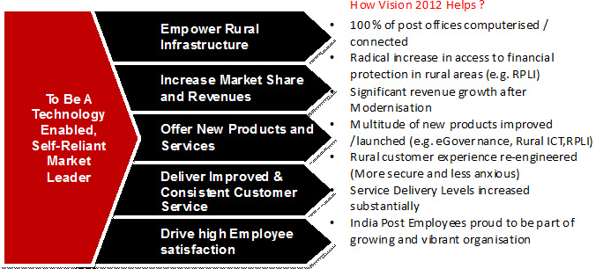
India Post Vision 2012 - IT Project 2012
VISION OF INDIA POST 2012
India Post 2012 aims at transforming the DoP into a “Technology Enabled, Self-Reliant Market Leader”. This translates into 5 initiatives covering increased market share and revenues, new products and services, improved service delivery, motivated workforce and rural development.

Slide 37
India Post 2012 – End State - Solution Blue Print – 8 Vendors
Business
RFP | Area
RFP#1 | Rural ICT – System Integrator (RSI)
RFP#2 | Rural ICT – Hardware (RH)
RFP#3 | Core System Integrator (CSI)
RFP#4 | Financial Services System Integrator (FSI)
RFP#5 | Data Centre Facility (DCF)
RFP#6 | Network Integrator (NI)
RFP#7 | Mail Operations Hardware (MOH)
RFP#8 | Change Management Vendor (CM)
Capabilities
Business Processes
Applications & Data
Interaction services
AAA
Security Mgmt.
Workflow and BPM services
Application Integration services
Security Management
Governance
Remote Access
Applications
IT operations
Infra. Security
Data Management & Integration services
Infrastructure
Physical platform services
Networks
Servers, storage & backup
DC & DR Infra

Slide 38
Sify as a partner to India Post - End to End service
Network Integration & Project Management
Plan, Supply, Design and Implement the network
    Data center Network
    Disaster Recovery center Network
    30,000 locations – WAN & LAN
    Migrate 1400 locations to MPLS
    Security design & Implementation
Network Service provider
MPLS VPN and Internet services across all the 30,000 sites on Sify network.
Build a second Redundant Network over a second service provider.
Bandwidth services with scale.
Managed service provider
Setup a captive NOC and deliver Managed services.
Own the DOP Network and ensure Uptimes are met.
Coordinate with Other SI to implement the DOP vision.
Own all KPIs for Network & Security
Successfully executed the project in 15 months time
Successfully managing the Enterprise since 5 Years

Slide 39
India Post today - We take pride in our role
DIGITAL TRANSFORMATION HAS LED TO
Indiapost becoming a Retail banking provider
Logistic Post – A major logistical partner for Ecommerce players
Reliable channel for Social spending disbursements
India Post payment banking
IPPB

