Slide 1

Hybrid Cloud Services for Mahindra Logistics
MAY 2021

Slide 2
AGENDA
Requirement Summary
Cloud Consolidation Business CASE
Security Requirement
Network Solution
CASE Studies

Slide 3
AGENDA
Requirement Summary
Solution approach- current challenges AND CRITICAL SUCCESS FACTOR
CHOICE OF PLATFORM
Solution building blocks
Service delivery and migration plan
SIFY security and network services
TRANSFORMATION ENGAGEMENTS- case studies
Cloud Adoption benefits
Business case

Slide 4
Requirement Summary
Mahindra Logistics Transformation and Landscape optimization
Infra/Cloud Consolidation
  Move all workloads from NextGen Datacentre to Cloud
  Option to Consolidate in one cloud
Sify Cloud @ Core
Sify Network Centric Services
Office 365
  Transfer of O365 Account to vendor for end to end management
Security
  Anti Virus license for End Users
Network Modernization
  Connection of 100 location to MPLS
  SD WAN Implementation

Slide 5
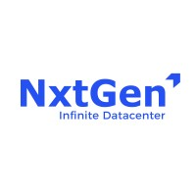




VISION
Present Infrastructure
OPTIONS
Consolidation
Sify CI
SIFY Managed Services
Hybrid Cloud
Sify CI + Hyperscalers
Single Cloud/Hybrid cloud platform maintained and Managed CSP
Hyperscalers
AWS/AZURE/OCI

Slide 6
Mahindra Logistics infra / Cloud : current challenges
Present Infrastructure
Challenges
20 VMs hosted on NextGen
Scattered Application Ecosystem across multiple cloud
Most of the VMs hosted in NxtGen is reaching ESOL
NO single interface to manage multi cloud environment
Scalable solution to handle unexpected business demands
High TCO
16 VMs hosted on Azure
15 VMs Hosted on AWS
Local inhouse datacentre @ Kandivali hosting few of the VM and Applications

Slide 7
Critical Success Factor
Sify Experience & Relevance
Experience of managing Multi cloud environment and have done DC Transformation 70+ projects from design to execution and sustenance One Sify Approach across Digital ICT Services Experience in Multiple DR Projects
Executed 100+ large-scale DC Migration 24*7 monitoring & management by global operation center with industry standard practice & tool. 100+ Cloud Certified Professional
Dedicated connectivity to hyperscaler clouds High Speed fiber for lower latency Centrally managed cloud based SDWAN solution
Highly scalable and secured hosting environment Scalable Firewall with Managed Services AV managed services Managed SOC services SIEM , WAF & DDOS
Cloud Consolidation on Robust, Scalable and secure IaaS
Private Cloud, Enterprise Cloud + Public Cloud
Integrated Security and Network solution
Ease of integration with newly acquired entities
Operations Transformation
Strong management across hybrid IT platform
Automation, tools and SLA driven framework
Manage the variations in dynamic growth as per business demand
Optimize and Modernize Network backbone
Implementation of SD WAN
Implementation of MPLS
New edge cloud security service provider
Zero Trust Security Framework across Hybrid IT
End Point to Applications security services spectrum
Consulting, Audit & Integrated Cloud Security Partner

Slide 8


OptionS Comparison
SIFY CI
HYBRID CLOUD
HYPERSCALER
All business system managed and controlled by single Cloud vendor
Hyperscaler adjacency
Managed and scalable network
Scalability and on-demand functionality
Lower TCO
Workload across multiple cloud
Leverage best of both of types of cloud
Managed and scalable network
Scalability and on-demand functionality
Low latency dedicated network
Lower TCO
All workload of any of one Hyperscaler
Leverage best of both of types of cloud
Managed and scalable network
Scalability and on-demand functionality
Lower TCO
All workload on one cloud
Single vendor scenario
Scattered Workload
Integration challenges
Additional Network and security requirement
High TCO
Data out charges
Additional Network and security Requirement

Slide 9
Sify Cloudinfinit v/s Hyperscalers
Private Cloud with all flexibility and features of Hyperscalers
Additional services procurement for shared storage
T-Shirt Based sizing
Oracle with Oracle Linux only
Cannot support multi cloud/hybrid cloud orchestrations
Only storage backups
Rely on Telecom and other vendors for all network and connectivity requirement
Hyperscalers
CloudInfinit
Shared Storage feasibility w/o technical complications
Customized Sizing
Support for Oracle with standard Linux
Common orchestration for multi cloud/hybrid cloud ecosystem
Managed backup with tape options
Telecom business backbone support for all network and VPN requirement
Technology Specifications
Operation Orchestration
Sizing / T-shirt based
Network Implementation
Time Slicing billing
Billing\Commercial viability\

Slide 10
Scope of work
@ MLL Current Data Centre Setup
@ SIFY Datacentre
DC Hosting @ Sify DC Airoli
NDR Hosting @ Sify DC Rabale DR Hosting@ Sify DC Bangalore
Managed O365 & AV service
Security Compliances
Work from Anywhere Flexibility
Low latency networks
Certain SAAS applications on hyperscale clouds like AWS, Azure, Oracle and NexGen
No. Of Server DC (41), NDR (17), DR (18)
OS-WIN, LINUX, OBUNTU
DB- MySQL, MSSQL, PostgreSQL
Network & Security
Storage
Backup
DR is available Partially
Mailing with O365
All offices and warehouses currently operational on MPLS VPN
Complete Managed infra and security architecture
DR – As – A - Service
Managed SDWAN with
MPLS VPN links

Slide 11
Cloud Consolidation Business CASE

Slide 12


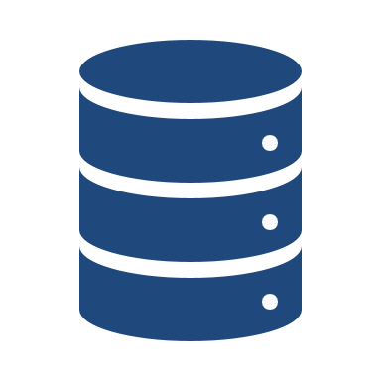



Business case: TCO Comparison – Current vs SIFy CLOUD
Present Services and Estimated Expenses In Cr. for 5 Years
Sify Services and Projected Expenses in Cr. for 5 Years
COLO Space Power Charges
Compute and Licenses
3.25
2.50
10% TCO Reduction + 12% Amortization Charges on CAPEX + Business Benefits
Sify Cloud Services
1.70
2.10
Network Component
Sify Smart Network Services
0.45
Sify High Performance Storage
0.40
Storage
0.50
Managed Backup and Restore Services
0.34
Backup and Tools
3.30
Sify Renowned Telecom Services
2.90
Telecom
2.10
Sify 24 X7 Global Service Center
2.00
Managed Services

Slide 13
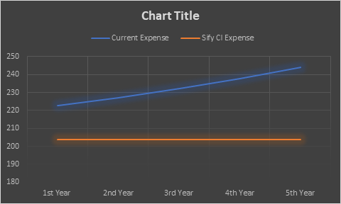
Saving Analysis
Overall Savings
Long Term Benefits
Appx 20% operational saving over period of 5 years
Technology refresh covered with existing cost
SLA based service management with dashboards and API integration
Business Case
Intangible Benefits
Features
State of Art Tier III data center
24 X 7 Monitoring and management with industry standard tools and practices
99.99% uptime guarantee
  Secured and Scalable Network services
  Highly scalable and secured hosting environment
  Low latency connections with Hyperscalers (>5ms)

Slide 14





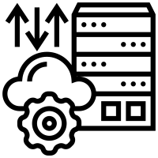
Sify cloud adoption business benefits
Better connectivity: Colocation data centers have fully redundant network connections ensuring that customers’ business critical applications always run uninterrupted.
Improved network security: Data centers have top-notch network security, including the latest firewalls / IDS systems to detect and prevent unauthorized access to their customers’ systems.
Redundant power supply: Colocation data centers offer power redundancy through a combination of multiple power grids, diesel power generators, double battery backup systems and excellent maintenance practices.
Bursting capability: Colocation centers provide customers with the flexibility to burst to higher bandwidth levels to accommodate their traffic demand without having to make repeat capital investments. Since data spikes are distributed over time across numerous users, bandwidth costs are significantly reduced.
Scalability: Colocation offers your company the flexibility to scale up or down easily, while allowing you to pay for only the space and power you need and only when you need it.
A step toward cloud migration: If your company is looking at cloud computing in the near future, colocation provides a smooth transition by allowing you to move your equipment to an offsite facility with increased capacity and performance to support business needs while ensuring a smooth cloud transition.

Slide 15






Sify cloud adoption business benefits
Reliability: Data centers and colocation facilities offer redundant cooling, power and communication systems that ensure constant connection.
Security: Data centers and colocation facilities are designed to ensure that your systems are protected from burglars, fires, and other things that can compromise the security of your information.
Reduced Maintenance: In many cases companies only begin to think about server support equipment after there is a failure. Data centers design, monitor and maintain support systems and have dedicated systems and staff to ensure that systems are running at top performance, so they are always reliable.
Speed: Data centers and colocation facilities offer cost-effective fast connections directly to multiple internet service providers to provide top performance and redundancy in the event of connection interruption or overload.
Experience: Data centers have staff on-site consisting of the brightest minds in the field of technology. These experts are hired to build, implement and maintain the best state of the art infrastructures utilizing high-performance equipment.
Risk Management: Emergencies happen, but when your mission-critical equipment operates at an off-site data center, you’ll have redundancies and security in place to continue operations unaffected.

Slide 16




Solution Building Blocks
Security
SIEM
WAF
NFV
DDOS
Application
Sify Managed Services for Hybrid Cloud and across all blocks
O365
O365 License
AV Activation
Private Cloud
Compute
Storage
Backup
Network
ILL
MPLS
SD WAN

Slide 17
Migration plan
Sify recommends phased approach for over all transformation journey
Fix The Core
Realize & Stabilize
Advance
Optimize
Setup All Prerequisites
Migrate All VMs and services from Nxt Gen to Sify CI
Business stabilization on new platform
Setup MLL specific routines
Plan and adopt the consolidation of other cloud VM
Optimize the cost of VMs and other service charges
6- 8 Weeks
8-10 Weeks
8-10 Weeks
Ongoing

Slide 18








services delivery model
MLL
O&M Pillars
Service Catalogue
Self Service Portal
Reporting
Tools
Ticketing
Process
MLL IT Group
Service Desk Tool
Dedicated Infra x86 - COLO
AIX/ AS-400 Env COLO
People
PHONE
EMAIL
Service Health
Remote Delivery Support
Sify Assure
(Quality & Security)
L1 Technical
Support Desk
L1 - Infra Monitoring, SOP & Management
MLL
Project Team
Sify Technology SMEs
Sify Offsite Teams
MLL Project Teams / Departments
AWS Cloud
Operating Systems
Database
Storage
Backup
NOC
SOC
Sify DC & Cloud Engineering
Quality & Audits
Information Security Management
Monitoring & Management Tools
ITSM Process
L2 - Technical Engineers
Third Party Support
L 3 - Technical Lead
OEM TAC
Vendors
Auditors
Technical Service
Delivery / Project Management

Slide 19
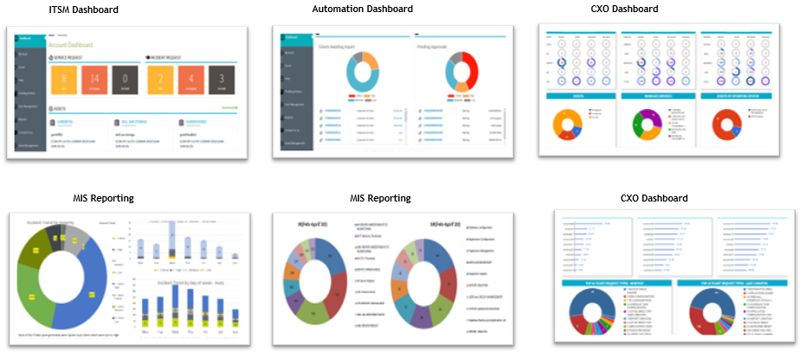
Service dashboards

Slide 20
Security Requirement

Slide 21








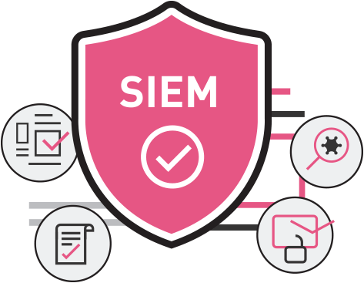



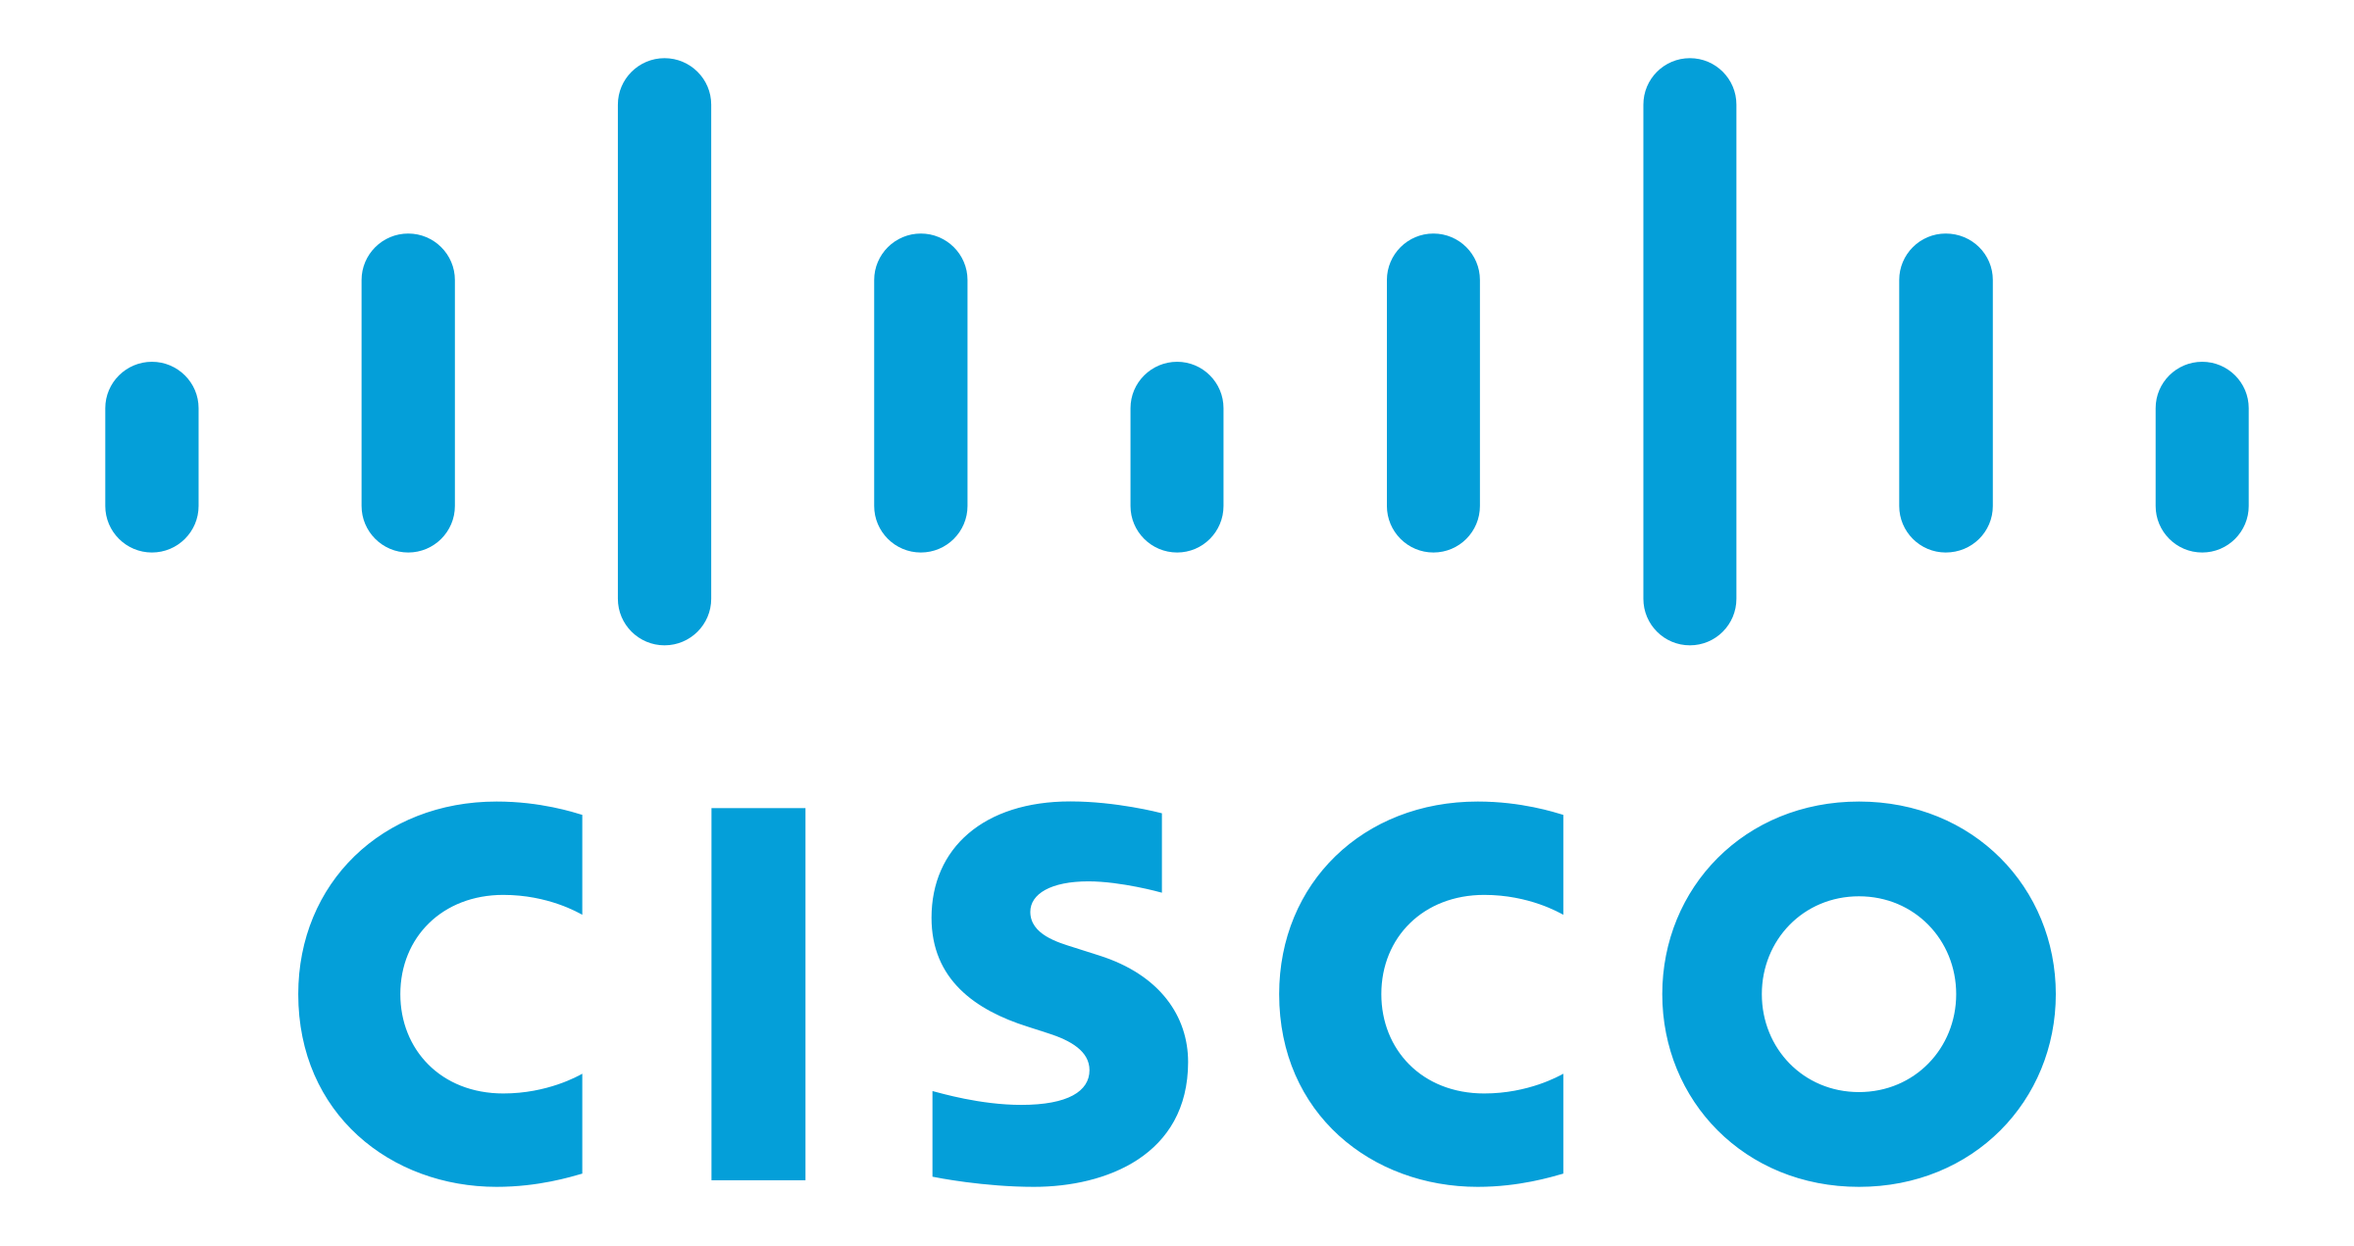








Security as a service for the Hybrid IT
SECURITY AS A SERVICE (FROM THE CLOUD)
Privileged Access Management
DDOS
Protection
Endpoint Detection & Response
Vulnerability
Mgmt.
Multifactor
Authentication
Email security
Partner Aligned
Anti-APT
SIEM
Sify Native
Log Management
Web Security
User | Device
Branch | WAN
Cloud | DC
Notes:
Security as a Service
Sify has engineered few technologies such as Log Management, SIEM, Multifactor Authentication, Vulnerability Management, Penetration Testing, Privilege Access Management, NextGen AV and Endpoint Detection and Response and have hosted them on Sify’s cloud.
Sify has also partnered with certain OEMs and are delivering certain technologies as a service which are hosted in OEMs cloud such as AKAMAI Content Delivery Network (CDN,) Web Application Firewall (WAF), Distributed Denial-of-Service (DDoS) and also with Cisco for delivering DNS Security, Email Security, etc.,
All of these services and are being delivered as a service irrespective of customers Hybrid IT infrastructure location

Slide 22
Network Solution

Slide 23
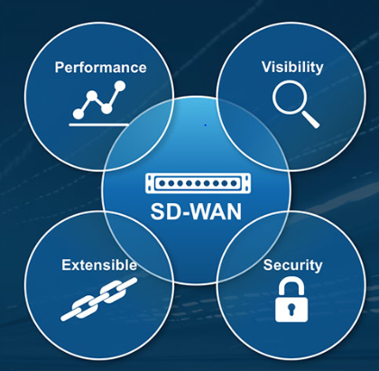
Business benefits to MLL
Commitment to provide 20% cost benefit over existing spend for MLL
20-30% Scope of bandwidth optimization/reduction due to effective network utilization.
Minimal onsite intervention resulting into lean IT org and operational cost savings.
Single window Monitoring will ensure no cost to deploy tools, people & processes onsite.
Provider agonistic approach not dependent on provider last mile feasibility .
No separate Security hardware required for termination of internet, broadband or 4G.
User wise application usage analytics for stronger IT policies enforcement.

Slide 24
CASE Studies

Slide 25







MAHINDRA FINANCE: DIGITAL TRANSFORMATION FOR NBFC
NBFC
Project Objective
Implement integrated future ready digital infrastructure on Hybrid cloud architecture for hosting core application and virtualizing landscape on a scalable Cloud Infrastructure with end-to-end Migration.
Integrated Value and Outcome
cloud@core products and services:
All new Security applications to be migrated to Sify cloudinfinit
All Existing Business apps to move to new Private Cloud (VMware).
Old Solaris Server in DC with interconnect to Private Cloud.
End-to-end hybrid IT implementation for highly complex environment utilizing multiple migration methodologies - Rehost, Re-platform and Retain
Customized Hybrid IT architecture and hybrid migration (V2V + P2V) to meet business application demand
Hybrid cloud management platform for management of the Hosted Private and AWS Cloud footprint.
Value for Client
Zero defect & minimum down time during migration,
TCO optimization via billing based on pay as you go model,
Single point of ownership for all infra consolidations,
single SLA covering the infra and network.
Value for Sify
Complete ownership for Infra and Network which has given wide scope for offering managed services, DR-as a service on SIFY CI.
Project Model
Private Cloud IT Build model along with Sify Enterprise Multi-Tenant Cloud for Cloud Bursting.
Competition
CtrlS, NexGen, Netmagic, Wipro & TCS
HYBRID CLOUD LED
Sify’s Uniqueness
The proposed Data Centre at Mumbai has a latency of less than 250 microseconds from AWS & Oracle Cloud; and less than 1 millisecond from TCS’s SaaS cloud located at CtrlS Navi Mumbai DC. Hybrid and Multi Cloud set up at the least latency, lowest connectivity cost and the best performance between the environments in multiple DC & Cloud. The same Data Centre hosts Sify’s multi-flavoured Cloud Infinit platforms ( Public, Private, Virtual Private) from where our customers can subscribe to IaaS/PaaS.
Contract Duration
5 years – large annuity revenue stream

Slide 26

PRAMERICA LIFE: DIGITAL TRANSFORMATION FOR LIFE INSURANCE
LIFE INSURANCE
Project Objective
Implement integrated future ready digital infrastructure on hyper-scale Cloud
Integrated Value and Outcome
cloud@core products and services:
All cloud ready applications migrated to hyperscale (AWS)
Legacy apps and infra in cloud adjacent DC with near 0 latency
DR at a different seismic zone with hybrid deployment of post cloud infra and DRaaS from cloud@core.
Hybrid security framework for both hosted & cloud footprint.
Full lifecycle responsibility through assessment, zero downtime migration & implementation within a record timeline.
Hybrid cloud management platform for management of the Hosted Private and AWS Cloud footprint.
Value for Client
25% reduction in yearly cost, return on investments , agile digital ready infrastructure, end to end ownership by one partner, no conflict of interest with application partners.
Value for Sify
Competitive edge, full stack products and services play, significant cost control, higher revenue and margin, great reference for hybrid cloud.
Project Model
Fully services model(vis-à-vis existing capex + services model)
Competition
IBM (incumbent), DXC, Wipro, CTS, Tech M, TCS
HYBRID CLOUD LED
Sify’s Uniqueness
Integrated value proposition built on: Cloud adjacent DC, Hyperscale (AWS) partnership, Hybrid cloud management platform, DRaaS, DC and Cloud Interconnect (Sify’s own service), Security services and Migration services
Contract Duration
5 years – large annuity revenue stream

Slide 28
O365 solution
Skills and Capabilities around the whole Microsoft Stack as Gold in all major Cloud competencies. Microsoft Certified Architects
Office 365 Migration Experiences for Large Implementations and Banks
Strong case studies of Migrations and Maintaining similar systems for customers in UK and Europe
Sify’s Best Practices Migration Framework Migration of systems to Office 365 reducing Time and Cost
Over 100+ Microsoft certified and skilled resources
Amongst Top CSP Partners for Microsoft India Business
Microsoft Certified Partner for Cloud & Managed Services
Certified Deployment Partner for deployment of Office 365 & Azure services
Experience in smooth transitions from On Prem to Cloud SAS services
Extensive experience in Cloud Hybrid solutions and Mature Cloud consulting services to suggest the right Cloud product
Standard Framework for providing unique Cloud ROI’s unique for each clients needs
Automated Solutions and Frameworks for migrations

