Slide 1


SIFY CAPABILITY PRESENTATION - EDUCATION

Slide 2

AGENDA
01
Key digital drivers in education
02
Cloud adoption and Sify relevance in education
03
Introducing Sify & Cloud @ Core
04
Sify engagement models/key strengths
05
Sify customer references

Slide 3

Key digital drivers in education

Slide 4
Key digital drivers
Customer Facing
Conventional education with little to no involvement of technology in profiling, assessment and delivery
Technology enabled education with digital assessments, advanced profiling and digital delivery
Digitally enhancing education
Majority of learning taking place in classrooms and physical locations
Majority of education being delivered online with participants at different geographical locations
E-Learning and online learning
Current State
Digital Transformation
Future State
Organization Facing
Majority of learning taking place in classrooms and physical locations
Majority of education being delivered online with participants at different geographical locations
Multicampus education model

Slide 5
How it enables these key digital drivers
E-Learning
Digital Transformation of Education
IT Enablers
IT Enablers
Cloud Based Apps
Cloud Infrastructure
Web
Acceleration
Services
Network Security
Cloud Infrastructure
Managed
Network
Network Security
LMS
AR/VR
Technologies
Technologies
Proprietary E-learning apps
AWS/Azure/Cloudinfinit cloud
Akamai/Cloudfront
Sify I-Test/E-learning
DDOS prevention/IPS/IDS
VR Headsets/AR apps
AWS/Azure/Cloudinfinit cloud
Sify NMS
DDOS prevention/IPS/IDS
Connected, Secure & Digital Institutes
Education Analytics & Digital Assessments
IT Enablers
IT Enablers
Cloud Infrastructure
& apps
Cloud Based Apps
Cloud Infrastructure
Connectivity
IoT
ERP Tools
Network Security
Network Security
Technologies
Technologies
MPLS
AWS/Azure/Cloudinfinit cloud
Sify IOT services
Cloud based HRMS/FMS
DDOS prevention/IPS/IDS
Student analytics & results delivery platforms
AWS/Azure/Cloudinfinit cloud
DDOS prevention/IPS/IDS
Notes:
Here are the key success factors of driving the 4 key pillars of education industry in India along with their success factors and the corresponding IT enablement opportunities that they open up.

Slide 6
Cloud adoption and sify relevance in education

Slide 7
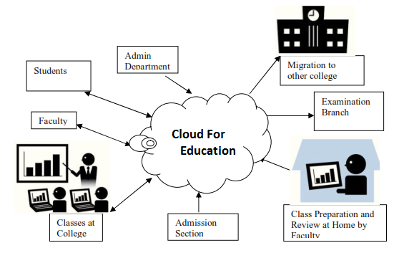
Cloud for education industry
Challenges
Solution
Cloud enabled infrastructure
Biggest Challenges in Educational Sector -
Lack of Infrastructure
Maintenance of Infrastructure
Virtual Infra on Pay-per-use Model for Colleges and Coaching Institutes
Redirect investment to develop engaging online, mobile friendly courses and learning platforms (LMS) instead of Infrastructure
Engaging more with students by spending less on IT infrastructure
IaaS eliminates need to buy more capacity to deal with business spikes
Leverage Cloud for on-demand infrastructure, to work on new digital learning focus
Enables Distant learning (like MOOCs) through mobile apps and to plan for services which needs unpredictable infra scalability
Holistic Learning Content Management on cloud (CMS, Courses, Quiz, Assessments)

Slide 8






Use Cases-Cloud Services
Application Context
IT infrastructure for all the administrative solutions( HR, Finance, Student/Teacher records)
Cloud Storage for education & Training videos
Hosting Analytics & BI Engine
Benefits
Intelligent student enrollment & selection -
Enhanced student experience through intelligent placement and course selection process
Low cost and high scalability reduces operational expenditure and brings in more flexibility
Enhanced user experience at low costs

Slide 9







Use Cases-Network & Security
Application Context
Creating smart, secure and interconnected campus
WiFi-enabled School Transportation
Creating a campus wide surveillance system
Benefits
Robust and resilient high speed connectivity that enables smart features like auto-attendance, class scheduling etc
Safety and security of students and staff on campus
Monitoring and security of students and staff till the time they reach home

Slide 10

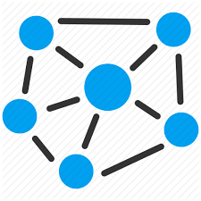


Use Cases-Digital solutions & E-Learning
Application Context
Ability to deliver MOOC(Massive Open Online Courses) and other E-learning courses
Delivery of education and training to remote areas where traditional models fail
Benefits
Education and training no longer bound by geography or language and is delivered at lower costs
Improves the reach and delivery of education and training at low cost

Slide 11





Use Cases-Digital Classroom
Application Context
Digitization of course material and digital streaming of course contents
Digital delivery of assessments, results and feedback
Usage of AR/VR for delivery of lectures/training content
Benefits
Delivery of realistic learning models based on AR/VR leads to better student cognition
Improved student experience
Easy and smart tracking of student performance and delivery of feedback

Slide 12
Sify overall relevance
Solution | Education Functions | Sify Services
Cloud services | On demand infrastructure to work on new digital learning focus Fully managed enterprise grade, virtual infrastructure for enabling digital learning Management of complete education content Scalable test and development test environment Respond to evolving e-learning dynamics Storing the huge data generated through content, classroom recordings, student submissions for meaningful insights | Sify GoInfinit Cloud+ AWS- GoInfinit AWS+ Azure – GoInfinit Azure+ CDN – GoInfinit Accelerate Security – GoInfinit Secure Sify Global Cloud Connect Goinfinit Container, VPE Goinfinit Auxiliary Services
Data Center Transformation - hybrid cloud, policy-based governance | Speeds up ROI with investments in digital solutions with Cloud & Managed Infra with Opex model minimize Capex Consolidation, optimization, virtualization and workload migration for agile and scalable online learning solutions | Sify Private Cloud – GoInfint Container GoInfinit Cloud AWS/Azure Sify Tier III Data Centers Sify Global Cloud Connect Sify Managed Services
Collaboration | Online Classroom Training Video conferencing for remote learning Conducting Guest Lectures/ Seminars through UC | Hosted Video Conference, Vidyo

Slide 13
Sify overall relevance Contd.
Solution | Education Functions | Sify Services
Application services (Industry Standard Applications) | CRM, Analytics & Machine learning for better student engagement Information shared can be accessed anytime/anywhere Real time collaboration between students and teachers Live streaming of media to a large audience | Azure stack, Office 365 Suite & EMS, Azure Media Services, Power BI, DB Management System
Application services (Sify Applications) | Elearning (LMS), Online training Conduct computer based tests to accommodate larger numbers | ITest testing and assessment platform, E-Learning
Telecom & Data Networks | Inter-Campus Connectivity Real time data sharing Robust e-education/ online education model | Managed WiFi, Internet of Things, Managed Network, Sify MPLS
Security Consulting & Managed Services; Data Protection | Protection against data breaches, hacks and leakages | Security Consulting services, network security services, managed security services Goinfinit Backup, Goinfinit Recover

Slide 14
Introducing sify & cloud@core

Slide 15
SIFY TODAY
TECHNOLOGY INTEGRATION SERVICES
Data Center IT
Network Integration
Information Security Services
Collaboration Services
End User Computing Services
TELECOM SERVICES
India Data Business
Global Data Business
Cloud Connect & Managed DWDM
Enterprise VoIP
Managed Network Services
APPLICATIONS SERVICES
iTest – Online Testing Platform
eLearning
Forum – Distribution Management System
Portal Solutions
DC, CLOUD & MANAGED SERVICES
Colocation/White labelling
Data center Transformation
Public Cloud (LaaS/PaaS)
Enterprise private and hybrid cloud
Cloud based DR
DC Managed Services
Managed Security Services
PLATFORM SERVICES
SAP / S4 Hana, Success Factors and hosted cloud infrastructure
Microsoft – Azure, Office & Productivity, Dynamics CRM
Oracle – SaaS, PaaS (HR, Database, Middleware, Cloud Machine)
A balanced portfolio to help clients navigate digital transformation

Slide 16




cloud@core
TM
ALIGNED TO OUR CUSTOMERS’ CLOUD TRANSFORMATION PURSUIT
CLOUD ENABLING
CLOUD INSPIRED
CLOUD PURE
CLOUD ENHANCED
Cloud DC
Hyper reach/Hyper scale transport
Oracle FastConnect | ExpressRoute | DirectConnect | Partner Interconnect
Software Defined Network services
Cloud build
Private | Hyperconverged | Enterprise
Security services for cloud
Migration and Implementation services
Sify CloudInfinit
  Enterprise Multi-Tenant
  Dedicated
  Hosted SAP/S4 HANA
  Azure Stack as a Service
Edge Connect Services
SD-WAN
Collaboration services on Cloud
AWS
Azure
OCI
GCP
Multi Cloud Management platform & services
Modern Applications
Kubernetes-as-a-Service
AI/ML
Forum DIGITAL
HCM Digital (iTest)
Learning Management
Internet-of-Things (IOT)
Industry Solution-as-a-Service

Slide 17







CLOUD@CORE: AGILITY, FLEXIBILITY & CHOICES
Investment and IP Commitments
Commitment beyond Infra: Platform & SaaS
CLOUD@CORE
Commitment beyond Cloud: Network for Cloud
Commitment to make Cloud secure
Capability and Commitment to build Cloud
Commitment of providing choices

Slide 18
How cloud@core powers education of future
TM
cloud@core
Secure valuable student data and protect against various attacks
Implement cloud based ERP’s and campus communication services
ALIGNED TO OUR CUSTOMERS’ CLOUD TRANSFORMATION PURSUIT
CLOUD ENABLING
CLOUD INSPIRED
CLOUD PURE
CLOUD ENHANCED
Cloud DC
Hyper reach/Hyper scale transport
Oracle FastConnect | ExpressRoute | DirectConnect | Partner Interconnect
Software Defined Network services
Cloud build
Private | Hyperconverged | Enterprise
Security services for cloud
Migration and Implementation services
Sify CloudInfinit
  Enterprise Multi-Tenant
  Dedicated
  Hosted SAP/S4 HANA
  Azure Stack as a Service
Edge Connect Services
SD-WAN
Collaboration services on Cloud
AWS
Azure
OCI
GCP
Multi Cloud Management platform & services
Modern Applications
Kubernetes-as-a-Service
AI/ML
Forum DIGITAL
HCM Digital (iTest)
Learning Management
Internet-of-Things (IOT)
Industry Solution-as-a-Service
Provide online learning solutions and enable connected learning
Create cloud based IT infrastructure and IT Transformation

Slide 19


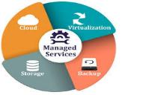

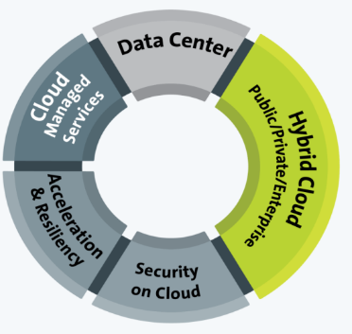


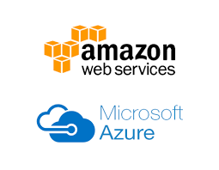

DATA CENTER SERVICES - CLOUD @ CORE
Rack | Space | Power
Managed Hosting Services
Cloud Ready
Managed Services
Enterprise Cloud
Cloud Nerve Center
OneTap | Dashboard
Security & Unified Reporting
Enterprise Grade
Secure & Custom Choices
Network Connected
Private Cloud
Converged | Hyper Converged
Fully Dedicated
Cloud in a BOX
Hybrid Ready
Application Acceleration & Security
Content | Media Delivery.
Cloud Security
Enterprise Application Access
CLOUD SERVICES
@ CORE
CLOUD SERVICES
@CORE
Public Cloud Services
Hyper Scale
Pay Per Use
Over 120+ Platforms
Resiliency Services
DR as a Service
Backup as a Service
Cyber Resiliency Service
Cloud Security Services
Zero Trust Security
SIEM Across Public, Private, Hybrid.
Cyber Resiliency

Slide 20
security transformation - Cloud @ core
Cloud delivered Security
From the Cloud
Security Services on utility model
Security for OT
Cloud Access Security
Securing Operations Technology
O365 | Salesforce | Google Apps
Data Security on Cloud
SDN & NFV based Services
Protecting Sensitive Data in the cloud
ADC | WAF | NGFW | NIPS
Vendor-agnostic approach
Cloud at Core
of Security
Transformation
Security Analytics
Security for Mobility
Enrich Intelligence with Visibility and Analytics
Anti-Phising | Anti-rogue
Securing the End Points
Security as a Service
User | Device | Thing
For the Cloud
Security Services build for Cloud IT

Slide 21
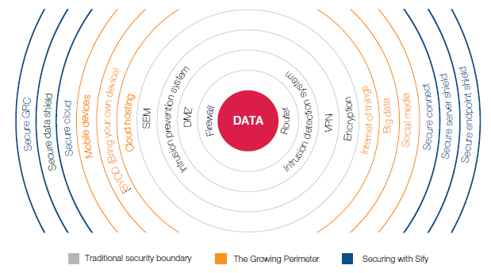
SECURITY SERVICES – CLOUD@CORE
Business drivers for securing IT environment
Advanced data breaches using sophisticated techniques
Increased exposure to hacktivism due to integration of new technologies
Increasing guidance and frameworks from industry organizations
Privacy and data protection regulations

Slide 22





Application services - cloud@core
Digital Platforms and Solutions on Cloud
Talent Management Service
Cloud driven Sify Mobile Application Solutions
Learning Analytics : Sify Learning Record Store for Learning Analytics solutions
ForumNxt and SffNxt
Sify LiveWire LMS : (3.0 and 4.0 under development. New UX and mobile app)
Business Process as a Service
Sify Customer Learning Portal Solutions
True SaaS Model
Partnerships :
Buzzyears Campus Management System
2. Sum Total Talent Management Suite
3. Partner HCM Integration on Cloud (Ramco)
Application & Registrations on Cloud
ForumNxt on Cloud
iTest on Cloud
AWS | Sify Cloud
Audit Apps on Cloud
SffNxt on Cloud
AWS | Sify Cloud
Exam day Support on Cloud
Support on Mobility and Cloud
CLOUD AT CORE
Results & Counselling on Cloud

Slide 23
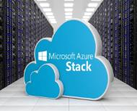

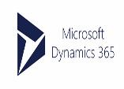
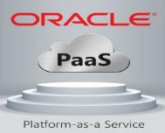
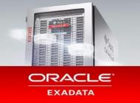






APPLICATION & PLATFORM SERVICES – Cloud@core
Sify Application and Platform Services
Applications
Big Data / Analytics
Platform
PaaS
IoT/ Blockchain
Network/Security
Storage/Compute
SAP Private and Public Cloud for S/4 HANA
Sify Application and Platform Services
SAP Cloud Platform
Automation / ML
PaaS
SAP Private and Public Cloud
SAP Cloud Platform
IaaS
SaaS
PaaS
PaaS
SaaS
IaaS
AIS-2 Cloud @ Core
AIS-2 Cloud @ Core

Slide 24


NETWORK SERVICES - CLOUD@CORE
Unified SLA
Integrated network and service management delivering high performance
Deliver transformational WANs to deliver transformational IT projects
Remote User
Branch Office
Internet
Integrated and scalable multi-service network
Enhanced business productivity
Sify WAN Transformation
Corporate Office
Mobility
MPLS
Public Cloud
Data Center
Optimal expense management
Integrated and uniform security management in the enterprise WAN
UC & C
Operational efficiency

Slide 25
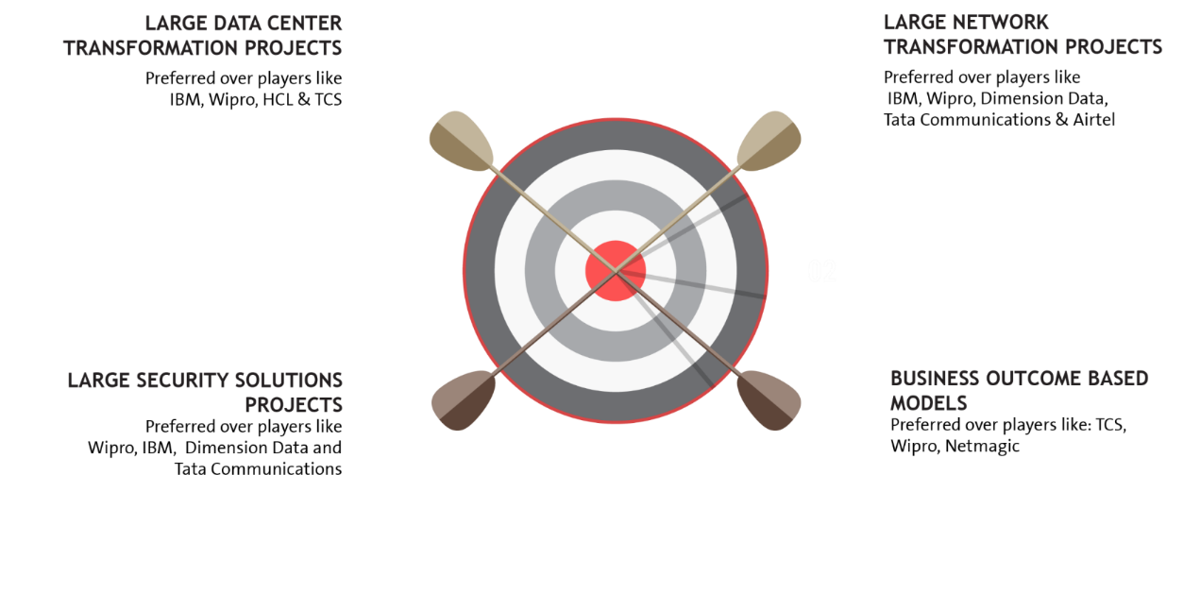

















EXECUTION CAPABILITIES

Slide 26
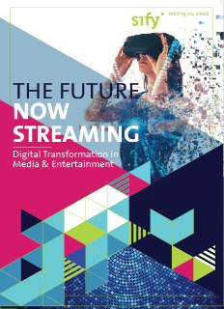
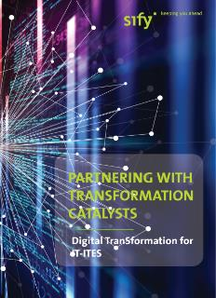



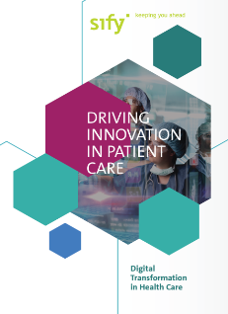

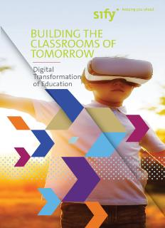
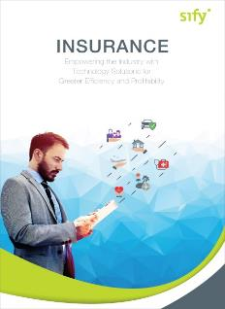

CLOUD@CORE: ALIGNING TO OUR VERTICAL STRATEGY

Slide 27
Sify engagement models and key strengths

Slide 28
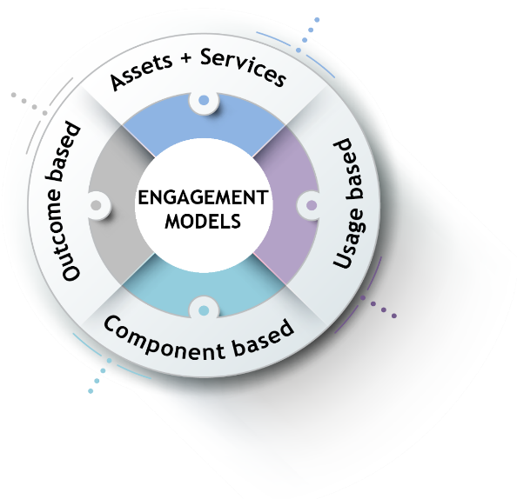
ENGAGEMENT MODELS
Systems are owned by the client and annuity based payout for services
Client engagement is based on defined business outcome generated by IT solutions and services
Less
Hardware
People
Licenses
No upfront investment by client and payout is based on consumption
Reduced upfront investment as client subscribes to infrastructure owned by Sify as a part of their overall infrastructure requirement

Slide 29
Our People Capabilities and Strengths
550+
DATA CENTER AND MANAGED SERVICES
1800+
NETWORK
SERVICES
70+
SECURITY
SERVICES
225+
APPLICATION
SERVICES

Slide 30


























Strategic Partnerships
Technology Partners
Cloud and Acceleration Partners
Application Partners
Security Partners

Slide 31
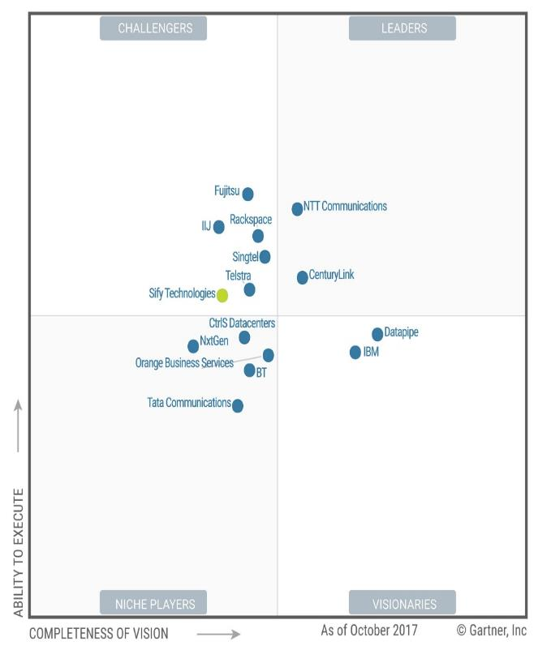

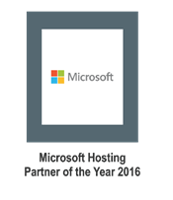
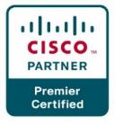


Recognitions
Partner of the year 2017
Network Transformation Services
2018
Data Center Transformation Services
2018
Sify moves up to the challenger position in the Gartner MQ for Managed Hybrid Cloud Hosting – Asia Pacific (2017)

Slide 32
Sify Customer references

Slide 33
KEY CUSTOMERS [WIP]

