Slide 1
AIRPORT AUTHORITY OF INDIA
Integration Case Study

Slide 2

AIRPORTS AUTHORITY OF INDIA
Project Objective
Design and implement a state-of-the-art, cost-effective, automated and secure DR for critical business application landscape
Migration of applications and copying data from DC to DR site
Integrated Value & Outcome
State-of-the-art & automated Disaster Recovery
Continuously improve RTO and RPO
Real-time dashboard of RTO and RPO
Regulatory compliance
Project Model
On-premise DR build model
Value for Client
Higher application availability, visibility and data availability
Increased customer satisfaction
Increased operational efficiency
Sify’s Uniqueness
Integrated solution covering different elements – Physical or Virtual Infrastructure, Software-Defined Network, Security and Managed Services
DR workflow automation, SOP and best practices
Application and Data Migration from DC to DR
Heterogeneous application-aware data replication
DR IT Platform:
DR built using best-of-breed technology elements at Hyderabad
Automation – Private Cloud Infra, One-click DR, EMS
Application-centric Software-Defined Network
Application Performance Monitoring
Virtualized environment to optimize Oracle apps & DB license
Dedicated infrastructure HA in DR, in always-on mode
DR Security – SIEM, Proxy, IPS, Email Security, WAF, APT and End-Point Protection

Slide 3
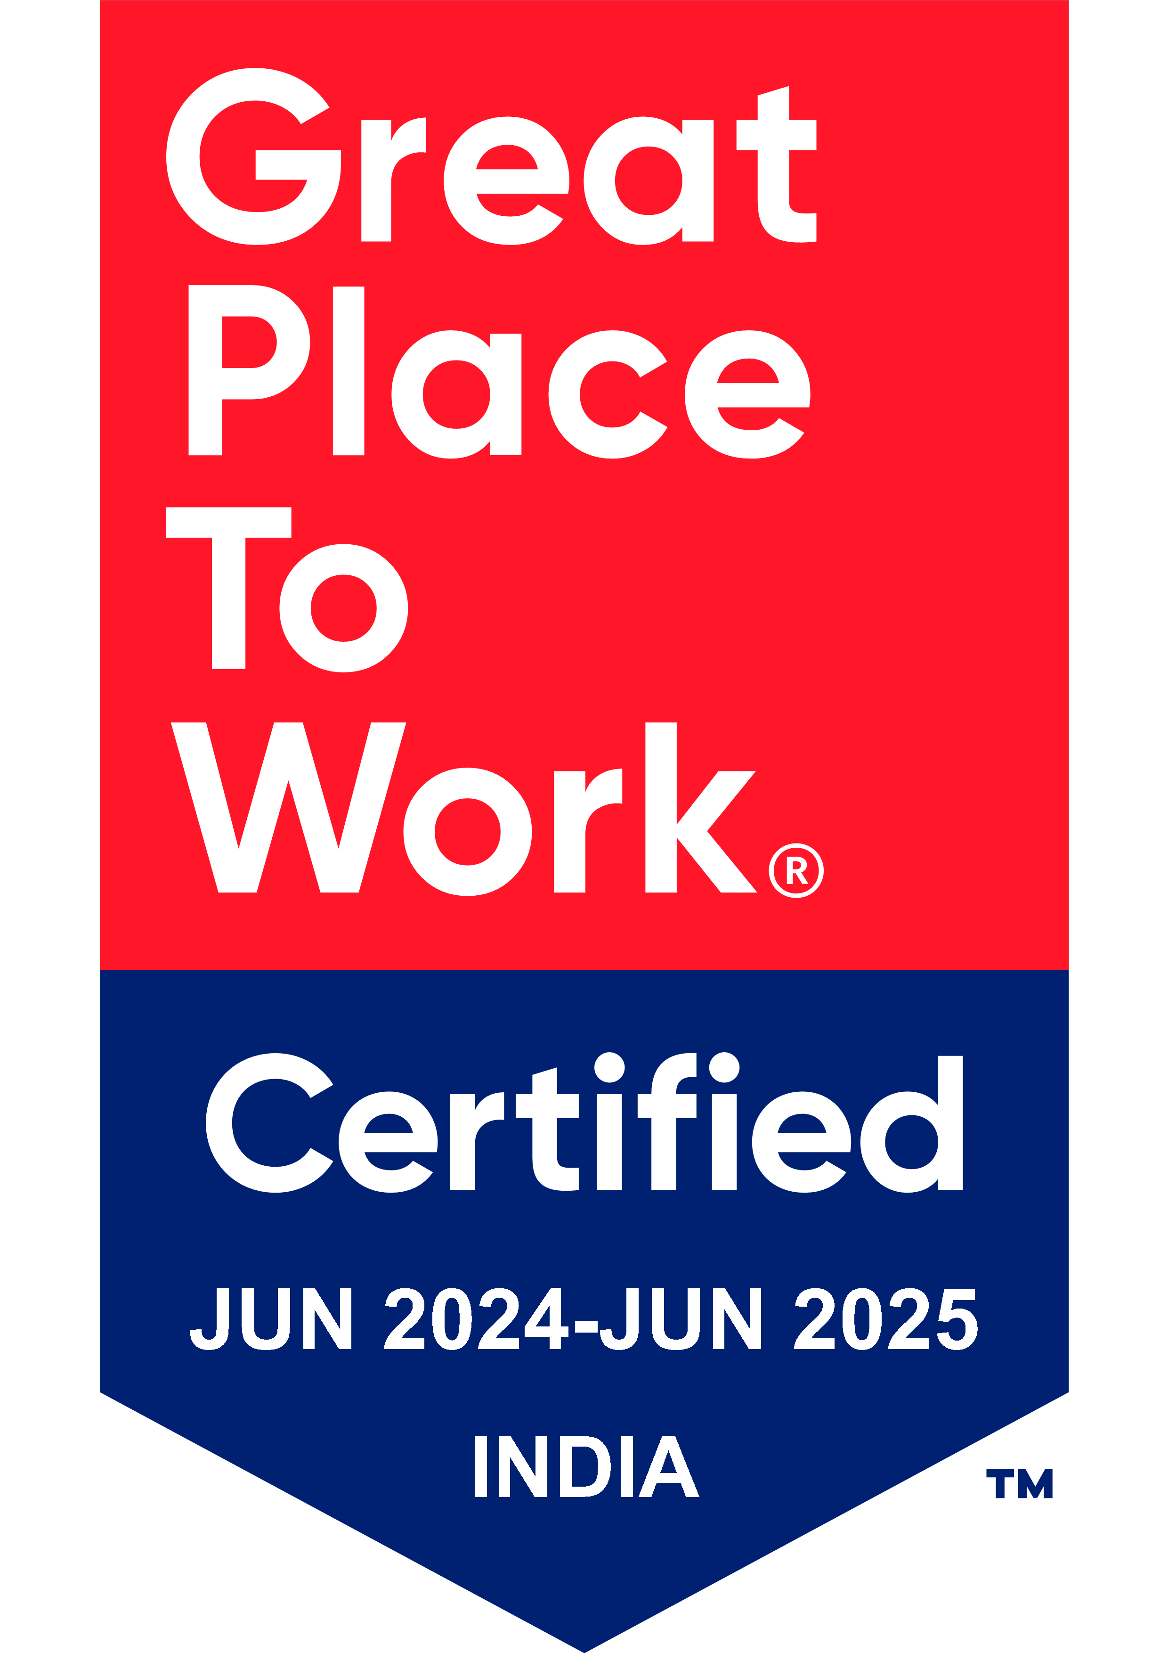
Thank You

