Slide 1
MAX HEALTHCARE
Integration Case Study

Slide 2

Integrated Value and Outcome
Cloud@coreTM products and services:
Started with Hosted Virtualization and Managed Services several years ago in first-generation initiatives
Migrated to Sify CloudInfinit with Cloud@coreTM in second-generation initiatives with minimal disruption
DRaaS from Cloud@coreTM is configured to mitigate the risk from unplanned disaster to prevent impacting the business
Hyperreach network connectivity for all hospitals with enterprise cloud
Hybrid Security and Managed Services for all applications
Value for Client
The client could provide better patient care and create new streams of revenue. As a one-stop IT infrastructure partner, Sify helped rationalize costs and release funds for modernization.
Project Objective
Deployment of client's application on Sify Cloud Platform to achieve digital initiative goals and increased revenue.
Project Model
Fully services model (vis-à-vis existing capex + services model)
Sify’s Uniqueness
Integrated value proposition: Private Cloud + Network Services + Disaster Recovery Services + Managed Services

Slide 3



How Max healthcare became a DIGITALLY ENHANCED ‘HOSPITAL OF THE FUTURE- 2 pager
Max Healthcare transformation goal: To transform the 4 main pillars of patient safety, revenue growth, customer experience and cost efficiency by refining processes and IT operations
Objective
Why Sify was chosen?
Sify’s value additions
Create an ecosystem of partners to better leverage Max’s investments for expansion of patient care services
Support their ambitious digital initiatives and quickly deploy new applications for better patient care and new streams of revenue
Transition into a highly available, scalable, agile and fully compliant cloud setup
Move from a hosted virtualization setup to Sify’s enterprise cloud with minimum services disruption.
State of the art management of Max’s current IT infra by Sify
Avoid work with other vendors and lock-in a single vendor
Sify already saved USD 2.7 million for Max making funds available for innovations and new projects
Earlier enabled the migration of critical apps to next-gen DC ensuring minimal disruption of IT services
Designed enterprise cloud on CloudInfinit CMP best practices
Migrated 130+ Instances and 85 TB data using the proven CloudInfinit workload migration process
Providing service assurance and management with CloudInfinit CMP
Highly redundant & scalable solution was offered for network
3

Slide 4



Built a private cloud and dr using cloudinfinit cmp best practices
Before transformation
After transformation
Customer success factors/ benefits
IT architecture was not scalable enough
IT landscape lacked agility
70% of the IT budget was used for keeping lights-on
IT infra were reaching end of support cycle
Applications demanded high performance storage
Increased capacity by 2 times while ensuring cost saving of 33% compared to dedicated infra
BYOL policy helped them save licensing costs
Able to manage the IT Infra dynamically to meet scaling needs of various applications
Moving to cloud improved agility, security and overall reliability of the IT landscape
Enabled smart ambulance and Max responder on bike program to revolutionize emergency care
Scale Infra for immediate deployment of new Apps in line with Max’s Digital Initiatives
Created single point of ownership and improving management of entire IT landscape
Highly scalable DR in case unplanned disaster without impacting business

Slide 5
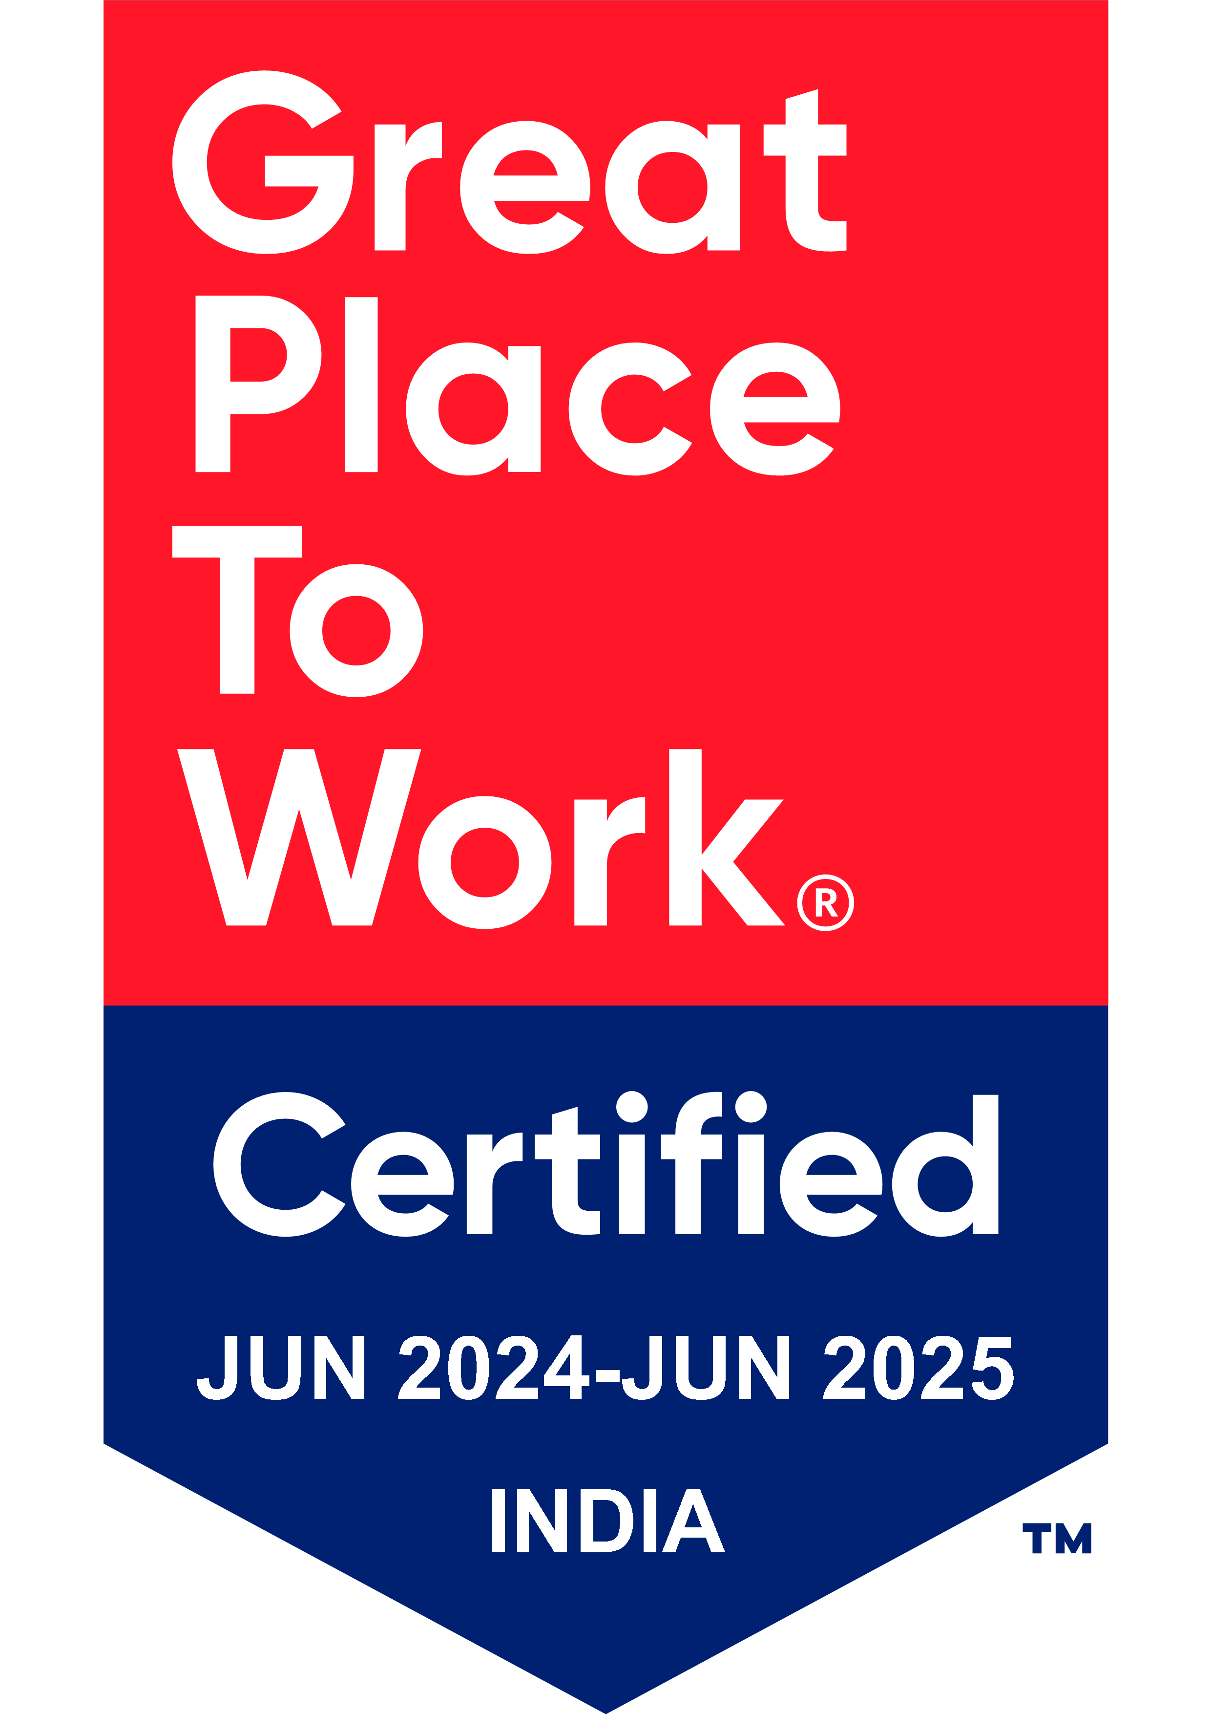
Thank You

