Slide 1
NATIONAL STOCK EXHANGE (NSE)
Integrated Case Study

Slide 2
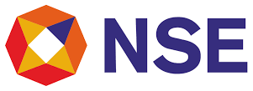





NSE: digital enhancement of 2nd largest stock exchange globally
Financial STOCK EXCHANGE
Project Objective
AWS Elastic Container Service (ECS) to be replicated and made highly available adhering to the RPO and RTO requirements as part of the DR Solution.
Integrated Value and Outcome
Automate application container image creation and deployment of application on RedHat OpenShift Platform
Enable Autoscaling of application pods dynamically on-demand based on application performance requirements
Build RedHat OpenShift Platform to provide Kubernetes as a Service
Build a DR process for failover of Microservices from AWS DC to Sify OpenShift DR Platform to enable live DR drill
Automate the process of failover using custom scripts that integrate with OpenShift and DevOps platform
Value for Client
Resilient IT Infrastructure without compromising the security & compliance guidelines. Unique DevOps process that collaborate with existing DevOps to enable faster Software Development Life Cycle / Release Management
Value for Sify
Leverage Sify’s cloud@coreTM investments around cloud enabling technologies like DC-DR services and tool sets for delivering managed security and digital services.
Customer Challenges
NSE has high security guidelines which limits them to host their source code in other cloud service provider including AWS.
Sify Infinitdigital LED
Sify’s Uniqueness Identify technical approach that allows for replication of Microservices and maintain application/database consistency as per dynamic demand.
DR Drill: Failover of Microservice and related components from AWS DC to Sify DR as Live DR drill process every quarter with RPO of 45 Mins and RTO of 2 Hrs.
Tools AWS: ECS, RDS EDB, Code Commit, RedHat OpenShift 3.11, Harbor Private Registry, Jenkins, Bitbucket, Maven, Clair and Docker, Monitoring Tools: Prometheus, Heapster, Grafana

Slide 3


National Stock Exchange
Business Requirement
Challenges
National Stock Exchange runs the NSE India Web application as Microservices on AWS ECS platform in Mumbai region and has opted to enable DR solution to meet the Service Availability and Compliance requirements.
NSE requires the AWS ECS containers to be replicated and highly available as part of the Disaster Recovery Solution. The AWS ECS containers running in the Microservices in stateless architecture must be synced and maintain consistency across AWS DC and Sify DR platform
NSE was looking for a Cloud service provider within India who can provide DR solution for their Microservices Platform in AWS ECS
AWS ECS platform currently doesn’t have an additional region within India to provide DR solutions
NSE has high security guidelines which limits them to host their source code in other cloud service provider including AWS
A seamless methodology to be evolved to replicate the Microservice platform from AWS to DR cloud service provider automatically while adhering the RPO and RTO requirements
3

Slide 4

Solution Approach
Key Requirements
Tools and Technologies
Enabling DC / DR for Stateless Microservices between AWS ECS and Sify DR Platform
Identify technical approach that allows for replication of Microservices and maintain application / database consistency
Dynamically meet performance requirements of the application based on demand
Failover of Microservice and related components from AWS DC to Sify DR as Live DR drill process every quarter with RPO of 45 Mins and RTO of 2 Hrs.
AWS Elastic Container Service
AWS Elastic Container Registry
AWS RDS EDB, Oracle, MySql
AWS Code Commit
RedHat OpenShift 3.11, Harbor Private Registry
Jenkins, Bitbucket, Maven, Clair and Docker
DevOps tool sets for Build, Test and Deploy Microservices
Monitoring Tools like Prometheus, Heapster, Grafana
4

Slide 5


Solution Approach
Constraints
Deployment Strategy
Achieving the replication of Microservices between AWS and Sify DR environment without extending the NSE source code with Sify Managed Services team
Identify the right tool sets and methodology that can integrate the two different heterogenous platform while maintaining Application consistency
Arrive at the unique DevOps process that collaborate with existing DevOps process of NSE and enable Software Development Life Cycle / Release Management.
Build RedHat OpenShift Platform to provide Kubernetes as a Service
Introduce Jenkins and associated DevOps tool sets along with streamlined process to build, test and deploy images in collaboration with NSE DevOps process and source images
Automate application container image creation and deployment of application on OpenShift Platform
Enable Autoscaling of application pods dynamically on-demand based on application performance requirements
Build a DR process that failover the Microservices from AWS DC to Sify OpenShift DR Platform to enable Live DR drill
Automate the process of failover using custom scripts that integrate with OpenShift and DevOps platform.
5

Slide 6
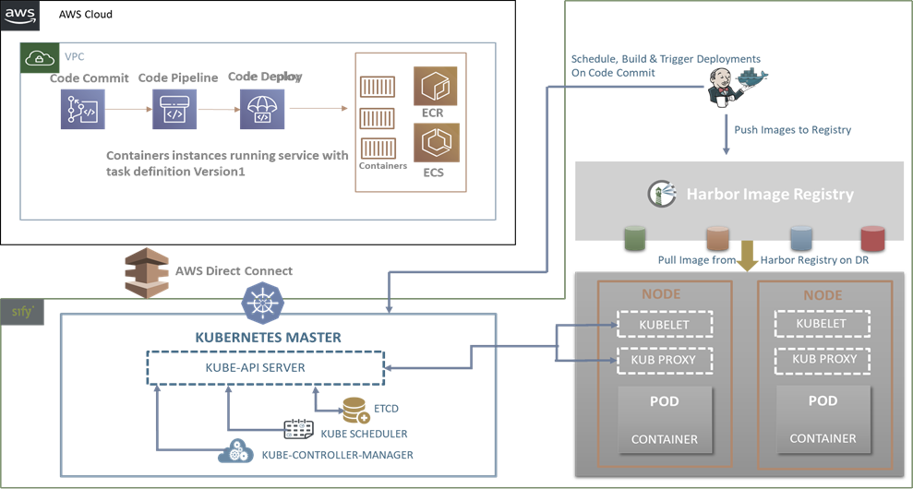
High Level Architecture Diagram
6

Slide 7
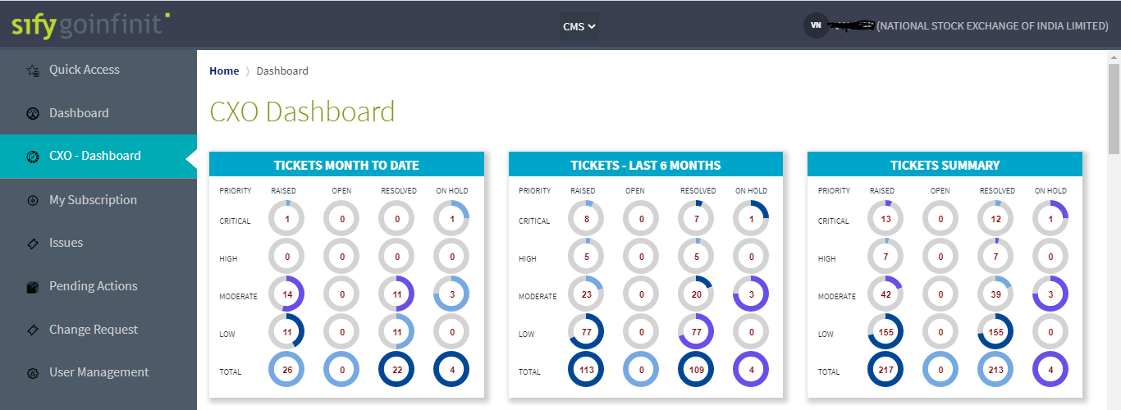

Slide 8
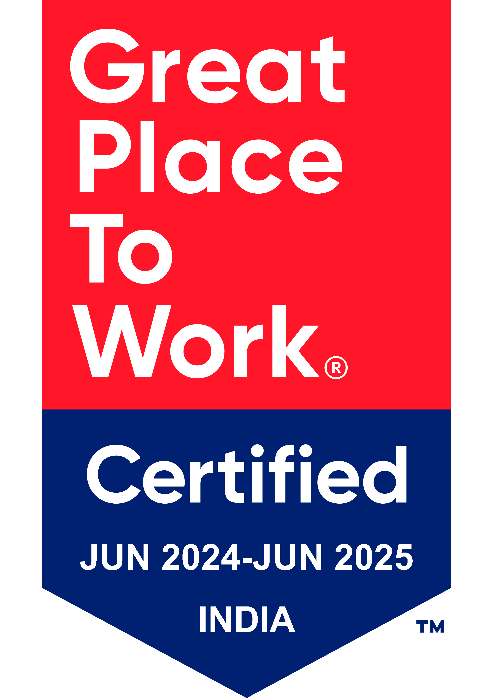
Thank You

