Slide 1
MAX LIFE INSURANCE
Integrated Case Study

Slide 2








MAX LIFE: DIGITAL TRANSFORMATION FOR GENERAL INSURANCE
general INSURANCE
Project Objective
Improve availability of IT infrastructure, along with a roadmap to leverage cloud technologies
Integrated Value and Outcome
cloud@coreTM products and services:
All cloud ready applications migrated to Sify CloudInfinit / AWS
All new digital applications to be built upon hyperscale (AWS)
Legacy apps and infra in cloud adjacent DC at near 0 latency
Hybrid security framework for both hosted & cloud footprint.
Meticulous migration in record timeline for client appreciation
Hybrid cloud management platform for management of the Hosted Private and AWS Cloud footprint.
Leveraged Sify’s partnerships to integrate CDN platform
Value for Client
Improved availability of IT infrastructure, free up IT teams time to test & plan new initiatives, adoption of new age loosely coupled stacks with containers and serverless etc. becomes possible, able to leverage readily available digital solutions – on demand.
Value for Sify
Competitive edge, full stack products and services play, significant cost control, higher revenue and margin, great reference for hybrid cloud.
Project Model
Fully services model(vis-à-vis existing capex + services model)
Competition
NTT, Tata Comm
HYBRID CLOUD LED
Sify’s Uniqueness
Integrated value proposition built on: Cloud adjacent DC, Hyperscale (AWS) partnership, Hybrid cloud management platform - Sify CloudInfinit, DC and Cloud Interconnect (cloud@coreTM service), Migration services and Security services
Contract Duration
3 years – large annuity revenue stream
Contract Value
US $2.85+ Million

Slide 3



A leading Life insurance company GOES Hybrid multi cloud- 2 pager
To drive effective and cost efficient multi department projects with speed and agility
Objective
Why Sify was chosen?
Sify’s value additions
To create agile & scalable Infrastructure that increases the velocity of time to market.
Single SPOC and SLA based service ownership for Cloud, Network, Infrastructure, DB, OS and DevOps.
Consistent service experience through Service Management Office (SMO) to implement and ensure ITIL process and compliance.
Sify’s strong multi cloud strategy for delivering end to end services under one roof.
Partnered with AWS for hyper-scale cloud platform.
Designed & configured the technology stack through microservices such as API Gateway, Kinesis, EMR, Athena, SQS, SES, SNS, Lambda, ECS, DynamoDB, Redis etc.
DC and AWS connectivity through Direct Connect for consuming large scale of the DC data for analytics using AWS EMR and Athena.
Chatbots application using serverless architecture such API Gateway, LAMBDA and DynamoDB.
3

Slide 4



Enabled agile deployment of AWS cloud-native applications
Before transformation
After transformation
Customer success benefits
Traditional DC architecture with own hardware at Noida.
Lacked agility & scalability for emerging business demands.
Suffered vendor lock-in for software.
High capex and un-predictable business growth.
Applications running under auto scalable model in AWS cloud.
Freedom from vendor lock-ins resulting in more flexibility.
Performance improvements & increased speed of implementation with serverless & containerization platform.
No capex or infra liabilities with pay-as-you-go billing option.
Enabled digital transformation and readiness for upcoming projects (Data Lakes, AI/ML etc.) along with future roadmap for multi-cloud.
Project wise cost optimization with ROI visibility.
Improvements in customer service & satisfaction due to agile applications developed on cloud platform.
The new architecture offered greater degree of automation & scalability.
Transformation of IT from a maintenance service to a strategic business contributor.

Slide 5
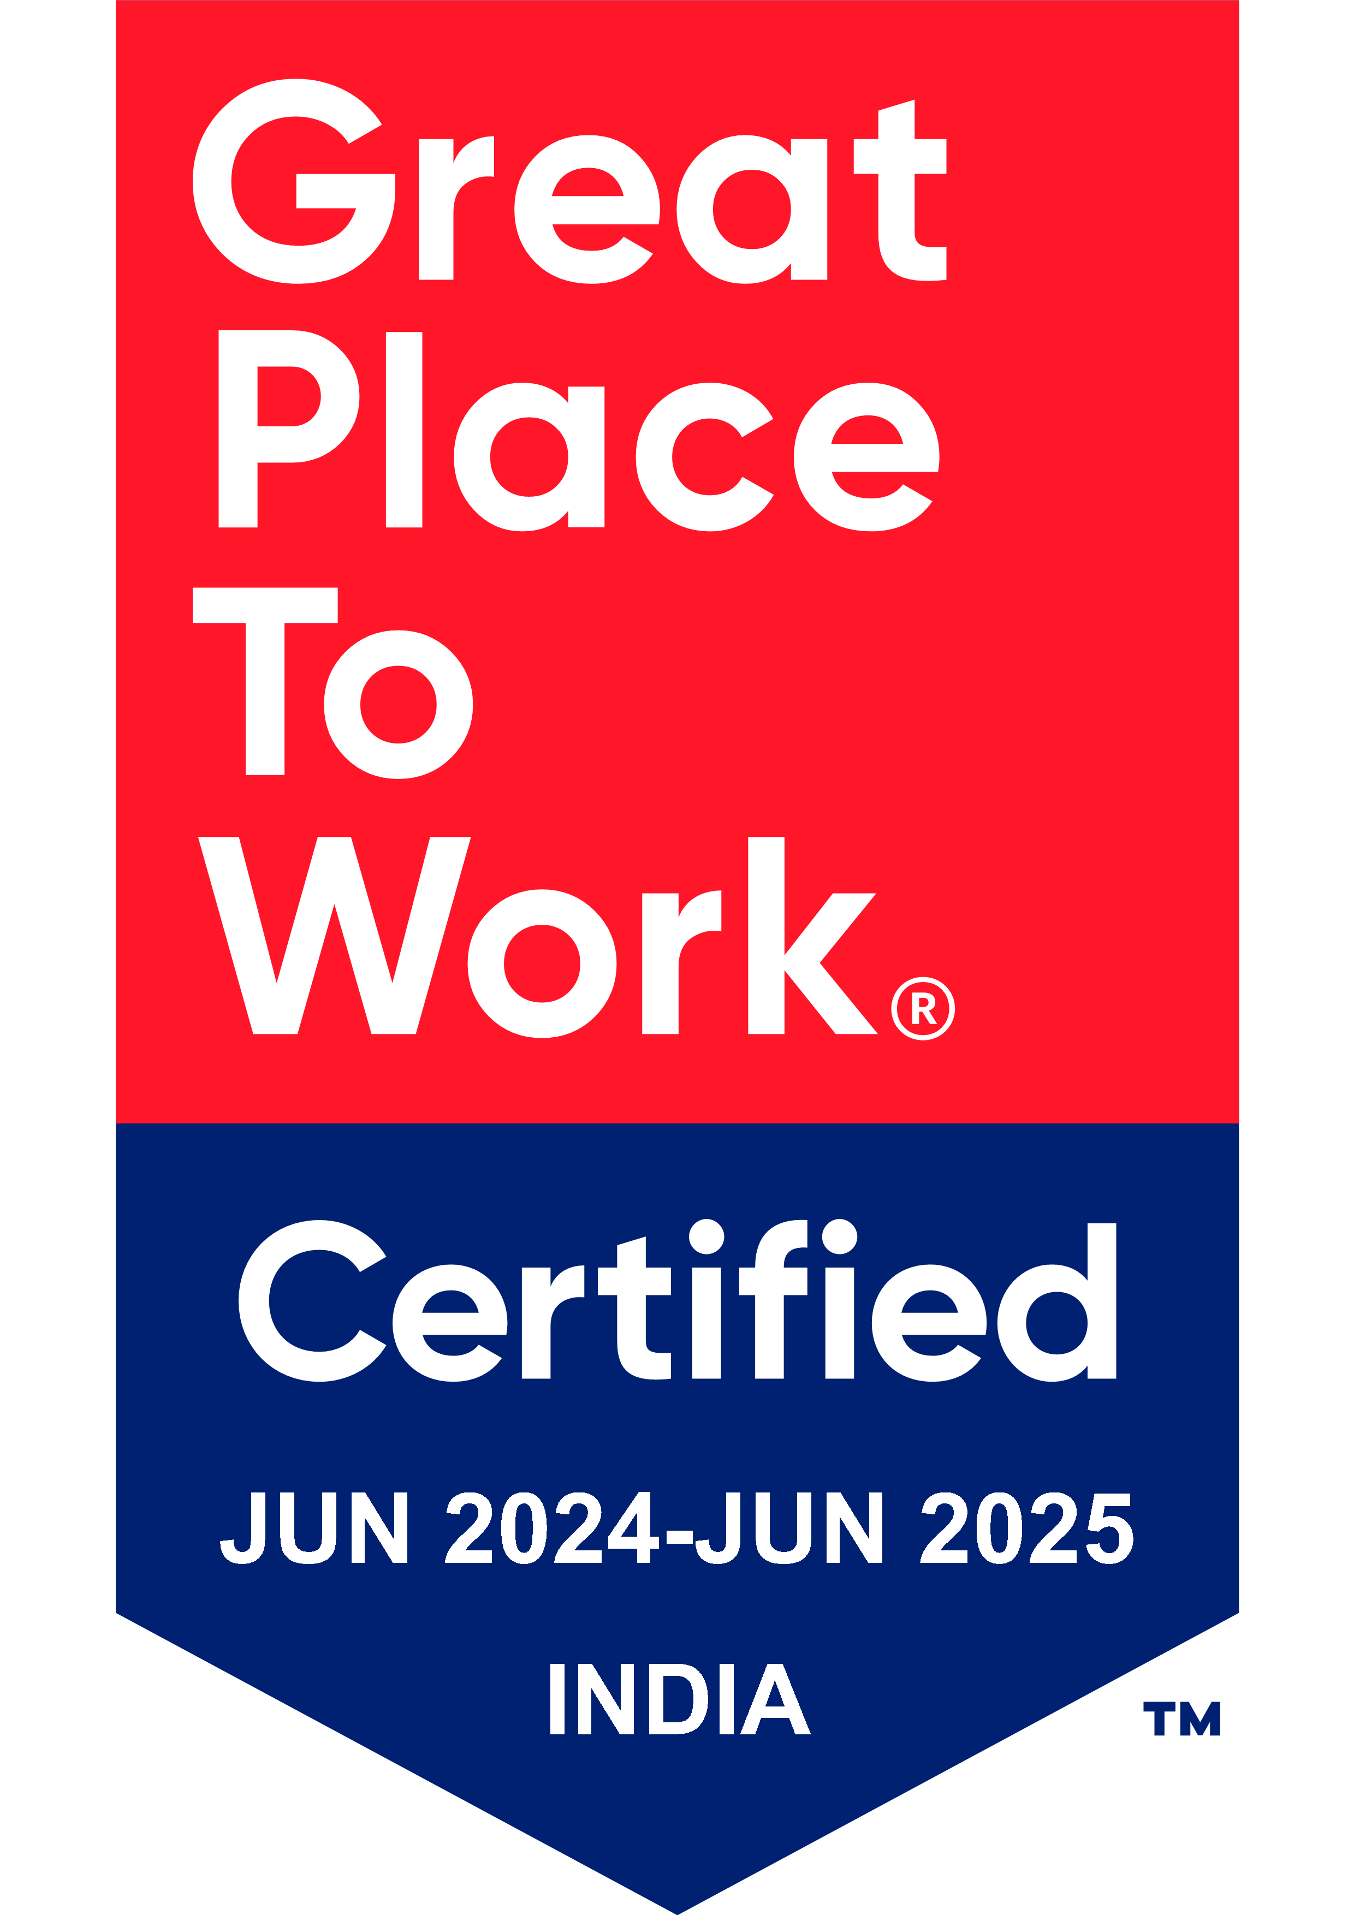
Thank You

