Slide 1
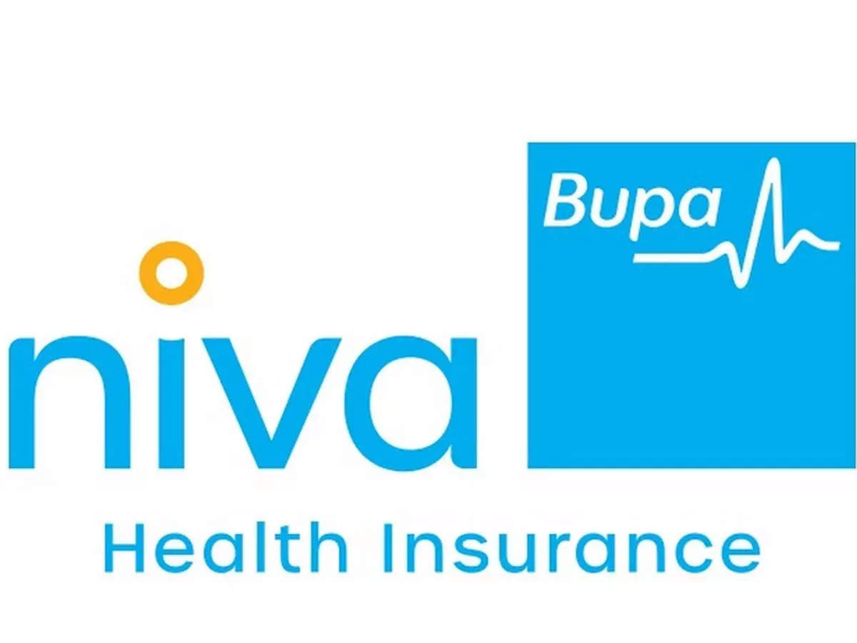
Win theme:
DC Transformation (2016)
and
Managed Services Transformation (2022)

Slide 2
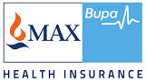







MAX/NIVA BUPA: DC & DR TRANSFORMATION OF HEALTH INSURANCE
HEALTH INSURANCE
Project Objective
Consolidate four data centre application workloads and build a Managed Private Cloud and DR Services at Sify DC.
Integrated Value and Outcome cloud@core products and services:
Design, Build and Deploy Hosted Private Cloud Infrastructure.
Study and Migrate close to 20 Applications to hosted private cloud with near zero downtime window.
Setup DR at a different seismic zone using DRaaS to provide granular data recovery time objectives.
Implement security framework to comply with Insurance Industry Regulatory Requirements.
Managed Services using Sify Managed Services Platform covering DC, DR, Branch Network and Security.
Value for Client
Resilient IT Infrastructure to roll out new solutions at a rapid rate without delays in procurement of new hardware, software and other IT Infrastructure resources with 10% reduction on TCO YoY.
Value for Sify
Leverage the cloud@core investments for cloud enabling tech (data centers), disaster recovery services, tool sets for delivering the managed security services and the full spectrum of managed services.
Project Model
Fully services model(vis-à-vis existing capex + services model)
Competition
Wipro, Net Magic, HPE, IBM
PRIVATE CLOUD LED
Sify’s Uniqueness Integrated value proposition built on: Cloud Assessment Services, designed a private cloud architecture using Sify CloudInfinit CMP best practices, automated DR on Sify DRaaS Model, Telecom Services for DC-DR Connectivity, End to End Managed IT Services
Contract Duration
3 years – large annuity revenue stream
Contract Value
US $3+ Million

Slide 3



How NIVA bupa achieved better compliance, improved efficiency and business agility
Niva Bupa transformation goal: To revolutionize the customer service by launching their cashless approvals within 30 mins initiative, they want to equip themselves with an IT infrastructure that’s massively scalable
Objective
Why Sify was chosen?
Sify’s value additions
Transform the current Infrastructure into a well architected framework
Consolidate the applications landscape into a single data center
Obtain 24x7 service assurance
Leverage analytics and big data to enhance their customer insight
Agility to support marketing & digital campaign management channels
Scalable and modular Infrastructure Architecture to be able to adapt to business and regulatory demands of Max Bupa
Extensive business relationship with the Max Group servicing Max Healthcare and Max Life
Confidence in the Sify teams
Competitors did not have a catalog based managed services model
Designed a private cloud architecture on CloudInfinit CMP best practices
Migrated 100+ Instances and 60 TB data using the proven CloudInfinit workload migration process
Providing service assurance with CloudInfinit CMP
3

Slide 4





Phased transformation
2016 to 2022
Phase 1 | Cloud Skeptical
Situation Appraisal
Challenges
Sify Value-Add
Benefits to Customer
People Involved
On-premise compute environment across 4 locations
Lack of standardization
Physical server environment
Due for hardware tech refresh
Multiple vendors to manage different DCs, DR & NoC
Services management through inhouse teams
Opensource monitoring tools with no integration points
No ITSM tools
Non-compliance with IRDA guidelines
Manual DR management
Service disruption due to power/AC issues
Multiple single point of failures
Long procurement cycle for new apps and system deployments
No visibility & control in IT Ops
Only business hours support available with frequent breaches in SLAs
Attrition impacting support & SLAs
Coordination related issues among multiple vendors
Consolidated all workloads @ Sify Noida DC
Better TCO for 5 years
Simplified architecture through virtualization
SLA based Remote Infrastructure Management
Basic security controls put in place
Support during system upgrades and new deployments
Streamlining SOPs and ITIL processes
Better TCO for 5 years
Single ownership for DC, DR, NoC & Security managed services
24*7 services with committed SLAs
Better visibility & control through SNOW dashboards
Better confidence on BCP
Bupa IT teams can focus on collaborating with their business teams & experimenting with new systems such as cloud
Quicker rollout of new apps and systems
IT Infra Head, CIO, COO & CPO

Slide 5
Phased transformation
2022 onwards
Phase 2 | Cloud Friendly
Situation Appraisal
Challenges
Sify Value-Add
Benefits to Customer
People Involved
Different vendors and ITSM platforms for IT Infra management, security & EUS
IT infrastructure management is through remote shared services model
Digital aspirations and regulatory environment demanded an integrated security management
Manual DR management
IT Ops led Backup strategy
No single view for end user SLAs
Manual intervention was high in IT ops
Provisioning/deprovisioning infra and troubleshooting issues was still time consuming
MIS reporting was not consolidated
No confidence on DR & BCP
Integrated Managed Service across DC, DR , EUS
Unified service desk
ITSM, Monitoring, management across DC, DR, EUS & application monitoring
Architecture review for Digital Platforms
Cloud evaluation & advisory
Business Continuity transformation & business led back-up solution
Onsite deployment of key resources
Unified enterprise IT infrastructure operations & service SLA’s
Improved enterprise user experience
Improved security management
Digital ready infra through AWS cloud adoption
Automated DR with replication monitoring
Improved TAT & application availability
IT Ops became proactive rather than reactive
Role of IT changed from operations to transformation
IT Infra Head, Apps Head, CIO, CISO, CPO & CEO

