Slide 1
STATE BANK OF INDIA
Digital Services Case Study

Slide 2
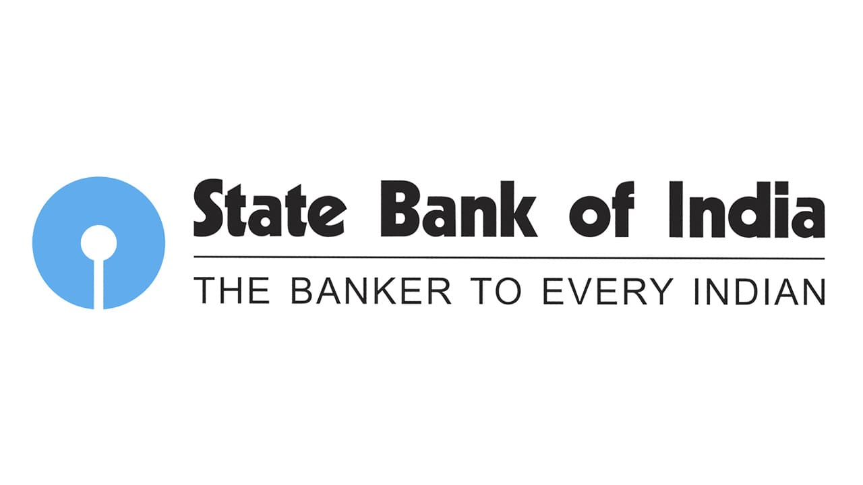



State bank of india
Public sector bank
Project Objective
Automate the first level of troubleshooting for network-related tickets, accelerate repetitive tasks done manually, enhance end-user experience with servicing agents/chatbots
Integrated Value and Outcome
Modular development & deployment
24x7 performance monitoring of the architecture
Fully managed services, facilities and features associated with RPA/chatbots
Automatic resolution of transaction invocation ticket
Health check for various components like CPU, memory, connectivity, device accessibility, and server
Value for Client
Unattended successful end-to-end processing
Increase in efficiency
Faster TAT
24x7 operability
Faster error detection and remediation
Improved user experience
Ultimately led to lower Total Cost of Ownership (TCO), improved Return on Investment (ROI) and enhanced controls
Sify Infinitdigital LED
Sify’s Uniqueness
Automation Edge Components: Workflow Scheduler, Agent Handler/AE Engine, File Store, Web Services, Request Queue, Std. RPA Architecture, integrate BMC Remedy & VuNet NMS

Slide 3

Thank You

