Slide 1
EMAMI CEMENT
Cloud Case Study

Slide 2








EMAMI CEMENT: DIGITAL TRANSFORMATION OF SAP INFRASTRUCTURE
MANUFACTURING - SAP
Project Objective
Implement integrated future ready digital infrastructure on Sify Private Cloud for SAP
Integrated Value and Outcome
cloud@coreTM products and services:
SAP HANA implementation on a private cloud (one of the earliest adopters) with both DC & DR on different Seismic zones
Hybrid IT with legacy infra in a Sify DC and interconnected to Sify private cloud at zero latency.
One of the earliest adopters of provisioning SAP HANA infrastructures on a services model
Hybrid security framework for both hosted & cloud footprint.
Integration of SAP dev & QA on Sify CloudInfinit enterprise cloud and production with HANA on a dedicated private cloud.
Management of the hosted private and enterprise cloud resources with hybrid cloud management platform
Value for Client
Nimble & agile SAP HANA infrastructure on a services model, end to end ownership by one partner for DC / DR, Cloud Interconnect, no conflict of interest with application partners.
Value for Sify
Competitive edge, full stack products and services play, significant cost control, higher revenue and margin, great reference for hybrid cloud & SAP HANA
Project Model
Fully services model
Competition
NTT, Ctrl-S, Nextgen, PwC, Nxtra
HYBRID CLOUD LED
Sify’s Uniqueness
Integrated value proposition built on: Private Cloud offering on Sify CI, Cloud Adjacent DC, Integrated Private Cloud and Hosting model, DC & DR in different Seismic Zones, DC and Branch Interconnect (Sify’s own service), Security services and Managed services
Contract Duration
5 years – large annuity revenue stream
Contract Value
US $750,000+

Slide 3

Emami Cement – SAP S/4 HANA DR- portal
Client
Overview
A well-know diversified group with strong manufacturing operations. It has chosen SAP S/4 HANA as ERP for the backend operations.
Scope of Work
Solution Highlights
This is a greenfield SAP S/4 HANA implementation.
Infrastructure provisioning for SAP
Managed Services(OS, Virtualization)
Managed Backup Services.
Network &Security Services.
Disaster Recovery setup for SAP HANA Production System.
Phase 1: One SAP HANA SP10 physical box for QAS and DEV, with 7 VMs, another SAP HANA SP10 Production Physical box with 3 VMs & Phase 2 - BI/BW 7.4 provisioning completed
Phase 3: DR needed after 18 months
Implementation DC location – Navi Mumbai (Rabale).
Implementation DR location – Bangalore.
HANA DB size 350 GB
RTO: <=4 hours and RPO: <=30minutes
Benefits
Challenges
This solution is aligned to client’s business objectives. They wanted to leverage S/4 HANA’s Simple Finance offering, besides the usual SAP ECC core modules
Single window governance of Infra.
Minor issues in Data Centre Readiness
There were some issues in ‘last mile’ connectivity (client office in Chhattisgarh)

Slide 4
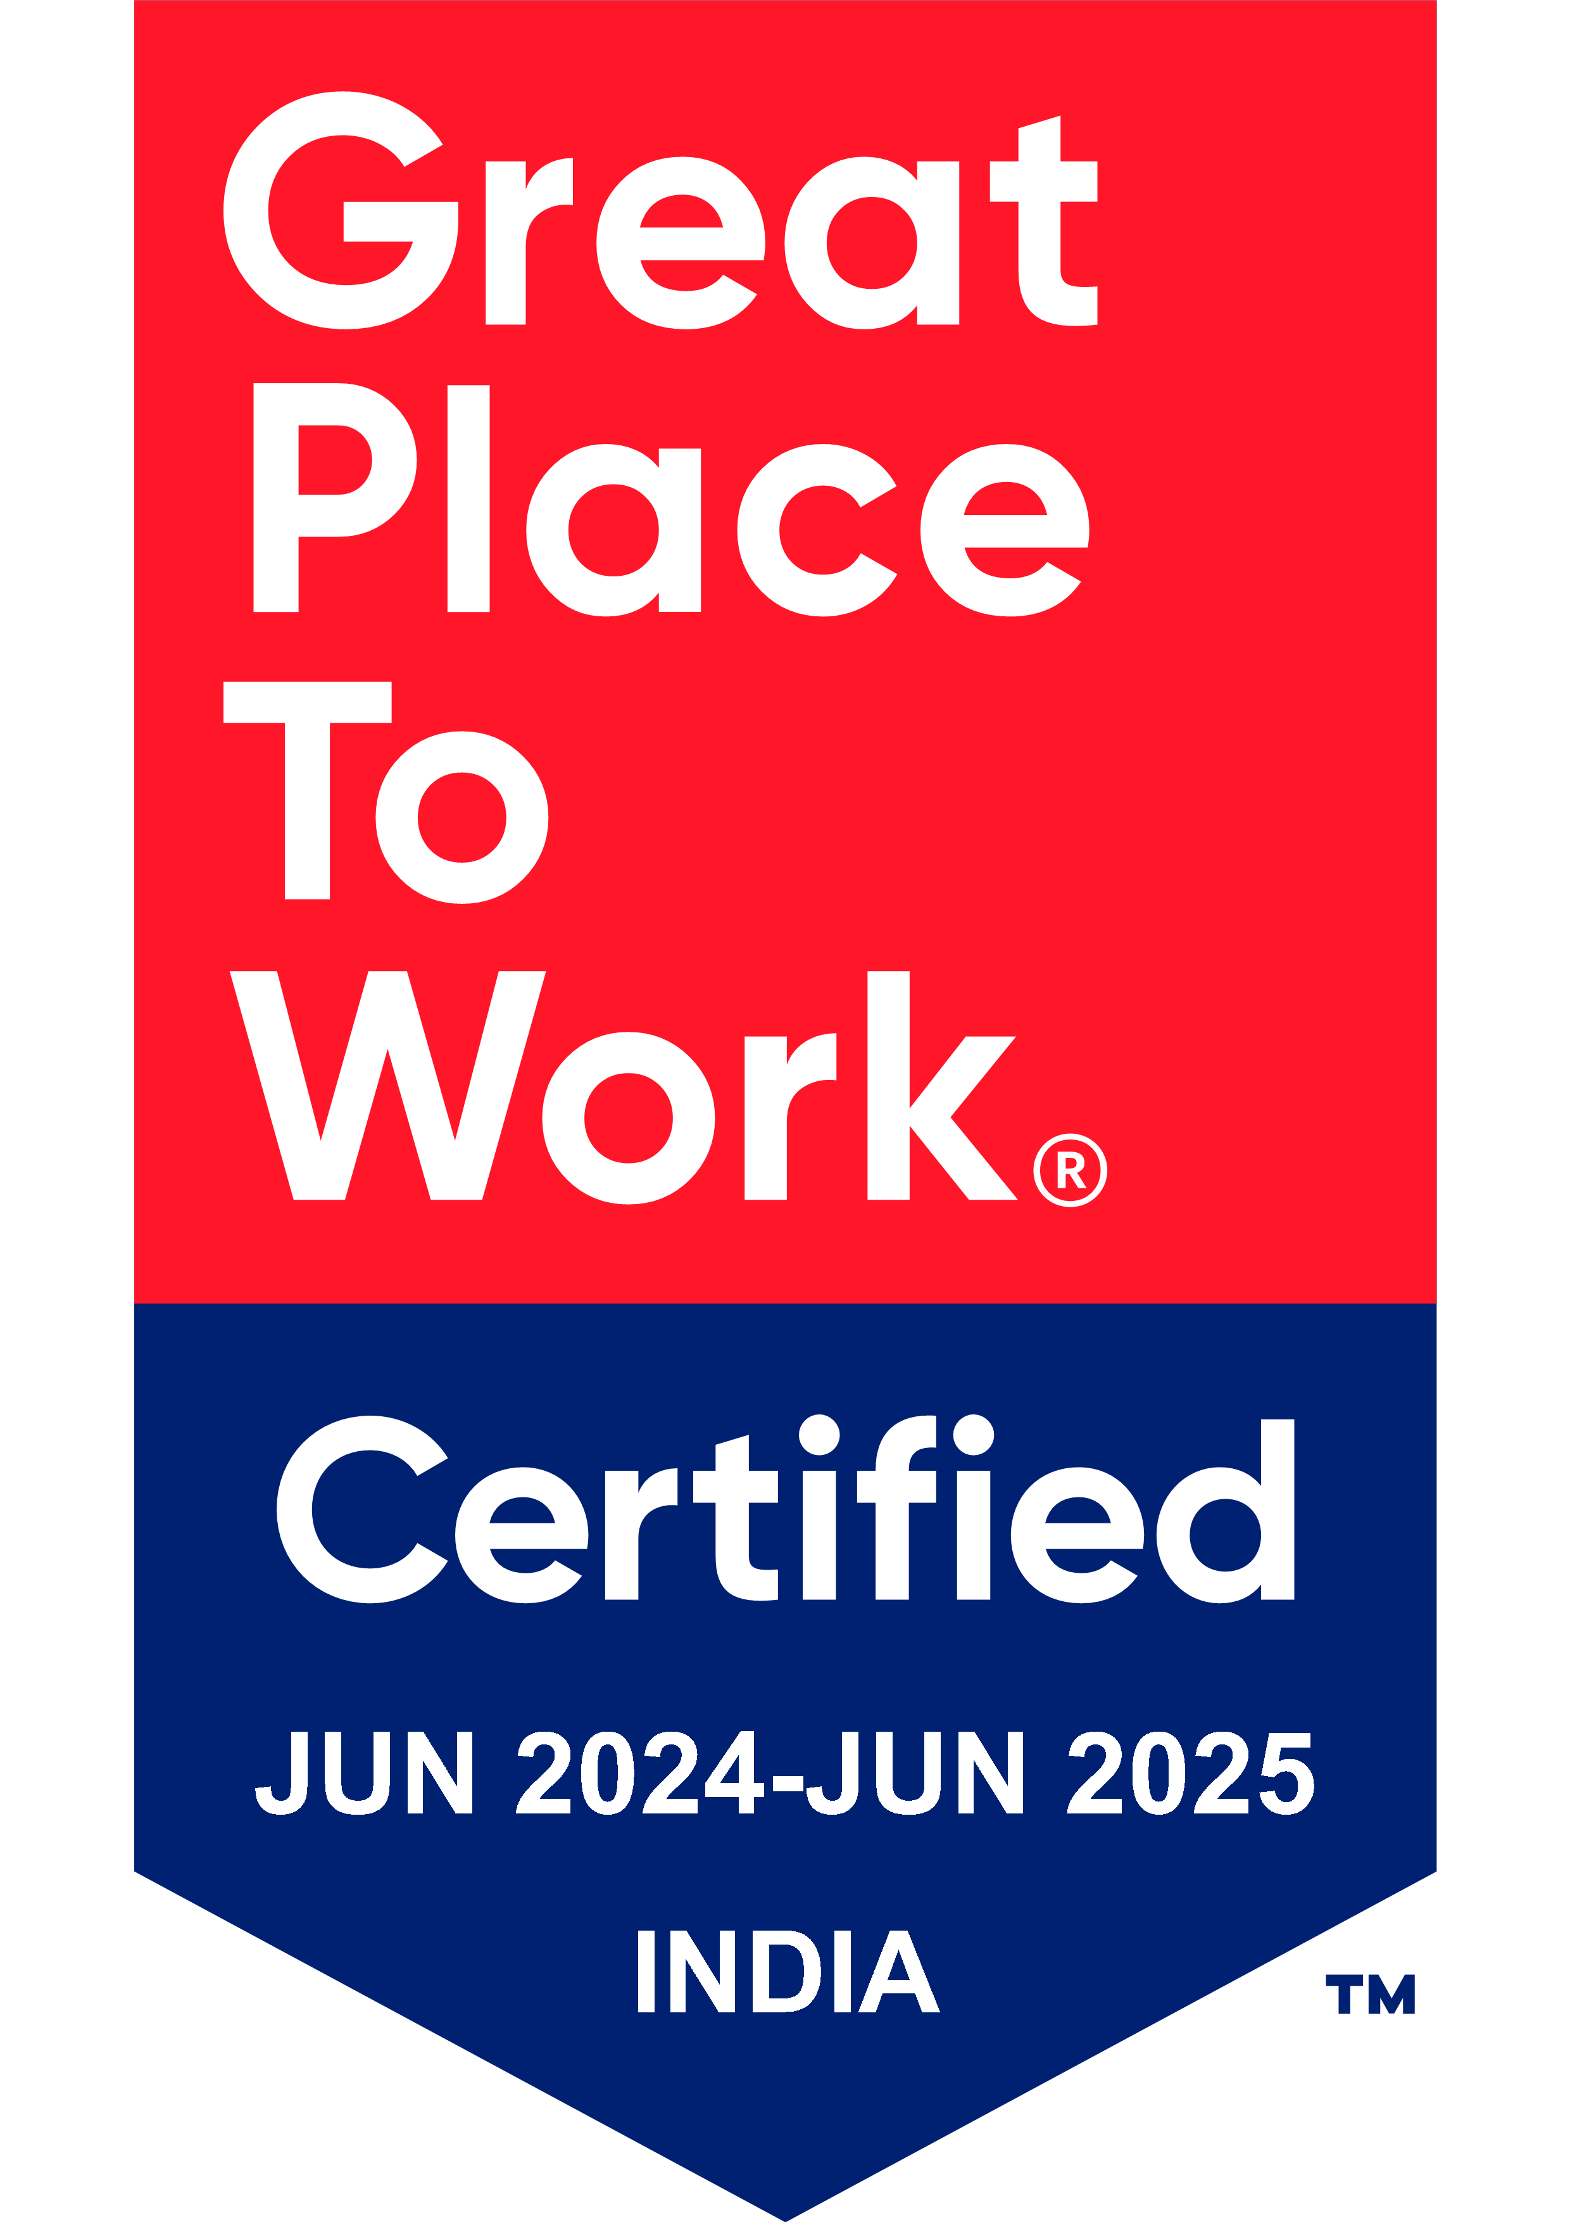
Thank You

