Slide 1
INDIAN STEEL & WIRE PRODUCTS LTD (ISWP)
SAP Case Study

Slide 2
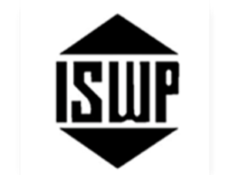
ISWPL – SAP Migration & EHP Upgrade
Client
Overview
The Indian Steel & Wire Products Ltd established in the year 1920. In the year 1935, it was incorporated as a company under the Companies Act, 1913. A primary manufacturer of wire rods, TMT rebars, and wires, welding products, Nails, rolls and castings; ISWPL strictly adheres to the highest standards of quality and services. There are many firsts with ISWPL. It established the first Wire Drawing Plant in Asia & is a pioneer in the Rolls industry of India. Pre-independence it also established the privately owned fasteners plant and supported industrial development. This is how ISWPL emerged as a major manufacturing Centre during the 20th Century thereby giving a boost to the nation building and industrial growth.
Scope of Work
Solution Highlights
Migrate SAP landscape (ECC) from Windows 2003 /MS SQL 2008 (On-premises) to Windows 2016 /MS SQL 2016(AWS)
SAP ECC Upgrade from ECC 6.0 to EHP 8
SAP landscape to be moved from on-premises to AWS cloud
SAP ECC 6.0 EHP 8 (DEV/QA/PRD)
Solution Manager 7.2 & SAP Router
Built the SAP ECC DEV, QAS and PRD, Solman, SAP Router from Windows 2003 /MS SQL 2008 (On-premises) to Windows 2016 /MS SQL 2016 (AWS)
SAP ECC Upgrade from ECC 6.0 to EHP 8 and Testing has been carried successfully.
The End User connectivity for the New Cloud Servers
Benefits
Challenges
Improvement in SAP system performance
Since SAP upgraded to ECC 6.0 EHP 8 they can use the new SAP features for business.
Database Oracle Upgraded to MS SQL 2016
Windows OS is upgraded to 2016
Mail server Connectivity from AWS to On-Premises & external services.
Minimum downtime for Migration and Upgrade.
SAP ECC Z reports

Slide 3
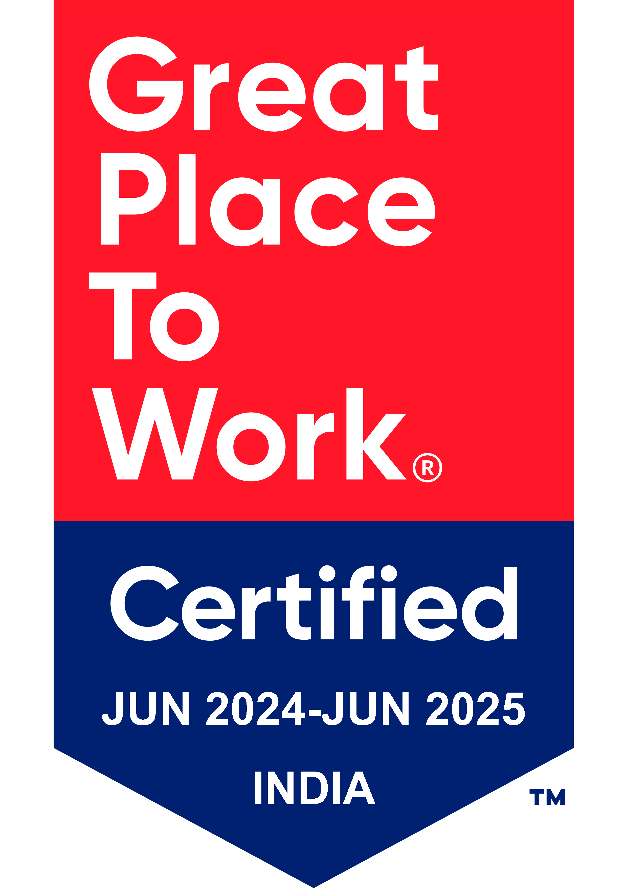
Thank You

