Slide 1
IREO
SAP Case Study

Slide 2

IREO– SAP ECC/ CRM DMS & DR
Client
Overview
Ireo is a leading property developer in India. Since establishing our presence in 2004. It was on SAP ECC, CRM & DMS , they wanted to setup DR in Sify Cloud.
Scope of Work
Solution Highlights
Infrastructure provisioning for SAP
Managed Services(OS, Virtualization)
Network &Security Services.
Disaster Recovery setup for SAP SYBASE & MAX DB Production System
Hardware Provisioning
Public IP , VPN & Replication link Provisioning
The End User connectivity for the New Cloud Servers
SAP ECC , CRM & DMS Installation & SYBASE
SYBASE & MAX DB DR Configuration
ECC DB size 100 GB and CRM DB size 80 GB and DMS DB size 20 GB
MAXDB Manual shipping and Sybase SRS method
RTO: <=4 hours and RPO: <=30minutes
Benefits
Challenges
System Replication is a standard SAP SYBASE feature. In this method, all data is replicated to the ternary site and data is pre-loaded into memory on the ternary site which helps to reduce the recovery time objective (RTO) significantly.
Data copy from Transrail DC to Sify DC.
Minimum downtime for migration process.
Port opening for the New Sify Cloud Servers
There were some issues in link connectivity between Sify DR Location / Client DC

Slide 3
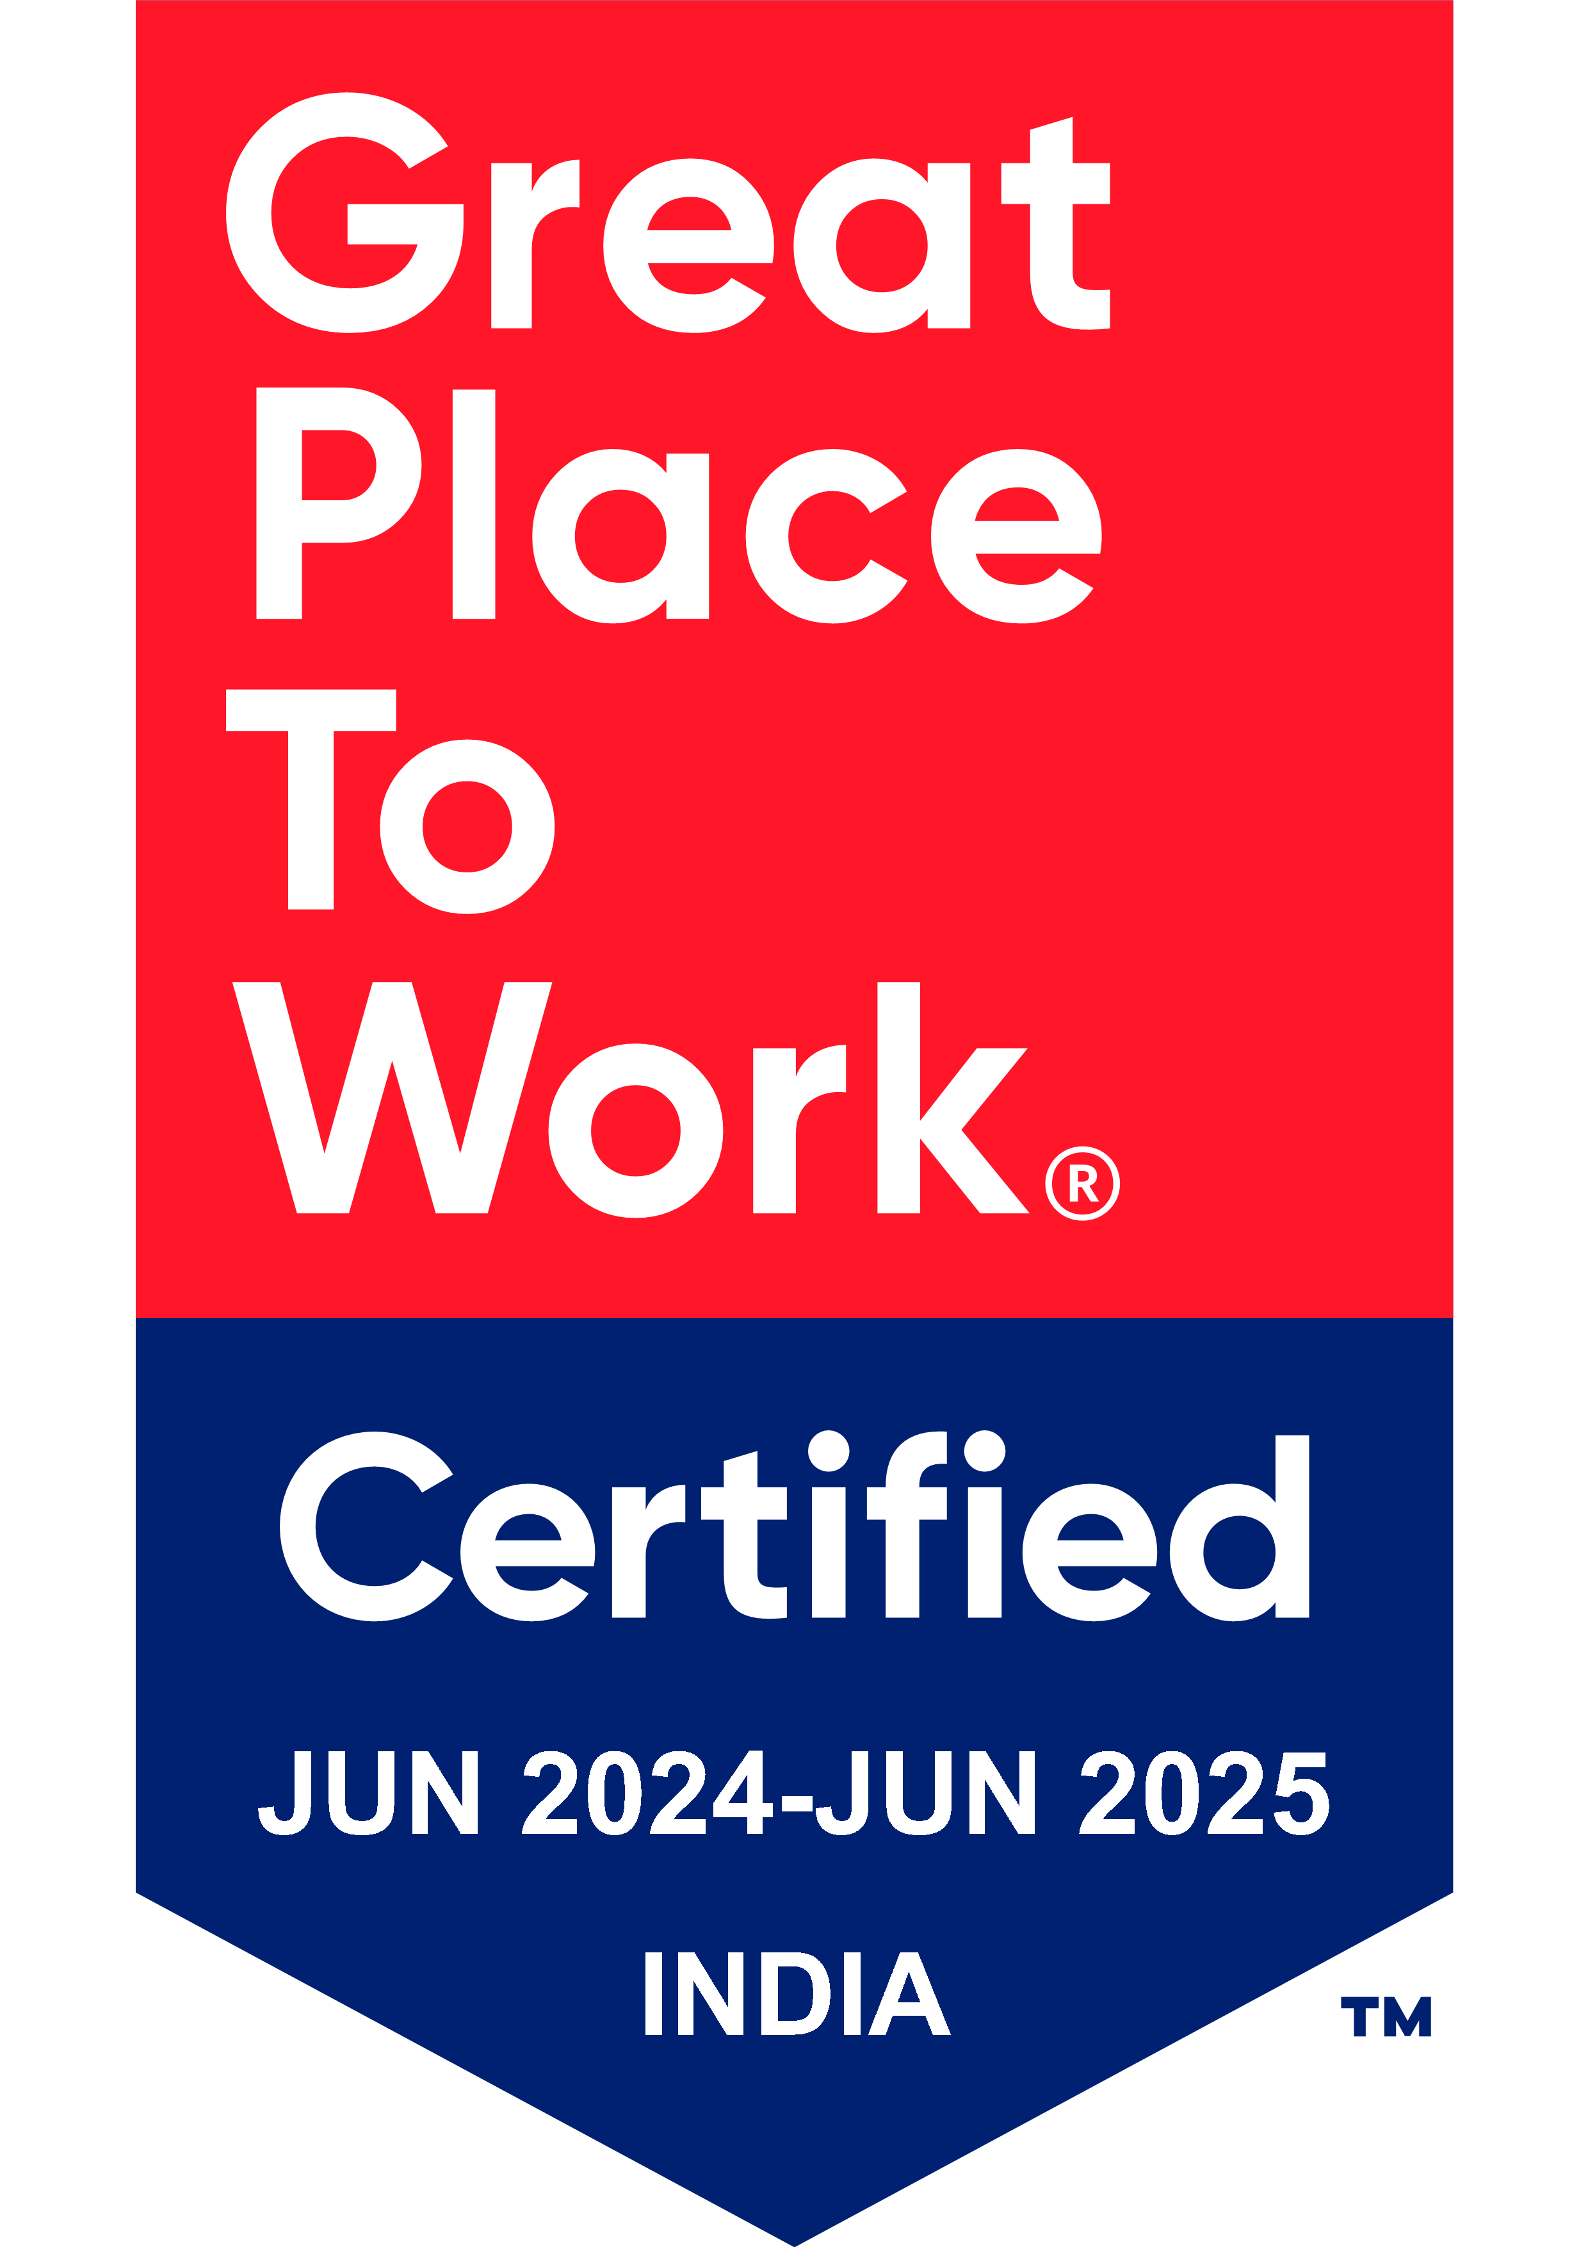
Thank You

