Slide 1
LUX INDUSTRIES
SAP Case Study

Slide 2

Lux Industries Ltd – SAP HANA DR SETUP ON AWS
Client
Overview
Client is from textile/retail segment. It has implemented SAP and HANA to automate their backend business processes
Scope of Work
Solution Highlights
Disaster Recovery setup for SAP HANA on AWS cloud
Infrastructure provisioning for SAP HANA
Managed Services(OS, Virtualization & HANA DB)
Managed Backup Services.
Network &Security Services.
We managed the entire project for setup HANA DR, working with multiple vendors (Win for OS, SAP components, & HANA replication)
We helped Lux integrate the proposed new setup with their running production for Stand by Production system as DR
Implementation location – AWS (Mumbai)
Monitoring the DC and DR Sync
Application and DB level patch upgrades.
Managing the DR Drills.
RTO: <=4 hours and RPO: <=30minutes
Benefits
Challenges
Business continuity in the event of primary disaster
Stand by for Production system
Maintain application availability during planned and unplanned downtime.
Avoid data loss
SLA-managed committed service Delivery
Some issues due to late delivery by hardware vendor
Coordination between vendor/s and internal teams

Slide 3
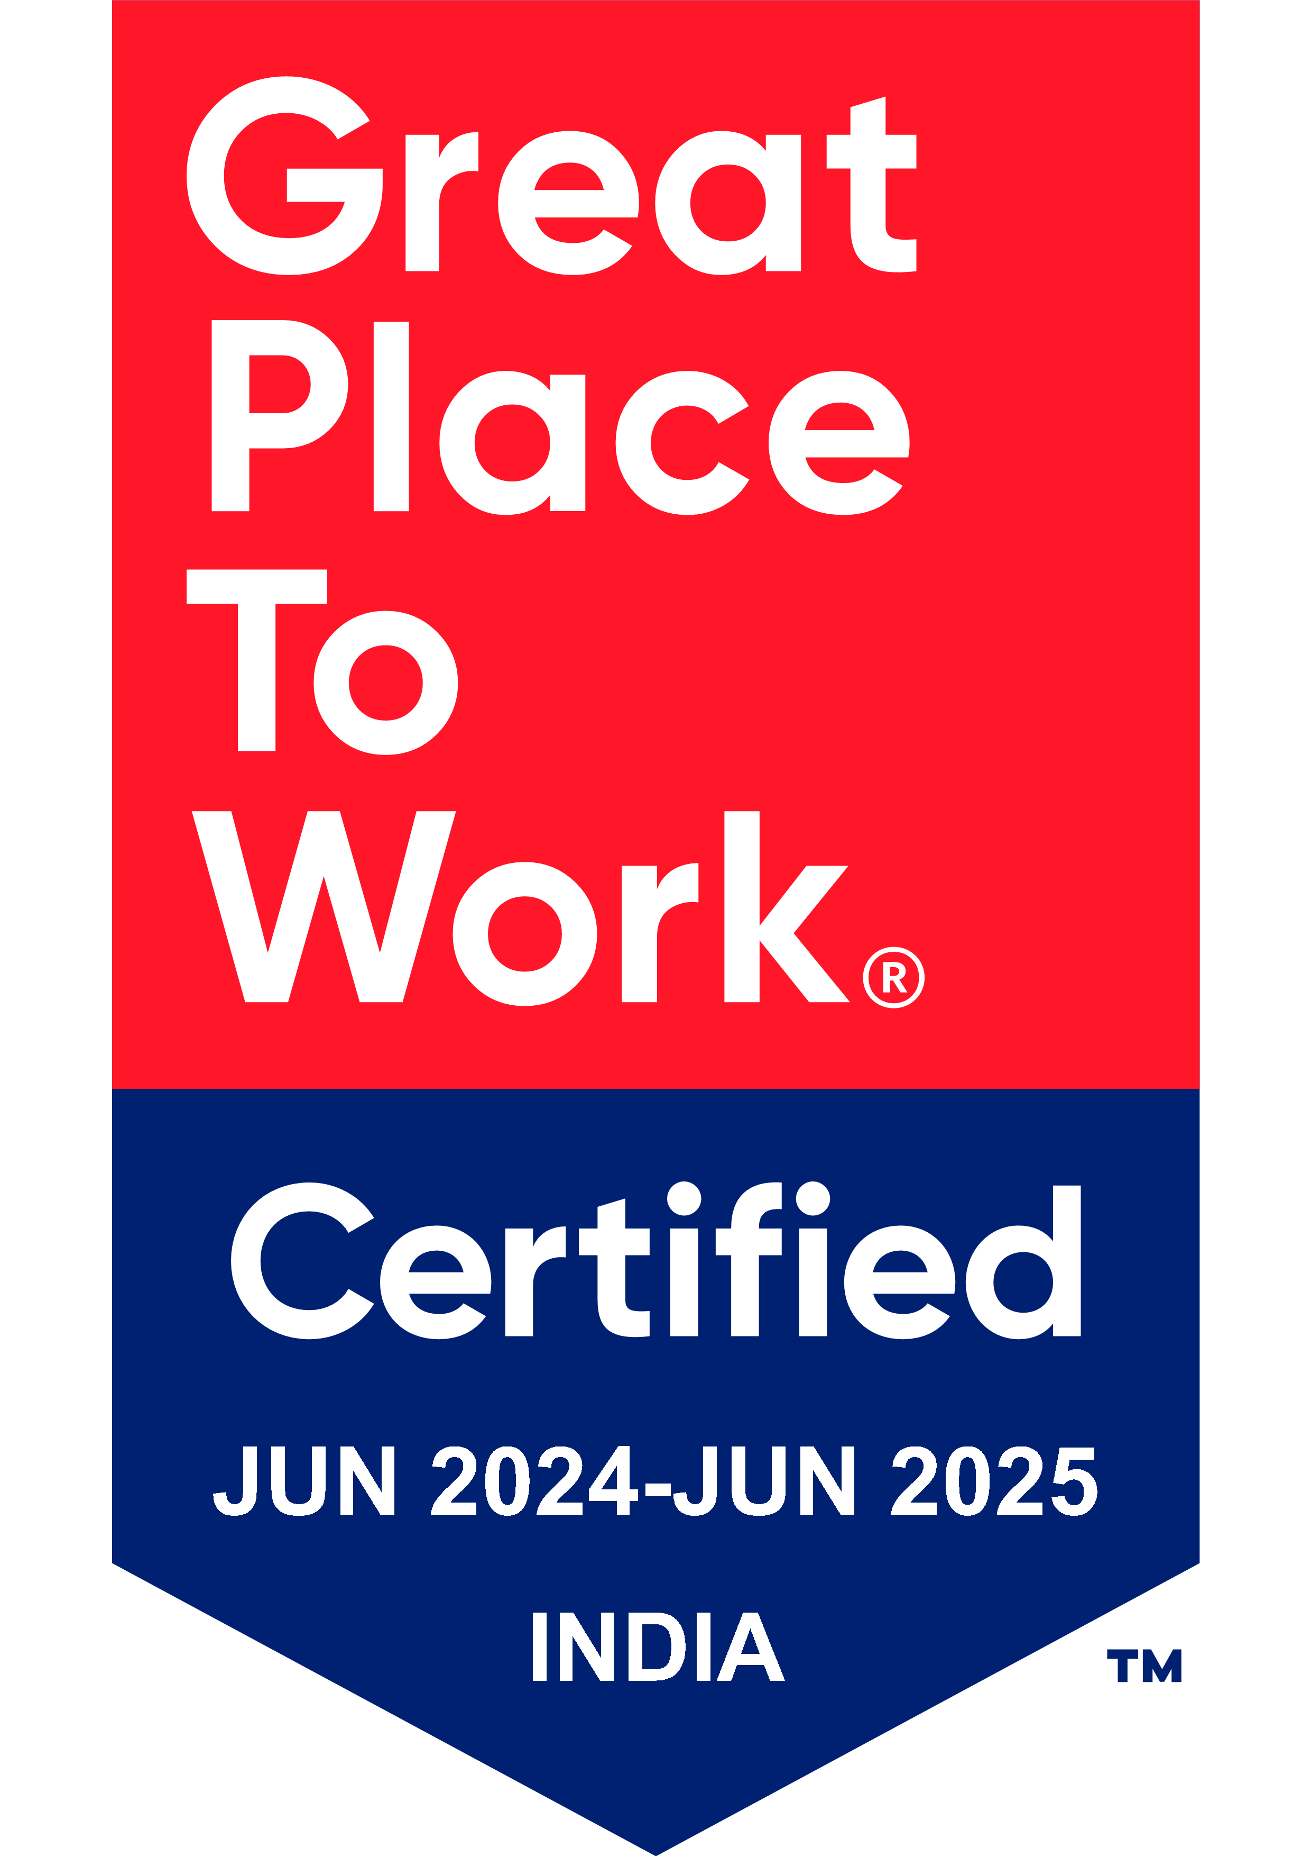
Thank You

