Slide 1
PI INDUSTRIES
SAP Case Study

Slide 2

PI Industries – SAP HANA DR
Client
Overview
PI Industries Limited (PI) is an Agri-sciences company with strong presence in both domestic and export market. It has chosen SAP HANA DR in Sify Cloud.
Scope of Work
Solution Highlights
Infrastructure provisioning for SAP
Managed Services(OS, Virtualization)
Network &Security Services.
Disaster Recovery setup for SAP HANA Production System.
Hardware Provisioning
Public IP , VPN & Replication link Provisioning
The End User connectivity for the New Cloud Servers
SAP ECC EHP7 Installation & HANA 1.0 SP12
HANA DR Configuration
HANA DB size 250 GB
HSR replication methodology
RTO: <=4 hours and RPO: <=30minutes
Benefits
Challenges
System Replication is a standard SAP HANA feature. In this method, all data is replicated to the ternary site and data is pre-loaded into memory on the ternary site which helps to reduce the recovery time objective (RTO) significantly.
Initially provisioned VMs Boolean memory
Port opening for the New Sify Cloud Servers
There were some issues in link connectivity between Sify DR Location / Client DC (client office in Noida)

Slide 3
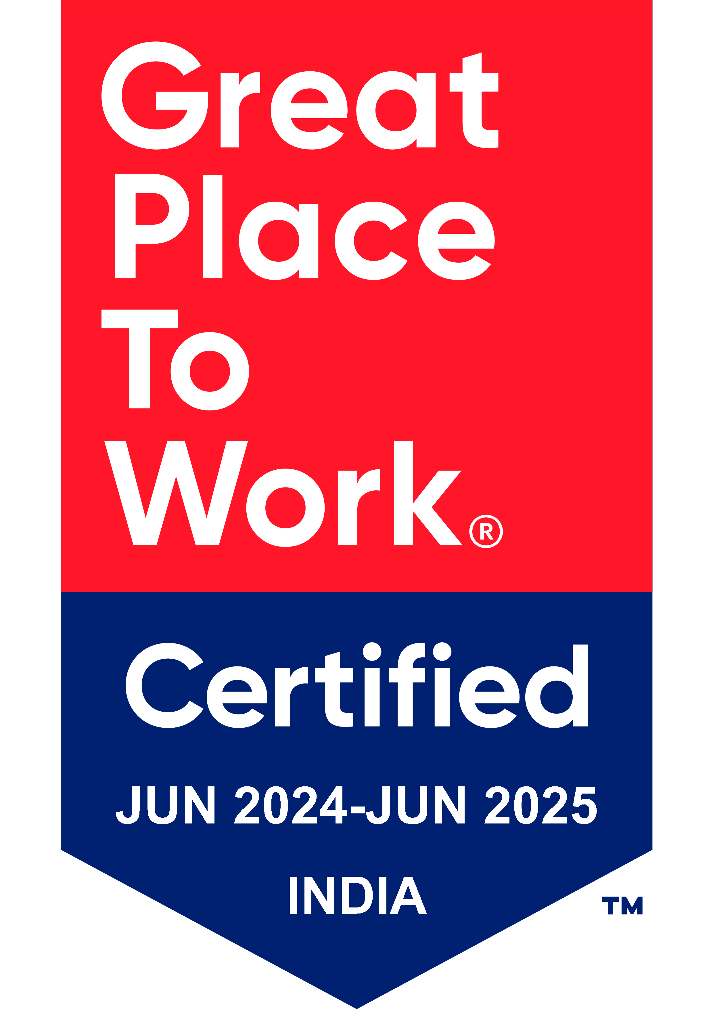
Thank You

