Slide 1
RJ CORP
SAP Case Study

Slide 2

RJ CORP – SAP HANA DR SETUP ON AWS
Client
Overview
RJ Corp are the second largest franchisee in the world (outside US) of carbonated soft drinks (“CSDs”) and non-carbonated beverages (“NCBs”) sold under trademarks owned by PepsiCo and a key player in the beverage industry
Scope of Work
Solution Highlights
Disaster Recovery setup for SAP HANA on AWS cloud
Infrastructure provisioning for SAP HANA
Managed Services(OS, Virtualization & HANA DB)
Managed Backup Services.
Network &Security Services.
We managed the entire project for setup HANA DR, working with multiple vendors (Win for OS, SAP components, & HANA replication)
We helped RJ Corp integrate the proposed new setup with their running production for Stand by Production system as DR
Implementation location – AWS (Mumbai)
DB size 1.6 TB
HSR replication methodology
RTO: <=4 hours and RPO: <=30minutes
Benefits
Challenges
Business continuity in the event of primary disaster
Stand by for Production system
Maintain application availability during planned and unplanned downtime.
Avoid data loss
SLA-managed committed service Delivery
    There were some minor network issues- MPLS line
    SAP Server Connectivity for both the Source and Target SAP servers
    Port opening for the Cloud Server DR to DC production

Slide 3
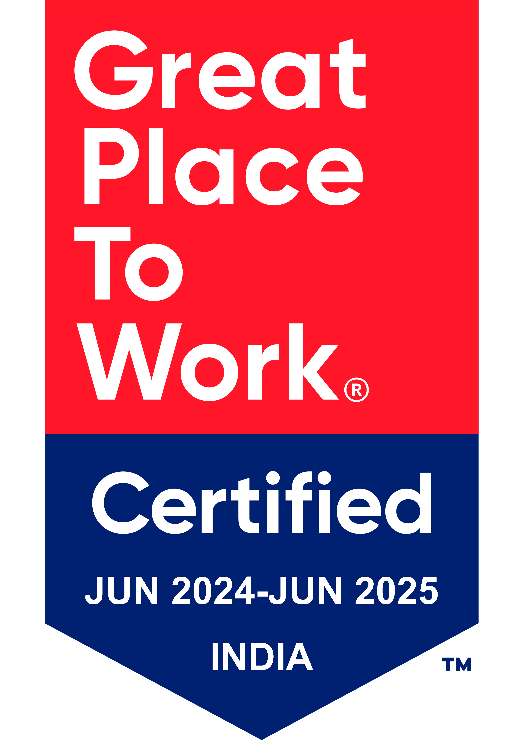
Thank You

