Slide 1
SAFEXPRESS
Integrated Case Study

Slide 2
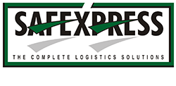




SERVICES - DIGITAL@CORE
Project Objective
Move away from legacy monolithic app architecture to improve time to market for customized offerings and service models for clients of logistics major
Integrated Value and Outcome
Sify’ s value proposition built on cloud@coreTM products and services:
Partnered with AWS for designing the right architecture for application modernization plan on hyperscale cloud platform
Existing applications and infrastructure running on Cloud-adjacent DC and interconnected to AWS cloud through Direct Connect at near-zero latency.
Designed and configured the technology stack for microservices using AWS services such as Kubernetes, RDS, Kafka, Istio, Alfresco. Grafana, Prometheus and so on
Infrastructure-as-a-Code: Designed the entire solution using Terraform configuration to easily create infrastructure from code
Implementation using DevOps CI/CD with opensource tools like Maven, Jenkins, Junit, JMeter, SonarQube, ECR, Selenium
Value for Client
Enabled digital transformation:
Cost optimization due to server-less framework and containers on open-source platforms and no OEM lock-in for applications and DBs, improvements in customer service
Greater satisfaction due to agile applications
No capex - with pay-as-you-go billing models, greater degree of automation and scalability
Project Model
Fully consumption-based model (vis-à-vis existing capex + services model)
CLOUD LED
Sify’s Uniqueness
Single SPOC across DC, Hyperscale Cloud & Network, Integrated value proposition built on: Cloud-adjacent DC, Hyperscale (AWS) partnership, DC and Sify Cloud Interconnect
Notes:
Description: app modernization and micro services led cloud adoption increasing CSAT and enhancing CX
Application modernization through microservices based containerization with full CI/CD implementation using AWS services led to agility and enhanced CX.

Slide 3



A leading supply chain & logistics company trusts sify to RUN microservices workloads on AWS cloud- 2 pager
Customer’s transformation goal: To move from a monolithic architecture to a scalable IT infrastructure and adopt CI/CD DevOps practices for increased productivity of business and IT teams
Objective
Why Sify was chosen?
Sify’s value additions
To create agile Infrastructure that enables faster deployment & a container-based, serverless platform
To deploy multi-account strategy for developers to support the requirements of running AWS ecosystem by separating the roles & resources access
Single SPOC and SLA based Service Ownership across the entire Data Centre Network
Consistent Service experience through Service Management Office (SMO) to implement and ensure ITIL process and compliance
Sify’s strong partnership with AWS in delivering end to end services aligned with Sify’s Cloud@coreTM philosophy
Partnered with AWS for hyper-scale cloud platform
Designed & configured the technology stack for microservices using AWS services such as Kubernetes, RDS, Kafka, Istio, Alfresco. Grafana, Prometheus etc. and individual cloud offerings such as elastic search from elastic cloud
Infrastructure as a Code: Designed the entire solution using Terraform configuration to easily create immutable infrastructure from code
Implementation using Devops CI/CD - AWS Code Commit, Maven, Jenkins, Junit, JMeter, SonarQube, ECR, Selenium
3

Slide 4



Greenfield project to develop devops CI/CD using AWS cloud-native applications
Before transformation
After transformation
Customer success factors/ benefits
Ran legacy ERP based on monolithic architecture
Lacked flexibility & scalability for emerging business demands
Suffered from vendor lock-in for software
Suboptimal performance due to older legacy applications
Applications are now scalable on AWS cloud
Freedom from vendor lock-ins
Performance improvements & increased speed of implementation due to application upgrade using devops CI/CD
Pay-as-you go model with auto-scalability
Enabled digital transformation and readiness for upcoming projects
Cost optimization due to serverless & containerization platform
Improvements in customer service & satisfaction due to agile applications developed on cloud platform
No capex or infra liabilities with pay-as-you-go billing option
The new architecture offered greater degree of automation & scalability

Slide 5
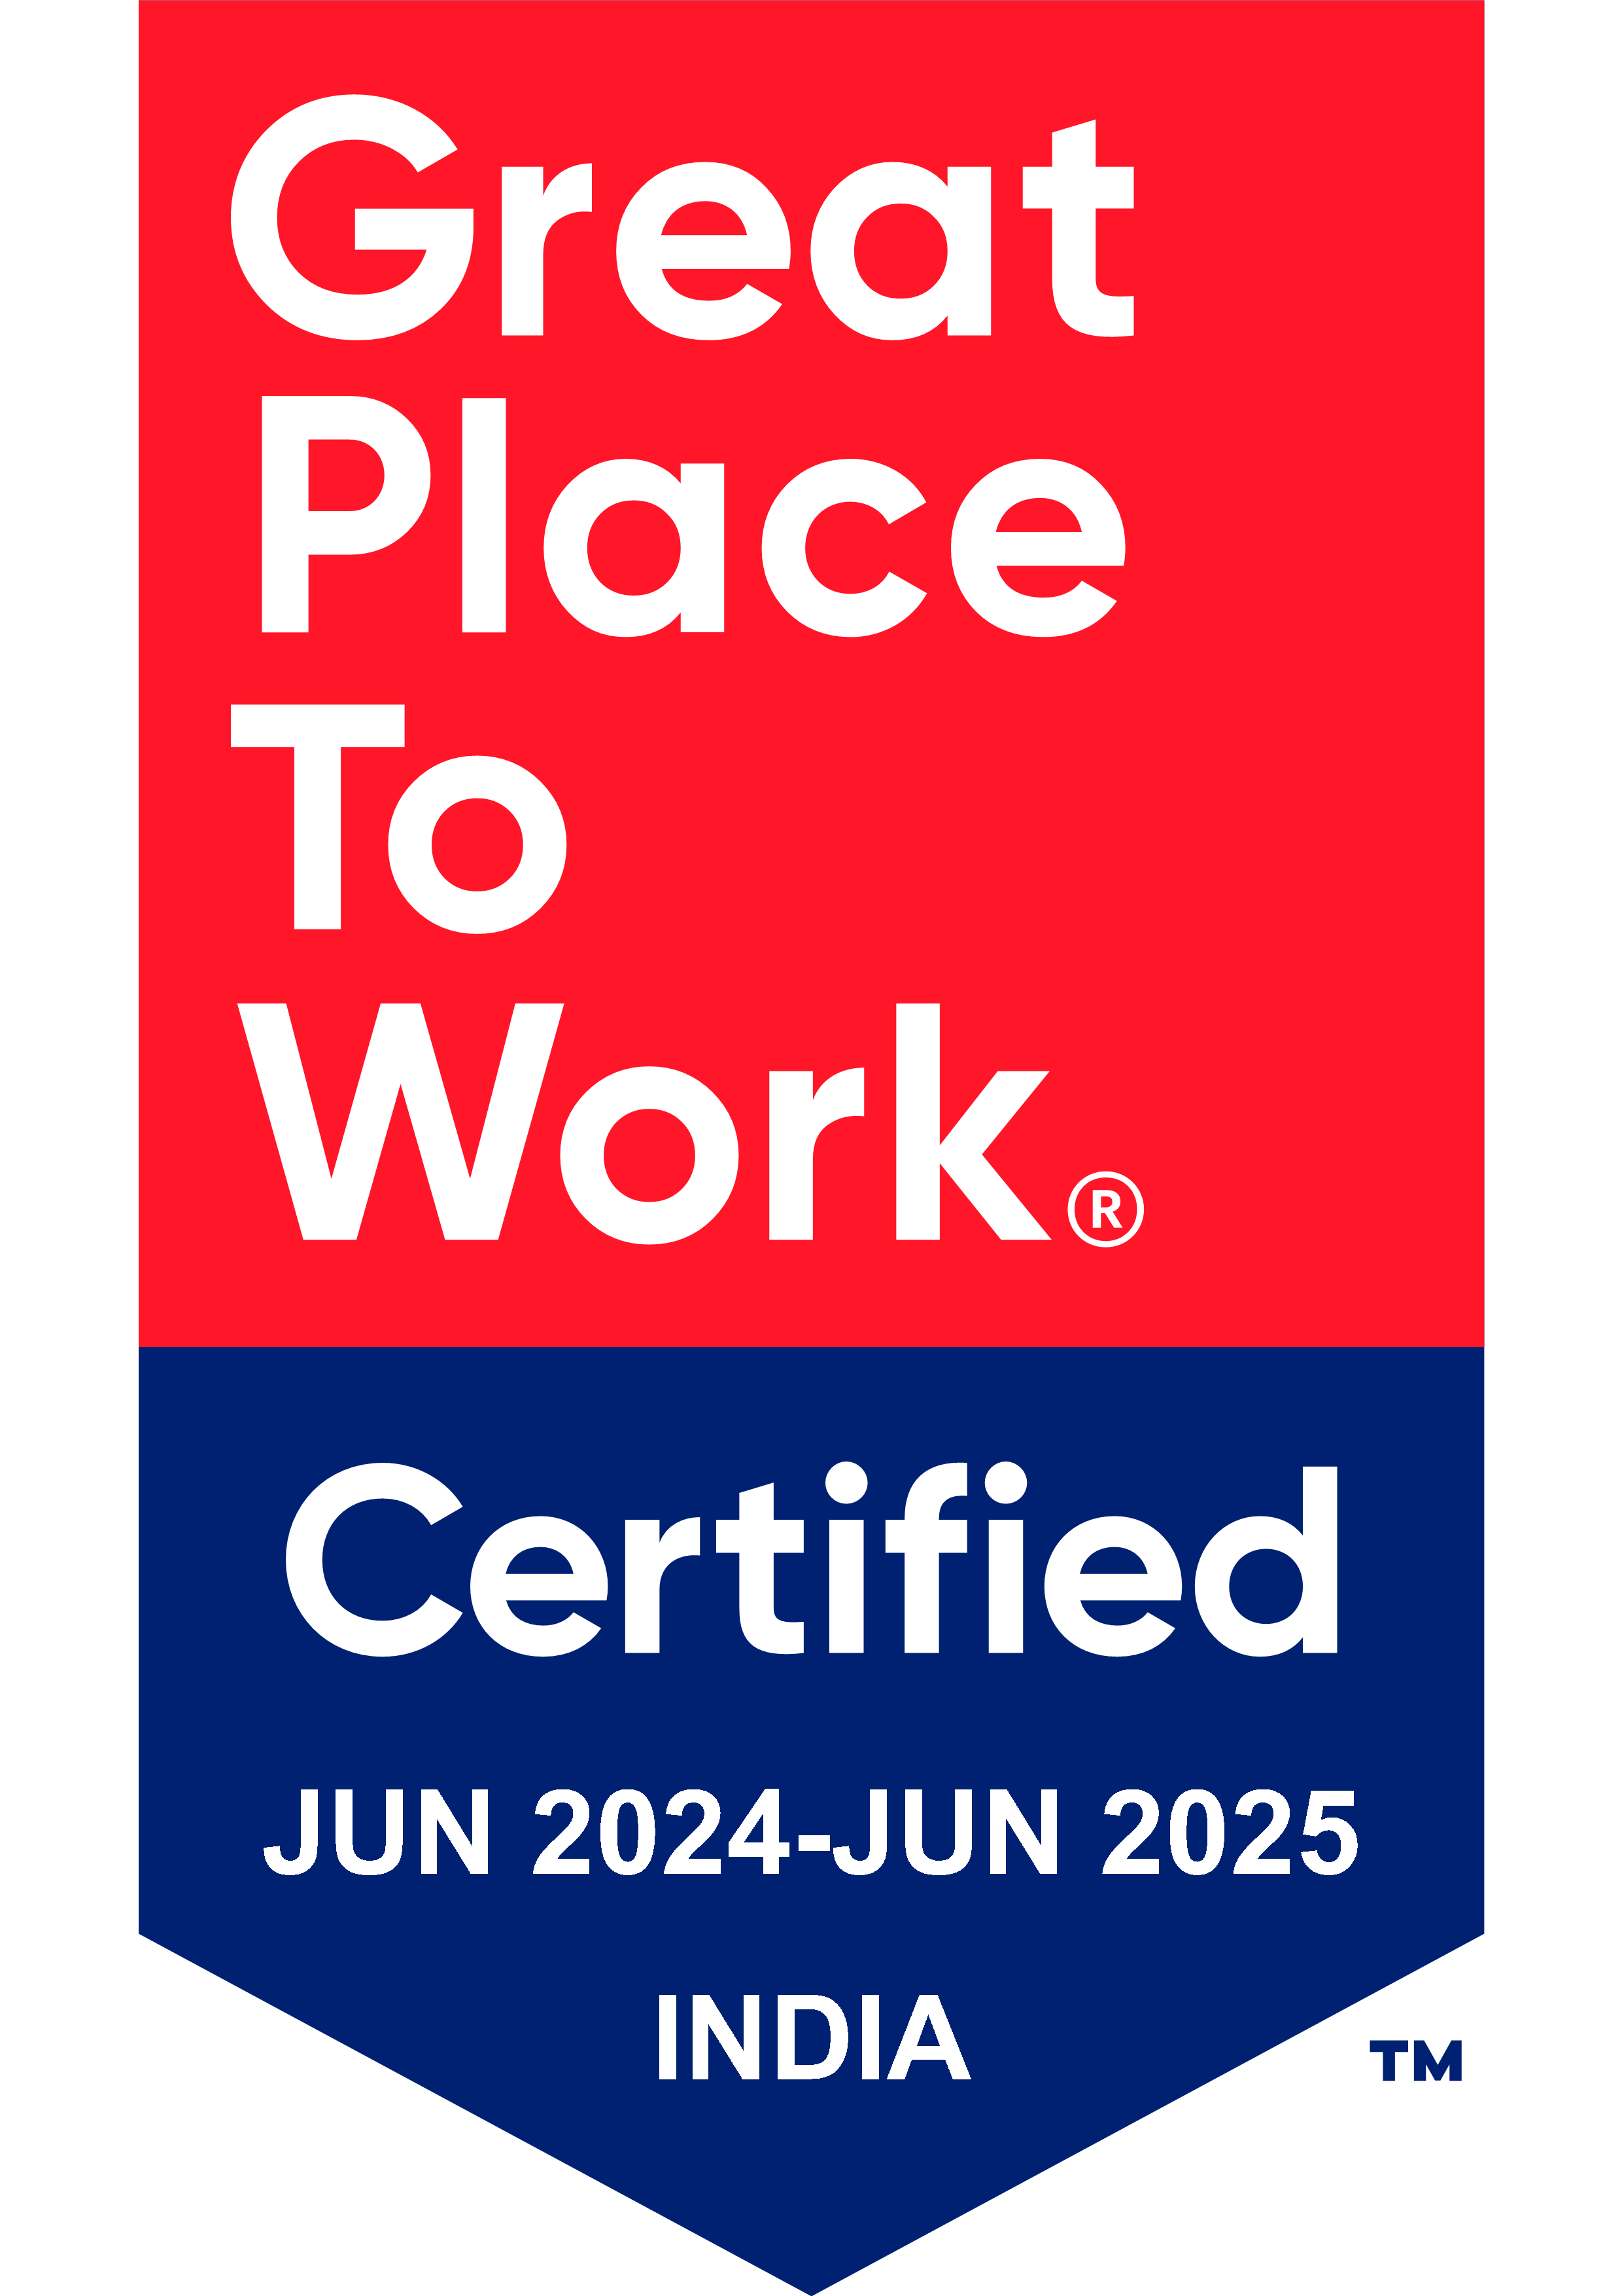
Thank You

