Slide 1
SANMAR
Integrated Case Study

Slide 2
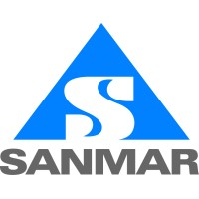




MANUFACTURING
Project Objective
Enhance the client’s IT Services and jointly work towards meeting the business dynamics and challenges of IT Service Organization.
Integrated Value and Outcome
Deliver comprehensive managed services on a canonical model modeled into a service catalog and outcomes linked payments
Seamless service transition to Sify Managed Services
Manage DC, DR, Network, Security, End-User Services.
Savings in telecom bills through Network Assessment Services
Cost reduction by migrating on-premise DC to Sify DC
Improved DR Services levels by Sify DRaaS Services
Cost reduction in Managed Services by improving productivity and reducing costs with hybrid Managed Services
Continuous improvement in IT Services reliability and scalability leveraging Sify hybrid cloud platform
Value for Client:
Higher uptime of service levels, improvement in customer delight, service dashboard providing a view on the IT services, state-of-the-art tools, process and procedures, secure application access through BYOD platform, Reduced cost of DC operations and improved uptime of Infrastructure.
Project Model
Services model
MANAGED SERVICES LED
Sify’s Uniqueness
Integrated value proposition: Support this customer with our strong management & monitoring toolsets, service-catalogue-based delivery for Data Center, Disaster Recovery Services, Network, Security, Service Desk & End-User Services.

Slide 3

Thank You

