Slide 1
ALLAHABAD BANK
Integrated Case Study

Slide 2





Achieving IT modernization for a Banking Major with Virtualization and server consolidation
Banking
Project Objective
Help the customer achieve IT modernization with virtualization and server consolidation solution and ready for future-ready transitions
Integrated Value and Outcome
Sify’s digitally-enabled products and services:
Supply, installation, commissioning, and managing Bank’s IT infrastructure at primary DC (Mumbai), NDR (Navi Mumbai), DR (Lucknow)
Setting up state-of-the-art automated disaster recovery with no manual interaction
Enhanced operational efficiency through Standard Operating Procedures (SoPs)
Design, migrate, and governance of the applications with minimal disruption
Server consolidation with highly efficient servers for the business-critical applications
Centralized monitoring and operational dashboards with proactive smart alerts for faster issue identification and remediation
High performance network to ensure low latency connectivity for business applications
Policy-based data protection to ensure data availability and ransomware protection
Skilled dedicated resources deployed at customer’s site for 24*7 support
Compliance ready infrastructure delivered inline with RBI guidelines
Project Model
Captive model
IT modernization
Sify’s Uniqueness
Sify’s dominating presence, experience, assets, and partner ecosystem for executing similar IT modernization projects for BFSI customers. The Integrated solution covering different elements–
65+ interconnected data centers across the nation
DC, NDR, DR built using best-of-breed technology
Multi-skilled resources to handle complex migration
Value for Client
Cloud-like on-demand, highly available, resilient infrastructure
Sify’s end-to-end ownership empowered the customer to focus on their core business goals
Invest in future strategic digital initiatives and generate new revenue streams
Robust security framework ensured protection from ransomware threats

Slide 3
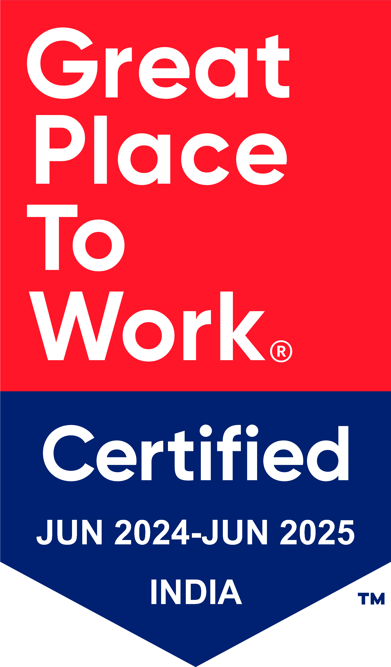
Thank You

