Slide 1
CSB BANK
Integrated Case Study

Slide 2





Helping A Banking Major Achieve its Digital Ambitions
Banking
Project Objective
Help customer expand its business in the West & North region with disaster recovery (DR) build and migration in Sify Mumbai data center
Technology refresh of EOL network & security components
Integrated Value and Outcome
Sify’s digitally-enabled products and services:
Supply design and implementation of bank’s critical network & security solutions at bank’s DR site
New DR design and implementation using software defined network considering SDN controller, Spine & Leaf architecture and security solutions to meet regulatory compliances
Designed a resilient network architecture ensuring flexibility, scalability, and visibility across complete network
Created a parallel critical application infra setup at Mumbai before the actual migration to ensure risk mitigation
Migration of 25 business critical applications to ensure business continuity during transition at temporary site
State-of-the-art DR and NDR setup in Mumbai and migration executed within the compliance framework to meet regulatory policies with zero defect and minimal disruption
Best practices and governance model ensured enhanced customer experience
Project Model
Capex model
Integrated DR Transformation
Sify’s Uniqueness
Sify’s dominating presence, experience, assets, and partner ecosystem for executing large scale migrations for BFSI customers. The Integrated solution covering different elements–
65+ interconnected data centers across the nation
Overall project governance & ownership from a single partner
Solution design, supply, & implementation for identified EOL devices
Integrated Network services for DC-DR connectivity, and end-to-end security services
Multi-skilled resources to handle complex migration projects
Value for Client
Higher application availability, visibility, and security resulting in increased operational efficiency and improved customer experience
Invest in future strategic digital initiatives and generate new revenue streams
Reduced Total cost of ownership (TCO)
Single point of ownership for entire network & security consolidation

Slide 3
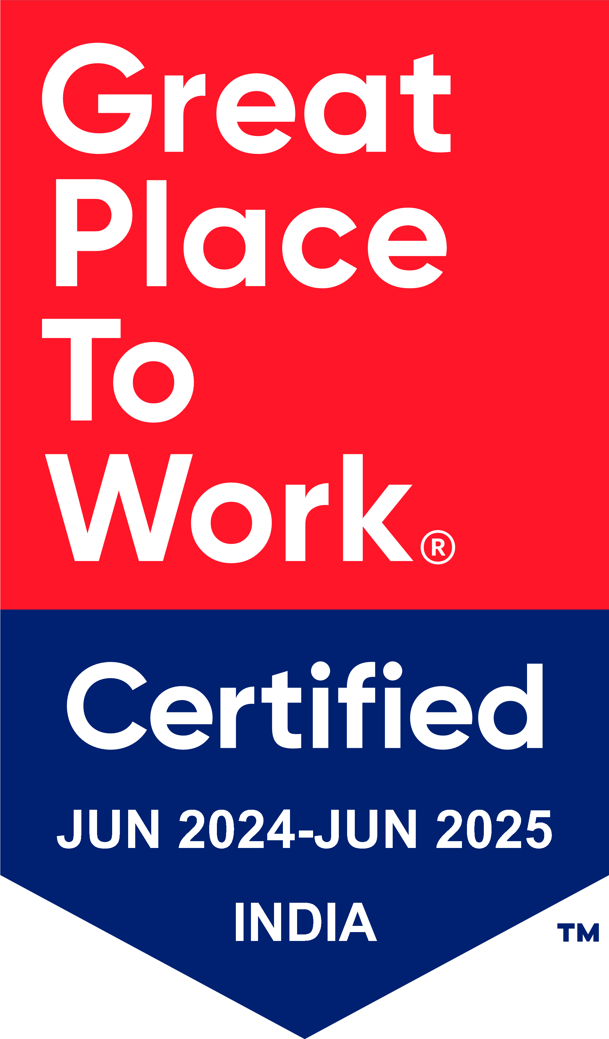
Thank You

