Slide 1
LIC HOUSING FINANCE LTD
Cloud Services Case Study

Slide 2
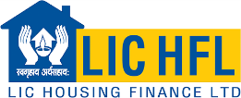




LIC HFL: Cloud Transformation with integrated services For a Financing Major
LIFE INSURANCE
Integrated Value and Outcome Sify’s digitally-enabled products and services:
Design, build, deploy, and migrate critical business applications to Sify’s Enterprise cloud with business continuity plan (DRaaS) ensuring better accessibility, enhanced user experience, and business resiliency
Assessed and migrated 19 critical business applications to Sify’s cloud with near-zero downtime
Enhanced scalability to manage dynamic workloads efficiently
Improved accessibility to services for customers and employees with privileged access management for specific admin accounts
Secured cloud infrastructure with Managed threat Detection and Response (MDR) for enhanced endpoint security
Dedicated virtual firewalls for applications, MS SQL server, and Oracle Enterprise databases with UTM features for filtering unauthorized access, NAT, and threat prevention
24x7 availability of complete IT Infra resulting in operations without any interruptions
Value for Client
Business Continuity Plan (BCP) for highly available core business applications
Compliance ready infrastructure with FDR meeting regulatory guidelines
Fixed cost cloud model ensured cost efficiency
Unified visibility across the entire IT landscape
Project Objective
Implement integrated future ready digital infrastructure with FDR for LIC HFL business applications on Sify Cloud from Bangalore.
Project Model
Hybrid IT model
HYBRID CLOUD LED
Sify’s Uniqueness Integrated value proposition built on: Cloud adjacent DC, Hybrid cloud management platform, DRaaS, DC and Cloud Interconnect (Sify’s own service), Security services and Migration services

Slide 3



A leading finance company looking to bring in more business resiliency, Security, and agility
LIC HFL goal: To sustain the growth and continue market differentiation by ensuring seamless operations and superior customer experience
Why Sify was chosen?
Sify’s value additions
Objective
Having performed large scale migrations of BFSI customers to hybrid cloud configurations along with security framework in line with best practices of Cloud Adoption
Flexibility regarding solution approach, customization and professional services.
Customized NGIT Framework to meet cloud requirements managed out of a single management, governance and security framework
Far DR services which will serve as a far disaster recovery center
Managing 350+ enterprise customer on Sify CloudInfinit and public cloud
Leading Colo services provider with 65+ interconnected DCs across the nation
Designed the cloud architecture on Sify Enterprise Cloud through cloud assessment services to deliver a well-architected framework for risk free cloud migration along with advanced security measures
Migrated 19 critical business applications using the proven CloudInfinit workload migration process
Provided service assurance and management with CloudInfinit CMP
Single window solution provider to meet Hybrid IT requirements such as Colo, Cloud adoption, Network, and Security
Implement integrated future ready digital infrastructure on Sify Cloud
Transition into a highly available, scalable, agile, and compliant cloud setup
Set up Far Disaster Recovery to ensure business continuity & resiliency
Set up a security framework to ensure data security from external threats
Adopt best practices of Cloud adoption

Slide 4



Built secure Enterprise cloud infrastructure with FAR DR
After transformation
Before transformation
Far DR setup while being compliant
Sify’s security framework to deliver adaptive detection, protection, and response for threats
99.9% availability of applications ensuring enhanced end user experience
Implementation of Virtual Private Enterprise (VPE) model at the Sify Bengaluru DC ensured increased operational efficiency and utmost privacy with benefits of Enterprise Cloud
Pro-active monitoring of utilization and performance through Sify Cloud Management Platform (CMP)
Single window solution touchpoint to manage the complexities
Customer success factors/ benefits
No compliance adherence due to absence of FAR DR
Absence of rigid security measures
Availability of business applications for internal and external users
Ineffective end-user experience
Distributed monitoring of utilization and performance
Multi-vendor touchpoint leading to complex processes, management and long approval cycles
Optimized accessibility and scalability resulted in enhanced operational efficiency
Migrated 19 critical business applications to Sify Cloud to ensure seamless service delivery, faster operations and enhanced user experience
Enhanced resiliency and availability by way of FAR DR
Robust security measures to meet monitoring and compliance requirements
Single pane of visibility across their complete IT infrastructure with improved MTTD and MTTR

Slide 5
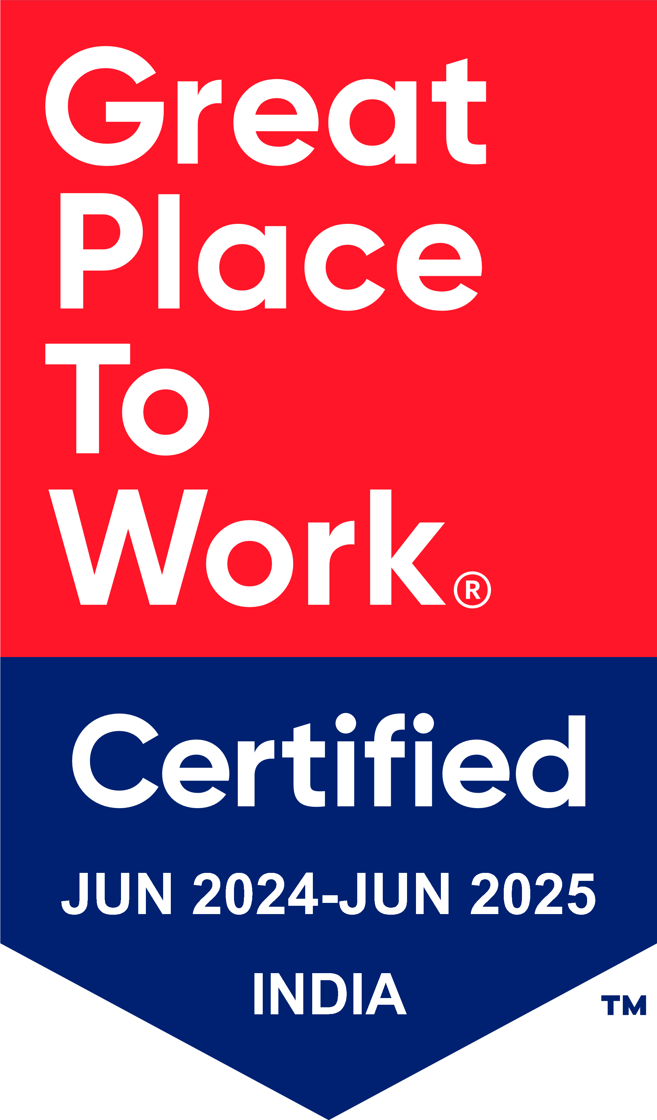
Thank You

