Slide 1
SARASWAT BANK
Integrated Case Study

Slide 2





Accelerating TRANSFORMATION Journey for A Banking Major
Banking
Project Objective
Design and Implement integrated digital infrastructure on Private Cloud
Integrated Value and Outcome
Sify’s digitally-enabled products and services:
Build and deployed Hyper Converged Infrastructure (HCI) based highly available, scalable, and secure private cloud platform for banking applications.
Implementation & configuration of infrastructure components
Infrastructure isolation basis on security and application requirements meeting application performance requirements
Migration of all (critical & non-critical) business applications and database on new platform with zero defect and minimal downtime
License cost optimization of OS and DB through architectural efficiencies
Policy-based data protection through a centralized backup ensured business continuity
State-of-the-art DR setup at a different seismic zone ensuring business resiliency during unprecedented events
Full lifecycle responsibility through assessment, implementation, and migration within a record timeline
Dashboards for real-time input to track resource utilization across deployed solution
Compliance ready infrastructure to meet regulatory guidelines
Project Model
Private Cloud IT Build model
Sify’s Uniqueness
Sify’s experience, assets, and partner ecosystem for executing large scale migrations of BFSI customers. The Integrated solution covering different elements –
Scalable, highly available, and virtual infrastructure for private cloud
DC setup and DR built using best-of-breed technology elements at Hyderabad
Application and Database Migration
Cost optimization
Digital Infra Build
Value for Client
Single point of ownership for design, consolidation, and management
Enhanced visibility and reduced downtime through highly available infrastructure
Increased operational efficiency resulted in enhanced CSAT scores

Slide 3
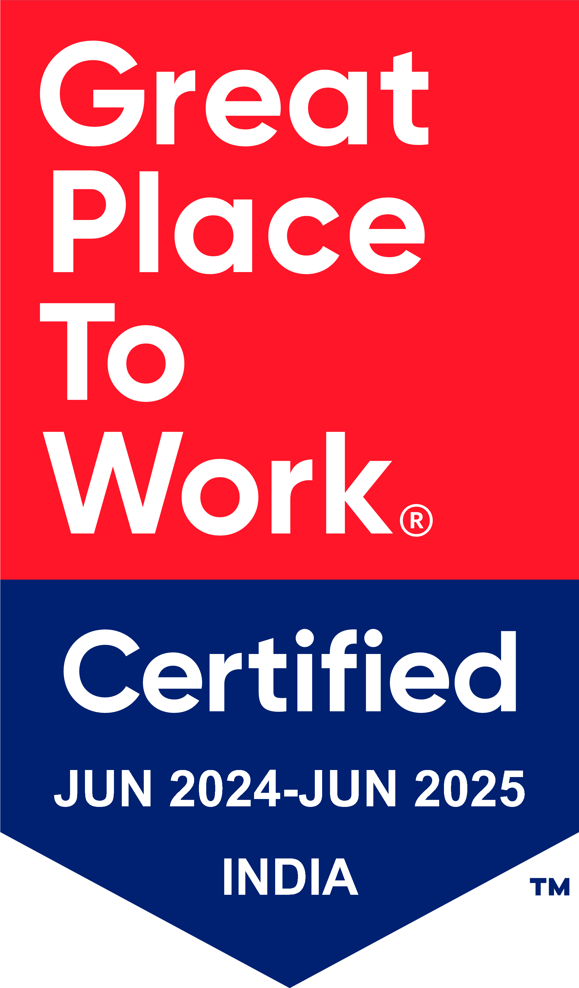
Thank You

