Slide 1
ARCELOR MITTAL / NIPPON STEEL
SAP Case Study

Slide 2

SIFY’S SAP EXPERIENCE WITH AN INTEGRATED CARBON STEEL COMPANY
Client
Overview
An integrated flat carbon steel manufacturer - from iron ore to ready-to-market products. The company has decided to Host S4 HANA instance on GCP with Disaster recovery site along with managed infra & security services from Sify.
Scope of Work
Solution Highlights
This is S4 HANA Conversion Project.
GCP Landing Zone & Infrastructure provisioning for S4 HANA instances
Managed Services(OS, GCP Infra)
Managed Backup Services through Commvault.
Network & Security Services (NGFW, PAM , WAF & Fortinet ).
Disaster Recovery setup for SAP HANA Production & other application instance
Setup Landing Zone for GCP DC in Mumbai Region & DR in Delhi Region
Deploy SAP HANA Database & Application (VM) Instances, block Storage, Network Components in GCP as per the sizing provided by customer.
Implement the native & 3rd party Security services
DR site pay per use model with RPO 15 Min & RTO 2 Hour
Managed Services for GCP & 3rd party solution
Benefits
Challenges
Improvement in SAP system performance
Minimal business impact
Harmonization of data
Reduction of time due to the optimization framework for Deployment
Single SLA for GCP Infra Managed service & other services
Best Practices & Governance model
Challenging Timeline to create the Landing Zone & Instance readiness at DC
Stringent SLA
Integrated managed services for GCP Infra , Network & Security services
Customer ITSM tool Integration with Sify Service Now

Slide 3
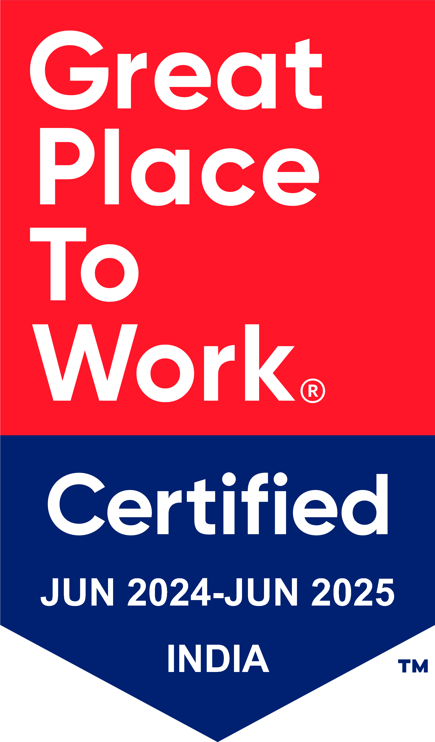
Thank You

