Slide 1
MANAGED Network SERVICS
Cisco BIAB Sales Training Deck
March 2024

Slide 2
AGENDA
What is “Branch-in-a-Box”/ “Business-in-a-Box”
Key Features and Capabilities
Product Benefits
Sales Strategy
Demonstration Guidelines
Market Overview
Sify’s Deliverables
Product Deep Dive
Industry-wise Use Cases
Identifying Potential Customers

Slide 3
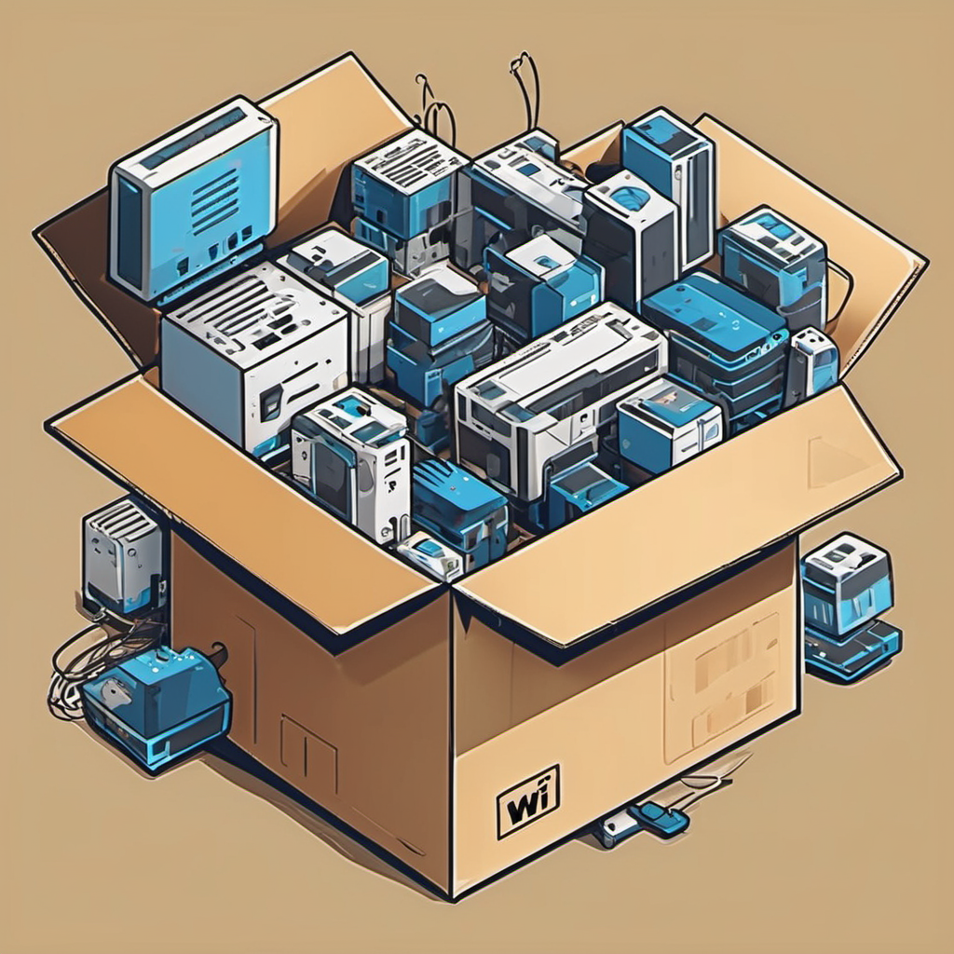
What is Branch-in-a-Box?
The “Business-in-a-Box” is a self-contained solution that provides essential tools and resources for setting up a functional office space.
This is particularly relevant in situations where there's a need for a quick and efficient establishment of a workspace
Comprehensive solution for a Branch – WAN, LAN & Security
Standardized design which can be easily replicated
Cost-effective & aligned to the needs of the branch
Fully managed & ability to add new services
Notes:
The “Branch-in-a-Box” or "Office-in-a-Box" concept is a comprehensive and self-contained solution designed to provide essential tools and resources for establishing a functional office space swiftly and efficiently. This concept proves particularly beneficial in situations where there is a demand for quick and convenient workspace setups, such as in remote, temporary, or rapidly evolving business environments. The solution integrates hardware, software, and office equipment, offering a modular and scalable approach to accommodate diverse organizational needs. From seamless connectivity and quick deployment to cost-effectiveness and adaptability, the Office-in-a-Box concept addresses various objectives, catering to a range of customers including remote teams, startups, global corporations, and educational institutions. It aligns with the evolving trends in modern workplaces, supporting remote work, scalability, and the integration of advanced technologies to provide a cohesive and standardized office environment across different settings.

Slide 4
Market Drivers for Branch-in-a-Box
Key Business Drivers
Faster Deployment
Seamless
Single Ownership
Availability of Network
Manageability of LAN & WAN Devices
Assurance Against Technological Obsolescence
Cost Effectiveness
Flexible Commercial Modelling
Notes:
Faster Deployment
Seamless
Single Ownership
Availability of network
Manageability of LAN & WAN devices
Assurance against technological obsolescence
Cost Effectiveness
flexible commercial modelling
<data on why businesses are expanding>
<industry trends>

Slide 5
Key Features & Functionalities
Branch Equipment | Functionality
Router and Network Switch | Directing WAN & LAN network traffic within the office. Provides connectivity and routing for both wired and wireless devices
Access Points | Ensuring reliable and widespread wireless connectivity. Extending the reach of Wi-Fi signals, enabling seamless internet access
Unified Threat Management | Safeguard the network from unauthorized access and cyber threats. Implement security measures such as intrusion detection, VPN support, and content filtering
Cloud-Based Management | Centralized Orchestration, alerting & deep analytics & security operations. Provides centralized storage, file sharing, and collaboration tools through cloud-based services or on-premise servers
Bundled Connectivity | Support wired & wireless connections (MPLS/ ILL/ Broadband, 5G, Ethernet). Includes cables, connectors, and other accessories for reliable wired connections for both WAN & LAN
Security Cameras & Sensors | Enhance physical security. Surveillance cameras for monitoring & access control for office premises

Slide 6
Key Benefits
User Experience
A positive and intuitive user experience, ensuring that users can easily operate in an office-in-a-box setup with minimal training.
Security and Compliance
Robust security measures and compliance with data protection regulations to safeguard sensitive information and build trust among users.
Scalability and Adaptability
Ability to scale and adapt to the varying needs of different-sized teams and changing business requirements.
Reliability and Stability
A reliable and stable infrastructure to support smooth operations, especially in remote or diverse locations with varying network conditions.
Quick Deployment
Rapid and straightforward setup process, allowing organizations to set up the office-in-a-box solution quickly.
Innovation and Future-Readiness
Continuous innovation & updates, ensuring the solution remains relevant and adaptable to future workplace trends.
Customization Options
Customization options provided to meet the unique needs and branding preferences of different organizations, promoting a personalized user experience.
Support and Maintenance
Comprehensive support services and regular maintenance to address technical issues, updates, and ensure ongoing functionality and performance.

Slide 7
Extended Features – Integrated Applications
Pre-built applications developed by ecosystem partners can be used by customers to solve their operational challenges of IT and IOT.
Customers can discover the right app for their business that help solve specific challenges like Hybrid Work, Safe Environments and Smart Spaces
Integrated Apps for Business Outcomes
Asset Tracking
Footfall Analytics
Environmental Monitoring
IoT Security
Point of Sale
IT Tools

Slide 8


Sify’s Business-in-a-Box-Deliverables
24x7 Management
SLA Reporting
Network & Security
Common reporting & ticketing platform.
Identifying transport providers at each site, engaging for ordering, connecting transport links, coordinating for any issues
Managing end-to-end SLA between BIAB components which includes Access Point, Switches, and Security Appliance etc.
Installation & Setup
Implementation of the BIAB solution end-to-end
Enabling seamless transition of customer’s network from incumbent to Sify Managed Services
Configuring common policies across regions with on request auditing
Management of all changes to be executed in customer networks proactively & on request
Coordination with vendors to work on issues related to BIAB services
Coordination with vendors to work on issues related to BIAB services
24x7 proactive monitoring with real-time & historic reporting
Managing logical resources of customer network

Slide 9

Supported OEM
Meraki
Access Points
Switches
Firewalls
Cellular Gateways
Surveillance Cameras
Sensors
Fortinet
Access Points
Switches
Firewalls
Cellular Gateways
Surveillance Cameras
Optimized Cost Option
Under Development

Slide 10
The Meraki Platform

Slide 11
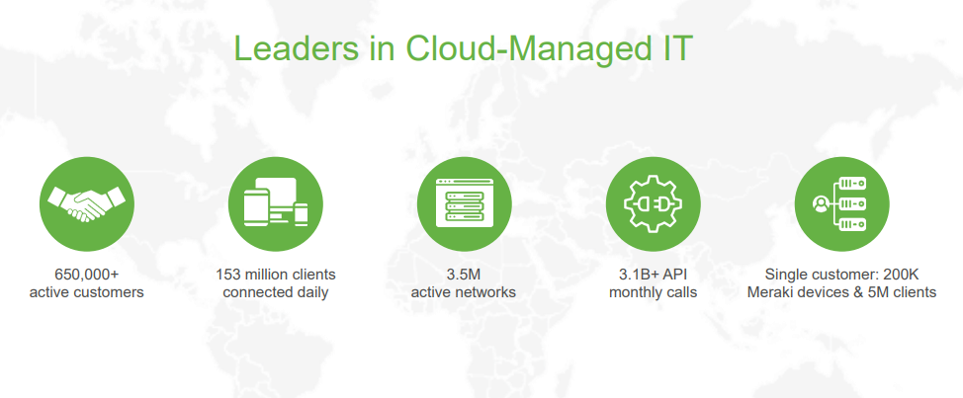
Meraki in the Market

Slide 12



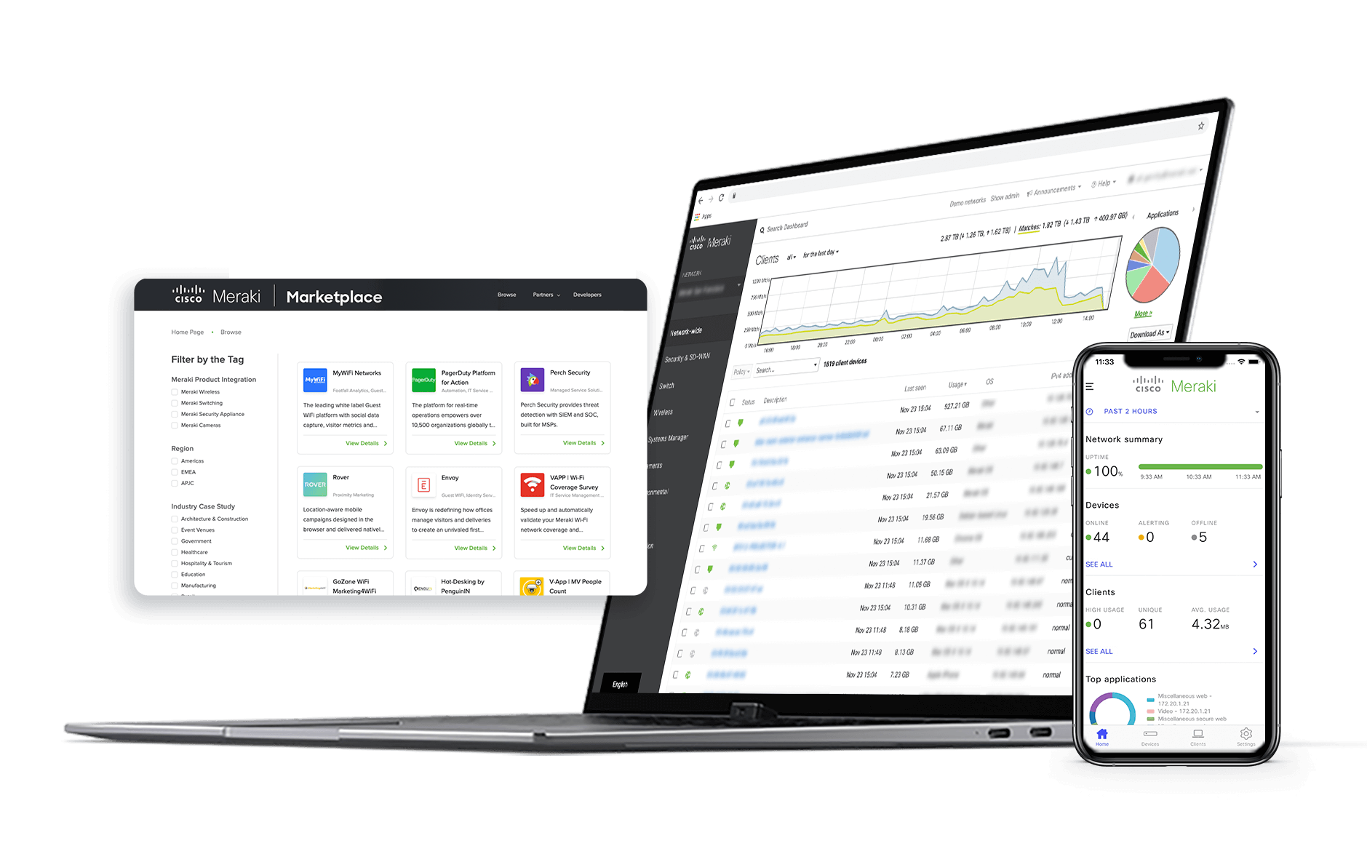
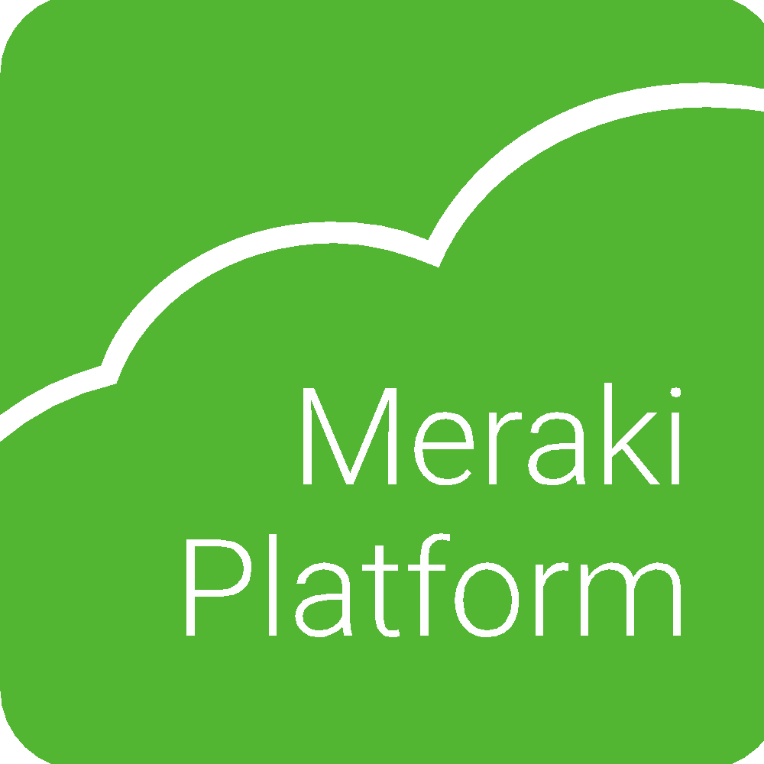
Key Benefits of the Meraki Platform
Data-powered products
Open APIs + ecosystem
Cloud-first operations
Designed and built to adapt to every network workload
and scale to any business opportunity.
Notes:
Smarter hybrid workspaces need to be: productive, provide for employee engagement, and of course, have reliable, easy connectivity (from anywhere), IoT enablement, and secure technology.
We all want to be productive ... everywhere!

Slide 13
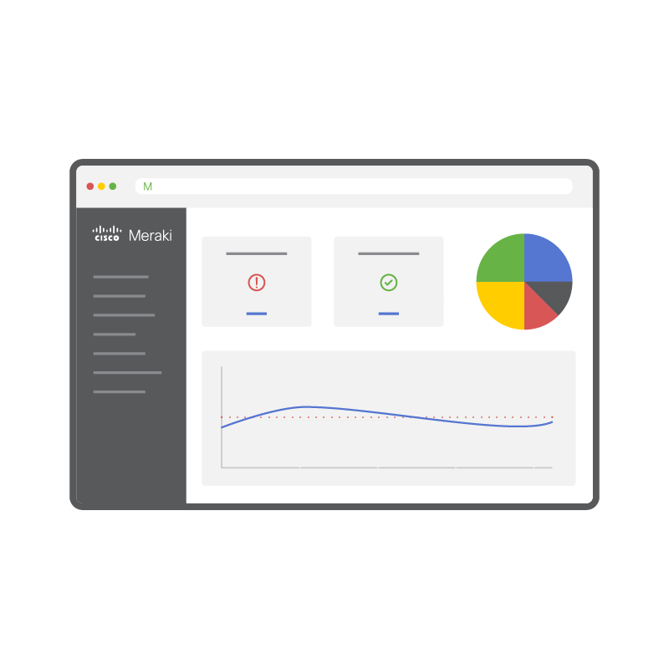
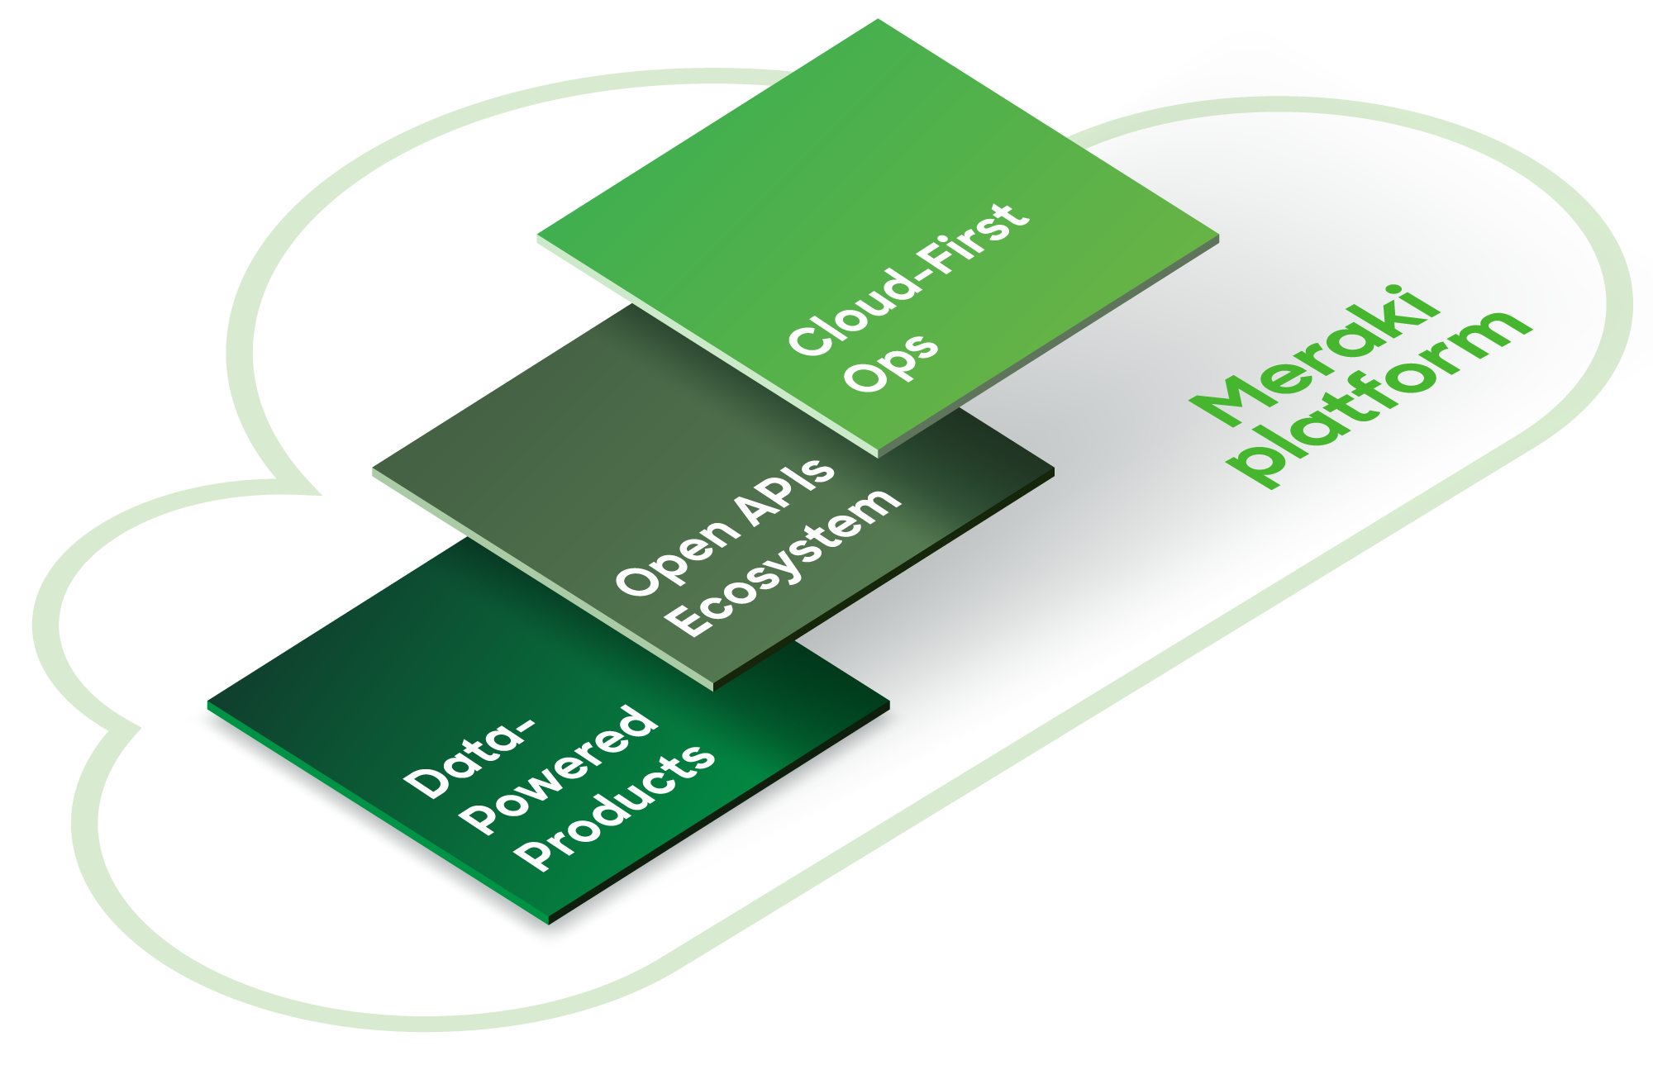


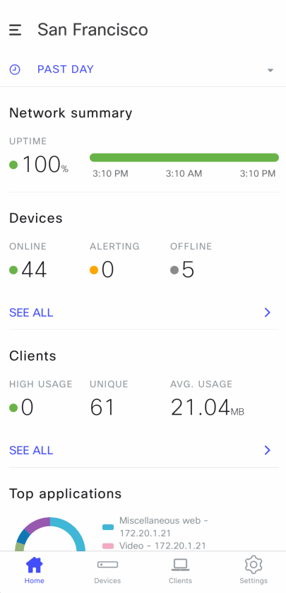

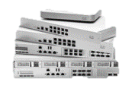
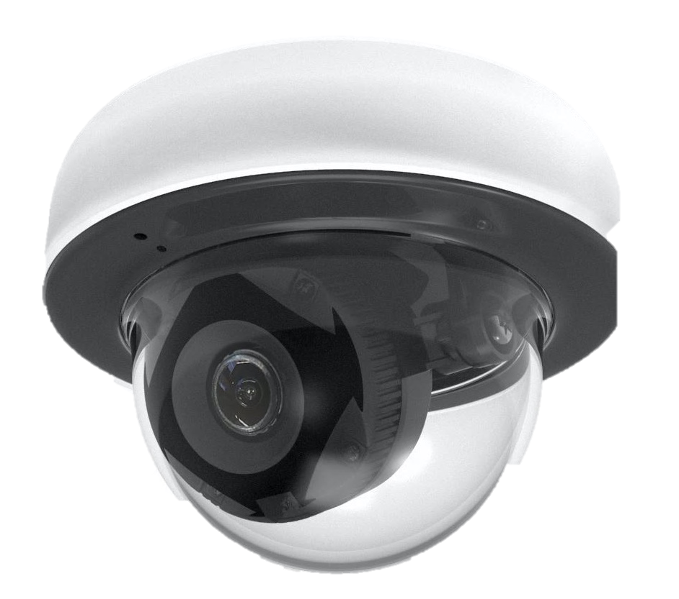





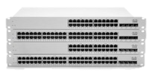
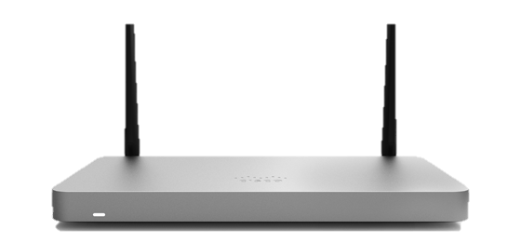
A Common Foundation for IT and IoT
CUSTOM BUILT APPS
developer.cisco.com/meraki
API
Built-in solutions
Tailored solutions
TECH PARTNER APPS
apps.meraki.io
MERAKI DASHBOARD
Wireless
Switching
Mobile Device Management
Security and SD-WAN
Cellular Gateways
Smart Cameras
Sensors
ACCESS
WAN
IOT
Notes:
The Meraki platform is the cloud-based engine that powers our IT and IoT full stack portfolio
Our platform is designed to be simple, secure, and intelligent:
The network must be simple to consume and easy to manage
The network must provide a secure, in-office experience anywhere
The network must evolve with dynamic workers and applications
Our strategy is simple:
Leverage the foundation of a stable platform, reusable frameworks, and continuously evolve our cloud architecture
Drive expanded reach through mobile, web, APIs
Invest in programmability and the ecosystem of developers that complement our solutions
Finally, use the data to continuously add intelligence across our products
To summarize our competitive advantages:
Our ADVANCED CLOUD PLATFORM evolves faster than our competitors
Our APIs + Ecosystem makes it easier to develop on our platform and provides agility for our customers
Data-powered features and products across Access, Security, and IoT: such as Meraki Health, MI (Meraki Insight), and MV continuously learn and get better the larger Meraki deployment and the longer you use Meraki products.
Do more in less time, at scale, quickly, and securely

Slide 14
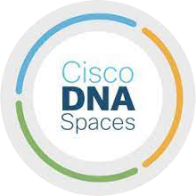
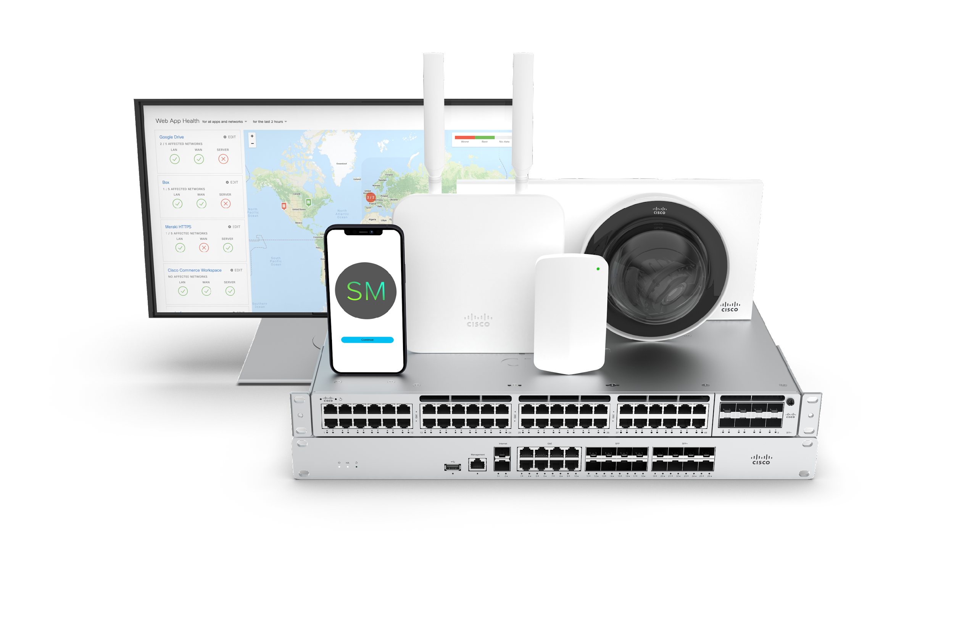
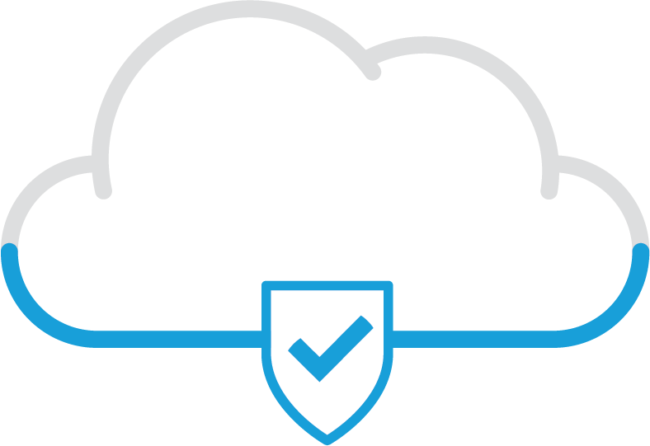
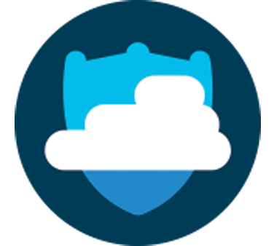
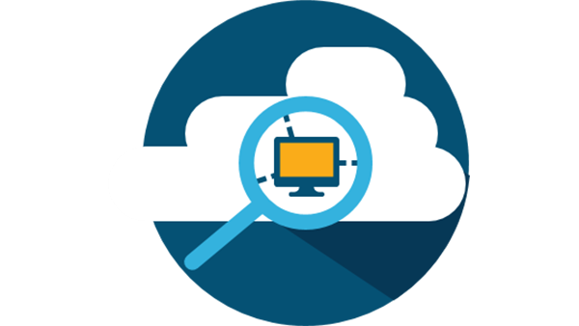

Integrations to Automate and Scale
CISCO PORTFOLIO
MERAKI PORTFOLIO
APIs + ECOSYSTEM
200+ apps, 500+ use cases
Cisco
Umbrella
Cisco DNA Spaces
Hybrid Work
hot desking, flex office, etc.
Cisco
ISE
Cisco
AnyConnect
Smart Spaces
asset tracking, IoT sensors, etc.
Safe Environments
contact tracing, safe occupancy, etc.
Cisco
AMP
Cisco SNORT
IDS/IPS
Analytics
footfall analytics, etc.
Cisco Stealthwatch
Marketing
guest Wi-Fi, online to offline, etc.
Cisco Duo
+ 25 more categories
Notes:
The Meraki Platform enables seamless integrations for your organization in multiple ways
1. Meraki portfolio: Starting with our own portfolio that we just covered
2. Cisco native integrations: Integrate with our Cisco family. Cisco creates leading IT, networking, and security products you can seamlessly plug into. For example:
Meraki MR Wireless + Cisco
Umbrella: leader in DNS-layer cloud security
Cisco ISE: Cisco Identity Services Engine -- next-gen identity and access control policy platform for enforcing compliance and improving security
DNA Spaces: Cloud-based location services platform – get insights into people’s behavior and how they interact with your physical spaces
Meraki MX Security & SD-WAN 🡪 powered by Cisco Talos, the leader in global threat intelligence
Umbrella: leader in DNS-layer cloud security
AnyConnect: Secure VPN access for remote workers – allow remote workers highly secure access to your enterprise networks
SNORT IDS/IPS: SNORT is a powerful open-source intrusion detection system (IDS) and intrusion prevention system (IPS) that provides real-time network traffic analysis and data packet logging
AMP: Cisco Advanced Malware Protection – protect against viruses, malware, and cyberthreats by detecting, preventing, and responding to threats
Systems Manager + Cisco
Duo: zero-trust security platform for users, devices, and applications – provide two-factor authentication, endpoint security, remote access solutions and more to protect sensitive data at scale
Plus many more Cisco integrations…
3. APIs + Ecosystem: Scale your teams and find solutions that meet your unique needs by integrating with APIs and the Meraki Marketplace ecosystem of Tech Partners. Integrate with 3rd parties across 30+ solution categories with over 185+ apps and 500+ use cases. Spotlight category examples:
Hybrid Work
Smart Spaces
Safe Environments
Analytics
Marketing

Slide 15
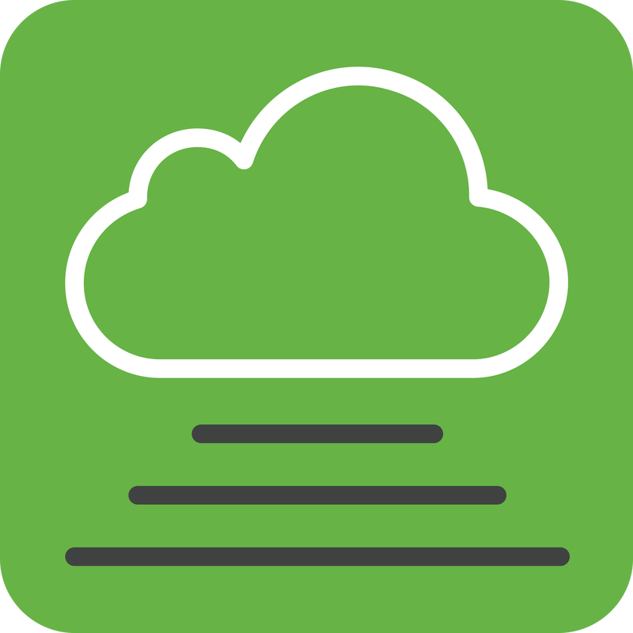
Rich API Tool-kit for Integrations
BUILD
{APIs and more}
Dashboard API
Webhook API
Scanning API
MQTT wireless
Captive portal API
MV Sense API
Programmability
Automation
Monitoring
Reporting
Data insights
Snapshot API
Event stream
Automation trigger
Asset tracking
Location analytics
Wayfinding
Real-time location services
Wayfinding*
Guest Wi-Fi
Secure Onboarding
Real-time (4 Hz) data stream
Historical time-series via REST
Current snapshot
*Application firmware deployed on Meraki hardware
Notes:
Off the shelf solutions for compatible with Meraki

Slide 16
Meraki Ecosystem
MR – Wireless
Variety of models that cater to indoor/ outdoor, hospitality, high performance, & value priced WiFi6E access points
MX – Security
A complete Unified Threat Management solution sized from small branch to Datacenter levels
MS – Switching
Stackable switches for networking & connectivity with 10 Gbps, 40 Gbps & 100 Gbps interface options
MG – Cellular Gateway
Unlock wireless WAN connectivity via cellular links for backup & redundancy

Slide 17
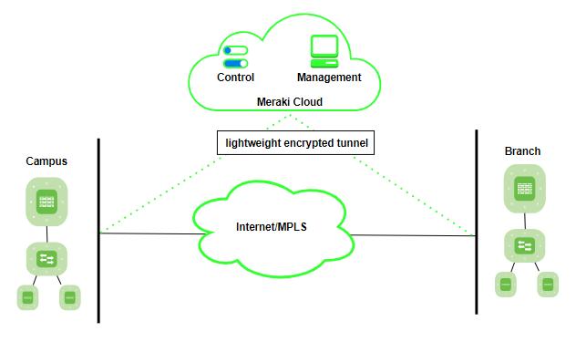
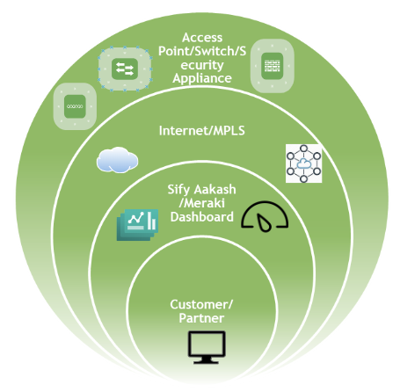
Meraki Architecture
Managed Wireless Services Architecture for the Meraki Platform

Slide 18
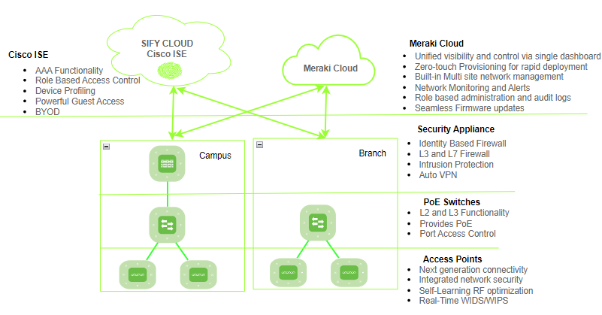
Meraki Solution Components

Slide 19

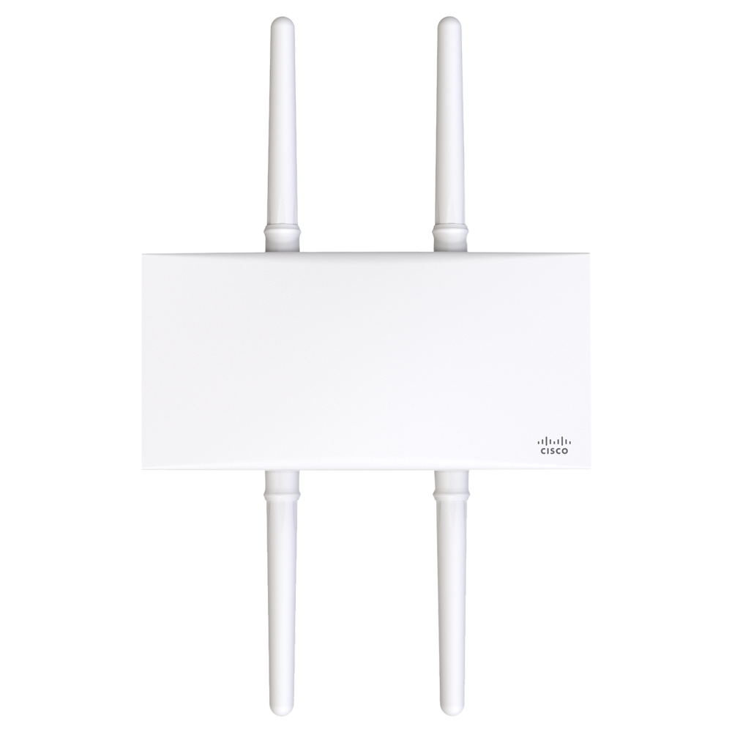
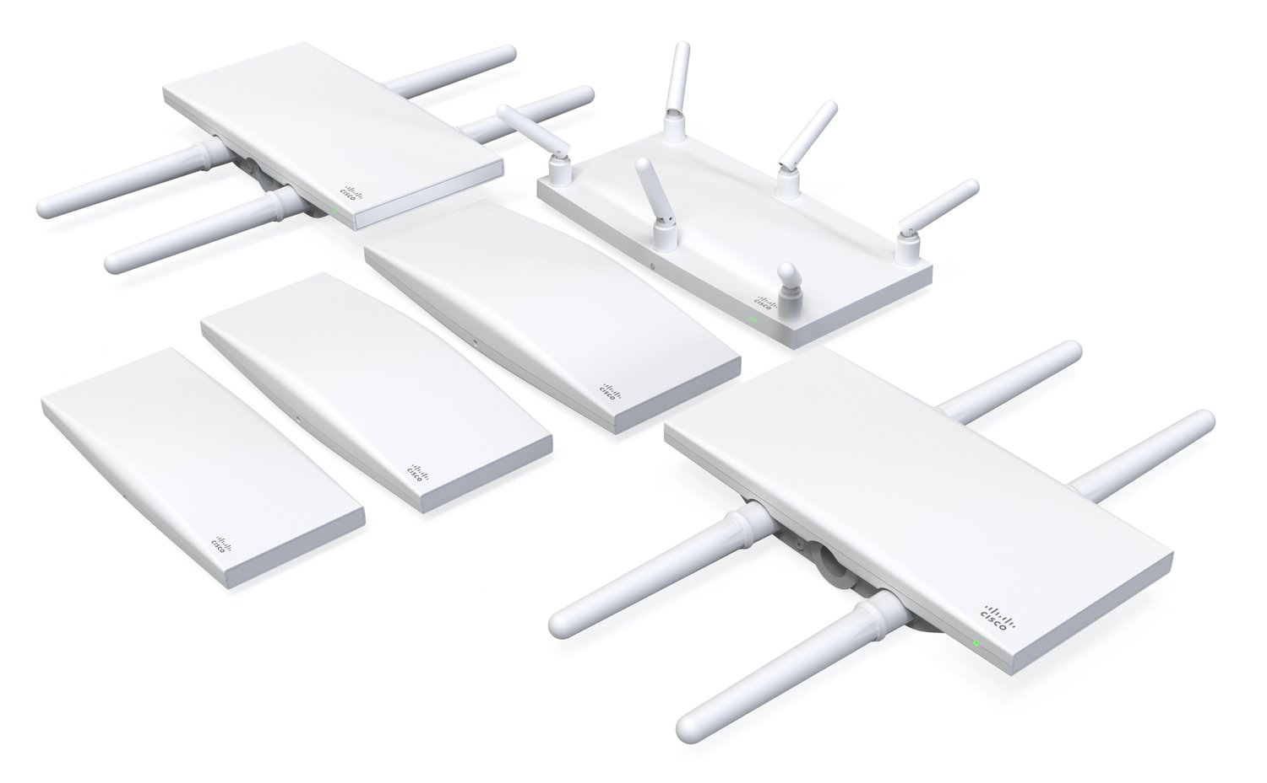
Meraki Access Points (MR)
Cloud Management
All Meraki devices can be centrally managed through the Meraki Dashboard, thus MRs can be configured, monitored, and troubleshot from any location with internet access
Zero-touch Deployment
All Meraki devices can be deployed with minimal manual configuration. Once connected to the network, they automatically pull configurations from the cloud, streamlining the deployment process
Intelligent Radio Assignment
Support intelligent radio assignment, which optimizes the allocation of 2.4 GHz and 5 GHz frequencies based on real-time usage and interference conditions
Mesh Networking
Support mesh networking, allowing MRs to wirelessly extend the network coverage without the need for additional cabling
Auto RF Management
The Auto RF feature continuously monitors the radio environment and adjusts settings dynamically to optimize performance
Integrated Security Features
MRs include built-in security features such as WPA3 encryption, stateful firewall, integrated Layer 7 application visibility, and content filtering
Scalability
Meraki solutions are designed to scale easily, whether deploying a small network for a single location or managing large, distributed networks with thousands of access points.
Location Analytics
MRs can provide location analytics, allowing ability to gather insights on visitor behavior, track foot traffic, and analyze user engagement within a physical space
Firmware Updates
Firmware updates are automatically managed through the cloud, ensuring that devices are always running the latest and most secure software.
Application Visibility & Control
MRs offer Layer 7 visibility, allowing administrators to see which applications are being used on the network for policy enforcement and network optimization.

Slide 20
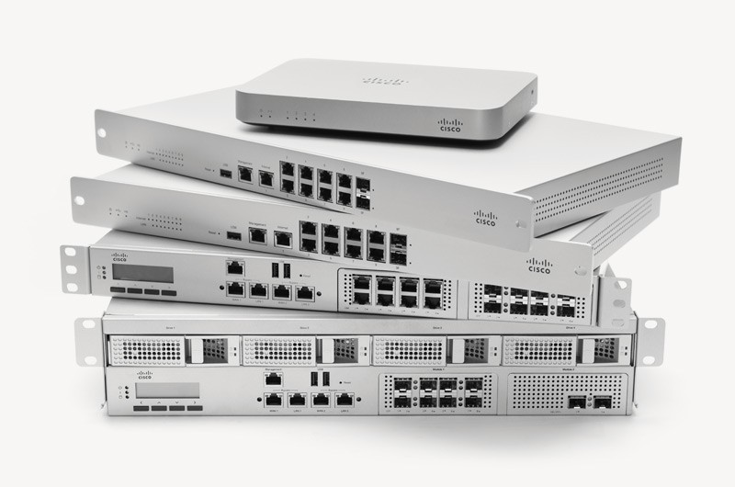
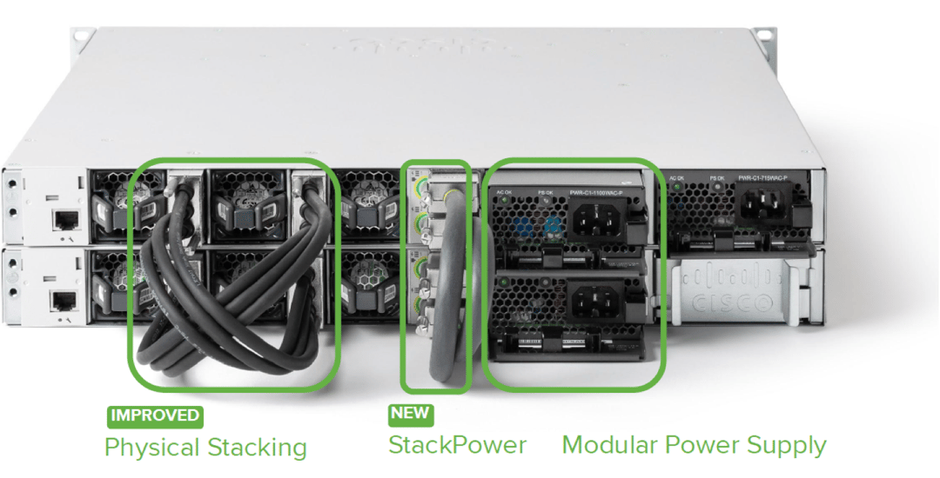
Meraki Switching (MS)
Network Visibility and Monitoring
The Meraki Dashboard provides comprehensive visibility into the network, including real-time monitoring, traffic analysis, and historical data. This allows administrators to quickly identify and address network issues
Power over Ethernet (PoE) Support
Many Meraki switches support Power over Ethernet (PoE) and PoE+ to power devices such as IP phones, cameras, and access points directly through the Ethernet cable, eliminating the need for separate power sources
Stacking and Virtual Stacking
Meraki switches support physical stacking, allowing multiple switches to be interconnected and managed as a single logical unit. Virtual stacking is also supported, enabling the management of multiple switches as a single entity, even if they are not physically stacked
Smart Link Aggregation
Meraki switches support link aggregation, allowing multiple physical links to be combined into a single logical link. This enhances redundancy and increases available bandwidth between switches and connected devices

Slide 21
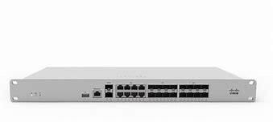
Meraki Firewalls (MX)
Cisco Meraki MX (Meraki Security Appliance) are a series of cloud-managed security appliances designed to provide a comprehensive security solution for networks. These are part of the Cisco Meraki cloud-managed networking portfolio and offer a range of features to secure and manage network traffic
Unified Threat Management (UTM)
Integrates various security features into a single appliance, offering UTM capabilities. This includes firewall, VPN, intrusion prevention, content filtering, and antivirus functionalities
Cloud Management
Fully cloud managed. Administrators can configure and monitor the MX devices using the Cisco Meraki dashboard, a centralized and intuitive web-based interface
Auto VPN and SD-WAN
Support Auto VPN, making it easier to establish secure site-to-site VPN connections.SD-WAN is also supported, optimizing the performance of network traffic across multiple locations
Application Visibility and Control
Provide visibility into network traffic, allowing administrators to monitor and control the usage of applications. This helps in optimizing bandwidth and ensuring appropriate application access policies
Threat Intelligence Integration
Leverage threat intelligence to enhance security. MX can identify and block threats based on real-time data and updates from Cisco's Threat Intelligence feeds
Content Filtering
The MX series includes content filtering capabilities, allowing administrators to enforce web usage policies and block access to inappropriate or non-business-related content
Layer 7 Firewall
Meraki MX firewalls operate at the application layer (Layer 7) of the OSI model, allowing for granular control and visibility into applications and user activities on the network
Integration with Other Meraki Devices
MX firewalls seamlessly integrate with other Meraki devices, such as Meraki access points and switches, creating a unified and centrally managed network infrastructure

Slide 22
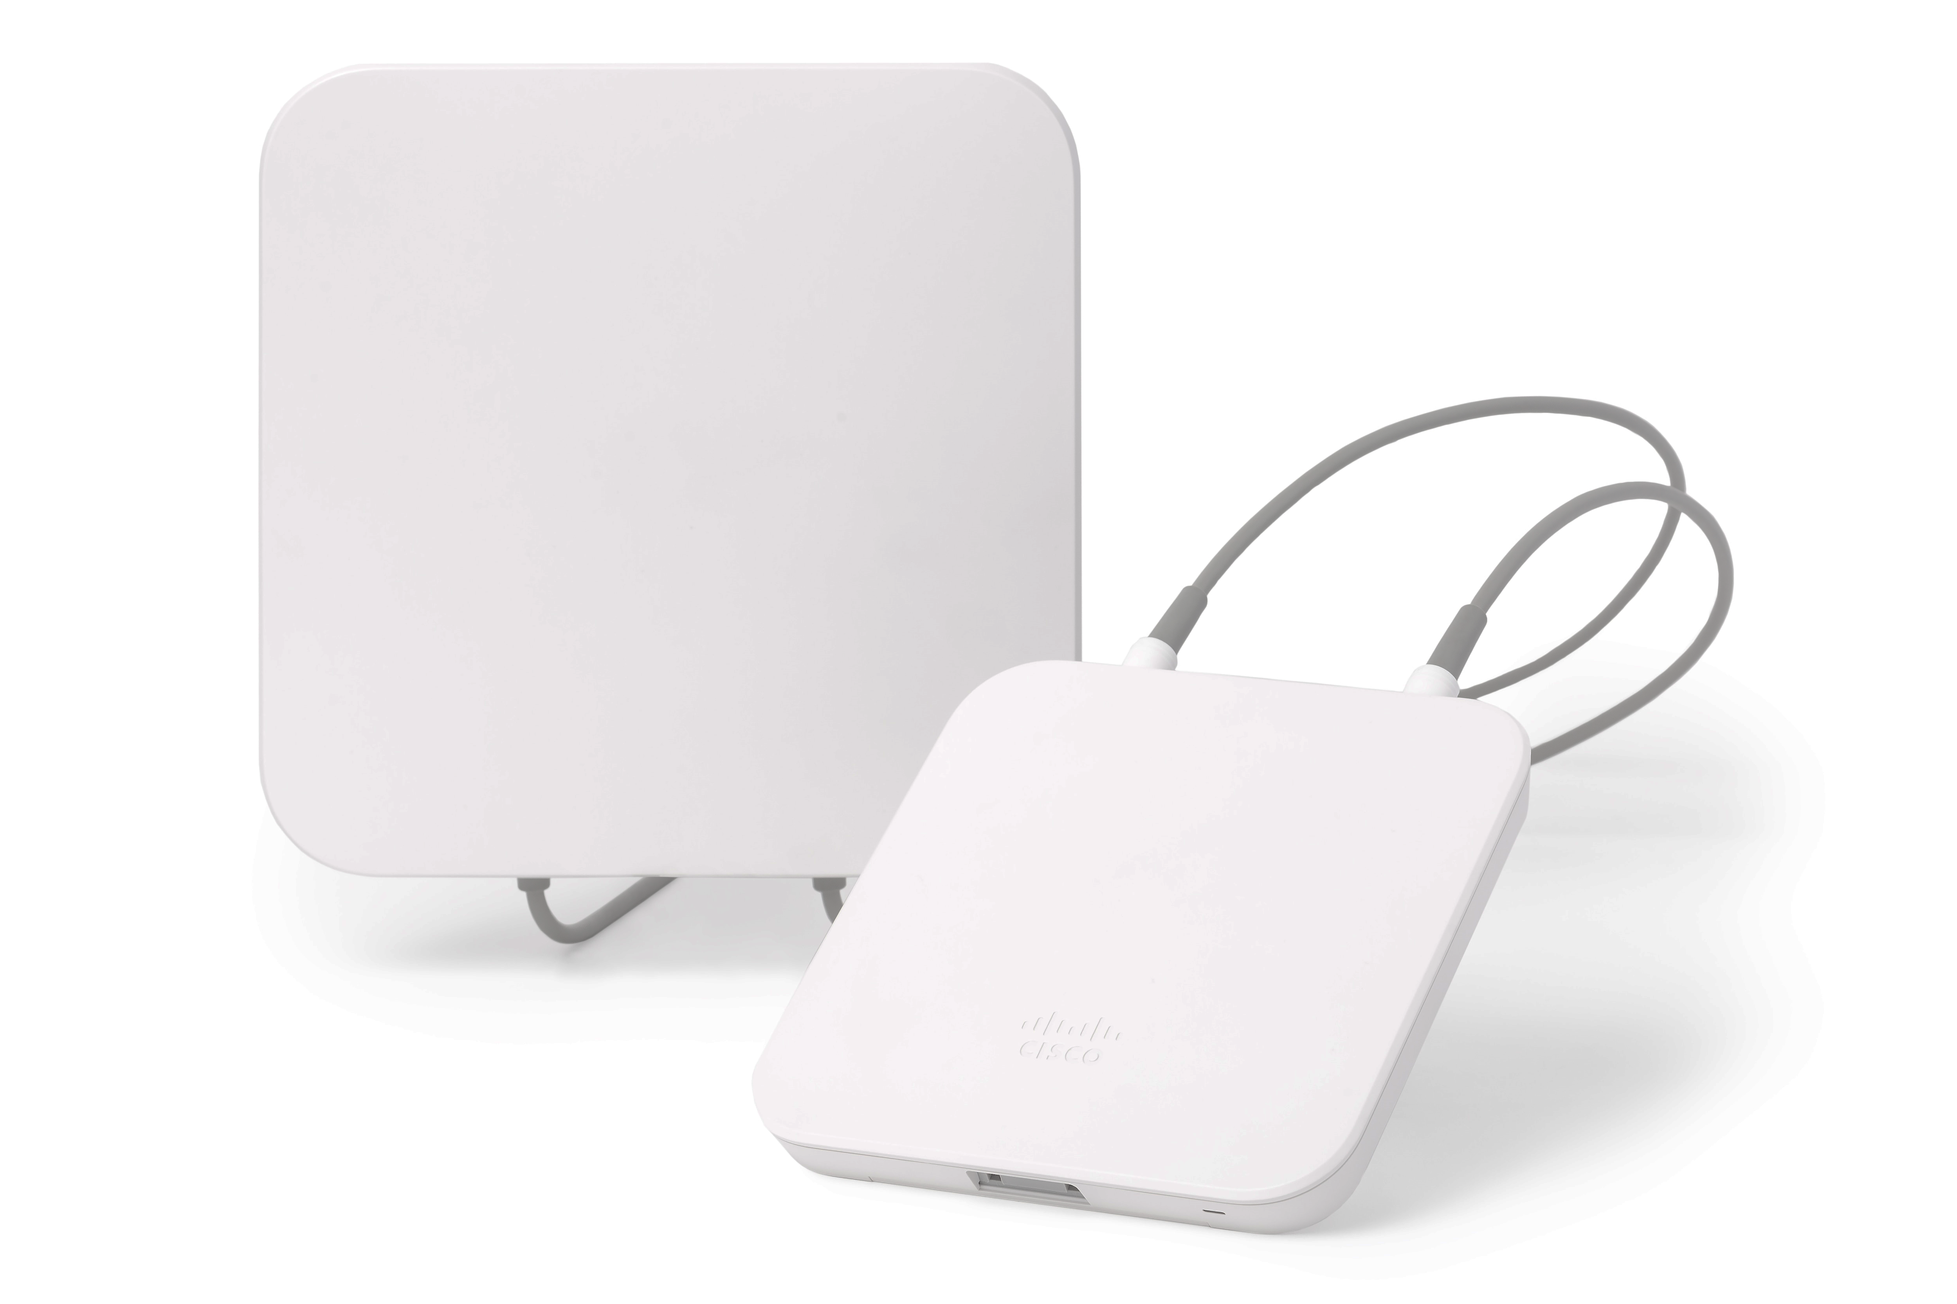
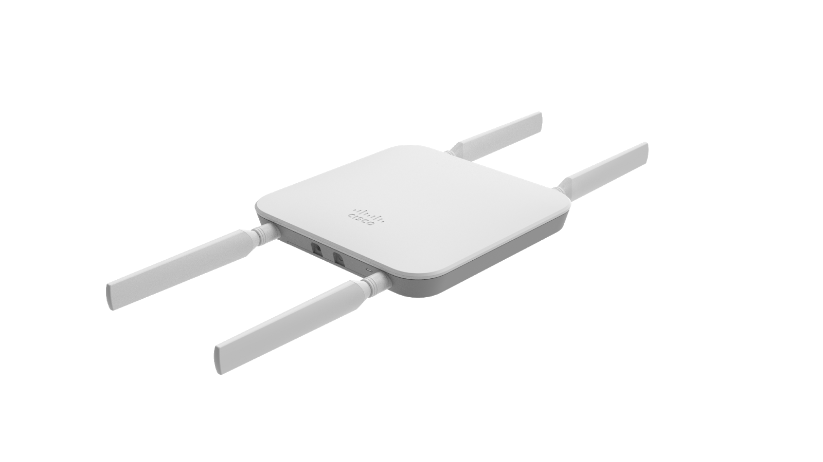
Meraki Cellular Gateway (MG)
Cisco Meraki Cellular Gateway "MG" is a device designed to provide cellular connectivity to the Cisco Meraki networking and security appliances. The Meraki Cellular Gateway is part of the Cisco Meraki portfolio, which focuses on cloud-managed networking solutions
Cellular Connectivity
Primary or Backup Connectivity
Cloud Management
Remote Locations
High Availability
The MG is equipped with cellular capabilities, allowing organizations to establish a reliable and secure internet connection using cellular networks
It can serve as either the primary or backup connectivity option, providing flexibility for businesses in various scenarios, especially in locations where wired internet is challenging to deploy
Like other Meraki devices, the MG is managed through the Cisco Meraki dashboard, offering centralized and cloud-based management. This simplifies configuration, monitoring, and troubleshooting
The MG is suitable for use in remote locations, branch offices, or temporary setups where traditional wired internet connectivity might be unavailable or impractical
Organizations can use the MG to ensure high availability and continuity of operations, especially in cases where a reliable internet connection is critical for business functions

Slide 23
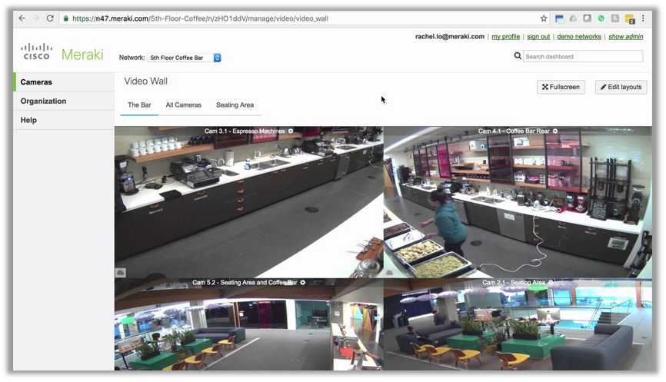
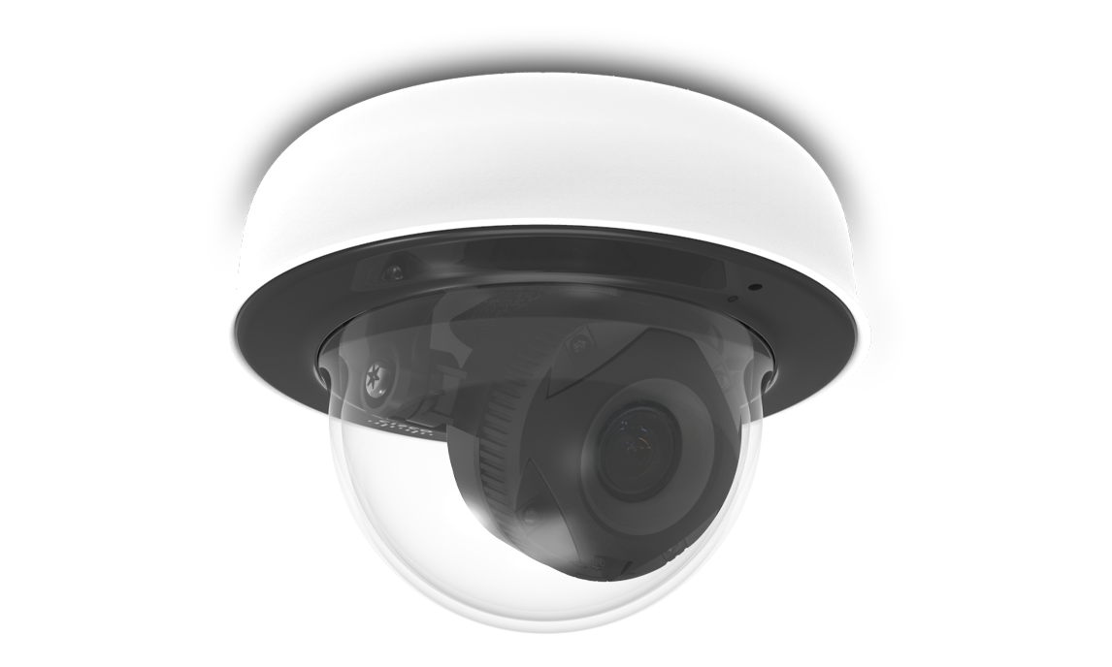
Meraki Cameras (MV)
Meraki MV is are a line of cloud-managed security cameras produced by Cisco Meraki. Meraki MV cameras are known for their integration with the broader Meraki cloud-managed ecosystem. This is a centralized platform for deploying, managing, and monitoring video surveillance
Cloud Management
Simplified Deployment
Edge Storage
Motion Search and Object Detection
Scalability
Integration with Meraki Ecosystem
Secure Communication
Video Retention and Access Control
MV cameras are managed through the Meraki dashboard. This allows for easy configuration, monitoring, and management of the cameras from any location
The cloud-managed architecture eliminates the need for on-premises servers. Deployment is simpler compared to traditional video surveillance systems.
MV cameras come with built-in storage. Video footage is stored locally on the camera, enhancing reliability and reducing complexity
MV cameras offer advanced analytics features such as motion search and object detection. Users can easily search for specific events or objects within the video footage using the Meraki dashboard.
Meraki MV is scales easily. Additional cameras can be added to the network, and the cloud-based management simplifies the scaling process.
MV cameras seamlessly integrate with other Meraki products, including MR, MS, and MX. This allows for a unified and easily manageable network infrastructure.
All communication between Meraki MV cameras and the Meraki cloud is encrypted, ensuring the security and privacy of video data.
The Meraki dashboard provides controls for video retention policies. Access control settings ensure that only authorized individuals can view or download video footage.

Slide 24
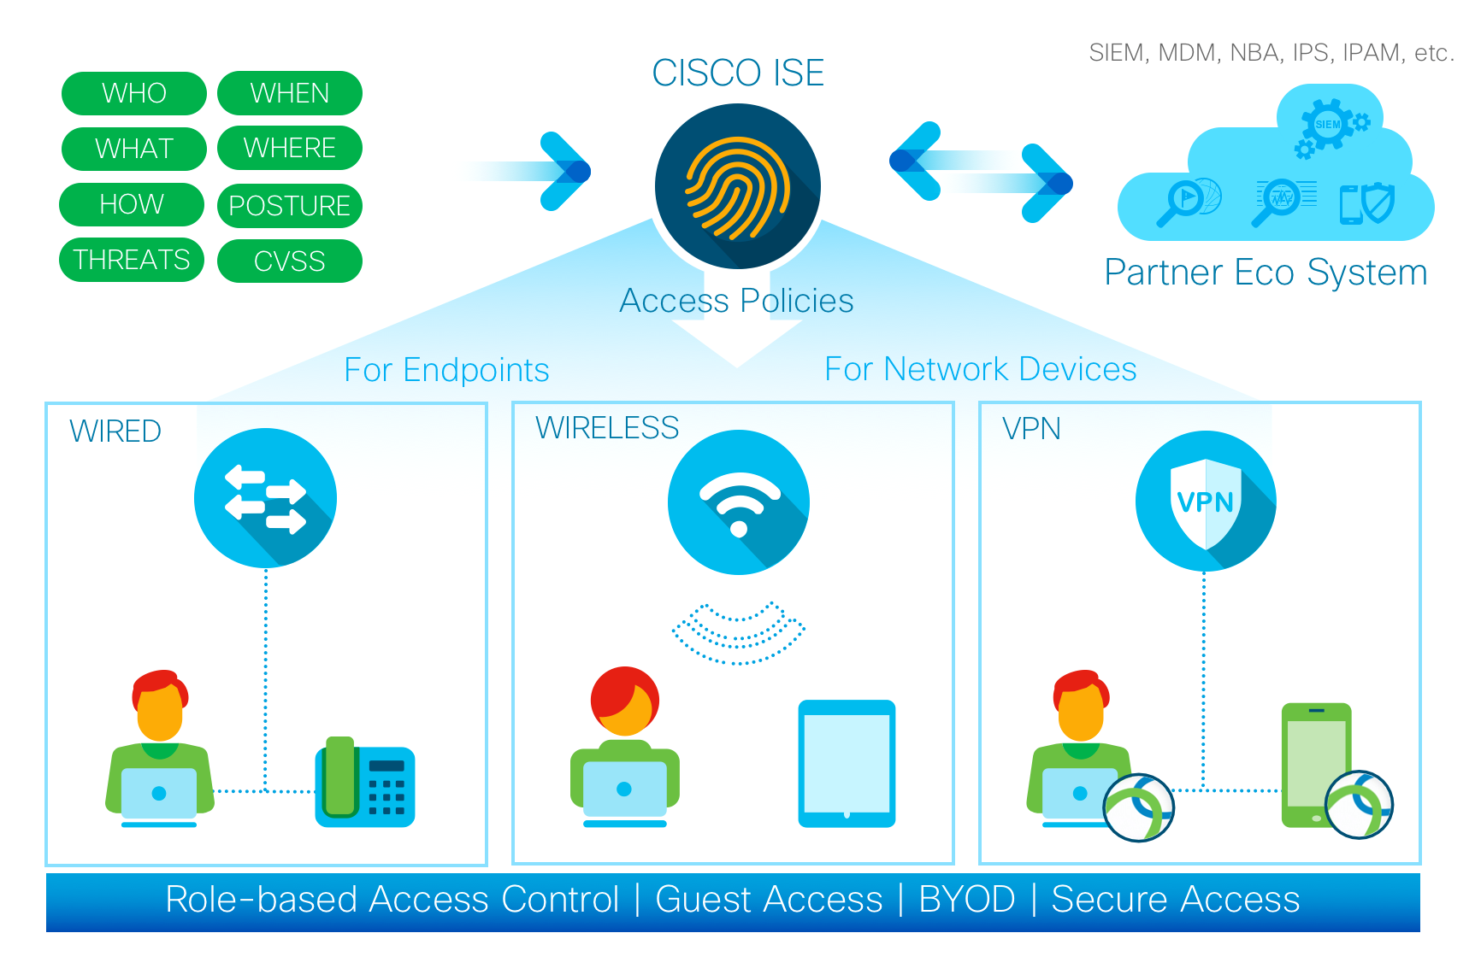
Licensing: Cisco ISE
Cisco Identity Services Engine (ISE) is a comprehensive security policy management platform that enables organizations to enforce security policies across the network infrastructure. When it comes to authentication, Cisco ISE offers different license types and features to support various authentication methods and requirements.
Base Licenses: Includes fundamental functionalities such as device administration, posture assessment, profiling, and guest services. It lays the foundation for all other features, including authentication
Authentication Licenses: Determines the number of concurrent authentications the ISE deployment can handle. Depending on the scale and needs, authentication license level is chosen
Advanced Cisco ISE Features
Multi-factor Authentication (MFA)
Device Registration
Adaptive Network Control (ANC)
BYOD Licenses
Guest Services Licenses
Notes:
Cisco ISE provides advanced features related to authentication, such as:
Multi-factor Authentication (MFA): ISE supports various MFA methods, including one-time passwords (OTP), certificates, and more. Advanced licenses may be required to enable and manage these features.
Device Registration: Some deployments may require device registration as part of the authentication process. Cisco ISE can assign policies based on the type and health of the device, and additional licenses may be needed for this functionality.
Adaptive Network Control (ANC): ANC allows ISE to dynamically adjust access policies based on the security posture of the endpoint device.
BYOD (Bring Your Own Device) Licenses: Cisco ISE can play a crucial role in BYOD scenarios, ensuring that personal devices meet security compliance before granting access to the network. Licenses associated with BYOD features may be required for this functionality.
Guest Services Licenses: Cisco ISE can provide guest access with different levels of authentication and authorization. Guest services licenses may be necessary to manage the guest access policies, including authentication for guest users.

Slide 25
Licensing: Enterprise & Advanced Security
Enterprise License:
The Enterprise License is a comprehensive license that covers a range of features across Meraki product lines
Advanced Security License:
This license is specific to Meraki security appliances and includes additional security features
Features
Features
Comprehensive Cloud Management
24/7 Customer Support
Firmware Updates
NBD Hardware Replacement
Scalability
Smart Licensing
Feature Enablers
Location Analytics
Bluetooth/ WiFi Analytics
Enhanced Threat Protection
Intrusion Detection and Prevention (IDS/IPS)
Advanced Malware Protection (AMP)
Content Filtering
Web Search Filtering
URL Categorization
Threat Intelligence Feeds
Security Dashboard and Reporting
Policy Enforcement
Notes:
Meraki Enterprise License:
Comprehensive Cloud Management:
The Enterprise License is the foundational license required for all Meraki devices. It enables cloud-based management through the Meraki Dashboard, allowing administrators to configure, monitor, and troubleshoot Meraki devices from anywhere with internet access.
Firmware Updates:
The Enterprise License includes access to firmware updates. This ensures that Meraki devices are running the latest and most secure software, with new features and enhancements.
24/7 Customer Support:
With the Enterprise License, customers have access to 24/7 customer support provided by Meraki. This support covers technical assistance, troubleshooting, and guidance in managing Meraki deployments.
Next-Business-Day Hardware Replacement:
In the event of hardware failure, the Enterprise License includes next-business-day hardware replacement. This helps minimize downtime by providing a replacement device promptly.
Feature Enablers:
While the core cloud management features are available with the base license, the Enterprise License may include additional feature enablers that enhance the capabilities of specific Meraki devices. For example, in the case of security appliances, the Enterprise License might include advanced security features.
Scalability:
The Enterprise License is designed to scale with the organization's needs, whether it's a small deployment or a large, distributed network with numerous Meraki devices.
Smart Licensing:
Meraki uses Smart Licensing to simplify the license management process. Smart Licensing allows administrators to manage and allocate licenses efficiently, ensuring that devices have the necessary licenses for their features.
Insight License:
The Insight License is designed for Meraki access points and provides enhanced analytics and location-based services, including location analytics and Bluetooth/Wi-Fi analytics.
Meraki Advanced Security License:
Enhanced Threat Protection:
The Advanced Security License includes enhanced threat protection features to bolster the security posture of the Meraki security appliances. This may include advanced threat detection and mitigation capabilities.
Advanced Malware Protection (AMP):
AMP is a key component of the Advanced Security License. It provides protection against advanced malware, including zero-day threats. It uses advanced techniques to analyze and detect malicious files in real-time.
Intrusion Detection and Prevention (IDS/IPS):
The license includes intrusion detection and prevention features that monitor network traffic for suspicious or malicious activity. It can help identify and block potential threats, enhancing overall network security.
Content Filtering:
Advanced Security License may include content filtering capabilities, allowing administrators to control and filter web content based on categories. This helps enforce acceptable use policies and enhances web security.
Web Search Filtering:
The license may provide web search filtering capabilities, allowing administrators to control access to search engine results and filter out potentially harmful content.
URL Categorization:
Advanced Security License may offer URL categorization features, enabling administrators to categorize and control access to websites based on predefined categories.
Threat Intelligence Feeds:
Integration with threat intelligence feeds provides real-time information on emerging threats and helps Meraki security appliances adapt to new and evolving security challenges.
Security Dashboard and Reporting:
The license may include additional reporting and dashboard features specific to security. This helps administrators gain insights into security events, threats, and the overall security posture of the network.
Policy Enforcement:
Advanced Security License allows for more granular policy enforcement based on the detected threats and the security policies defined by the organization.
Smart Licensing:
Like other Meraki licenses, the Advanced Security License may be managed through Smart Licensing, providing a simplified approach to license management

Slide 26
The Fortinet Platform

Slide 27
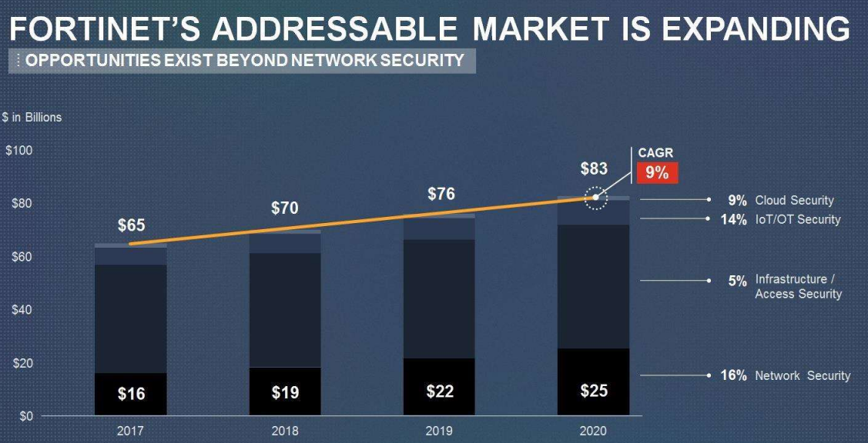
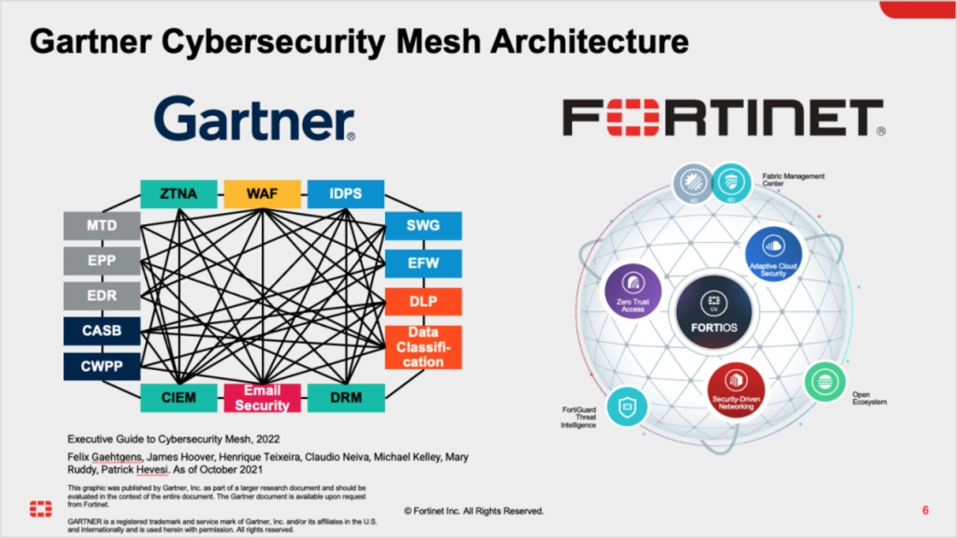
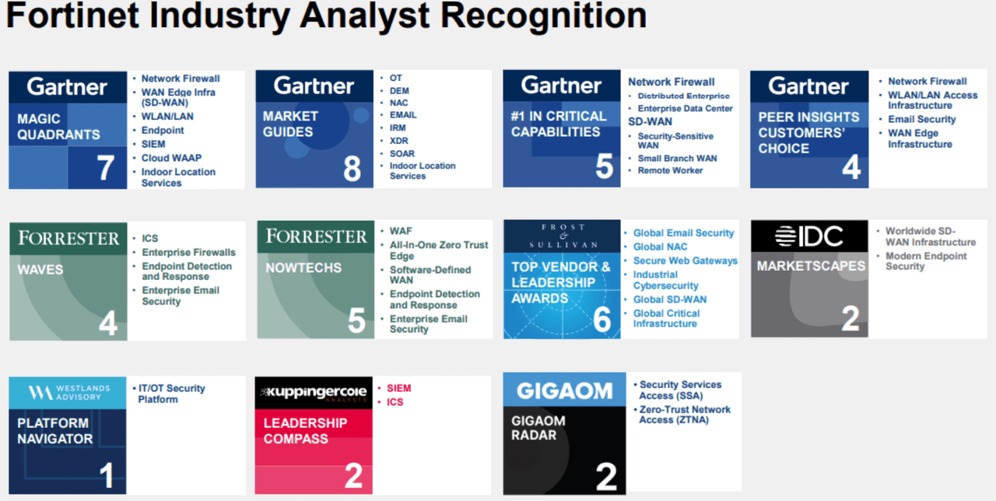
Fortinet in the Market
Fortinet Security Fabric is the Industry’s Highest-performing Cybersecurity Mesh Platform

Slide 28
Fortinet Ecosystem
FortiGate (FG): FortiGate is Fortinet's flagship firewall appliance, providing robust network security and unified threat management to safeguard organizations from cyber threats.
FortiWiFi (FWF): FortiWiFi combines the security features of FortiGate with built-in Wi-Fi functionality, offering comprehensive network protection and wireless connectivity in a single device.
FortiSwitch (FS): FortiSwitch is Fortinet's line of secure, high-performance Ethernet switches designed to enhance network connectivity and provide advanced security features.
FortiAP (FAP): FortiAP represents Fortinet's wireless access points, delivering secure and scalable Wi-Fi solutions to extend network coverage while maintaining robust security protocols.
FortiExtender (FEX): FortiExtender is Fortinet's solution for extending network connectivity to remote locations, providing reliable and secure connectivity through wireless broadband networks.
FortiCamera (FCM): FortiCamera is a video surveillance solution which includes the high-performance FortiRecorder, and AI-powered FortiCentral video management software (VMS). This integrated physical security gives intelligent insights with remote, real-time visibility

Slide 29







Key Benefits of the Fortinet Platform
Fortinet Security Fabric
Fortinet Security Fabric is a comprehensive cybersecurity framework designed to provide integrated and collaborative protection across an organization's entire digital infrastructure.
Built on the principles of visibility, integration, automation, and threat intelligence to enhance the overall security posture of an organization
Fabric Management Center
Network
Access
Open Fabric Ecosystem
Secure
WLAN/LAN
Cloud
Infrastructure
  Broad
  visibility of the entire digital attack surface to better manage risk
  Integrated
  solution that reduces the complexity of supporting multiple point products
  Automated
  workflows to increase speed of operations and response
NGFW
SD-WAN
Endpoint
Applications
Security Operations
Notes:
Smarter hybrid workspaces need to be: productive, provide for employee engagement, and of course, have reliable, easy connectivity (from anywhere), IoT enablement, and secure technology.
We all want to be productive ... everywhere!

Slide 30




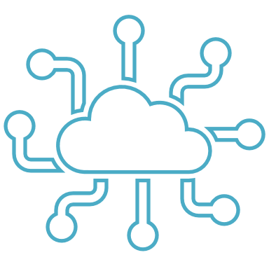

Unified Threat Protection (UTP) FEATURES
Intrusion Prevention System (IPS)
Antispam Service
UTP
Application Control
FortiCare Premium
Advanced Malware Protection (AMP)
Web Security
Antivirus, Botnet, Mobile Malware, FortiGate Cloud Sandbox, Outbreak Prevention
Web and Content Filtering (URL Filtering), Secure DNS filtering & Video Filtering

Slide 31

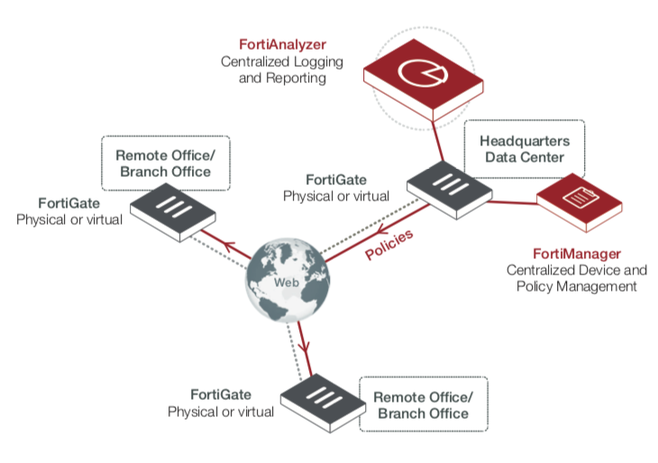




Centralized Management & Reporting
Logging, Reporting And Analysis From Multiple Fortinet Devices
Automation-driven Centralized Management From A Single Console
 | Centralized Search and Reports
 | Real-time and Historical Views into Network Activity
 | Scans security logs using FortiGuard IOC Intelligence for APT detection
 | Light-weight Event Management
 | Seamless Integration with the Fortinet Security Fabric
Single-Pane Management and Provisioning
Fabric Automation
Monitoring and Visibility
FortiAnalyzer
FortiManager

Slide 32
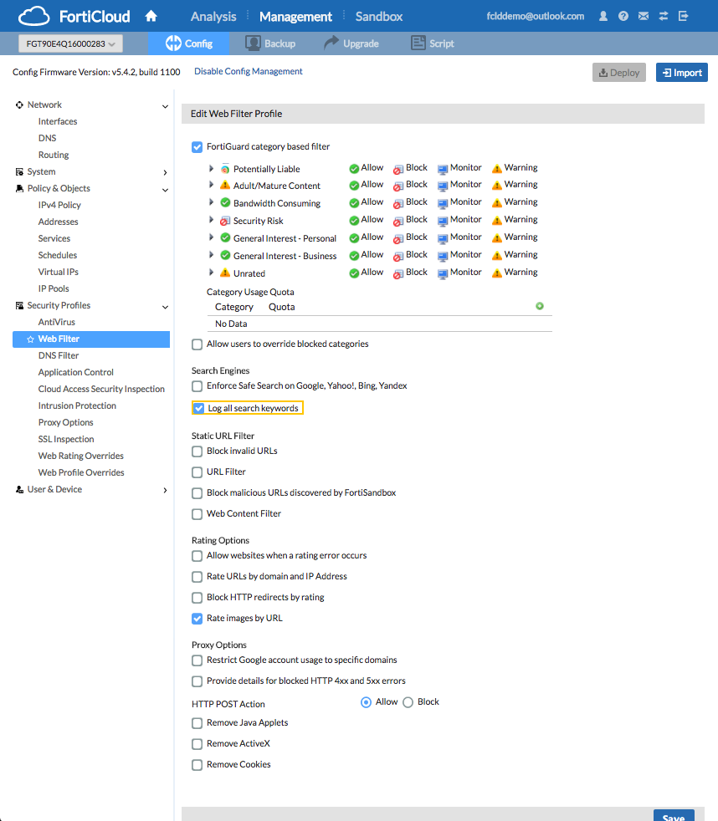
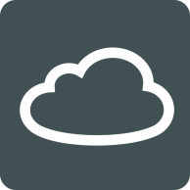
Centralized Provisioning Platform
FortiCloud
Cloud-based SaaS, offering a range of management and services across the Fortinet Firewalls and Access Points
Multi-Tenancy support using group management features
International Data Centers
Device Management
Monitor device status over the cloud
Configuration Management
Configure and provision FortiGate remotely via cloud portal
Log & Analytics
Cloud-based log storage and analysis

Slide 33
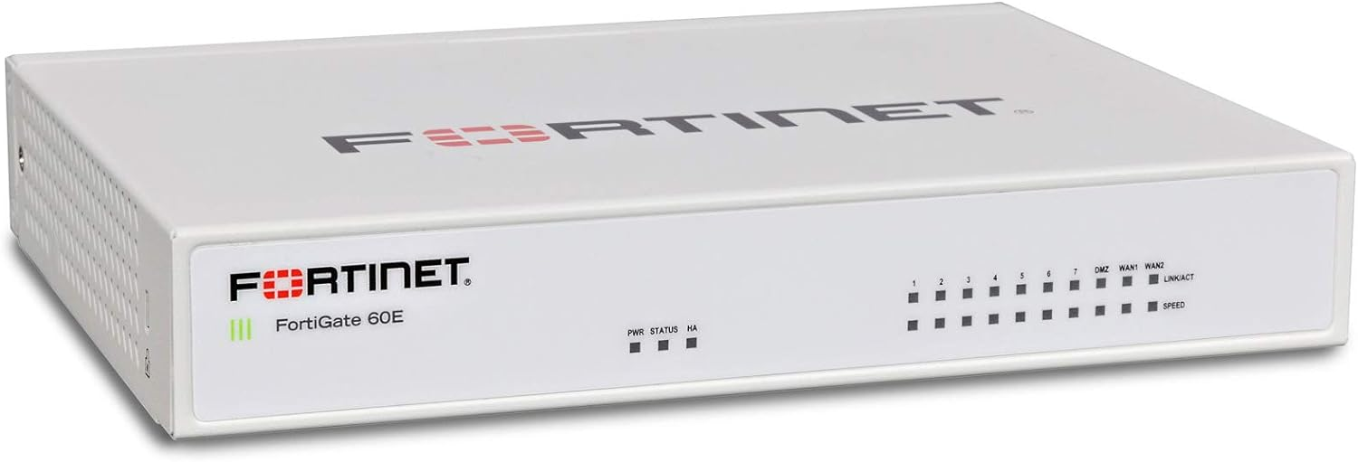
FortiGate (FG)
Fortinet FortiGate is a family of integrated cybersecurity appliances developed by Fortinet. FortiGate devices serve as next-generation firewalls (NGFW) and Unified Threat Management (UTM) solutions, providing a comprehensive set of security features to protect networks from various cyber threats
Firewall Protection
Intrusion Prevention System (IPS)
Virtual Private Network (VPN)
Antivirus and Antimalware
Web Filtering
Application Control
Data Loss Prevention (DLP)
Secure SD-WAN
FortiGate devices function as advanced firewalls, inspecting and controlling traffic based on security policies to prevent unauthorized access and protect against cyber threats.
FortiGate includes an IPS that actively monitors network and/or system activities for malicious exploits or security policy violations and takes action to block or allow traffic accordingly.
FortiGate supports secure VPN connectivity, allowing remote users and branch offices to securely connect to the corporate network over encrypted connections.
FortiGate appliances incorporate antivirus and antimalware capabilities to scan and detect malicious software, viruses, and other threats within network traffic.
FortiGate includes web filtering features to control access to websites based on categories, enabling organizations to enforce web usage policies and protect against malicious websites.
FortiGate provides visibility and control over applications running on the network, allowing administrators to manage and prioritize application traffic based on security and business requirements.
FortiGate devices may include DLP features to prevent unauthorized access, sharing, or transmission of sensitive data, helping organizations comply with data protection regulations.
FortiGate supports Secure SD-WAN functionality, enabling organizations to optimize and secure wide-area network (WAN) connectivity.

Slide 34
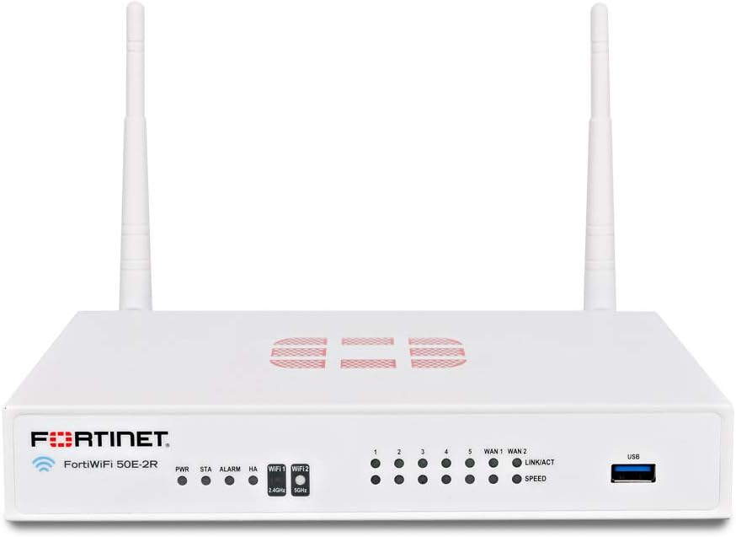
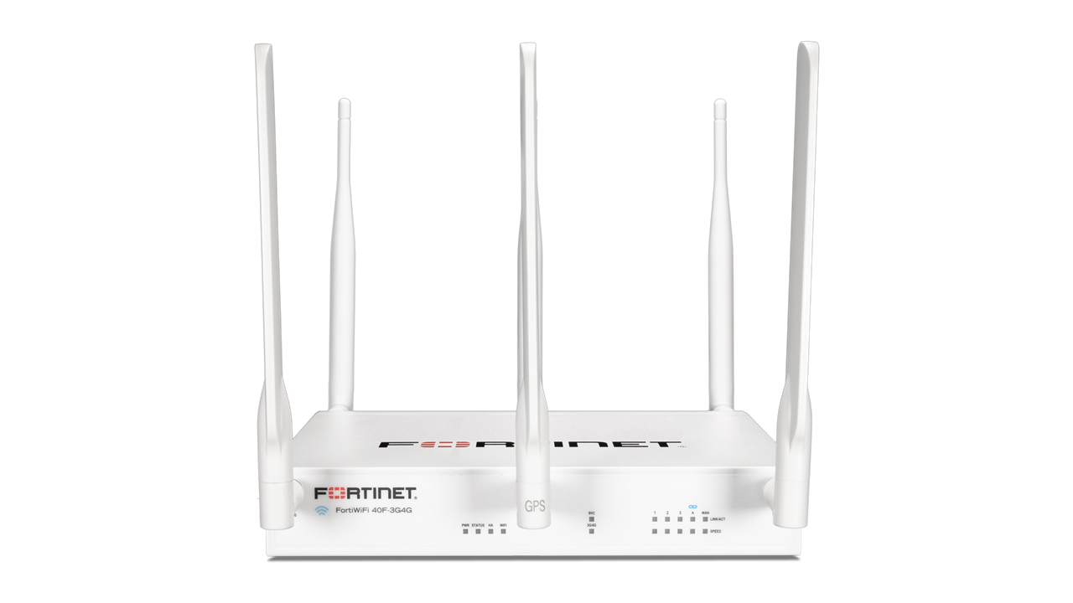
FortiWiFi (FWF)
FortiWiFi is a product line within Fortinet's portfolio that combines Fortinet's FortiGate next-generation firewall (NGFW) capabilities with built-in wireless functionality. Essentially, FortiWiFi devices integrate the features of FortiGate firewalls with wireless access points, providing a unified solution for network security and wireless connectivity
Unified Threat Management (UTM)
FortiWiFi devices offer UTM capabilities, including firewall protection, intrusion prevention, antivirus, web filtering, and application control.
Wireless Access Points (WAP)
FortiWiFi devices include built-in wireless access points, allowing organizations to establish secure Wi-Fi networks for connectivity within their premises.
VPN Connectivity
FortiWiFi supports Virtual Private Network (VPN) connectivity, allowing remote users and branch offices to securely connect to the corporate network over encrypted connections.
Secure SD-WAN
FortiWiFi devices may support Secure SD-WAN functionality, enabling organizations to optimize and secure wide-area network (WAN) connectivity.
Web Filtering
FortiWiFi appliances incorporate web filtering features to control access to websites based on categories, helping organizations enforce web usage policies.
Application Control
FortiWiFi provides visibility and control over applications running on the network, allowing administrators to manage and prioritize application traffic based on security and business requirements.
Antivirus and Antimalware
FortiWiFi devices include antivirus and antimalware capabilities to scan and detect malicious software within both wired and wireless traffic.
Data Loss Prevention (DLP)
FortiWiFi appliances may include DLP features to prevent unauthorized access, sharing, or transmission of sensitive data over the network.
Security Fabric Integration
FortiWiFi devices can be part of Fortinet's Security Fabric, an integrated and collaborative security architecture that allows different Fortinet security solutions to work together for comprehensive threat detection and response.
Cloud Integration
FortiWiFi devices are designed for centralized management and may offer cloud-based management options for administrators to monitor and configure security policies.

Slide 35
FortiSwitch (FS)
FortiSwitch is a family of Ethernet switches developed by Fortinet. FortiSwitch devices are designed to work seamlessly with Fortinet's integrated security solutions, providing network administrators with enhanced control and visibility over their network traffic
Network Switching
Security Fabric Integration
Cloud Management
Unified Access Control
PoE (Power over Ethernet)
Link Aggregation (LAG) and Redundancy
VLAN (Virtual LAN) Support
Quality of Service (QoS)
Rapid Spanning Tree Protocol (RSTP)
Network Segmentation
Role-Based Access Control
Security Compliance
FortiSwitch devices function as Ethernet switches, facilitating the connectivity of various devices within a local area network (LAN).
FortiSwitch integrates with Fortinet's Security Fabric, allowing for coordinated threat detection and response across different Fortinet security solutions.
FortiSwitch switches are often managed through Fortinet's cloud-based management platform, providing a centralized and user-friendly interface for configuration and monitoring.
FortiSwitch supports unified access control policies, allowing administrators to define and enforce security policies based on user identity and device type.
Some FortiSwitch models support Power over Ethernet, providing power to connected devices such as IP phones, cameras, and access points through the Ethernet cable.
FortiSwitch devices often support link aggregation for increased bandwidth and redundancy. This allows multiple physical links to be grouped together to form a logical link.
FortiSwitch enables the use of VLANs to logically segment a network, improving network efficiency and security by isolating broadcast domains.
FortiSwitch supports QoS features to prioritize certain types of network traffic, ensuring optimal performance for critical applications.
FortiSwitch devices implement RSTP to prevent loops in the network and improve network stability.
FortiSwitch switches contribute to network segmentation strategies, helping organizations isolate and secure different parts of their network.
Administrators can implement role-based access control, defining specific roles for users or devices and controlling their access to network resources.
FortiSwitch devices contribute to overall network security compliance by enforcing access policies and integrating with other Fortinet security solutions.

Slide 36
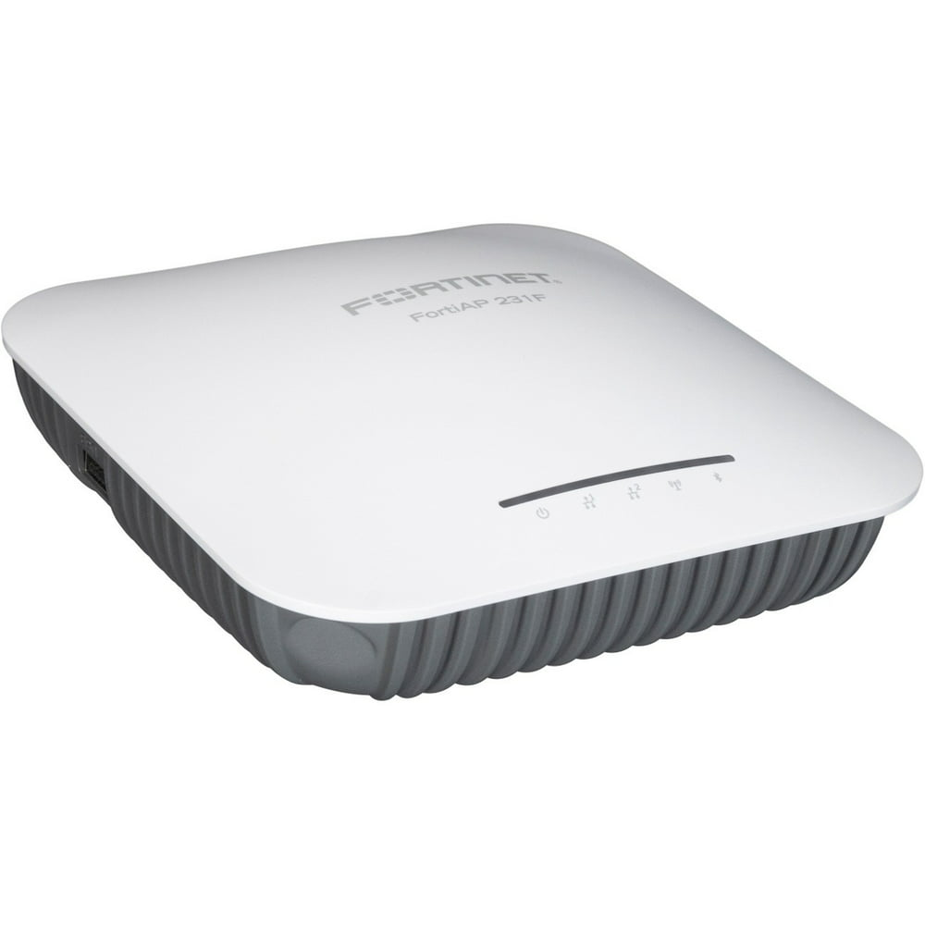
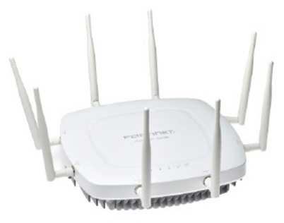
FortiAP (FAP)
Fortinet FortiAP is a family of wireless access points developed by Fortinet. FortiAP devices are designed to provide secure and reliable wireless connectivity. These access points are integrated into Fortinet's Security Fabric, allowing for seamless coordination with other Fortinet security solutions.
Wireless Connectivity
Security Integration
Cloud Management
Unified Access Control
Guest Wi-Fi Services
Provides wireless connectivity for a variety of devices, including laptops, smartphones, tablets, and IoT devices.
Works in conjunction with Fortinet's integrated security solutions, such as FortiGate firewalls. This integration allows for consistent security policies and threat detection across wired and wireless networks.
FortiAP devices are often managed through Fortinet's cloud-based management platform, providing centralized control and visibility over the wireless network.
FortiAP supports unified access control policies, allowing administrators to define and enforce security policies based on user identity and device type.
FortiAP enables organizations to provide guest Wi-Fi services with secure and isolated access, ensuring that guest users have limited and controlled access to the network.
Power over Ethernet (PoE)
FortiAP supports QoS features to prioritize certain types of network traffic, ensuring optimal performance for critical applications.
Supports Power over Ethernet, allowing them to receive power and data over a single Ethernet cable. This can simplify installation and reduce the need for additional power sources.
Fast Roaming
FortiAP devices support fast roaming capabilities, allowing wireless clients to seamlessly transition between access points without experiencing service interruption.
Mesh Networking
FortiAP supports mesh networking, allowing them to wirelessly connect to each other to extend wireless coverage without the need for additional cabling.
Application Control
FortiAP provides visibility and control over applications running on the wireless network, allowing administrators to manage and prioritize application traffic based on security and business requirements.
Quality of Service (QoS)

Slide 37
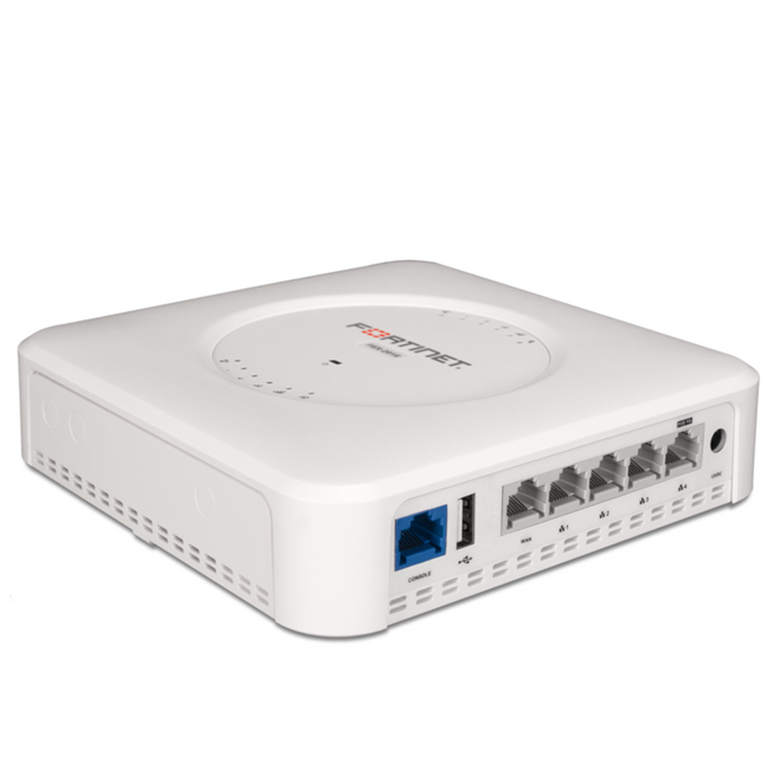
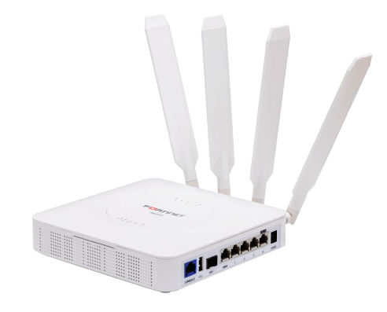
FortiExtender (FEX)
Fortinet FortiExtender is a family of devices designed to extend the reach of Fortinet's security services to remote locations or areas with limited connectivity. FortiExtender devices are typically used in conjunction with FortiGate firewalls and provide a secure way to extend network connectivity to remote sites, such as branch offices, temporary locations, or areas with challenging network conditions
LTE Connectivity
FortiExtender devices often leverage LTE or 4G cellular networks to provide high-speed and reliable connectivity in areas where traditional wired connections may be unavailable or impractical.
Integration with FortiGate
FortiExtender is designed to seamlessly integrate with FortiGate firewalls, allowing organizations to extend the reach of their network security services to remote locations.
Secure VPN Connectivity
FortiExtender supports secure Virtual Private Network (VPN) connections, ensuring that data transmitted over the cellular network is encrypted and secure.
Dual SIM Support
Some FortiExtender models come with dual SIM slots, providing redundancy in case one cellular network is unavailable or experiences issues.
Automatic Failover
FortiExtender devices can be configured for automatic failover, switching to a backup cellular connection if the primary connection becomes unstable or goes offline.
Load Balancing
FortiExtender supports load balancing between multiple cellular connections, optimizing bandwidth usage and ensuring reliable connectivity.

Slide 38
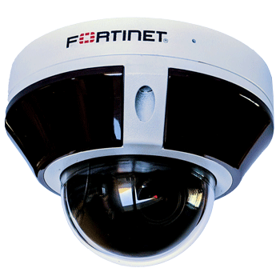
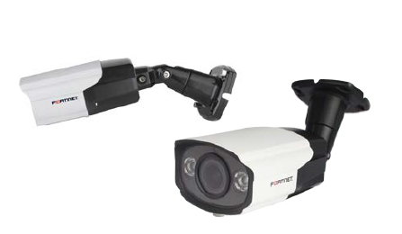
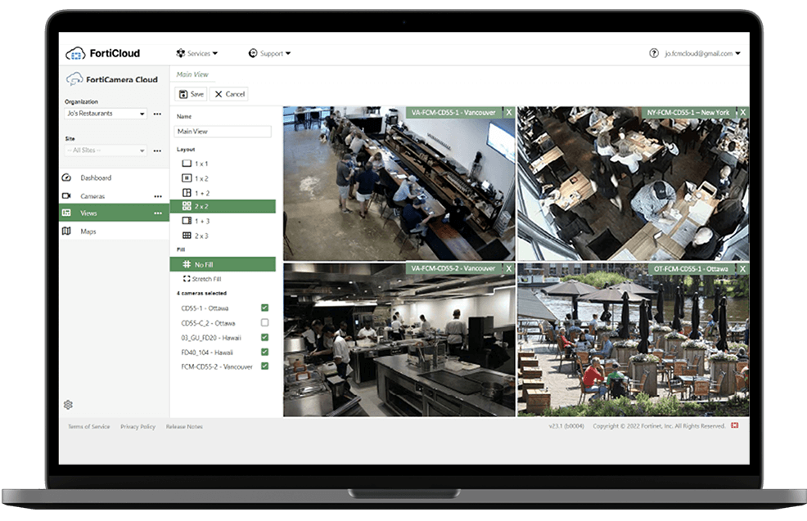
FortiCamera (FCM)
FortiCamera refers to a range of security cameras produced by Fortinet. FortiCam devices are designed to provide video surveillance capabilities for physical security applications within an organization's infrastructure. With the smart FortiCamera, high-performance FortiRecorder, and AI-powered FortiCentral video management software (VMS), Fortinet offers a tailor-made video surveillance solution.
Security Surveillance
Integration with Fortinet Solutions
High Definition (HD) Video
PoE (Power over Ethernet)
Remote Monitoring
Analytics and Motion Detection
Durable and Weather-Resistant Design
Secure Communication
FortiCamera is used for video surveillance, monitoring and securing physical locations such as offices, entry points, corridors, and outdoor areas
FortiCamera is designed to integrate seamlessly with Fortinet's broader security ecosystem, including FG firewalls and FortiRecorder video management solutions. This integration enhances the overall security posture by combining physical and cybersecurity measures
FortiCamera offers high-definition video quality, providing clear and detailed footage for effective monitoring and analysis
FortiCamera supports Power over Ethernet, simplifying installation by delivering both power and data over a single Ethernet cable
FortiCamera supports remote monitoring, allowing authorized users to view live or recorded video feeds from any location with internet access.
FortiCamera includes analytics features such as motion detection, enabling the cameras to trigger alerts or recordings based on detected movement
FortiCamera is designed to withstand various environmental conditions, making them suitable for both indoor and outdoor deployment.
FortiCamera prioritizes secure communication, helping protect video streams and data from unauthorized access

Slide 39
Licensing: Unified Threat Protection (UTP)
Intrusion Prevention System (IPS)
Antispam Service
UTP
Application Control
FortiCare Premium
Advanced Malware Protection (AMP)
Web Security
Antivirus, Botnet, Mobile Malware, FortiGate Cloud Sandbox, Outbreak Prevention
Web and Content Filtering (URL Filtering), Secure DNS filtering & Video Filtering

Slide 40
GTM Strategy

Slide 41
Key Considerations for Potential Customers
Office Setup Requirements
Describe the purpose of setting up a new office or enhancing the existing one.
Are you looking to set up a new office, or establish a temporary workspace?
What is the preferred office size or workspace capacity?
Location & Mobility
Will the office be set up in a remote/ less connected location?
Do you have remote or mobile teams that require a standardized office environment?
Technology & Connectivity
What are your specific connectivity requirements?
Are there any specific technology integrations you prioritize?
Do you have preferences for specific hardware or software solutions?
Scalability
Do you anticipate changes in the size of your team soon?
How important is scalability in your office setup?
Budget & Cost Considerations
What is your budget range for setting up the office?
Are you looking for a cost-effective alternative to traditional office setups?
Security & Compliance
What security measures are crucial for your business (data security, access control, etc.)?
Are there any specific compliance standards your office setup must adhere to?
Preferred Features
What features or functionalities do you consider essential for your office setup?
Are there any specific features you would like to prioritize (e.g., collaboration tools, video conferencing, etc.)?
Preferred OEM
Do you have a preferred vendor or OEM for hardware and software solutions?
Are there specific brands or products you have in mind?
Timeline
What is the desired timeline for setting up the office?
Are there any specific deadlines or time constraints?
Additional Requirements or Preferences
Are there any additional requirements, preferences, or specific considerations not covered in the above questions?

Slide 42
Sales Strategy – Positioning the Product
To effectively communicate the unique benefits and capabilities of Sify’s Branch-in-a-Box product in the market, emphasize these USPs, UVPs and differentiators to make it stand out among other products
Positioning Strategies for Branch-in-a-Box Products
Connectivity and Network Stability
Quick Deployment
Modularity and Integration
Portability
Scalability
Cost-Effectiveness
Technology Integration
Standardization
Flexibility and Adaptability
Remote Work Support

Slide 43
Demonstration Guidelines
When conducting a demonstration of a Branch-in-a-Box product, it's important to showcase the platform's key features and capabilities effectively. Follow the below steps for demonstrating the product
Understand Customer Requirements
Focus on Key Use Cases
Start with an Overview
Live Demonstration
Showcase Product Features
Q&A Session
Follow-Up and Next Steps
Gather Feedback

Slide 44
Thank you

