Slide 1
EMPOWERING
INDIA’S AI AMBITION
Sify Digital Services Overview
FEB 2025

Slide 2
DIGITAL APPs & Industry Apps MANAGED SERVICES
Fostering enterprise-wide transformation with SaaS and custom solutions
Infinit FSO
AIOps driven excellence with observability across your digital stack
Infinit AI/ML
Supervise & simplify your entire AI/ML lifecycle
Infinit DAM
Increase brand visibility & enhance your digital
content strategy
Infinit Retail Intelligence
Digitalize your forward supply chain management
Build a Digital culture within the organization with Digital Assessment, XR & AI Learning
App Modernization
and DevSecOps for faster time to market
Industry Application Services to unlock business agility
SAP, Oracle, Microsoft

Slide 3
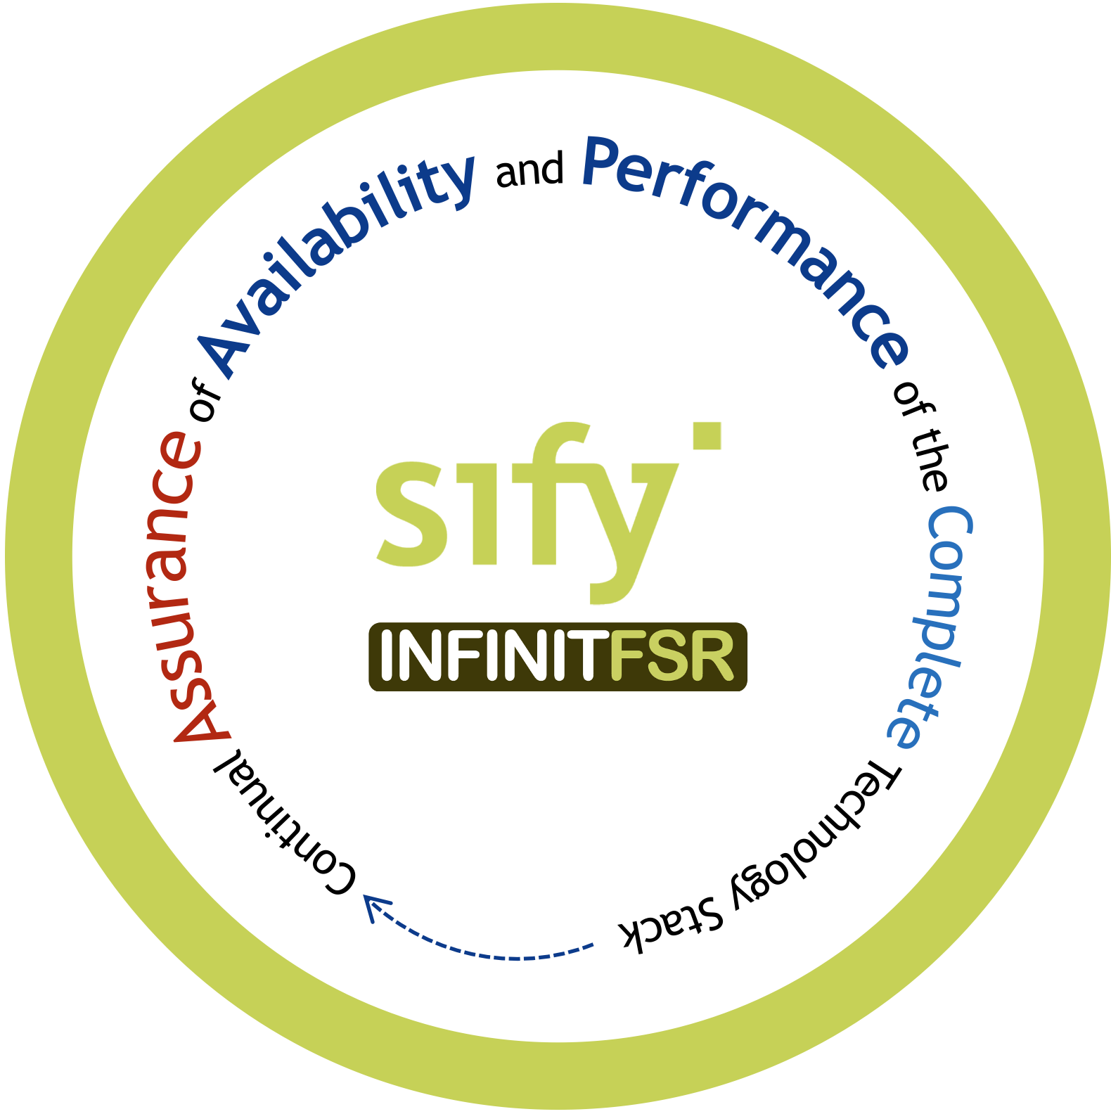
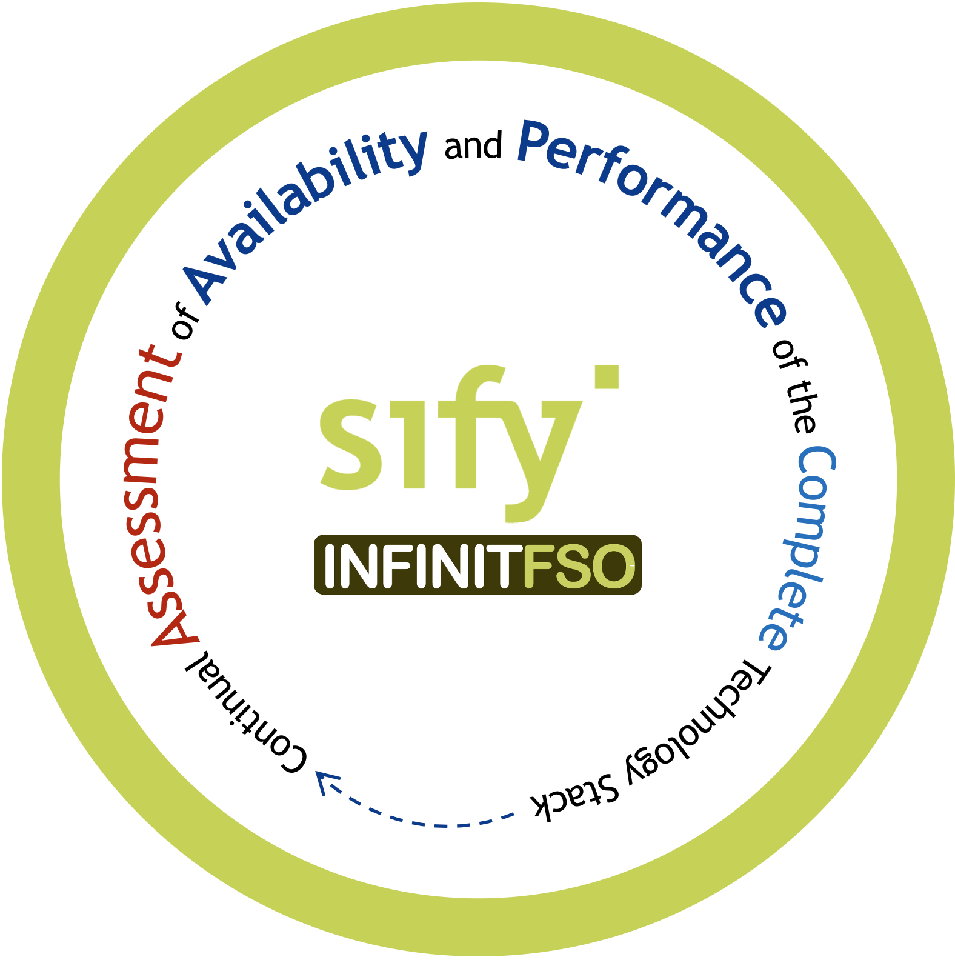
infinit FSO Full Stack Observability for operational efficiency
Service Management and Visualization Dashboard
4
Prediction, Prevention, and Remediation of Business Service Availability and Performance Issues
Network Performance
Multi Cloud FinOps
App Security Services
App Performance
App Resource Optimization
...
BATCH
Real Time Predictive Insights Multi Domain Telemetry
3
AI OPS
Asset Dependency Map Generation
X-MELT
STREAM
2
1
Telemetry - Metrics, Event Logs, Traces From All Sources
NET OPS
IT OPS
SEC OPS
APP OPS
Gain insights, ensure high performance & availability of your business-critical applications

Slide 4
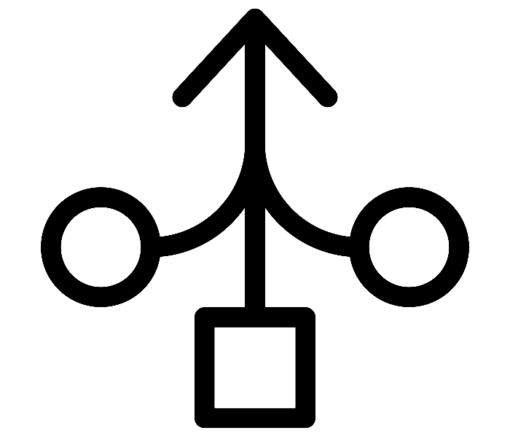

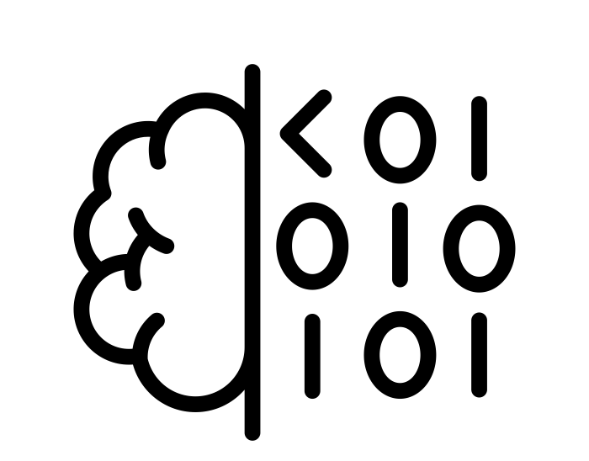
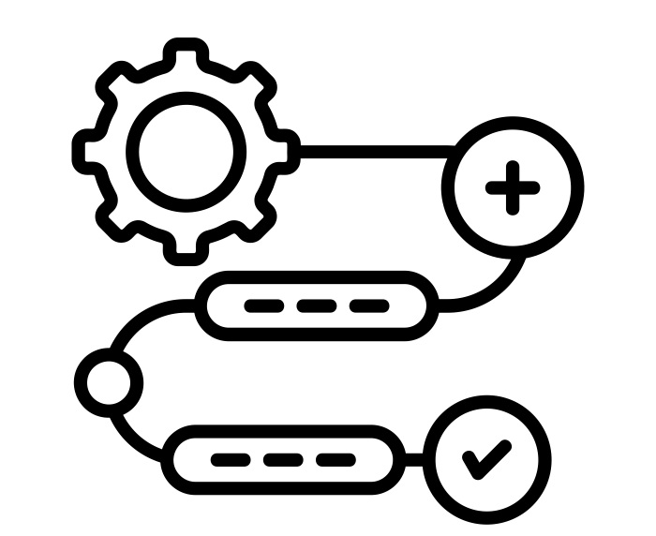
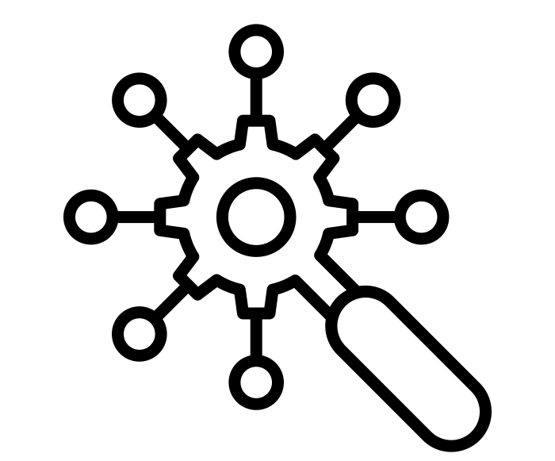

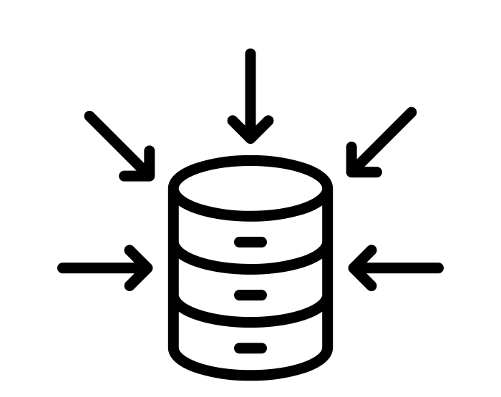




Infinit FSO with aiops for real time insights on service performance
Ability to aggregate multidomain X-MELT telemetry data
Generate Asset Maps with rich contextual information
Low code AI/ML pipelines with simple declarative SQL statements
Streamline every aspect of data preparation and feature engineering
Intelligent Event correlation for root cause sequence
Offline feature store for swift retrieval of prior learnings
Inbuilt aggregations, point in time joins and time travel for predictions
AI/ML model training with batch and streaming data
Service assurance with real-time prediction and prevention of problems
High performance and Highly available feature store for all stages of AI pipelines
Auto detect data drift and alerts to maintain model quality

Slide 5

Infinit Ai/ML PlaTFORM for informed decision making
Rapidly develop AI solutions tailored to your needs by seamlessly connecting with your existing systems
ERP
CRM
MES
Energy Optimization
Predictive Maintenance
Mix Optimization
Defect Detection
Inventory Management
Chatbot & Virtual Assistants
PLM
SCM
Sify-AIZEN Foresight
QMS
IoT
YOUR SYSTEMS
AI MODELS
OUTCOMES
Notes:
Our approach transforms your raw data into actionable features, allowing us to fine-tune prebuilt models or construct new ones from scratch. We specialize in serving predictions based on current data streams, ensuring a smooth integration into your applications for immediate impact and enhanced decision-making capabilities.

Slide 6
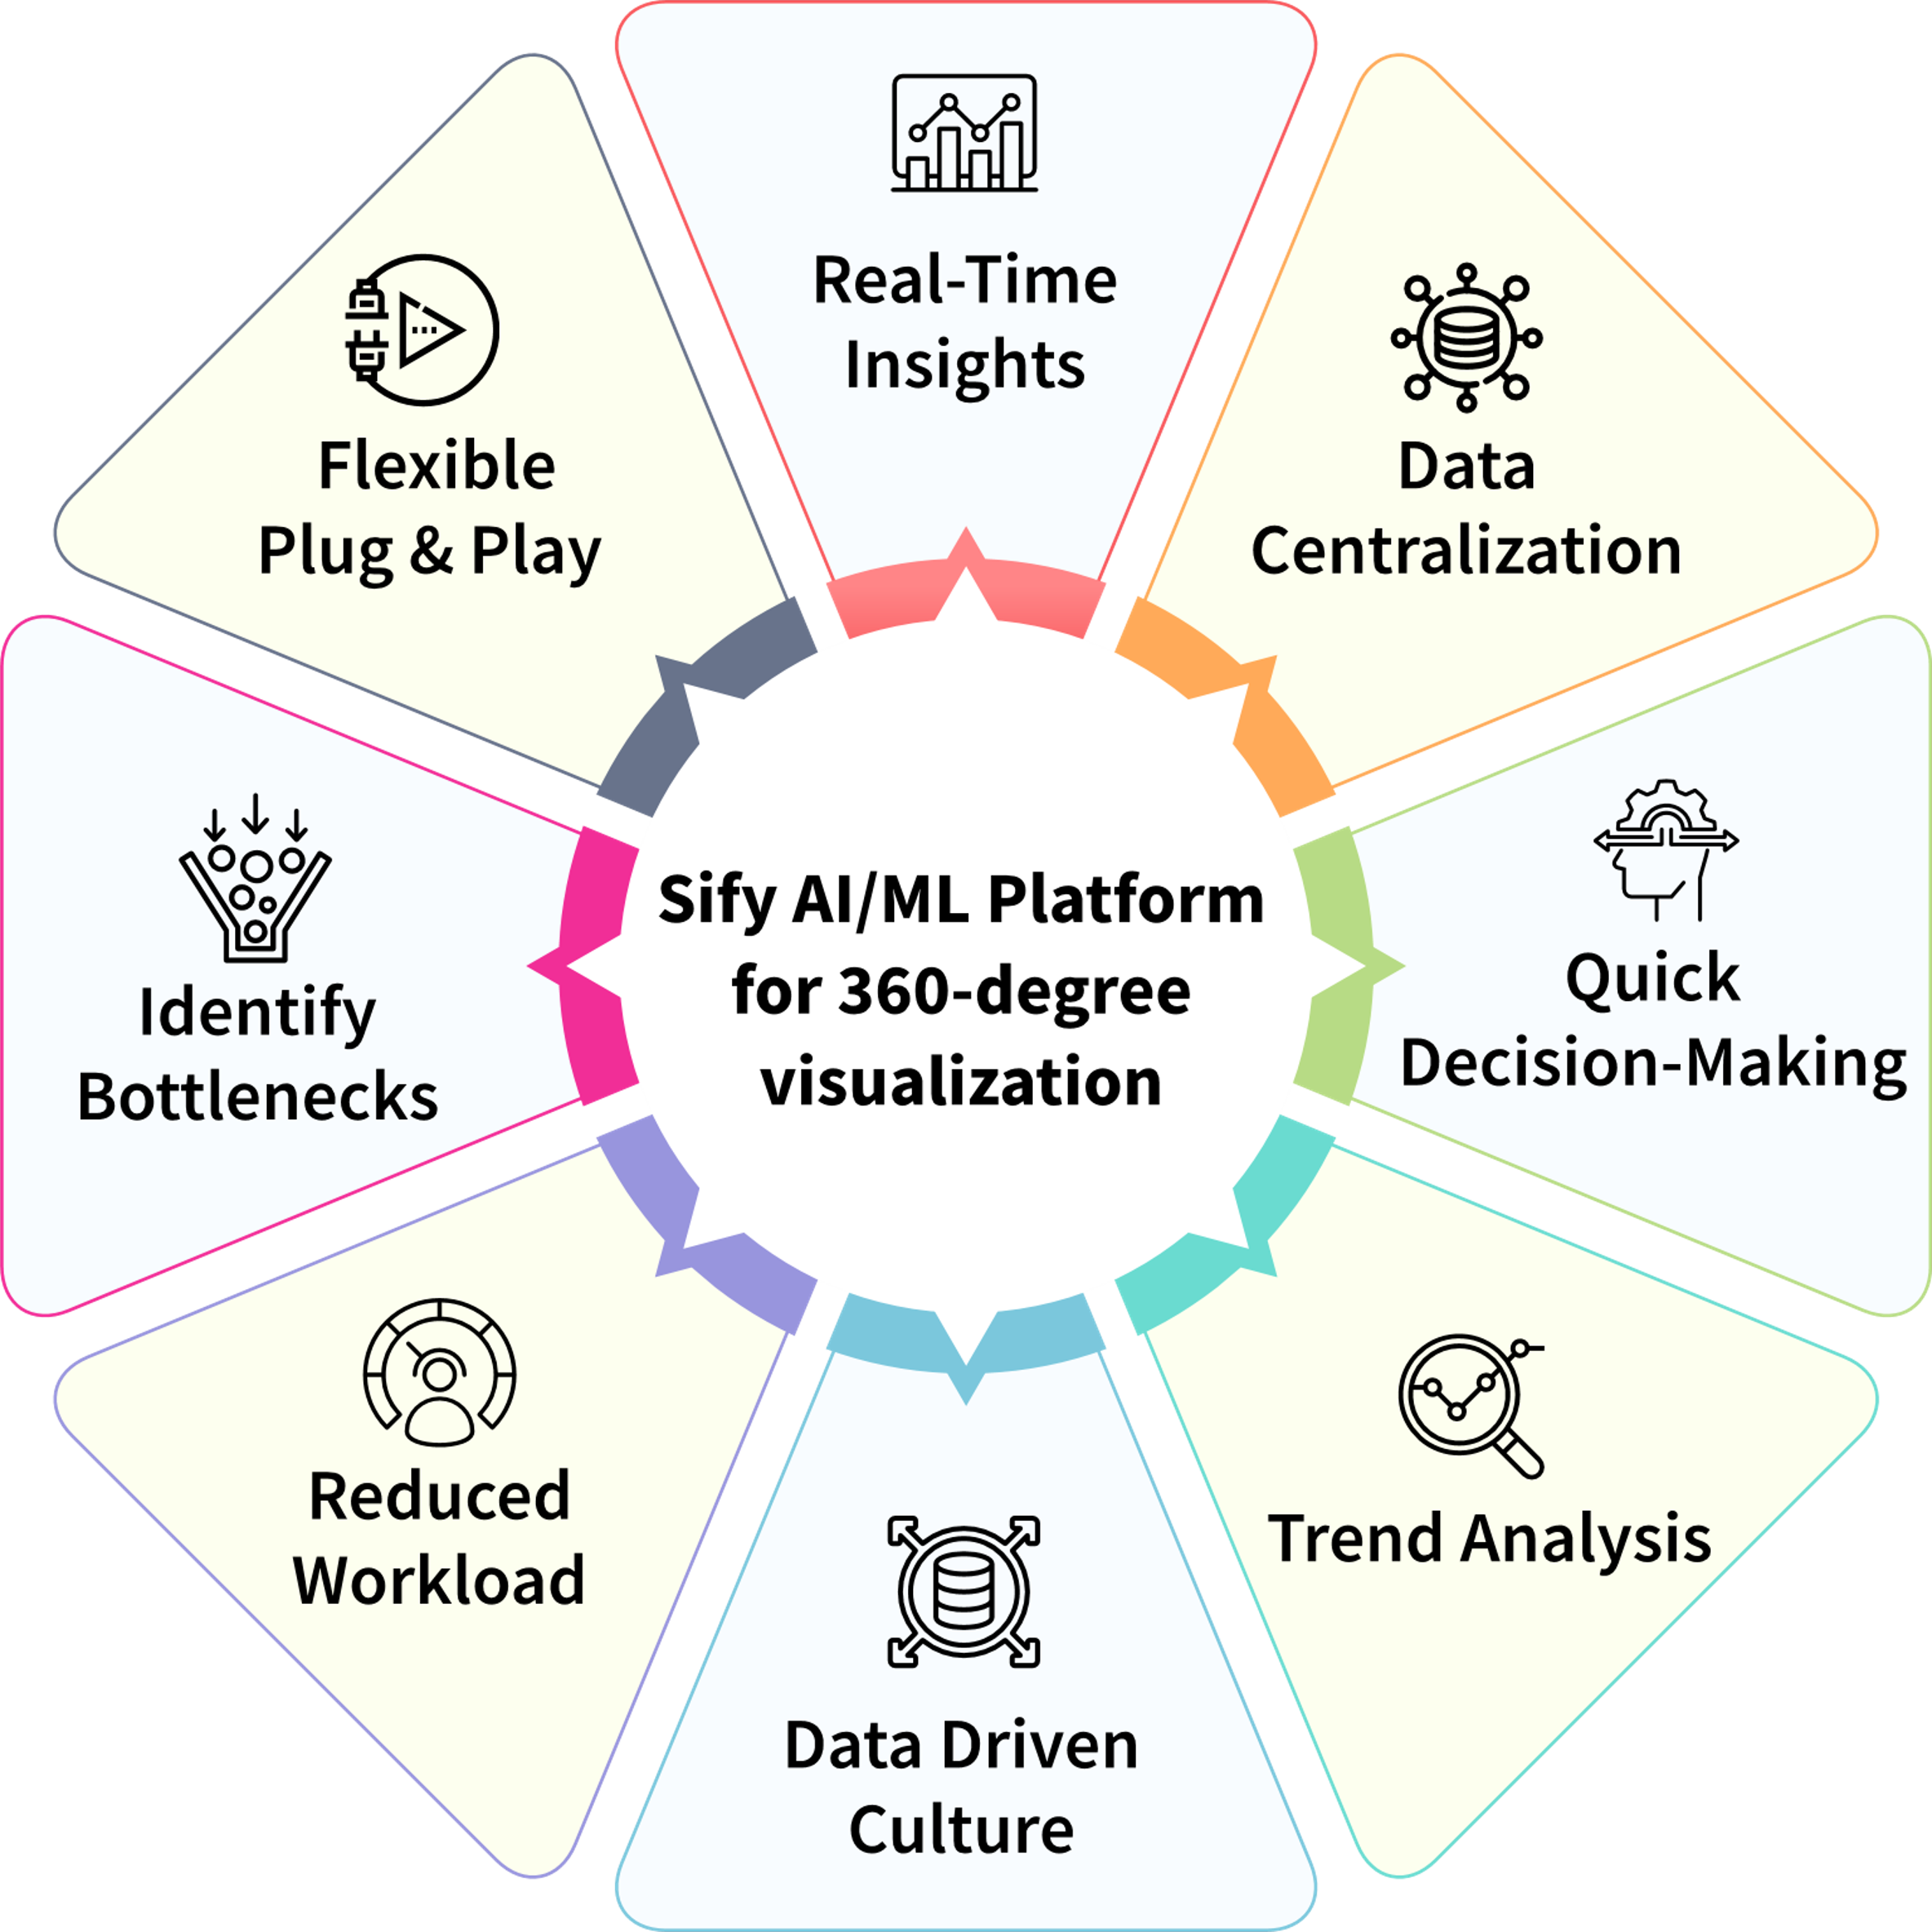
ONE STOP SHOP to Create and Consume AI
Automatically evaluate, Build and deploy ML models
Flexible data access and preparation with connectors to various data sources, cloud, and non-cloud​
Deploy latest generative AI techniques curated by NVIDIA and public domain​
Visual tooling studios to create business specific AI applications and assistants​
Rapid deployment options for batch and real time use cases ​
Prebuilt AI Solution Starters – sales forecast, anomaly detection
Design, Develop, Deploy AI models and services at scale to enhance digital business outcomes
Notes:
Sify’s comprehensive AI/ML platform, designed to streamline the creation and deployment of AI models for enhanced business outcomes. It offers automated ML model deployment, rapid integration with various data sources, and cutting-edge generative AI capabilities. With prebuilt solutions and visual tooling, the platform empowers data-driven insights, real-time decision-making, and a seamless, flexible approach to AI adoption.
Double click
Infinit GenAI Studio is a robust platform designed to enable businesses to easily build and deploy AI-driven applications. Whether you need a conversational chatbot, real-time speech-to-text functionality, or customized AI models for specific tasks, GenAI Studio provides the tools and infrastructure to bring your AI solutions to life. It allows you to leverage Large Language Models (LLMs), integrate open-source models like those from Hugging Face, or tap into pre-built models for immediate deployment.
Key Features of GenAI Studio:
Model Flexibility and Integration: GenAI Studio supports a variety of AI models, including public models from leading platforms like Hugging Face, and custom models tailored to your business needs. You can choose between using cloud-hosted models or those available on your local systems, ensuring flexibility in deployment and performance.
Conversational AI with LLMs: Build intelligent chatbots that understand and respond to user queries in real-time. Whether your use case involves customer support, lead generation, or virtual assistants, our platform integrates advanced LLMs to deliver human-like interaction with your users.
Speech-to-Text and Text-to-Speech Integration: GenAI Studio features powerful speech recognition capabilities with models like Whisper, allowing for real-time conversion of speech to text. This makes it easy to handle voice inputs from mobile or web apps, turning spoken words into actionable queries.
API Compatibility and Customization: Our platform is compatible with popular APIs such as OpenAI, making it easy to integrate foundational models into your workflow. Additionally, you can customize models with specific names and configurations to meet your unique requirements, ensuring a fully personalized AI experience.
Comprehensive Model Management: GenAI Studio provides a streamlined interface to manage all your AI models in one place. From foundational models to chatbot-specific options, you can easily switch between models, test configurations, and deploy the best solution for your project.

Slide 7






Infinit OT: Enabling INDUSTRIAL GRADE AUTOMATION
Audit and Scale
Let’s Start Today
Quality Enhanced
Go Live!
Resource Allocation
Define the Need,
Assess the Value
Quantify the return on investment
Scale existing solution across multiple sites and generate new use cases
Leverage historical data for further AI use
Maturity level of automation elevated
Sustained use of your solution for AI powered automation
Continuously tracking and measuring AI solution parameters
Solution implementation
Initial collection of images
Smooth transition of operations
On-site user trainings
Team up the human capital
Configure your tech stack and leverage existing hardware
Procure and install
Analyze the current processes
Identify the value add and value drivers of your solution
Sify Products and Services
Notes:
Increasing quality automation efficiency (for 4th column)

Slide 8







SIFY - RELIMETRICS INFINIT AI/ML DRIVEN OT APP ARCHITECTURE
Industrial grade AI for Automation with Security and Latency Prioritization
Single solution for multiple use cases
No code AI/ML solution development & maintenance enabling users to be self-sufficient
Ultimate security with on-prem AI training option
Low latency with on-prem audit module
Sify Infinit QA
Automation
Sify Infinit
Traceability
Sify Infinit
Efficiency
Deployed in the Sify CI cloud
Self-Service AI/ML Solution Development &
Maintenance via Sify RM Trainer
Sify RM Audit
Module
Cameras,
Devices,
Sensors
AI
Deployment
Data
Feed
Data Cleaning & Pre-processing & Annotation
Train AI/ML Models without any Data Science experience
Evaluate Model Accuracy
Create and Modify Complex Inspection Pipelines from Trained Models
Audit
Results
On-prem
On-prem
On-prem and/or in the Sify CI cloud
(Re)Training Data Feed for
AI/ML Solution Development & Solution Maintenance

Slide 9
Industry Applications Services: SAP, ORACLE, Microsoft
Apps Functional Support
Apps Technical Support
Middleware Support
DBA Support
Production Support
Configuration Support
Customization Support
Proactive Monitoring & Alert
SRs & Patch Testing
Interface & Integration Support
End User Education
AMS Support
L2 and L3 Support
24x7 Support
Problem Management
Service Request
Incident Resolution
Proactive Monitoring
Across Application Layer
360º Services
ITIL Process Enabled
Our multi-disciplinary managed services experts integrate efforts to optimize and manage critical business systems

Slide 10
Sify Infinit SAP Innovation Lab Business Value for S/4
Customers have the opportunity to bring their challenge into a Lab
Sify offers customers a test-drive in the Lab of a productive state as a digital twin
SAP Cloud Digital Core and AI to proof point process transformation from ECC to S/4
Iterative phase approach enables organizations to maximize the value of their SAP investment using test-run migration of certain processes from ECC to S/4 in a fully automated experience
Future software-ready
Latest
release
Clean-core code line to get started

Slide 11
a platform centric approach
Digital Twins and Virtual Environments
Better decision-making and validation for several new system integrations
Leverage embedded or bolt-on AI, depending on the context
Infinit AIML From SAP to Shop Floor
Infinit SAP Innovation Lab
Accelerate the modernization of SAP alongside migration to the cloud
AI/ML powered side-by-side solutions to extend SAP via BTP
Build intelligent ERP workflows with a single system of action with ServiceNow

Slide 12









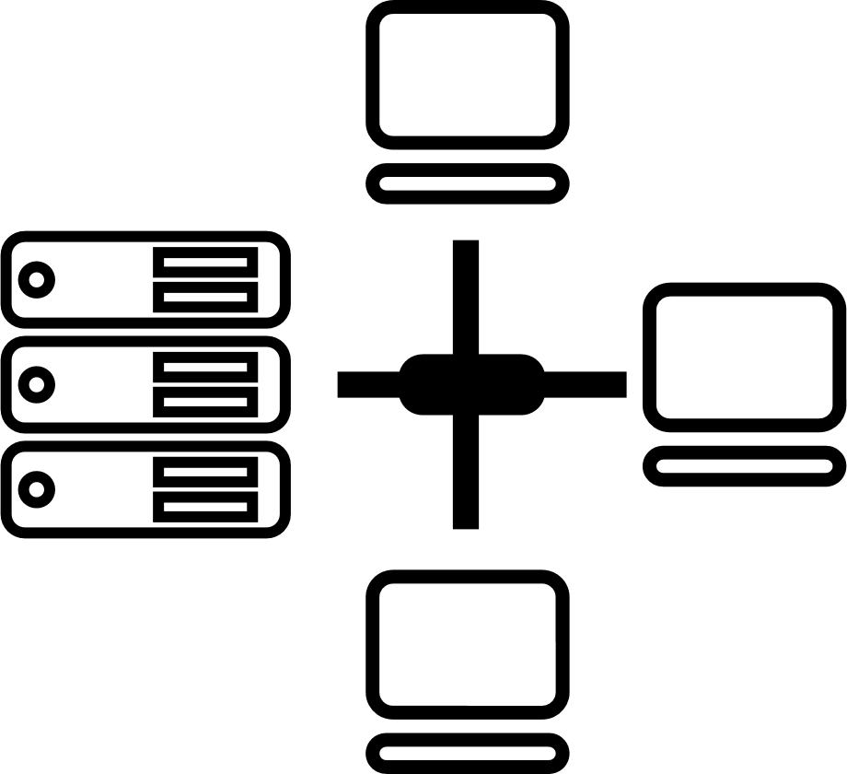






CIO Choice 2025 for
AI Ready Data Centers
Best Future-Proof Data Center Project
Award for Sustainability
Innovation in Data Center
India’s 1st Nvidia
DGX Ready Liquid &
Air Cooled DCs
Best in
Services Industry
DC Services India & ​Managed Cloud Services APAC ​
Managed Network Services - MQ
Tried Tested Trusted
Your digital infrastructure partner for over 25 years
Network
Infra Services
Network Digital
Managed Services
Data Center
Colo Services
CloudInfinit^{+AI}
GPU Cloud
Cloud & IT
Managed Services
Digital Apps
Managed Services
Industry Apps
Managed Services
Security
Managed Services
Thank You

Slide 13

Digital augmentation - ar/vr/MR services
Sify Digital Learning solutions help organizations empower their employees to acquire critical knowledge and new skill sets, extend their existing skills, and build core competencies to meet the operational requirements of the digital savvy work environment.
LMS & Custom Content
New Age Digital Solutions
Learning Platforms and Implementation Services
Interactive 3D simulations
Legacy Content Transformation
Digital Learning
Virtual Reality (VR) solutions
360
Consulting & Advisory Services
Augmented Reality (AR) Solutions
Globalization Services
MR/AR/AI
Interactive 3D Factory Scenario
Interactive 3D
Data Center Hardware Simulator
Virtual Reality
VR Turbine for Training Engineers
Virtual Reality
VR with Haptics- LAB SOPS Training
Augmented Reality
AR Based work Instructions for Training
Mixed Reality HoloLens Based Mixed Reality Soln
Sify Confidential

Slide 14
AI LEARNING Highlights
OneSify.AI is a comprehensive destination that provides the required infrastructure, technology, and services to build AI applications ground-up, and provides training on AI Mastery skills.
Interactive chatbot copilot drives the discovery process to discern project goals.
Personalized and differentiated learning paths based on your project requirements.
Hands-on projects using real-world datasets, AI tools, and frameworks to help you become AI-ready.
Real-world examples of AI applications in various industries.
Discussions on ethical implications of AI, such as bias, privacy, and transparency.
Explores best practices for AI application design, development, and deployment.
Self-paced and bite-sized learning on-the-go.
Engaging content using text and graphics, videos, animations, and infographics
Interactive content with quizzes, simulations, and case studies.
Uses principles of adult learning and neuroscience.
Ethical AI discussions to foster AI mastery

Slide 15
Digital Assessment
Sify Digital Assessment solutions modernize talent assessment and recruitment processes for organizations to conduct high volume exams in a secure and scalable environment.
Online Application Management
CBT
SAAS
Question Paper Management
Student Management
Question Paper Development Support
Question Authoring Management
iTest
Exam Delivery Management
Exam Delivery Management
AI/ML Based Auto Proctoring Tools
Exam Security Management
360
Challenge Window/Result Management
Remote Proctored Exam Delivery
Post Exam Analytics
Post Exam Analytics
Cert-In Certified Test Engine
Multiple Question Formats
Multi-lingual Display of Questions
AI/ML based Facial Recognition
Trained & Certified Manpower
Help Desk Support

Slide 16




























Forum digital- forward supply chain management
Solution overview
Marketing Team
Consumer
Purchase Management
Content Management
After Sales/ Warranty/ Service Management
Inventory Management
Rural Distributor
Influencer
Sales Management
Points & Redemption Management
Return Management
Broadcast Management
Retailer
CXOs
Digital Product Catalogue
Schemes & Claims
Help & Support
Dashboard
Salesmen
Distributor
Common Platform Offerings
Gamification
Sales Analysis
Content Analysis
Tracking
Reporting
Automation
Approvals
Intelligent Recommendations

