Slide 1
AI-READY, HYPERSCALE, HYPERCONNECTED, GREEN,
EDGE, DATA CENTER CAMPUSES
India’s Data Center Pioneer
February 2025
Gautam Bakhru | VP & LOB Head, Data Center Services

Slide 2
Agenda
INDIA DATA CENTER HUB
DATA CENTER AI READINESS
01
04
SIFY DATA CENTERS
CHENNAI 02 DATA CENTER
02
03

Slide 3
India: A Data Center Hub
India’s Colo Data Center capacity stood at 977 MW IT Load as of H2 2023
India will be adding 464 MW of new Colo capacity each year until 2028
KEY DRIVERS
Digital Economy Expansion
Increased Data Consumption
Cloud & Emerging Tech: AI, 5G, Edge Solutions
Growth Segments: GDC/GCCs
30+ Cities- Tier 2 and 3
Government policy & Regulatory Frameworks
Source: Research Firms

Slide 4




Key Challenges shaping data center strategies
AVAILABILITY OF POWER
MODERN COOLING TECHNOLOGIES
“By 2028, more than 70% of enterprises will alter their data center strategies, due to limited energy supplies, a major increase from less than 5% in 2023”
“By 2027, AI workloads will consume nearly 50% of data center compute power, making liquid cooling essential to support the increasing demands of AI-driven infrastructure”
SUSTAINABILITY
SCALABILITY
“By 2027, 75% of organizations will have a data center sustainability program, up from less than 5% in 2022, driven by cost optimization and stakeholder pressures”
“By 2026, 75% of organizations will prioritize scalable IT strategies to support growth initiatives like entering new markets and launching products”
Source: Gartner forecasts

Slide 5
our focus areas
AI-Ready Infrastructure
Power, Cooling, Network, Server Hall
Specialized Hardware-GPUs, TPUs for HPC
Advanced Liquid Cooling
Scalability and Modular Designs
Edge Computing and Decentralization
Modular Data Centers with BTS capabilities
Horizontal and Vertical expansion
Proximity to End-Users
Hybrid Cloud Integration
Sustainability and Operational excellence
Enhanced Security and Compliance
Green Initiatives
Energy Optimization
Blending Automation
Zero-Trust Architecture
Global Regulations and Compliance

Slide 6
Future-READY data center architecture
CUSTOMIZABLE & MODULAR INFRA
ENGINEERED FOR AI WORKLOADS
MULTI-LAYERED NETWORKS
Multi tower campuses with Vertical and Horizontal expansion to support future business growth
Designed for 200 kW/rack high density racks. 6.3m floor to floor height, 2100 kg/m² load bearing capacity
Multi-tier fiber and copper for low-latency deployments, supporting high-capacity network bandwidth up to 600 Gbps
RELIABLE
POWER SUPPLY
SUSTAINABLE
OPERATIONS
On-premises 110, 220, and 230 kV substation with 48 hours of fuel storage with redundant supply contracts
Liquid & Air-cooling solutions, 60% renewable energy, ESG best practices and automation led continuous monitoring
Ensure business continuity, maximize uptime, resilient connectivity and sustainability
with RAS designed scalable digital infrastructure

Slide 7






Operational Philosophy
Zero
Availability Incidents
Zero
Redundancy Incidents
Zero
Security Incidents
Enhance infrastructure with automated failover systems to ensure uninterrupted operations.
Penalty-proof SLAs by proactively testing and documenting redundancy systems.
AI-driven anomaly detection to monitor cyber and physical security in real-time.
Zero
Safety Incidents
Zero
Defects
Zero
Carbon Footprint
Transparent safety dashboard to track incident-free days and improvements.
Real time visibility & measurability across operations, predictive maintenance, cross-functional quality audit team.
RE 100 (carbon neutral by 2030), Contracted 231 MW green power, ASHRAE, IGBC, carbon abetment policy, low PUE/WUE.

Slide 8

Our DATA CENTER FOOTPRINT- 6 Major metros
CHANDIGARH 01
EDGE | 14 MW
NOIDA 01
Noida
10.8MW
NOIDA 02 CAMPUS
Tower B
43+ MW
Tower 1
11.5 MW
Tower 2
9.6 MW
Tower 3
BTS
LUCKNOW 01
EDGE |14 MW
Tower A
43+ MW
Tower C
43+ MW
1st Tier 3
in 2000
Tower 4
8.1 MW
Tower 5
43+ MW
Tower 6
40+ MW
Q2 2025
MUMBAI 01
Vashi
0.9 MW
Tower 7
40+ MW
Q3 2025
Tower 8
40+ MW
Tower 9
40+ MW
Tower 10
40+ MW
KOLKATA 01
2.2 MW
Tower 11
40+ MW
Q3 2025
Tower 12
40+ MW
Q4 2025
MUMBAI 02
Airoli
5.4 MW
HYDERABAD 02 CAMPUS
(FAB CITY)
MUMBAI 03 CAMPUS (RABALE)
HYDERABAD 01
Financial Dist.
14.4 MW
5 Blocks
Current Plan: 26-52 MW each
AI Optimized Plan
Up to ~500MW
BANGALORE 02 CAMPUS (AEROSPACE PARK)
BANGALORE 01
Electronic City
7.6 MW
Tower 1
20+ MW
Q2 2025
Tower 2
20+ MW
CHENNAI 02 CAMPUS (SIRUSERI)
CHENNAI 01
Tidel Park
3.6 MW
Tower A
43+ MW
Tower B
43+ MW
Tower C
43+ MW
Operational
In Development
Planning
All Power references are Design IT Power at Full Capacity
All Power references are Design IT Power at maximum Capacity

Slide 9
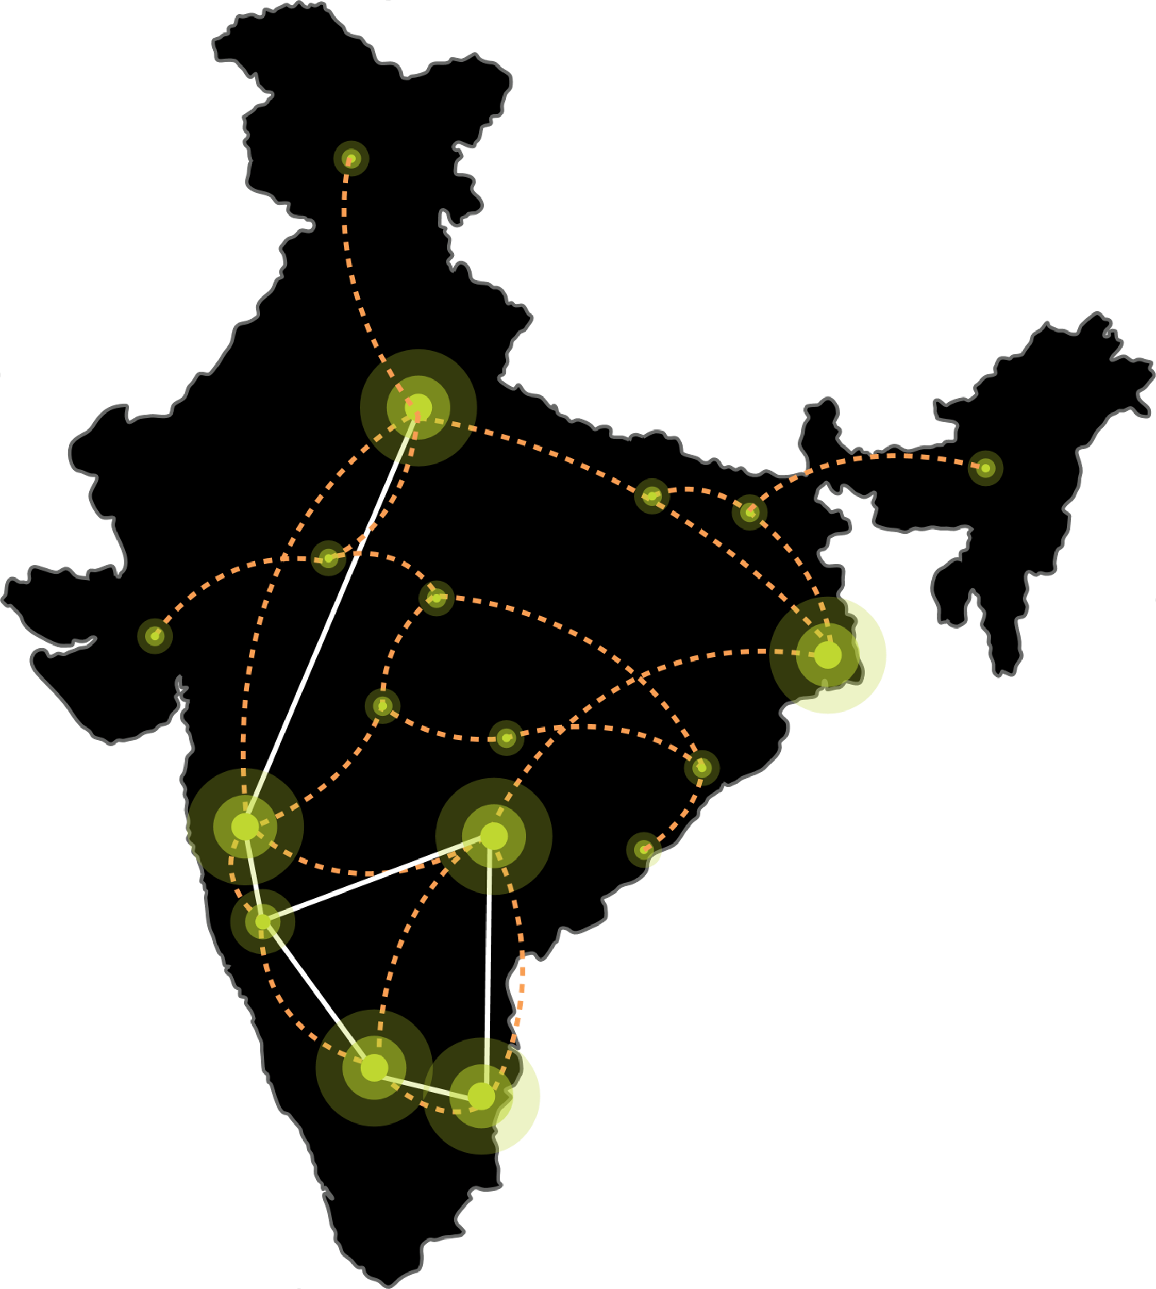
Edge data center footprint. Rollout planned over 2-3 years
Low latency, easy access and faster content delivery in non-metro locations, ensuring seamless data processing and superior customer experience.
CHANDIGARH 01
Oct 2025
NOIDA 02
NOIDA 01
LUCKNOW 01
June 2025
JAIPUR 01
PATNA 01
NAGPUR 01
GUWAHATI 01
AHMEDABAD 01
3.6-14.4 MW Tier 3 data centers with diverse carriers, ISPs, Transit nodes, IXs and CDN.
Leverage Sify’s extensive Network presence; connect with Sify NLD fabric.
The data center consumption and interconnections driven by the pull of anchor tenant.
INDORE 01
RANCHI 01
SAARC Gateway, Kolkata
BHOPAL 01
KOLKATA 01
MUMBAI 03 RABALE
VISAKHAPATNAM 01
MUMBAI 02 AIROLI
BHUBANESWAR 01
MUMBAI 01 VASHI
VIJAYAWADA 01
RAIPUR 01
CLS, Versova, Mumbai
HYDERABAD 02
HYDERABAD 01
COCHIN 01
CHENNAI 02
BENGALURU 02
CHENNAI 01
BENGALURU 01
CLS, Siruseri, Chennai
Construction
Design
Planning
Notes:
Special Economic Zones, IT resources, IT outsourcing companies are going into tier 2 cities. We need to build digital infrastructure for AI in these locations. AI training needs more investments, that can happen in the large metros, AI inferencing is cost effective which you can build in tier 2 cities. We have a plan to begin with 10-20 locations in Tier 2 and 3 cities leveraging our Pan India Network and DC footprint.

Slide 10


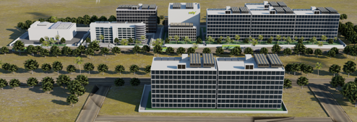
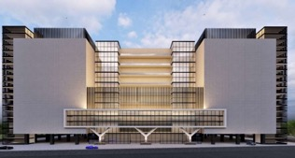
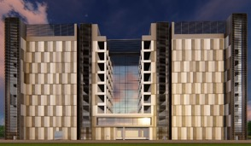
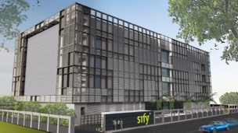
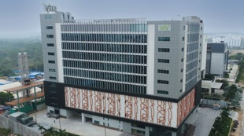
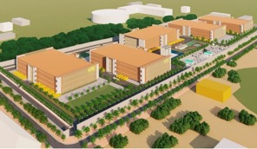
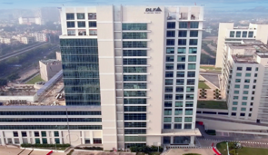
AI-READY, hyperscale, Hyperconnected, Green, Data Center campuses
India’s 1st Nvidia DGX Ready Air-Cooled DCs
March 2022
India’s 1st Nvidia DGX Ready Liquid Cooled DCs
August 2024
Mumbai 03, Rabale
IT Power: 377+ MW
Noida 02
IT Power: 130+ MW
Chennai 02, Siruseri
IT Power: 130+ MW
5 Towers Operational
4 Towers In Development
3 Towers in Planning
1 Tower Operational
2 Towers in Planning
1 Tower Operational
2 Towers in Planning
Bengaluru 02
IT Power: 40+ MW
Hyderabad 01, Financial Dist.
IT Power: 14.4+ MW
Hyderabad 02, Fab City
IT Power: 250+ MW
Kolkata 01, DLF IT Park New Town
IT Power: 2.2+ MW
In Development
Operational
Planning
Operational
14 DCs - 227+ MW IT power | 407+ MW by 2025 | Campuses scalable to 970+ MW with BTS | 231 MW Green Power

Slide 11
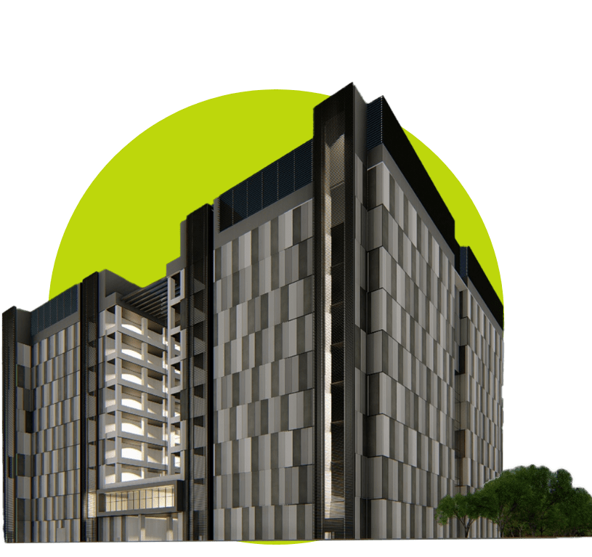
LARGEST AI-READY, IGBC PLATINUM RATED GREEN DATA CENTER CAMPUS IN SOUTH INDIA CHENNAI 02
Notes:
We are the largest to check

Slide 12
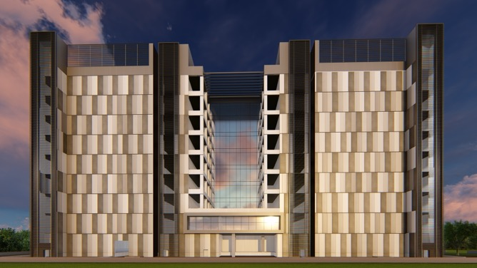
Overview: Chennai 02 Data Center Campus, SIRUSERI
LARGEST AI-READY, IGBC PLATINUM RATED GREEN DATA CENTER CAMPUS IN SOUTH INDIA
A
B
C
Hyperscale &
AI-Ready Infrastructure
IGBC Platinum Certified. ESG best practices, 70% RE eventually
Vertical & Horizontal expansion
Dedicated
on-site 230 kV GIS substation (N+1)
130+ MW IT capacity in 3 Data Center Towers
Scalable, resilient, hyperconnected, secure and green
K8-rated
perimeter wall with 10 level secure access control
Option of 2
Built To Suit Towers for 86+ MW
Integrated Transpacific CLS designed for 4 cables with over 2 Petabyte capacity
4 dedicated fiber entry paths with multiple telcos

Slide 13
FLEXIBLE AND scalable DESIGN
Vertical & Horizontal expansion
A
B
C
Expandable substation
Dual CHW system for air & liquid cooling
Hot aisle or cold aisle options by floor
Convertible floors for high-density expansion
Independent office tower accessible from all towers
Potential for both BTS and Colo in shared campus
Designed to support high-density workloads, ensuring scalability for future growth and enhanced operational efficiency

Slide 14
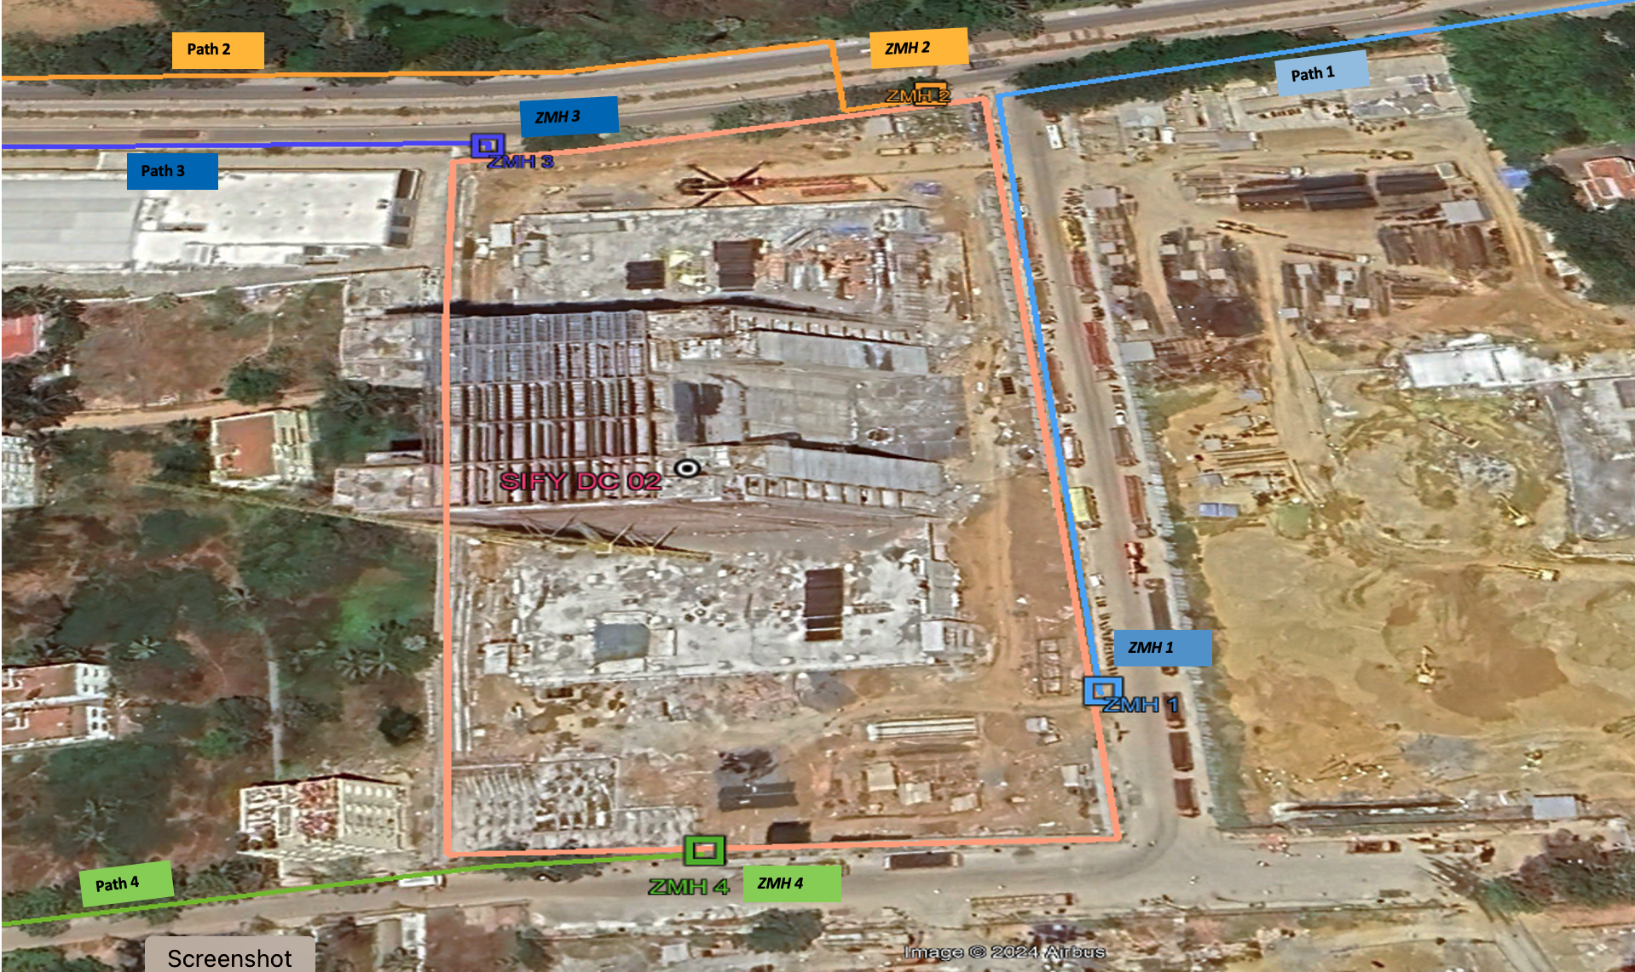
strategic location
Strategically located near business parks and IT hubs with excellent air, rail, and road connectivity.
Supports mission-critical customers across Hyperscalers, OTT, IT/ITeS, Manufacturing, BFSI, Healthcare/Pharma sectors.
Robust network ecosystem, connecting to major city nodes and cable landing stations via geo-diverse routes.
Four access paths from the main road ensure smooth logistics, IT asset transfer, personnel movement, and fuel replenishment.
Four fiber entry paths to the campus for stable network.
Strategically located, offering robust connectivity and ideal to support mission-critical operations

Slide 15

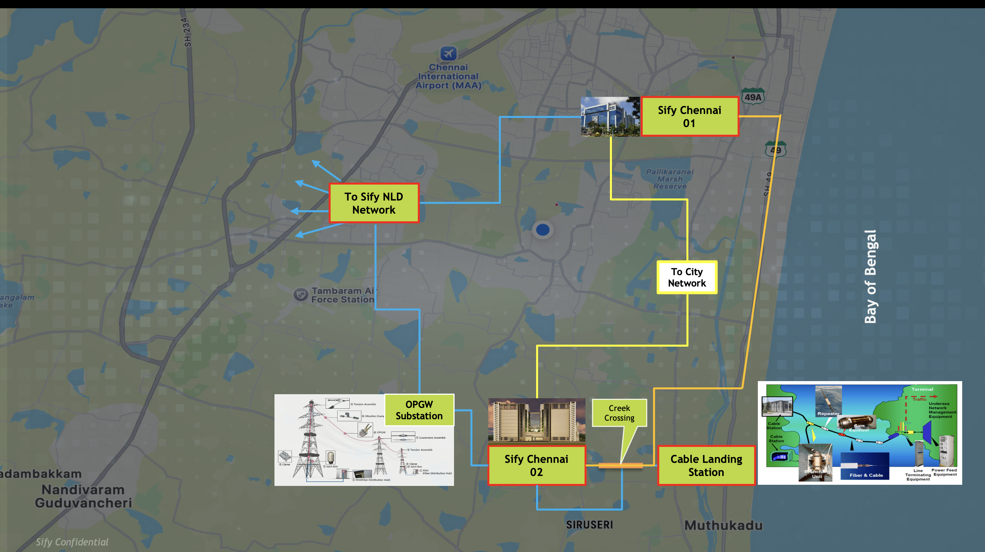
our pan India Data Center & Network Architecture with Chennai 02 as hub
NOIDA 01 DC
NOIDA 02 DC
NOIDA
Express Long-Haul Backbone, High Bandwidth
Low Latency across Key Locations
MUMBAI01 DC | MUMBAI02 DC | MUMBAI03 DC
MUMBAI
SAARC GATEWAY, KOLKATA
KOLKATA
KOLKATA01 DC
CLS, MUMBAI
HYD01 DC HYD02 DC
HYDERABAD
Arabian Sea
Bay of Bengal
CLS, CHENNAI
CHENNAI01 DC
CHENNAI02 DC
CHENNAI
BLR01 DC
BLR02 DC
BENGALURU

Slide 16
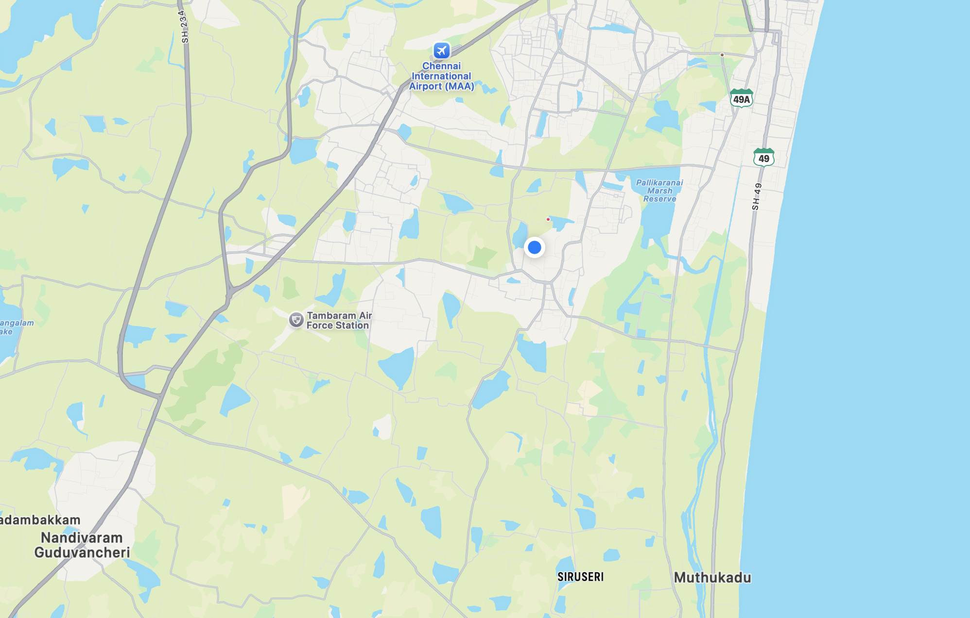
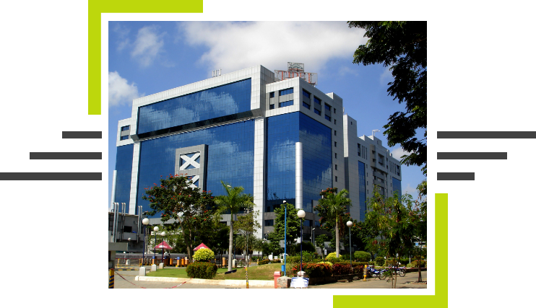
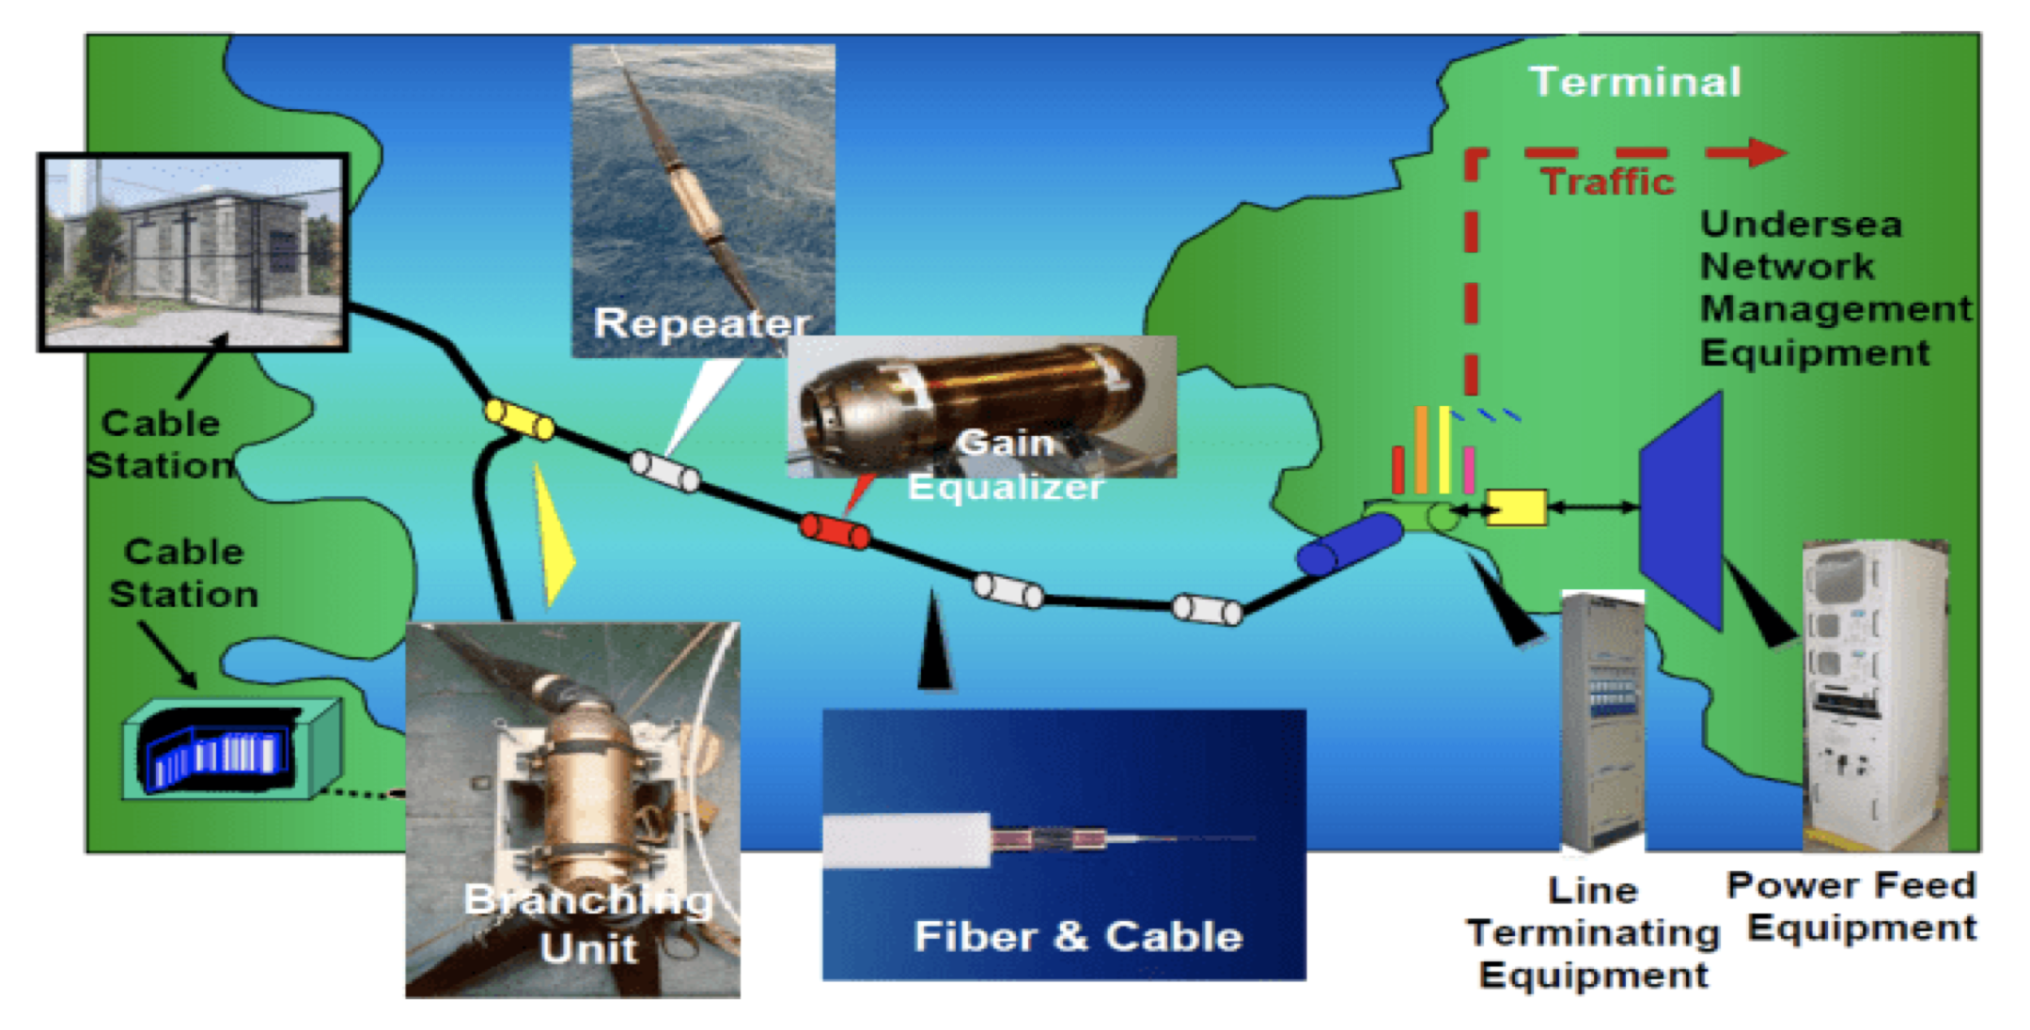
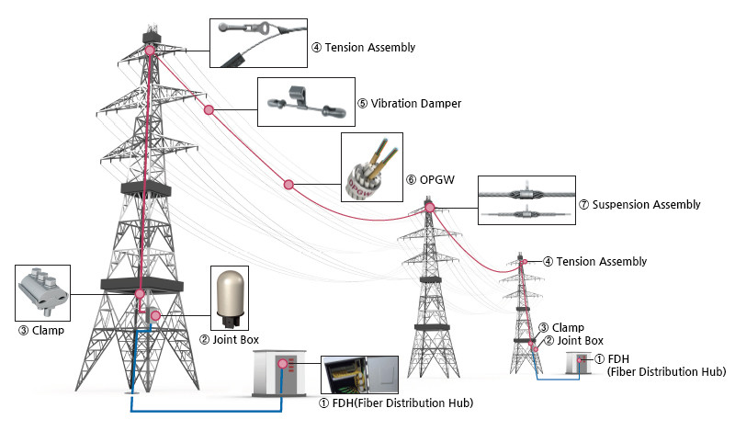
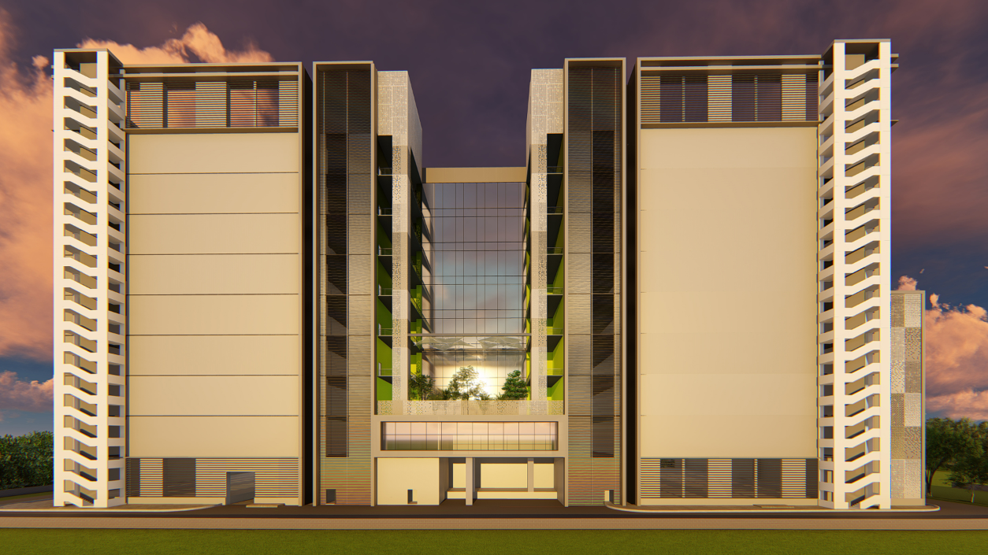
Chennai 02 data center network ecosystem
Sify Chennai 01
To Sify NLD Network
To City Network
Bay of Bengal
Your seamless gateway to the global communication network with high-speed connectivity.
OPGW Substation
Creek Crossing
Sify Chennai 02
Cable Landing Station
Notes:
Weel architected Network & Data Center – our pan India DC & Network Architecture
Most converged
Reliable connectivity to all key business hubs in Chennai, India and Globally
Seamlessly connecting- Chennai to India to Global

Slide 17
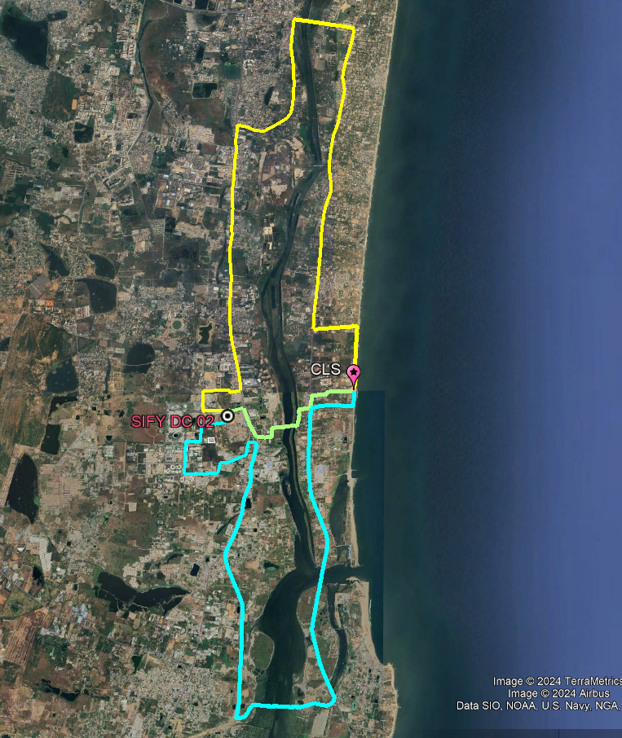
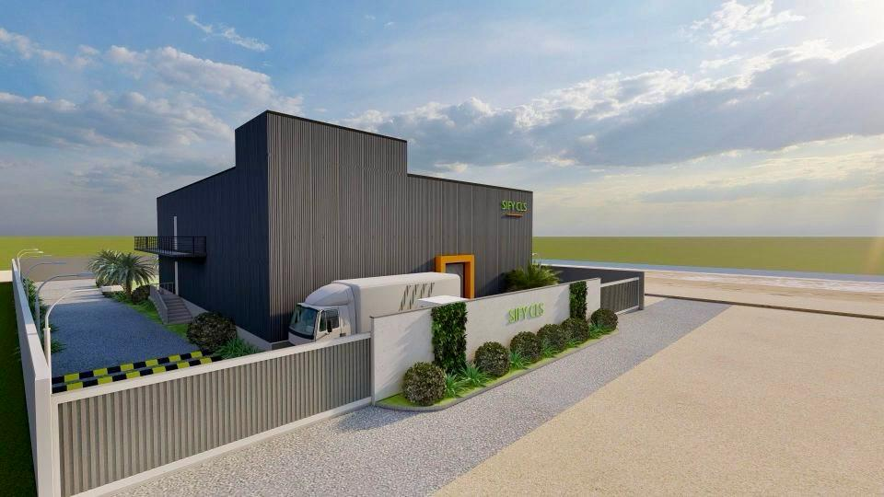
Cable landing station
Your seamless gateway to the global communication network for high-speed connectivity.
Integrated Cable Landing Station for Transpacific fiber access
Built on Tsunami resistant stilt structure, all equipment to be on Level 2 and 3
Initial power is 700 KW; to be ramped per requirement
Designed for 4 cables with over 2 Peta Byte capacity
4 networks paths from CLS to Chennai 02 data Center
CLS is away from port, fishing zones, oil blocks
Notes:
Integrated Cable Landing Station for Transpacific fiber access
Remove the pic to the right Where all the congestion is coming today, away from rest of the cables if we can show that we are away from it. Chck with harsha

Slide 18
FLOOD-RESILIENT DATA CENTERS: ENSURING UNINTERRUPTED SERVICE
Strategically Located in a risk-free zone
100-year flood risk study, declares the location as no probability of flood
Additional design features, floor level at 1.8 meter from road level
Storm water drainage along the perimeters and connection to the municipal drain network. Automatic dewatering pumps
Zero risk
from Tsunami
Building designed for seismic compliances, wind conditions as per the latest building codes
Built for maximum flood protection with elevated campus and advanced drainage systems

Slide 19
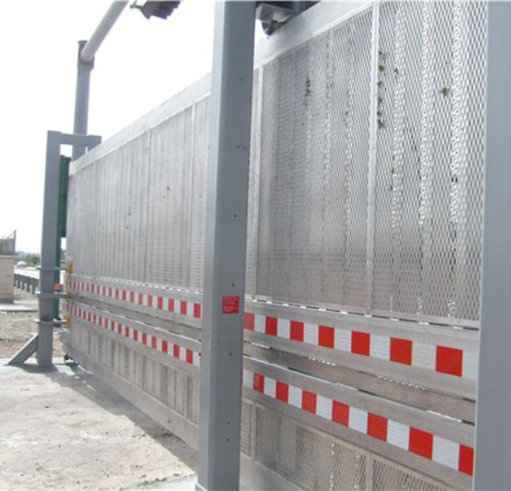
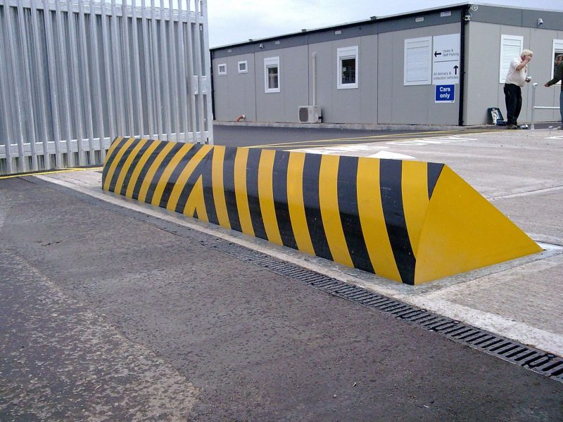
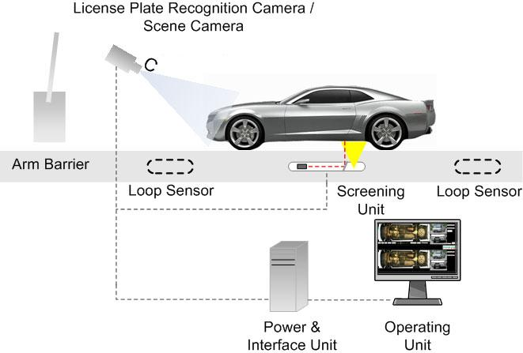
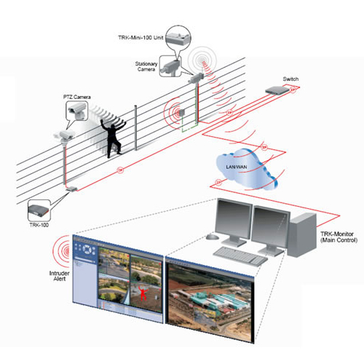
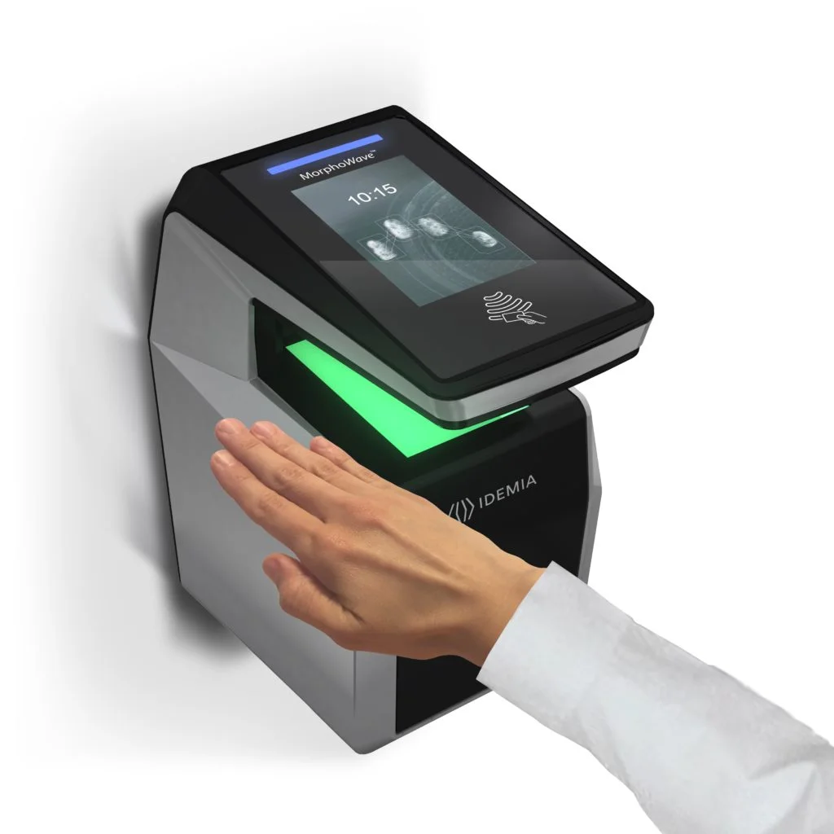

ENHANCED SECURITY
K8 Rated
Boundary Wall
Truck
Rejection
Automatic
Road Blocker
Under Vehicle Surveillance System (UVSS)
Perimeter intrusion detection system (PIDS)
Advanced Security Software
Anti-Terrorism/Force Protection (ATFP) US DOS standard; designed to stop a 15000-pound vehicle at 40MPH
The truck entry path is designed in a way unauthorised trucks are rejected and exited without entering the compound
K8 rated road blocker - manually operated once the UVSS clears the vehicle. Can also be automated once the UVSS system completes the vehicle scan and found normal
Provides automatic vehicle inspection, real-time monitoring, threat detection, image archiving, and integration with other security systems to enhance security protocols by thoroughly inspecting and capturing high-resolution images
Video Analytics
Facial Recognition
Integrated access and visitor management
Realtime access control dashboard
Contactless Palm Reader
Electric pulse, gives a non-hazardous shock to people trying to climb to disable them and give alarm with the incident location.
Integrated with CCTV system – fixed zoom camera immediately takes images, PTZ will turn towards the incident area, with popup alert, audible alarm, email alert, and SMS to security officers
10-tiered physical and electronic security powered by automation and 24x7 surveillance

Slide 20


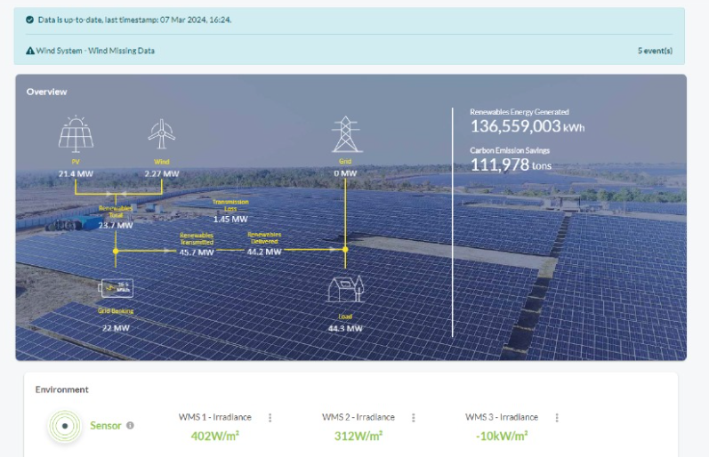


ESG FOcus
Data Center MEP
Sustainable Processes
High efficiency for Equipment even at low utilization levels
Selection of equipment with high energy saving parameters
Right redundancy levels
ASHRAE Guidelines, IGBC
ISO 14001 Environmental Certification
Carbon abetment policy
Low PUE, WUE
Green Power Contracts
Future Roadmap
Contracted 231 MW Green power via Power Purchase Agreements
Additional nation-wide Green power for future projects ~500MW planned to meet long-term sustainability goals
Up to 70% Green Power in Chennai
To become RE100 (Carbon Neutral) by 2030. 29% GHG emission reduction by FY2025
Secure up to highest RE penetration for Sify DCs, as permitted by regulation
Targeting high level of Renewable Energy penetration by year 2025
Driving sustainability from BASE BUILD - POD - PROCESS

Slide 21
Global Command and Control Center (GC3)
GC3 @ NOIDA 02
DCs and EDGE DCs in North and Northeast
Backbone of our Data Center Operations​
Real-time anomaly detection and root cause analysis​
Automated alerts and intelligent escalation mechanisms​
Proactive risk mitigation to prevent downtime​
Efficient energy and infrastructure optimization​
Seamless remote management of edge and core data centers
GC3 @ MUMBAI 03
DCs and EDGE DCs in West and Central India
GC3 @ CHENNAI 02
DCs and EDGE DCs in South
A Unified Digital Nerve System
Together, our three GC3s form a highly resilient, AI-driven, and incident-ready digital nerve system, reinforcing our commitment to delivering high-performance, secure, and scalable data center services across India.

Slide 22


CHENNAI 02 campus: Technical specifications
DATA CENTER SHELL
ELECTRICAL
Building: RCC shell and core for Ground floor, Service floor and seven server hall floors
Room Height: 6300 mm slab to slab. 5100mm clearance from floor to 1st obstruction, 900 mm raised floor
Structural Design: IS 456:2000, Importance Factor 1.5
Structural Floor Loading: 2100 Kg/sqm
Freight Elevators: 4 freight elevators with 4-ton capacity
Fire Rating of Walls & Doors: 2 hours
Power Feeder: Onsite 230 KV GIS substation
Power Capacity: Designed for 130+ MW IT capacity
Power Density: Power density of 8 -25 KW for air cooled racks and up to 200 KW for Liquid cooled workloads
Transformer/Generator Configuration: N+2, N+2C
Downstream Power Configuration: N+N power distribution with overhead bus bars
Onsite Fuel Storage: 48 hours, agreement with 2 fuel supply companies and another fuel supply agency for supply of fuel within 4 hours
Specifications will vary as per customer demands

Slide 23



CHENNAI 02 campus: Technical specifications
BUILDING MANAGEMENT
COOLING
Building Management: Integrated building automation system with PLC SCADA
Physical Security: 10 Level access control. Perimeter protection with licensed electric fence and Intrusion detection, K8 rated wall. Access controlled Gates and hydraulic crash guards, Security control room, X-ray Baggage scanner, 24x7 security guard service
Access Control: Smart card and biometric
Video Surveillance: 24x7 for all critical areas, retention for 90 days
Fire Detection: Addressable smoke detectors and aspirating smoke detectors for early warning
Fire Suppression: Novec© 1230 fire suppression system for Data Centre and electrical rooms. Option for pre-action water sprinklers available.
Chiller: Air cooled chillers and Dry coolers for Liquid cooling with adiabatic accessories with N+2 redundancy
Environment: Temperature and Humidity as per ASHRAE standards
Containment: Cold Aisle/ Hot isle Containment
NETWORK
Integrated Cable landing Station
MMR: Dual meet me room for telecom fiber links; N+N power with UPS and 5 minutes battery backup
Carrier Neutral: Multiple IXs, IP Transit POPs, Multiple Telecom MUXs
Four telecom entry paths to the MMR. MDF (Network Closet) in every floor, connected to MMR via 4 network risers.

Slide 24
Data Center AI-Readiness
Roopesh Kumar | SVP & Head – Data Center Projects

Slide 25




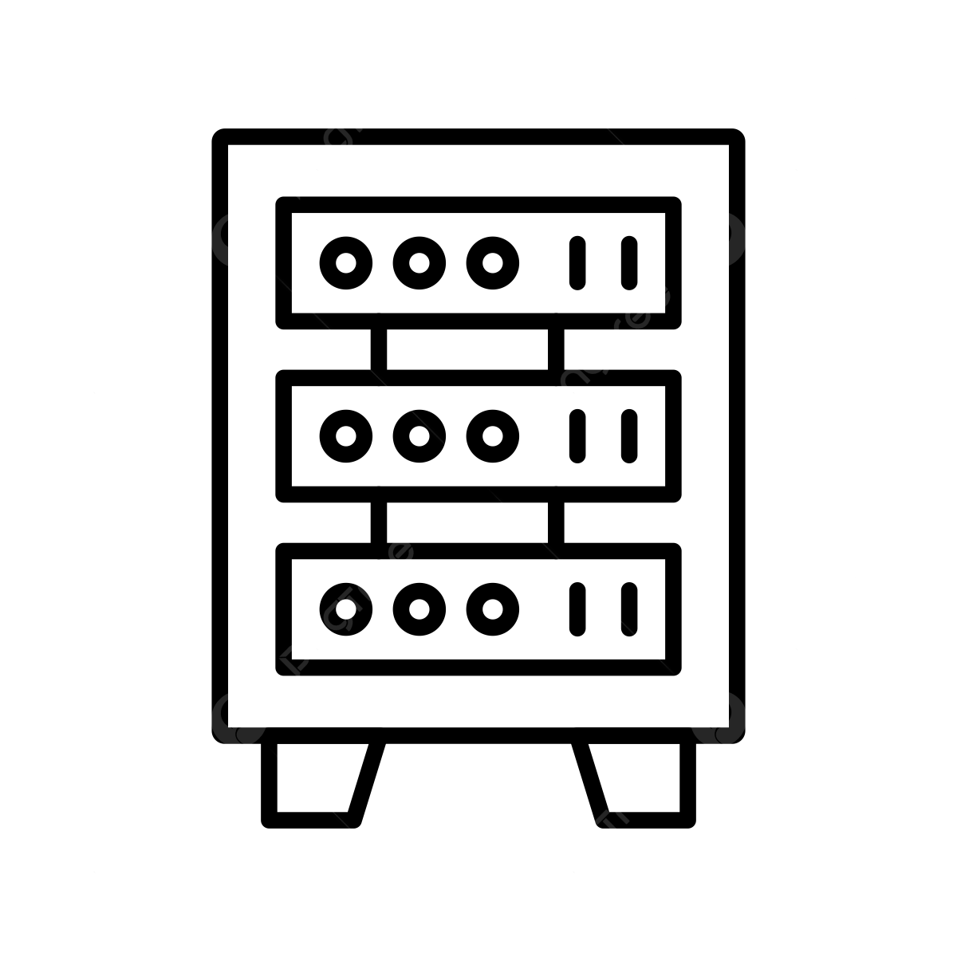
Data Center AI-Readiness
POWER
Scalable and robust power infrastructure
Tolerant to dynamic load variations
Redundant distribution systems
Support multiple water temperature scenarios
Support different cooling methodologies
COOLING
High-capacity fiber and copper network
Multiple paths, dual meet-me-rooms, and distribution
NETWORK
Purpose-built data center buildings
Structural design to meet local codes and seismic rating
SERVER HALL
Designed and built to accelerate your AI Adoption

Slide 26
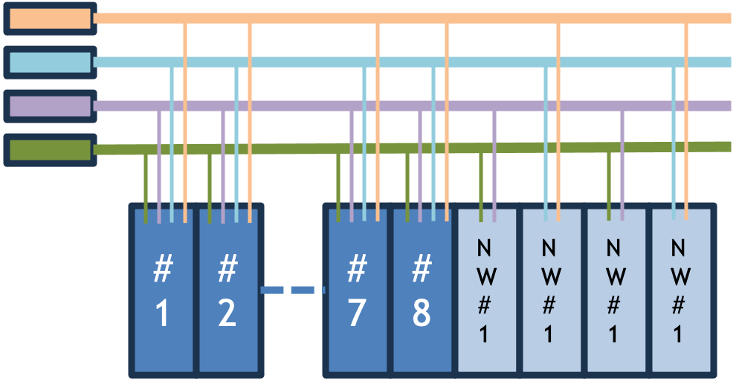
AI-ready Data Centers: Power
Sub Station
Transformer
Switch Gears
UPS
Power Distribution
Busway/ PDU
Rack PDU
Diesel Generator
Battery
Typical Power Distribution for AI Data Centers
On site 220 KV substation connected to national grid for highly reliable power supply
Facility power scalability up to 300 MW
Redundant Power Transformer and Switchgears for the MV (medium voltage) distribution
Redundant Distribution and Switchgears for the low voltage (LV) distribution
N+N or 4N3 (for three bus requirement by certain AI racks) rack power distribution
32 A to 63A 3 ph power with Up to 8 cables / Busways per rack
AI workload racks Power Distribution
Scalable power infrastructure with high redundancy for maximum reliability

Slide 27
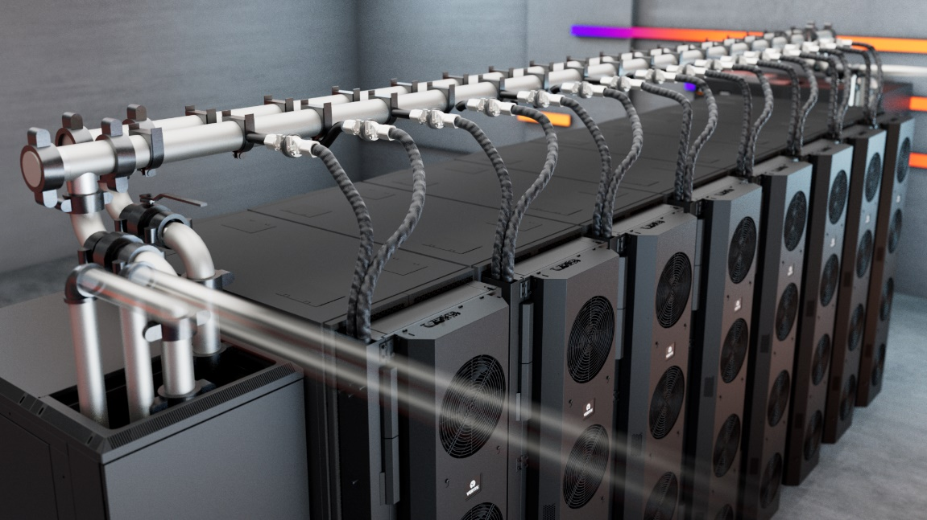
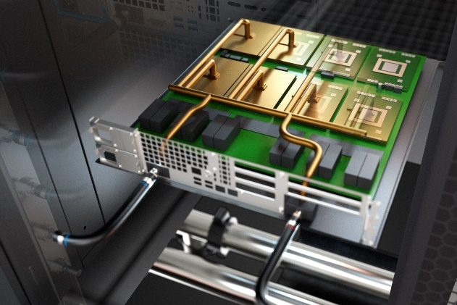
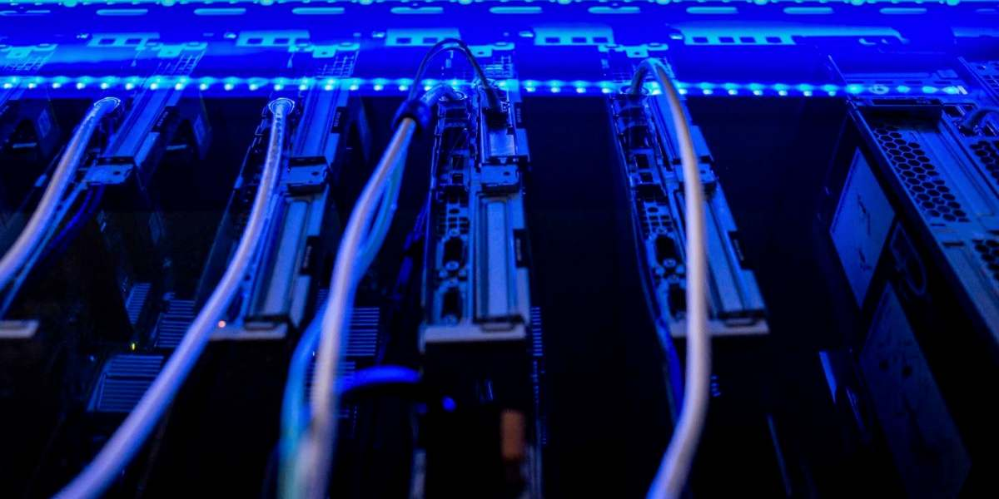
AI-ready Data Centers: cooling
REAR DOOR HEAT EXCHANGER
Direct-to-chip
Liquid immersion cooling
Ideal for 20-50 kW Rack load
PUE: 1.4
Ideal for 50 – 150 kW Rack load
PUE: 1.2 - 1.4
Ideal for 50-200 kW Rack load
PUE: 1.2 – 1.35
Advanced liquid cooling solutions to shield your AI hub from heat surges

Slide 28
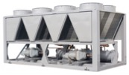
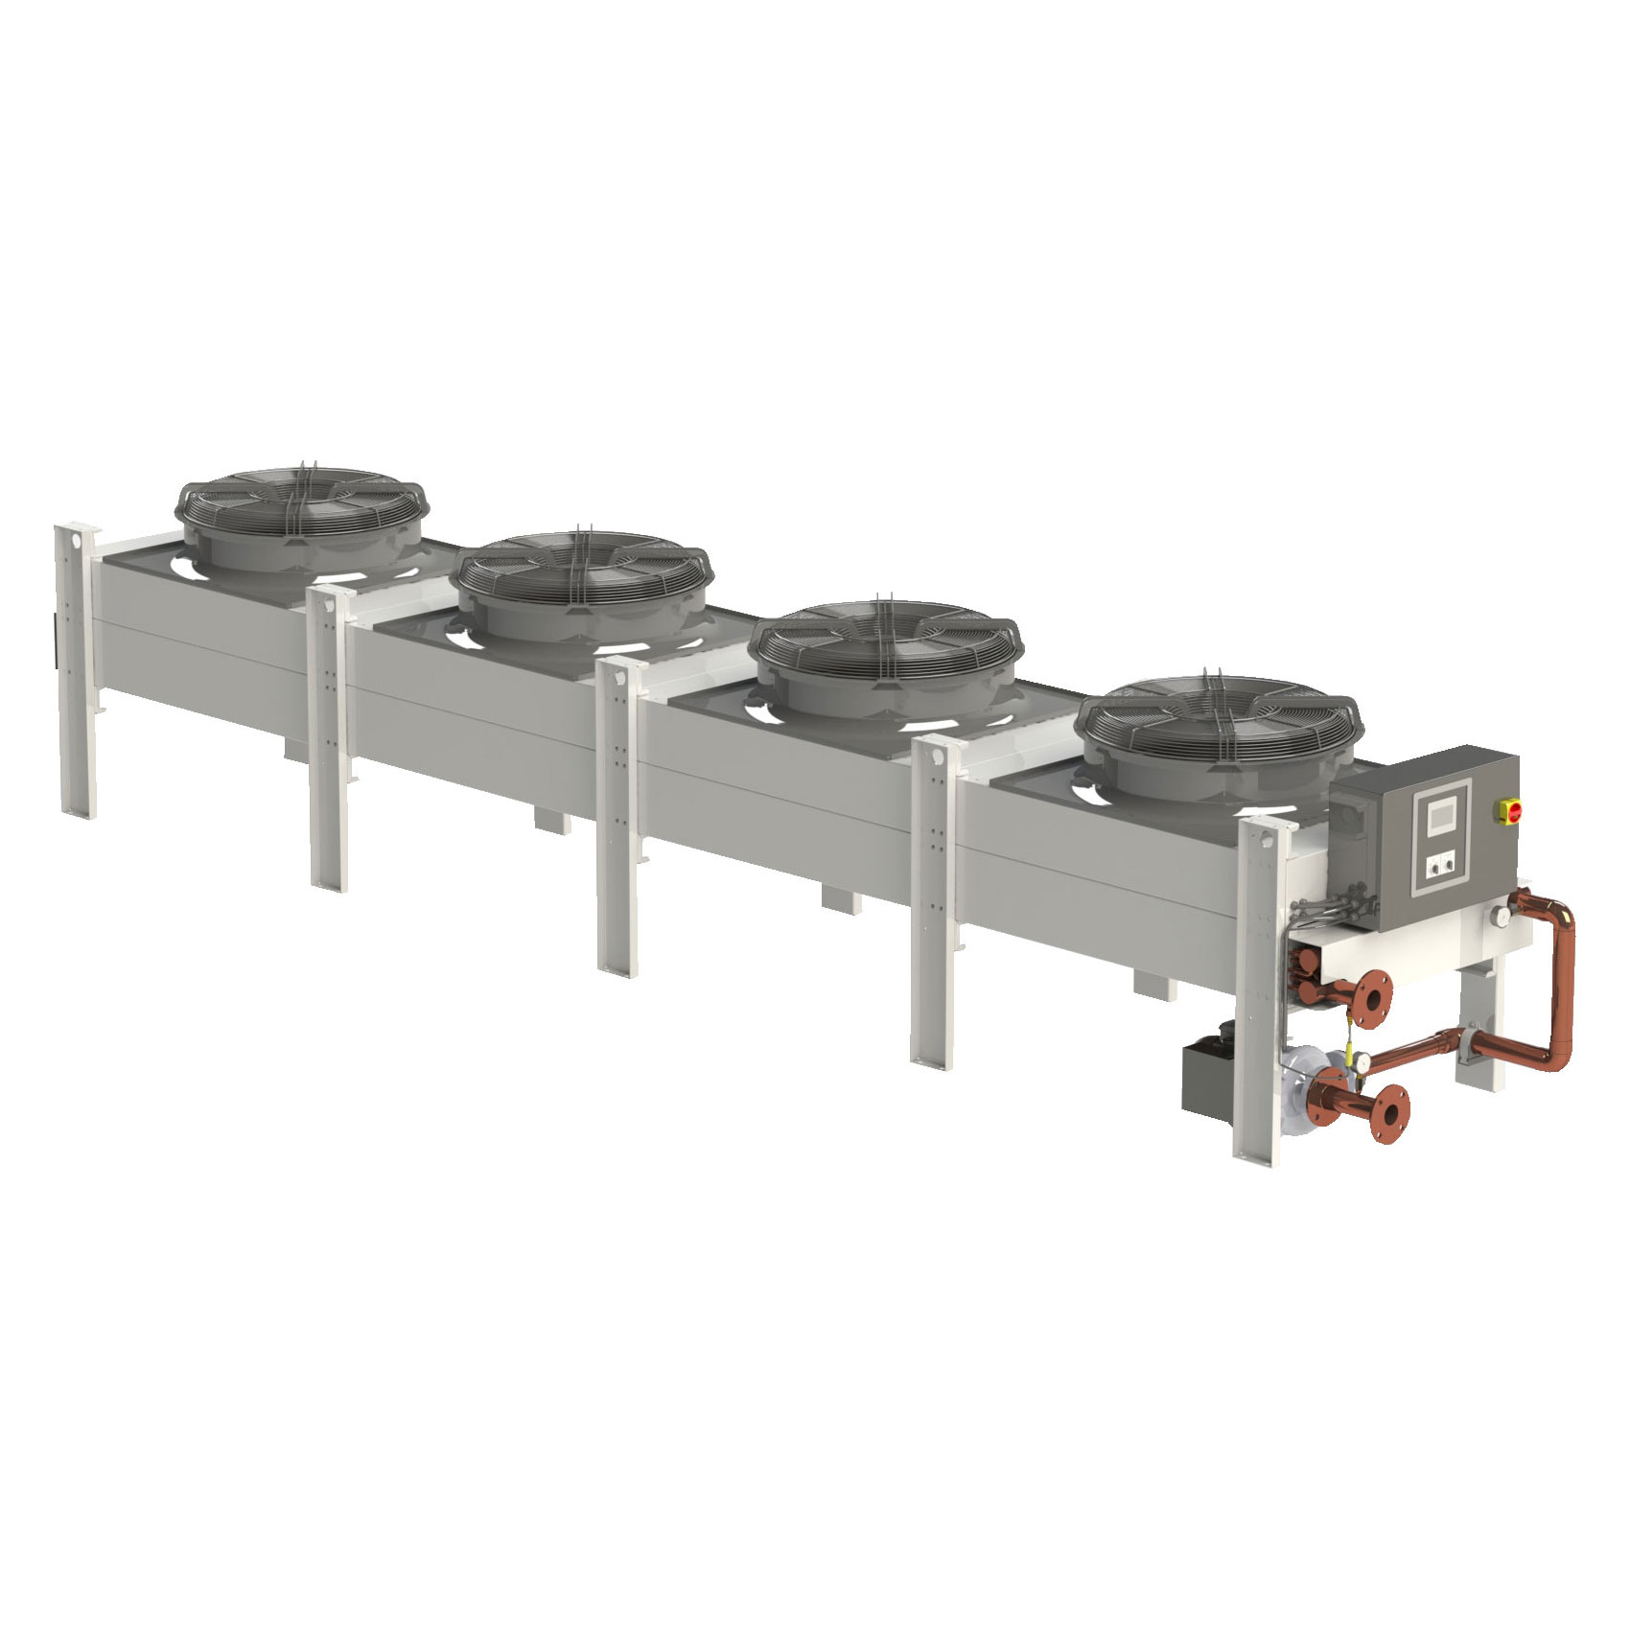
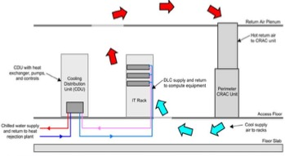
AI-ready Data Centers: Cooling
Liquid Cooling Technologies
Air Cooled Chiller
Rear Door Heat Exchanger (RDHx)
Dry Cooler/Adiabatic Cooler
All Liquid Cooling systems that requires water temperature of 20 deg C to 24 Deg C supported by the chiller-based HVAC infrastructure
Various air-cooling systems for the server hall
Liquid cooling system that needs higher water temperature, general ask is 30º C to 40º C
All Gen3 DCs are feasible for provisioning the required infrastructure
Significant savings in PUE due to elimination of compressors for cooling
Direct to Chip Liquid Cooling (DCLC)
Liquid Immersion Cooling (LIC)
Fault Tolerant Hybrid model using air-to-air and/or air-to-liquid cooling methodologies in single rack
Redundant Water Distribution system for both Chilled and warm water
Compatible with all leading Coolant Distribution Unit (CDU) manufacturers for precise supply of water pressure, flow rate, and temperature
Unique water distribution system without the use of CDU to deliver precise pressure, flow, and temperature for specific AI chips
Supports scattered high-density AI racks with standalone liquid distribution equipment (e.g. side car or AHX)
Fully Integrated Building Management System
Fault-tolerant, hybrid cooling systems with precise liquid distribution for high-density racks

Slide 29
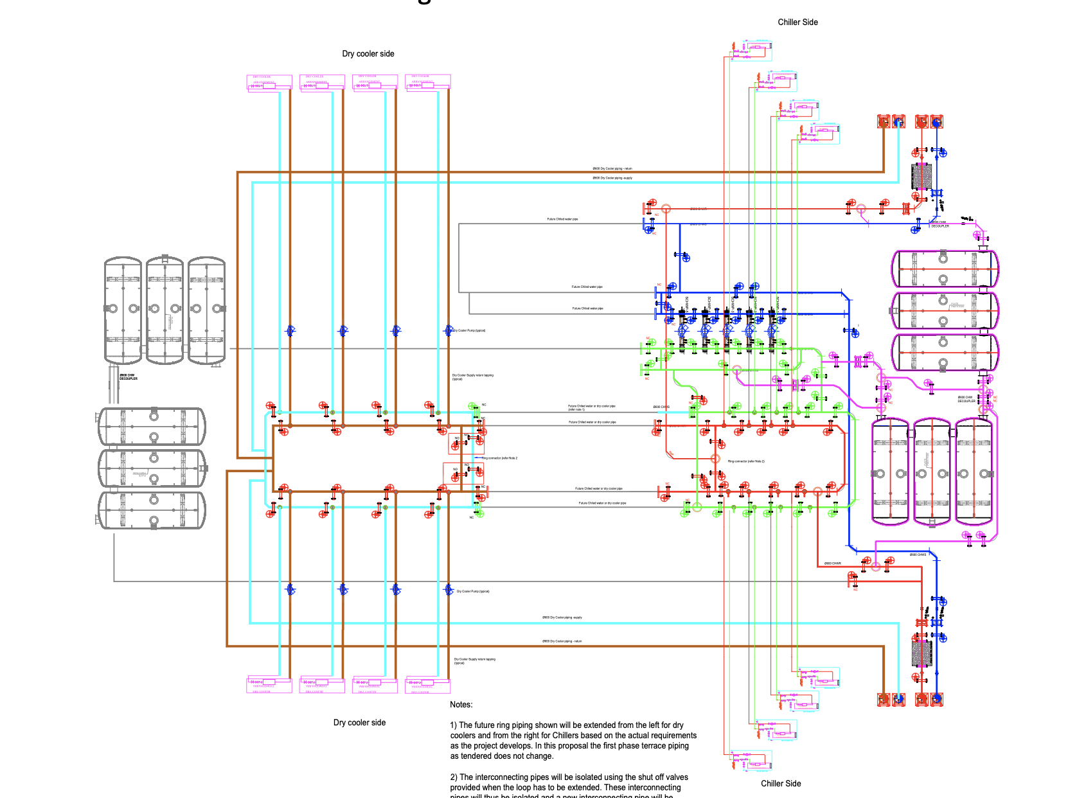
AI-ready Data Centers: cooling
Sify’s Unique Design – Hybrid Cooling Infrastructure
Hybrid water distribution
Provision for warm water and chilled water for various cooling workload
Modular expansion either from dry cooler side or chiller side and/or both
Piping network is in designed as add on modules for seamless expansion of warm water and chilled water distribution
Provision to introduce standalone dry cooler systems for smaller, or independent floor or specific applications such as two-phase liquid immersion system etc
Intelligent monitoring system suing SCADA and PLC supported by AI/ML software tool
Warm Water Distribution Riser A
Dry Coolers
Chillers
Chilled Water Distribution Riser A
Dry Coolers
Chillers
Chilled Water Distribution Riser B
Warm Water Distribution Riser B

Slide 30
AI-ready Data Centers: cooling
Sify’s Unique Design – Hybrid Cooling Infrastructure
Hybrid water distribution
Provision for warm water and chilled water for various cooling workload
Modular expansion either from dry cooler side or chiller side and/or both
Piping network is in designed as add on modules for seamless expansion of warm water and chilled water distribution
Provision to introduce standalone dry cooler systems for smaller, or independent floor or specific applications such as two-phase liquid immersion system etc.
Intelligent monitoring system suing SCADA and PLC supported by AI/ML software tool
Warm Water Distribution Riser A
Dry Coolers
Chillers
Chilled Water Distribution Riser A
Dry Coolers
Chillers
Chilled Water Distribution Riser B
Warm Water Distribution Riser B

Slide 31
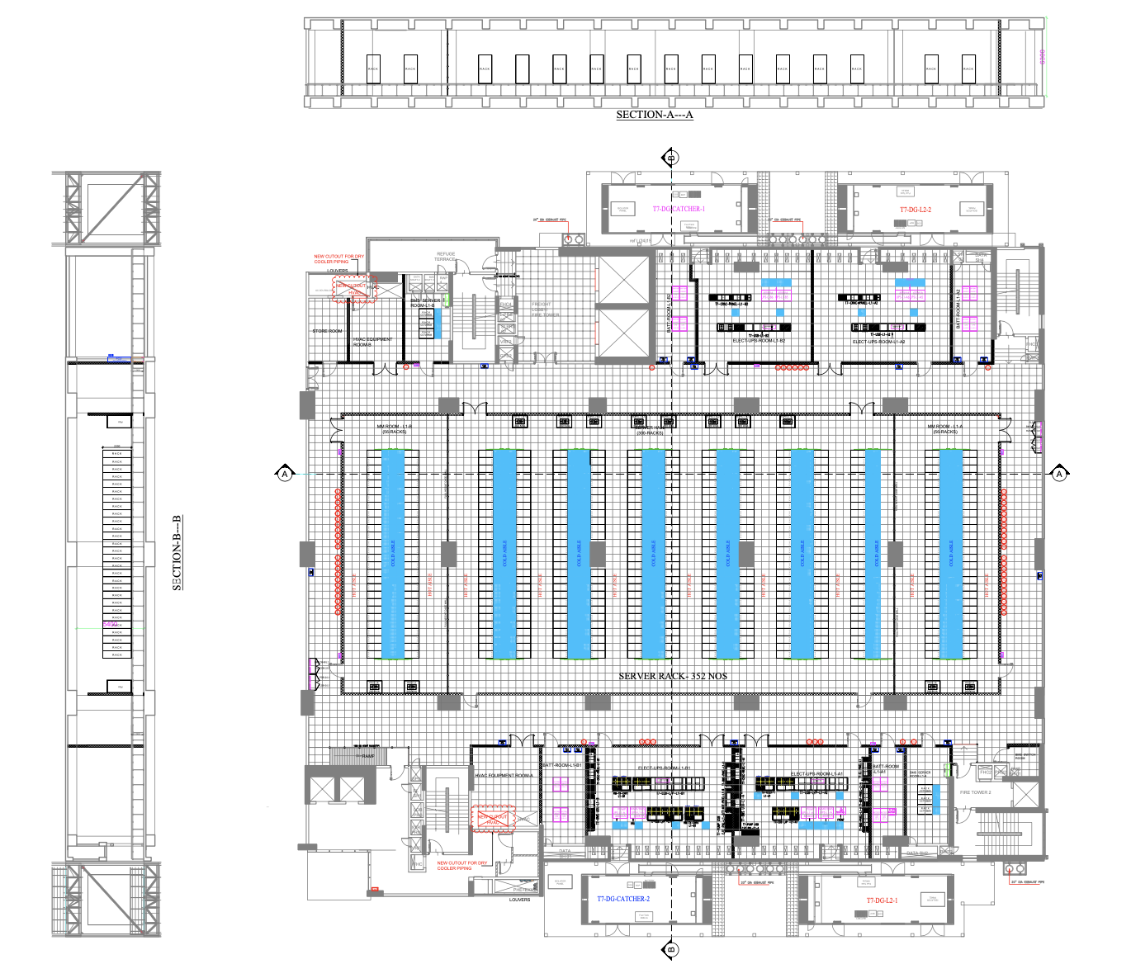
AI-ready Data Centers: server hall
Server hall supports perimeter cooling via PAHUs or FWU
Compatible for both Cold Aisle and Hot Aisle containments
Liquid to Liquid cooling for DCLC racks or Liquid Immersion Racks using CDUs and without CDUs
Dual pipelines for redundant water supply
Equipment redundancy in N+1, N+2 or N+N based on customer requirements
Supports high density racks with floor load bearing capacity of 2100kg/SqMtr, feasible even for larger LIC racks
6300mm slab to slab room height, for multi layer network and power distribution systems
Warm Water Distribution Riser A
Chilled Water Distribution Riser A
Liquid Cooling Infrastructure
(CDU, LIC, RDHx)
Air Cooled Infrastructure
(PAHU, FWU, RDHx)
Chilled Water Distribution Riser B
Warm Water Distribution Riser B

Slide 32
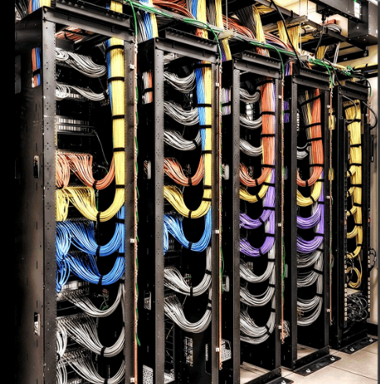



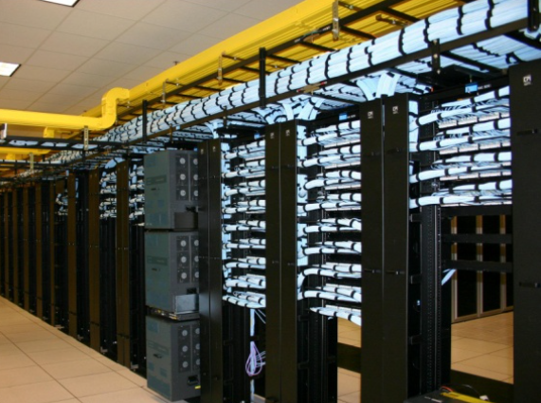



AI-Ready Data Centers: network
Multi-tier Network
Reliable Network Access
Cross-Connectivity
Multi-tier Fiber and Copper for low latency Infini-band like deployment
Cluster based rack placement
High capacity intra rack and inter rack network
Multiple Fiber routes to the building and MMRs at each tower of the DCs.
Enables connect for DR, NDR, FDR deployments
Access via high capacity 600 gbps networks
Lower TCO as expensive network bandwidth not required
Carrier Neutral
Meet-Me-Room
Access to Clouds Internet Exchanges & Cable Landing stations
90% of fiber links are from non Sify Telcos
Extension simplified with in-campus wiring and is a low capex option for all Telcos
MDF(Network Closet) in every floor, connected to MMR via network risers
Separate access to telco MMRs for O&M in the BTS
Proximity to Internet exchanges, Hyperscale, OTT, Social Media
Access to Cable landing station
High capacity, robust connectivity, and cost-effective bandwidth
Notes:
Access via high capacity 200 gbps + networks
Multi-tier Fiber and Copper for low latency deployments with high capacity 200 Gbps+ networks.
Cluster based rack placement
High capacity intra rack and inter rack network

Slide 33
Your trusted data center partner
SIFY IS A LEADER IN THE IDC MARKETSCAPE DATA CENTER SERVICES INDIA, 2024
Mission Critical Customer Experience
2 Decades of Operational Experience
Future-ready Data Centers
Trusted
Partner
3 out of 4 Hyperscalers
Global OTT & social media players
India’s top 10 banks
Global InfoSec security providers
600+ customers across all major industries
100% uptime
Best Practices covering Safety, Security, Availability, Excellence
PUE & WUE prediction and optimization
Certifications: Information Security, EHS, PCI-DSS, SOC 1 SOC 2, NVDIA, MeitY, IGBC
Mega campus approach for long term scalability with BTS
Next Gen Data Center design & operations.
AI ready infra with liquid cooling solutions
AI/ML platform enabling faster decision-making
Up to 70% Green Power available
1st commercial Data Center provider in India since year 2000
Data Center, Networks Digital and Security services under one roof
Reliability for services
Flexibility for customer requirements
Ensuring accountability, reliability, flexibility and choices through our innovative designs and services

Slide 34








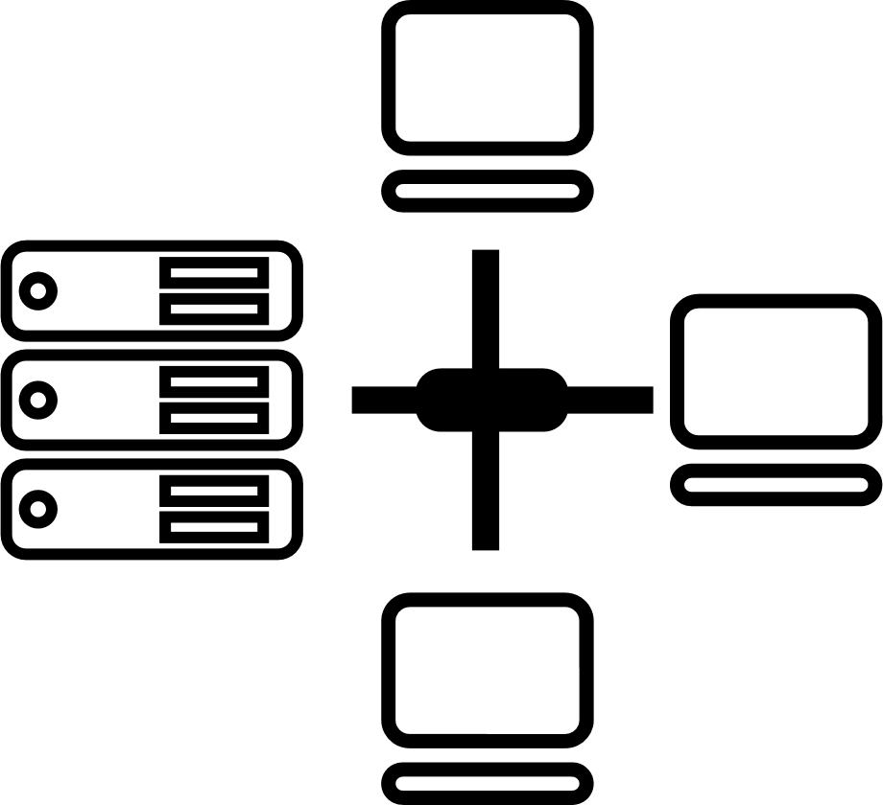






CIO Choice 2025 for
AI Ready Data Centers
Best Future-Proof Data Center Project
Award for Sustainability
Innovation in Data Center
India’s 1st Nvidia
DGX Ready Liquid &
Air Cooled DCs
Best in
Services Industry
DC Services India & ​Managed Cloud Services APAC ​
Managed Network Services - MQ
Tried Tested Trusted
Your digital infrastructure partner for over 25 years
Network
Infra Services
Network Digital
Managed Services
Data Center
Colo Services
CloudInfinit^{+AI}
GPU Cloud
Cloud & IT
Managed Services
Digital Apps
Managed Services
Industry Apps
Managed Services
Security
Managed Services
Thank You

Slide 35

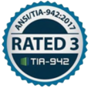














COMPLIANCE AND CERTIFICATIONS
MEITY Cloud Empanelled
India’s 1st Nvidia DGX Ready Air Cooled DC since 2022
Rated 3: Concurrently Maintainable Site Infrastructure
Data Center, Cloud &
Managed Services
IT Service Management
Telecom Data Center & Managed Services
India’s 1st Nvidia DGX Ready Liquid Cooled 130/kW/rack DC since 2024
Hosting Partner
PCI DSS
SOC 1 Type II
SOC 2 Type II
World’s international standard for occupational health and safety
Business Continuity Management System
Environmental Management system
Green Building
SAP Certified In Hosting Services
SAP Certified In Cloud Services
SAP Certified In SAP HANA Operations Services
SAP Certified In Application Management Services

Slide 36
Sify Data Center Advantage
Hyperscale, Hyperconnected, Green, Edge, AI-ready
RAS based design for future ready infrastructure
Liquid & Air-Cooling ready Data Centers, up to 200 kW power/rack.
14 DCs, 227+ MW IT power, expanding to 407+ MW by 2025. 10+ Edge DCs.
Hyperconnected, Carrier-neutral and Rich Interconnect ecosystem
India’s Data Center Powerhouse for over 2 decades
3 of 4 Hyperscalers, Global OTT & Social media players,
India’s Top 10 banks,
and 600+ enterprises…
Campuses scalable to
970+ MW with BTS capabilities
AI/ML led operational excellence with 100% uptime
Enhanced 10 levels of security with automation
231 MW renewable energy contracted
Sify is a LEADER in the IDC MarketScape Data Center Services India, 2024
Notes:
Operational- as is ready: 227.7 rounded to 227 (included tower B Noida, Chen 02)
Expanding: operational + development: 407.7 rounded to 407 MW
Scalable to: expanding to, operational + development+ planning: 970.5, 970 MW

Slide 37
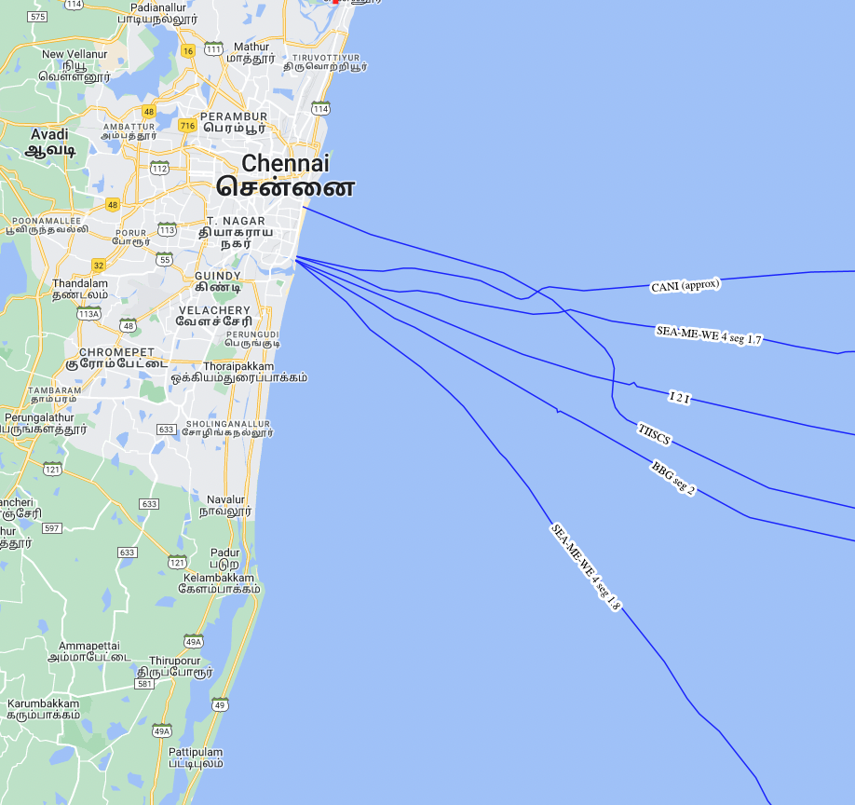
Cable landing station
Your seamless gateway to the global communication network for high-speed connectivity.
Other CLS
Sify CLS
Integrated Cable Landing Station for Transpacific fiber access
Built on Tsunami resistant stilt structure, all equipment to be on Level 2 and 3
Initial power is 700 KW; to be ramped per requirement
Designed for 4 cables with over 2 Peta Byte capacity
4 networks paths from CLS to Chennai 02 data Center
CLS is away from port, fishing zones, oil blocks
Notes:
Integrated Cable Landing Station for Transpacific fiber access
Remove the pic to the right Where all the congestion is coming today, away from rest of the cables if we can show that we are away from it. Chck with harsha

