Slide 1
INDIA’S DATA CENTER PIONEER
AI-READY, HYPERSCALE, HYPERCONNECTED, GREEN, EDGE, DATA CENTER CAMPUSES
EMPOWERING INDIA’S AI AMBITION

Slide 2


Why are we excited - Explosion in compute and storage demand
AI Growth Trends
Generative AI Workload Explosion
Global AI market
Projected Growth: CAGR of 37.3%, reaching $1.8 trillion by 2030. (Source: Gartner)
Large Language Models (LLMs) like OpenAI's GPT and Google's Gemini require high-performance compute environments.
APAC AI market
Projected Growth: CAGR of 28.58%, reaching approximately $298.40 billion by 2030. (Source: Statista)
Demand for hosting AI training and inference workloads is expanding across Asia-Pacific and Middle Eastern regions, driven by increased digital transformation initiatives. (Source: JLL)

Slide 3
India: A Data Center Hub
Data Center power capacity will rise from 950 MW in 2024 to 1,800 MW by 2026
KEY DRIVERS
Digital Economy Expansion
Increased Data Consumption
Cloud & Emerging Tech: AI, 5G, Edge Solutions
Growth Segments: GDC/GCCs
30+ Cities- Tier 2 and 3
Government policy & Regulatory Frameworks
Source: Research Firms

Slide 4
our focus areas
AI-Ready Infrastructure
Power, Cooling, Network, Server Hall
Specialized Hardware-GPUs, TPUs for HPC
Advanced Liquid Cooling
Scalability and Modular Designs
Edge Computing and Decentralization
Modular Data Centers with BTS capabilities
Horizontal and Vertical expansion
Proximity to End-Users
Hybrid Cloud Integration
Sustainability and Operational excellence
Enhanced Security and Compliance
Green Initiatives
Energy Optimization
Blending Automation
Zero-Trust Architecture
Global Regulations and Compliance

Slide 5

Our DATA CENTER FOOTPRINT- 6 Major metros
CHANDIGARH 01
EDGE | 14 MW
NOIDA 01
Noida
10.8MW
NOIDA 02 CAMPUS
Tower B
43+ MW
Tower 1
11.5 MW
Tower 2
9.6 MW
Tower 3
BTS
LUCKNOW 01
EDGE |14 MW
Tower A
43+ MW
Tower C
43+ MW
1st Tier 3
in 2000
Tower 4
8.1 MW
Tower 5
43+ MW
Tower 6
40+ MW
Q2 2025
MUMBAI 01
Vashi
0.9 MW
Tower 7
40+ MW
Q3 2025
Tower 8
40+ MW
Tower 9
40+ MW
Tower 10
40+ MW
KOLKATA 01
2.2 MW
Tower 11
40+ MW
Q3 2025
Tower 12
40+ MW
Q4 2025
MUMBAI 02
Airoli
5.4 MW
HYDERABAD 02 CAMPUS
(FAB CITY)
MUMBAI 03 CAMPUS (RABALE)
HYDERABAD 01
Financial Dist.
14.4 MW
5 Blocks
Current Plan: 26-52 MW each
AI Optimized Plan
Up to ~500MW
BANGALORE 02 CAMPUS (AEROSPACE PARK)
BANGALORE 01
Electronic City
7.6 MW
Tower 1
20+ MW
Q2 2025
Tower 2
20+ MW
CHENNAI 02 CAMPUS (SIRUSERI)
CHENNAI 01
Tidel Park
3.6 MW
Tower A
43+ MW
Tower B
43+ MW
Tower C
43+ MW
Operational
In Development
Planning
All Power references are Design IT Power at Full Capacity
All Power references are Design IT Power at maximum Capacity

Slide 6
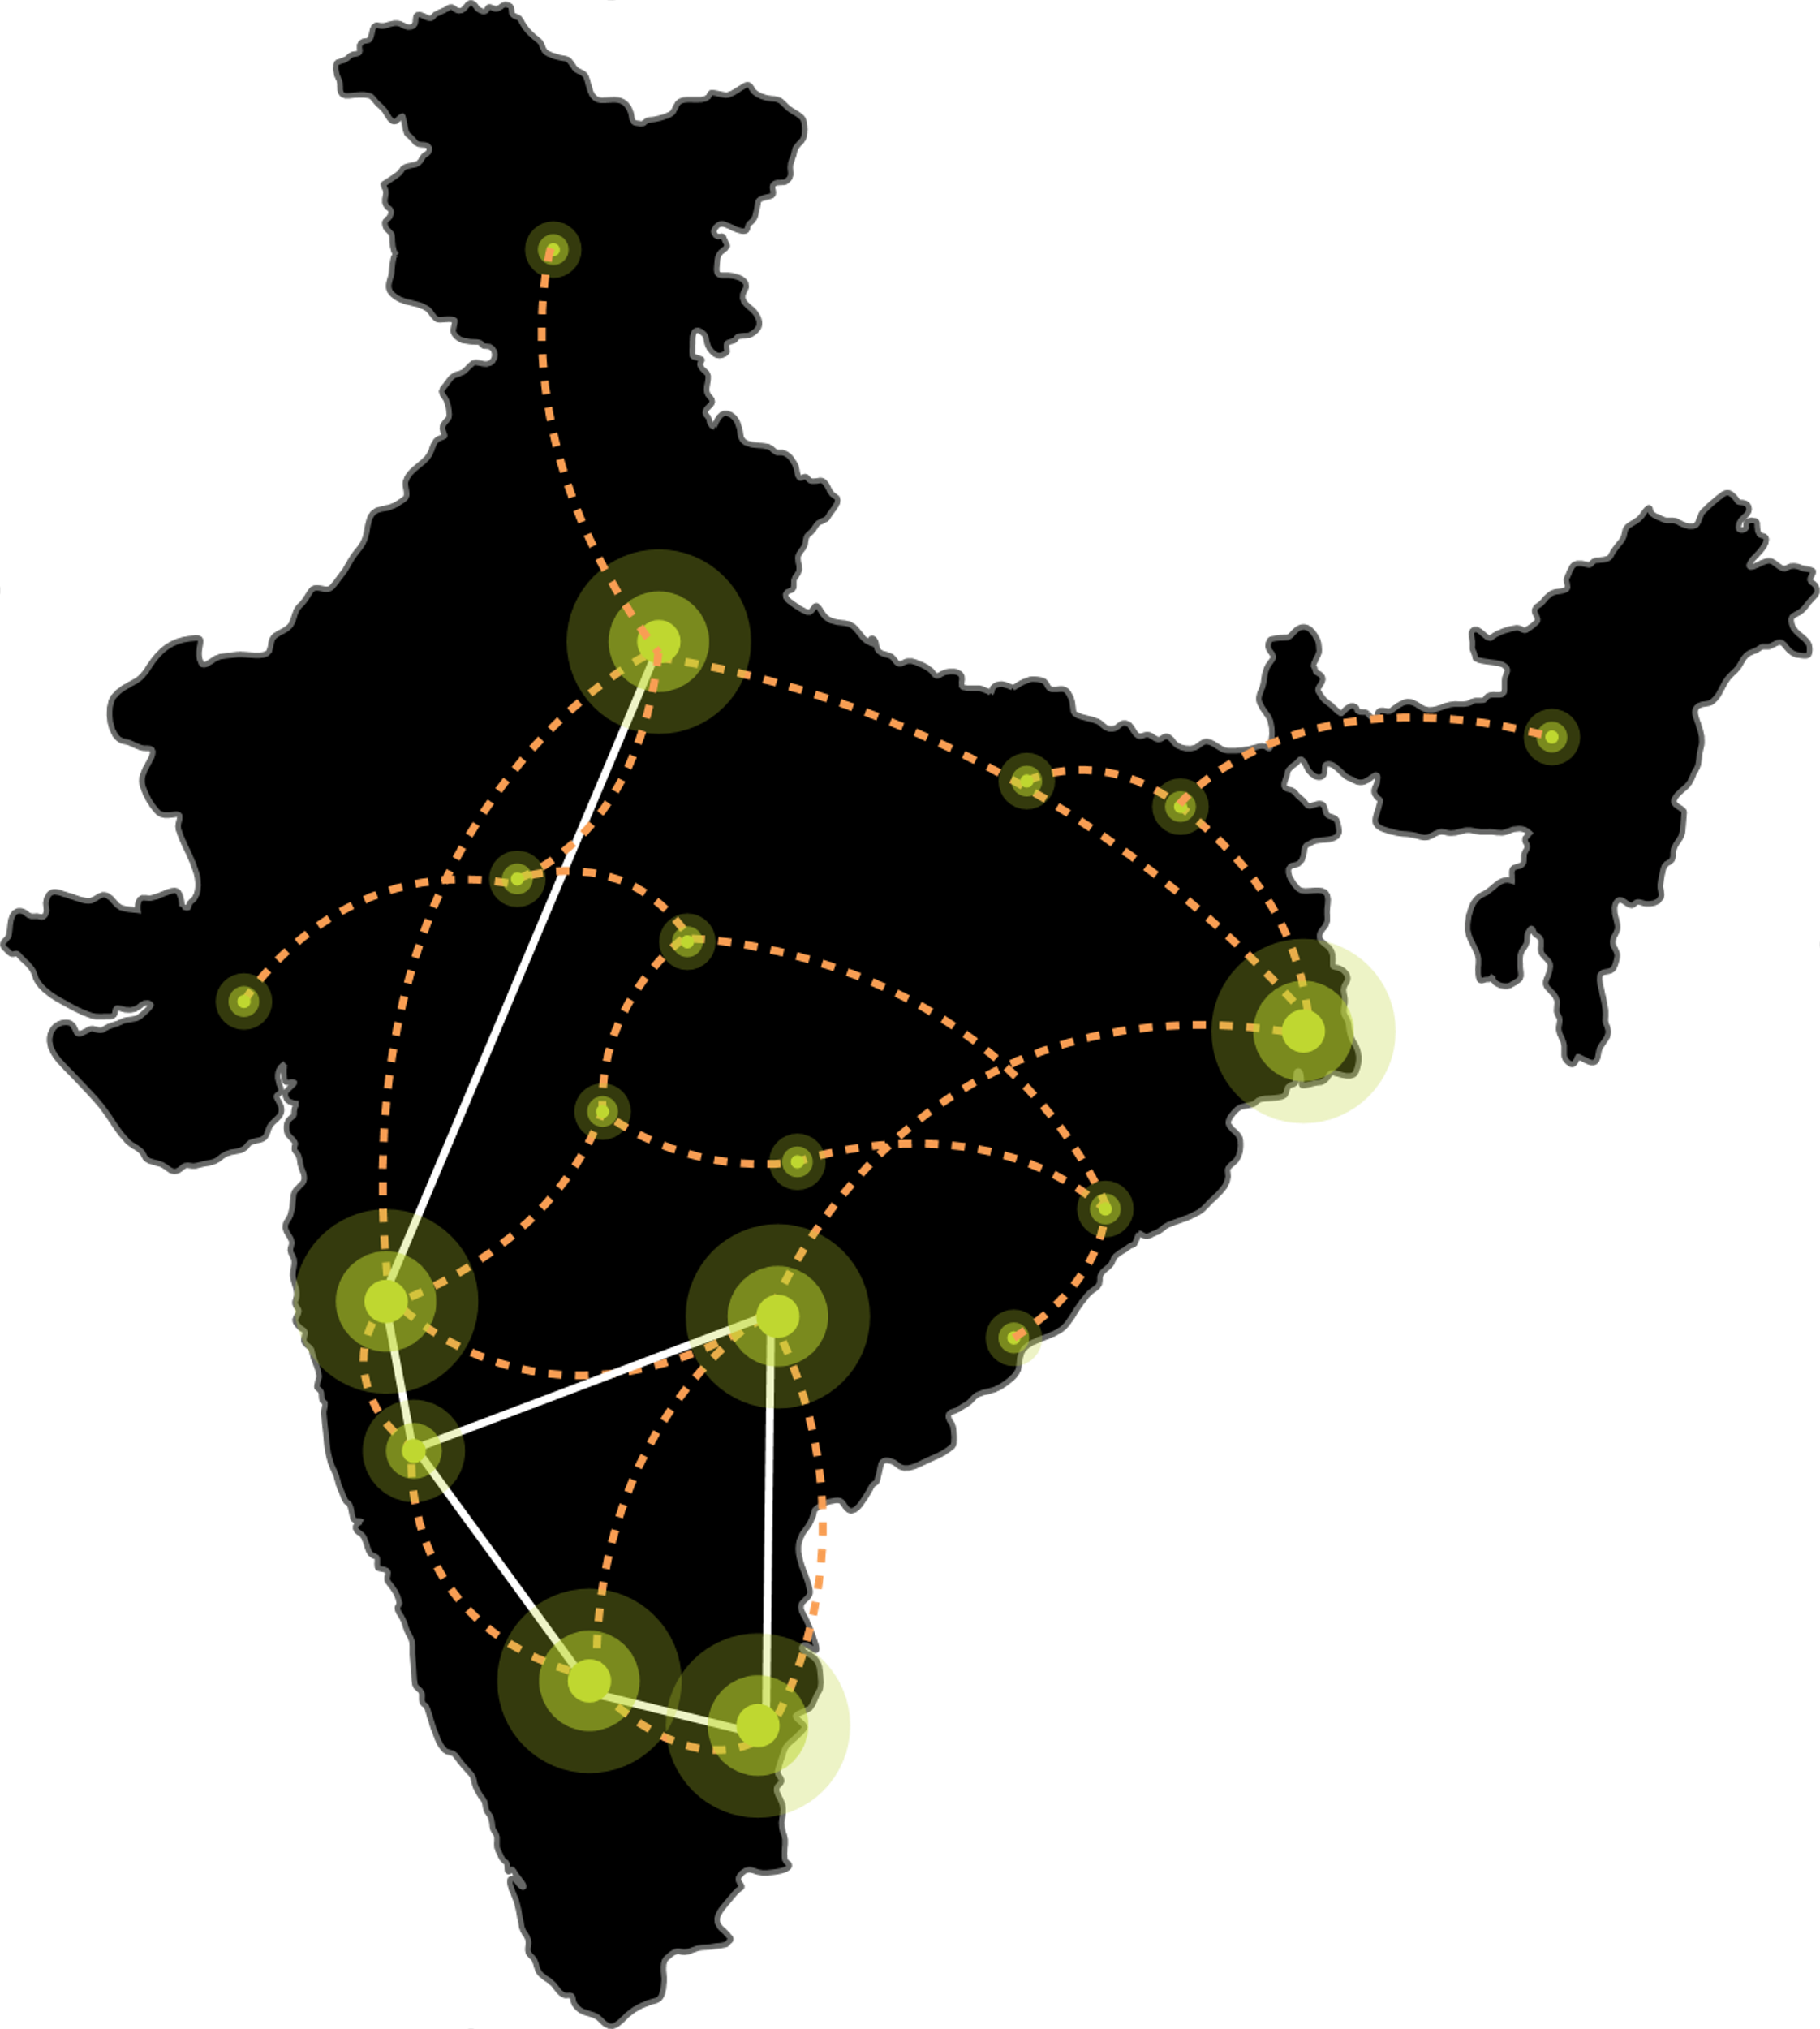
Edge data center footprint. Rollout planned over 2-3 years
Low latency, easy access and faster content delivery in non-metro locations, ensuring seamless data processing and superior customer experience.
CHANDIGARH 01
Oct 2025
NOIDA 02
NOIDA 01
LUCKNOW 01
June 2025
JAIPUR 01
PATNA 01
NAGPUR 01
GUWAHATI 01
AHMEDABAD 01
3.6-14.4 MW Tier 3 data centers with diverse carriers, ISPs, Transit nodes, IXs and CDN.
Leverage Sify’s extensive Network presence; connect with Sify NLD fabric.
The data center consumption and interconnections driven by the pull of anchor tenant.
INDORE 01
RANCHI 01
SAARC Gateway, Kolkata
BHOPAL 01
KOLKATA 01
MUMBAI 03 RABALE
VISAKHAPATNAM 01
MUMBAI 02 AIROLI
BHUBANESWAR 01
MUMBAI 01 VASHI
VIJAYAWADA 01
RAIPUR 01
CLS, Versova, Mumbai
HYDERABAD 02
HYDERABAD 01
COCHIN 01
CHENNAI 02
BENGALURU 02
CHENNAI 01
BENGALURU 01
CLS, Siruseri, Chennai
Construction
Design
Planning
Notes:
Special Economic Zones, IT resources, IT outsourcing companies are going into tier 2 cities. We need to build digital infrastructure for AI in these locations. AI training needs more investments, that can happen in the large metros, AI inferencing is cost effective which you can build in tier 2 cities. We have a plan to begin with 10-20 locations in Tier 2 and 3 cities leveraging our Pan India Network and DC footprint.

Slide 7
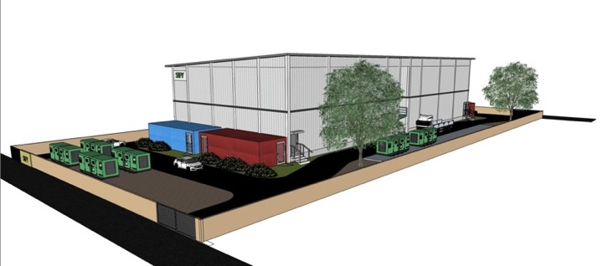
Overview: Lucknow 01 Edge Data Center
ELEVATE YOUR EDGE EXPERIENCE
14+ MW IT capacity in 2 Data Center building blocks
IGBC certified ESG best practices
Dedicated
Dual feeder power supply
Hyperscale &
AI-Ready Infrastructure
Multi level perimeter and internal security layers
Standalone purpose-built prefab shell
Fast, Agile, Local, Efficient, and Secure
Customised designs with vertical and horizontal expansion
3 dedicated fiber entry paths with multiple telcos
Interconnect for various Content Creators, TELCO IP Transit nodes, IXs and ISPs

Slide 8

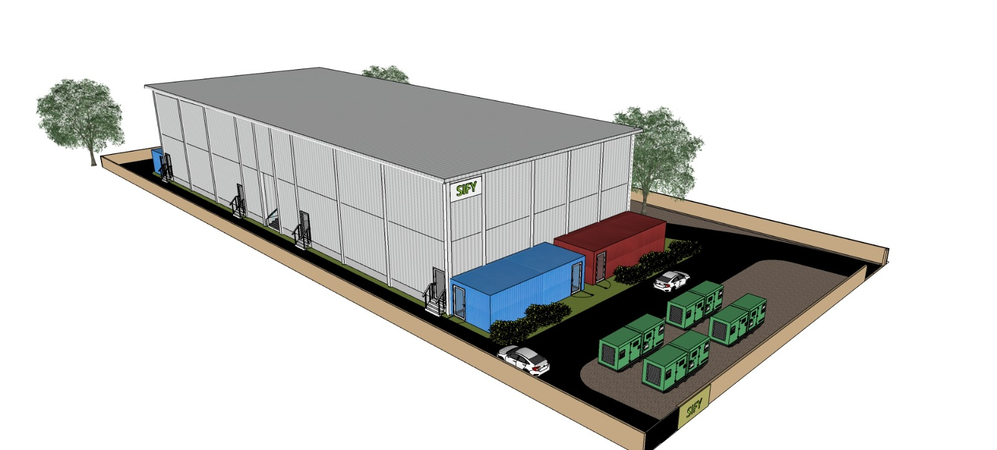
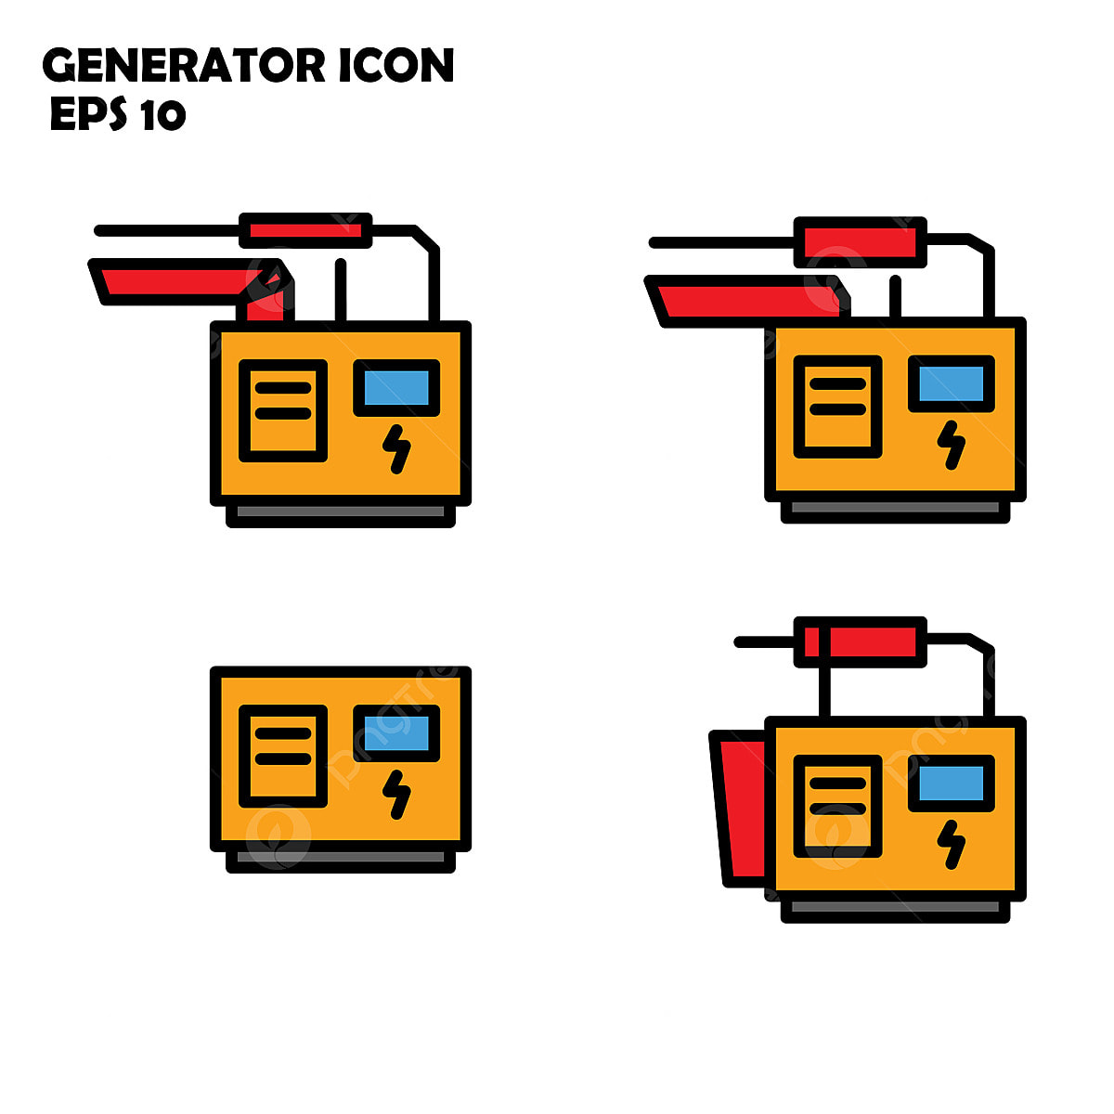
AI-READY, Modular scalable Edge Data centres
True modular and scalable design
Horizontal and/or vertical scalability
Server Hall Module: up to 120 standard rack positions
Power Module: in multiples of 600kW
Service Module: Operations & Logistics
Typical total IT power capacity from 1200kw to 3600kw
4.5-meter height, 1500kg floor loading
Expandable per Land area available
Deployment 8-10 months from contract
EL A2+B2
EL A1+B1
SM1
L1
SH2
SH1
L0
Our modular edge data centers can scale up to 14.4 MW and can be deployed in 6-9 months

Slide 9
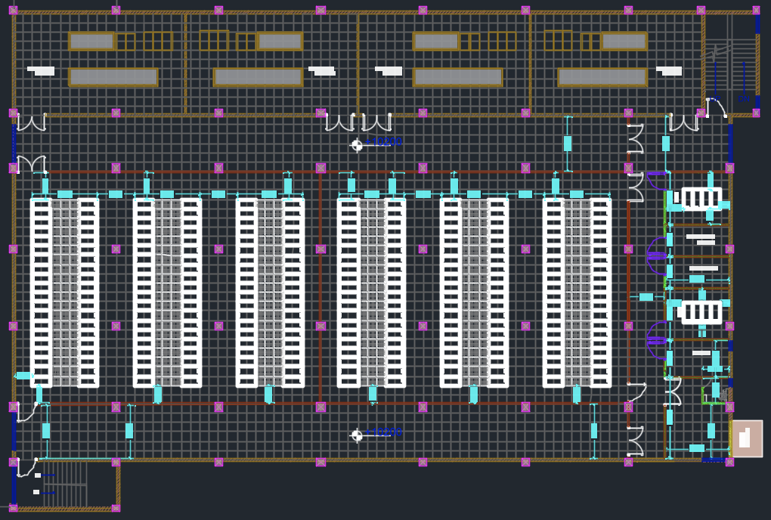
Overview: sify pico edge data center
Two server hall modules per floor
Each server hall module supports upto 120 racks
20 racks and 6 rows per floor. The aisle are 3 tiles
Each floor has 2 MMRs, Operations room, de-box or staging room
Two electrical modules support each server hall module
Server hall modules can be connected or independent modules
The foundation design to support up to G+2 deployment.
Rest rooms and pantry at every floor
Fire exits and escape routes as per local codes
EL A2+B2
EL A1+B1
SM1
L1
SH2
SH1
L0
Our modular edge data centers can scale up to 14.4 MW and can be deployed in 6-12 months

Slide 10
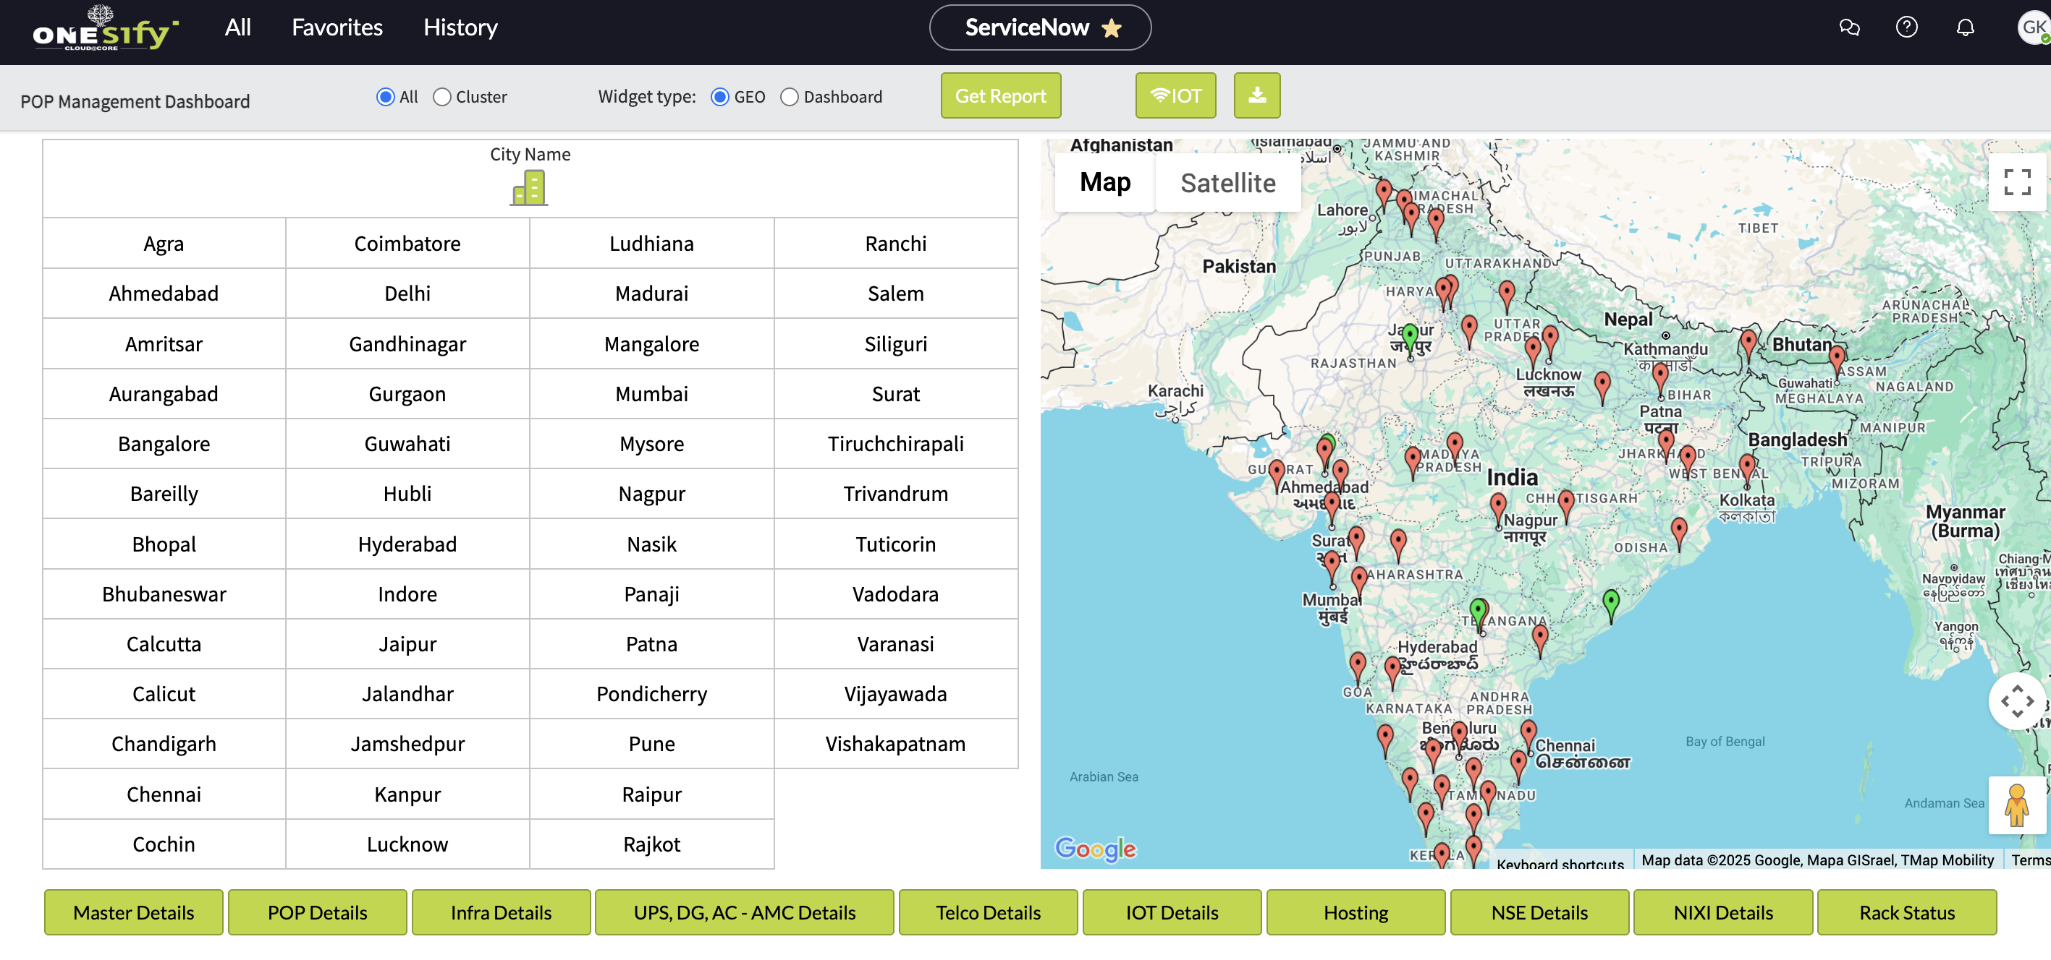
Network operations management
POP Category | Total POP
Data Centers | 10
T1 | 9
T2 | 35
T3 | 6
Grand Total | 60
24 x 7 Manned Operations for continuous monitoring and uninterrupted performance
Redundant Power & Cooling infrastructure
Multiple in building fibers, Ducts supported with Sify Metro Network
Smart IoT adopted for proactive monitoring and better resource management
Carriers’ agnostic and availability of all major national carriers and ISP’s
Direct access to NIXI, NSE, and other Sify aggregation nodes for enhanced network performance.
Existing Network Operations teams across India will ensure seamless initiation of the edge projects to execution

Slide 11
Global Command and Control Center (GC3)
GC3 @ NOIDA 02
DCs and EDGE DCs in North and Northeast
Backbone of our Data Center Operations​
Real-time anomaly detection and root cause analysis​
Automated alerts and intelligent escalation mechanisms​
Proactive risk mitigation to prevent downtime​
Efficient energy and infrastructure optimization​
Seamless remote management of edge and core data centers
GC3 @ MUMBAI 03
DCs and EDGE DCs in West and Central India
GC3 @ CHENNAI 02
DCs and EDGE DCs in South India
A Unified Digital Nerve System
Together, our three GC3s form a highly resilient, AI-driven, and incident-ready digital nerve system, reinforcing our commitment to delivering high-performance, secure, and scalable data center services across India.

Slide 12






Operational excellence
Zero
Availability Incidents
Zero
Redundancy Incidents
Zero
Security Incidents
Enhance infrastructure with automated failover systems to ensure uninterrupted operations.
Penalty-proof SLAs by proactively testing and documenting redundancy systems.
AI-driven anomaly detection to monitor cyber and physical security in real-time.
Zero
Safety Incidents
Zero
Carbon Footprint
Zero
Defects
Transparent safety dashboard to track incident-free days and improvements.
RE 100 (carbon neutral by 2030), Contracted 231 MW green power, ASHRAE, IGBC, carbon abetment policy, low PUE/WUE.
Real time visibility & measurability across operations, predictive maintenance, cross-functional quality audit team.

Slide 13
Your preferred partner for AI edge data centers pan India
Standardized Design
Pre-fab design for DC layout, core, and shell, ensuring consistency and faster deployments.
Team of 20 to deliver each site within 9 months
Network Operations
24 x 7 manned operations across 60 POPs. Upskill to seamlessly manage edge sites and ensure continuous monitoring and uninterrupted performance
Pan-India presence and seamless supply chain
Rapid deployment across key locations with existing Admin, Network Ops & DC teams and deploy new workforce as per requirement within 30 days
Leadership in Network & Data Centers
Leverage our 25+ years of expertise in managing mission critical digital infrastructure. Scalable infra, carrier neutral, seamless interconnects with multiple Telcos, Content providers, ISPs, IXs
Standardized design, existing network operations, streamlined supply chain system, presence in all major cities, and diverse team structure allows Sify to deliver multiple EDGE DCs at the same time.

Slide 14
Your trusted data center partner
Sify is a LEADER in the IDC MarketScape Data Center Services India, 2024
Mission Critical Customer Experience
2 Decades of Operational Experience
Future-ready Data Centers
Trusted
Partner
3 out of 4 Hyperscalers
Global OTT & social media players
India’s top 10 banks
Global InfoSec security providers
600+ customers across all major industries
100% uptime
Best Practices covering Safety, Security, Availability, Excellence
PUE & WUE prediction and optimization
Certifications: Information Security, EHS, PCI-DSS, SOC 1 SOC 2, NVDIA, MeitY, IGBC
Mega campus approach for long term scalability with BTS
Next Gen Data Center design & operations.
AI ready infra with liquid cooling solutions
AI/ML platform enabling faster decision-making
Up to 70% Green Power available
1st commercial Data Center provider in India since year 2000
Data Center, Networks Digital and Security services under one roof
Reliability for services
Flexibility for customer requirements
Ensuring accountability, reliability, flexibility and choices through our innovative designs and services

Slide 15









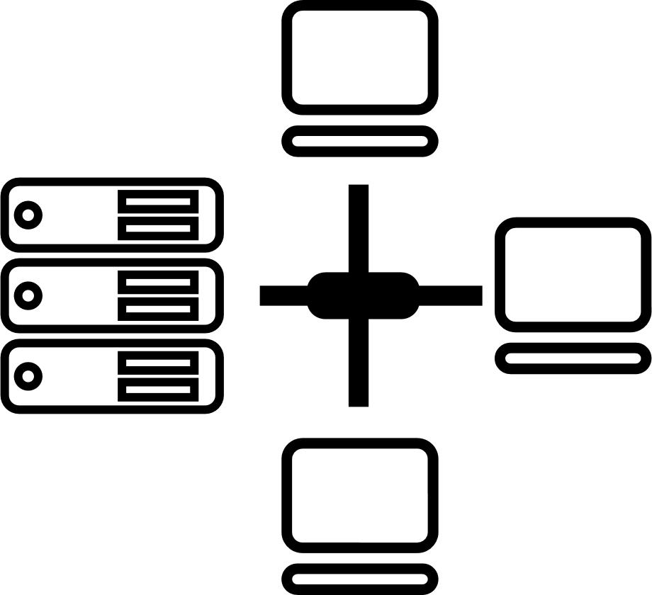






CIO Choice 2025 for
AI Ready Data Centers
Best Future-Proof Data Center Project
Award for Sustainability
Innovation in Data Center
India’s 1st Nvidia
DGX Ready Liquid &
Air Cooled DCs
Best in
Services Industry
DC Services India & ​Managed Cloud Services APAC ​
Managed Network Services - MQ
Tried Tested Trusted
Your digital infrastructure partner for over 25 years
Network
Infra Services
Network Digital
Managed Services
Data Center
Colo Services
CloudInfinit^{+AI}
GPU Cloud
Cloud & IT
Managed Services
Digital Apps
Managed Services
Industry Apps
Managed Services
Security
Managed Services
Thank You

Slide 16


Tech specs I : sify pico edge data center
ELEVATE YOUR EDGE EXPERIENCE
DATA CENTER SHELL
ELECTRICAL
Building: RCC foundation and prefab steel data center floors.
Room Height: 4500 mm slab to slab. 3900mm clearance from floor to 1st obstruction, 700 mm raised floor
Structural Design: IS 456:2000, Importance Factor 1.5
Structural Floor Loading: 1500 Kg/sqm
Freight Elevators: 1 freight elevators with 4-ton capacity
Fire Rating of Walls & Doors: 2 hours
Power Feeder: Onsite MV substation. (11kV or 33kV dual feeders)
Power Capacity: Designed for up to 14.4MW IT capacity
Power Density: Power density of 10 KW for air cooled racks. Higher density racks possible with customized design
Transformer/Generator Configuration: redundancy of N+1
Downstream Power Configuration: N+N power distribution with overhead bus bars or whips
Onsite Fuel Storage: 24 hours, agreement with fuel supply companies for refill

Slide 17



Tech specs II : sify pico edge data center
ELEVATE YOUR EDGE EXPERIENCE
BUILDING MANAGEMENT
COOLING
Building Management: Integrated building automation system with PLC SCADA
Physical Security: Multi level access control. Perimeter protection with Electric fence and Intrusion detection, K8 rated wall. Access controlled Gates and hydraulic crash guards, Security control room, X-ray Baggage scanner, 24x7 security guard service
Access Control: Smart card and biometric
Video Surveillance: 24x7 for all critical areas, retention for 90 days
Fire Detection: Addressable smoke detectors and aspirating smoke detectors for early warning
Fire Suppression: Novec© 1230 fire suppression system for Data Centre and electrical rooms. Option for pre-action water sprinklers available.
Air Conditioning: Direct Expansion precision air conditioning units for perimeter cooling. Can support liquid cooling with HVAC systems upgrade
Environment: Temperature and Humidity as per ASHRAE standards. Operating parameters 24+/-2 deg C and rH 20% - 80%
NETWORK
MMR: Dual meet me room for telecom fiber links; N+N power with UPS and 10 minutes battery backup
Carrier Neutral: Multiple IXs, IP Transit POPs, Multiple Telecom MUXs
A minimum of three telecom entry paths to the MMR.

Slide 18
Overview: sify pico edge data center- general for any other location
ELEVATE YOUR EDGE EXPERIENCE
14+ MW IT capacity in 2 Data Center building blocks
IGBC certified ESG best practices
Dedicated
Dual feeder power supply
Hyperscale &
AI-Ready Infrastructure
Multi level perimeter and internal security layers
Standalone purpose-built prefab shell
Fast, Agile, Local, Efficient, and Secure
Customised designs with vertical and horizontal expansion
3 dedicated fiber entry paths with multiple telcos
Interconnect for various Content Creators, TELCO IP Transit nodes, IXs and ISPs

