Slide 1
Empowering your
DIGITAL transformation
Sify Corporate Overview
Sept 2024
Your digital bridge for transformation, built on world class digital infrastructure, platforms and services.

Slide 2

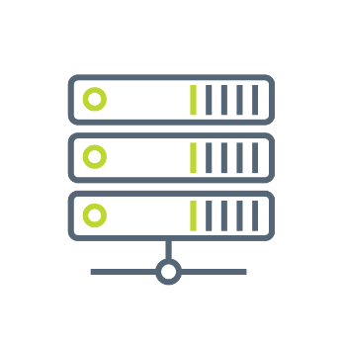

SIFY GROUP COMPANIES
NETWORK
SERVICES
DATA CENTER
INFRASTRUCTURE
CLOUD &
DIGITAL SERVICES
Sify Technologies Ltd.
Sify Infinit Spaces Ltd.
Sify Digital Services Ltd.

Slide 3
CONSISTENT Financial PERFORMANCE
Revenue Growth
Figures in INR Crores
Services vs Product
CAGR 12%
Network – Data Center – Digital Services
Profit After Tax (PAT)
CAGR (49%)
Notes:
Should we write ‘Digital Services’ or ‘IT Services’?

Slide 4
SIFY’S Global presence
MPLS network presence in over 1600 Cities
14 Operational Data Centers
66+ Pan-India Edge Nodes
3 Open Cable Landing Stations
Delivery Centers in 6 Major Indian Cities
Canada
Toronto
Europe
London
Dubai
India
USA
Santa Clara
USA
New Jersey
Singapore
Presence in
6 countries
Partnering with enterprises for Digital Transformation
Proven track record of executing complex programs
Over 3000+ skilled associates
Quality benchmarks –
CMMi 5, ISO 9001, ISO 27001, SSAE 16 certifications

Slide 5


25 YEARS OF KEEPING YOU AHEAD
Technology @ Core
Enterprise
Centric
Digital
First
Cloud
First
Consumer Centric
DIGITAL TRANSFORMATION PARTNER
(digital@core)
ENTERPRISE SERVICES COMPANY
DIGITAL ICT SERVICES PROVIDER
RETAIL INTERNET SERVICE PROVIDER
Launch of MPLS & Data Center services
in India
Launch of Enterprise Cloud services
Launch of end-to-end
digital services
First private ISP
in India
Sify 1.0
Sify 2.0
Sify 3.0
Sify 4.0
RELEVANCE
INVESTMENTS
ACHIEVEMENTS
GROWTH
Products and Services always aligned to market trends and customer need
Investments in line with market trend and strategic objectives
Recognized as a trend setter or leader in multiple lines of business
Consistent growth through investments and customer engagements
From revolutionizing consumer internet in the 90s to becoming Enterprises’ Digital Transformation Partner
Notes:
Anjali to share updated slide

Slide 6
OUR Investment PHILOSOPHY
Digital
Services
  Skilled workforce to support modern technologies
  Services across the digital spectrum
  Embedded AI
  Secure by design
3000+ SMEs across platform automation, modern apps, AI/ML, DC, Cloud, Networks, Security
Infinit AI/ML, Infinit FSO, SaaS & Industry solutions
  Modern cloud platform – x86 & GPU support
  Ample data stores for data explosion
  Cybersecurity Operations Centers
  Cloud Management Platform for efficient operations
CloudInfinit AI Sovereign Cloud
Hybrid Cloud Infrastructure
Sify Cloud Anywhere Edge Cloud
Infinit CMP, Infinit MNS platform
Global SOC, MSS, Infinit Security
Cloud,
AI & Security
  AI ready data centers
  Core and Edge data centers for edge use cases
  Certified and compliant
  Focus on sustainability
14 DCs, 227+ MW IT power
407+ MW by 2025
Scalable to 970+ MW
231+ MW RE Power
AIOps, AI Ready, Liquid cooling
Data
Centers
Network
Infra
  Reliable national network backbone
  On-demand capacities
  Deep Distribution Capillarity
  Open Cable Landing Stations for subsea cables
1700+ Cities, 3700+ PoPs
Fiber coverage 24+ Metros
3 CLS, 8 International POPs
Sify OnNet- automated Ent WAN
Notes:
1400+ Digital Networks
350+ Cloud
450+ Modern Apps & AI/ML,
100+ Cybersecurity,
100+ Platform automation,
500+ Technology Integration

Slide 7

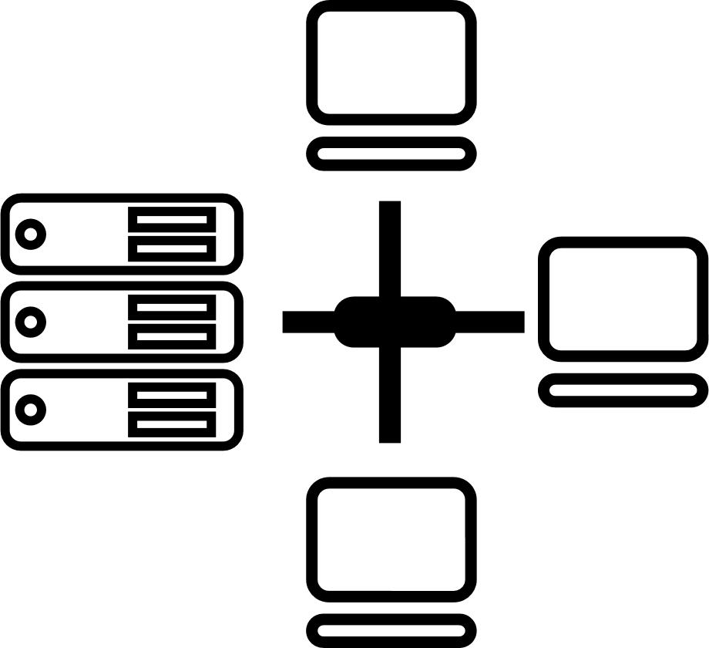

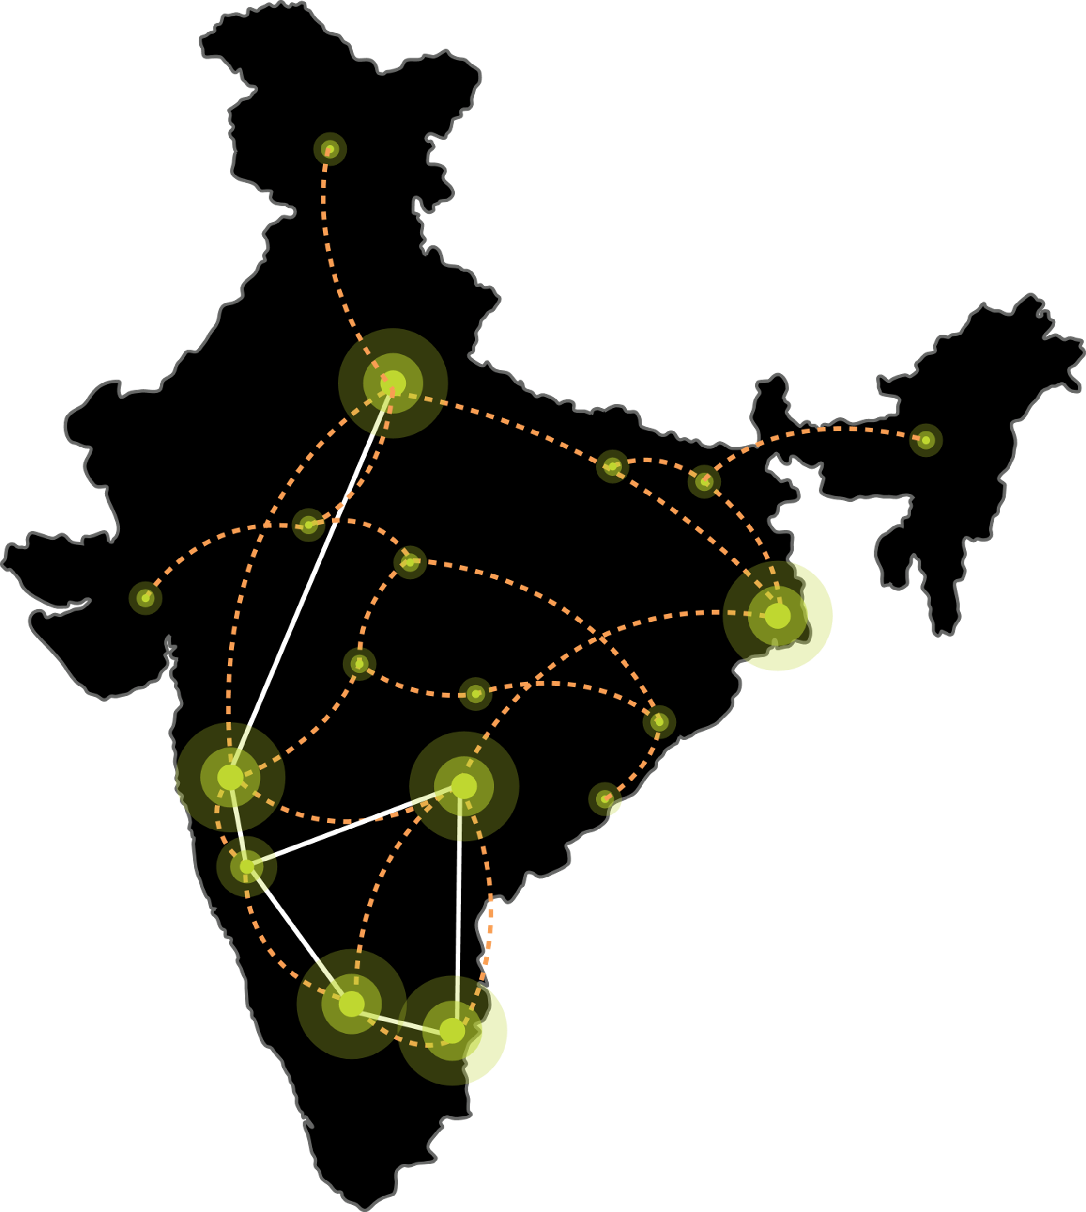






SIFY’S DIGITAL INFRASTRUCTURE & PLATFORMS
India’s Top 10 banks, Top 4 Manufacturing, 3 Major Hyperscalers, Global Social Media, OTT, Security Players,
and 10,000+ Enterprises trust Sify.
Metro Networks
Fiber access
Connected Buildings
Interconnected DCs
Express Long-Haul Backbone, High Bandwidth and Low Latency across Key Locations
Network
Infra Services
Network Digital
Managed Services
NOIDA 02
NOIDA 01
SAARC Gateway, Kolkata
Data Center
Colo Services
CloudInfinit
Ent Cloud Infra
MUMBAI 03 RABALE
KOLKATA 01
MUMBAI 02 AIROLI
MUMBAI 01 VASHI
CLS, Versova, Mumbai
HYDERABAD 02
HYDERABAD 01
Cloud & IT
Managed Services
Security
Managed Services
CHENNAI 02
BENGALURU O2
CHENNAI 01
BENGALURU 01
CLS, Siruseri, Chennai
Digital Apps
Managed Services
Industry Apps
Managed Services
Notes:
Swap cloud and dc

Slide 8
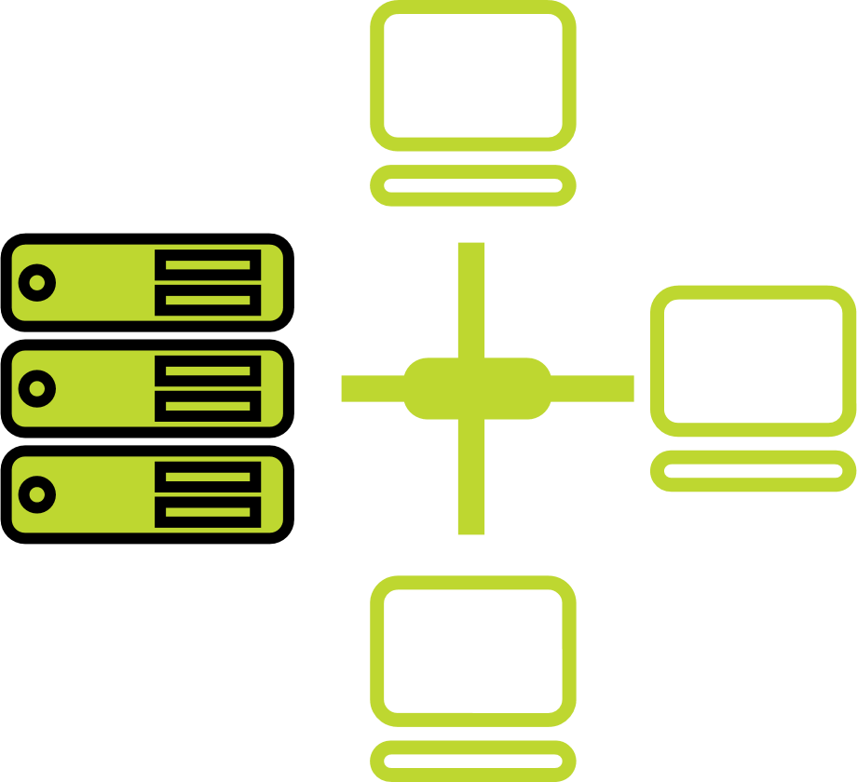




one-stop engagement for enterprises’ digital pursuits
Network
Infra Services
Network Digital
Managed Services
Data Center
Colo Services
CloudInfinit
Ent Cloud Infra
Cloud & IT
Managed Services
Enterprise connectivity- WAN, NLD
Edge Connect- Pvt 5G, Wi-Fi
Global Cloud Connect, DC Interconnect
International POPs, Cable Landing Stations
Network transformation and consolidation
Managed Secure Networks- SDWAN, SASE, DDOS protect
Campus & Branch Networks
Smart Edge
Captive & Hybrid NOC services
Network Observability
CaaS & Collaboration Services
Cloud Onramp
RAS Design
AI Ready with Liquid Cooling
Hyperconnected
Built-to-suit
AIOps
Renewable Energy
Managed Public/Private Cloud
Hosted AI Platform (Multi Instance GPU) as a Service
Cloud Anywhere-Edge Cloud
BCP- DRaaS
Regulatory and compliance ready
Hybrid Cloud Assessment, Migration and Managed Services
Multi Cloud Platform
Hyperscale Cloud services AWS, Azure, GCP, OCI
End-to-End IT Managed Services
Networks
Data Centers
Cloud & IT
Digital Apps
Managed Services
Industry Apps
Managed Services
Security
Managed Services
25 years
of digital
trust…
Digital
Infinit Full Stack Observability
Infinit AI/ML Platform
App Modernization & DevSecOps
Retail Intelligence- Forum Digital
Digital Assessment and XR
Consulting, Support, Maintenance, and Upgrades
Microsoft
Oracle
SAP
Security
Cybersecurity assessment and managed services
MSS, MDR & GRC
Global SOC
AI/ML driven Security Assurance

Slide 9






Digital Infra & Platform capabilities
AI Ready
Data Centers
Virtual Private Cloud
Multi Cloud
Operations Center
Enterprise Cloud grid. Flexible compute with predictive costs.
Cloud Anywhere-Edge cloud pod for faster data processing
AI ready DCs with modern liquid cooling. Adjacent to Hyperscale CSPs.
231 MW Green Power. 14 Pan-India DCs-227+ MW, expanding to 407 MW by 2025
Gen V Multi Cloud Platform,
One Click deployment, Cloud Governance, AI powered FinOps
Digital & Applications
CloudConnect
Network
AI/ML, Full Stack Observability, App Modernization- DevSecOps, Industry Solutions and services
Hyperscale Connectivity to AWS, Azure, GCP, Oracle ‘DC inter-connect’ data superhighway to 66+ data centers
Designed for mission critical Networks. Fiber coverage in 24+ Metro Cities. Largest MPLS network, 3700+ PoPs across 1600+ towns in India. 7 International POPs, 3 CLS

Slide 10
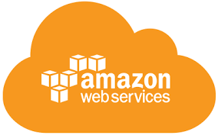
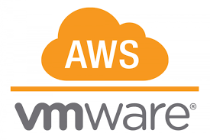
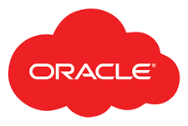
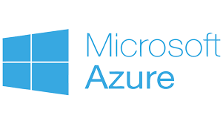



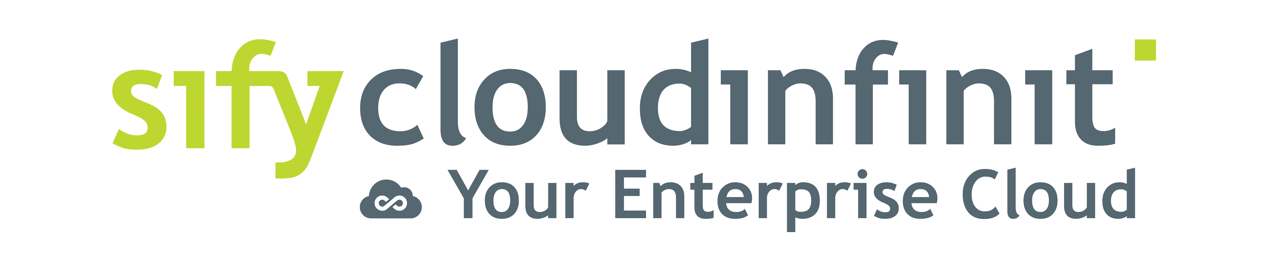
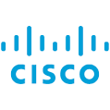

SIFY CLOUDINFINIT: HYBRID/MULTI-CLOUD WITH
CLOUD ADJACENCY
Sify CloudInfinit brings transparency of usage, cost control policy, operational efficiency led by automation, maintaining SLA and uptime.
Hybrid Cloud
  Configure flexible compute instances on demand, right size VMs as per application and license
Hyperscale Clouds AT VERY LOW LATENCY
Express Route
RABALE DATA CENTER (Cloud Adjacent)
DC INTERCONNECT
Hybrid Cloud
Predictive costs across catalog with no bill shock and no egress costs
Direct Connect
Sify Cloud Connect
Partner Interconnect
Managed Services
Hybrid Multi Cloud Management Platform
Far DR
  Sify Cloud Anywhere enables enterprises to deploy an Edge Cloud pod for faster data processing
AIROLI DC ^{(Near Cloud / DR)} - Enterprise Multi Tenant Cloud ^{AT MINIMAL LATENCY}
Regulatory and compliance ready POD: SEBI, RBI, IRDA, MeitY empaneled and meet Data Localization
Colo
Sify MULTI-CMP driven | AIOps Platform for Managed Services
FAR DR READY
SEC - SAP GRID
CI Community
GCC –Make-in-India
CI Trading Cloud
Enable Hybrid Cloud adoption with low latency interconnect to Hyperscalers
Hyderabad Data Center
Notes:
Sify USP and strength is integrated service stream of Sify Cloud and low latency Cloud connect to Public cloud

Slide 11




Sify as a transformation partner
Managed
security
services
managed
Multi cloud
& Automation
services
Implement consistent set of controls to prevent security threats
Continuously monitor to detect security breaches
Tactical threat containment and automated response
Workload migration
services
Multi-cloud infrastructure and applications
Gen 5 CloudInfinit Cloud Management Platform
Orchestration platform/
Service Now/ CA UIM
AIOPS tools for Workload lifecycle monitoring & management
Cloud
assessment
services
Move from on-premise to Public and/or Private cloud
or
On–premise Data Centers to Sify’s world class
Data Centers
Recommend the to-be architecture and approach for a least disruptive and reliable migration

Slide 12


Sify as a transformation partner
TAKE ADVANTAGE OF
SIFY’S cloud & Digital WISDOM
RATIONALIZE YOUR INFRA
Investments WITH…
Leverage
SIFY’S network EXPERIENCE
strengthen your cloud and digital pursuit WITH…
BENEFIT FROM
Sify’s cloud & Digital expertise
ENSURE END-TO-END
CLOUD MANAGEMENT WITH…
CloudInfinit (Enterprise multi tenant and private cloud)
SAP Grid/ Exadata/ Azurestack Infrastructure
CloudInfinit CMP
Orchestration platform/ Service Now/ CA UIM
Data Center fabric
High performance storage, compute, security
AI/ML led automation
FSO, AI/ML platform
App Modernization: DevSecOps, K8s
AR/VR/XR, Digital Learning
Process Automation, FinOps, Cloud Economics
WAN Infrastructure such as metro rings
Network Observability
Network Transformation Services
Managed Network Services
Cloud Connect Services
SD-WAN, SASE
EdgeConnect Services for IT + OT + People
Cloud-enabled Unified Communication Services
Network Security Services like CleanConnect & DDOS protect
All aspects of building cloud and digital infrastructure
Managing public and hybrid cloud services
CloudInfinit CMP to provide multi cloud operational best practices
AWS/Azure/Oracle/Google cloud implementation
InfinitDigital Platform for actionable insights and faster delivery of core product and services
Delivering SaaS: Retail Intelligence, Digital Asset Management, Digital Assessment

Slide 13


SIFY’S BUSINESS MODELS
Systems are owned by the client and annuity-based payout for services
Assets +
Services
Less
Hardware
People
Licenses
Client engagement is based on defined business outcome generated by IT solutions and services
Reduced upfront investment as client subscribes to infrastructure owned by Sify as a part of their overall infrastructure requirement
Outcome based
Engagement Models
Component based
Usage based
No upfront investment by client and payout is based on consumption
From Systems Integration to Business Outcome-based Models

Slide 14


Sify ICT Services: Key Facts
700+
900+
100+
Global
PEOPLE
Data Center, Cloud & Managed Services Team
Network Experts
Certified Security Experts
PRESENCE
India (HQ) | USA | Canada | UK | UAE | Singapore
500+
600+
700+
70+
50+
CUSTOMERS
Cloud clients
Data Center Clients
Network Clients
Private Cloud & DR clients
CDN & Cloud Security clients
50+
500+
300+
80+
PROJECTS
IT Ops Transformation projects
Data Center services projects executed
Data Center Migration projects
Platform Migration Projects
22K+
100K+
91k+
5000+
7 Petabyte
VOLUME
Managed Tickets per Month
Network Devices
Managed Mailbox
Security Devices
  Managed Storage and Back-up
Notes:
Check with PK on this slide

Slide 15
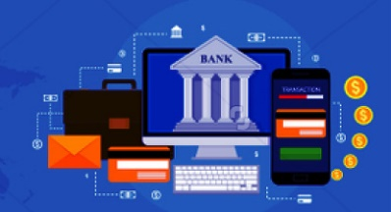

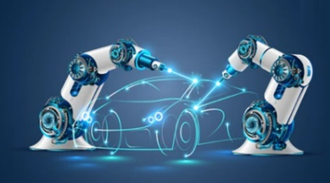






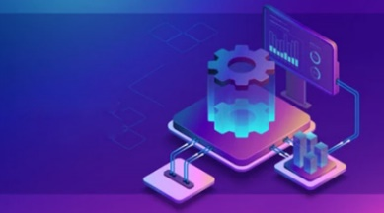
Industry aligned
BANKING
Insurance
Manufacturing
Retail
E-COMMERCE
Ensuring secure digital banking
Enabling faster
claim processes
Building smart digital factories
Enhancing in-store experiences
Creating intuitive
user experiences
Healthcare
PHARMACEUTICALS
MEDIA & ENT
EDUCATION
IT & ITES
Driving innovation in patient care
Faster medicine creation and delivery
Elevating digital streaming
Empowering digital learning for all
Digital Transformation for the change catalysts

Slide 16




Sify as a DIGITAL SERVICES partner
OUR PURPOSE (WHY)
OUR OFFERING (WHAT)
To build a high-value customer-centric organization through Cloud-Native Digital Transformation.
To help customers achieve their Digital Ambition by optimizing and transforming Value Chains digitally, through the 2 pillars.
DIGITAL OPTIMIZATION
DIGITAL TRANSFORMATION
PROMOTES Automation of Routine Tasks
INCREASES Efficiency
ENHANCES Customer Experience
REQUIRES Low code automation frameworks (SaaS based)
OFFERS RPA, Chatbot, App Development, AI/ML, Consumable Analytics
HELPS build new Go-To-Market offerings
REDUCES Time to Market
INCREASES Business Revenue
REQUIRES Complex Tool-Chains to design, develop, implement and operate new business generating platforms
OFFERS Cloud-Native Value Chain, Kubernetes as a Service, Digital-as-a-Service
Notes:
Our Cloud-Native Value Chain connects islands of discrete Tool-Chains to synergistically bring out high levels of efficiency for all stakeholders to increase the velocity to market. Availability-Scalability- Security-Resiliency-Economics
Cloud-Native Value Chain: Devops tool chain, streamline applications, all on cloud where customers pay as per consumption
Kubernetes as a service: is a subset of Cloud Native Value Chain for container orchestration, helps to club applications on cloud on a pay as you go model
Digital-as-a-service- all digital services: RPA, Chatbot, App Development, AI/ML, Consumable Analytics

Slide 17
digital transformation of enterprises

Slide 18








Empowering digital India
DIGITAL BRIDGE FOR BUSINESS TRANSFORMATION
BFSI
Manufacturing
Retail
Logistics
Healthcare
Education
Media
Govt./PSU
Enabling User
- Mobile First Engagement
Enchanting User
- Immersive Experiences
Enriching User
- Omni Channel Experience
Empowering User
- Contextual Insights
Business Priorities
(CXOs)
Scalability
Productivity
Security
INFINITFSO
Managed Services across
Cloud, DC, NW, Security, Digital, End User
InfinitDigital Applications Services
AI/ML, DevSecOps, DAM, XR & Digital Learning,
Retail Intelligence, Digital Assessment
Industry Applications Services
SAP, Oracle, Microsoft
AI/ML Powered Automation
Applications
INFINITMNS Platform
NOC, SDWAN, SASE
CLOUDINFINIT Platform
Enterprise Cloud
INFINITCMP
Hybrid/Multi Cloud Services
INFINITSECURITY
SOC, MSS, MDR, GRC
Platforms
Network & Data Center Infrastructure
Hyper Reach, Hyperconnect, Edge Connect, Private 5G, On-Demand Bandwidth| RAS Design, Hyperscale, BTS, Green, AIOps, AI Ready DCs
Infrastructure

Slide 19





Trusted digital infrastructure & platform partner
India’s top 10 banks trust Sify’s
data center and network services.
Every trading transaction of the world’s #1 derivative stock exchange passes through the network designed, implemented, and managed by Sify.
All of India’s inter-banking transactions are done on data center and network designed, implemented, and managed by Sify.
India’s #1 Bank chose Sify to deploy a modern NOC with AI/ML enabling intelligent and secure network monitoring across global locations.
India’s largest power utility company chose Sify’s cloud@core platform with business-outcome-based model to scale their service to 25 million+ subscribers.

Slide 20





Trusted digital infrastructure & platform partner
Sify’s data centers host 3 out of 4 Hyperscalers, global OTT players, the world’s leading social media network, Europe’s leading payment gateway, and 600+ enterprises.
A leading healthcare provider chose Sify’s cloud@core platform for the digital transformation of patient care services while saving 33% on cloud costs.
The world’s most widely distributed postal system trusts Sify’s managed network services to offer 24×7 country-wide postal, banking, logistics, and insurance services.
A top FMCG company in India with 25 mother brands uses Sify’s Retail Intelligence Solution for their forward supply chain to service 7 million+ retailers across the country.
Sify’s integration service enhanced the digital experience in the treatment of cancer by making patient information and radiation device availability visible from anywhere.
Notes:
Small and medium vs large

Slide 21





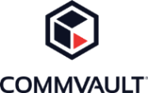





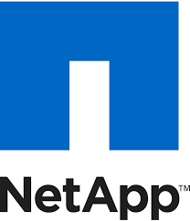



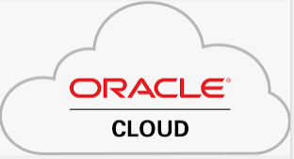


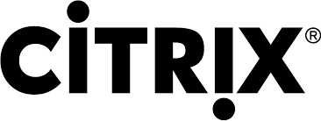

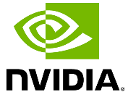




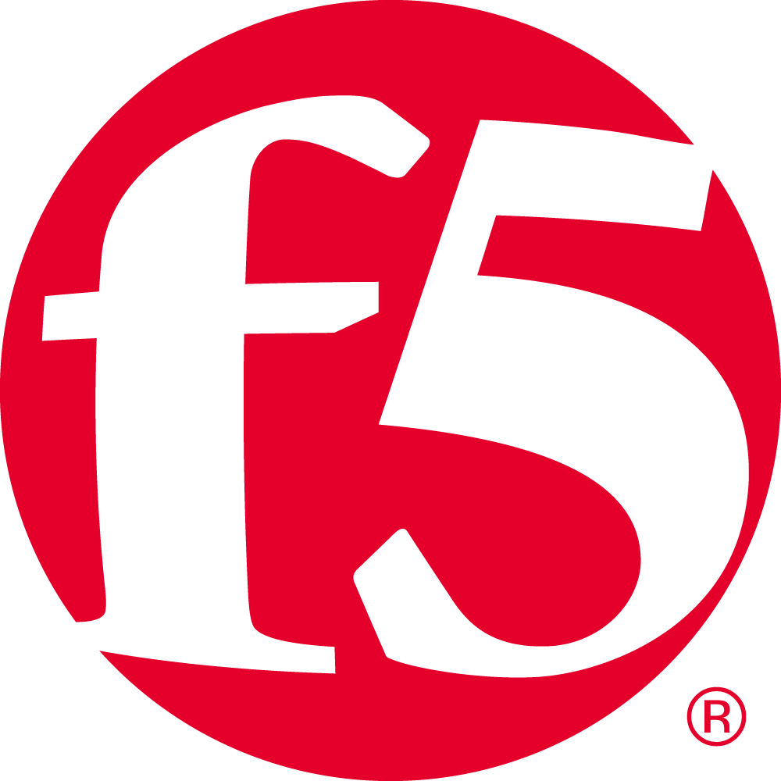


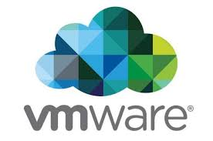




SIFY’S technology Partner ECOSYSTEM
CLOUD
SECURITY
APPLICATION
TECHNOLOGY

Slide 22

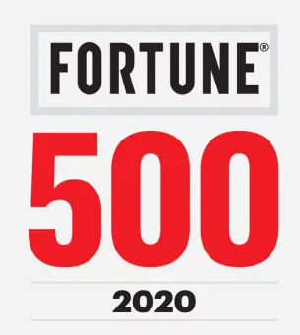







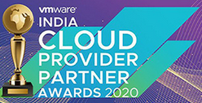
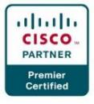


INDUSTRY RECOGNITIONS
Brand Perspective
Industry Perspective
Sify is a Niche Player in Gartner’s MQ for Managed Network Services Global 2023
Recognition in Market Guide for Public Cloud Managed and Professional Services Providers
APAC 2021
Recognition in Market Guide for Backup as a Service 2021
Recognition in Market Guide for Security Testing & Consulting Services in India 2021
Recognized as among ‘The Best Firms for Women in Tech’ by Analytics India Magazine.
PARTNER Perspective
‘The Economic Times – Choice of Tech Leaders’ Awardee for Managed SD-WAN 2023
Major Player in
MarketScape for Managed Cloud Services APeJ 2021
The Economic Times Iconic Brands 2020
Hybrid Multi Cloud
Sify was awarded the Best System Integrator, FY 2022 by HPE Aruba Networking
Hosting Partner
Data Center Transformation Services 2018
Network
Transformation Services 2018

Slide 23
SIFY as your strategic long-term partner
Matured Delivery for Cloud, Network, Infrastructure and Application Managed Services and Migrations
Network Services
SDN based self service access to Cloud and DCs
Trusted Hybrid Cloud Advisor Support choice of deployments
Single Vendor for end-to-end Uptime SLA
DIGITAL TRANSFORMATION
Invested in State of art Tools and Automation Sify CMP, FlashNet, OnNet InfinitDigital Platform
Integrated play across Network, Data Center, Cloud, Applications and Security towards Digital Transformation
Digital Services
infusing AI/ML, Full Stack Observability, and Application Modernization

Slide 24







Award for Sustainability
Innovation in Data Center
India’s 1st Nvidia
DGX Ready Liquid &
Air Cooled DCs
Best in
Services Industry
Managed Network Services - MQ
Tried Tested Trusted
Your digital infrastructure partner for over 25 years
Network
Infra Services
Network Digital
Managed Services
Data Center
Colo Services
CloudInfinit
Ent. Cloud Infra
Cloud & IT
Managed Services
Digital Apps
Managed Services
Industry Apps
Managed Services
Security
Managed Services
Thank You

