Slide 1
YOUR DIGITAL BRIDGE FOR BUSINESS TRANSFORMATION
Built on world-class digital infrastructure,
platforms and services
Sept 2024

Slide 2


BUSINESS priorities
Business Expansion
Diverse Product Portfolio
Operational Efficiency
Security & Compliance
Expand operations to diverse geographical locations.
Enter new markets to support business growth and new customer access.
Innovative products/services for evolving customers’ needs.
Personalized experience and recommendations.
Streamline operations, processes and resource usage.
Maximize productivity and reduce costs.
Ensuring robust security to protect user data, IPs, and critical systems.
Adhering to regulations.
Technology PRIORITIES
Integrated IT, Digital Marketplace
Digital-first Platforms
AI/ML &
Analytics
Cybersecurity & GRC
Jumpstart biz operations in new locations.
Scalable, agile IT stack and digital marketplaces for global reach.
Intuitive user experience across platforms (mobile apps, internet portals, IVRs, open APIs, microservices, and cloud)
Faster time to market.
Automate routine tasks, improve decision-making.
Enable predictive maintenance and enhance service delivery.
Next gen firewalls, intrusion detection, and encryption. Multi-factor authentication.
Automated compliance tools.

Slide 3


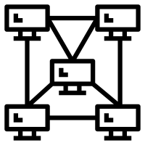
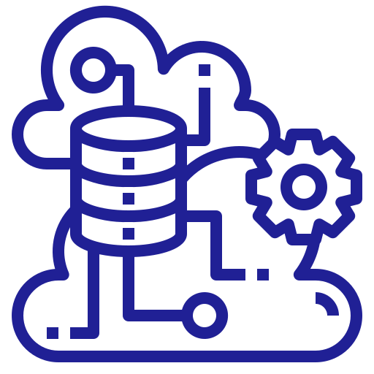




Enabling digital experiences
Trends, Proposition & Growth Levers
HYBRID CLOUD ADOPTION
INFORMATION SECURITY
HYBRID NETWORK
APP MODERNIZATION
Build service, cloud service, hyperscale partnerships
Cloud Access Security, Cloud Security Posture management, Cloud Native Application security
SDWAN, SASE, ZTNA
DevSecOps, Cloud native app, InfinitDigital SaaS services
App modernization skills across multiple verticals to offer higher value and enhanced customer experience
SDWAN, SASE, ZTNA technologies to empower hybrid networks built on decades of network management experience
Value Stream Management and DevSecOps to ensure faster time to market, release quality, security, and compliance
FSO and comprehensive security services to secure the agile and borderless enterprise 24x7
FULL STACK OBSERVABILITY
EDGE TRANSFORMATION
CUSTOMER EXPERIENCE
AI/ML FORESIGHTS
InfinitFSO platform for availability and performance
Intelligent Edge
Immersive customer experience with AR/VR custom content creation
For real time prescriptive foresights for workflow optimization
AI/ML Foresights for real time data driven workflow optimization at the edge and send outcomes to cloud for reinforcement learning
Higher availability, performance and security for existing and new customers with digital infrastructure and hybrid IT
Immersive AR/VR experiences to help organizations convert impulsive customers in the free / trial mode into paying customers
AI/ML Foresights platform with Auto MLOps to transform domain experts or citizen data scientists into formally trained data scientists
Sify Confidential

Slide 4





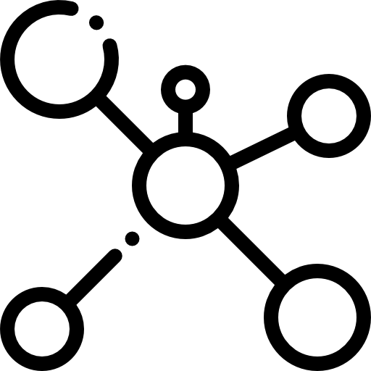

Future of Digital Enterprise
Scalability
Productivity
Security
ICT ecosystem
AI/ML
Predictive analytics
Hybrid IT
Hybrid Work
Enterprises are converging to secure, scalable end-to-end data center, network and digital
Sify Confidential
Notes:
Need for a Scalable and Hardened Technological Infrastructure is required for a future ready digital enterprise:
Operational Efficiency:
• Decrease average transaction process time by 25% through automation
• Implement process automation for 5 key operational workflows
• Decrease operational costs by 15% with no loss of service quality
Enhanced Customer Experience
• Increase mobile app ratings to 4.7 stars with 80% +ve reviews
• Achieve a 30% reduction in customer support tickets
• Increase digital banking transaction volumes by 25% YoY
Security & Compliance
•Implement consistent data encryption standards across on-premises, private cloud and public cloud environments.
• Achieve compliance certifications for all regulated workloads
• Achieve maximum coverage of multifactor authentication and stringent access controls
AI/ML and predictive analytics is used by Banks for fraud detection and prevention, personalized banking services, process automation, and predictive analytics.
Blockchain: Banks use blockchain for various applications, including cross-border payments, trade finance, identity verification, and compliance with regulatory standards.
Hybrid IT: deploying hybrid environments as per business priorities
Network Backbone: rearchitect the network architecture for digital transformation
Key results like these typically require multiple technology initiatives depending on the bank's digital transformation state. The specific results highlighted above require a highly available and performant core banking system, API gateway, embedded AI/ML insight and foresight engine, and versatile data Lakehouse to power a consumer-grade, modern user experience.

Slide 5

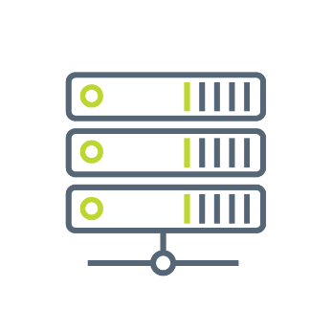

SIFY GROUP COMPANIES
NETWORK
SERVICES
DATA CENTER COLOCATION SERVICES
CLOUD & DIGITAL
SERVICES
Sify Technologies Ltd.
Sify Infinit Spaces Ltd.
Sify Digital Services Ltd.
Innovation led by Sify Ventures
Sify Confidential

Slide 6
Innovating TO STAY Relevant
1995-2005
Internet Revolution
2006-2011
Data Explosion
2012-2020
Cloud Innovation
2021 onwards
Digital Acceleration
Age
of
AI
Sify 1.0
Sify 2.0
Sify 3.0
Sify 4.0
RETAIL INTERNET SERVICE PROVIDER
ENTERPRISE SERVICES COMPANY
DIGITAL ICT SERVICES PROVIDER
DIGITAL TRANSFORMATION PARTNER (digital@core)
First private
ISP in India
Launch of MPLS &
Data Center services in India
Launch of Enterprise Cloud platform & Hybrid Cloud services
Launch of end-to-end
Digital services
From revolutionizing consumer internet in the 90s to becoming a Digital Transformation Partner for Enterprises

Slide 7
OUR Investment PHILOSOPHY
Digital
Services
Skilled workforce to support modern technologies
Services across the digital spectrum
Embedded AI
Secure by design
3000+ SMEs across platform automation, modern apps, AI/ML, DC, Cloud, Networks, Security
Infinit AI/ML, Infinit FSO, SaaS & Industry solutions
Modern cloud platform – x86 & GPU support
Ample data stores for data explosion
Cybersecurity Operations Centers
Cloud Management Platform for efficient operations
CloudInfinit AI Sovereign Cloud
Hybrid Cloud Infrastructure
Sify Cloud Anywhere Edge Cloud
Infinit CMP, Infinit MNS platform
Global SOC, MSS, Infinit Security
Cloud,
AI & Security
AI ready data centers
Core and Edge data centers for edge use cases
Certified and compliant
Focus on sustainability
14 DCs, 227+ MW IT power
407+ MW by 2025
Scalable to 970+ MW
231+ MW RE Power
AIOps, AI Ready, Liquid cooling
Data
Centers
Network
Infra
Reliable national network backbone
On-demand capacities
Deep Distribution Capillarity
Open Cable Landing Stations for subsea cables
1700+ Cities, 3700+ PoPs
Fiber coverage 24+ Metros
3 CLS, 8 International POPs
Sify OnNet- automated Ent WAN
Sify Confidential
Notes:
1400+ Digital Networks
350+ Cloud
450+ Modern Apps & AI/ML,
100+ Cybersecurity,
100+ Platform automation,
500+ Technology Integration

Slide 8

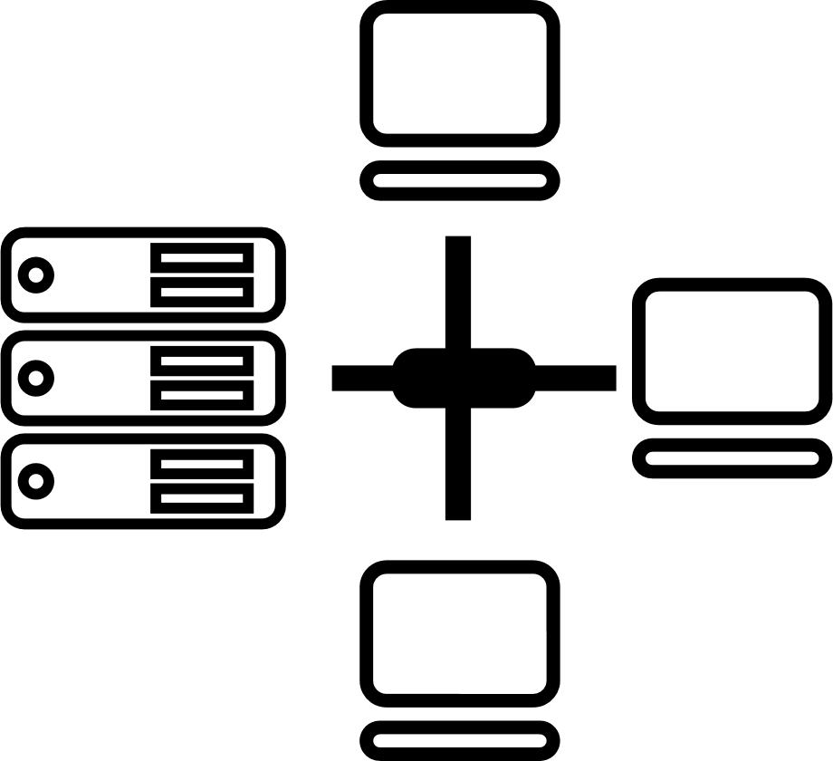

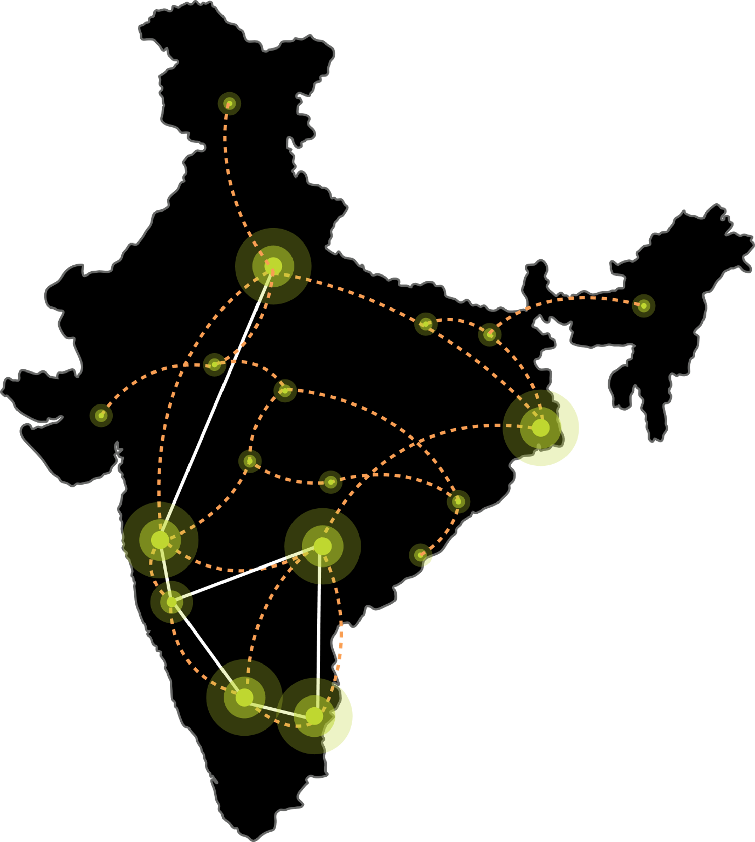






SIFY’S DIGITAL INFRASTRUCTURE & PLATFORMS
India’s Top 10 banks, Top 4 Manufacturing, 3 Major Hyperscalers, Global Social Media, OTT, Security Players, and 10,000+ Enterprises trust Sify.
Metro Networks
Fiber access
Connected Buildings
Interconnected DCs
Express Long-Haul Backbone, High Bandwidth and Low Latency across Key Locations
Network
Infra Services
Network Digital
Managed Services
NOIDA 02
NOIDA 01
SAARC Gateway, Kolkata
Data Center
Colo Services
CloudInfinit
Ent Cloud Infra
MUMBAI 03 RABALE
KOLKATA 01
MUMBAI 02 AIROLI
MUMBAI 01 VASHI
CLS, Versova, Mumbai
HYDERABAD 02
HYDERABAD 01
Cloud & IT
Managed Services
Security
Managed Services
CHENNAI 02
BENGALURU O2
CHENNAI 01
BENGALURU 01
CLS, Siruseri, Chennai
Digital Apps
Managed Services
Industry Apps
Managed Services
Sify Confidential
Notes:
Swap cloud and dc

Slide 9
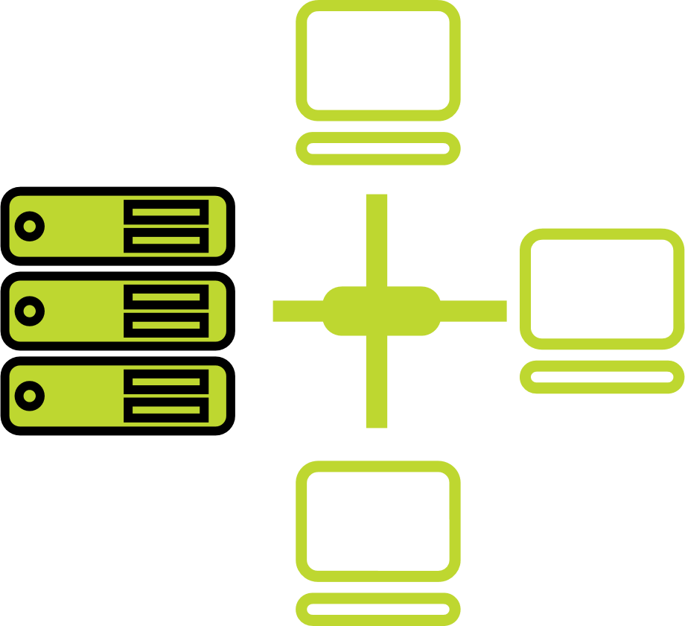




one-stop engagement for enterprises’ digital pursuits
Network
Infra Services
Network Digital
Managed Services
Data Center
Colo Services
CloudInfinit
Ent Cloud Infra
Cloud & IT
Managed Services
Enterprise connectivity- WAN, NLD
Edge Connect- Pvt 5G, Wi-Fi
Global Cloud Connect, DC Interconnect
International POPs, Cable Landing Stations
Network transformation and consolidation
Managed Secure Networks- SDWAN, SASE, DDOS protect
Campus & Branch Networks
Smart Edge
Captive & Hybrid NOC services
Network Observability
CaaS & Collaboration Services
Cloud Onramp
RAS Design
AI Ready with Liquid Cooling
Hyperconnected
Built-to-suit
AIOps
Renewable Energy
Managed Public/Private Cloud
Hosted AI Platform (Multi Instance GPU) as a Service
Cloud Anywhere-Edge Cloud
BCP- DRaaS
Regulatory and compliance ready
Hybrid Cloud Assessment, Migration and Managed Services
Multi Cloud Platform
Hyperscale Cloud services AWS, Azure, GCP, OCI
End-to-End IT Managed Services
Networks
Data Centers
Cloud & IT
Digital Apps
Managed Services
Industry Apps
Managed Services
Security
Managed Services
25 years
of digital
trust…
Digital
Infinit Full Stack Observability
Infinit AI/ML Platform
App Modernization & DevSecOps
Retail Intelligence- Forum Digital
Digital Assessment and XR
Consulting, Support, Maintenance, and Upgrades
Microsoft
Oracle
SAP
Security
Cybersecurity assessment and managed services
MSS, MDR & GRC
Global SOC
AI/ML driven Security Assurance
Sify Confidential

Slide 10
networks

Slide 11




Building future ready network backbone
Hybrid
Access Strategy
Cloud and
Digital Ready
Designed for Mission Critical Networks
Automation
Pan-India wireless enterprise connects across 1700+ Cities, 3700+ PoPs
Fiber coverage across 24+ Metro Cities
8 International PoPs, global partnerships with Telecom Carriers and Internet Exchanges
66+ Interconnected DCs, 99.999% guaranteed availability
Connectivity to all major Hyperscalers
High Bandwidth and Low Latency
Fully meshed backbone for resiliency
CLS: Mumbai, Chennai, Kolkata
Edge Network strategy to augment tier 2 cities digital infrastructure
Sify OnNet: India’s first automated enterprise WAN
On Demand network infrastructure services
Powered by AI/ML based operations with dual NOCs
Sify Confidential

Slide 12
NETWORK DIGITAL MANAGED SERVICES
Outcome-based Network Managed Services enabling scalability & reliability
Cloud Managed Branch & Campus operations with integrated Security
Secure WAN employing Managed SD-WAN & SASE
Software Defined & Secure DC Network Architecture
Capability built over 2+ decades supporting large, diverse customers
Modern Tools enabling AIOps & Observability for enhanced customer experience
Service Delivery Platform
Actionable Insights & Analytics
Delivery Process Automation & AIOps
Expertise across Network, Security, Cloud Communication, and IoT, fortified by the innovative capabilities of
Sify's Service Delivery Platform, constitutes an unparalleled value proposition.

Slide 13




Network Digital Services Portfolio
Network Transformation
Secure WAN Edge
Cloud communication & collaboration
Mobility & IOT
Managed SDWAN
Managed Campus / Branch Network
Data Centre Network
Managed Cyber Security
Network Observability
Automation, Orchestration & AIOps
NFV/ NFVI
SASE
Secure SD-WAN
Cloud Managed Wi-Fi
Managed DDOS
Firewall As a Service
Remote VPN
uCPE
Private 5G
Mobile Edge Compute
IOT Solutions
IOT Connect
IT/OT Security
IOT Applications
UCaaS
CCaaS
CPaaS – Omnichannel
Platforms ( on-prem / hosted )
Microsoft Teams
Cisco Webex
Service Delivery Platform
Actionable Insights & Analytics
Delivery Process Automation & AIOps
Core Capabilities
Consult / Advisory
Design / Implement
Managed Operations / NaaS
Expertise across Network, Security, Cloud Communication, and IoT, fortified by the innovative capabilities of Sify's Service Delivery Platform, constitutes an unparalleled value proposition
Sify Confidential

Slide 14
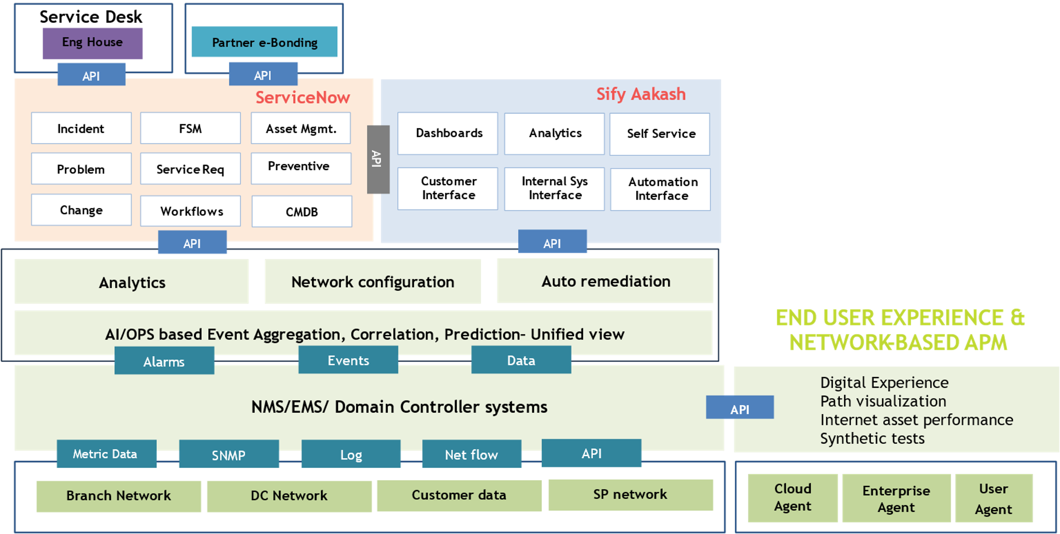
NETWORK DIGITAL SERVICE DELIVERY PLATFORM
Automation & AI Driven
Incident Co-relation, Diagnostics Bots, Service Provisioning, Predictive Insights & AIOps
Network Observability
End to End visibility: Topology, Service Relationship & End user experience
Customer Experience
Aakash provides intuitive Analytics, Inventory & Self Service
Tools Integration
Multi Vendor NMS, EMS & Controllers. E-Bonding with key Telco’s & OEM’s ITSM tools
ITSM
Sify Confidential

Slide 15
AI Ready DATA CENTERs
FROM India’s Data Center Pioneer

Slide 16

Our DATA CENTERS: INDIA FOOTPRINT (SIX Markets)
NOIDA 02 CAMPUS
Tower B
43+ MW
Tower 1
11.5 MW
Tower 2
9.6 MW
Tower 3
BTS
NOIDA 01
Noida
10.8MW
Tower A
43+ MW
Tower C
43+ MW
1st Tier 3
in 2000
Tower 4
8.1 MW
Tower 5
43+ MW
Tower 6
40+ MW
Q2 2025
MUMBAI 01
Vashi
0.9 MW
Tower 7
40+ MW
Q3 2025
Tower 8
40+ MW
Tower 9
40+ MW
Tower 10
40+ MW
KOLKATA 01
2.2 MW
Tower 11
40+ MW
Q3 2025
Tower 12
40+ MW
Q4 2025
MUMBAI 02
Airoli
5.4 MW
HYDERABAD 02 CAMPUS
(FAB CITY)
MUMBAI 03 CAMPUS (RABALE)
HYDERABAD 01
Financial Dist.
14.4 MW
Block 1
26 MW
Additional Blocks
26-52 MW each
(including BTS)
BANGALORE 02 CAMPUS (AEROSPACE PARK)
BANGALORE 01
Electronic City
7.6 MW
Tower 1
20+ MW
Q2 2025
Tower 2
20+ MW
CHENNAI 02 CAMPUS (SIRUSERI)
CHENNAI 01
Tidel Park
3.6 MW
Tower A
43+ MW
Tower B
43+ MW
Tower C
43+ MW
Operational
In Development
Planning
All Power references are Design IT Power at maximum Capacity
All Power references are Design IT Power at Full Capacity

Slide 17

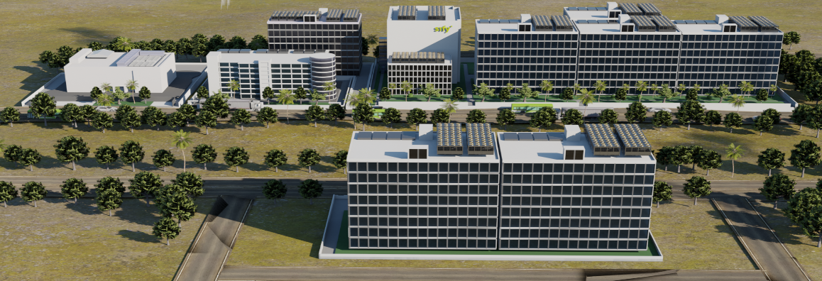


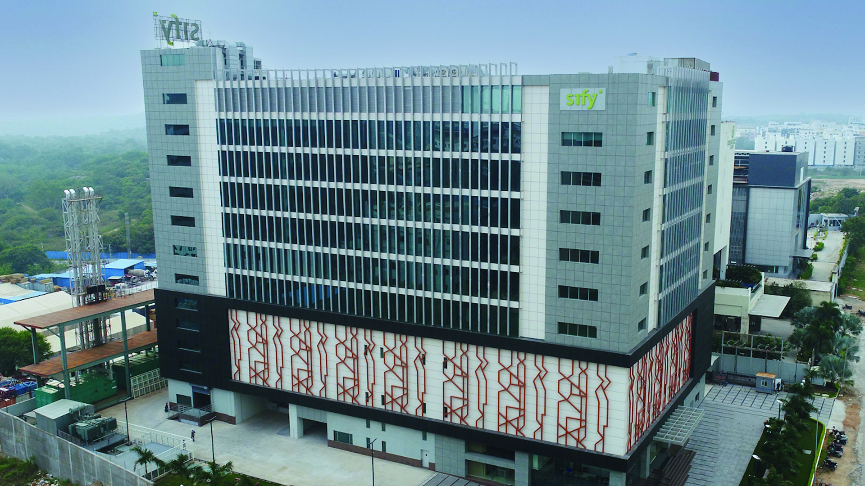
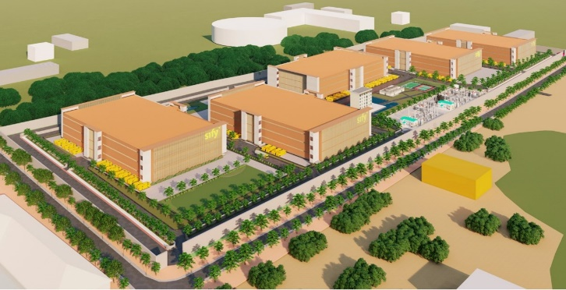
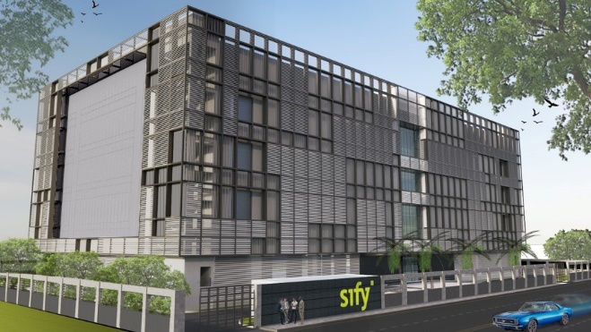
AI-READY, hyperscale, Hyperconnected, Green, Data Center campuses
India’s 1st Nvidia DGX Ready Air-Cooled DCs
March 2022
India’s 1st Nvidia DGX Ready Liquid Cooled DCs
August 2024
MUMBAI 03, RABALE
IT Power: 377+ MW | Racks: 32,000
5 Towers Operational
4 Towers in Development
NOIDA 02
IT Power: 130+ MW | Racks: 13,000
CHENNAI 02, SIRUSERI
IT Power: 130+ MW | Racks: 13,000
3 Towers in Planning
1 Tower Operational
2 Towers in Planning
1 Tower Operational
2 Towers in Planning
HYDERABAD 01, FINANCIAL DISTRICT
IT Power: 14.4+ MW | Racks: 3,000
HYDERABAD 02, FAB CITY
IT Power: 250+ MW | Racks: 25,000
BENGALURU 02
IT Power: 40+ MW | Racks: 4,500
Operational
Planning
In Development
IT Power Capacity includes customized BTS towers designed for high-capacity AI workloads with liquid cooling.
Design Rack Capacity will vary based on customer power density, rack size, cage deployment, and other factors.
14 DCs - 227+ MW IT power | 407+ MW by 2025 | Scalable to 970+ MW with BTS
Notes:
Total power 1.5 X of IT power

Slide 18
Future ready data center architecture
CUSTOMIZABLE & MODULAR INFRA
ENGINEERED FOR AI WORKLOADS
MULTI LAYERED NETWORKS
Multi tower campuses with Vertical and Horizontal expansion to support future business growth
Designed for 200 kW/rack high density racks. 6.3m floor to floor height, 2100 kg/m² load bearing capacity
Multi-tier fiber and copper for low-latency deployments, supporting high-capacity network bandwidth of 200 Gbps+
RELIABLE
POWER SUPPLY
SUSTAINABLE
OPERATIONS
On premise 110, 220, 230 kV substation with 48 hours of fuel storage with redundant supply contracts
Liquid & Air-cooling solutions, 60% renewable energy and automation led continuous monitoring
Ensure business continuity, maximize uptime, resilient connectivity and sustainability
with RAS designed scalable digital infrastructure

Slide 19
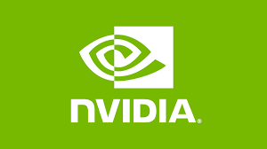
NVIDIA Certified Data Center with liquid cooling
Sify is India’s first NVDIA certified DGX Ready Data Center Service Provider for Liquid Cooling
Support 130+ kw/rack power and cooling
Meets ASHRAE’s 30-year environmental guidelines
DGX B200
Liquid Cooling
In 2022, Sify was India’s first Air Cooled Certified Data Center for A100, H100 Servers
Notes:
Sify, India's First NVIDIA DGX-Ready Liquid Cooling Certified Data Center

Slide 20
Data Center Advantage
Hyperscale, Hyperconnected, Green, AI-ready
RAS based design for future ready infrastructure
Liquid & Air-Cooling ready Data Centers, up to 200 KW power/rack.
14 DCs, 227+ MW IT power, expanding to 407+ MW by 2025
Hyperconnected, Carrier-neutral and Rich Interconnect ecosystem
India’s Data Center Powerhouse for over 2 decades
3 of 4 Hyperscalers, Global OTT & Social media players,
India’s Top 5 banks,
and 600+ enterprises…
Campuses scalable to
970+ MW with BTS capabilities
AI/ML led operational excellence with 100% uptime
Enhanced 10 levels of security with automation
231 MW renewable energy contracted
* Alternative BTS Design available for higher capacity for AI applications.
40-50MW per tower can be deployed with 100% Liquid Cooled @ 40-200 KW/rack
Notes:
Operational- as is ready: 227.7 rounded to 227 (included tower B Noida, Chen 02)
Expanding: operational + development: 407.7 rounded to 407 MW
Scalable to: expanding to, operational + development+ planning: 970.5, 970 MW

Slide 21
Cloudinfinit & IT Managed Services

Slide 22






Sify CloudInfinit: AI Enterprise Cloud
Sify CloudInfinit is a comprehensive cloud computing platform that provides a wide range of cloud services designed to meet the diverse needs of businesses, from startups to large enterprises.
Infrastructure as a Service (IaaS)
Platform as a Service (PaaS)
Software as a Service (SaaS)
Managed
Services
Predictive costs across catalog - No bill shock &
No egress costs
SIFY CLOUDINFINIT ENTERPRISE PLATFORM
Various Sovereign cloud landscapes, such as Banking, Trading, and Make-in-India Cloud
ENTERPRISE SAP GRID
SOVEREIGN AI CLOUD
GCC CLOUD
Regulatory and compliance-ready POD: SEBI, RBI, IRDA, MeitY empaneled to meet Data Localization
Enable Hybrid Cloud adoption with low latency interconnect to Colo & Hyperscalers
Powered by automation, ensures transparency of usage, cost control, and operational efficiency.
Sify Confidential

Slide 23







Cloud & IT Services portfolio
Sify CI Enterprise Managed Private /Hybrid Cloud
Hyperscale Cloud Services (AWS, OCI, GCP, Azure) & Hyperscale adjacent DC
Assessment led architecture design, build services for multi/hybrid IT solution
Migration best practices for minimal services disruption
Comprehensive security framework- preventive, corrective & detective
Resiliency and data protection solutions and services
Cloud enhanced services
AI/ML, Microservices,
Analytics etc.
Multi cloud management platform providing unified visibility & cost control
Sify Confidential

Slide 24
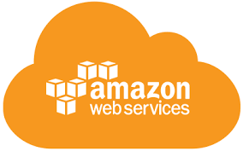
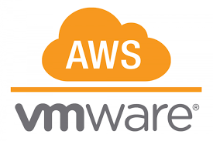
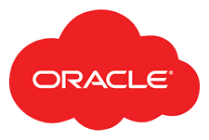
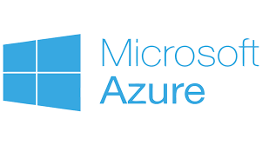



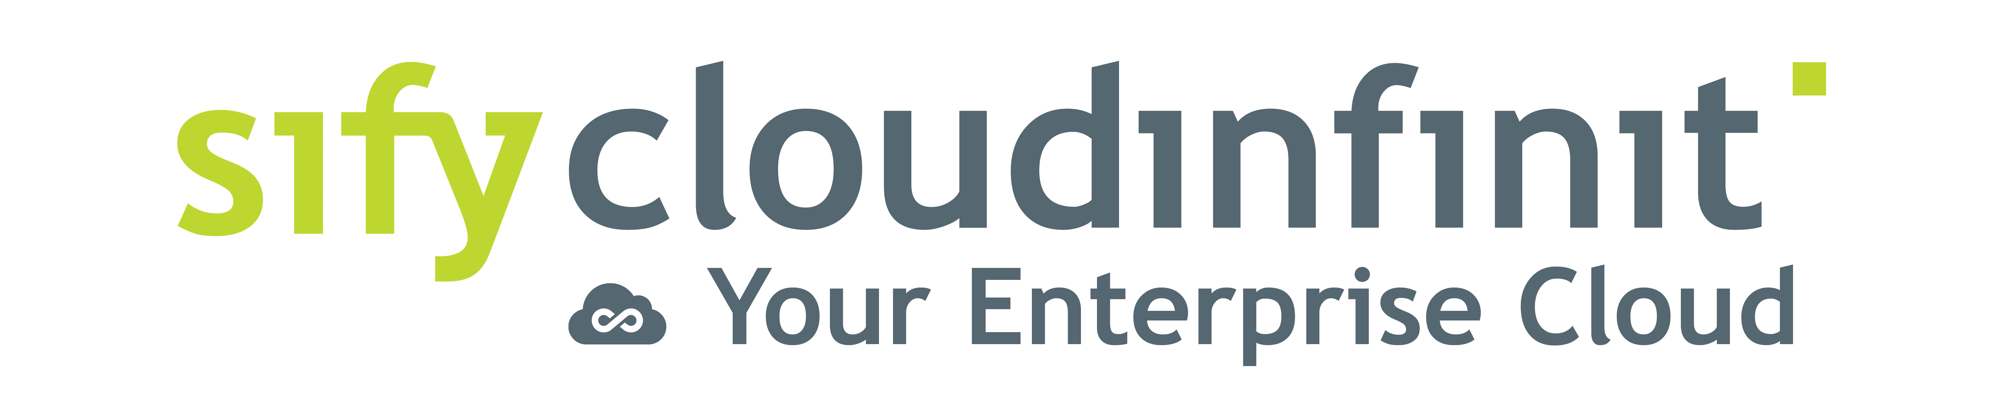
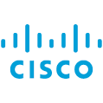
Hybrid/multi cloud with cloud adjacency
Best of breed performance with Hybrid Cloud configuration
Efficient integrations with extended ecosystems
Compliance with data sovereignty
Business continuity with resilience
Simplicity with self service
Operational efficiency with reduced IT administration
Cost reduction with
on-demand bursting to public clouds
Hybrid Cloud
Hyperscale Clouds AT VERY LOW LATENCY
Express Route
RABALE DATA CENTER (Cloud Adjacent)
DC INTERCONNECT
Hybrid Cloud
Direct Connect
Sify Cloud Connect
Partner Interconnect
Managed Services
Hybrid Multi Cloud Management Platform
Far DR
AIROLI DC ^{(Near Cloud / DR)} - Enterprise Multi Tenant Cloud ^{AT MINIMAL LATENCY}
Colo
Sify MULTI-CMP driven | AIOps Platform for Managed Services
FAR DR READY
SEC - SAP GRID
CI Community
GCC –Make-in-India
CI Trading Cloud
Hyderabad Data Center
Sify Confidential
Notes:
Sify USP and strength is integrated service stream of Sify Cloud and low latency Cloud connect to Public cloud

Slide 25





















SIFY INFINITCMP: Gen V MULTI-Cloud Management
Sify InfinitCMP ensures better visibility, control and governance across multi clouds.
Provisioning
Orchestration
Configuration
Billing / Chargeback
Systems Management
Capacity
Cost Management
Cloud Management Platform
(Action & Automation)
Cloud Administrators
One-click blueprint deployment of distributed workloads across multi-clouds
Self Service
APIs
SEC Anywhere
Resource Dashboard and governance from a single portal for all clouds
DevOps Management
Unified Dashboard
Role(Profile) Based Access
Automation
Blueprints
Policy Engine
Security & Compliance
App & DevOps
FinOps:
AI/ML driven real-time observability to optimize and control cloud costs
Dashboard
Request / Change
Event / Incident
Monitoring
Discovery
ITSM
(Engagement & Records)
All Users
Unified analytical view on overall utilization, trending, resource planning and security assessment
Native Tools
AI / ML
One interface to manage all cloud accounts and chargeback across tenant and clouds
CxO Users
Automation
SLA
HA / DR
Knowledge Base
Logs
Users
Core Platform
POD
Sify Confidential
Notes:
CMP's Building blocks illustrate various services' capabilities, supporting, provisioning, configuration management, automation, blueprints and cost management.
All the CMP configuration parameters are synced with ITSM for seamless integration and life cycle management of platform
The CMP is designed to support diverse user profiles.

Slide 26



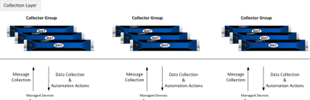
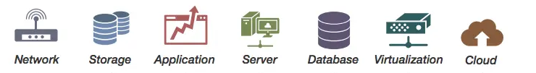

IT MANAGED SERVICES FRAMEWORK
Customers
Sify Delivery Team
Single partner for Managed Services across Digital IT
Operational Excellence driven by Automation
Proactive Assurance, Predictive Analytics & AIOps
Customer-centric Service Delivery model
Service Management Portal
Service Fulfilment
Provisioning, Orchestration & Service Assurance – Sify Multi-CMP
Request
Event
Incident
Problem
Change
Asset Mgmt.
CMDB
Service Mapping
AI/ML Tools
Sify Monitoring Tool
Data Store
Discovery & Mapping
Monitoring
Business Services Dashboard
Automation
Event Management
AIOps
Data
Visualization
Backup
Polled
Logs
Agents
API
Patch Management
Syslogs
VA / PT
AV
SIEM
API
Agents
DR
Any Cloud
Operations Support Systems
Sify Confidential

Slide 27






end-to-end IT Managed Services
It Infra & Systems
End User Support
Applications
Cloud
Network
Security
AMS
Microsoft Stack AMS
Oracle AMS
SAP, S4/HANA AMS
Application Security
Server
Virtualization
Operating Systems
Storage
Backup & Recovery
DR Management
Database
Middleware's
Hyperscale Cloud - AWS, Azure, OCI, GCP
IAAS Support
PAAS Support
Cloud Security
Private / Hybrid Cloud
Multi Cloud Orchestration
NOC
Network Security
IT Network
WLAN / Wi-Fi
WAN / MPLS
Telecom
IP/VoIP
VC
SDWAN
Access
Host
Data
Deskside Support
VDI Support
Mobility Support
Messaging & Collaboration
Office Productivity Suites
End Point Protection
Branch Infra
SIEM, Threat Management, Governance Risk Compliance
Service Desk
Omni-Channel, 24x7, Multi-Lingual
Tools
Service Desk/ITSM, Discovery, Automation, Orchestration, Correlation, Operation Insights, Dashboards, AIOps, DevOps
Processes
ITSM – ITIL, ITAM, ITOM, ISO 27001, ISO 2000
Sify Confidential

Slide 28
digital services

Slide 29
DIGITAL APPs & Industry Apps MANAGED SERVICES
Fostering enterprise-wide transformation with SaaS and custom solutions
Infinit FSO
AIOps driven excellence with observability across your digital stack
Infinit AI/ML
Supervise & simplify your entire AI/ML lifecycle
Infinit DAM
Increase brand visibility & enhance your digital
content strategy
Infinit Retail Intelligence
Digitalize your forward supply chain management
Build a Digital culture within the organization with Digital Assessment & AR/VR/XR services
App Modernization
and DevSecOps for faster time to market
Industry Application Services to unlock business agility
SAP, Oracle, Microsoft
Sify Confidential

Slide 30
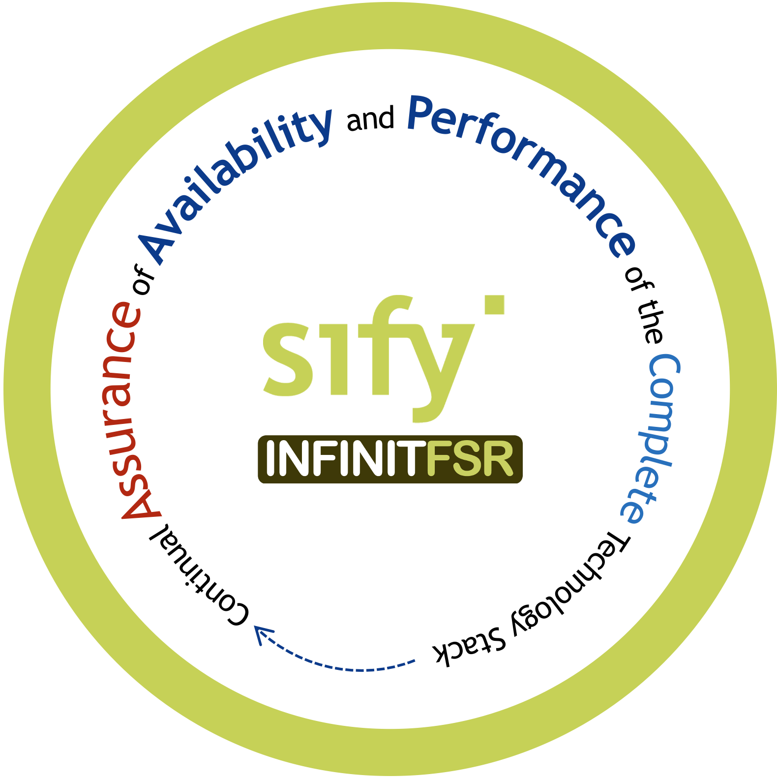
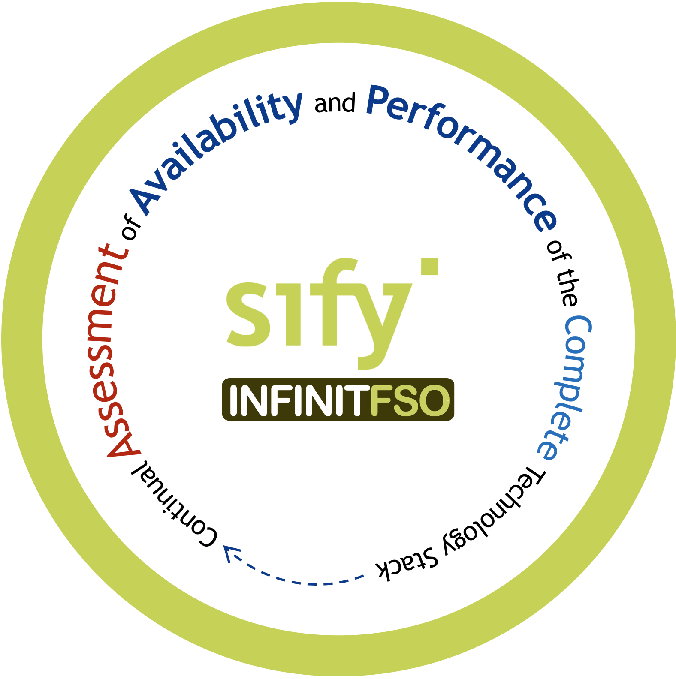
AI Powered infinit Full Stack Observability
Service Management and Visualization Dashboard
4
Prediction, Prevention, and Remediation of Business Service Availability and Performance Issues
Network Performance
Multi Cloud FinOps
App Security Services
App Performance
App Resource Optimization
...
BATCH
Real Time Predictive Insights Multi Domain Telemetry
3
AI OPS
Asset Dependency Map Generation
X-MELT
STREAM
2
1
Telemetry - Metrics, Event Logs, Traces From All Sources
NET OPS
IT OPS
SEC OPS
APP OPS
Gain insights, ensure high performance & availability of your business-critical applications
Sify Confidential

Slide 31
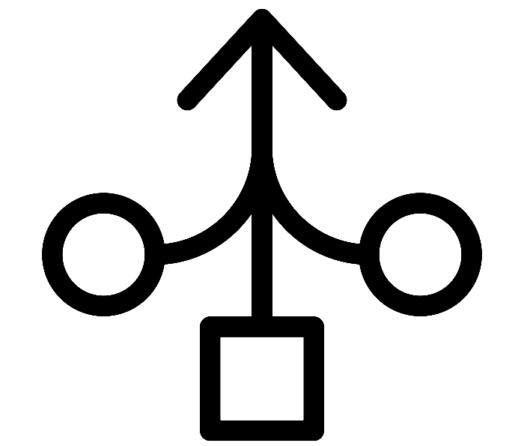


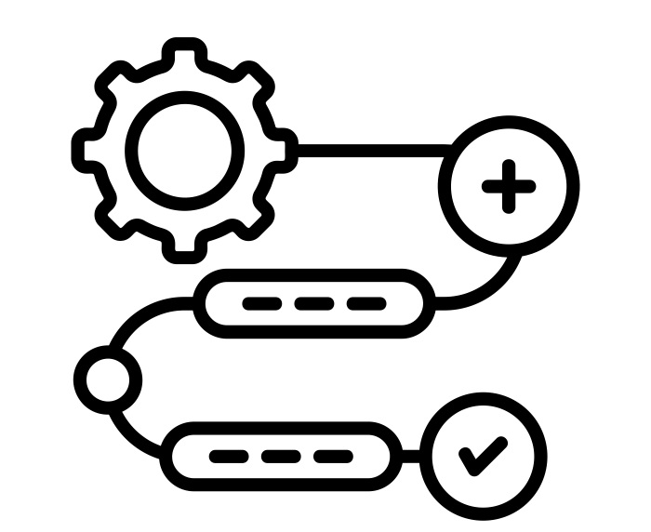


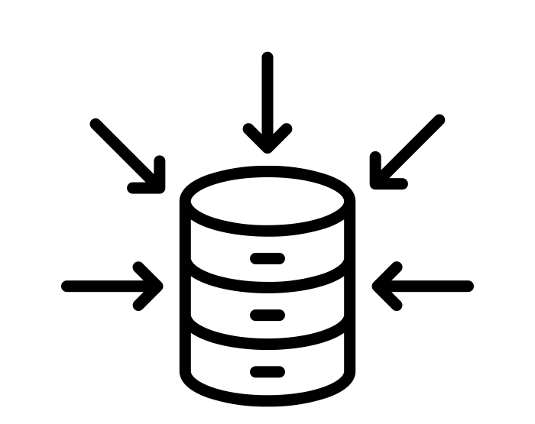




InfinitFSO with aiops for real time insights on service performance
Ability to aggregate multidomain X-MELT telemetry data
Generate Asset Maps with rich contextual information
Low code AI/ML pipelines with simple declarative SQL statements
Streamline every aspect of data preparation and feature engineering
Intelligent Event correlation for root cause sequence
Offline feature store for swift retrieval of prior learnings
Inbuilt aggregations, point in time joins and time travel for predictions
AI/ML model training with batch and streaming data
Service assurance with real-time prediction and prevention of problems
High performance and Highly available feature store for all stages of AI pipelines
Auto detect data drift and alerts to maintain model quality
Sify Confidential

Slide 32



Infinit AI/ML Platform
Rapidly build the entire AI/ML lifecycle, from data ingestion and preparation to model creation and deployment
Improve Productivity
AI
Solutions
Our low-code, end-to-end stack empowers you to build AI/ML solutions using simple, declarative SQL scripts
Increase Efficiency
Enhance the accuracy of AI/ML model predictions by ingesting/transforming real-time raw data into contextual features
Mitigate risks
Track and report how models are created, trained, tested, deployed, monitored, and managed to make audits seamless
Fully-integrated AI stack that collapses all layers of AI and automatically
transforms real-time business data into AI predictions.
Sify Confidential

Slide 33

Digital augmentation - ar/vr/MR services
Sify Digital Learning solutions help organizations empower their employees to acquire critical knowledge and new skill sets, extend their existing skills, and build core competencies to meet the operational requirements of the digital savvy work environment.
LMS & Custom Content
New Age Digital Solutions
Learning Platforms and Implementation Services
Interactive 3D simulations
Legacy Content Transformation
Digital Learning
Virtual Reality (VR) solutions
360
Consulting & Advisory Services
Augmented Reality (AR) Solutions
Globalization Services
MR/AR/AI
Interactive 3D Factory Scenario
Interactive 3D
Data Center Hardware Simulator
Virtual Reality
VR Turbine for Training Engineers
Virtual Reality
VR with Haptics- LAB SOPS Training
Augmented Reality
AR Based work Instructions for Training
Mixed Reality HoloLens Based Mixed Reality Soln
Sify Confidential

Slide 34
Digital Assessment
Sify Digital Assessment solutions modernize talent assessment and recruitment processes for organizations to conduct high volume exams in a secure and scalable environment.
Online Application Management
CBT
SAAS
Question Paper Management
Student Management
Question Paper Development Support
Question Authoring Management
iTest
Exam Delivery Management
Exam Delivery Management
AI/ML Based Auto Proctoring Tools
Exam Security Management
360
Challenge Window/Result Management
Remote Proctored Exam Delivery
Post Exam Analytics
Post Exam Analytics
Cert-In Certified Test Engine
Multiple Question Formats
Multi-lingual Display of Questions
AI/ML based Facial Recognition
Trained & Certified Manpower
Help Desk Support
Sify Confidential

Slide 35
Industry Applications Services: SAP, ORACLE, Microsoft
Apps Functional Support
Apps Technical Support
Middleware Support
DBA Support
Production Support
Configuration Support
Customization Support
Proactive Monitoring & Alert
SRs & Patch Testing
Interface & Integration Support
End User Education
AMS Support
L2 and L3 Support
24x7 Support
Problem Management
Service Request
Incident Resolution
Proactive Monitoring
Across Application Layer
360º Services
ITIL Process Enabled
Our multi-disciplinary managed services experts integrate efforts to optimize and manage critical business systems
Sify Confidential

Slide 36
Security services

Slide 37








Security Managed Services overview
Cyber Security Advisory Services
Design & Build Services
Operate & Protect
Cloud Security & Policy Management
Security Platform as a Service
Managed Security Services
Managed Detection & Response
Governance Risk & Compliance (GRC)
AI/ML driven continuous Security Assurance Monitoring, & Automated Incident Management
Sify Confidential
Notes:
Change icons

Slide 38






SECURITY MANAGED SERVICES FRAMEWORK
Comprehensive Managed Security Services from Edge to Cloud Deployments
Single solution provider covering DC, Network, Cloud, App, Hosts and Data
Offering Shared/On site/Hybrid Services to manage diverse solution portfolio with customized support models
Integrated seamlessly with other managed services in the ITSM platform to provide a unified view with faster ticket resolution
SLA driven Security Services by virtue of SASE & Security providers hosted in Sify DCs
AI/ML driven continuous Security Assurance Monitoring, & Automated Incident Management
Real-time monitoring through multiple feeds, to safeguard all the systems and sensitive information
Correlate security inputs to business context and current threat insights for Auto remediation
Governance, Risk & Compliance Assurance
Identify security vulnerabilities across your digital IT infrastructure and remediate with Sify’s advanced managed services
Enable organizations to meet regulatory and compliance requirements: SEBI, RBI, IRDA, ISO27001…
Customers
Sify SOC
Service Management Portal
Service Fulfilment
Service Assurance
Provisioning & Orchestration (SOAR)
Request
Event
Incident
Problem
Change
Asset Mgmt.
CMDB
Service Mapping
Monitoring / Management (MSS)
Detection (MDR)
Governance Risk & Compliance (GRC)
Tools
Performance & Availability
IAM
SIEM
UEBA
EDR
NBAD
Vulnerability Assessment
Penetration Testing
OS & Application Patch Management
Security Product Consoles
Threat Intelligence
Security Audits
Firewall, IDS/IPS, ATP, RA VPN, WAF, SWG, SASE. DDoS, DNS Security
NGAV
DLP, Email Security
CASB, PAM, MFA
User | Device
Branch | WAN
DC
Any Cloud
Security Controls
Sify Confidential
Notes:
We adhere to a structured framework that consists of three distinct layers: assurance, tools, and security controls.
Within the SOC, there are three separate teams: MSS (Makers), MDR (Checkers), and GRC (responsible for IT security audits, VA & PT services). These teams collectively extend their oversight and supervision of security controls, regardless of their geographical locations, as illustrated in the lower right corner of the screen.
The assurance layer encompasses the closely integrated IT Service Management (ITSM) platform, which aligns with ITIL standards, and the Security Orchestration, Automation, and Response (SOAR) platform.
Structured framework covering Assurance, Tools, and Security controls
SOC powered MSS (Makers), MDR (Checkers), and GRC (IT security audits, VAPT services)
Geo agnostic with complete visibility of all security controls and centrally managed
Security Orchestration, Automation, and Response (SOAR) platform
Assurance layer includes an ITSM platform as per ITIL standards

Slide 39
SIFY Infinit Security services catalog
Sify Colo, 3rd Party Colo, Customer DC
Sify Products and Services (IaaS, PaaS, SaaS)
MSS
MDR
GRC
NW Security
Host Security
Data Security
IAM
NextGen Firewall with IDS/IPS, Advanced Threat Protection, Remote Access VPN, Web Application Firewall, Secure Web Gateway, SASE, DNS Security
NextGen Antivirus, EDR, OS & Application Patch Management,
DLP, Email Security, Database Activity Monitoring
CASB, Privilege Access Management, Multi Factor Authentication
SIEM, UEBA, Network Detection & Response, Threat Intelligence
Vulnerability Assessment & Penetration Testing, Security Audits
Sify CI Enterprise Cloud, AWS, AZURE, OCI, GCP
OEM
Fortinet, Checkpoint, Cisco, Palo Alto, F5
CrowdStrike, McAfee, Forcepoint, Trend Micro
McAfee, Forcepoint, Trend Micro
Arcon, Cisco
Fortinet, Cisco
Rapid7, Nessus, Metasploit, Burp Suit
Service Desk
Omni-Channel, 24x7, Multi-Lingual
Tools
Service Desk/ITSM, Discovery, Correlation, Security Orchestration Automation, Operation Insights, Dashboards, AIOps, DevOps
Processes
ITSM – ITIL, ITAM, ITOM, ISO 27001, ISO 2000
Sify Confidential

Slide 40
Your digital transformation partner

Slide 41





Trusted digital infrastructure & platform partner
India’s top 10 banks trust Sify’s
data center and network services.
Every trading transaction of the world’s #1 derivative stock exchange passes through the network designed, implemented, and managed by Sify.
All of India’s inter-banking transactions are done on data center and network designed, implemented, and managed by Sify.
India’s #1 Bank chose Sify to deploy a modern NOC with AI/ML enabling intelligent and secure network monitoring across global locations.
India’s largest power utility company chose Sify’s cloud@core platform with business-outcome-based model to scale their service to 25 million+ subscribers.
Sify Confidential

Slide 42





Trusted digital infrastructure & platform partner
Sify’s data centers host 3 out of 4 Hyperscalers, global OTT players, the world’s leading social media network, Europe’s leading payment gateway, and 600+ enterprises.
A leading healthcare provider chose Sify’s cloud@core platform for the digital transformation of patient care services while saving 33% on cloud costs.
The world’s most widely distributed postal system trusts Sify’s managed network services to offer 24×7 country-wide postal, banking, logistics, and insurance services.
A top FMCG company in India with 25 mother brands uses Sify’s Retail Intelligence Solution for their forward supply chain to service 7 million+ retailers across the country.
Sify’s integration service enhanced the digital experience in the treatment of cancer by making patient information and radiation device availability visible from anywhere.
Sify Confidential
Notes:
Small and medium vs large

Slide 43



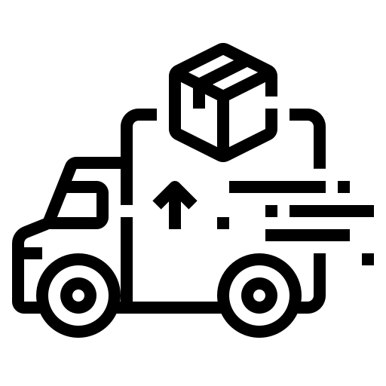




Empowering digital India
DIGITAL BRIDGE FOR BUSINESS TRANSFORMATION
BFSI
Manufacturing
Retail
Logistics
Healthcare
Education
Media
Govt./PSU
Enabling User
- Mobile First Engagement
Enchanting User
- Immersive Experiences
Enriching User
- Omni Channel Experience
Empowering User
- Contextual Insights
Business Priorities
(CXOs)
Scalability
Productivity
Security
INFINITFSO
Managed Services across
Cloud, DC, NW, Security, Digital, End User
InfinitDigital Applications Services
AI/ML, DevSecOps, DAM, XR & Digital Learning,
Retail Intelligence, Digital Assessment
Industry Applications Services
SAP, Oracle, Microsoft
AI/ML Powered Automation
Applications
INFINITMNS Platform
NOC, SDWAN, SASE
CLOUDINFINIT Platform
Enterprise Cloud
INFINITCMP
Hybrid/Multi Cloud Services
INFINITSECURITY
SOC, MSS, MDR, GRC
Platforms
Network & Data Center Infrastructure
Hyper Reach, Hyperconnect, Edge Connect, Private 5G, On-Demand Bandwidth| RAS Design, Hyperscale, BTS, Green, AIOps, AI Ready DCs
Infrastructure

Slide 44

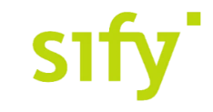



Award for Sustainability
Innovation in Data Center
India’s 1st Nvidia
DGX Ready Liquid &
Air Cooled DCs
Best in
Services Industry
Managed Network Services - MQ
Tried Tested Trusted
Your digital infrastructure partner for over 25 years
Network
Infra Services
Network Digital
Managed Services
Data Center
Colo Services
CloudInfinit
Ent. Cloud Infra
Cloud & IT
Managed Services
Digital Apps
Managed Services
Industry Apps
Managed Services
Security
Managed Services
Thank You

