Slide 1
07/08/24

Slide 2
agenda
ONE
TWO
THREE
FOUR
FIVE

Slide 8


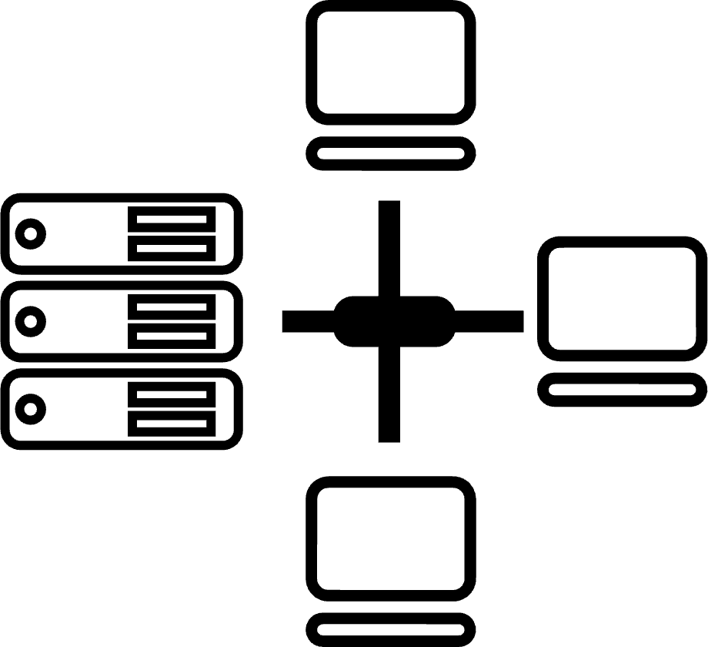






Tried Tested Trusted
Your digital infrastructure partner for over 25 years
Network
Infra Services
Network Digital
Managed Services
Data Center
Colo Services
CloudInfinit
Ent Cloud Infra
Cloud & IT
Managed Services
Digital Apps
Managed Services
Industry Apps
Managed Services
Security
Managed Services
Thank You

