Slide 1
NETWORK DIGITAL
MANAGED SERVICES
SECURE, SCALABLE & RELIABLE MANAGED NETWORKS TO FAST TRACK YOUR AI AMBITION
April 2025

Slide 2
Innovating TO STAY Relevant
1995-2005
Internet Revolution
2006-2011
Data Explosion
2012-2020
Cloud Innovation
2021 onwards
Digital Acceleration
2025 onwards
The Age of AI
Sify 1.0
Sify 2.0
Sify 3.0
Sify 4.0
Sify 5.0
RETAIL INTERNET SERVICE PROVIDER
ENTERPRISE SERVICES COMPANY
DIGITAL ICT SERVICES PROVIDER
(cloud@core)
DIGITAL TRANSFORMATION PARTNER (digital@core)
AI – POWERED INNOVATION
PARTNER (innovation@core)
First private
ISP in India
Launch of MPLS &
Data Center services in India
Launch of Enterprise Cloud platform & Hybrid Cloud services
Launch of end-to-end
Digital services
Launch of AI-Driven Digital Solutions
From revolutionizing consumer internet in the 90s to leading AI-powered innovation for Enterprises

Slide 3
OUR Investment PHILOSOPHY
Digital
Services
Skilled workforce to support modern technologies
Services across the digital spectrum
Embedded AI
Secure by design
3000+ SMEs across platform automation, modern apps, AI/ML, DC, Cloud, Networks, Security
Infinit AI, Infinit FSO, SaaS & Industry solutions
Modern cloud platform – x86 & GPU support
Ample data stores for data explosion
Cybersecurity Operations Centers
Cloud Management Platform for efficient operations
CloudInfinit^{+AI} , GPU as a Service
Hybrid Cloud Infrastructure
Infinit CMP, Cloud Anywhere Edge Cloud
Infinit MNS platform, NOC
Global SOC, MSS, Infinit Security
Cloud,
AI & Security
AI ready data centers
Core and Edge data centers for edge use cases
Certified and compliant
Focus on sustainability
14 DCs, 227+ MW IT power
407+ MW by 2025. 10+ Edge DCs
Scalable to 970+ MW
231+ MW RE Power
AIOps, AI Ready, Liquid cooling
Data
Centers
Network
Infra
Reliable national network backbone
On-demand capacities
Deep Distribution Capillarity
Open Cable Landing Stations for subsea cables
1700+ Cities, 3700+ PoPs
Fiber coverage 24+ Metros
3 CLS, 8 International POPs
Sify OnNet- automated Ent WAN
Notes:
1400+ Digital Networks
350+ Cloud
450+ Modern Apps & AI/ML,
100+ Cybersecurity,
100+ Platform automation,
500+ Technology Integration

Slide 4

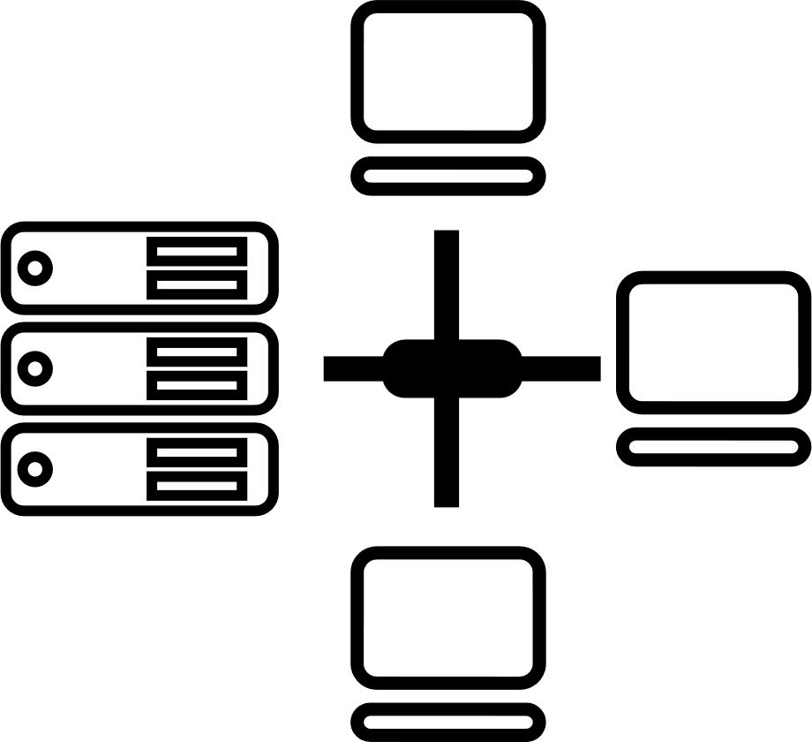

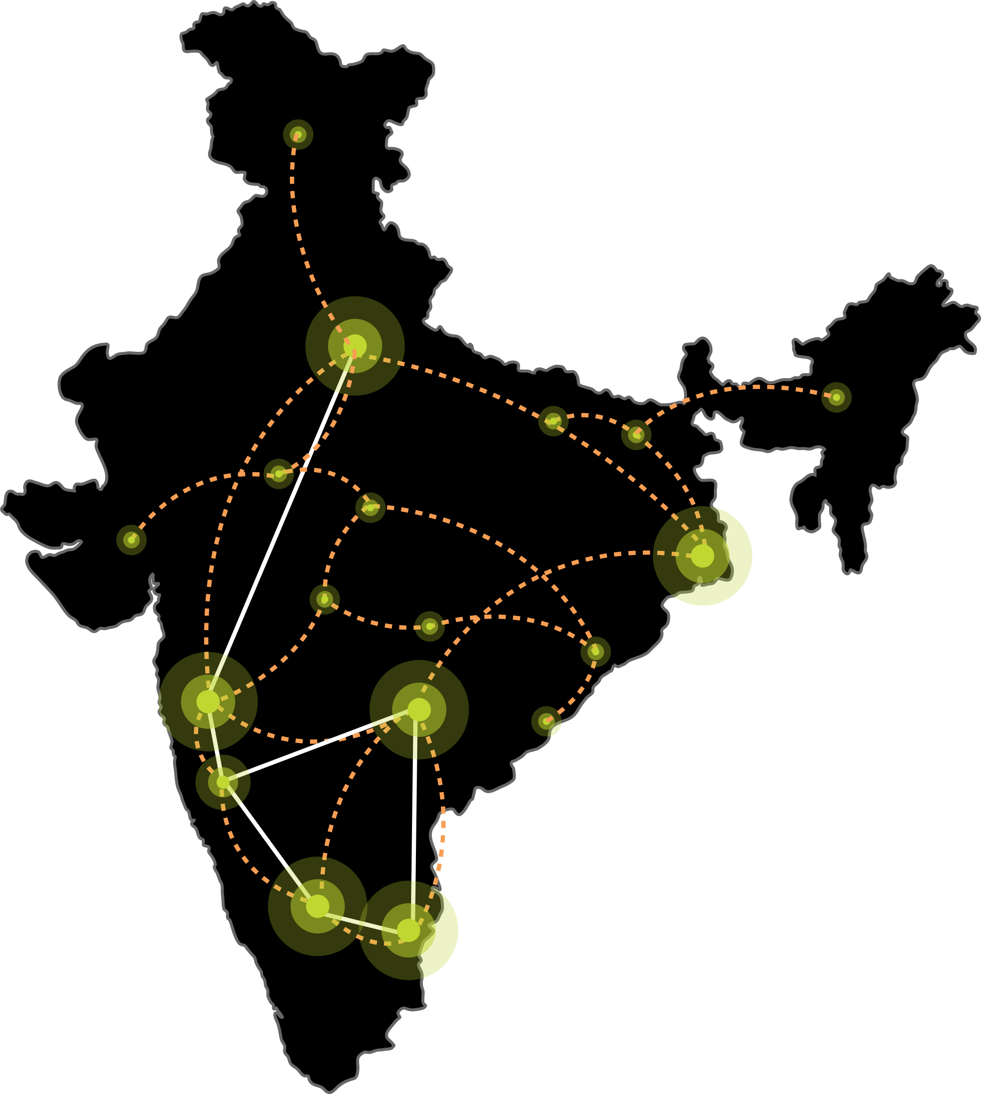






Our DIGITAL INFRASTRUCTURE & PLATFORMS
India’s Top 10 banks, Top 4 Manufacturing, 3 Major Hyperscalers, Global Social Media, OTT, Security Players, and 10,000+ Enterprises trust Sify.
Metro Networks
Fiber access
Connected Buildings
Interconnected DCs
Express Long-Haul Backbone, High Bandwidth and Low Latency across Key Locations
Network
Infra Services
Network Digital
Managed Services
NOIDA 02
NOIDA 01
Data Center
Colo Services
CloudInfinit^{+AI}
GPU Cloud
MUMBAI 03 RABALE
SAARC Gateway, Kolkata
KOLKATA 01
MUMBAI 02 AIROLI
MUMBAI 01 VASHI
CLS, Versova, Mumbai
HYDERABAD 02
HYDERABAD 01
Cloud & IT
Managed Services
Security
Managed Services
CHENNAI 02
BENGALURU O2
CHENNAI 01
BENGALURU 01
CLS, Siruseri, Chennai
Digital Apps
Managed Services
Industry Apps
Managed Services

Slide 5



SIFY GROUP COMPANIES
NETWORK
SERVICES
DATA CENTER COLOCATION SERVICES
CLOUD & DIGITAL
SERVICES
Sify Technologies Ltd.
Sify Infinit Spaces Ltd.
Sify Digital Services Ltd.
Innovation led by Sify Ventures
Your digital bridge for transformation, built on world class digital infrastructure, platforms and services

Slide 6
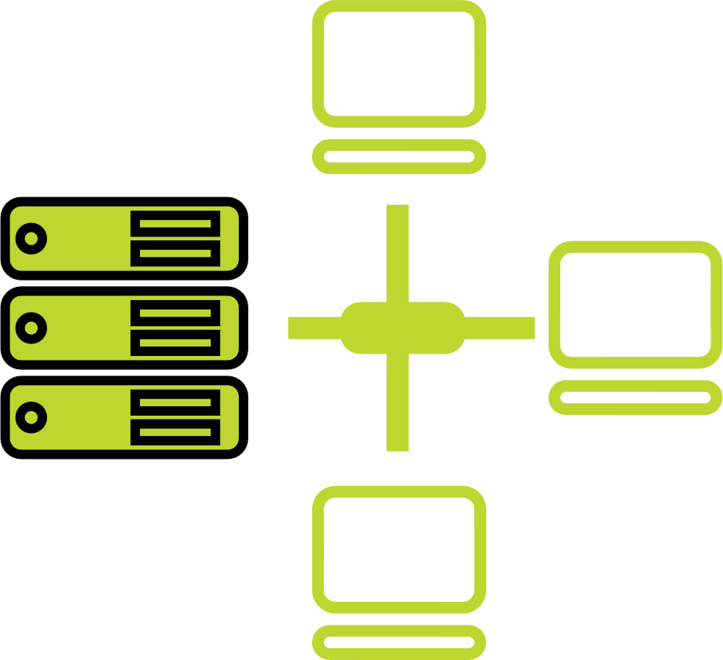




one-stop engagement for enterprises’ digital pursuits
Network
Infra Services
Network Digital
Managed Services
Data Center
Colo Services
CloudInfinit^{+AI GPU Cloud}
Cloud & IT
Managed Services
Enterprise connectivity- WAN, NLD
Edge Connect- Pvt 5G, Wi-Fi
Global Cloud Connect, DC Interconnect
International POPs, Cable Landing Stations
Network transformation and consolidation
Managed Secure Networks- SDWAN, SASE, DDOS protect
Campus & Branch Networks
Smart Edge
Captive & Hybrid NOC services
Network Observability
CaaS & Collaboration Services
AI ready
Hyperscale Cloud adjacency
RAS Design
Liquid Cooling
Hyperconnected
Built-to-suit
AIOps
Renewable Energy
Managed Public/Private Cloud
GPU as a Service
Cloud Anywhere-Edge Cloud
BCP- DRaaS
Regulatory and compliance ready
Hybrid Cloud Assessment, Migration and Managed Services
Multi Cloud Platform
Hyperscale Cloud services AWS, Azure, GCP, OCI
End-to-End IT Managed Services
Networks
Data Centers
Cloud & IT
Digital Apps
Managed Services
Industry Apps
Managed Services
Security
Managed Services
25 years
of digital
trust…
Digital
Infinit AI/ML Platform
Infinit Full Stack Observability
App Modernization & DevSecOps
Retail Intelligence- Forum Digital
Digital Assessment, AI Learning & XR
Consulting, Support, Maintenance, and Upgrades
Microsoft
Oracle
SAP
Security
Cybersecurity assessment and managed services
MSS, MDR & GRC
Global SOC
AI/ML driven Security Assurance

Slide 7
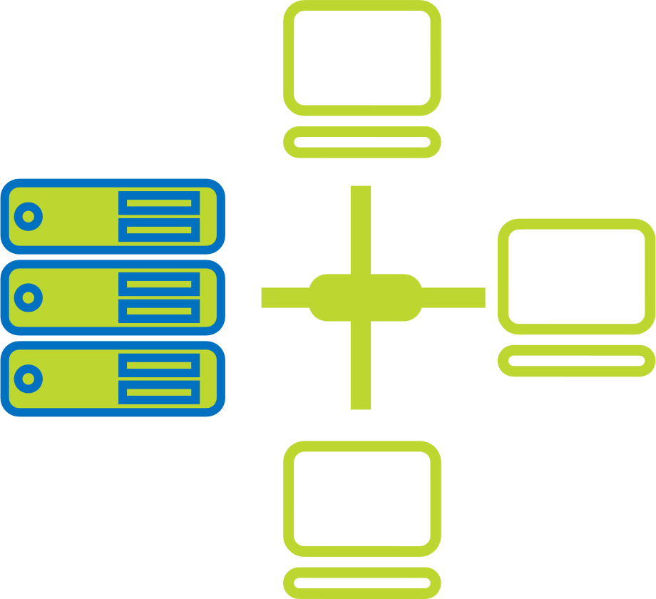
Sify digital services Ltd. overview
Network Digital
Managed Services
CloudInfinit^{+AI}
GPU Cloud
Cloud & IT
Managed Services
Network transformation and consolidation
Managed Secure Networks- SDWAN, SASE, DDOS protect
Campus & Branch Networks
Smart Edge
Captive & Hybrid NOC services
Network Observability
CaaS & Collaboration Services
Hosted AI Platform (Multi Instance GPU) as a Service
Managed Public/Private Cloud
Cloud Anywhere-Edge Cloud
BCP- DRaaS
Regulatory and compliance ready
Hybrid Cloud Assessment, Migration and Managed Services
Multi Cloud Platform
Hyperscale Cloud services AWS, Azure, GCP, OCI
End-to-End IT Managed Services
Digital Apps
Managed Services
Industry Apps
Managed Services
Security
Managed Services
Infinit Full Stack Observability
Infinit AI/ML Platform
App Modernization & DevSecOps
Retail Intelligence- Forum Digital
Digital Assessment and XR
Consulting, Support, Maintenance, and Upgrades
Microsoft
Oracle
SAP
Cybersecurity assessment and managed services
MSS, MDR & GRC
Global SOC
AI/ML driven Security Assurance

Slide 8
Outcome based NETWORK DIGITAL MANAGED SERVICES
Network Managed Services enabling scalability & reliability
Cloud Managed Branch & Campus operations with integrated Security
Secure WAN employing Managed SD-WAN & SASE
Software Defined & Secure DC Network Architecture
Capability built over 2+ decades supporting large, diverse customers
Modern Tools enabling AIOps & Observability for enhanced customer experience
Service Delivery Platform
Actionable Insights & Analytics
Delivery Process Automation & AIOps
Expertise across Network, Security, Cloud Communication, and IoT, fortified by the innovative capabilities of
Sify's Service Delivery Platform, constitutes an unparalleled value proposition.
Notes:
Use this or either of the next two slides as per requirement

Slide 9
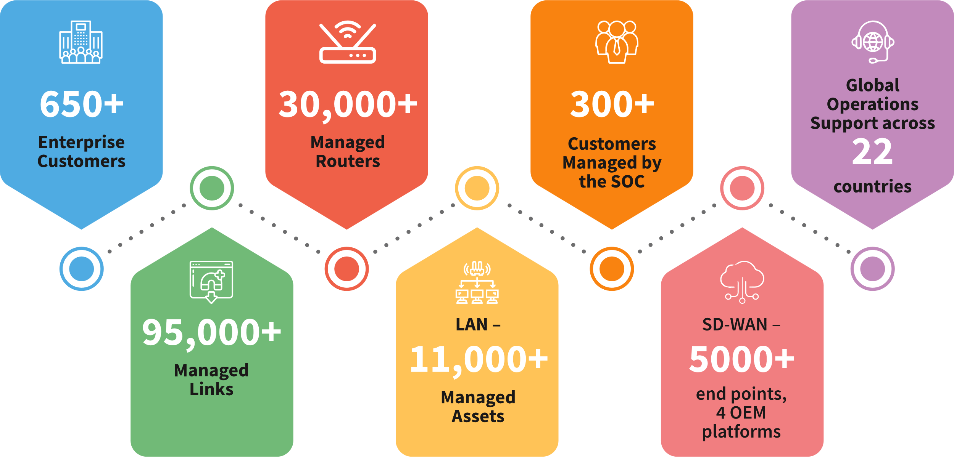
NETWORK Digital managed SERVICES
Large Project Experience
Extensive Skillsets
Advanced Network Tools & Integration
Constant Innovation
Technology Partnerships
1 Lakh+
Sify in
Gartner’s Magic Quadrant for
Managed Network Services 2024
Notes:
Customers prefer Sify for its expertise in end-to-end managed solutions, deep engagement with OEMs, Network-agnostic managed services, quick & cost-effective rollouts, project implementation expertise and extensive operations support across 1700+ cities

Slide 10




Network Digital Services Portfolio
Network Transformation
Secure WAN Edge
Cloud communication & collaboration
Mobility & IOT
Managed SDWAN
Managed Campus / Branch Network
Data Centre Network
Managed Cyber Security
Network Observability
Automation, Orchestration & AIOps
NFV/ NFVI
SASE
Secure SD-WAN
Cloud Managed Wi-Fi
Managed DDOS
Firewall As a Service
Remote VPN
uCPE
Private 5G
Mobile Edge Compute
IOT Solutions
IOT Connect
IT/OT Security
IOT Applications
UCaaS
CCaaS
CPaaS – Omnichannel
Platforms ( on-prem / hosted )
Microsoft Teams
Zoom workplace
Cisco Webex
Service Delivery Platform
Actionable Insights & Analytics
Delivery Process Automation & AIOps
Core Capabilities
Consult / Advisory
Design / Implement
Managed Operations / NaaS
Expertise across Network, Security, Cloud Communication, and IoT, fortified by the innovative capabilities of Sify's Service Delivery Platform, constitutes an unparalleled value proposition

Slide 11



Network Management and Operations scope
Network Operations Outsourcing
Network Consolidation & Operations Outsourcing
Network Transformation & Operations
Operations Transition from existing managed services provider to Sify
Advanced NOC Services
SLA Management
Vendor Management
AMC Management
Network Study & Assessment
Service Provider Consolidation (Including Sify’s participation)
Performance Management and Optimization
CPE Management (with or without AMC)
Network Redesign/ Reengineering
Software Defined Network Deployment

Slide 12
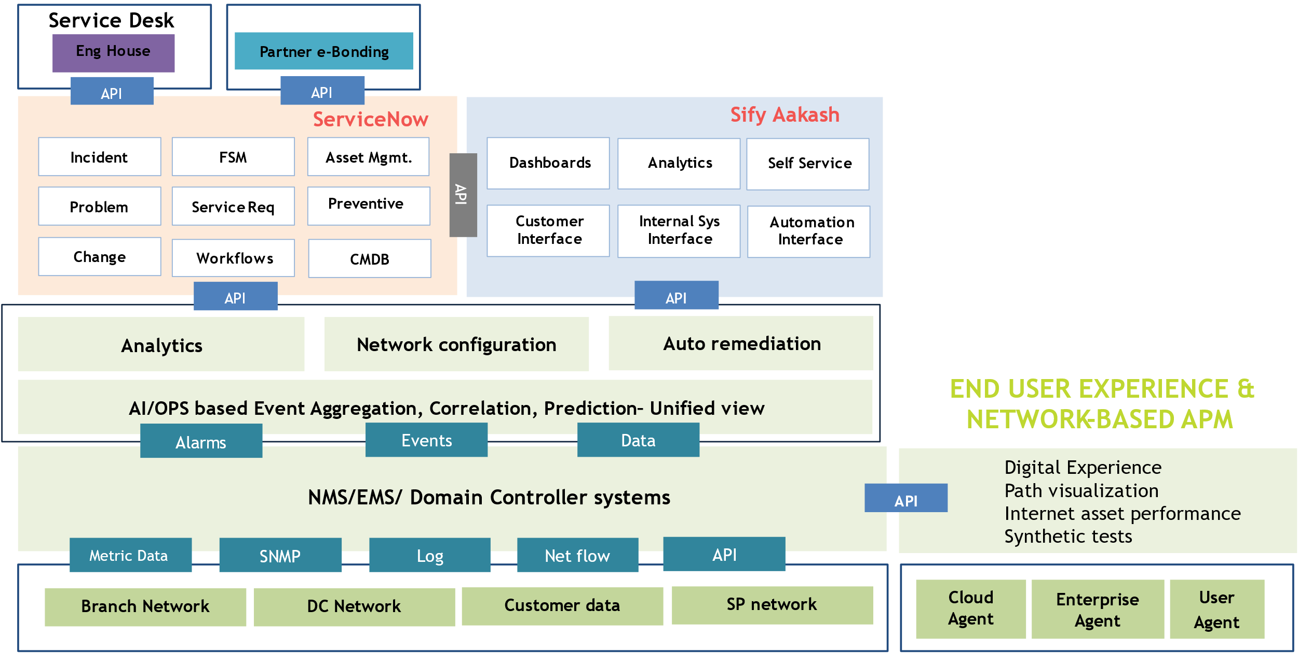
Our NDMS Service delivery platform
Automation & AI Driven
Incident Co-relation, Diagnostics Bots, Service Provisioning, Predictive Insights & AIOps
Network Observability
End to End visibility: Topology, Service Relationship & End user experience
Customer Experience
Aakash provides intuitive Analytics, Inventory & Self Service
Tools Integration
Multi Vendor NMS, EMS & Controllers. E-Bonding with key Telco’s & OEM’s ITSM tools
ITSM
Sify’s NDMS Service Delivery Platform integrates AI-driven automation, network observability, and multi-vendor tools to enhance end-user experience, deliver predictive insights, and self-service management efficiency.

Slide 13
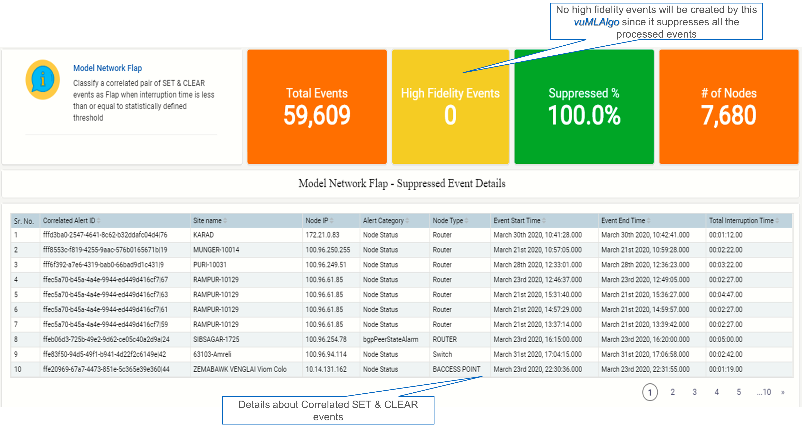
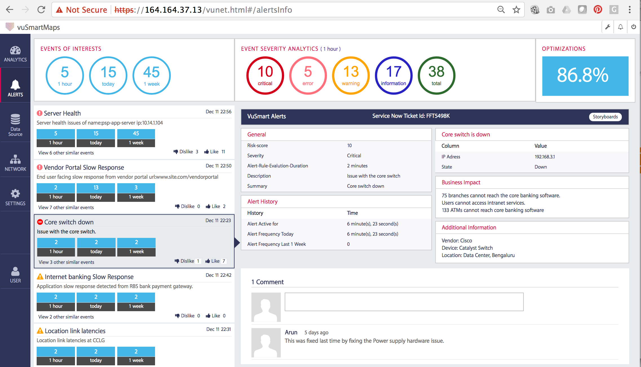
INTELLIGENCE – AI OPS
Functionalities
Event correlation using network topology and relationships
Event suppression & Deduplication
Event/Alarm clustering and grouping for predictive analytics
Rule based suppression of subsequent events of same incident
Unsupervised learning and anomaly detection through dynamic baselining
Benefits
Probable root causes
Reduce MTTR due to quick identification of issue
Control complexity through Noise reduction
Predict outages
Capacity management
Event Correlation &
Noise Reduction
AI/OPS | Correlation | CMDB | Service Mapping | Prediction
Alarms
Events
Data

Slide 14
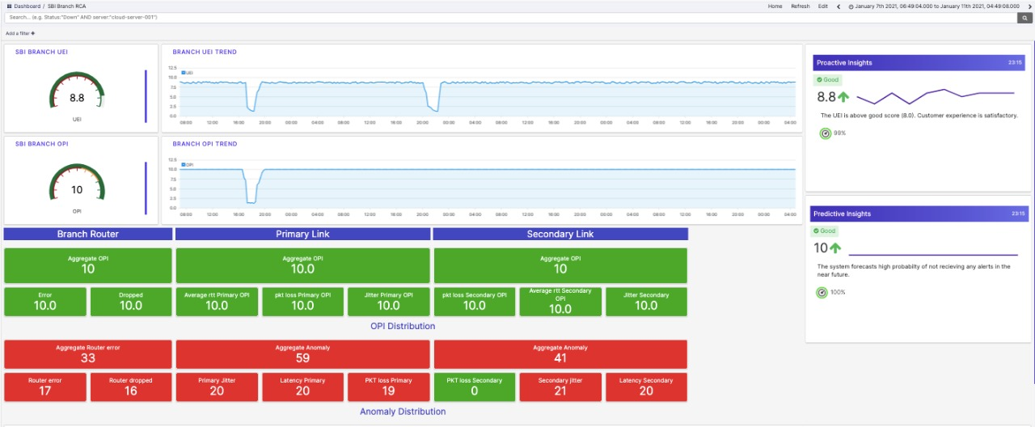
PREDICTIVE ANALYTICS
Predictive analytics will leverage machine learning techniques by analyzing past behavior of composite metrics to identify and even correct the hidden anomalies before it becomes the potential problems
Identify potential problems in the environment even before they start manifesting in a large way impacting user experience
Triggering automated workflows to prevent both known and novel incidents by executing known solutions, even without human intervention
Use Case
Identifying the Branch connectivity which might go down in the near future by looking at the past pattern of events such as interface metrics & device health metrics and predict the failures
Performance degradation of Primary link by identifying the jitter & latency KPI's and predict the next action for link switchover through automation/manual processes
AI/OPS | Correlation | CMDB | Service Mapping | Prediction
Alarms
Events
Data

Slide 15
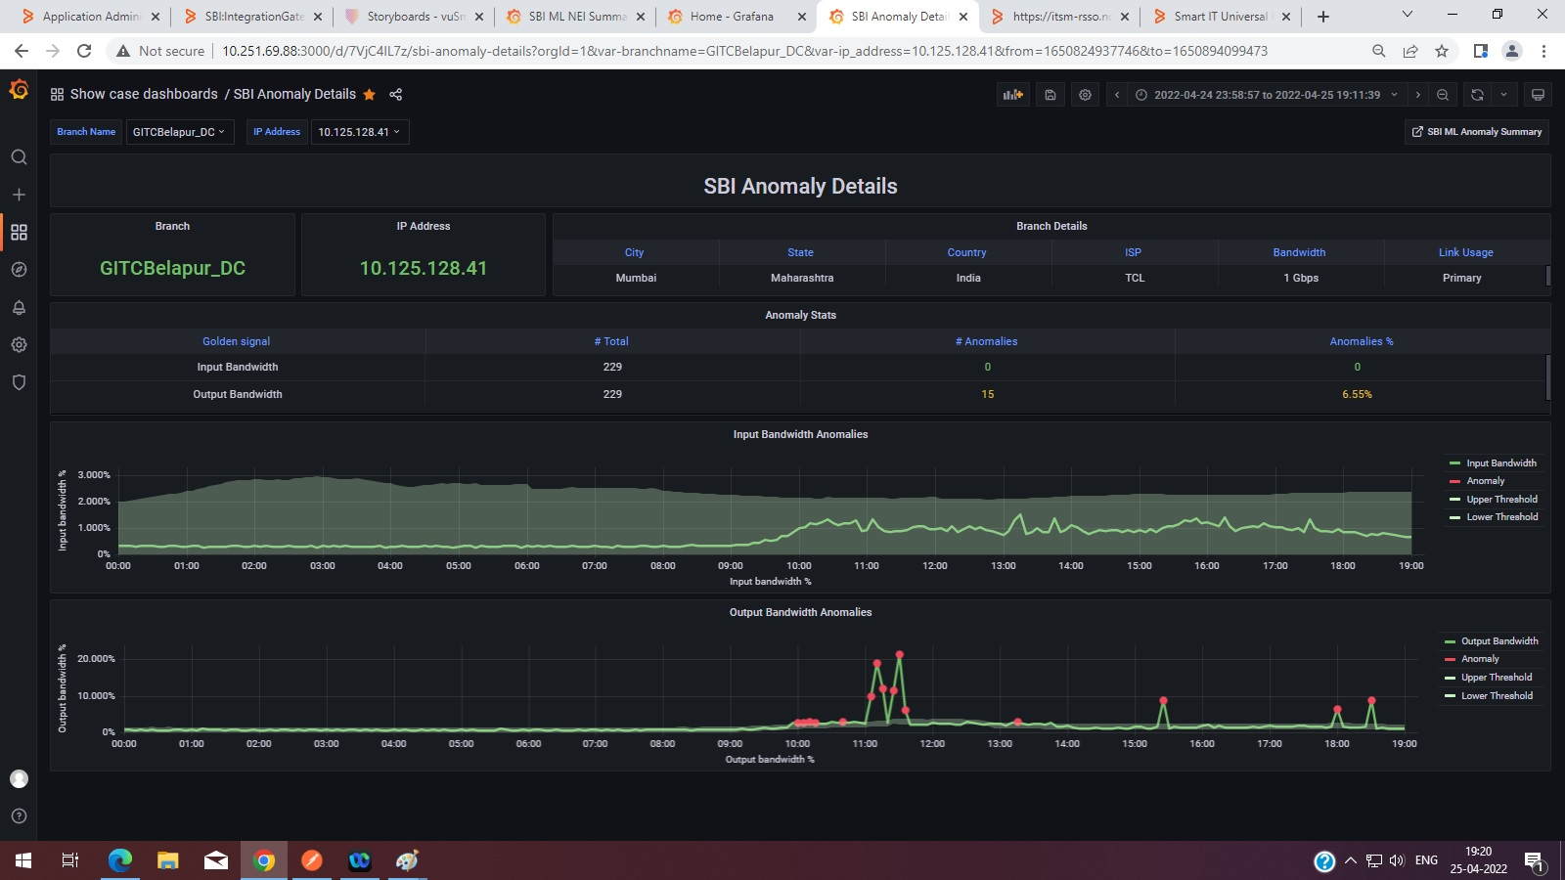
ANOMALY DETECTION
Using data training on how the metrics auto-learns and reduce the false positives over a period of time
Prediction error and percentile are the critical feedbacks during the auto-learning process
Deployed on streaming real-time data
Use Case
Detecting anomalies for a specific branch using bandwidth thresholds and Latency parameters
Dynamic baselining of network performance parameters such as latency, packet loss since the committed latency for every link will vary due to last mile type, location, number of hops, etc.
AI/OPS | Correlation | CMDB | Service Mapping | Prediction
Alarms
Events
Data

Slide 16
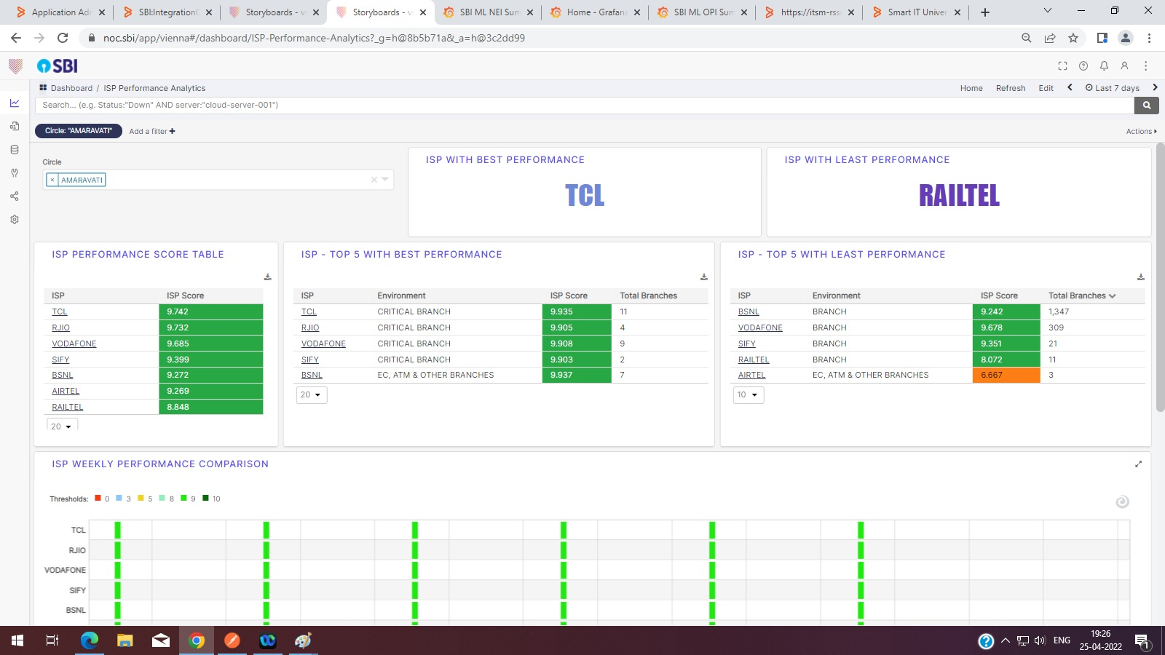
SERVICE PROVIDER PERFORMANCE INDEX
Service Provider Ranking is done using ISP Performance Index(IPI) which is calculated considering variety of parameters including number of flapping’s, outages, time taken to recover and overall downtime for each link
Service Provider Ranking uses Analytics Workload Correlation Algorithm
AI/OPS | Correlation | CMDB | Service Mapping | Prediction
Alarms
Events
Data

Slide 17
NETWORK EXPERIENCE INDEX
Network Experience Index is the Statistical model based predictive indictor that provides a single value of measure
NEI is a component-based lead indicator which gets rolled-up to show Interface level and overall health index
Use Case
Measuring Link performance based on golden signal of each indicator
Aggregate NEI score is calculated based on individual NEI scores
AI/OPS | Correlation | CMDB | Service Mapping | Prediction
Alarms
Events
Data

Slide 18
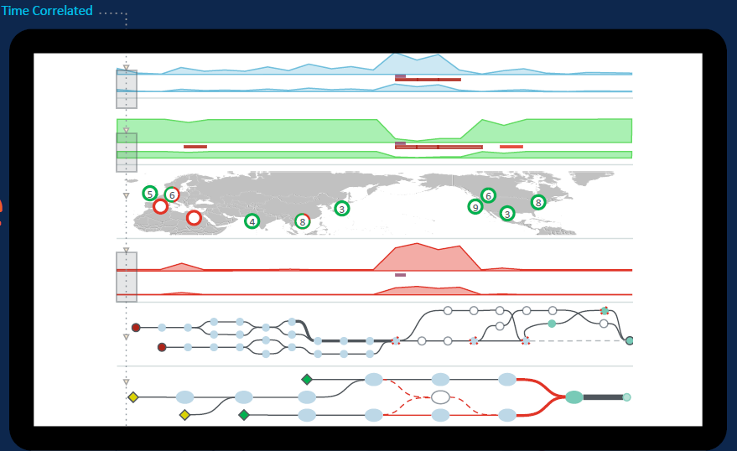
Network visibility
Correlate performance across every layer
Visualize services end-to-end across every domain

Slide 19
Network visibility
Pinpoint
issues from user
to application
Reduced time
to diagnosis & innocence

Slide 20






MANAGED SD-WAN SERVICES
Centralized management
SD-WAN USE CASES
Improve Resiliency through Overlay SD-WAN across MPLS & Internet Links
Optimize Cost through Load balancing across links and Application Prioritization
Improve Operational Efficiency & Visibility through Centralized Management
Secure Branch Internet Breakout & Multi-cloud Access
Smart capacity planning through Application-level visibility
Changes can be made quickly across multiple sites
Allows template usage for same routing policies
Automation
Automatic switching based on congestion & criteria
Automated deployments across network from single console
Web-based consoles
Easily orchestrate configurations
Enables connectivity for app requirements on-demand
SD-WAN
Detailed Reporting
Full Visibility Performance dashboards
Enables network configuration based on app intelligence & UX
Performance-based policy routing
Distributing bandwidth based on links across ISPs
Ensuring reliable outbound link for apps & svc’s
Fast setups for secure communication
Apps managed with policies
Drives down costs
Improving security, availability & business continuity

Slide 21


SASE SERVICES
Cloud Platforms
SASE FUNCTIONALITIES
Secure Web gateway
Firewall as a service
Zero trust network access
Cloud access security broker
Remote Browser isolation
Data loss prevention
Network sandbox
DNS Protection
Web app & API Protection
CDN, External DNS
Legacy VPN
Edge compute protection
Branch
Datacenter
Corporate/HO
Smartphone
Factory
Laptop
Security Service Edge (SSE) provides cloud-based, integrated security for secure access to websites, SaaS apps and private apps
Combines SD-WAN access and traffic monitoring functions in a unified solution for all types of accesses
Decreases Latency and enhance App and Network Performance by removing backhauled traffic flows
SASE helps Detect and Mitigate Threats, Connect and Secure Remote Workers, Identify and Protect Sensitive Data

Slide 22
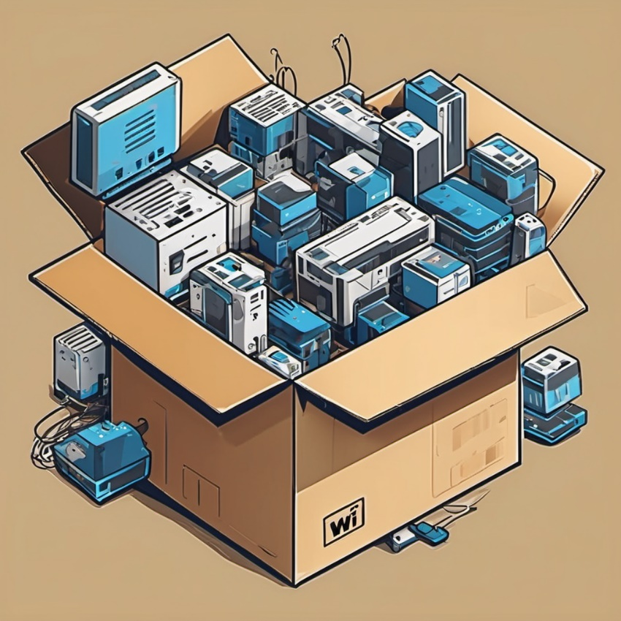
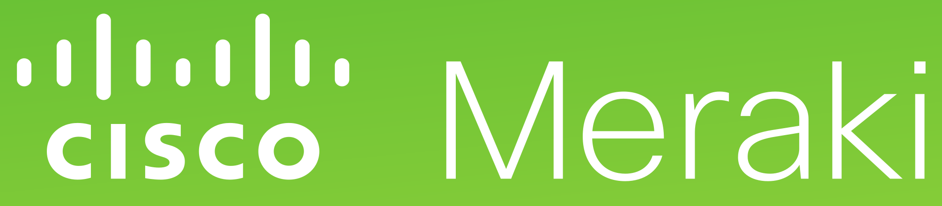

Branch-in-a-Box
The “Branch-in-a-Box” is a self-contained solution that provides essential tools and resources for setting up a functional office space.
This is particularly relevant in situations where there's a need for a quick and efficient establishment of a workspace
Comprehensive solution for a Branch – WAN, LAN & Security bundled with connectivity
Standardized design which can be easily replicated
Cost-effective & aligned to the needs of the branch
Fully managed & ability to add new services
Notes:
The “Branch-in-a-Box” or "Office-in-a-Box" concept is a comprehensive and self-contained solution designed to provide essential tools and resources for establishing a functional office space swiftly and efficiently. This concept proves particularly beneficial in situations where there is a demand for quick and convenient workspace setups, such as in remote, temporary, or rapidly evolving business environments. The solution integrates hardware, software, and office equipment, offering a modular and scalable approach to accommodate diverse organizational needs. From seamless connectivity and quick deployment to cost-effectiveness and adaptability, the Office-in-a-Box concept addresses various objectives, catering to a range of customers including remote teams, startups, global corporations, and educational institutions. It aligns with the evolving trends in modern workplaces, supporting remote work, scalability, and the integration of advanced technologies to provide a cohesive and standardized office environment across different settings.

Slide 23
Branch-in-a-Box outcomes
Faster Deployment
Seamless
Single Ownership
Availability of Network
Manageability of
LAN & WAN Devices
Assurance Against Technological Obsolescence
Cost Effectiveness
Flexible Commercial Modelling
Notes:
Faster Deployment
Seamless
Single Ownership
Availability of network
Manageability of LAN & WAN devices
Assurance against technological obsolescence
Cost Effectiveness
flexible commercial modelling
<data on why businesses are expanding>
<industry trends>

Slide 24
Sify’s strong presence in India’s Financial Services Industry
As a preferred partner to BFSI industry leaders, Sify enables over 60% of financial transactions in India through its integrated Digital ICT services,
built on data centers, cloud, network, and digital services. Sify is proud to support the government's digital initiatives, digital payments, and financial inclusion with its comprehensive hosting, network, and managed services.
300+ leading BFSI customers’ networks are managed by Sify.
Top 10 Banks in India are using integrated Data Center and Network services from Sify.
Network Integration + Network Build + Managed Network Services with AI/ML powered modern NOC for India’s Top Bank
300+ Data Center services projects executed in BFSI.
Multi-cast, multi service management across 3800 members and 31 POPs for the #1 Derivative Stock Exchange.
Data Center migration & transition projects executed: 100+ BFSI Private. 80+ Pub BFSI, PSU.
World’s most widely distributed postal system runs on network managed by Sify across ~27000 sites with all links and network devices
35+ leading Banks, 15+ Insurance companies, 2nd largest housing finance company, largest general insurance company, large NBFCs, new age Fintechs have signed multi-year Data Center services contract with Sify.
Sify has designed, deployed and is managing the infrastructure that runs India’s entire inter banking transactions.
Sify Connects…
25,000+
27000+
5,000+
13,000+
4,500+
4000+
Bank branch and back offices
Postal Banks
Co-operative Bank offices
Private sector & Small Banks
Insurance branch and back offices
Payment & Stock Exchanges

Slide 25
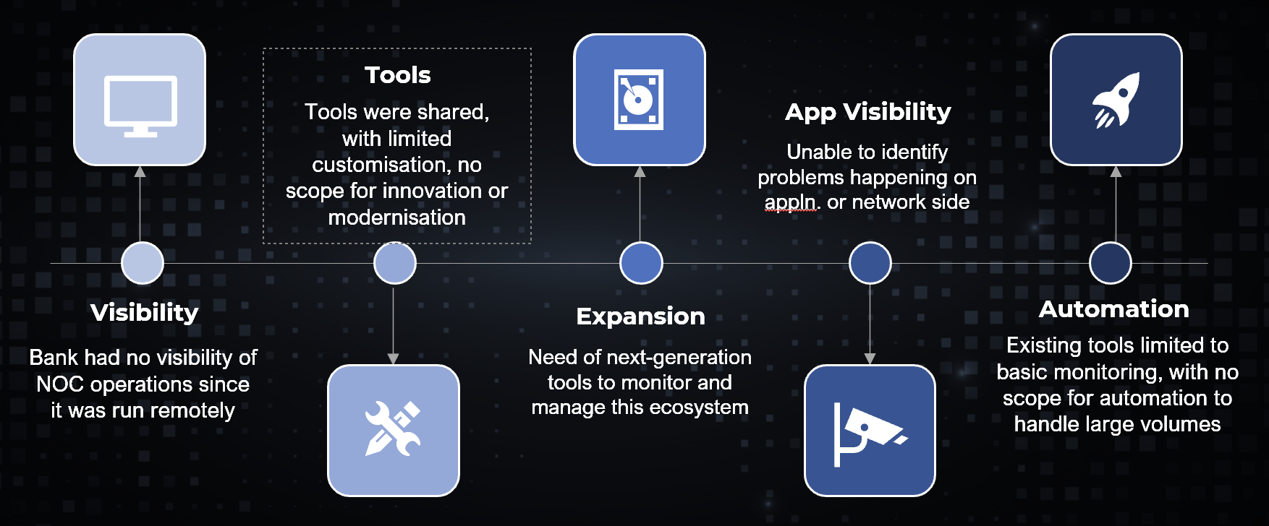
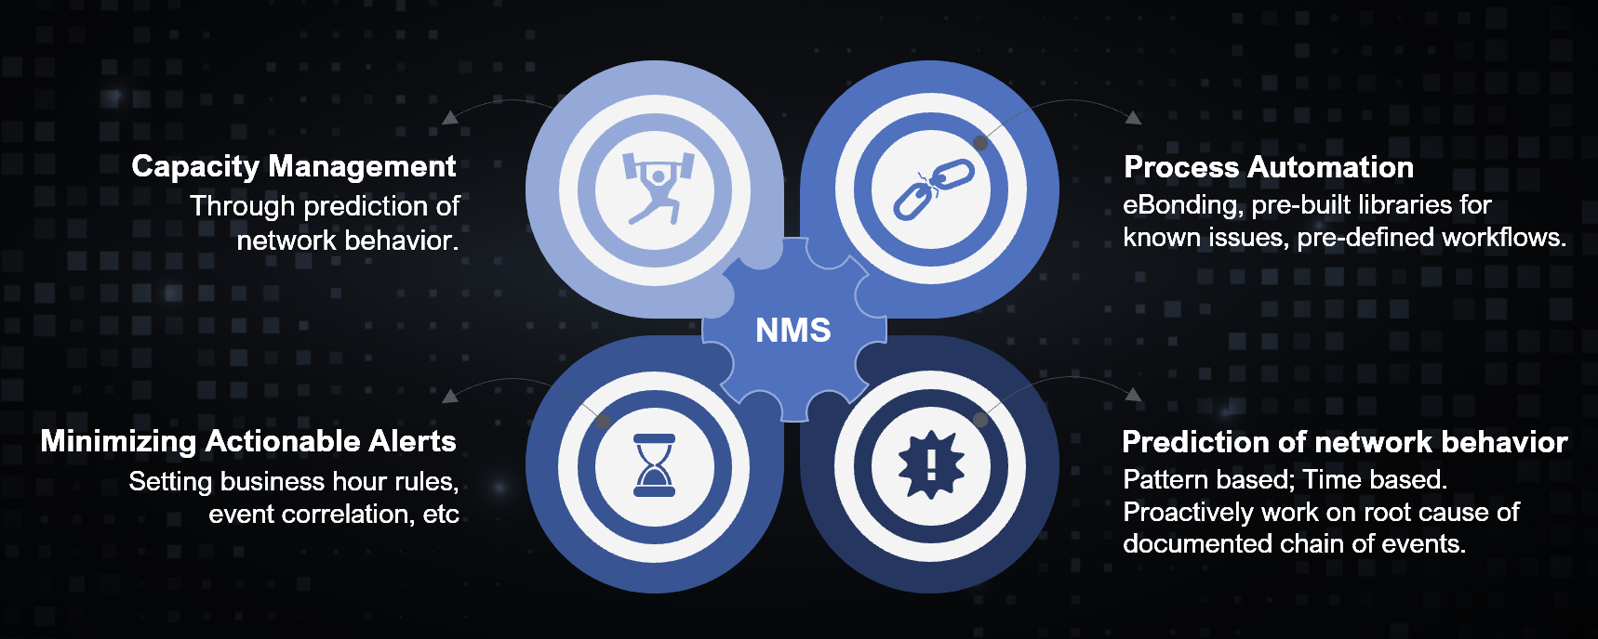
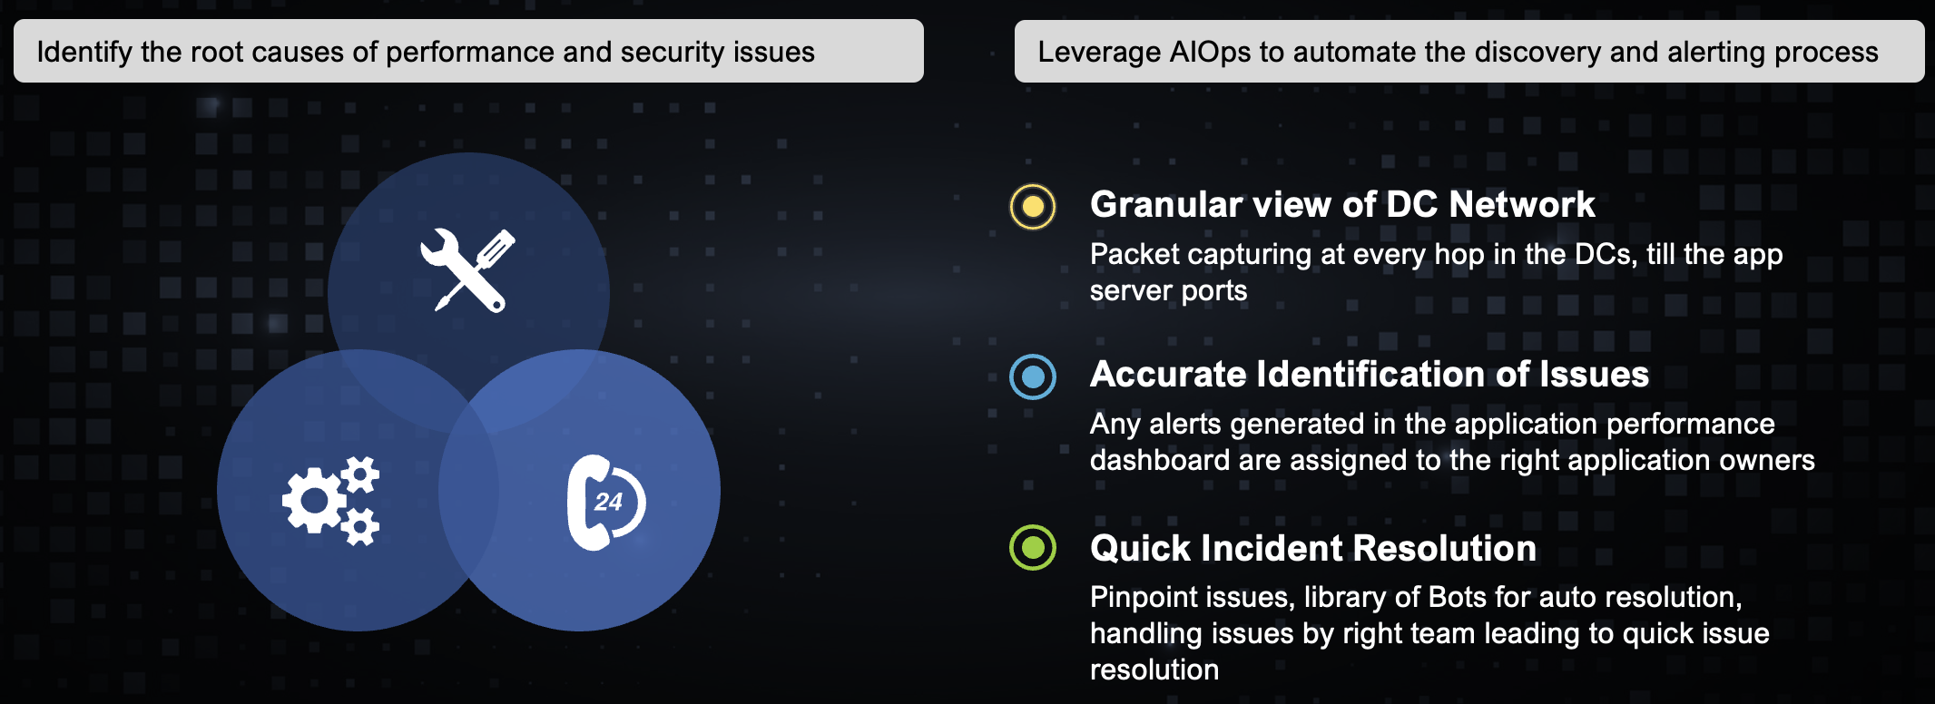
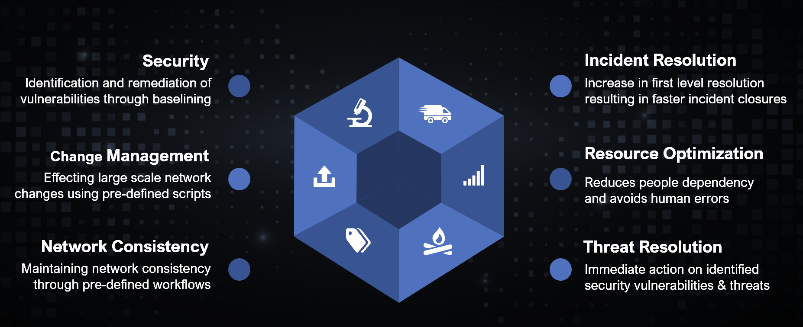
Network transformation for a large bank
Sify is the Network Integrator for the Bank with 22k+ Branches, 480 Mn customers & 3 Data centers
Situation prior to Sify
Intelligent Network Monitoring
Robotic Process Automation
Network Performance & Visibility

Slide 26



Critical NATIONAL networks managed by sify
SCALE
COMPLEXITY
RELIABILITY
Most widely distributed postal system
India’s Inter Banking Transactions
#1 Derivative Stock Exchange
The largest network in terms of scale, spanning ~28000 sites with ~56,000 links and ~28,000 routers & switches
Data Center Management for DC and DR
Sify is the Network Integrator and Service Provider for the last 9+ years
The network spanning RBI, IFTAS, CCIL and member bank Data Centers and branches, is the backbone of the Indian banking system, which enables all inter-bank transactions in India
Secure Network connectivity from Member Banks to the Applications
Multi-service provider management and scale
Aggregating member traffic to enable creation of a digital platform for its members.
Multi-cast management across 3800 members and 31 POP’s
Managing a multi service provider environment
Trusted Partner for Secure & Reliable Network Services
NDA/Sify Confidential
Notes:
DOP, IFTAS, NSE

Slide 27
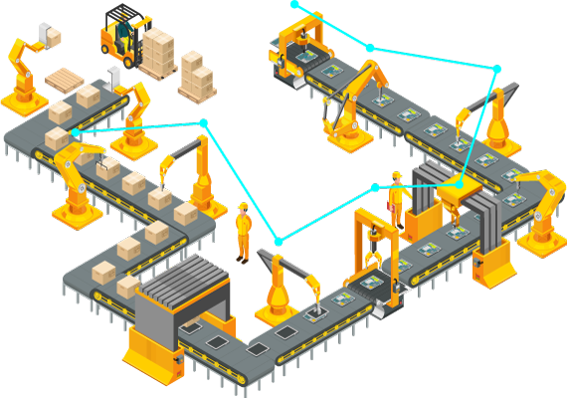
Smart manufacturing solutions
Connected Factory Solutions
IOT Network Access Solutions
Wifi6 / Pvt 5G Wireless Access
Software Defined Visibility & Control
EDGE Computing Infrastructure
Secure Network
IOT Network Security
IT/OT Security
Smart Applications
Asset Tracking & control
Safe Working Environment
Process Automation / Quality Control
Physical Security – Surveillance & Access
Work from anywhere - workload everywhere
Expand the network
Move data securely to applications & analytics
Extract and route IoT edge data
Notes:
The multi-domain, end-to-end, secure IoT architecture, enables customers to easily extend the network they and know trust, across their production environment. It offers the same powerful capabilities of the enterprise network, but is specially designed to satisfy specific demands of the manufacturing environment, such as resiliency, long life cycle, and easy to deploy and use. Cisco supports all the protocols used by assets on the plant floor, and offers hardened technology for extreme conditions that’s purpose-built to thrive in any industrial control system environment, no matter how harsh or challenging.
Customers can also realize unprecedented scale, with the automation capabilities of Cisco intent-based networking, which captures and translates IT and OT intent, so it can be applied across the network. This eliminates the manual work required to deploy and scale a network, and reduces the management burden.

Slide 28
Sify’s strong presence in India’s manufacturing sector
500+ India’s leading Manufacturing companies trust Sify’s DC, Cloud, Network and Digital services. 270+ Top Manufacturing enterprises trust Sify’s Managed Digital Network Services.
Digital Network for integrating IT, OT & People for the world’s second-largest geographically diversified steel producer
India’s Top 3 out of 5 Automobile companies in the two-wheeler segments trust Sify’s Network infra and managed services
Sify offers Internet, P2P, MPLS Connectivity, Network Management and Managed Wi-Fi to one of India’s biggest FMCG Companies
Sify Offer’s Secure SD-WAN
to one of India’s leading Luxury Retail Chains
Sify manages the NOC of a Global commercial vehicle manufacturing, renowned for innovation and reliability
Sify’s Manages the SD-WAN
setup of a Pioneer In Automotive Excellence
One of India’s leading Tyre manufacturer’s NOC is managed by Sify
Sify manages NOC for one of India’s largest manufacturer and distributer of packaged foods
Three leading Logistics companies trust Sify Managed Network Services
Notes:
Network deployment-
Renault
Hero MotoCorp
Apollo Tyres
JSW Steel
Tata steel

Slide 29
Key technology partner capabilities
SD-WAN
Cisco
Versa
Routing /switch
Cisco ISR/ Catalyst
Juniper
Wi-fi
Cisco Meraki
Aruba
Fortinet
Fatpipe
Aruba / Silverpeak
HPE/Aruba
Cisco Meraki
SASE
Cisco Umbrella
Netskope
Zscaler
Collab
Cisco CUCM / UCCE
CISCO CUBE
Oracle SBC
Cisco Video conferencing
Cisco WLC/AP
Fortinet

Slide 30






Skillsets and certifications
Solutioning
Engineering
Development / Integrations
Support &
Delivery
Trainings & Certifications
Enterprise Network & Security Solution expertise
Enterprise Cloud Security Solution expertise
SP Network Service
Design & Testing
Enterprise Network Service Design & Testing
Observability &
Automation
MSSP
ITSM integrations
Multi NMS Integrations
Business workflow automation
Datalake & AIOps
SOAR
SP & ENT R&S
SDWAN, SDA, Meraki
WIFI & WLC
NMS, Observability & AIOps
MSS, MDR, GRC services
800+
Trained Resources
600+ Certified Resources
Cisco, Fortinet, Juniper, ITSM, Security and PMI certification

Slide 31
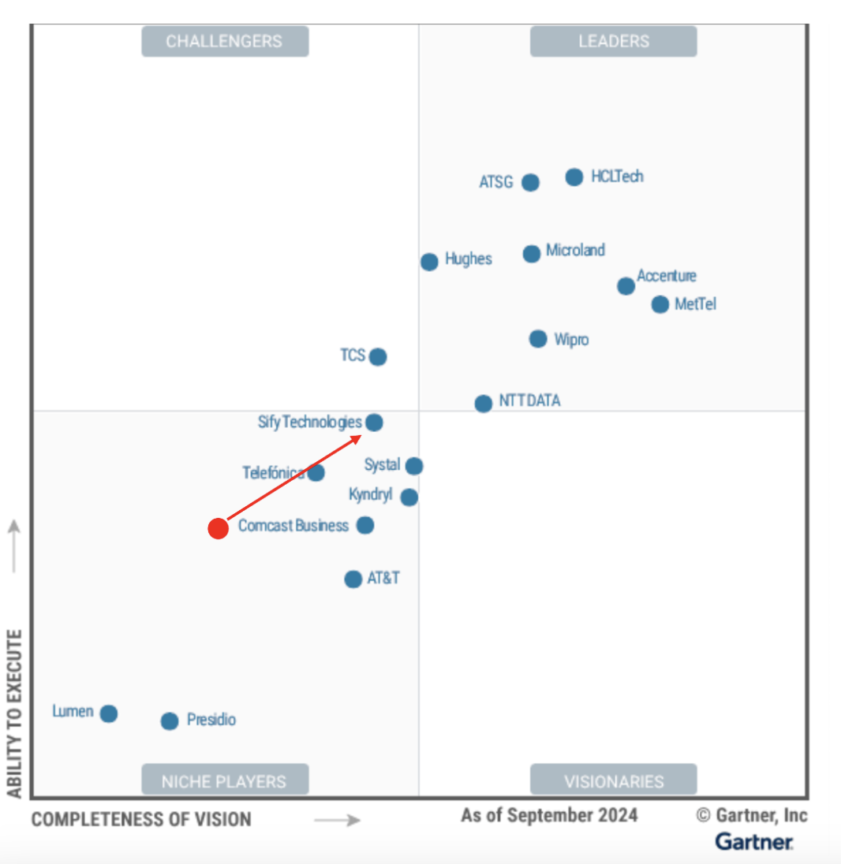
Gartner Magic Quadrant Recognition
Sify being an NSP, have a better understanding of customer network and its management requirements
Our offerings are NSP agnostic, and we offer product packages that have adjacent Network Services offerings
Our experience working with other NSPs enable us to provide great SLAs, Hybrid network support and Service Quality
Our services support hybrid distribution of workload for cloud apps
We have significant resource support for India-based field services customer support
We manage nearly 135,000 LAN and WAN endpoints globally across approximately 36,000 customer sites
Our
Strengths
Robust Service Delivery Platform
Sify is a Niche Player in Gartner’s MQ for
Managed Network Services Global 2024
Focus on Customer Experience Management
Expertise in Managed WAN/LAN/WLAN Services

Slide 32








CIO Choice 2025 for
AI Ready Data Centers
Best Future-Proof Data Center Project
Award for Sustainability
Innovation in Data Center
India’s 1st Nvidia
DGX Ready Liquid &
Air Cooled DCs
Best in
Services Industry
DC Services India & ​Managed Cloud Services APAC ​
Managed Network Services - MQ
Tried Tested Trusted
Your digital infrastructure partner for over 25 years
Network
Infra Services
Network Digital
Managed Services
Data Center
Colo Services
CloudInfinit^{+AI}
GPU Cloud
Cloud & IT
Managed Services
Digital Apps
Managed Services
Industry Apps
Managed Services
Security
Managed Services
Thank You

Slide 33






























SIFY’s MANAGED NETWORK SERVICES CUSTOMERS
Not to be shared with anyone strict nda
Notes:
Redington, , ABP, ,

Slide 34
Our portfolio spread for key customers
# | Customer | Network Design | Network Build / Integration | Network Managed Services | Bandwidth Service Provider | Network Consolidation Transformation | Managed SD-WAN | DC/DR Network management
1 | Department of Post | ü | ü | ü | ü | ü | û | ü
2 | State Bank of India | û | ü | ü | ü | ü | û | ü
3 | Bank of India | û | ü | ü | ü | û | û | ü
4 | Punjab & Sind Bank | ü | ü | ü | ü | ü | ü | ü
5 | Nainital Bank | ü | ü | ü | ü | ü | ü | ü
6 | Pramerica Life Insurance | û | û | ü | ü | û | û | ü
7 | Oriental Insurance Company | ü | ü | ü | ü | ü | û | ü
8 | Max Healthcare | ü | ü | ü | ü | ü | ü | ü
9 | Shoppers Stop | ü | ü | ü | ü | ü | ü | ü
10 | Gati Ltd | ü | ü | ü | ü | û | ü | ü
11 | National Stock Exchange | ü | ü | ü | ü | ü | û | û
12 | New India Assurance | ü | ü | ü | ü | ü | û | û
13 | Birla Management Centre Services Ltd. | û | ü | ü | ü | ü | û | û
14 | IDRBT / IFTAS | ü | ü | ü | ü | ü | û | û
15 | ICICI Bank Ltd | û | û | ü | ü | û | û | û
16 | United India Insurance Company | ü | ü | ü | ü | ü | ü | û
17 | HDFC Bank | û | û | û | ü | û | û | û
Not to be shared with anyone strict nda
Notes:
Redington, , ABP, ,

Slide 35
Our portfolio spread for key customers
# | Customer | Network Design | Network Build / Integration | Network Managed Services | Bandwidth Service Provider | Network Consolidation Transformation | Managed SD-WAN | DC/DR Network management
18 | CCIL | û | û | ü | ü | û | ü | û
19 | National Insurance Company Ltd. | ü | ü | ü | ü | ü | û | û
20 | United Bank of India - RRB | ü | ü | ü | ü | ü | û | û
21 | Knowlarity | ü | ü | ü | ü | ü | ü | û
22 | Indian Overseas Bank | û | û | ü | ü | û | û | û
23 | Oriental Bank of Commerce | û | û | ü | ü | û | û | û
24 | Uttar Pradesh Power Corporation Ltd. | ü | ü | ü | ü | ü | ü | û
25 | Uttar Pradesh Co-operative Bank Ltd. | ü | ü | ü | ü | ü | û | û
26 | Axis Bank Ltd. | û | û | ü | ü | û | û | û
27 | The Jammu & Kashmir Bank | û | û | ü | ü | û | û | û
28 | Manappuram Finance Ltd. | ü | ü | ü | ü | ü | û | û
29 | Aditya Birla Fashion & Retail | ü | ü | ü | ü | ü | ü | û
30 | SIS Group Enterprises | ü | ü | ü | ü | ü | ü | û
Not to be shared with anyone strict nda
Notes:
Redington, , ABP, ,

Slide 36
Sify Managed SD-WAN DELIVERABLES (1/2)
Deliverable | Description
Service portal | Sify Aakash Portal to customer, able to view, configure, monitor WAN network performance of Sify and other providers
Capacity management | Measure WAN link utilization trends, create baselines and recommend customer on the actions taken – upgrade, downgrade
Transition and implementation services | Site survey, CRD, HLD and LLD. Deploy initial CPE devices across all sites. Perform MACD as and when changes required [bandwidth upgrade/downgrade, new features]
Proactive network monitoring | 24x7 Monitoring of network related faults and performance management. Able to view this alerts on self-service portal
Application visibility | Identify applications and sub-applications, report the performance of applications
Incident reporting and management | Trouble ticketing for all network related issues including other SP links. Detection of alerts from fault and performance management systems
Problem management | Diagnose, identify and isolate issues. Work on fix and workarounds with providers and SD-WAN vendors
Configuration management | Configuration of managed CPE devices, auditing, backup of configuration, template-based configuration
Inventory management | Manages inventory of CPE devices, resources – IP address, VLAN etc

Slide 37
Sify Managed SD-WAN DELIVERABLES (2/2)
Deliverable | Description
Vendor management | Co-ordinate with vendors for issue reporting and resolution, faulty hardware management, recommended best practices
Change management | Scheduled network changes – changing software based on EOL, proactive identification of network issues and resolution, MACD of WAN links and bandwidth
Service desk | 24x7 technical support team to co-ordinate with customer for issue reporting and resolution
Hardware replacement time | Replacement of faulty hardware and components
Support systems | IAM, NTP, OOB management systems
Root cause analysis | Analysis of issues and identify root causes – including CPE and provider links

Slide 38
Sify Managed SD-WAN Lifecycle management
A/C & BD Team
Project Manager
Engagement Manager
Solution architects
Activation & Delivery teams
NOC + Field Ops
Consult
Design
Implement
Migrate
Operate
Transition
Develop a right WAN strategy
Assess current network and propose an SD-WAN design.
Align network design with transformation objectives.
Proof of concept against key objectives.
Network High level and low -level design.
Identify the right network partners
Cloud connect design.
Configuration templates.
Documentation
AT plan.
Project Management
Site RFE
Links RFU
Hardware supply, I&C.
Branch onboarding and provisioning.
AT & Ops handoff
Migration plan.
Migration calendar.
Sites RFM assessment.
Migration execution.
Roll back
Failure assessment
Documentation handover
Systems visibility
Design vs as-built
Customer contacts
Escalation matrix and review mechanisms
Custom KPIs.& SLA review
Spares transfer.
Reporting custom build up
Project signoff.
Network monitoring
Fault and Incident management.
Telco management.
Change, Assets Problem, config and SW management.
Security policy management
Solution sustenance & continuity.
Network MACDs

Slide 39
Integrated NETWORK Operation Model

Slide 40




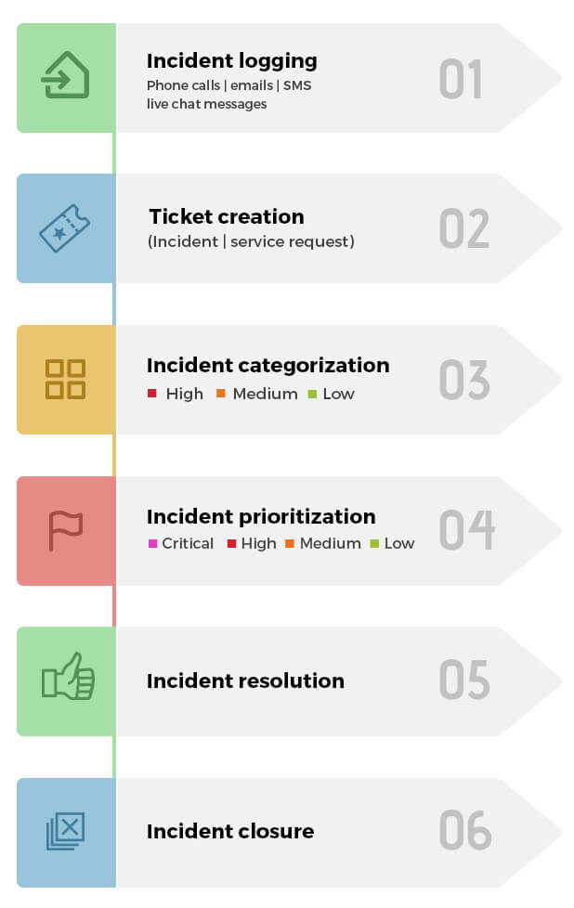

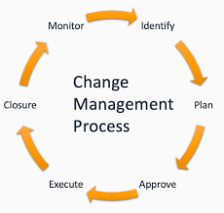



NOC Processes & Practices (1/2)
Incident Management
Event to Ticket
Ticket priority
Ticket Assignment rules
SLA
Escalations
Major Incident Management
Major Incident
Ticket priority
MIT Formation
Quick Resolution
Communication
Problem Management
Analyze and Eliminate Recurring Incidents
Permanent Fix
Improve Customer Satisfaction
Change Management
Planned Changes
Assess, prioritize, and schedule changes
Impact analysis
Customer Communication
Identification
Incident Analysis
Identifying possible causes
Identifying a cause with its solution
Managing work arounds
Reduce impact of incidents by identifying actual and potential causes of incidents
Choosing best solution
Improve customer satisfaction (CSAT)
Containment
Resolution
Maintenance

Slide 41



NOC Processes & Practices (2/2)
Asset Management
Asset Discovery
Manage Asset
Track your assets (Hardware/Software)
CMDB Updation
Config Management
Config Backup
Compare
Compliance
Golden Template
Restore
Capacity Management
Realtime Monitoring
Trend Analysis
Redesigning
Planning
Performance Management
Monitor Device health
Trend Analysis
Source for capacity planning
Communication
Dashboards/ Reports
Gain control over all hardware and software inventory
Track assets across their life cycle from requisition to retirement, along with ownership
Map relationships between assets and business services
Keep track of asset depreciation and other costs
Manage all your software license investments
Centralize the asset contracts management process
Periodic Config Backups
Config restorations
Config standardization
Software version analysis
CM Process
Security Vulnerability
Monitor, analyze, and optimize network resource utilization
Manage demand for additional resources
Capacity Planning that covers:
Current usage
Growth analysis
Forecast needs
Visibility into Network Health
Gathering data
Identify and reduce bottlenecks
Intelligent Visualization
Helps Optimization
SLA monitoring & Management

Slide 42

















Unified Communication and Collaboration Services
Voice:
SIP Trunk & VOIP
Audio & Video:
Conferencing solutions including MTR,ZoomRooms
Service Management Automation
Conversational AI
Omnichannel
Licence Subscription:
Webex, Zoom ,MS teams
MS Teams/Zoom/Webex + PSTN calling Integration
Collaboration
Message & Bots
Contact Centre: Cloud/Hybrid
Unified Dashboard
Cloud PBX
AV Integrated Solutions:
DSPs,video walls ,Controllers,Speakers,
Microphones,Colloboration wall
Messaging:
A2P SMS,Whatsapp,RCS
Simplified Ticketing platform
Integrated AI Enabled IT friendly Technology for seamless integration and enhanced UX
* UX- User experience

Slide 43

USP
INTEGRATED DIGITAL COMMUNICATION PLAYER
AI Driven Communication & Collaboration Suite
CX Value Chain Driven
One stop shop for Solutions, Infrastructure & Managed Services.
Multiple OEM agnostic Eco-system
Omni Channel Communication
Opex-Based, Pay as you to Model
Strong Solutions & Support Team
Cloud, Hybrid & On-Premise Models
Enhanced Workspace Engagement
Easy Integration with apps with API’s
Ease of Scale, Speed & Agility

