Slide 1
EMPOWERING
INDIA’S AI AMBITION
Sify’s 8 GTM Overview
April 2025
Mission Critical Networks
AI-ready
Data Centers
AI Cloud,
Hybrid IT
Digital
Services
Robust
Security

Slide 2

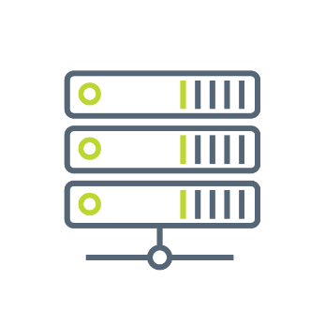

SIFY GROUP COMPANIES
NETWORK
SERVICES
DATA CENTER
COLOCATION SERVICES
CLOUD & DIGITAL
SERVICES
Sify Technologies Ltd.
Sify Infinit Spaces Ltd.
Sify Digital Services Ltd.
Innovation led by Sify Ventures
Your digital bridge for transformation, built on world class digital infrastructure, platforms and services

Slide 3
CONSISTENT Financial PERFORMANCE
Revenue Growth
Figures in INR Crores
Services vs Product
CAGR 12%
Network – Data Center – Digital Services
Profit After Tax (PAT)
CAGR (49%)

Slide 4
SIFY’S Global presence
MPLS network presence in over 1700 Cities
14 Operational Data Centers
66+ Pan-India Edge Nodes
3 Open Cable Landing Stations
Delivery Centers in 6 Major Indian Cities
Canada
Toronto
Europe
London
Dubai
India
USA
Santa Clara
USA
New Jersey
Singapore
Presence in
6 countries
Partnering with enterprises for Digital Transformation
Proven track record of executing complex programs
Over 3000+ skilled associates
Quality benchmarks –
CMMi 5, ISO 9001, ISO 27001, SSAE 16 certifications

Slide 5
Innovating TO STAY Relevant
1995-2005
Internet Revolution
2006-2011
Data Explosion
2012-2020
Cloud Innovation
2021 onwards
Digital Acceleration
2025 onwards
The Age of AI
Sify 1.0
Sify 2.0
Sify 3.0
Sify 4.0
Sify 5.0
RETAIL INTERNET SERVICE PROVIDER
ENTERPRISE SERVICES COMPANY
DIGITAL ICT SERVICES PROVIDER
(cloud@core)
DIGITAL TRANSFORMATION PARTNER
(digital@core)
AI – POWERED
INNOVATION
PARTNER (innovation@core)
First private
ISP in India
Launch of MPLS &
Data Center services in India
Launch of Enterprise Cloud platform & Hybrid Cloud services
Launch of end-to-end
Digital services
Launch of AI-Driven Digital Solutions
From revolutionizing consumer internet in the 90s to leading AI-powered innovation for Enterprises

Slide 6
OUR Investment PHILOSOPHY
Digital
Services
  Skilled workforce to support modern technologies
  Services across the digital spectrum
  Embedded AI
  Secure by design
3000+ SMEs across platform automation, modern apps, AI/ML, DC, Cloud, Networks, Security
Infinit AI, Infinit FSO, SaaS & Industry solutions
  Modern cloud platform – x86 & GPU support
  Ample data stores for data explosion
  Cybersecurity Operations Centers
  Cloud Management Platform for efficient operations
CloudInfinit^{+AI} , GPU as a Service
Hybrid Cloud Infrastructure
Infinit CMP, Cloud Anywhere Edge Cloud
Infinit MNS platform, NOC
Global SOC, MSS, Infinit Security
Cloud,
AI & Security
  AI ready data centers
  Core and Edge data centers for edge use cases
  Certified and compliant
  Focus on sustainability
14 DCs, 227+ MW IT power
407+ MW by 2025. 10+ Edge DCs
Scalable to 970+ MW
231+ MW RE Power
AIOps, AI Ready, Liquid cooling
Data
Centers
Network
Infra
  Reliable national network backbone
  On-demand capacities
  Deep Distribution Capillarity
  Open Cable Landing Stations for subsea cables
1700+ Cities, 3700+ PoPs
Fiber coverage 24+ Metros
3 CLS, 8 International POPs
Sify OnNet- automated Ent WAN
Notes:
1400+ Digital Networks
350+ Cloud
450+ Modern Apps & AI/ML,
100+ Cybersecurity,
100+ Platform automation,
500+ Technology Integration

Slide 7

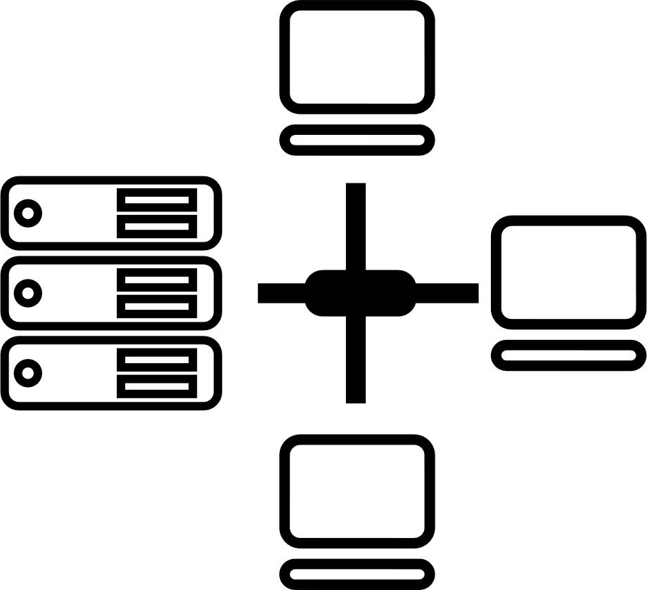

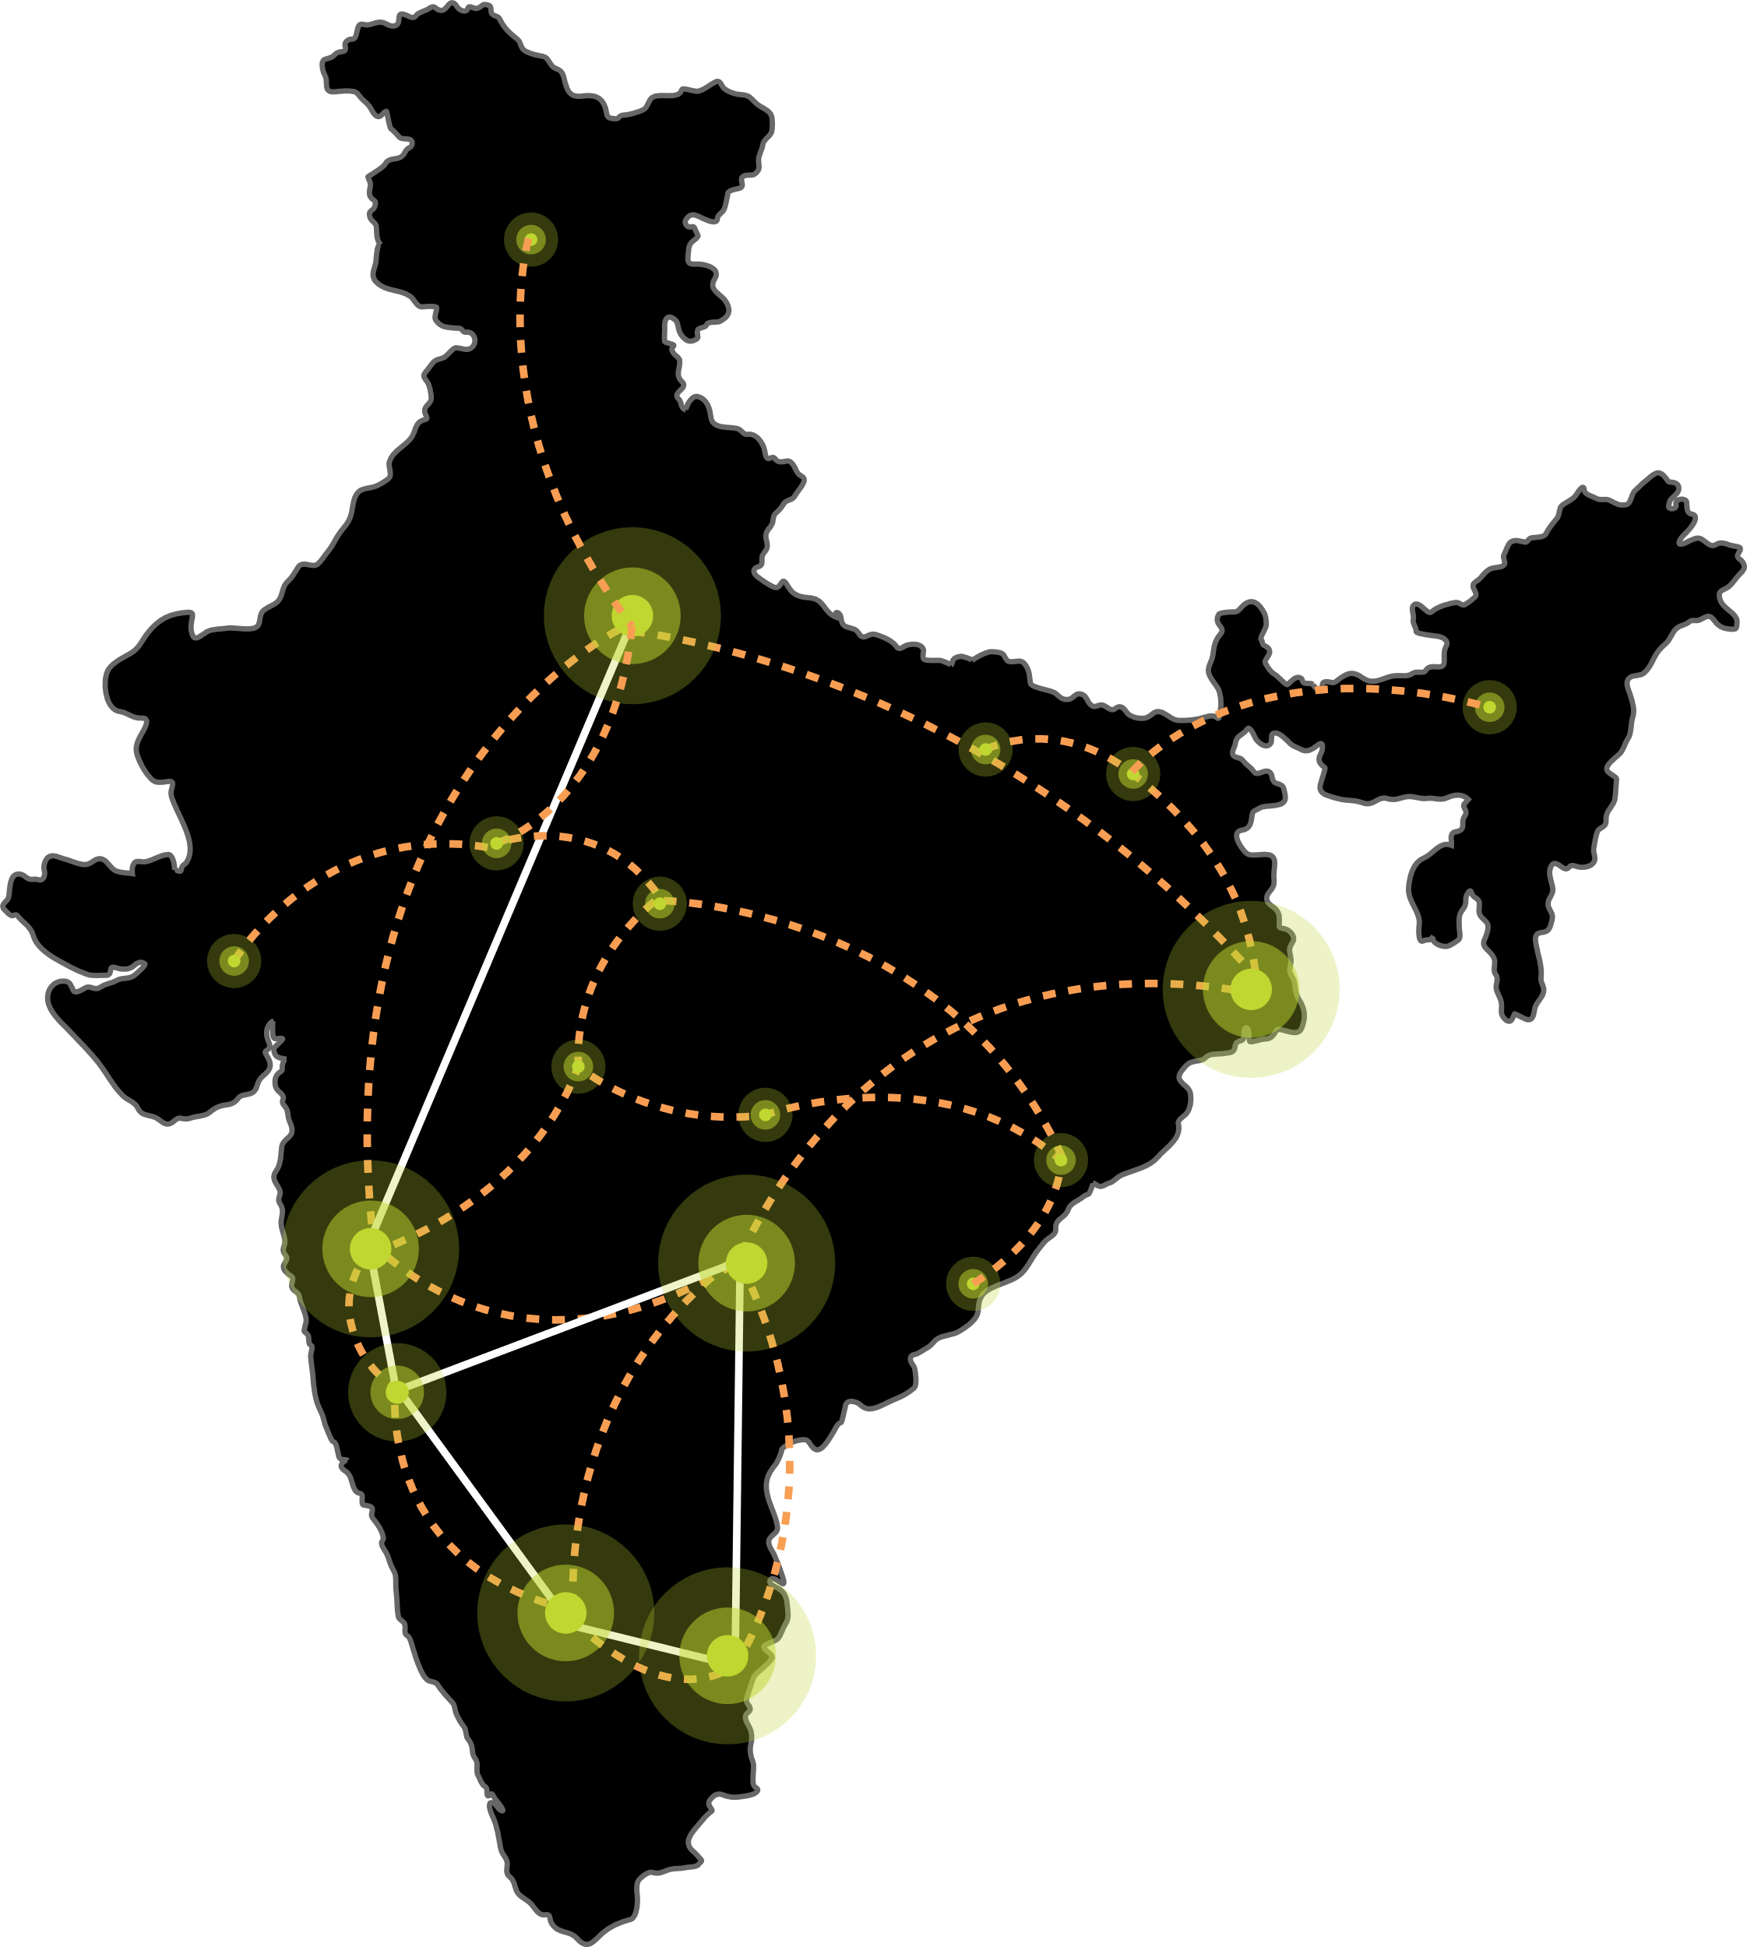






Our DIGITAL INFRASTRUCTURE & PLATFORMS
India’s Top 10 banks, Top 4 Manufacturing, 3 Major Hyperscalers, Global Social Media, OTT, Security Players, and 10,000+ Enterprises trust Sify.
Metro Networks
Fiber access
Connected Buildings
Interconnected DCs
Express Long-Haul Backbone, High Bandwidth and Low Latency across Key Locations
Network
Infra Services
Network Digital
Managed Services
NOIDA 02
NOIDA 01
SAARC Gateway, Kolkata
Data Center
Colo Services
CloudInfinit^{+AI}
GPU Cloud
MUMBAI 03 RABALE
KOLKATA 01
MUMBAI 02 AIROLI
MUMBAI 01 VASHI
CLS, Versova, Mumbai
HYDERABAD 02
HYDERABAD 01
Cloud & IT
Managed Services
Security
Managed Services
CHENNAI 02
BENGALURU O2
CHENNAI 01
BENGALURU 01
CLS, Siruseri, Chennai
Digital Apps
Managed Services
Industry Apps
Managed Services

Slide 8
Sify AI Overview
The Sify portfolio offers a comprehensive range of AI services, designed to build and operate solutions that boost business productivity and competitiveness. With agile, flexible infrastructure and secure, cutting-edge platforms, Sify offers everything needed to empower your AI journey.
AI-READY
Networks
High capacity with ultra-low
latency
Data Centers
High-density hosting for
AI workloads
CloudInfinit^{+AI}
High performance compute with GPU as a service
Platform
Develop and Deploy AI models &
services
Learning
Training modules with Companion Labs to build AI solutions
Security
Proactive Detection, Defense & Rapid Response
From Infrastructure to innovation, Sify empowers your AI journey
Notes:
The rise of Generative AI has ignited a push for operational excellence and transformative user engagement across industries. Yet, AI ambitions face familiar and new challenges, demanding a seamless approach to explore, experiment, and execute AI projects effectively.

Slide 9



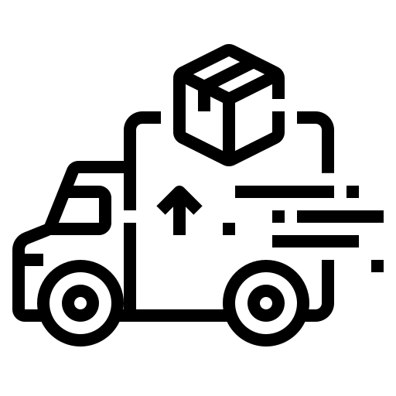




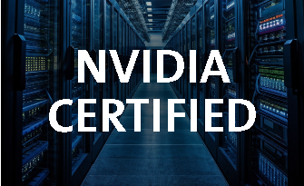
Sify's AI ​
Ecosystem ​
Architecture​
BFSI
Manufacturing
Retail
Logistics
Healthcare
Education
Media
IT/ITeS
DNB
Govt./PSU
Flexible
Scalability
Increase
Productivity
Predictive
Analytics
Mitigate
Risks
Sify Al Platform
Al Enterprise Suite
Gen Al Studios, AlOps-Digital Twins
Innovation
Data Science Tools, Frameworks,
Dashboard, Governance
Tools: Pre-trained Models, Jupyter -Tensorflow, Python, Inference server...
Sify
Al Learning
Sify CloudInfinit^{+AI}
Hybrid IT
Sify CMP
Sify GPU as a Service
Orchestration | Provisioning | GPU Workload Containers
Companion
Labs,
Training
Modules
Sify GPU
NVIDIA
Sify
Compute
Sify
Networking
Sify
Storage
DGX POD
X86 GPU
Sify AI Data Centers
Scalable, Secure, Green
DGX-ready Certified DC
Cloud Adjacent DC
Infrastructure
Sify AI Network Infra​
600 Gbps Bandwidth
Ent & CSP Workloads
Hyper Reach, Hyperconnect, Edge Connect, Private 5G,
On-demand Bandwidth

Slide 10
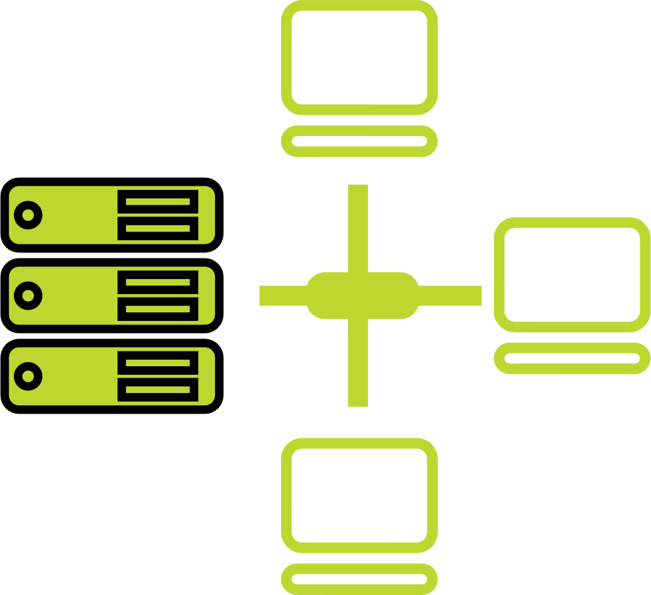




one-stop engagement for enterprises’ digital pursuits
Network
Infra Services
Network Digital
Managed Services
Data Center
Colo Services
CloudInfinit^{+AI GPU Cloud}
Cloud & IT
Managed Services
Enterprise connectivity- WAN, NLD
Edge Connect- Pvt 5G, Wi-Fi
Global Cloud Connect, DC Interconnect
International POPs, Cable Landing Stations
Network transformation and consolidation
Managed Secure Networks- SDWAN, SASE, DDOS protect
Campus & Branch Networks
Smart Edge
Captive & Hybrid NOC services
Network Observability
CaaS & Collaboration Services
AI ready
Hyperscale Cloud adjacency
RAS Design
Liquid Cooling
Hyperconnected
Built-to-suit
AIOps
Renewable Energy
Managed Public/Private Cloud
GPU as a Service
Cloud Anywhere-Edge Cloud
BCP- DRaaS
Regulatory and compliance ready
Hybrid Cloud Assessment, Migration and Managed Services
Multi Cloud Platform
Hyperscale Cloud services AWS, Azure, GCP, OCI
End-to-End IT Managed Services
Networks
Data Centers
Cloud & IT
Digital Apps
Managed Services
Industry Apps
Managed Services
Security
Managed Services
25 years
of digital
trust…
Digital
Infinit AI/ML Platform
Infinit Full Stack Observability
App Modernization & DevSecOps
Retail Intelligence- Forum Digital
Digital Assessment, AI Learning & XR
Consulting, Support, Maintenance, and Upgrades
Microsoft
Oracle
SAP
Security
Cybersecurity assessment and managed services
MSS, MDR & GRC
Global SOC
AI/ML driven Security Assurance

Slide 11
Networks Infra & Network Digital Managed Services

Slide 12




future ready network backbone
Hybrid
Access Strategy
Cloud and
AI Ready
Designed for Mission Critical Networks
Automation
Pan-India wired and wireless enterprise connects across 1700+ Cities, 3700+ PoPs
1,20,000 Kms of Fiber coverage across 24+ Metro Cities
Dark fiber economic model with nation-wide regulatory compliance
Edge strategy to augment 10+ tier 2 cities, interconnect with NIXI across 20+ cities- 32+ MN eyeball access
National long-distance network connecting 5 major cities
Doubled national long distance network capacity from 300G to 600G
66+ interconnected DCs, 99.999% guaranteed availability
>1 ms latency connectivity to major hyperscalers enabling hybrid deployments
Fully meshed backbone for resiliency
3 CLS: Mumbai, Chennai, Kolkata serving global customers
Coastal subsea systems interconnecting India-West to India-East
8 international PoPs, global partnerships with Telecom Carriers and Internet Exchanges
Sify OnNet: India’s first automated enterprise WAN
On Demand network infrastructure services
Powered by AI/ML based operations with dual NOCs
Reliable connectivity for mission critical networks, AI applications and hyperscale CSPs

Slide 13

NETWORK DIGITAL MANAGED SERVICES
Outcome-based Network Managed Services enabling scalability & reliability
Cloud Managed Branch & Campus operations with integrated Security
Secure WAN employing Managed SD-WAN & SASE
Software Defined & Secure DC Network Architecture
Capability built over 2+ decades supporting large, diverse customers
Modern Tools enabling AIOps & Observability for enhanced customer experience
Expertise across Network, Security, Cloud Communication, and IoT, fortified by the innovative capabilities of
Sify's Service Delivery Platform, constitutes an unparalleled value proposition.

Slide 14




Network Digital Services Portfolio
Network Transformation
Secure WAN Edge
Cloud communication & collaboration
Mobility & IOT
Managed SDWAN
Managed Campus / Branch Network
Data Centre Network
Managed Cyber Security
Network Observability
Automation, Orchestration & AIOps
NFV/ NFVI
SASE
Secure SD-WAN
Cloud Managed Wi-Fi
Managed DDOS
Firewall As a Service
Remote VPN
uCPE
Private 5G
Mobile Edge Compute
IOT Solutions
    IOT Connect
    IT/OT Security
    IOT Applications
UCaaS
CCaaS
CPaaS – Omnichannel
Platforms ( on-prem / hosted )
    Microsoft Teams
    Cisco Webex
Service Delivery Platform
Actionable Insights & Analytics
Delivery Process Automation & AIOps
Core Capabilities
Consult / Advisory
Design / Implement
Managed Operations / NaaS
Expertise across Network, Security, Cloud Communication, and IoT, fortified by the innovative capabilities of Sify's Service Delivery Platform, constitutes an unparalleled value proposition

Slide 15
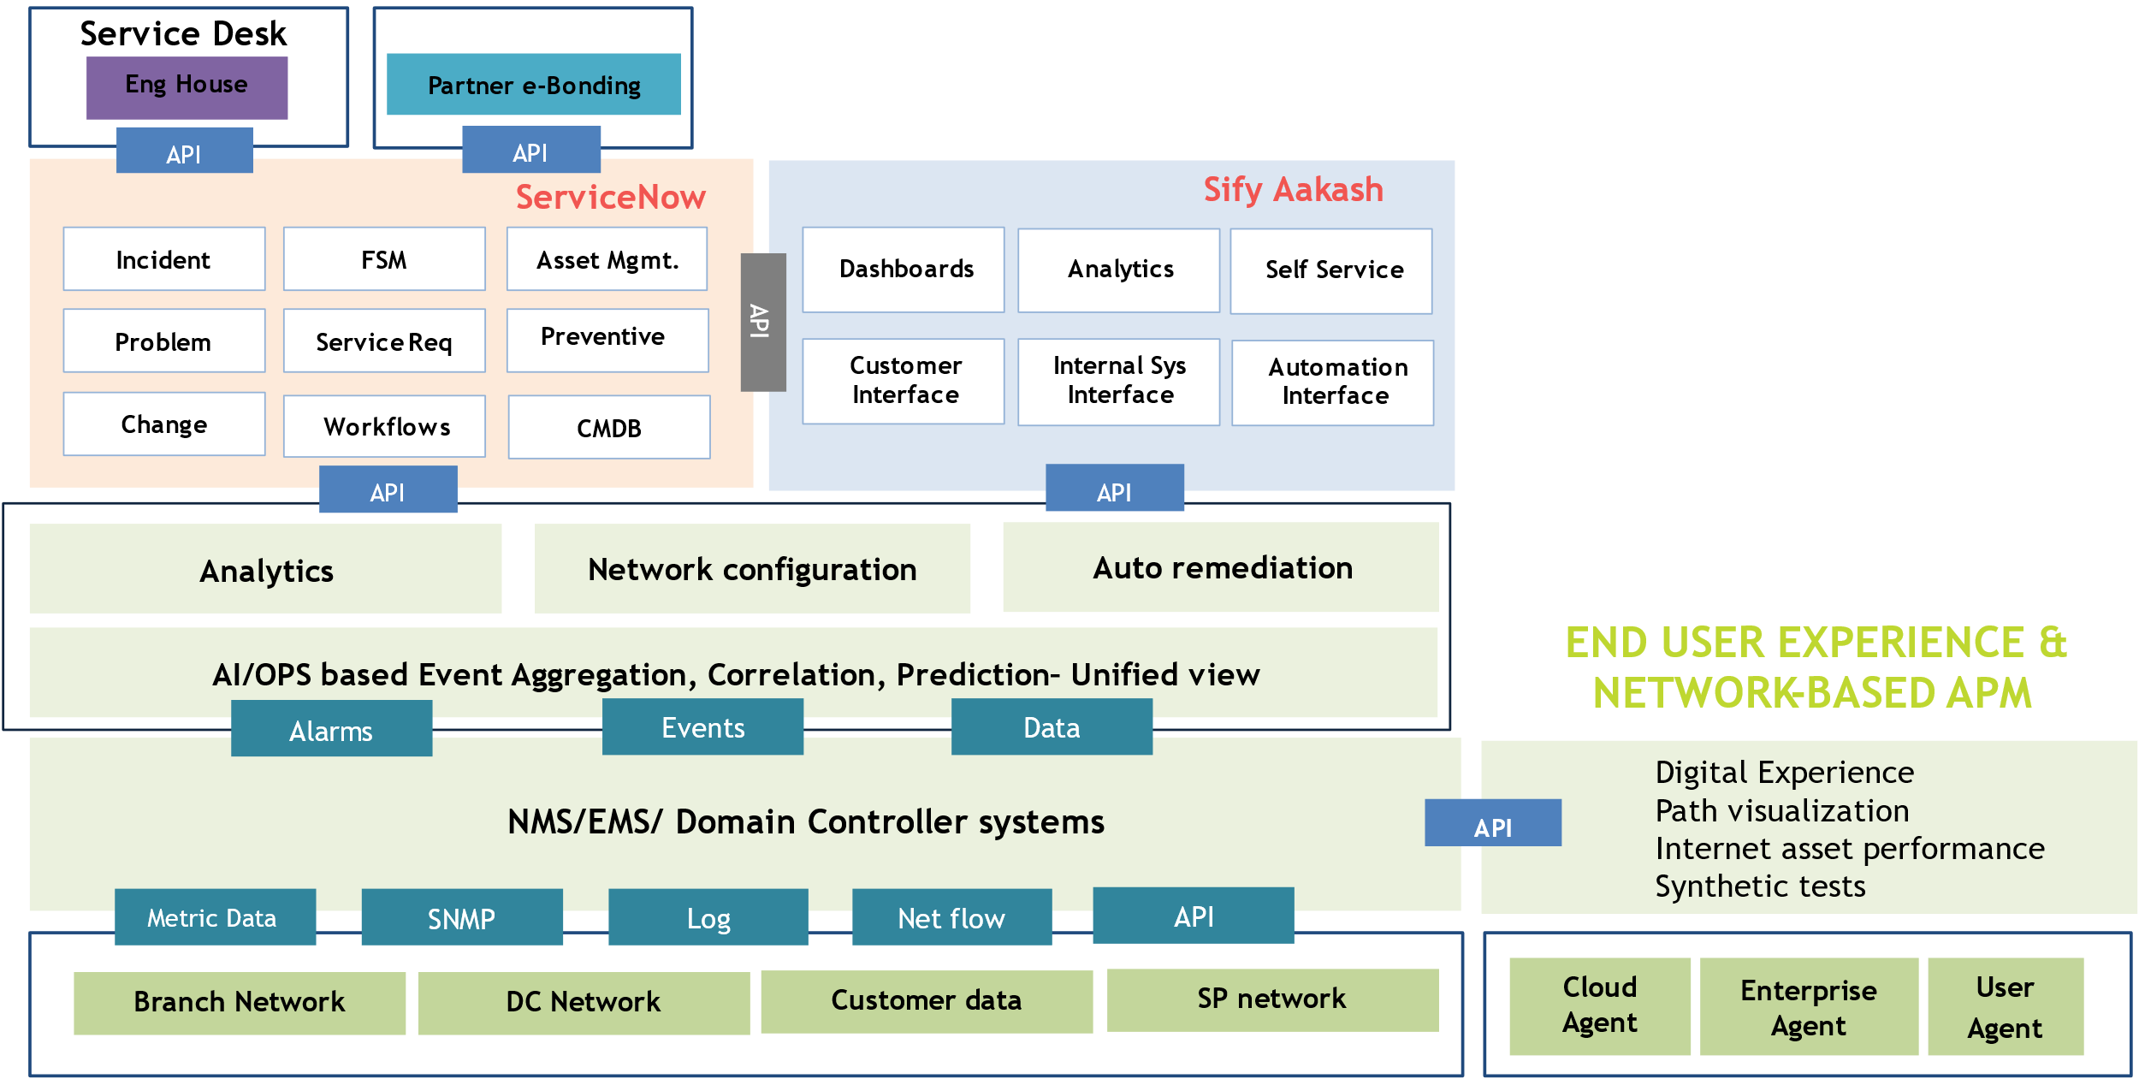
NETWORK DIGITAL SERVICE DELIVERY PLATFORM
Automation & AI Driven
Incident Co-relation, Diagnostics Bots, Service Provisioning, Predictive Insights & AIOps
Network Observability
End to End visibility: Topology, Service Relationship & End user experience
Customer Experience
Aakash provides intuitive Analytics, Inventory & Self Service
Tools Integration
Multi Vendor NMS, EMS & Controllers. E-Bonding with key Telco’s & OEM’s ITSM tools
ITSM

Slide 16
AI Ready DATA CENTERs
FROM India’s Data Center Pioneer

Slide 17
Future rEADY Data CentER aRCHITECTURE
CUSTOMIZABLE & MODULAR INFRA
ENGINEERED FOR
AI WORKLOADS
MULTI-LAYERED NETWORKS
Purpose-built compliant infra with Vertical and Horizontal expansion to support AI deployments
Designed for 130 kW/rack high density racks. 6.3m floor to floor height, 2100 kg/m² load bearing capacity
Multi-tier fiber and copper for low-latency deployments, supporting high-capacity network bandwidth up to 600 Gbps
RELIABLE
POWER SUPPLY
SUSTAINABLE
OPERATIONS
Robust power supply to handle dynamic load variations. On-premises 220 kV and 230 kV substation, 48 hours of fuel storage
Liquid & Air-cooling solutions, 60% renewable energy, ESG best practices and automation led continuous monitoring
Ensure business continuity, maximize uptime, resilient connectivity and sustainability
with RAS designed scalable digital infrastructure

Slide 18

Our DATA CENTERS: INDIA FOOTPRINT
CHANDIGARH 01
14 MW
NOIDA 01
Noida
10.8MW
NOIDA 02 CAMPUS
Tower B
43+ MW
Tower 1
11.5 MW
Tower 2
9.6 MW
Tower 3
BTS
LUCKNOW 01
14 MW
Tower A
43+ MW
Tower C
43+ MW
1st Tier 3
in 2000
Tower 4
8.1 MW
Tower 5
43+ MW
Tower 6
40+ MW
Q2 2025
MUMBAI 01
Vashi
0.9 MW
Tower 7
40+ MW
Q3 2025
Tower 8
40+ MW
Tower 9
40+ MW
Tower 10
40+ MW
KOLKATA 01
2.2 MW
Tower 11
40+ MW
Q3 2025
Tower 12
40+ MW
Q4 2025
MUMBAI 02
Airoli
5.4 MW
HYDERABAD 02 CAMPUS
(FAB CITY)
MUMBAI 03 CAMPUS (RABALE)
HYDERABAD 01
Financial Dist.
14.4 MW
Block 1
26 MW
Additional Blocks
26-52 MW each
(including BTS)
BANGALORE 02 CAMPUS (AEROSPACE PARK)
BANGALORE 01
Electronic City
7.6 MW
Tower 1
20+ MW
Q2 2025
Tower 2
20+ MW
CHENNAI 02 CAMPUS (SIRUSERI)
CHENNAI 01
Tidel Park
3.6 MW
Tower A
43+ MW
Tower B
43+ MW
Tower C
43+ MW
Operational
In Development
Planning
All Power references are Design IT Power at maximum Capacity
All Power references are Design IT Power at Full Capacity
Notes:
Data Center Expansion in major metropolitan- Mumbai, Delhi (NOIDA) Chennai, Hyderabad, Chennai and Bengaluru
Edge data centers in 10+ tier 2 cities
Additional 180+ MW IT capacity to be added by 2025. Campuses scalable to 970+ MW with BTS capabilities
231+ MW Renewable energy contracted; ~500MW planned to meet long-term sustainability goals
Al/ML based Automation for driving operational excellence
NVIDIA certified DGX ready data center provider, 130+ kW power per rack with air & liquid cooling
Achieving six Zeros- Availability Incidents, Redundancy Incidents , Security Incidents, Safety Incidents, Defects (In design & operations), Carbon Footprint

Slide 19
Edge data center footprint.
Rollout planned over 2-3 years
Low latency, easy access and faster content delivery in non-metro locations, ensuring seamless data processing and superior customer experience.
CHANDIGARH 01
Oct 2025
NOIDA 02
NOIDA 01
LUCKNOW 01
June 2025
JAIPUR 01
PATNA 01
NAGPUR 01
GUWAHATI 01
AHMEDABAD 01
3.6-14.4 MW Tier 3 data centers with diverse carriers, ISPs, Transit nodes, IXs and CDN.
Leverage Sify’s extensive Network presence; connect with Sify NLD fabric.
The data center consumption and interconnections driven by the pull of anchor tenant.
INDORE 01
RANCHI 01
SAARC Gateway, Kolkata
BHOPAL 01
KOLKATA 01
MUMBAI 03 RABALE
VISAKHAPATNAM 01
MUMBAI 02 AIROLI
BHUBANESWAR 01
MUMBAI 01 VASHI
VIJAYAWADA 01
RAIPUR 01
CLS, Versova, Mumbai
HYDERABAD 02
HYDERABAD 01
COCHIN 01
CHENNAI 02
BENGALURU 02
CHENNAI 01
BENGALURU 01
CLS, Siruseri, Chennai
Construction
Design
Planning
Notes:
Special Economic Zones, IT resources, IT outsourcing companies are going into tier 2 cities. We need to build digital infrastructure for AI in these locations. AI training needs more investments, that can happen in the large metros, AI inferencing is cost effective which you can build in tier 2 cities. We have a plan to begin with 10-20 locations in Tier 2 and 3 cities leveraging our Pan India Network and DC footprint.

Slide 20






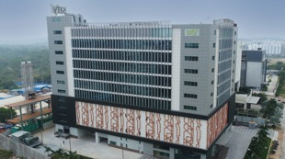

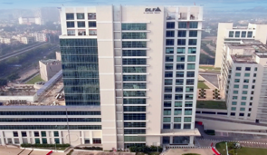
AI-READY, hyperscale, Hyperconnected,
Green, Data Center campuses
India’s 1st Nvidia DGX Ready Air-Cooled DCs
March 2022
India’s 1st Nvidia DGX Ready Liquid Cooled DCs
August 2024
Mumbai 03, Rabale
IT Power: 377+ MW
Noida 02
IT Power: 130+ MW
Chennai 02, Siruseri
IT Power: 130+ MW
5 Towers Operational
4 Towers In Development
3 Towers in Planning
1 Tower Operational
2 Towers in Planning
1 Tower Operational
2 Towers in Planning
Bengaluru 02
IT Power: 40+ MW
Hyderabad 01, Financial Dist.
IT Power: 14.4+ MW
Hyderabad 02, Fab City
IT Power: 250+ MW
Kolkata 01, DLF IT Park New Town
IT Power: 2.2+ MW
In Development
Operational
Planning
Operational
14 DCs - 227+ MW IT power | 407+ MW by 2025 | Campuses scalable to 970+ MW with BTS | 231 MW Green Power

Slide 21
Your trusted data center partner
Sify is a LEADER in the IDC MarketScape Data Center Services India, 2024
Mission Critical Customer Experience
2 Decades of Operational Experience
Future-ready
Data Centers
Trusted
Partner
3 out of 4 Hyperscalers
Global OTT & social media players
India’s top 10 banks
Global InfoSec security providers
600+ customers across all major industries
100% uptime
Best Practices covering Safety, Security, Availability, Excellence
PUE & WUE prediction and optimization
Certifications: Information Security, EHS, PCI-DSS, SOC 1 SOC 2, NVDIA, MeitY, IGBC
Mega campus approach for long term scalability with BTS
Next Gen Data Center design & operations.
AI ready infra with liquid cooling solutions
AI/ML platform enabling faster decision-making
Up to 70% Green Power available
1st commercial Data Center provider in India since year 2000
Data Center, Networks Digital and Security services under one roof
Reliability for services
Flexibility for customer requirements
Ensuring accountability, reliability, flexibility and choices through our innovative designs and services

Slide 22
Cloudinfinit^{+AI} | Cloud & IT Managed Services
Notes:
Dheeraj

Slide 23






CloudInfinit: agile & scalable Hybrid cloud platform
A comprehensive cloud computing platform that provides a wide range of cloud services designed to meet the diverse needs of businesses, from startups to large enterprises.
Infrastructure as a Service (IaaS)
Platform as a Service (PaaS)
Software as a Service (SaaS)
Managed
Services
Flexible choice of sizing the instance as per business and performance demand
SIFY CLOUDINFINIT ENTERPRISE PLATFORM
Predictive costs across catalog - No bill shock &
No egress costs
ENTERPRISE SAP GRID
SOVEREIGN
AI CLOUD
GCC CLOUD
Various Sovereign cloud landscapes, such as Banking, Trading, and Make-In-India Cloud
Regulatory and compliance-ready POD: SEBI, RBI, IRDA, MeitY empaneled to meet Data Localization
Designed for scalable, cost-efficient, and compliance ready workloads across industries

Slide 24
CloudInfinit^{+AI}: High performance GPU AS a service
Our cloud platform is now elevated to meet demands of deep learning, machine learning, AI training, inferencing...
With Nvidia's advanced GPUs, get unparalleled performance, high network throughput & low latency, crucial for AI workloads.
High-Performance
Infrastructure
Optimized for
AI Workloads
High Network Throughput &
Low Latency
Powered by Nvidia's state-of-the-art GPUs, Sify CloudInfinit^{+AI} offers exceptional computational power, enabling rapid AI model training and efficient inferencing.
Tailored specifically for deep learning and AI applications, the platform supports complex algorithms and large datasets, enhancing the accuracy and speed of AI operations.
Enable low latency interconnect to Hyperscalers and other Data Centers supporting all Hybrid Cloud deployment data sources
State-of-the-Art Data Centres
Scalability, Flexibility & Security
Enhanced Collaboration
Hosted within Sify's top-tier data centers, CloudInfinit^{+AI} delivers secure, dependable, and scalable computing resources, supported by Sify’s extensive network and infrastructure expertise.
Offers scalable resources to support growing AI workloads, allowing to expand seamlessly while maintaining robust data security and compliance with industry standards.
By integrating Nvidia’s technology with Sify’s CloudInfinit^{+AI}, businesses can leverage advanced AI tools and frameworks, fostering innovation and accelerating time-to-market
Democratizing access to high-performance computing, driving innovation and efficiency for organizations

Slide 25
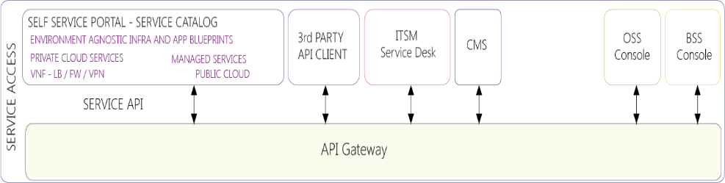
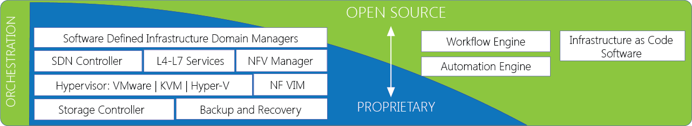







CloudInfinit^{+AI}: Service catalogue
COMPUTE
AI COMPUTE
STORAGE
NETWORK
SECURITY
BACKUP
Virtual Private Instances (VPI)
Virtual Private Enterprise (VPE)
BareMetal Server
Disaster Recovery as a Service
SAP Grid
AI Infra DGX, VGPU & MIG
GPU VDI
Generative AI
Machine Learning
AI Training & Inferencing
Nvidia H100, L40s, L4
Enterprise SAN
All Flash NVMe
High Performance
Low Latency
Scale on IOPs
Network Attached Storage
Object storage
Internet bandwidth Mbps / GB plan
SLB/GSLB
DNS
IP-Sec VPN
Cloud Connect
InfiniBand
Nvidia NVLink
Firewall (VPDC)
NIDS / IPS
Host Security
Fortnox UTM
WAF and DDoS
SIEM
Log Management
Antivirus
MFA
D2D, D2C, D2T
Ransomware Protection
Air Gap Backup
Immutable
Second Copy
Snapshot Management
Archival
Cold Copy
Scalable, secure cloud Infrastructure support for diverse business needs

Slide 26
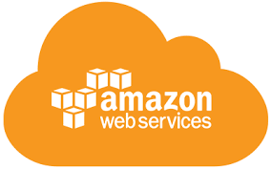
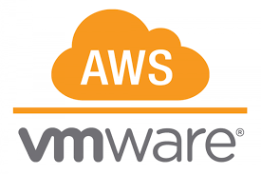





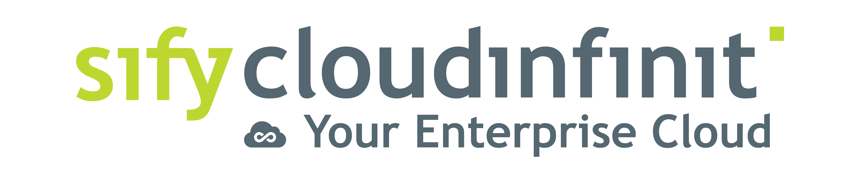

Hybrid/multi cloud with cloud adjacency
Best of breed performance with Hybrid Cloud configuration
Efficient integrations with extended ecosystems
Compliance with data sovereignty
Business continuity with resilience
Simplicity with self service
Operational efficiency with reduced IT administration
Cost reduction with
on-demand bursting to public clouds
Hybrid Cloud
Hyperscale Clouds AT VERY LOW LATENCY
Express Route
RABALE DATA CENTER (Cloud Adjacent)
DC INTERCONNECT
Hybrid Cloud
Direct Connect
Sify Cloud Connect
Partner Interconnect
Managed Services
Hybrid Multi Cloud Management Platform
Far DR
AIROLI DC ^{(Near Cloud / DR)} - Enterprise Multi Tenant Cloud ^{AT MINIMAL LATENCY}
Colo
Sify MULTI-CMP driven | AIOps Platform for Managed Services
FAR DR READY
SEC - SAP GRID
CI Community
GCC –Make-in-India
CI Trading Cloud
Hyderabad Data Center
Notes:
Sify USP and strength is integrated service stream of Sify Cloud and low latency Cloud connect to Public cloud

Slide 27





















SIFY INFINITCMP: Gen V MULTI-Cloud Management
Sify InfinitCMP ensures better visibility, control and governance across multi clouds.
Provisioning
Orchestration
Configuration
Billing / Chargeback
Systems Management
Capacity
Cost Management
Cloud Management Platform
(Action & Automation)
Cloud Administrators
  One-click blueprint deployment of distributed workloads across multi-clouds
Self Service
APIs
SEC
Anywhere
  Resource Dashboard and governance from a single portal for all clouds
DevOps Management
Unified Dashboard
Role(Profile) Based Access
Automation
Blueprints
Policy Engine
Security & Compliance
App & DevOps
  FinOps:
  AI/ML driven real-time observability to optimize and control cloud costs
Dashboard
Request / Change
Event / Incident
Monitoring
Discovery
ITSM
(Engagement & Records)
All Users
  Unified analytical view on overall utilization, trending, resource planning and security assessment
Native Tools
AI / ML
  One interface to manage all cloud accounts and chargeback across tenant and clouds
CxO Users
Automation
SLA
HA / DR
Knowledge Base
Logs
Users
Core Platform
POD
Notes:
CMP's Building blocks illustrate various services' capabilities, supporting, provisioning, configuration management, automation, blueprints and cost management.
All the CMP configuration parameters are synced with ITSM for seamless integration and life cycle management of platform
The CMP is designed to support diverse user profiles.

Slide 28



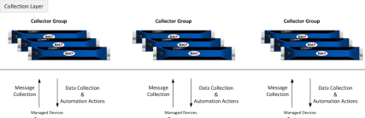
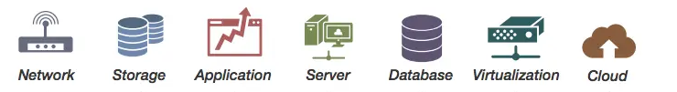

IT MANAGED SERVICES FRAMEWORK
Customers
Sify Delivery Team
Single partner for Managed Services across Digital IT
Operational Excellence driven by Automation
Proactive Assurance, Predictive Analytics & AIOps
Customer-centric Service Delivery model
Service Management Portal
Service Fulfilment
Provisioning, Orchestration & Service Assurance – Sify Multi-CMP
Request
Event
Incident
Problem
Change
Asset Mgmt.
CMDB
Service Mapping
AI/ML Tools
Sify Monitoring Tool
Data Store
Discovery & Mapping
Monitoring
Business Services Dashboard
Automation
Event Management
AIOps
Data
Visualization
Backup
Polled
Logs
Agents
API
Patch Management
Syslogs
VA / PT
AV
SIEM
API
Agents
DR
Any Cloud
Operations Support Systems

Slide 29
Security Managed Services
Notes:
Dheeraj/Pranesh

Slide 30




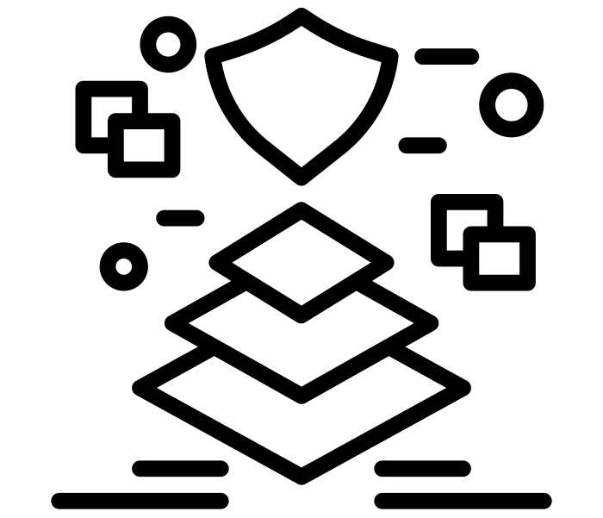



Security Managed Services overview
Cyber Security Advisory Services
Design & Build
Services
Operate &
Protect
Cloud Security & Policy Management
Security Platform as a Service
Managed Security Services
Managed Detection & Response
Governance Risk & Compliance (GRC)
AI/ML driven continuous Security Assurance Monitoring, & Automated Incident Management
Notes:
Change icons

Slide 31






SECURITY MANAGED SERVICES FRAMEWORK
Comprehensive Managed Security Services from Edge to Cloud Deployments
Single solution provider covering DC, Network, Cloud, App, Hosts and Data
Offering Shared/On site/Hybrid Services to manage diverse solution portfolio with customized support models
Integrated seamlessly with other managed services in the ITSM platform to provide a unified view with faster ticket resolution
SLA driven Security Services by virtue of SASE & Security providers hosted in Sify DCs
AI/ML driven continuous Security Assurance Monitoring, & Automated Incident Management
Real-time monitoring through multiple feeds, to safeguard all the systems and sensitive information
Correlate security inputs to business context and current threat insights for Auto remediation
Governance, Risk & Compliance Assurance
Identify security vulnerabilities across your digital IT infrastructure and remediate with Sify’s advanced managed services
Enable organizations to meet regulatory and compliance requirements: SEBI, RBI, IRDA, ISO27001…
Customers
Sify SOC
Service Management Portal
Service Fulfilment
Service Assurance
Provisioning & Orchestration (SOAR)
Request
Event
Incident
Problem
Change
Asset Mgmt.
CMDB
Service Mapping
Monitoring / Management (MSS)
Detection (MDR)
Governance Risk & Compliance (GRC)
Tools
Performance & Availability
IAM
SIEM
UEBA
EDR
NBAD
Vulnerability Assessment
Penetration Testing
OS & Application Patch Management
Security Product Consoles
Threat Intelligence
Security Audits
Firewall, IDS/IPS, ATP, RA VPN, WAF, SWG, SASE. DDoS, DNS Security
NGAV
DLP, Email Security
CASB, PAM, MFA
User | Device
Branch | WAN
DC
Any Cloud
Security Controls
Notes:
We adhere to a structured framework that consists of three distinct layers: assurance, tools, and security controls.
Within the SOC, there are three separate teams: MSS (Makers), MDR (Checkers), and GRC (responsible for IT security audits, VA & PT services). These teams collectively extend their oversight and supervision of security controls, regardless of their geographical locations, as illustrated in the lower right corner of the screen.
The assurance layer encompasses the closely integrated IT Service Management (ITSM) platform, which aligns with ITIL standards, and the Security Orchestration, Automation, and Response (SOAR) platform.
Structured framework covering Assurance, Tools, and Security controls
SOC powered MSS (Makers), MDR (Checkers), and GRC (IT security audits, VAPT services)
Geo agnostic with complete visibility of all security controls and centrally managed
Security Orchestration, Automation, and Response (SOAR) platform
Assurance layer includes an ITSM platform as per ITIL standards

Slide 32
Digital Apps & Industry Apps Services

Slide 33
DIGITAL APPs & Industry Apps MANAGED SERVICES
Fostering enterprise-wide transformation with SaaS and custom solutions
Infinit FSO
AIOps driven excellence with observability across your digital stack
Infinit AI/ML
Supervise & simplify your entire AI/ML lifecycle
Infinit DAM
Increase brand visibility & enhance your digital
content strategy
Infinit Retail Intelligence
Digitalize your forward supply chain management
Build a Digital culture within the organization with Digital Assessment, XR & AI Learning
App Modernization
and DevSecOps for faster time to market
Industry Application Services to unlock business agility
SAP, Oracle, Microsoft

Slide 34
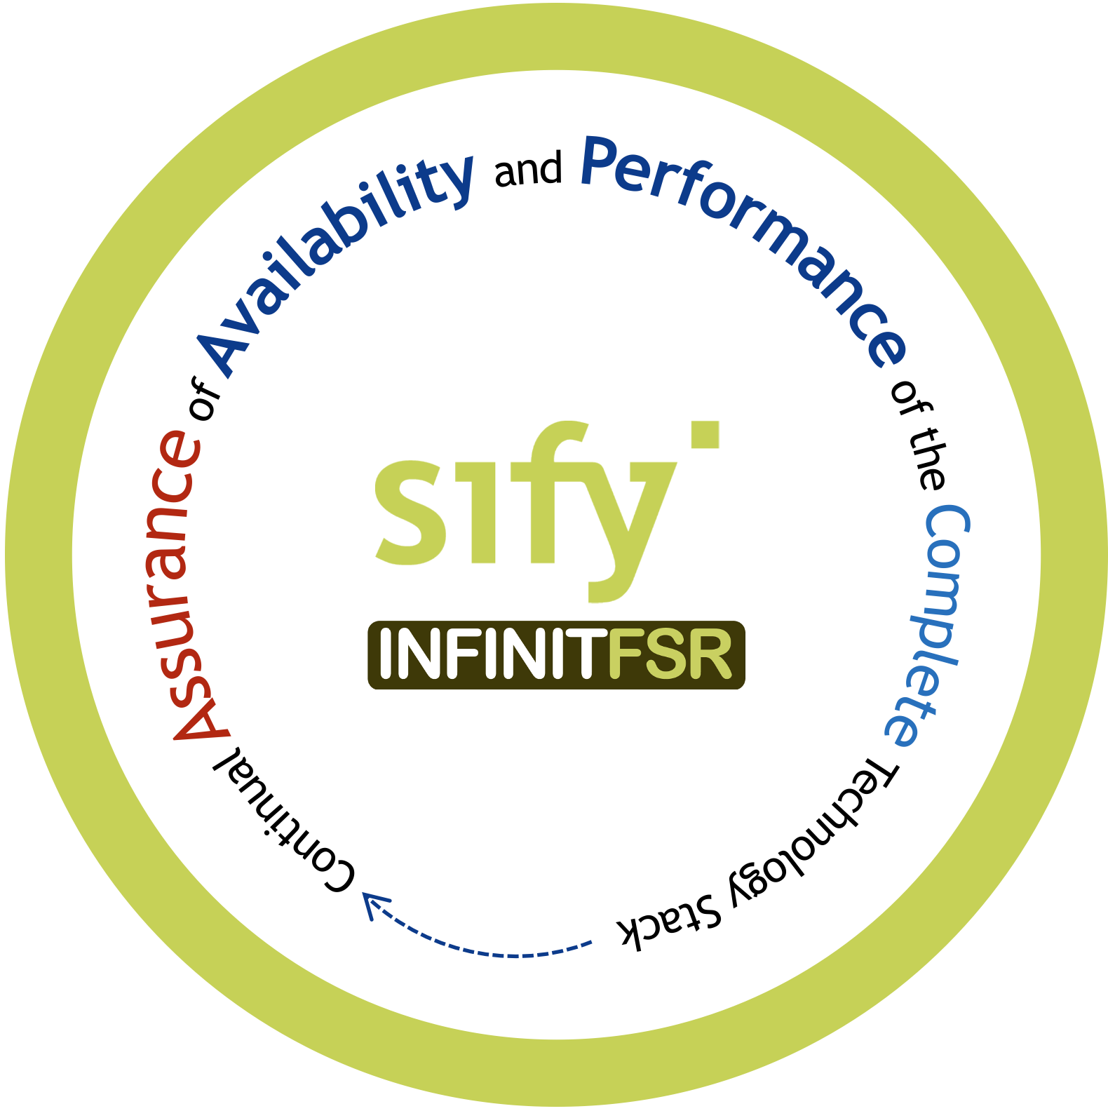
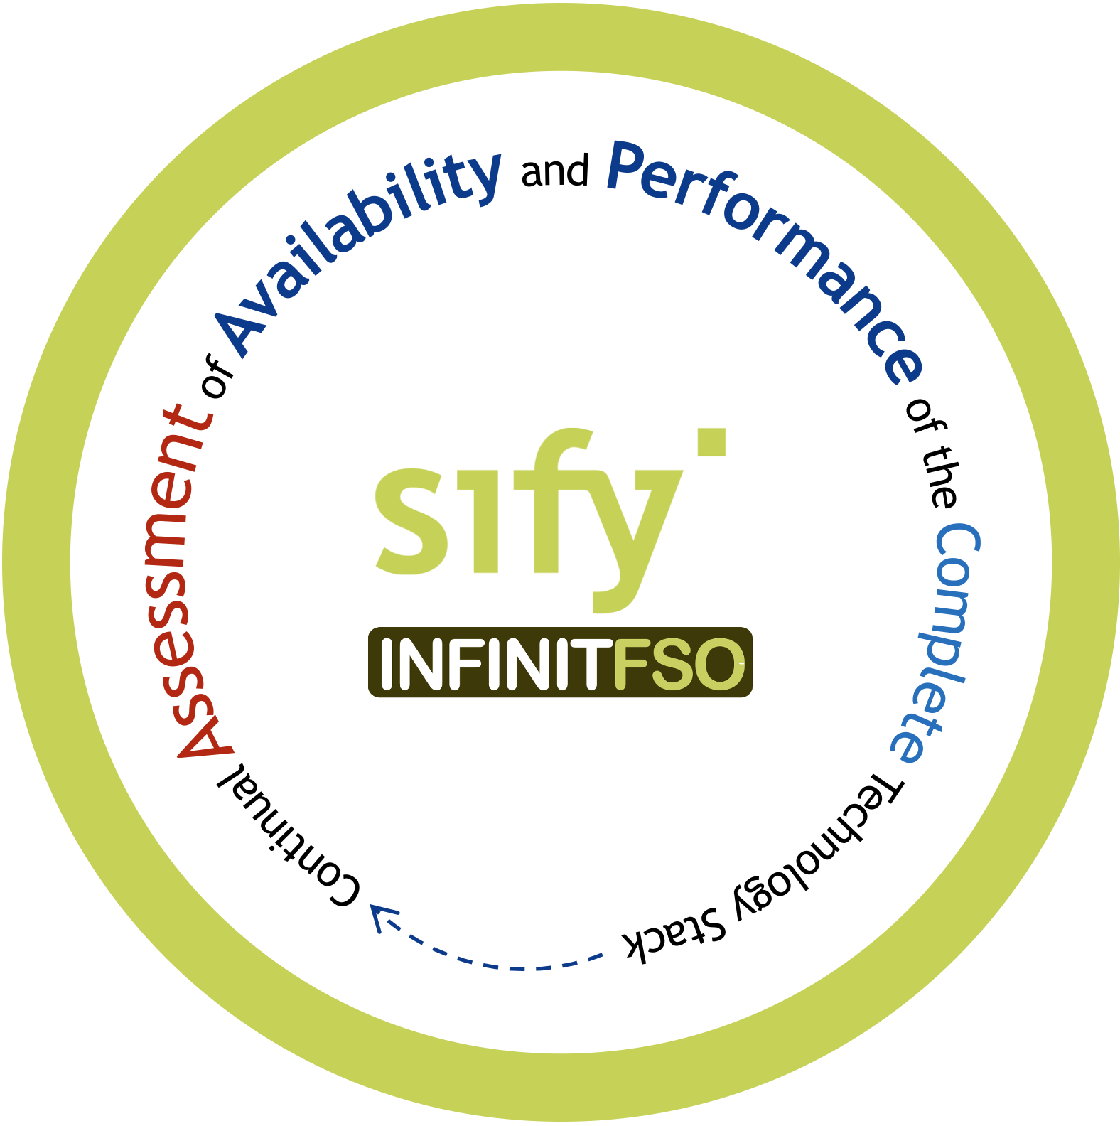
infinit FSO Full Stack Observability for operational efficiency
Service Management and Visualization Dashboard
4
Prediction, Prevention, and Remediation of
Business Service Availability and Performance Issues
Network Performance
Multi Cloud FinOps
App Security Services
App Performance
App Resource Optimization
...
BATCH
Real Time Predictive Insights
Multi Domain Telemetry
3
AI OPS
Asset Dependency Map Generation
X-MELT
STREAM
2
1
Telemetry - Metrics, Event Logs, Traces From All Sources
NET OPS
IT OPS
SEC OPS
APP OPS
Gain insights, ensure high performance & availability of your business-critical applications

Slide 35
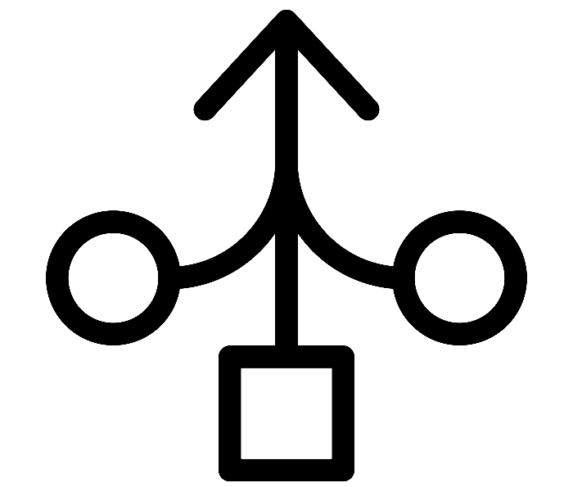

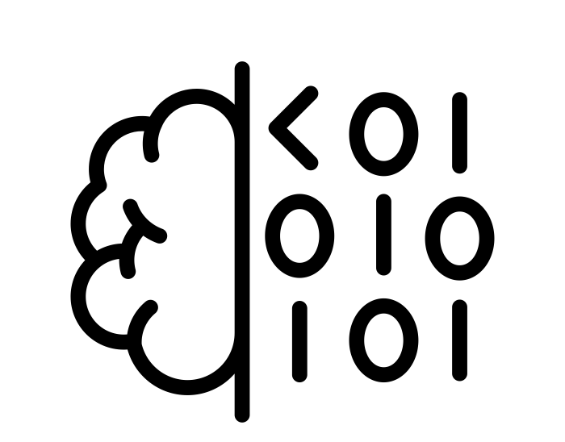
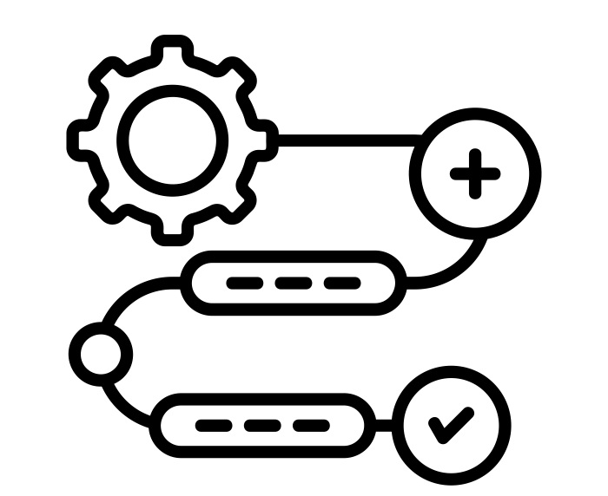
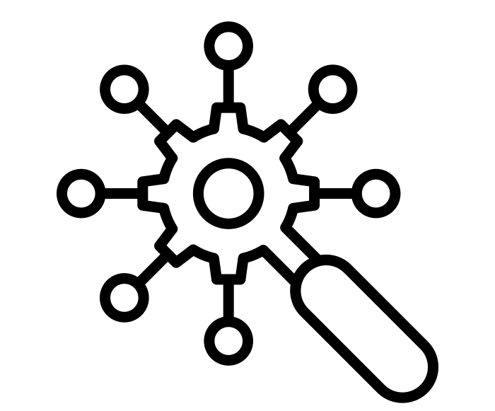

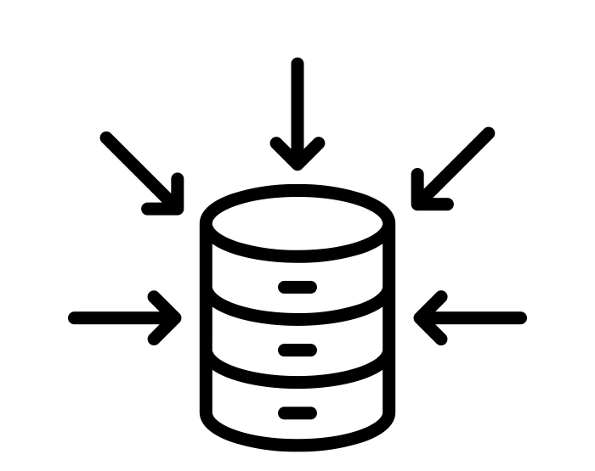




Infinit FSO with aiops for real time insights on service performance
Ability to aggregate multidomain X-MELT telemetry data
Generate Asset Maps with rich contextual information
Low code AI/ML pipelines with simple declarative SQL statements
Streamline every aspect of data preparation and feature engineering
Intelligent Event correlation for root cause sequence
Offline feature store for swift retrieval of prior learnings
Inbuilt aggregations, point in time joins and time travel for predictions
AI/ML model training with batch and streaming data
Service assurance with real-time prediction and prevention of problems
High performance and Highly available feature store for all stages of AI pipelines
Auto detect data drift and alerts to maintain model quality

Slide 36

Infinit Ai/ML PlaTFORM for informed decision making
Rapidly develop AI solutions tailored to your needs by seamlessly connecting with your existing systems
ERP
CRM
MES
Energy Optimization
Predictive Maintenance
Mix Optimization
Defect Detection
Inventory Management
Chatbot & Virtual Assistants
PLM
SCM
Sify-AIZEN Foresight
QMS
IoT
YOUR SYSTEMS
AI MODELS
OUTCOMES
Notes:
Our approach transforms your raw data into actionable features, allowing us to fine-tune prebuilt models or construct new ones from scratch. We specialize in serving predictions based on current data streams, ensuring a smooth integration into your applications for immediate impact and enhanced decision-making capabilities.

Slide 37
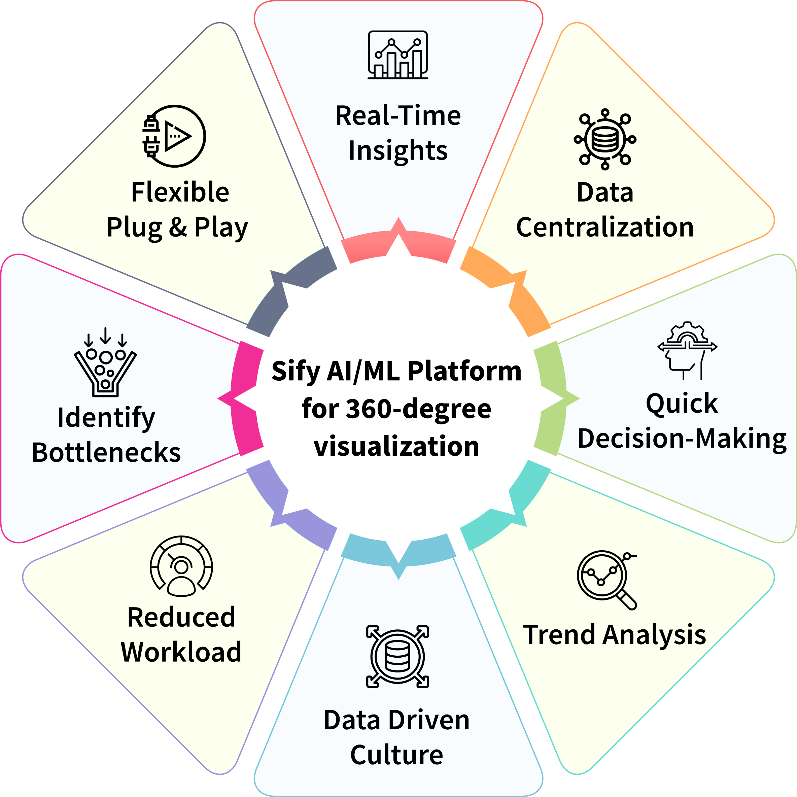
ONE STOP SHOP to Create and Consume AI
Automatically evaluate, Build and deploy ML models
Flexible data access and preparation with connectors to various data sources, cloud, and non-cloud​
Deploy latest generative AI techniques curated by NVIDIA and public domain​
Visual tooling studios to create business specific AI applications and assistants​
Rapid deployment options for batch and real time use cases ​
Prebuilt AI Solution Starters – sales forecast, anomaly detection
Design, Develop, Deploy AI models and services at scale to enhance digital business outcomes
Notes:
Sify’s comprehensive AI/ML platform, designed to streamline the creation and deployment of AI models for enhanced business outcomes. It offers automated ML model deployment, rapid integration with various data sources, and cutting-edge generative AI capabilities. With prebuilt solutions and visual tooling, the platform empowers data-driven insights, real-time decision-making, and a seamless, flexible approach to AI adoption.
Double click
Infinit GenAI Studio is a robust platform designed to enable businesses to easily build and deploy AI-driven applications. Whether you need a conversational chatbot, real-time speech-to-text functionality, or customized AI models for specific tasks, GenAI Studio provides the tools and infrastructure to bring your AI solutions to life. It allows you to leverage Large Language Models (LLMs), integrate open-source models like those from Hugging Face, or tap into pre-built models for immediate deployment.
Key Features of GenAI Studio:
Model Flexibility and Integration: GenAI Studio supports a variety of AI models, including public models from leading platforms like Hugging Face, and custom models tailored to your business needs. You can choose between using cloud-hosted models or those available on your local systems, ensuring flexibility in deployment and performance.
Conversational AI with LLMs: Build intelligent chatbots that understand and respond to user queries in real-time. Whether your use case involves customer support, lead generation, or virtual assistants, our platform integrates advanced LLMs to deliver human-like interaction with your users.
Speech-to-Text and Text-to-Speech Integration: GenAI Studio features powerful speech recognition capabilities with models like Whisper, allowing for real-time conversion of speech to text. This makes it easy to handle voice inputs from mobile or web apps, turning spoken words into actionable queries.
API Compatibility and Customization: Our platform is compatible with popular APIs such as OpenAI, making it easy to integrate foundational models into your workflow. Additionally, you can customize models with specific names and configurations to meet your unique requirements, ensuring a fully personalized AI experience.
Comprehensive Model Management: GenAI Studio provides a streamlined interface to manage all your AI models in one place. From foundational models to chatbot-specific options, you can easily switch between models, test configurations, and deploy the best solution for your project.

Slide 38






Infinit OT: Enabling INDUSTRIAL GRADE AUTOMATION
Audit and Scale
Let’s Start Today
Quality Enhanced
Go Live!
Resource Allocation
Define the Need,
Assess the Value
Quantify the return on investment
Scale existing solution across multiple sites and generate new use cases
Leverage historical data for further AI use
Maturity level of automation elevated
Sustained use of your solution for AI powered automation
Continuously tracking and measuring AI solution parameters
Solution implementation
Initial collection of images
Smooth transition of operations
On-site user trainings
Team up the human capital
Configure your tech stack and leverage existing hardware
Procure and install
Analyze the current processes
Identify the value add and value drivers of your solution
Sify Products and Services
Notes:
Increasing quality automation efficiency (for 4th column)

Slide 39







SIFY - RELIMETRICS INFINIT AI/ML DRIVEN OT APP ARCHITECTURE
Industrial grade AI for Automation with Security and Latency Prioritization
Single solution for multiple use cases
No code AI/ML solution development & maintenance enabling users to be self-sufficient
Ultimate security with on-prem AI training option
Low latency with on-prem audit module
Sify Infinit QA
Automation
Sify Infinit
Traceability
Sify Infinit
Efficiency
Deployed in the Sify CI cloud
Self-Service AI/ML Solution Development &
Maintenance via Sify RM Trainer
Sify RM Audit
Module
Cameras,
Devices,
Sensors
AI
Deployment
Data
Feed
Data Cleaning
& Pre-processing & Annotation
Train AI/ML Models without any Data Science experience
Evaluate Model Accuracy
Create and Modify Complex Inspection Pipelines from Trained Models
Audit
Results
On-prem
On-prem
On-prem and/or in the Sify CI cloud
(Re)Training Data Feed for
AI/ML Solution Development & Solution Maintenance

Slide 40
Industry Applications Services: SAP, ORACLE, Microsoft
Apps Functional Support
Apps Technical Support
Middleware Support
DBA Support
Production Support
Configuration Support
Customization Support
Proactive Monitoring & Alert
SRs & Patch Testing
Interface & Integration Support
End User Education
AMS Support
L2 and L3 Support
24x7 Support
Problem Management
Service Request
Incident Resolution
Proactive Monitoring
Across Application Layer
360º Services
ITIL Process Enabled
Our multi-disciplinary managed services experts integrate efforts to optimize and manage critical business systems

Slide 41
digital transformation of enterprises

Slide 42





Trusted digital infrastructure & platform partner
India’s top 10 banks trust Sify’s
data center and network services.
Every trading transaction of the world’s #1 derivative stock exchange passes through the network designed, implemented, and managed by Sify.
All of India’s inter-banking transactions are done on data center and network designed, implemented, and managed by Sify.
India’s #1 Bank chose Sify to deploy a modern NOC with AI/ML enabling intelligent and secure network monitoring across global locations.
India’s largest power utility company chose Sify’s cloud@core platform with business-outcome-based model to scale their service to 25 million+ subscribers.

Slide 43





Trusted digital infrastructure & platform partner
Sify’s data centers host 3 out of 4 Hyperscalers, global OTT players, the world’s leading social media network, Europe’s leading payment gateway, and 600+ enterprises.
A leading healthcare provider chose Sify’s cloud@core platform for the digital transformation of patient care services while saving 33% on cloud costs.
The world’s most widely distributed postal system trusts Sify’s managed network services to offer 24×7 country-wide postal, banking, logistics, and insurance services.
A top FMCG company in India with 25 mother brands uses Sify’s Retail Intelligence Solution for their forward supply chain to service 7 million+ retailers across the country.
Sify’s integration service enhanced the digital experience in the treatment of cancer by making patient information and radiation device availability visible from anywhere.
Notes:
Small and medium vs large

Slide 44


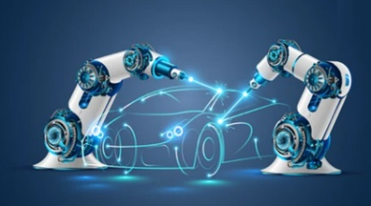







Empowering Industries to accelerate ai & digital adoption
BANKING
Insurance
Manufacturing
Retail
E-COMMERCE
Ensuring secure digital banking
Enabling faster
claim processes
Building smart digital factories
Enhancing in-store experiences
Creating intuitive
user experiences
Healthcare
PHARMACEUTICALS
MEDIA & ENT
EDUCATION
IT & ITES
Driving innovation in patient care
Faster medicine creation and delivery
Elevating digital streaming
Empowering digital learning for all
Digital Transformation for the change catalysts
Employees Key Customers
1400+
Digital Networks
350+
Managed Cloud
400+
Modern Apps + AI/ML
100+
Platform Automation
100+
Cyber Security
100+
Enterprise Apps
500+
Technology Integration
400+
GTM Specialists
500+
Cloud & Security Clients
600+
Data Center
Clients
700+
Managed Network Clients
3000+
Network Infra
Clients

Slide 45
Empowering digital India
DIGITAL BRIDGE FOR BUSINESS TRANSFORMATION
BFSI
Manufacturing
Retail
Logistics
Healthcare
Education
Media
Govt./PSU
Enabling User
- Mobile First Engagement
Enchanting User
- Immersive Experiences
Enriching User
- Omni Channel Experience
Empowering User
- Contextual Insights
Business Priorities
(CXOs)
Scalability
Productivity
Security
INFINITFSO
Managed Services across
Cloud, DC, NW, Security, Digital, End User
InfinitDigital Applications Services
AI/ML, DevSecOps, DAM, XR & Digital Learning,
Retail Intelligence, Digital Assessment
Industry Applications Services
SAP, Oracle, Microsoft
AI/ML Powered Automation
Applications
INFINITMNS Platform
NOC, SDWAN, SASE
CLOUDINFINIT^{+AI} Platform
GPU Cloud
INFINITCMP
Hybrid/Multi Cloud Services
INFINITSECURITY
SOC, MSS, MDR, GRC
Platforms
Network & Data Center Infrastructure
Hyper Reach, Hyperconnect, Edge Connect, Private 5G, On-Demand Bandwidth| RAS Design, Hyperscale, BTS, Green, AIOps, AI Ready DCs
Infrastructure

Slide 46


Sify ICT Services: Key Facts
700+
900+
100+
Global
PEOPLE
Data Center, Cloud & Managed Services Team
Network Experts
Certified Security Experts
PRESENCE
India (HQ) | USA | Canada | UK | UAE | Singapore
500+
600+
700+
70+
50+
CUSTOMERS
Cloud clients
Data Center Clients
Network Clients
Private Cloud & DR clients
CDN & Cloud Security clients
50+
500+
300+
80+
PROJECTS
IT Ops Transformation projects
Data Center services projects executed
Data Center Migration projects
Platform Migration Projects
22K+
100K+
91k+
5000+
7 Petabyte
VOLUME
Managed Tickets per Month
Network Devices
Managed Mailbox
Security Devices
  Managed Storage and Back-up
Notes:
Check with PK on this slide

Slide 47






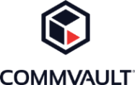





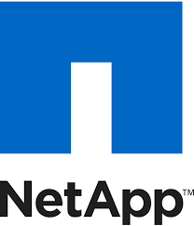








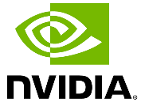




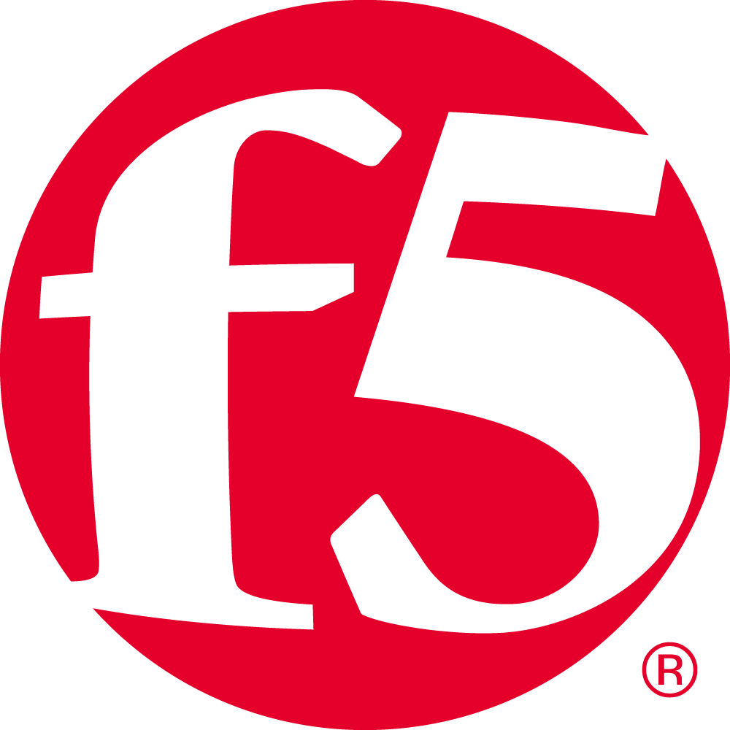


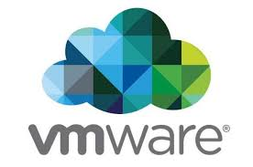




SIFY’S technology Partner ECOSYSTEM
CLOUD
SECURITY
APPLICATION
TECHNOLOGY

Slide 48





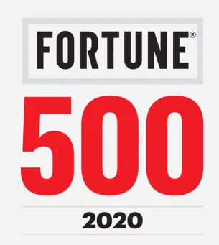




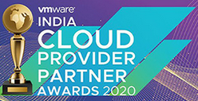


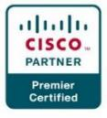

INDUSTRY RECOGNITIONS
Brand Perspective
Industry Perspective
Sify is a Niche Player in Gartner’s MQ for Managed Network Services Global 2024
Recognition in Market Guide for Public Cloud Managed and Professional Services Providers
APAC 2021
Recognition in Market Guide for Backup as a Service 2021
Recognition in Market Guide for Security Testing & Consulting Services in India 2021
Award for Sustainability 2024
Best in Services Industry 2024
Recognized as among ‘The Best Firms for Women in Tech’ by Analytics India Magazine 2023
PARTNER Perspective
CIO Choice 2025 for
AI Ready
Data Centers
Major player in MarketScape for Managed Cloud Services APAC 2024-2025
Leader in MarketScape for India Data Center Services 2024
India’s 1st Nvidia ​DGX Ready ​Air & Liquid Cooled DCs
Best System Integrator 2022, Accelerating Next, 2023
Unity Partner
Innovation in
Data Center 2024
Best Future-Proof Data Center Project 2024
Hosting Partner

Slide 49
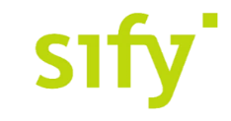


CIO Choice 2025 for
AI Ready Data Centers
Best Future-Proof Data Center Project
Award for Sustainability
Innovation in Data Center
India’s 1st Nvidia
DGX Ready Liquid &
Air Cooled DCs
Best in
Services Industry
DC Services India & ​Managed Cloud Services APAC ​
Managed Network Services - MQ
Tried Tested Trusted
Your digital infrastructure partner for over 25 years
Network
Infra Services
Network Digital
Managed Services
Data Center
Colo Services
CloudInfinit^{+AI}
GPU Cloud
Cloud & IT
Managed Services
Digital Apps
Managed Services
Industry Apps
Managed Services
Security
Managed Services
Thank You

Slide 50




























Forum digital- forward supply chain management
Solution overview
Marketing Team
Consumer
Purchase Management
Content Management
After Sales/ Warranty/ Service Management
Inventory Management
Rural Distributor
Influencer
Sales Management
Points & Redemption Management
Return Management
Broadcast Management
Retailer
CXOs
Digital Product Catalogue
Schemes & Claims
Help & Support
Dashboard
Salesmen
Distributor
Common Platform Offerings
Gamification
Sales Analysis
Content Analysis
Tracking
Reporting
Automation
Approvals
Intelligent Recommendations

Slide 51

Digital augmentation - ar/vr/MR services
Sify Digital Learning solutions help organizations empower their employees to acquire critical knowledge and new skill sets, extend their existing skills, and build core competencies to meet the operational requirements of the digital savvy work environment.
LMS & Custom Content
New Age Digital Solutions
Learning Platforms and Implementation Services
Interactive 3D simulations
  Legacy Content Transformation
Digital Learning
  Virtual Reality (VR) solutions
360
  Consulting & Advisory Services
  Augmented Reality (AR) Solutions
  Globalization Services
  MR/AR/AI
Interactive 3D Factory Scenario
Interactive 3D
Data Center Hardware Simulator
Virtual Reality
VR Turbine for Training Engineers
Virtual Reality
VR with Haptics- LAB SOPS Training
Augmented Reality
AR Based work Instructions for Training
Mixed Reality HoloLens Based Mixed Reality Soln
Sify Confidential

Slide 52
AI LEARNING Highlights
OneSify.AI is a comprehensive destination that provides the required infrastructure, technology, and services to build AI applications ground-up, and provides training on AI Mastery skills.
Interactive chatbot copilot drives the discovery process to discern project goals.
Personalized and differentiated learning paths based on your project requirements.
Hands-on projects using real-world datasets, AI tools, and frameworks to help you become AI-ready.
Real-world examples of AI applications in various industries.
Discussions on ethical implications of AI, such as bias, privacy, and transparency.
Explores best practices for AI application design, development, and deployment.
Self-paced and bite-sized learning on-the-go.
Engaging content using text and graphics, videos, animations, and infographics
Interactive content with quizzes, simulations, and case studies.
Uses principles of adult learning and neuroscience.
Ethical AI discussions to foster AI mastery

Slide 53
Digital Assessment
Sify Digital Assessment solutions modernize talent assessment and recruitment processes for organizations to conduct high volume exams in a secure and scalable environment.
Online Application Management
CBT
SAAS
Question Paper Management
Student Management
  Question Paper Development Support
  Question Authoring Management
iTest
  Exam Delivery Management
  Exam Delivery Management
  AI/ML Based Auto Proctoring Tools
  Exam Security Management
360
  Challenge Window/Result Management
  Remote Proctored Exam Delivery
  Post Exam Analytics
  Post Exam Analytics
Cert-In Certified Test Engine
Multiple Question Formats
Multi-lingual Display
of Questions
AI/ML based Facial Recognition
Trained & Certified Manpower
Help Desk Support

