Slide 1
EMPOWERING
INDIA’S AI AMBITION
Sify Executive Overview
APRIL 2025
Mission Critical Networks
AI-ready
Data Centers
AI Cloud,
Hybrid IT
Digital
Services
Robust
Security

Slide 2

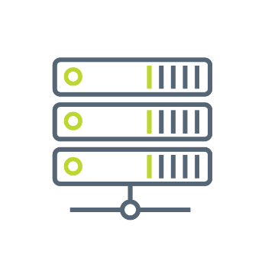

SIFY GROUP COMPANIES
NETWORK
SERVICES
DATA CENTER COLOCATION SERVICES
CLOUD & DIGITAL
SERVICES
Sify Technologies Ltd.
Sify Infinit Spaces Ltd.
Sify Digital Services Ltd.
Innovation led by Sify Ventures
Your digital bridge for transformation, built on world class digital infrastructure, platforms and services

Slide 3
CONSISTENT Financial PERFORMANCE
Revenue Growth
Figures in INR Crores
Services vs Product
CAGR 12%
Network – Data Center – Digital Services
Profit After Tax (PAT)
CAGR (49%)

Slide 4
SIFY’S Global presence
MPLS network presence in over 1700 Cities
14 Operational Data Centers
66+ Pan-India Edge Nodes
3 Open Cable Landing Stations
Delivery Centers in 6 Major Indian Cities
Canada
Toronto
Europe
London
Dubai
India
USA
Santa Clara
USA
New Jersey
Singapore
Presence in
6 countries
Partnering with enterprises for Digital Transformation
Proven track record of executing complex programs
Over 3000+ skilled associates
Quality benchmarks –
CMMi 5, ISO 9001, ISO 27001, SSAE 16 certifications

Slide 5
Innovating TO STAY Relevant
1995-2005
Internet Revolution
2006-2011
Data Explosion
2012-2020
Cloud Innovation
2021 onwards
Digital Acceleration
2025 onwards
The Age of AI
Sify 1.0
Sify 2.0
Sify 3.0
Sify 4.0
Sify 5.0
RETAIL INTERNET SERVICE PROVIDER
ENTERPRISE SERVICES COMPANY
DIGITAL ICT SERVICES PROVIDER
(cloud@core)
DIGITAL TRANSFORMATION PARTNER (digital@core)
AI – POWERED INNOVATION
PARTNER (innovation@core)
First private
ISP in India
Launch of MPLS &
Data Center services in India
Launch of Enterprise Cloud platform & Hybrid Cloud services
Launch of end-to-end
Digital services
Launch of AI-Driven Digital Solutions
From revolutionizing consumer internet in the 90s to leading AI-powered innovation for Enterprises

Slide 6
OUR Investment PHILOSOPHY
Digital
Services
Skilled workforce to support modern technologies
Services across the digital spectrum
Embedded AI
Secure by design
3000+ SMEs across platform automation, modern apps, AI/ML, DC, Cloud, Networks, Security
Infinit AI, Infinit FSO, SaaS & Industry solutions
Modern cloud platform – x86 & GPU support
Ample data stores for data explosion
Cybersecurity Operations Centers
Cloud Management Platform for efficient operations
CloudInfinit^{+AI} , GPU as a Service
Hybrid Cloud Infrastructure
Infinit CMP, Cloud Anywhere Edge Cloud
Infinit MNS platform, NOC
Global SOC, MSS, Infinit Security
Cloud,
AI & Security
AI ready data centers
Core and Edge data centers for edge use cases
Certified and compliant
Focus on sustainability
14 DCs, 227+ MW IT power
407+ MW by 2025. 10+ Edge DCs
Scalable to 970+ MW
231+ MW RE Power
AIOps, AI Ready, Liquid cooling
Data
Centers
Network
Infra
Reliable national network backbone
On-demand capacities
Deep Distribution Capillarity
Open Cable Landing Stations for subsea cables
1700+ Cities, 3700+ PoPs
Fiber coverage 24+ Metros
3 CLS, 8 International POPs
Sify OnNet- automated Ent WAN
Notes:
1400+ Digital Networks
350+ Cloud
450+ Modern Apps & AI/ML,
100+ Cybersecurity,
100+ Platform automation,
500+ Technology Integration

Slide 7
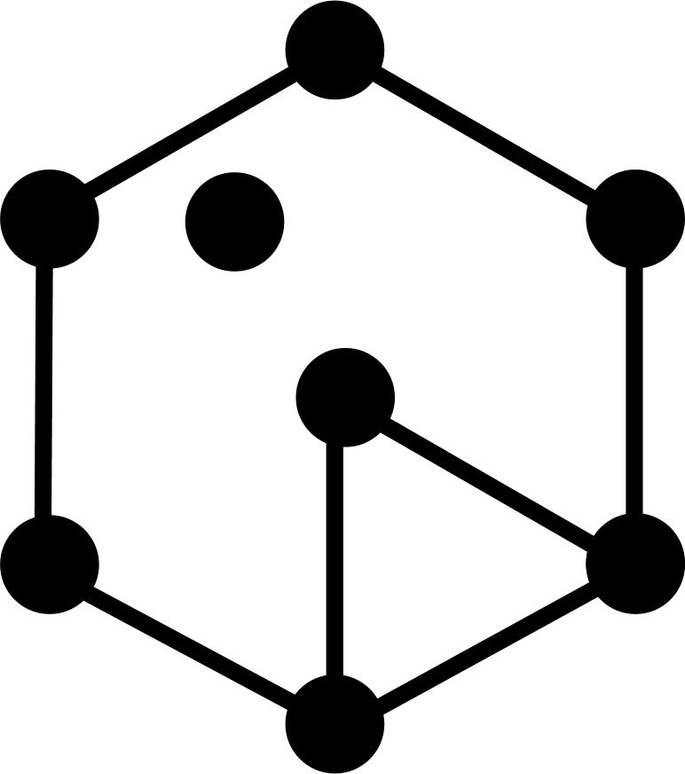
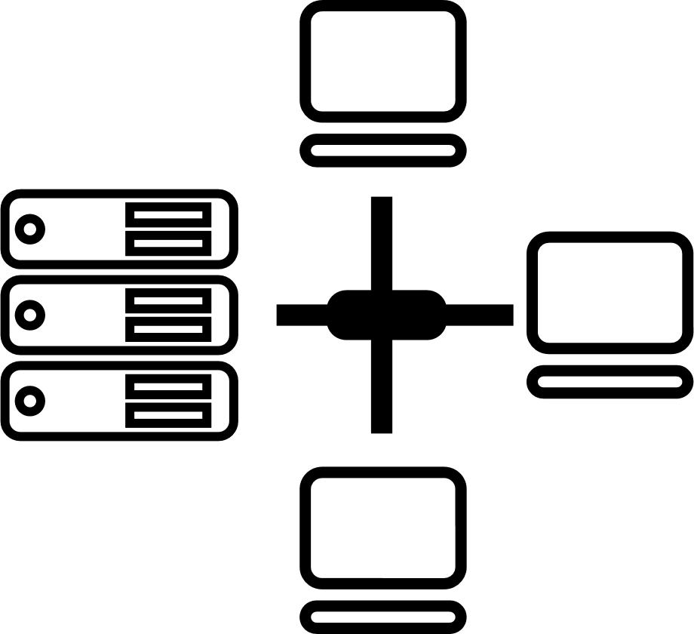

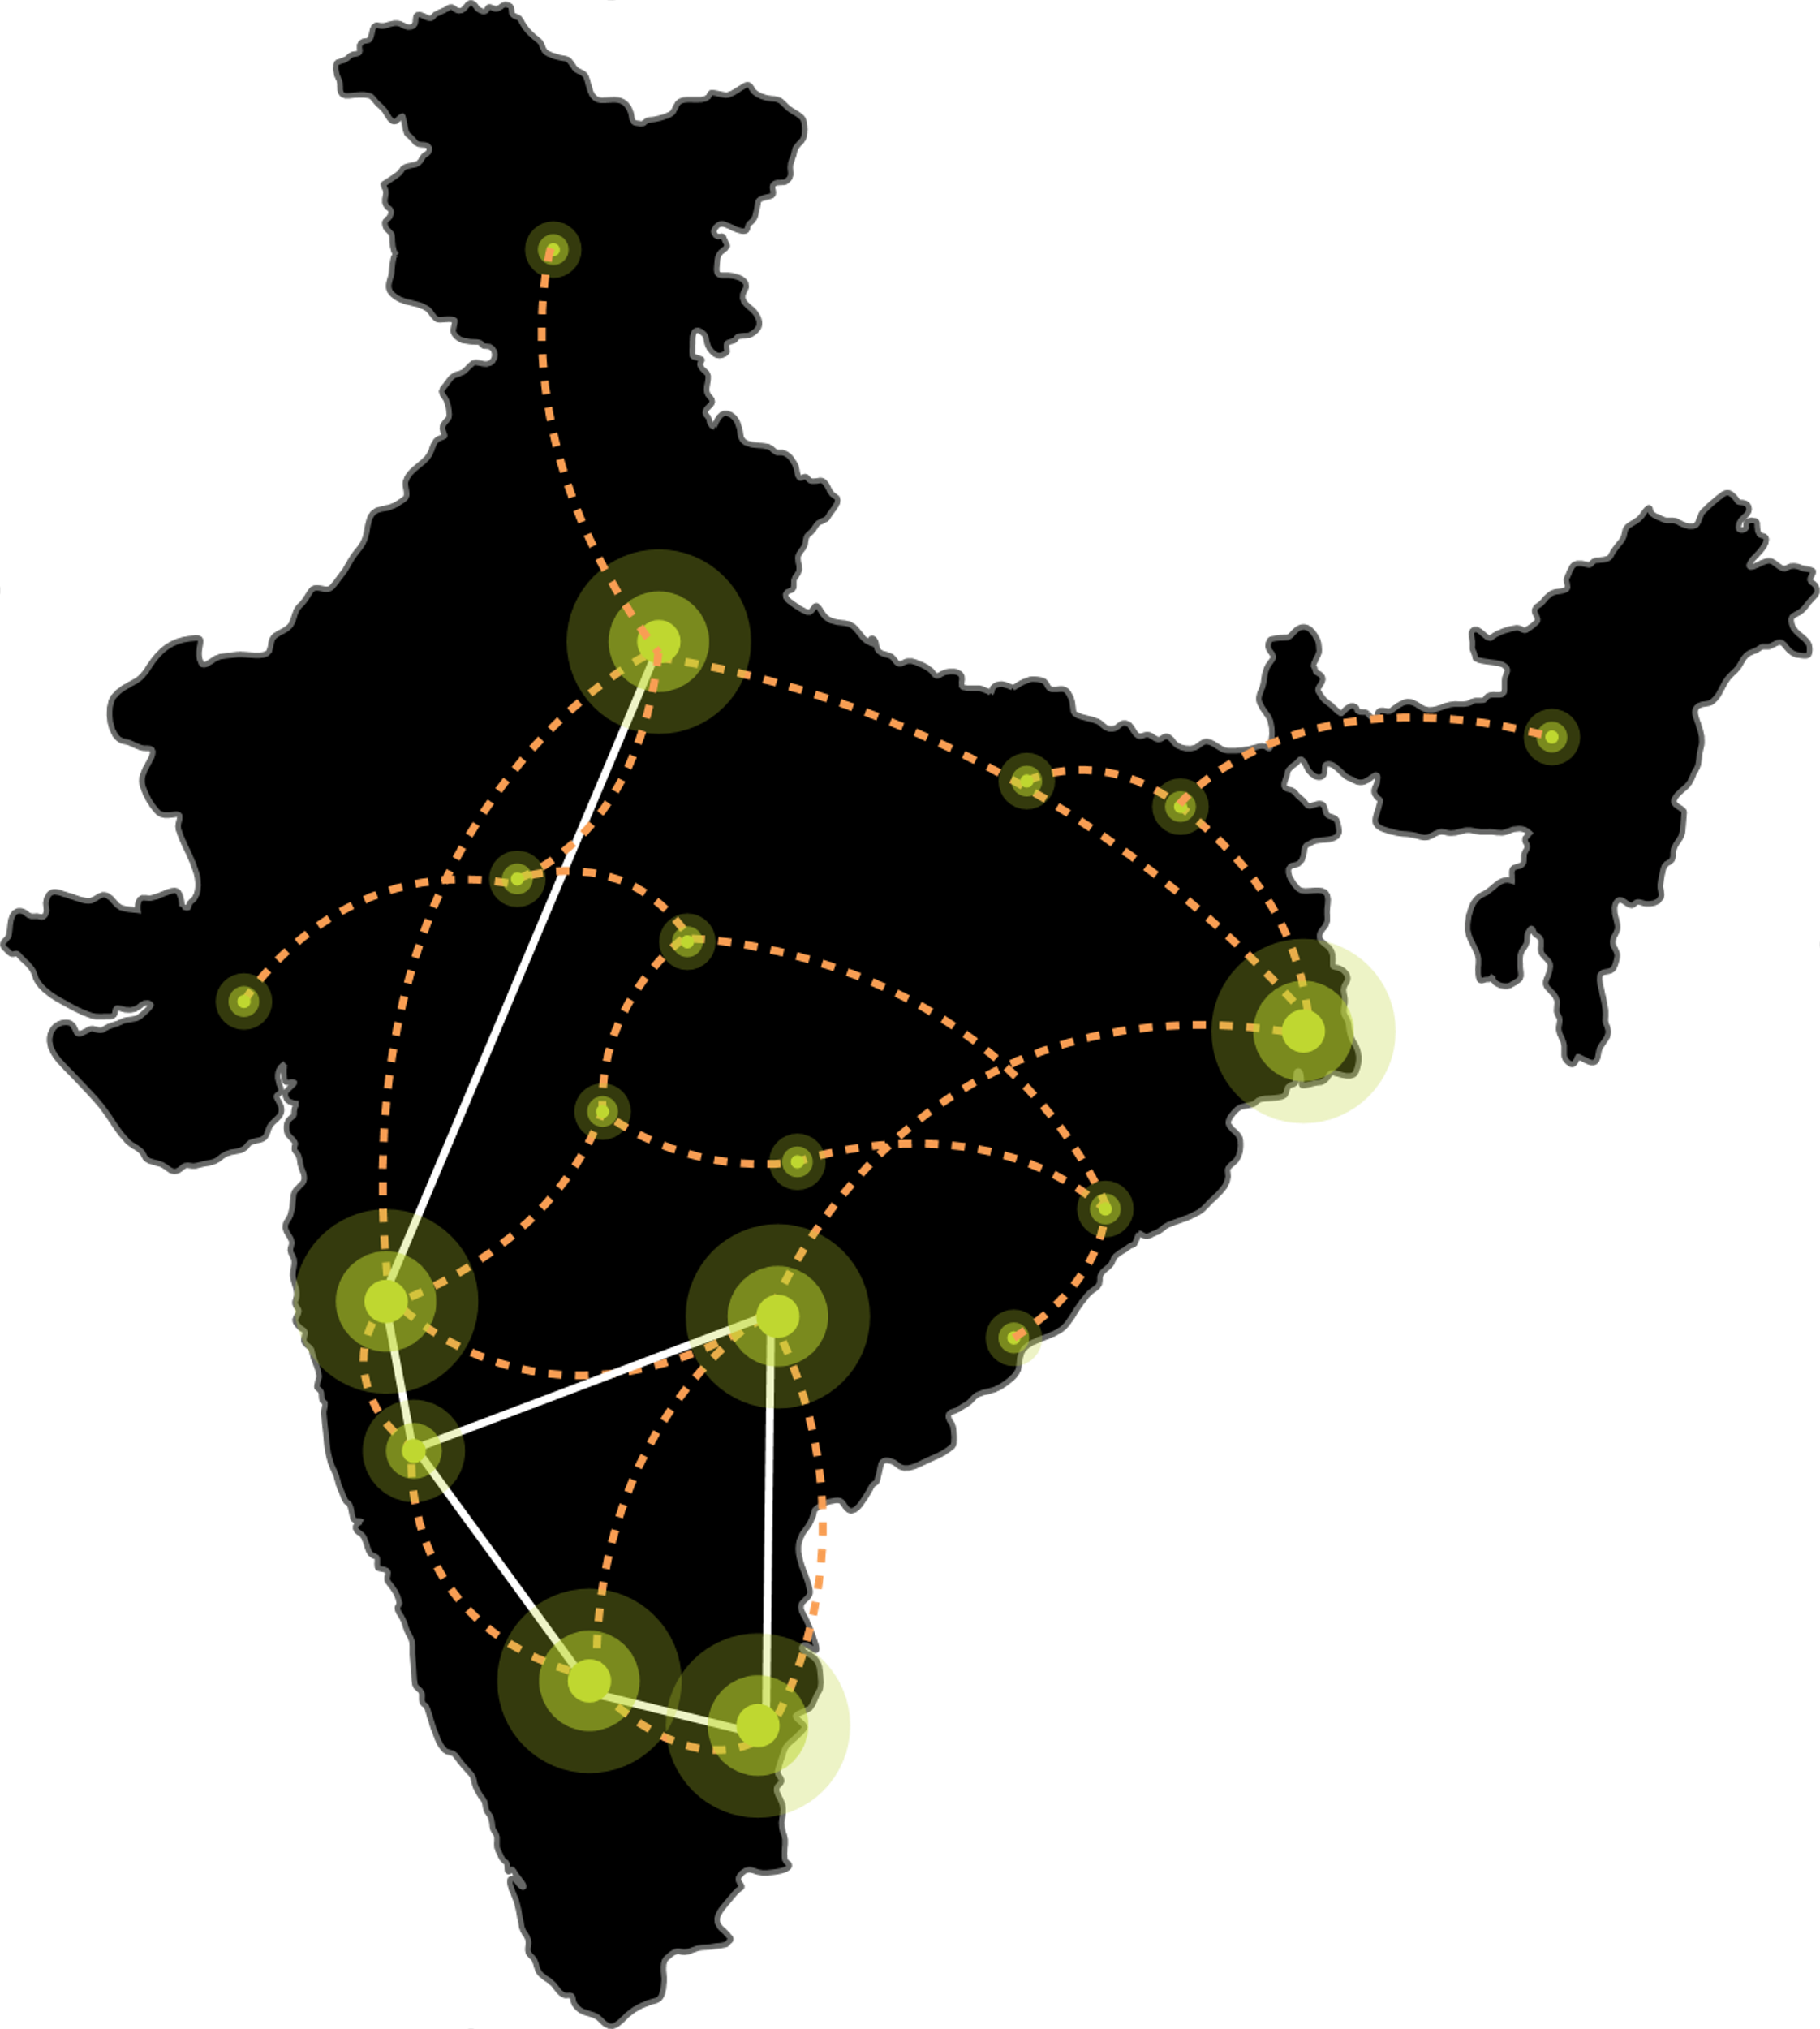






Our DIGITAL INFRASTRUCTURE & PLATFORMS
India’s Top 10 banks, Top 4 Manufacturing, 3 Major Hyperscalers, Global Social Media, OTT, Security Players, and 10,000+ Enterprises trust Sify.
Metro Networks
Fiber access
Connected Buildings
Interconnected DCs
Express Long-Haul Backbone, High Bandwidth and Low Latency across Key Locations
Network
Infra Services
Network Digital
Managed Services
NOIDA 02
NOIDA 01
SAARC Gateway, Kolkata
Data Center
Colo Services
CloudInfinit^{+AI}
GPU Cloud
MUMBAI 03 RABALE
KOLKATA 01
MUMBAI 02 AIROLI
MUMBAI 01 VASHI
CLS, Versova, Mumbai
HYDERABAD 02
HYDERABAD 01
Cloud & IT
Managed Services
Security
Managed Services
CHENNAI 02
BENGALURU O2
CHENNAI 01
BENGALURU 01
CLS, Siruseri, Chennai
Digital Apps
Managed Services
Industry Apps
Managed Services

Slide 8
Sify AI Overview
The Sify portfolio offers a comprehensive range of AI services, designed to build and operate solutions that boost business productivity and competitiveness. With agile, flexible infrastructure and secure, cutting-edge platforms, Sify offers everything needed to empower your AI journey.
AI-READY
Networks
High capacity with ultra-low
latency
Data Centers
High-density hosting for
AI workloads
CloudInfinit^{+AI}
High performance compute with GPU as a service
Platform
Develop and Deploy AI models &
services
Learning
Training modules with Companion Labs to build AI solutions
Security
Proactive Detection, Defense & Rapid Response
From Infrastructure to innovation, Sify empowers your AI journey
Notes:
The rise of Generative AI has ignited a push for operational excellence and transformative user engagement across industries. Yet, AI ambitions face familiar and new challenges, demanding a seamless approach to explore, experiment, and execute AI projects effectively.

Slide 9

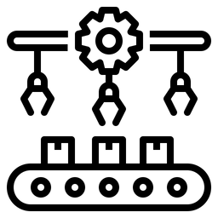

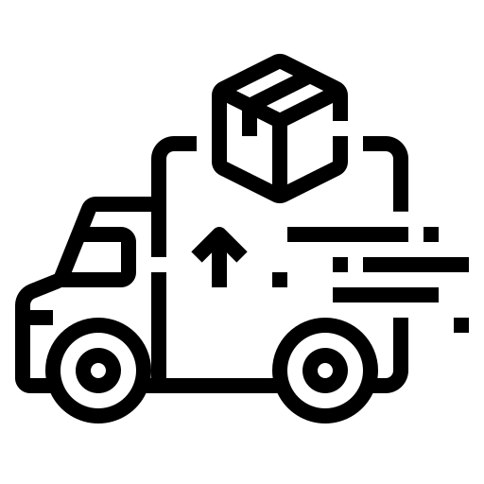





Sify's AI ​ Ecosystem ​ Architecture​
BFSI
Manufacturing
Retail
Logistics
Healthcare
Education
Media
IT/ITeS
DNB
Govt./PSU
Flexible
Scalability
Increase
Productivity
Predictive
Analytics
Mitigate
Risks
Sify Al Platform
Al Enterprise Suite
Gen Al Studios, AlOps-Digital Twins
Innovation
Data Science Tools, Frameworks,
Dashboard, Governance
Tools: Pre-trained Models, Jupyter -Tensorflow, Python, Inference server...
Sify
Al Learning
Sify CloudInfinit^{+AI}
Hybrid IT
Sify CMP
Sify GPU as a Service
Orchestration | Provisioning | GPU Workload Containers
Companion
Labs,
Training
Modules
Sify GPU
NVIDIA
Sify
Compute
Sify
Networking
Sify Storage
DGX POD
X86 GPU
Sify AI Data Centers
Scalable, Secure, Green
DGX-ready Certified DC
Cloud Adjacent DC
Infrastructure
Sify AI Network Infra​
600 Gbps Bandwidth
Ent & CSP Workloads
Hyper Reach, Hyperconnect, Edge Connect, Private 5G,
On-demand Bandwidth

Slide 10
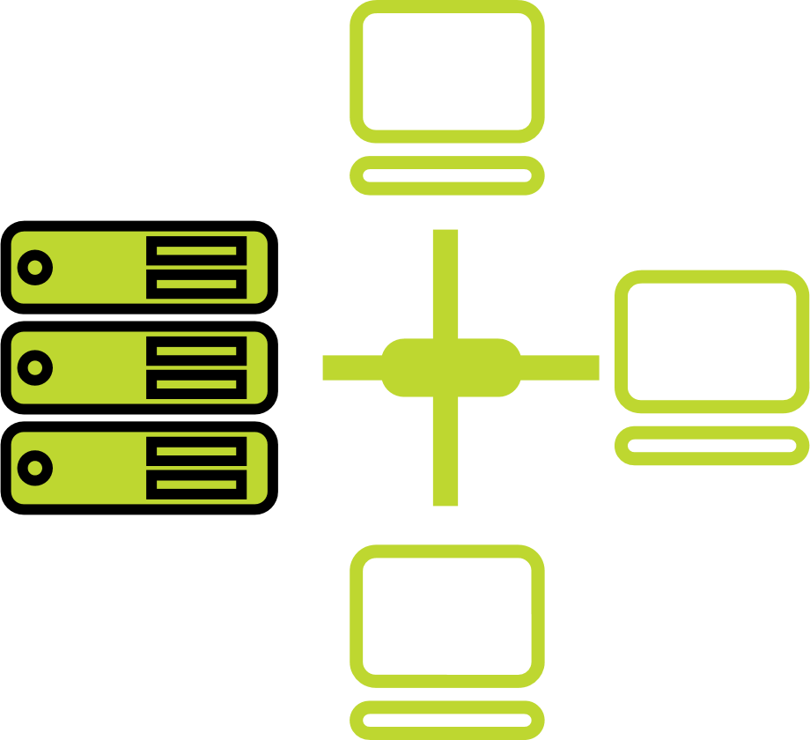




one-stop engagement for enterprises’ digital pursuits
Network
Infra Services
Network Digital
Managed Services
Data Center
Colo Services
CloudInfinit^{+AI GPU Cloud}
Cloud & IT
Managed Services
Enterprise connectivity- WAN, NLD
Edge Connect- Pvt 5G, Wi-Fi
Global Cloud Connect, DC Interconnect
International POPs, Cable Landing Stations
Network transformation and consolidation
Managed Secure Networks- SDWAN, SASE, DDOS protect
Campus & Branch Networks
Smart Edge
Captive & Hybrid NOC services
Network Observability
CaaS & Collaboration Services
AI ready
Hyperscale Cloud adjacency
RAS Design
Liquid Cooling
Hyperconnected
Built-to-suit
AIOps
Renewable Energy
Managed Public/Private Cloud
GPU as a Service
Cloud Anywhere-Edge Cloud
BCP- DRaaS
Regulatory and compliance ready
Hybrid Cloud Assessment, Migration and Managed Services
Multi Cloud Platform
Hyperscale Cloud services AWS, Azure, GCP, OCI
End-to-End IT Managed Services
Networks
Data Centers
Cloud & IT
Digital Apps
Managed Services
Industry Apps
Managed Services
Security
Managed Services
25 years
of digital
trust…
Digital
Infinit AI/ML Platform
Infinit Full Stack Observability
App Modernization & DevSecOps
Retail Intelligence- Forum Digital
Digital Assessment, AI Learning & XR
Consulting, Support, Maintenance, and Upgrades
Microsoft
Oracle
SAP
Security
Cybersecurity assessment and managed services
MSS, MDR & GRC
Global SOC
AI/ML driven Security Assurance

Slide 11
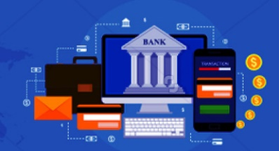

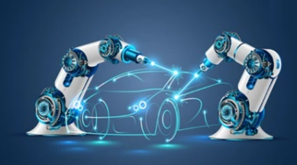







Empowering Industries to accelerate ai & digital adoption
BANKING
Insurance
Manufacturing
Retail
E-COMMERCE
Ensuring secure digital banking
Enabling faster claim processes
Building smart digital factories
Enhancing in-store experiences
Creating intuitive
user experiences
Healthcare
PHARMACEUTICALS
MEDIA & ENT
EDUCATION
IT & ITES
Driving innovation in patient care
Faster medicine creation and delivery
Elevating digital streaming
Empowering digital learning for all
Digital Transformation for the change catalysts
Employees Key Customers
1400+
Digital Networks
350+
Managed Cloud
400+
Modern Apps + AI/ML
100+
Platform Automation
100+
Cyber Security
100+
Enterprise Apps
500+
Technology Integration
400+
GTM Specialists
500+
Cloud & Security Clients
600+
Data Center Clients
700+
Managed Network Clients
3000+
Network Infra
Clients

Slide 12




Sify as a DIGITAL SERVICES partner
OUR PURPOSE (WHY)
OUR OFFERING (WHAT)
To build a high-value customer-centric organization with continuous investments and innovations.
To help customers achieve their Digital Ambition by optimizing and transforming Value Chains digitally, through the 2 pillars.
DIGITAL OPTIMIZATION
DIGITAL TRANSFORMATION
Streamline operations with automation of routine tasks and optimized workflows
Accelerate go-to-market offerings, build new products and services faster
Rationalize costs with IT as a Service and
GPU as a Service
Rearchitect IT with Digital as a Service & Industry solutions
Boosting efficiency and enhancing customer experience
Reducing time to market and driving revenue growth

Slide 13
digital transformation of enterprises

Slide 14





Trusted digital infrastructure & platform partner
India’s top 10 banks trust Sify’s
data center and network services.
Every trading transaction of the world’s #1 derivative stock exchange passes through the network designed, implemented, and managed by Sify.
All of India’s inter-banking transactions are done on data center and network designed, implemented, and managed by Sify.
India’s #1 Bank chose Sify to deploy a modern NOC with AI/ML enabling intelligent and secure network monitoring across global locations.
India’s largest power utility company chose Sify’s cloud@core platform with business-outcome-based model to scale their service to 25 million+ subscribers.

Slide 15





Trusted digital infrastructure & platform partner
Sify’s data centers host 3 out of 4 Hyperscalers, global OTT players, the world’s leading social media network, Europe’s leading payment gateway, and 600+ enterprises.
A leading healthcare provider chose Sify’s cloud@core platform for the digital transformation of patient care services while saving 33% on cloud costs.
The world’s most widely distributed postal system trusts Sify’s managed network services to offer 24×7 country-wide postal, banking, logistics, and insurance services.
A top FMCG company in India with 25 mother brands uses Sify’s Retail Intelligence Solution for their forward supply chain to service 7 million+ retailers across the country.
Sify’s integration service enhanced the digital experience in the treatment of cancer by making patient information and radiation device availability visible from anywhere.
Notes:
Small and medium vs large

Slide 16


Sify ICT Services: Key Facts
700+
900+
100+
Global
PEOPLE
Data Center, Cloud & Managed Services Team
Network Experts
Certified Security Experts
PRESENCE
India (HQ) | USA | Canada | UK | UAE | Singapore
500+
600+
700+
70+
50+
CUSTOMERS
Cloud clients
Data Center Clients
Network Clients
Private Cloud & DR clients
CDN & Cloud Security clients
50+
500+
300+
80+
PROJECTS
IT Ops Transformation projects
Data Center services projects executed
Data Center Migration projects
Platform Migration Projects
22K+
100K+
91k+
5000+
7 Petabyte
VOLUME
Managed Tickets per Month
Network Devices
Managed Mailbox
Security Devices
Managed Storage and Back-up
Notes:
Check with PK on this slide

Slide 17












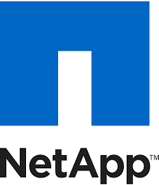








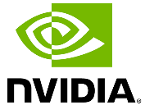




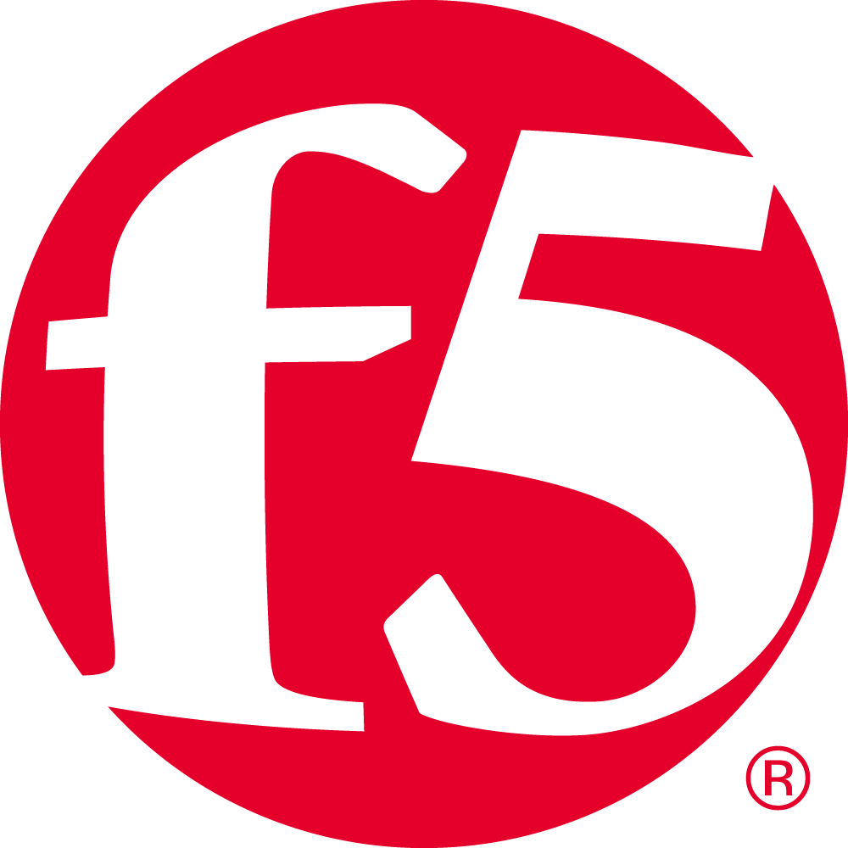


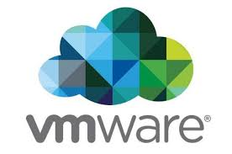




SIFY’S technology Partner ECOSYSTEM
CLOUD
SECURITY
APPLICATION
TECHNOLOGY

Slide 18











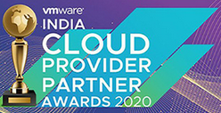




INDUSTRY RECOGNITIONS
Brand Perspective
Industry Perspective
Sify is a Niche Player in Gartner’s MQ for Managed Network Services Global 2024
Recognition in Market Guide for Public Cloud Managed and Professional Services Providers APAC 2021
Recognition in Market Guide for Backup as a Service 2021
Recognition in Market Guide for Security Testing & Consulting Services in India 2021
Award for Sustainability 2024
Best in Services Industry 2024
Recognized as among ‘The Best Firms for Women in Tech’ by Analytics India Magazine 2023
PARTNER Perspective
CIO Choice 2025 for
AI Ready
Data Centers
Major player in MarketScape for Managed Cloud Services APAC 2024-2025
Leader in MarketScape for India Data Center Services 2024
India’s 1st Nvidia ​DGX Ready ​Air & Liquid Cooled DCs
Best System Integrator 2022, Accelerating Next, 2023
Unity Partner
Innovation in
Data Center 2024
Best Future-Proof Data Center Project 2024
Hosting Partner

Slide 19
Empowering digital India
DIGITAL BRIDGE FOR BUSINESS TRANSFORMATION
BFSI
Manufacturing
Retail
Logistics
Healthcare
Education
Media
Govt./PSU
Enabling User
- Mobile First Engagement
Enchanting User
- Immersive Experiences
Enriching User
- Omni Channel Experience
Empowering User
- Contextual Insights
Business Priorities
(CXOs)
Scalability
Productivity
Security
INFINITFSO
Managed Services across
Cloud, DC, NW, Security, Digital, End User
InfinitDigital Applications Services
AI/ML, DevSecOps, DAM, XR & Digital Learning,
Retail Intelligence, Digital Assessment
Industry Applications Services
SAP, Oracle, Microsoft
AI/ML Powered Automation
Applications
INFINITMNS Platform
NOC, SDWAN, SASE
CLOUDINFINIT^{+AI} Platform
GPU Cloud
INFINITCMP
Hybrid/Multi Cloud Services
INFINITSECURITY
SOC, MSS, MDR, GRC
Platforms
Network & Data Center Infrastructure
Hyper Reach, Hyperconnect, Edge Connect, Private 5G, On-Demand Bandwidth| RAS Design, Hyperscale, BTS, Green, AIOps, AI Ready DCs
Infrastructure

Slide 20



CIO Choice 2025 for
AI Ready Data Centers
Best Future-Proof Data Center Project
Award for Sustainability
Innovation in Data Center
India’s 1st Nvidia
DGX Ready Liquid &
Air Cooled DCs
Best in
Services Industry
DC Services India & ​Managed Cloud Services APAC ​
Managed Network Services - MQ
Tried Tested Trusted
Your digital infrastructure partner for over 25 years
Network
Infra Services
Network Digital
Managed Services
Data Center
Colo Services
CloudInfinit^{+AI}
GPU Cloud
Cloud & IT
Managed Services
Digital Apps
Managed Services
Industry Apps
Managed Services
Security
Managed Services
Thank You

