Slide 1


INDIA:
The Global Epicenter of GCC 4.0
Presented by Sify Technologies
Mission Critical Networks
Hyperscale AI-ready Data Centers
AI Cloud,
Hybrid IT
Digital
Services
Robust
Security

Slide 2

GCCs in India
Where the world’s ideas are built, refined and scaled.

Slide 3
SLIDE TITLE COMES HERE

Slide 5
SECTION TITLE COMES HERE

Slide 6









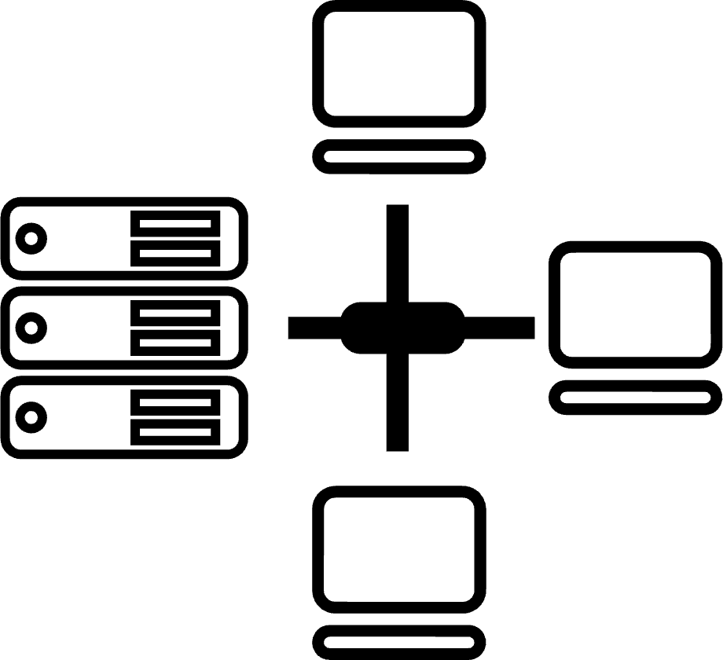






CIO Choice 2025 for
AI Ready Data Centers
Best Future-Proof Data Center Project
Award for Sustainability
Innovation in Data Center
India’s 1st Nvidia
DGX Ready Liquid &
Air Cooled DCs
Best in
Services Industry
DC Services India & ​Managed Cloud Services APAC ​
Managed Network Services - MQ
Tried Tested Trusted
Your digital infrastructure partner for over 25 years
Network
Infra Services
Network Digital
Managed Services
Data Center
Colo Services
CloudInfinit^{+AI}
GPU Cloud
Cloud & IT
Managed Services
Digital Apps
Managed Services
Industry Apps
Managed Services
Security
Managed Services
Thank You

