Slide 1
Presenter Name | Designation, Company Name

Slide 2
AGENDA
ONE
TWO
THREE
FOUR
FIVE
SIX
SEVEN

Slide 3
SLIDE TITLE COMES HERE

Slide 5
SEPARATOR TITLE COMES HERE TITLE COMES HERE

Slide 6




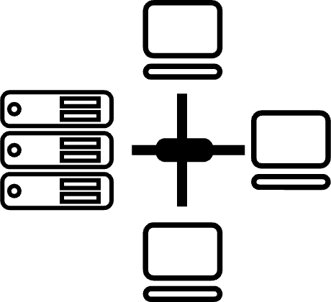











Network Infra Services
Tried
Tested
Trusted
Network Digital Managed Services
Data Center Colo Services
CIO Choice 2025 for AI-Ready Data Centers
Best Future-Proof Data Center Project
Award for Sustainability
CloudInfinit^{+AI} GPU Cloud
Cloud & IT Managed Services
Innovation in Data Center
India’s 1st Nvidia
DGX Ready Liquid &
Air Cooled DCs
Best in
Services Industry
Digital Apps Managed Services
Your digital infrastructure partner for over 25 years
Industry Apps Managed Services
DC Services India & ​Managed Cloud Services APAC ​
Managed Network Services - MQ
Security Managed Services
THANK YOU

